Slide 1
Chapters 10, 11b
1. First-cut DCD,
2. first cut CRC,
3. detailed sequence diagram,
4. update DCD,
5. make packages
Homework: What is MVC?

Slide 2
Quiz:
Q1: What is the difference between a system sequence diagram and a sequence diagram?
Q2: What is the difference between a domain class and a design class?
Q3: What is a design class used for?
Q4: What is the process for doing detailed design?

Slide 3
Answ:
A1: The SSD only shows the entire system as a single unit. A sequence diagram shows the objects (classes) inside the system.
A2: The domain class only has names of attributes. Design class has names and type information for attributes and method signatures
A3: To write program code.
A4: First-cut DCD, first cut CRC, detailed sequence diagram, update DCD, make packages

Slide 4
Outcomes:
First-cut DCD,
first cut CRC,
detailed sequence diagram,
update DCD,
make packages

Slide 5
Introduction:
Basic principles that will guide design decisions:
  Coupling
  Cohesion
  Protection from variation
  Indirection
  Object responsibility

Slide 6
Coupling:
Coupling is a qualitative measure of how closely the classes in a design class diagram are linked.
A simple way to think about coupling is as the number of navigation arrows on the design class diagram.
Low coupling is usually better for a system than high coupling. In other words, fewer navigation visibility arrows indicate that a system is easier to understand and maintain.
High coupling is bad because a change in one class ripples through the entire system.

Slide 7
Cohesion:
Cohesion is a qualitative measure of the focus or unity of purpose within a single class.
Classes with low cohesion have several negative effects. First, they are hard to maintain. Because they perform many different functions, they tend to be overly sensitive to changes within the system, suffering from ripple effects.
Second, it is hard to reuse such classes.

Slide 8
      Protection from Variations:
One of the underlying principles of good design is protection from variations
  — the idea that the parts of a system that are unlikely to change should be segregated (or protected) from those that will change.
Protection from variations is a principle that drives the multilayer design pattern:
  If the user-interface classes are tightly coupled to the business classes, there could be a ripple effect of changes throughout the user interface classes whenever a change is required. Protection from variations affects almost every design decision, so you should watch for and recognize the application of this principle in
  all design activities

Slide 9
      Indirection
Indirection is the principle of decoupling two classes or other system components by placing an intermediate class between them to serve as a link.
A good example of indirection is where companies have firewalls and proxy servers that receive and send messages between an internal network and the Internet.

Slide 10
      Object Responsibility
One of the most fundamental principles of object-oriented development is the idea of object responsibility.
These responsibilities are categorized in two major areas: knowing and doing.
In other words, what is an object expected to know, and what is an object expected to do or to initiate?
  “Knowing” includes an object’s responsibilities for knowing about its own data and knowing about other classes with which it must collaborate to carry out use cases.
  “Doing” includes all the activities an object does to assist in executing a use case.

Slide 11
CRC Cards (p290-293)
Brainstorming technique among O-O developers.
Class-Responsibility-Collaboration
Advantage:
  It produces substantial information from which to begin.
  Especially if it can be followed up with pseudo-code
  “Nothing helps a person to learn how to design well than having to write the code from the design documents”.

Slide 12
Designing With CRC Cards
CRC Cards—Classes, Responsibilities, Collaboration Cards
OO design is about assigning Responsibilities to Classes for how they Collaborate to accomplish a use case
Usually a manual process done in a brainstorming session
  3 X 5 note cards
  One card per class
  Front has responsibilities and collaborations
  Back has attributes needed
© 2012 Cengage Learning. All Rights Reserved. This edition is intended for use outside of the U.S. only, with content that may be different from the U.S. Edition.
May not be scanned, copied, duplicated, or posted to a publicly accessible website, in whole or in part.

Slide 13
Example of CRC Card
© 2012 Cengage Learning. All Rights Reserved. This edition is intended for use outside of the U.S. only, with content that may be different from the U.S. Edition.
May not be scanned, copied, duplicated, or posted to a publicly accessible website, in whole or in part.

Slide 14
CRC Cards Procedure
Because the process is to design, or realize, a single use case, start with a set of unused CRC cards. Add a controller class (Controller design pattern).
Identify a problem domain class that has primary responsibility for this use case that will receive the first message from the use case controller. For example, a Customer object for new sale.
Use the first cut design class diagram to identify other classes that must collaborate with the primary object class to complete the use case.
Have use case descriptions and SSDs handy
© 2012 Cengage Learning. All Rights Reserved. This edition is intended for use outside of the U.S. only, with content that may be different from the U.S. Edition.
May not be scanned, copied, duplicated, or posted to a publicly accessible website, in whole or in part.

Slide 15
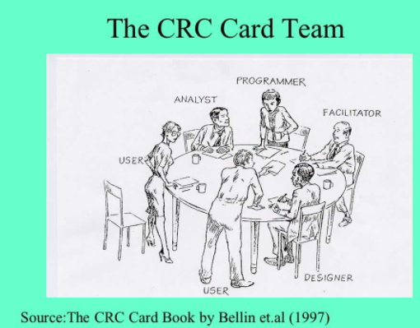

Slide 16
CRC Cards Procedure (continued)
Start with the class that gets the first message from the controller. Name the responsibility and write it on card.
Now ask what this first class needs to carry out the responsibility. Assign other classes responsibilities to satisfy each need. Write responsibilities on those cards.
Sometimes different designers play the role of each class, acting out the use case by verbally sending messages to each other demonstrating responsibilities
Add collaborators to cards showing which collaborate with which. Add attributes to back when data is used
Eventually, user interface classes or even data access classes can be added
© 2012 Cengage Learning. All Rights Reserved. This edition is intended for use outside of the U.S. only, with content that may be different from the U.S. Edition.
May not be scanned, copied, duplicated, or posted to a publicly accessible website, in whole or in part.

Slide 17
CRC Cards Results
Several Use Cases
© 2012 Cengage Learning. All Rights Reserved. This edition is intended for use outside of the U.S. only, with content that may be different from the U.S. Edition.
May not be scanned, copied, duplicated, or posted to a publicly accessible website, in whole or in part.

Slide 18
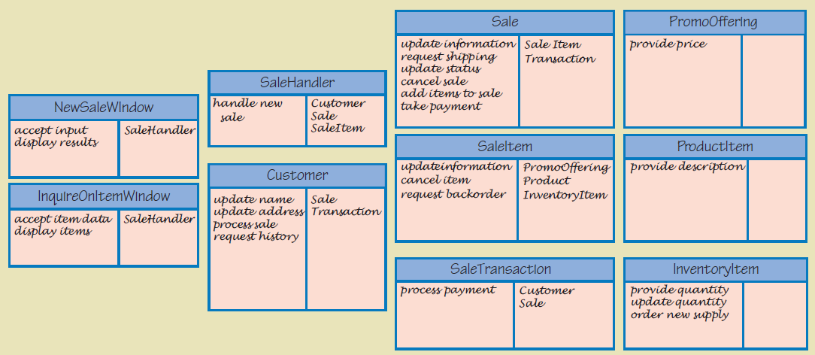
CRC Cards Results
Adding In User Interface Layer
© 2012 Cengage Learning. All Rights Reserved. This edition is intended for use outside of the U.S. only, with content that may be different from the U.S. Edition.
May not be scanned, copied, duplicated, or posted to a publicly accessible website, in whole or in part.

Slide 19
CRC Cards
Update design class diagram based on CRC results
Responsibilities become methods
Arguments and return types not yet added
© 2012 Cengage Learning. All Rights Reserved. This edition is intended for use outside of the U.S. only, with content that may be different from the U.S. Edition.
May not be scanned, copied, duplicated, or posted to a publicly accessible website, in whole or in part.

