Slide 1
Chapters 10, 11
1. Three Layer Architecture
2. From SSD → SD
3. Class diagram
      4. Object-Oriented Design Process
      5. UI Design

Slide 3
Object-Oriented Program Flow
Three Layer Architecture
© 2012 Cengage Learning. All Rights Reserved. This edition is intended for use outside of the U.S. only, with content that may be different from the U.S. Edition.
May not be scanned, copied, duplicated, or posted to a publicly accessible website, in whole or in part.

Slide 4
Programming: O-O
An object-oriented program consists of a set of program objects that cooperate to accomplish a result.
Each program object has program logic and necessary attributes encapsulated into a single unit. These objects work together by sending each other messages and working in concert to support the functions of the main program.
Conclusion: An object-oriented system consists of sets of computing objects. Each object has data and program logic encapsulated within itself.

Slide 5
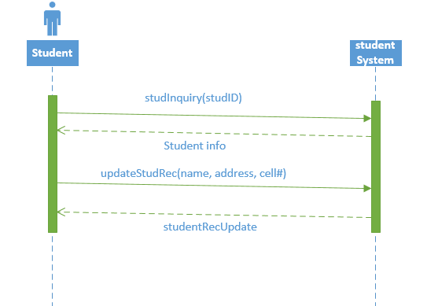

Slide 7
Terms:
entity class – a design identifier for a problem domain class
persistent class – an entity class whose objects exist after a system is shut down
boundary class, or view class – a class that exists on a system’s automation boundary, such as an input window
control class – a class that mediates between boundary classes and entity classes, acting as a switchboard between the view layer and domain layer
data access class – a class that is used to retrieve data from and send data to a database

Slide 9
      Object-Oriented Design Process
Object-oriented design is model-driven and use case–driven.
In other words, we develop the design models use case by use case.
For example, a design sequence diagram is developed for each use case.
The process of object-oriented design can be summarized with five major steps:

Slide 10
5 Steps:
Develop the first-cut design class diagram (DCD).
Determine the responsibilities (methods) and collaborations (interactions) between classes.
Develop detailed sequence diagrams in two steps:
  First cut sequence diagrams,
  multilayer sequence diagrams
Update the DCD with method signatures and navigation information
Partition the solution into packages or components
“method signature – a notation that shows all the information needed to invoke, or call, the method” → API

Slide 11
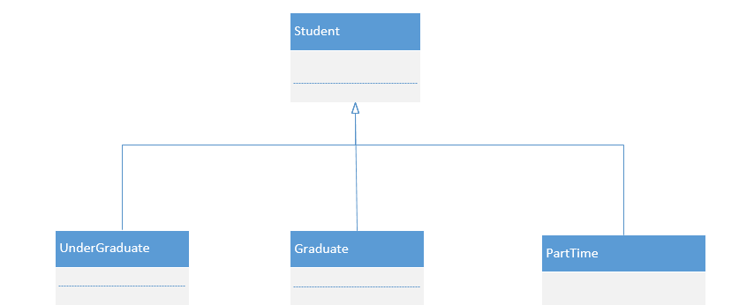

Slide 12
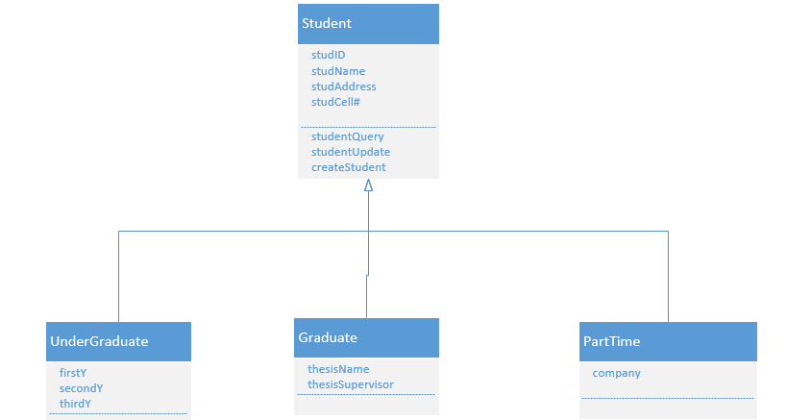

Slide 13
