Slide 1
Chapter 2:
The Project Management and Information Technology Context

Slide 2
Learning Objectives
Understand the systems view of project management and how it applies to information technology projects
Analyze a formal organization using the structural, human resources, political, and symbolic organizational frames
Explain the differences among functional, matrix, and project organizational structures
Explain why stakeholder management and top management commitment are critical for a project’s success

Slide 3
Learning Objectives
Understand the concept, development, implementation, and close-out phases of the project life cycle
Distinguish between project development and product development
Discuss the unique attributes and diverse nature of information technology projects
List the skills and attributes of a good project manager in general and in the information technology field

Slide 4
Projects Cannot Be Run in Isolation
Projects must operate in a broad organizational environment
Project managers need to take a holistic or systems view of a project and understand how it is situated within the larger organization
See example in opening and closing case to illustrate this concept

Slide 5
A Systems View of Project Management
A systems approach emerged in the 1950s to describe a more analytical approach to management and problem solving
Three parts include:
  Systems philosophy: View things as systems, interacting components working within an environment to fulfill some purpose
  Systems analysis: problem-solving approach
  Systems management: Address business, technological, and organizational issues before making changes to systems

Slide 6
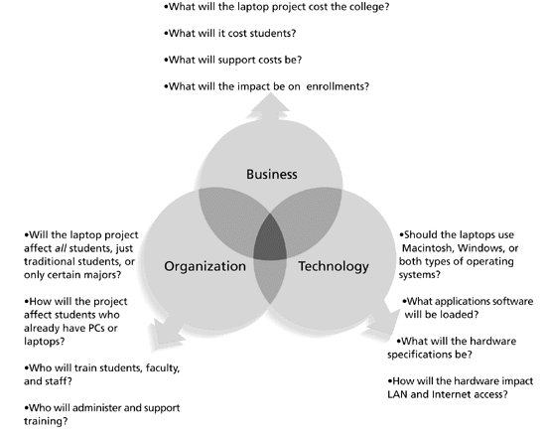
Figure 2-1. Three Sphere Model for Systems Management

Slide 7
Understanding Organizations
Structural frame: Focuses on roles and responsibilities, coordination and control. Organizational charts help define this frame.
Human resources frame: Focuses on providing harmony between needs of the organization and needs of people.
Political frame: Assumes organizations are coalitions composed of varied individuals and interest groups. Conflict and power are key issues.
Symbolic frame: Focuses on symbols and meanings related to events. Culture is important.

Slide 8
What Went Wrong?
Many enterprise resource planning (ERP) projects fail due to organizational issues. For example, Sobey’s Canadian grocery store chain abandoned its two-year, $90 million ERP system due to organizational problems.
As Dalhousie University Associate Professor Sunny Marche states, “The problem of building an integrated system that can accommodate different people is a very serious challenge. You can’t divorce technology from the sociocultural issues. They have an equal role.” Sobey’s ERP system shut down for five days and employees were scrambling to stock potentially empty shelves in several stores for weeks. The system failure cost Sobey’s more than $90 million and caused shareholders to take an 82-cent after-tax hit per share.*
*Hoare, Eva. “Software hardships,” The Herald, Halifax, Nova Scotia (2001)

Slide 9
Many Organizations Focus on the Structural Frame
Most people understand what organizational charts are
Many new managers try to change organizational structure when other changes are needed
3 basic organizational structures
  functional
  project
  matrix

Slide 10
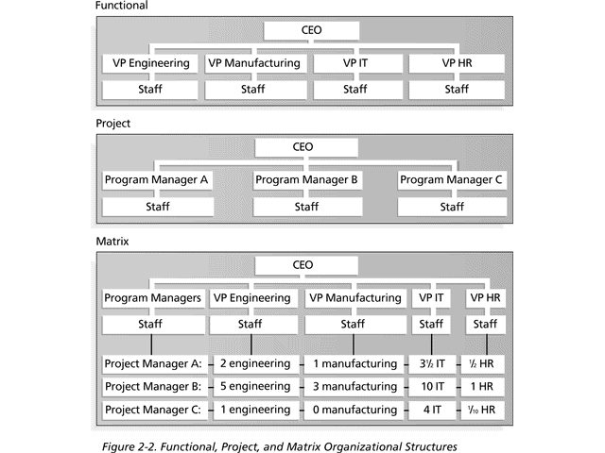
Basic Organizational Structures

Slide 11
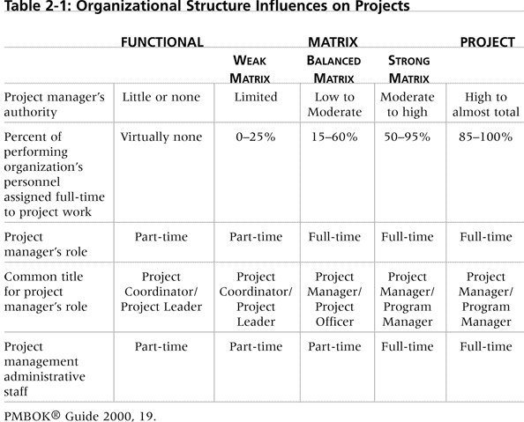
Table 2-1. Organizational Structure Influences on Projects
The organizational structure influences the project manager’s authority, but project managers need to remember to address the human resources, political, and symbolic frames, too.

Slide 12
Recognize the Importance of Project Stakeholders
Recall that project stakeholders are the people involved in or affected by project activities
Project managers must take time to identify, understand, and manage relationships with all project stakeholders
Using the four frames of organizations can help meet stakeholder needs and expectations
Senior executives are very important stakeholders

Slide 13
What Helps Projects Succeed?
According to the Standish Group’s report “CHAOS 2001: A Recipe for Success,” the following items help IT projects succeed, in order of importance:
  Executive support
  User involvement
  Experienced project manager
  Clear business objectives
  Minimized scope
  Standard software infrastructure
  Firm basic requirements
  Formal methodology
  Reliable estimates

Slide 14
Need for Top Management Commitment
Several studies cite top management commitment as one of the key factors associated with project success
Top management can help project managers
  secure adequate resources
  get approval for unique project needs in a timely manner
  receive cooperation from people throughout the organization
  learn how to be better leaders

Slide 15
Need for Organizational Commitment to Information Technology (IT)
If the organization has a negative attitude toward IT, it will be difficult for an IT project to succeed
Having a Chief Information Officer (CIO) at a high level in the organization helps IT projects
Assigning non-IT people to IT projects also encourages more commitment

Slide 16
Need for Organizational Standards
Standards and guidelines help project managers be more effective
Senior management can encourage
  the use of standard forms and software for project management
  the development and use of guidelines for writing project plans or providing status information
  the creation of a project management office (PMO) or center of excellence

Slide 17
Fifteen Project Management Job Functions*
Identify and evaluate risks
Prepare contingency plan
Identify interdependencies
Identify and track critical milestones
Participate in project phase review
Secure needed resources
Manage the change control process
Report project status
Define scope of project
Identify stakeholders, decision-makers, and escalation procedures
Develop detailed task list (work breakdown structures)
Estimate time requirements
Develop initial project management flow chart
Identify required resources and budget
Evaluate project requirements
*Northwest Center for Emerging Technologies, "Building a Foundation for Tomorrow: Skills Standards for Information Technology,"Belleview, WA, 1999

Slide 18
Suggested Skills for Project Managers
Project managers need a wide variety of skills
They should be comfortable with change, understand the organizations they work in and with, and be able to lead teams to accomplish project goals
Project managers need both “hard” and “soft” skills. Hard skills include product knowledge and knowing how to use various project management tools and techniques, and soft skills include being able to work with various types of people

Slide 19
Suggested Skills for Project Managers
    Communication skills: listening, persuading
    Organizational skills: planning, goal-setting, analyzing
    Team Building skills: empathy, motivation, esprit de corps
    Leadership skills: set examples, be energetic, have vision (big picture), delegate, be positive
    Coping skills: flexibility, creativity, patience, persistence
    Technological skills: experience, project knowledge

Slide 20
Most Significant Characteristics of Effective and Ineffective Project Managers
Effective Project Managers Ineffective Project Managers
Lead by example
Are visionaries
Are technically competent
Are decisive
Are good communicators
Are good motivators
Stand up to upper management when necessary
Support team members
Encourage new ideas
Set bad examples
Are not self-assured
Lack technical expertise
Are poor communicators
Are poor motivators

Slide 21
Project Phases and the Project Life Cycle
A project life cycle is a collection of project phases
Project phases vary by project or industry, but some general phases include
  concept
  development
  implementation
  support

Slide 22
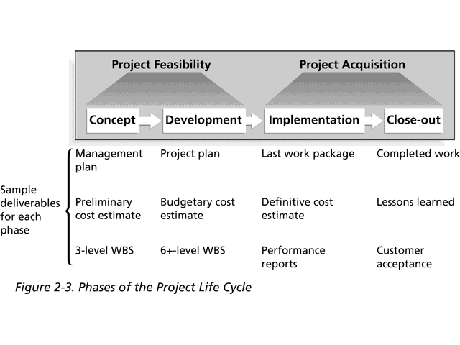
Phases of the Project Life Cycle

Slide 23
Product Life Cycles
Products also have life cycles
The Systems Development Life Cycle (SDLC) is a framework for describing the phases involved in developing and maintaining information systems
Systems development projects can follow
  predictive models: the scope of the project can be clearly articulated and the schedule and cost can be predicted
  adaptive models: projects are mission driven and component based, using time-based cycles to meet target dates

Slide 24
Predictive Life Cycle Models
The waterfall model has well-defined, linear stages of systems development and support
The spiral model shows that software is developed using an iterative or spiral approach rather than a linear approach
The incremental release model provides for progressive development of operational software
The prototyping model is used for developing prototypes to clarify user requirements
The RAD model is used to produce systems quickly without sacrificing quality

Slide 25
Adaptive Life Cycle Models
Extreme Programming (XP): Developers program in pairs and must write the tests for their own code. XP teams include developers, managers, and users
Scrum: Repetitions of iterative development are referred to as sprints, which normally last thirty days. Teams often meet every day for a short meeting, called a scrum, to decide what to accomplish that day. Works best for object-oriented technology projects and requires strong leadership to coordinate the work

Slide 26
Distinguishing Project Life Cycles and Product Life Cycles
The project life cycle applies to all projects, regardless of the products being produced
Product life cycle models vary considerably based on the nature of the product
Most large IT systems are developed as a series of projects
Project management is done in all of the product life cycle phases

Slide 27
Why Have Project Phases and Management Reviews?
A project should successfully pass through each of the project phases in order to continue on to the next
Management reviews (also called phase exits or kill points) should occur after each phase to evaluate the project’s progress, likely success, and continued compatibility with organizational goals

Slide 28
What Went Right?
"The real improvement that I saw was in our ability to⎯in the words of Thomas Edison⎯know when to stop beating a dead horse.…Edison's key to success was that he failed fairly often; but as he said, he could recognize a dead horse before it started to smell...as a result he had 14,000 patents and was very successful…In IT we ride dead horses⎯failing projects⎯a long time before we give up. But what we are seeing now is that we are able to get off them; able to reduce cost overrun and time overrun. That's where the major impact came on the success rate.”
  Cabanis, Jeannette, "'A Major Impact': The Standish Group's Jim Johnson On Project Management and IT Project Success," PM Network, PMI, September 1998, p. 7

Slide 29
The Context of IT Projects
IT projects can be very diverse in terms of size, complexity, products produced, application area, and resource requirements
IT project team members often have diverse backgrounds and skill sets
IT projects use diverse technologies that change rapidly. Even within one technology area, people must be highly specialized

