Slide 1
Tutorial 6:
Sharing Project Information with Other People & Applications

Slide 2
In this tutorial you will:
Copy or export Project 2010 data to other Microsoft Office programs
Copy or import data from Microsoft Office programs to Project 2010
Create a link between Project 2010 information and Microsoft Excel
Embed data in Project 2010
Use the Drawing tool

Slide 3
In this tutorial you will, cont.:
Use and create Project 2010 templates
Use the Project 2010 global template and Organizer
Create and share a resource pool
Use master projects
Create a hyperlink between a Project 2010 file and a Microsoft Word document
Create a custom field
Notes:
3

Slide 4
Sharing Project Data with Other Applications
Project 2010 provides many features to manage, analyze, and report project information.
Since Project 2010 is part of the Microsoft Office suite of programs, it is easy to share project information with people who don’t use Project, but do use Word and Excel, for example.
Notes:
4

Slide 5
Sharing Project Data with Other Applications, Cont.
If you export a Project 2010 file to Excel, the Project map feature will create an Excel file with all the data from the Project file.
Outlook tasks can also be imported into a Project file.
Project integrates with Access using Open Database Connectivity (ODBC) standards.
Notes:
5

Slide 6
Methods for sharing Project 2010 information with other programs
The methods are:
  Copying and pasting
  Importing or exporting
  Earned value analysis
  Linking
  Embedding

Slide 7
Using Excel to Analyze Numeric Data
Excel is an excellent tool for analyzing and graphing numbers.
People use Excel to track expenses and budgetary information.
You might find that the tools in Excel are better than Project for some types of cost analysis.

Slide 8
Copying Data from Project to Excel
When you work in Excel, the cell address is the cell that intersects the column letter and row number.
A group of cells in Excel is called a range.
Ranges are defined by the first cell address in the upper-left corner of the group of cells and the last cell address in the lower-right corner of the range

Slide 9
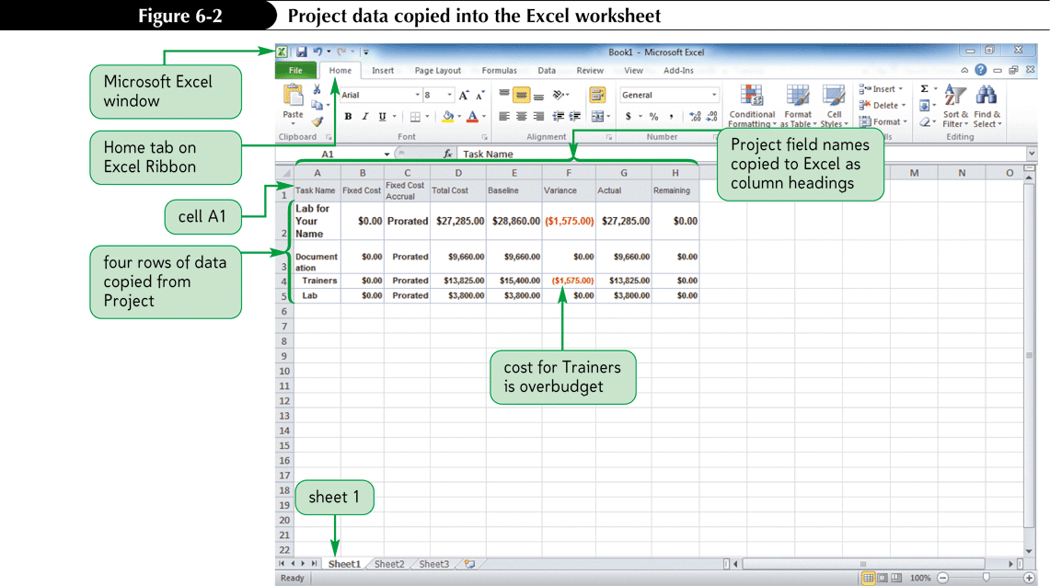
Project Data Copied into an Excel Worksheet

Slide 10
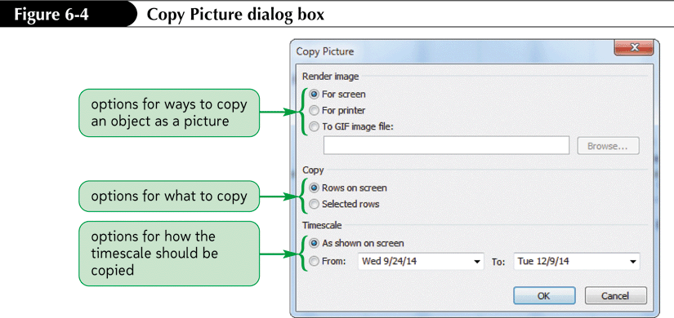
Using the Copy Picture Feature
The Copy Picture feature allows you to copy almost any view of a project as a picture.
Once copied, you can paste the picture in another Office file, such as a Word document or a PowerPoint presentation.

Slide 11
The Three Options for Copying Pictures
For screen – copies the information on the screen with all color formatting intact.
For printer – copies the view as it would print on a black-and-white printer.
To Gif image – allows you to create a GIF file, for use in a Web page or other program
  A GIF (graphics interchange format) file is a common form of graphical image, often used for Web pages.

Slide 12
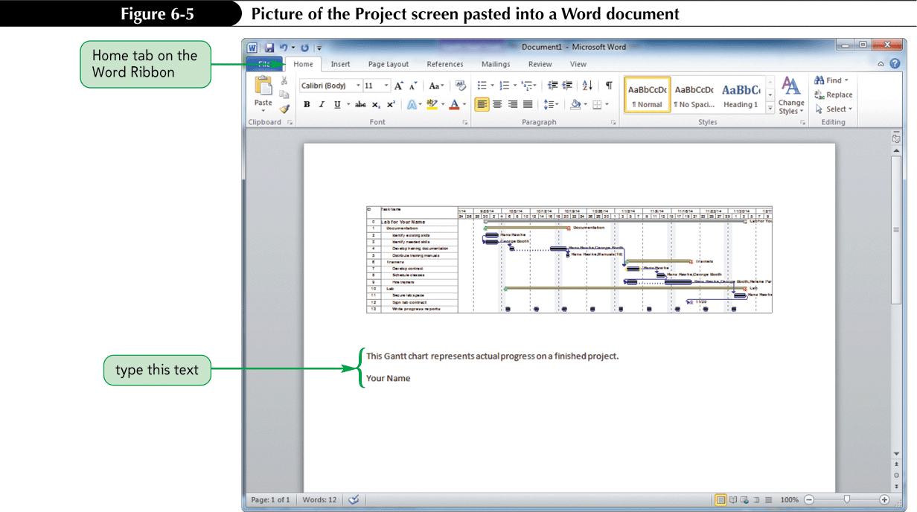
Gantt Chart Pasted as a Picture

Slide 13
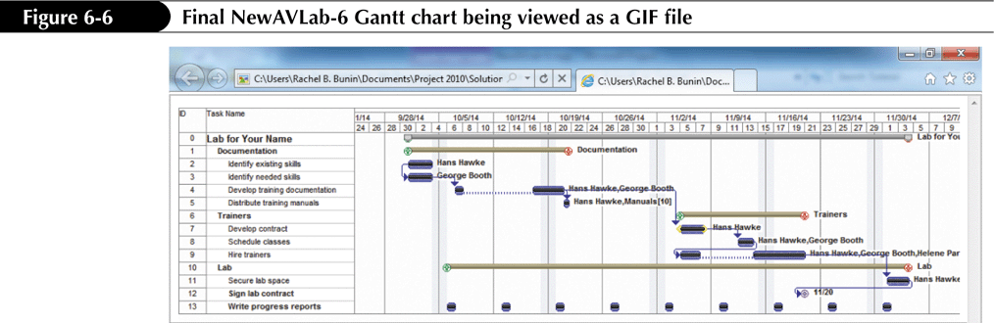
Gantt Chart as a GIF File

Slide 14
Exporting Project Data to Excel
The fields of a project revolve around three major categories: tasks, resources, and assignments.
When you export a project to a new format, the fields in the Project file must map to the corresponding fields in the new program.
Project has a list of predefined maps for most standard export tasks.
The Export Wizard manages the export of all fields for a given category to a new format.

Slide 15
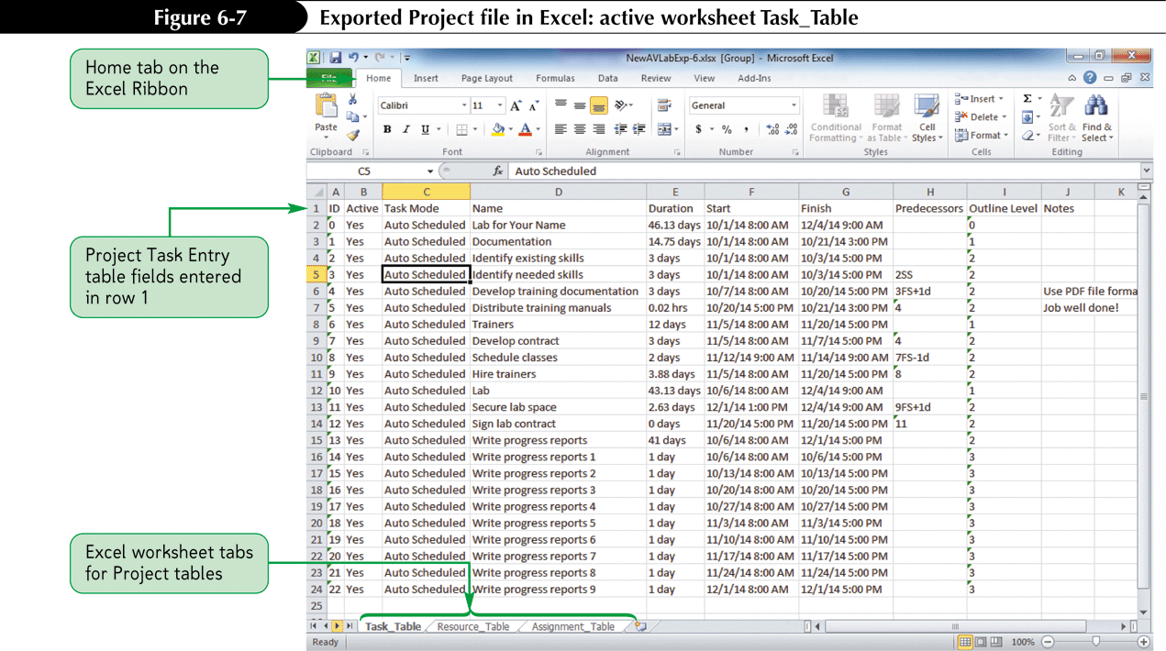
Exported Project File in Excel

Slide 16
Earned Value Data Exported to Excel
Project provides a way to show project costs as a budget and then compare the expected progress with actual progress.
This process, called earned value analysis (EVA) uses budget values for each task to calculate variance values.
These values can be easily exported to Excel, to show useful ratios.

Slide 17
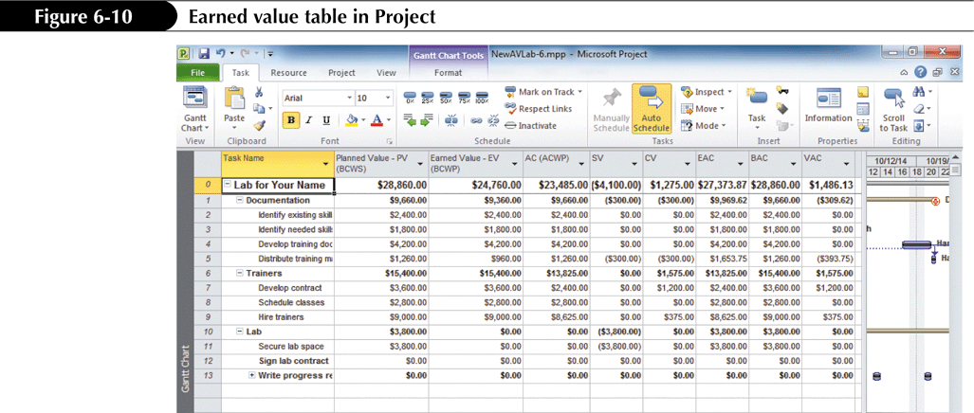
Earned Value Table in Project

Slide 18
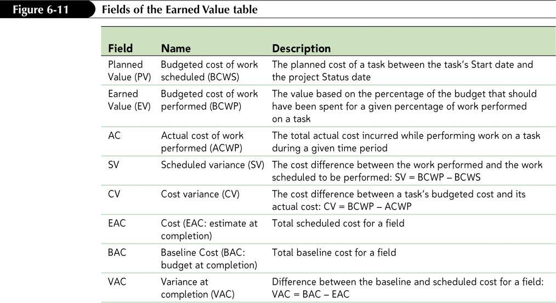
Fields of the Earned Value Table

Slide 19
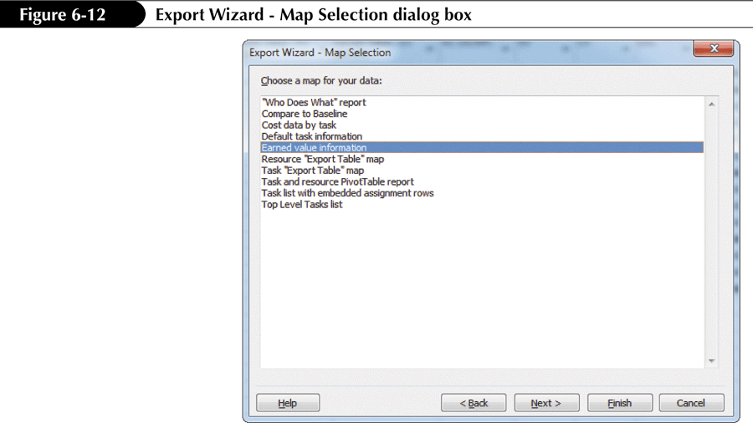
Exporting Earned Value Data to Excel

Slide 20
Starting a Project Plan by Using the Excel Task List Template
You can use an Excel template to start a new project.
The data is entered into the Excel template, then imported into Project to create a Project file.

Slide 21
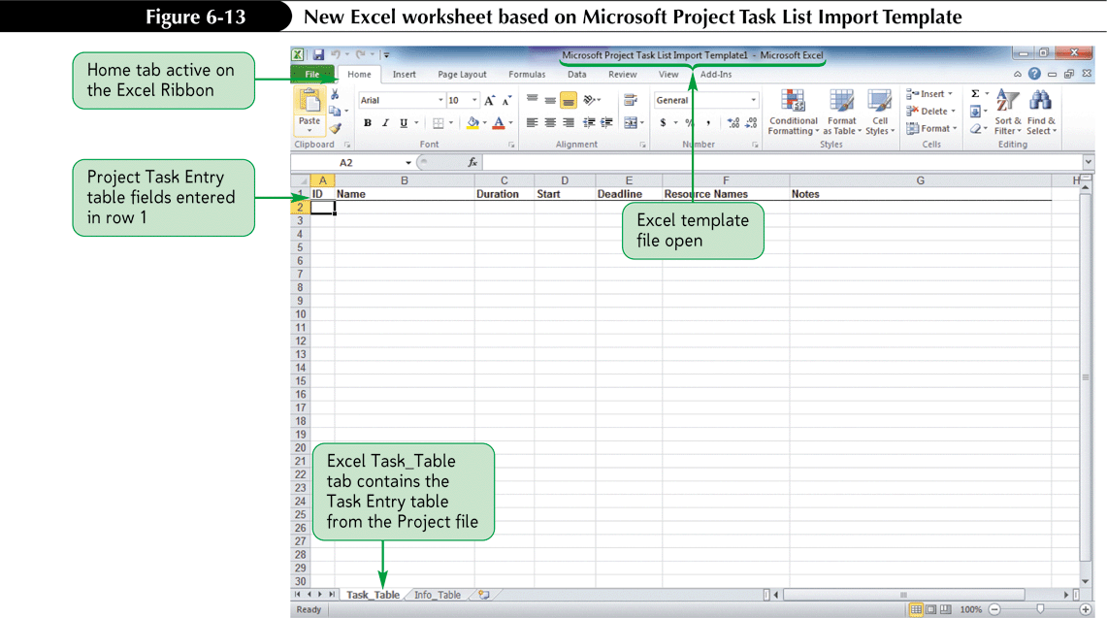
Excel Task List Template

Slide 22
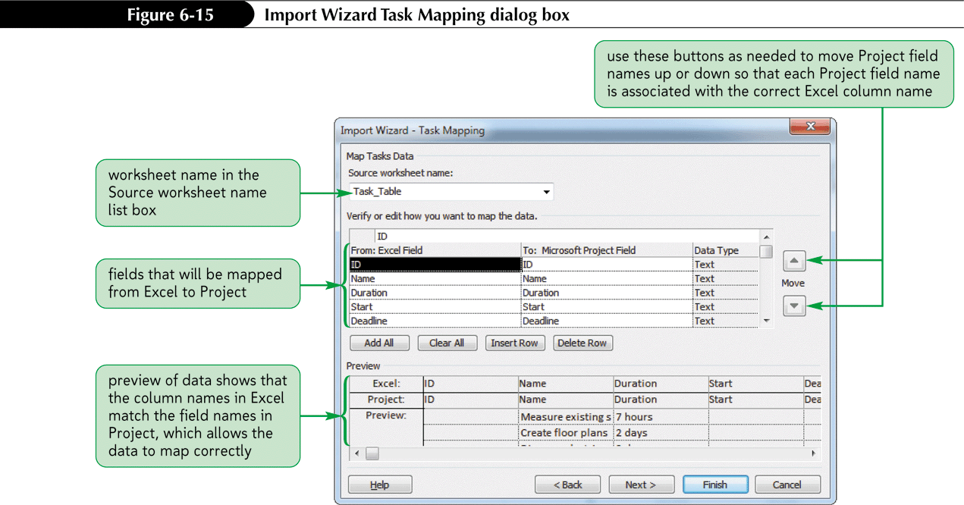
Importing Excel Data into Project 2010

Slide 23
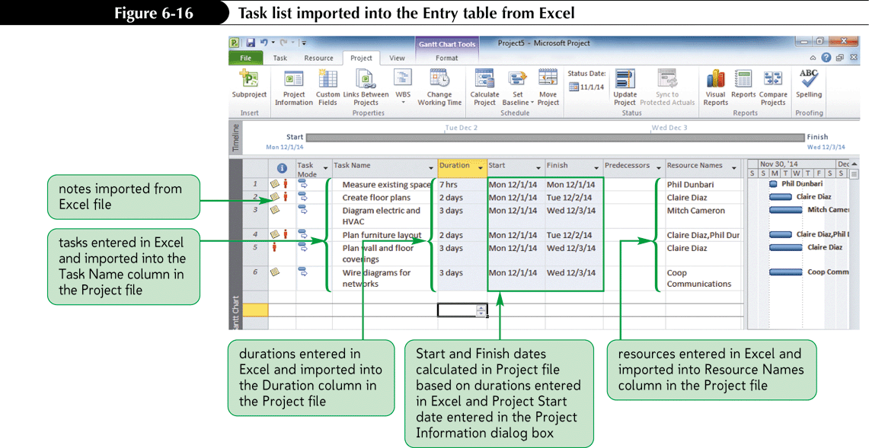
Imported Task List from Excel

Slide 24
Importing Outlook Tasks into a
Project File
You can import all or selected tasks from Outlook into Project
The selected Outlook tasks are appended into the currently open Project file.
Task dates from Outlook are ignored when imported into Project.
Project is used to schedule and assign Start and Finish dates.

Slide 25
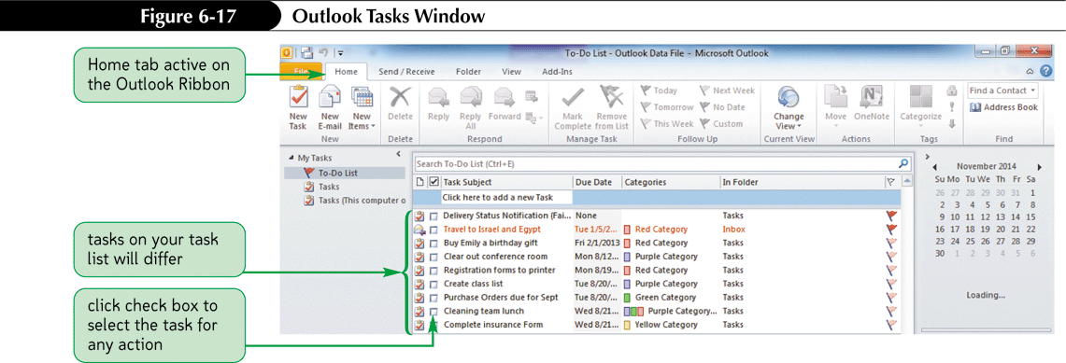
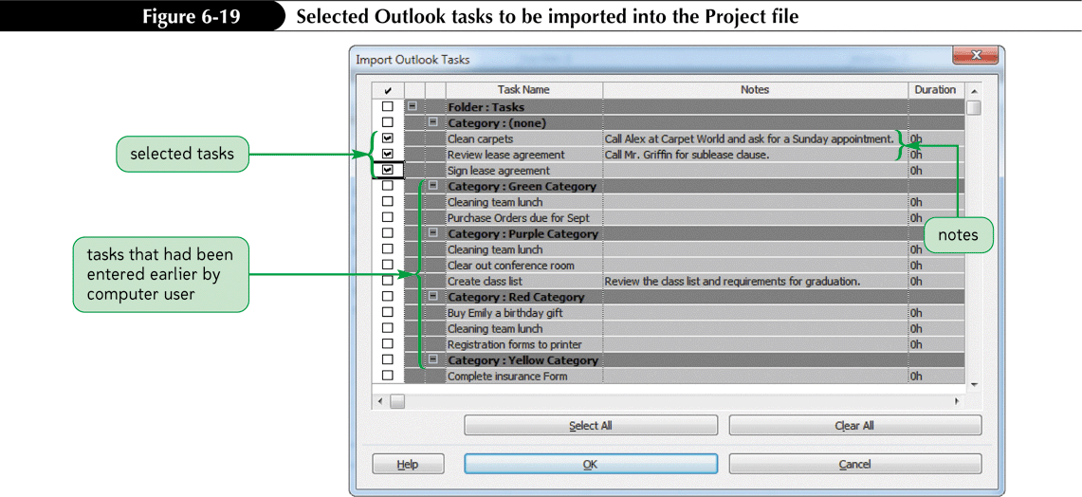
Outlook Task Selection

Slide 26
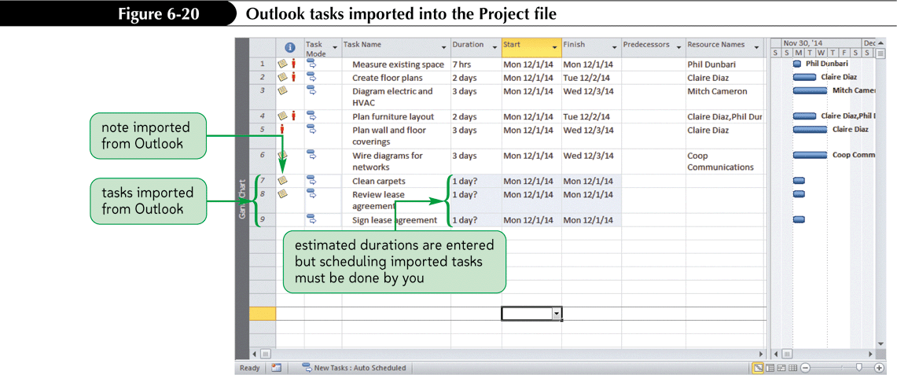
Tasks Imported to Project

Slide 27
Linking Excel Data to Project
The major benefit of linking data is that the process avoids creating a duplicate copy of data in the destination file; the data is physically stored only in the source file.
Changes made to either file will update in both files, if both files are open.
If both files are not open, changes made to one file are made to the second file the next time the file is opened.

Slide 28
Disadvantages of Linking Data
Linking data is not as powerful as the import process.
Linked data cannot be mapped.
Linked files must travel together if they are copied or moved to avoid broken links.

Slide 29
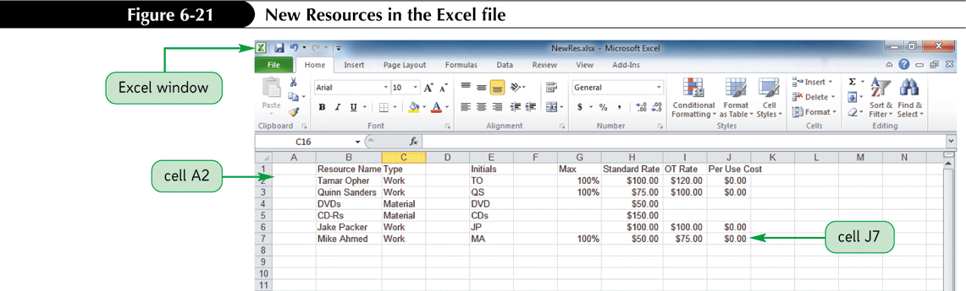
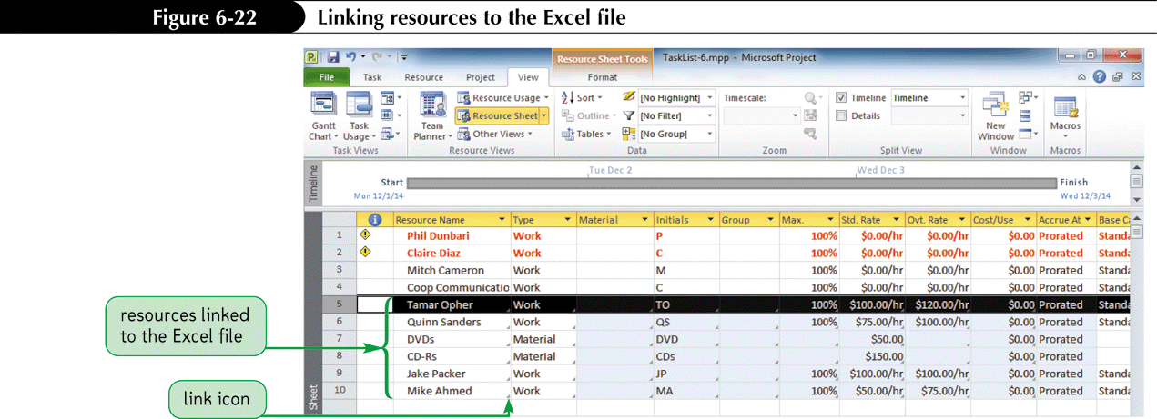
Linked Resource Files

Slide 30
Using the Drawing Tool
The Drawing tool allows you to add drawn shapes, lines, and boxes to a Gantt chart.
It is commonly used to annotate or draw attention to key information.
Adding graphical effects to a Gantt chart helps to communicate information.

Slide 31
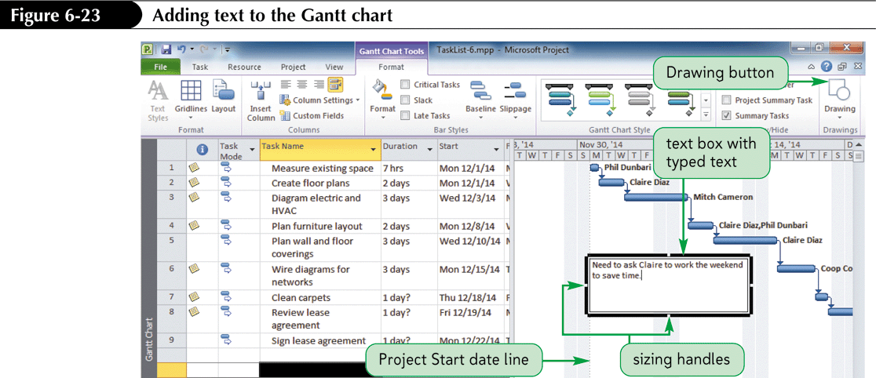
Text Added to a Gantt Chart

Slide 32
Working with Project Templates
A template is a special Project file that contains sample information such as task, resource, cost, and baseline data on which you can base a new Project file.
A template is a powerful tool for storing standard data on which multiple projects will be based.
Templates help you build projects faster and ensure that projects based on the template are standardized.

Slide 33
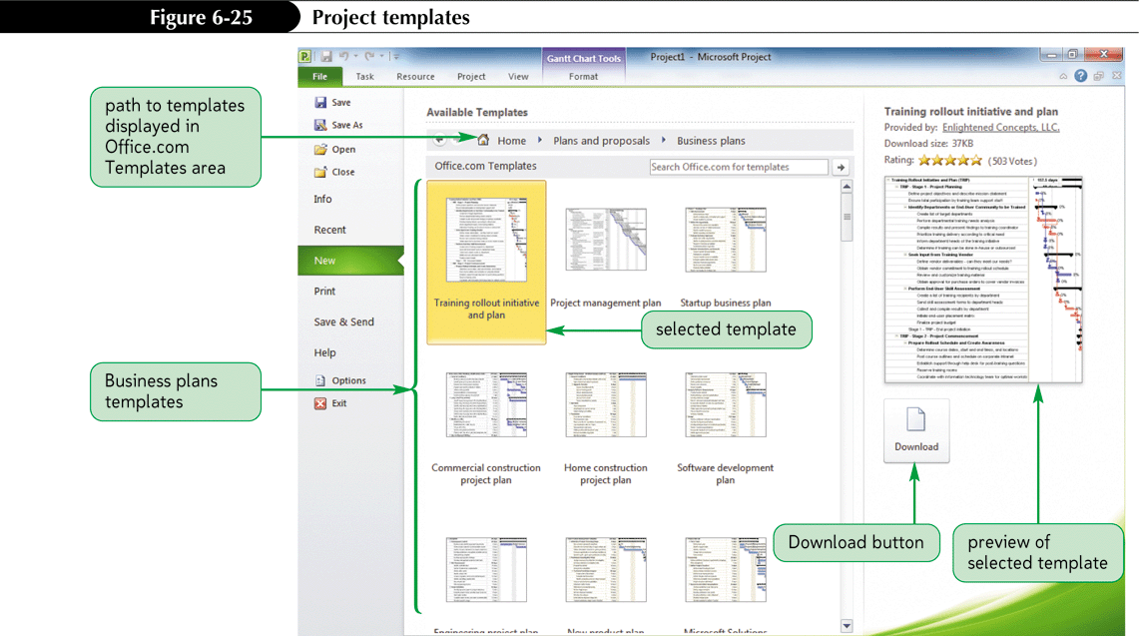
Project Templates

Slide 34
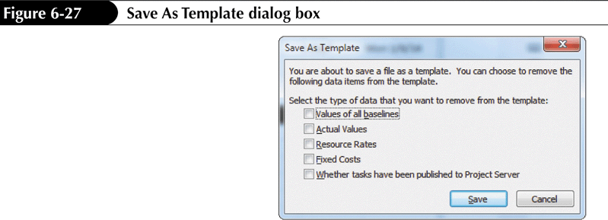
Creating a Custom Template
If you manage many projects that contain the same basics tasks, you could create a custom template for reuse on multiple projects.
You would not need to remember the common tasks for each new project.

Slide 35
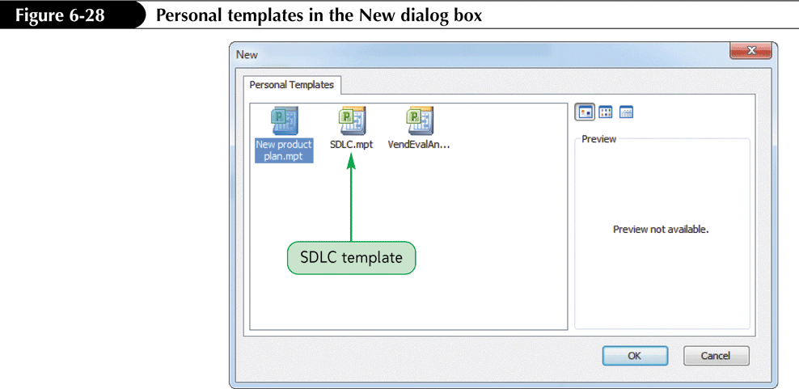
Using a Custom Template

Slide 36
Working with Data Templates
In Project 2010, you can create a special type of template called a data template or a box template.
These boxes then define those displayed in Network Diagram view.
Once data templates are created, you can share them with other projects.
The Standard data template includes the scheduled Start and Finish dates, and the letter X on tasks that are complete.
You can change the default formatting by creating a new data template and applying it to a box type.

Slide 37
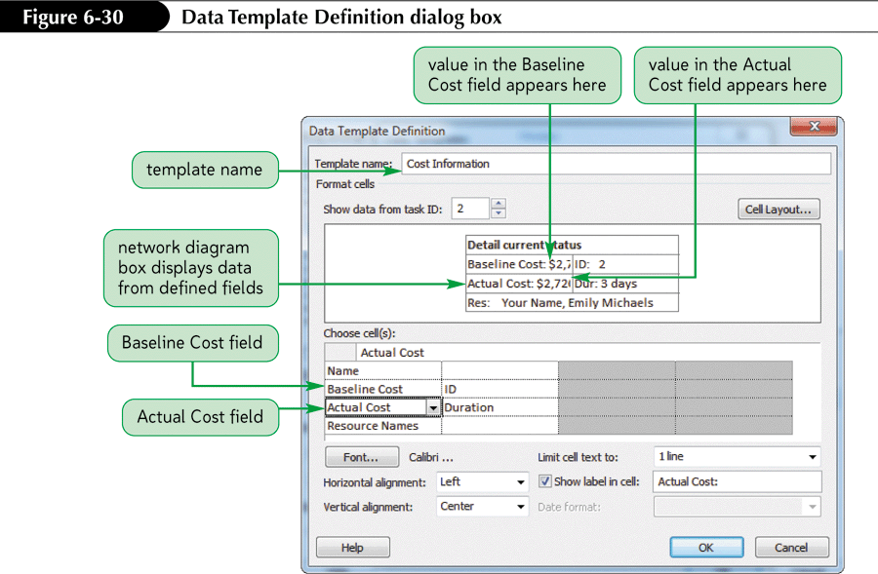
Data Template Definition

Slide 38
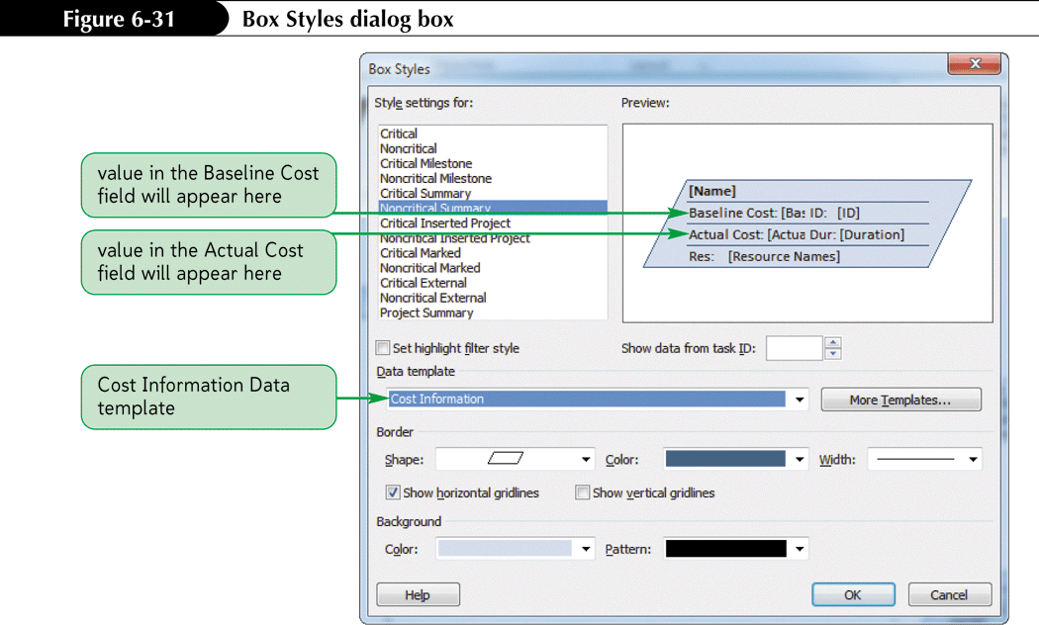
Box Styles Dialog Box

Slide 39
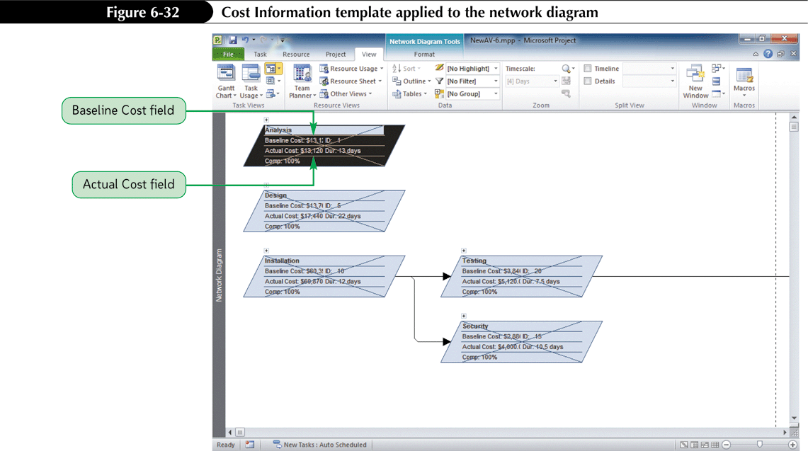
Cost Information Template Applied

Slide 40
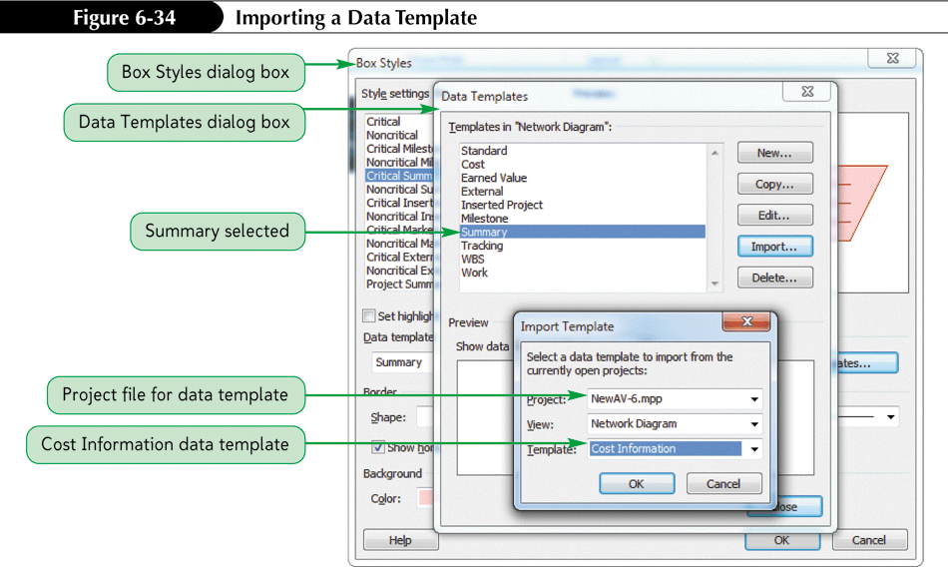
Importing a Data Template

Slide 41
Using the Organizer
The Organizer is a special tool that allows you to copy custom views, tables, filters, data maps, forms, calendars, macros, toolbars, and other customizations from one project file to another.
The Global.MPT is the global template that stores all the views, tables, filters, etc. that are available for each new project.
Therefore, when you create a custom view, calendar, report, etc. and want it to be available to every project, you should copy it to the Global.MPT using the Organizer.

Slide 42
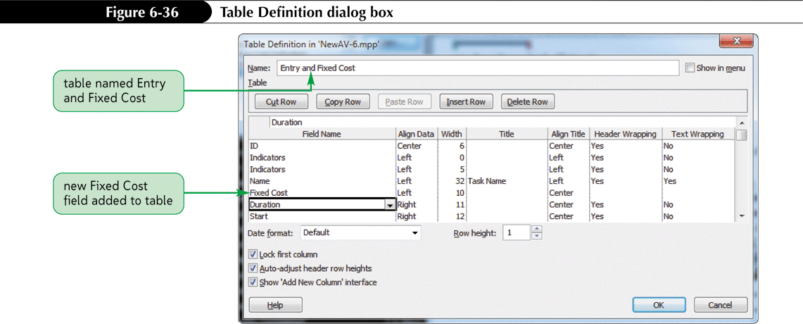
To Create a New Table and use the Organizer

Slide 43
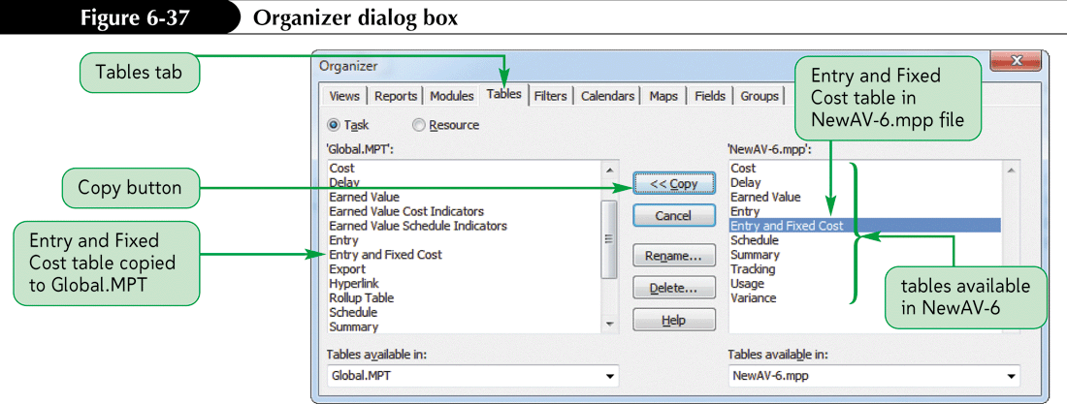
Organizer Dialog Box

Slide 44
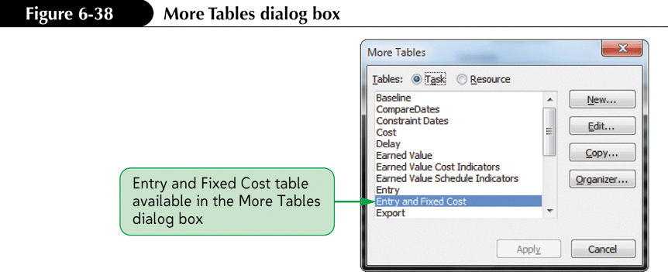
Verifying a Table was Moved to the Global.MPT File

Slide 45
Resource Pools
A resource pool is a project file that usually contains only data associated with resources, such as name, costs, units and calendar information.
A resource pool file is linked to other Project files in a way that allows you to share the resources in the pool.

Slide 46
Advantages of Resource Pools
Enter shared resources only once
Schedule resources while taking into consideration resource allocations made in other projects
Identify conflicts among assignments in different projects
Manage resource units, costs and calendars in only one place

Slide 47
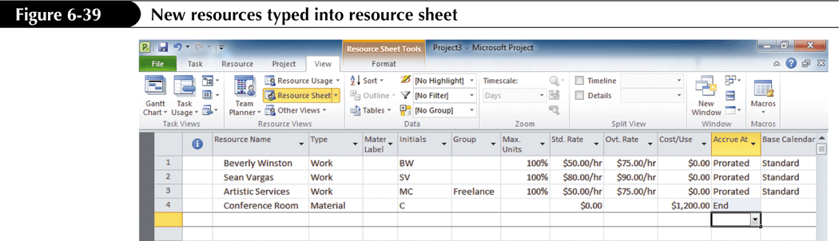
Creating a Resource Pool File

Slide 48
Sharing Existing Resources Between Project Files
When you share resources, you need to determine which file should take precedence if conflicts arise between the two files.
Precedence determines which file’s resources and resource information will be used if conflicts arise when they are merged.
  “Pool takes precedence” means the resource pool file will overwrite conflicting information from the sharing file.
  “Sharer takes precedence” means the sharing file will over-write information in the resource pool and other sharing files.

Slide 49
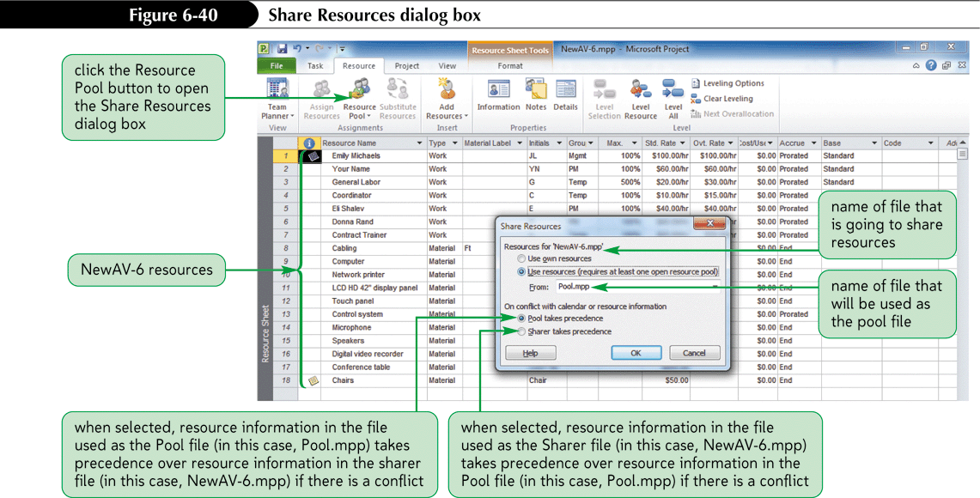
Sharing Resources Between Two Files

Slide 50
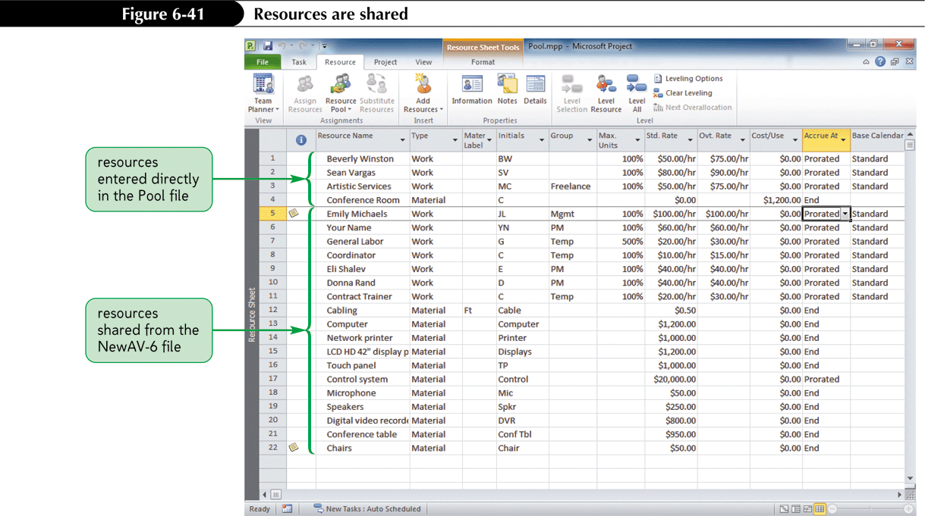
Resources Shared

Slide 51
Updating and Refreshing the Pool
When both the sharing and resource pool files are open on your computer, changes entered in one file will update in the other file. If not, updates must be made manually.
Read-write access is the ability to both open (read) a file and edit (write to) a file.
Only one person at a time can have read-write access to the resource pool file.
When one person is using the file with read-write access, all others using the file at the same time only have read access. Their updates must be made manually.

Slide 52
Using a Master Project
A master project, also called a consolidated project, is a project file that contains subprojects.
A subproject is a project file that is inserted into a master project.
Using master project-subproject organization allows more than one person to enter, edit and update tasks simultaneously by working in separate subproject files that are linked to the master project.

Slide 53
Creating a Master Project and Its Subprojects
A master file can:
  contain master-level tasks
  serve as a container into which subprojects are linked, or
  can contain both master-level tasks and linked subprojects

Slide 54
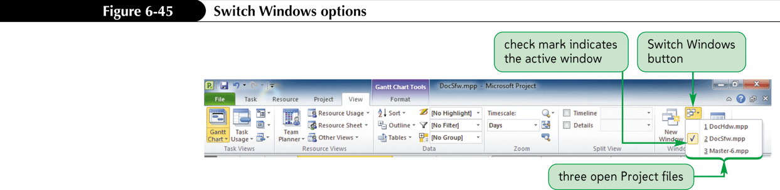
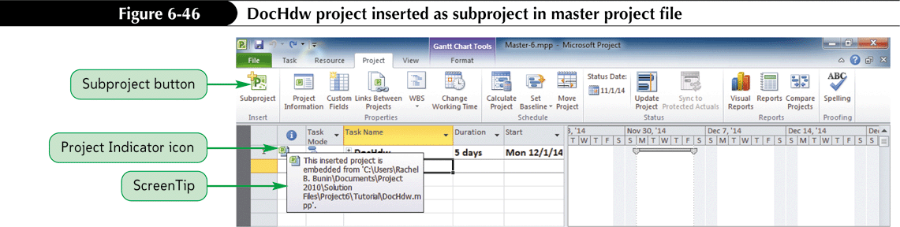
Inserting a Subproject into a Master Project

Slide 55
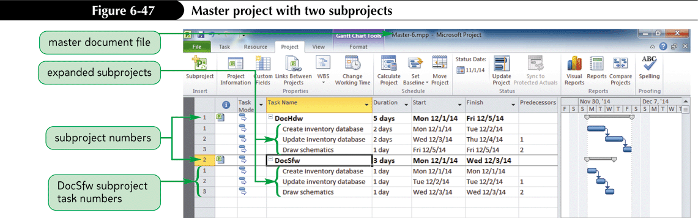
Master Project with Two Subprojects

Slide 56
Calculation Options and the Master File
By default, a subproject filename acts as the summary task for that subproject in the master project file.
Therefore, all duration and cost values for the subproject are applied to that subproject’s task name in the master project.
You can change the way the master file calculates the subproject by changing the Calculation options in the Options dialog box on either the Schedule tab or the Advanced tab depending on the types of changes you want to make.

Slide 57
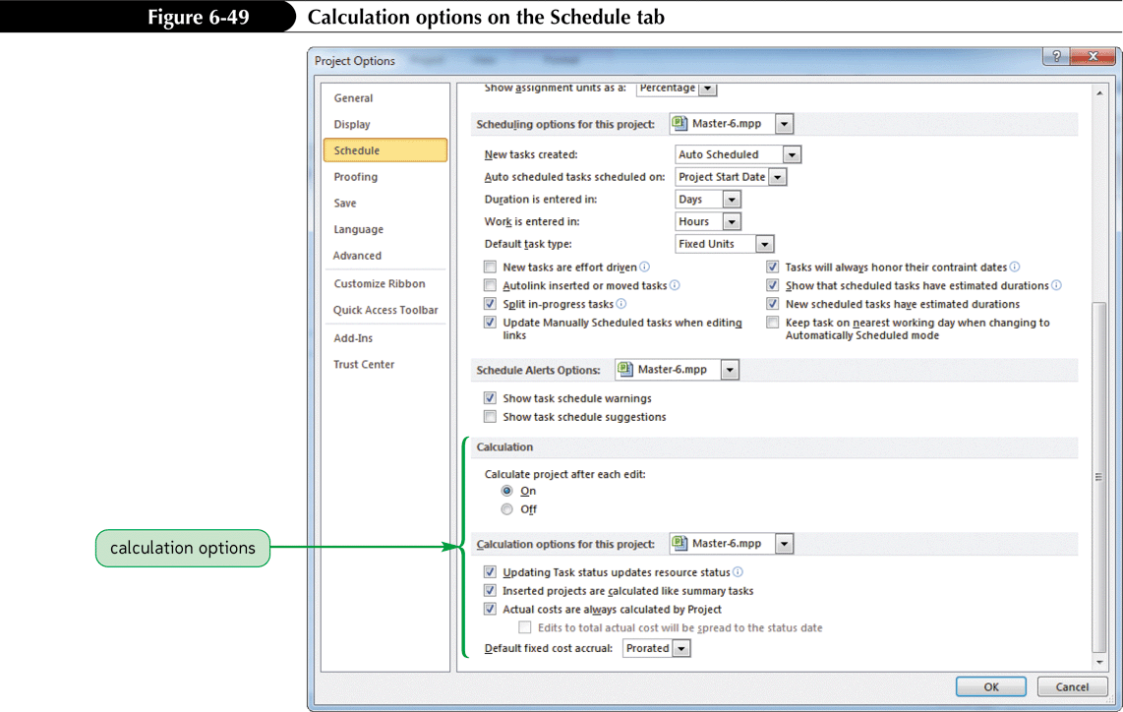
Calculation Options on the
Schedule Tab

Slide 58
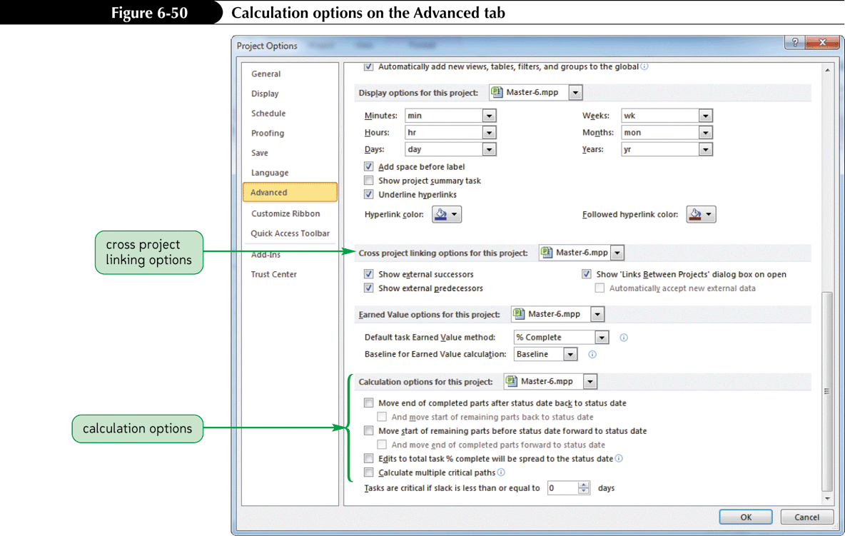
Calculation Options on the
Advanced Tab

Slide 59
Adding Hyperlinks to a Project File
A hyperlink is text of graphics that, when clicked, opens a Word document, PowerPoint presentation, Access database, Excel worksheet, or any file or Web page that is associated with that hyperlink.
You can link to another file or a location within a file.

Slide 60
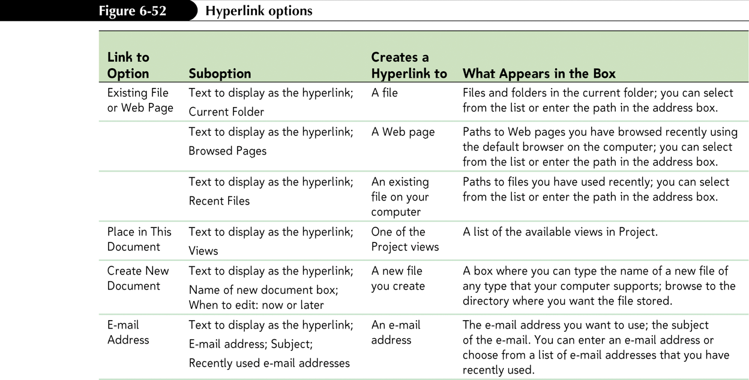
Hyperlink Options

Slide 61
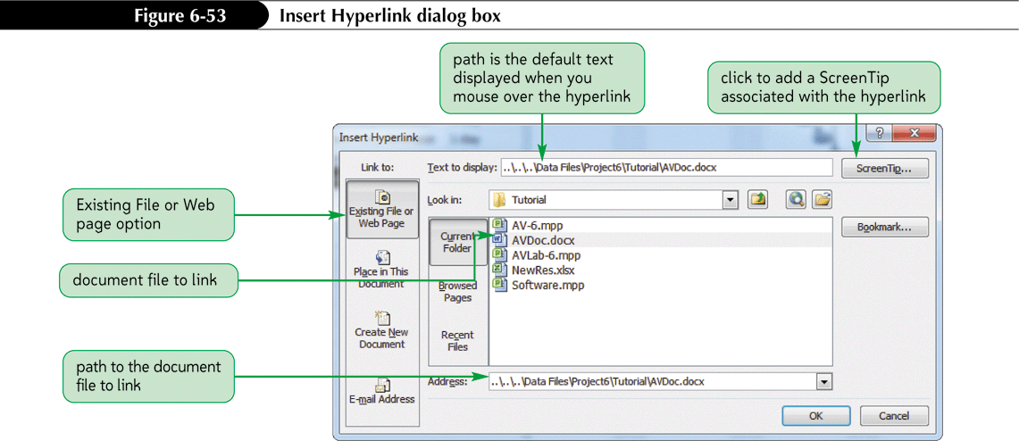
Adding a Hyperlink

Slide 62
Working with Custom Fields
A custom field is a field that is defined by a user for a specific purpose.
It can be used with either tasks or resources.
A custom field can be a new field or an existing field that is renamed.
It can contain an input value list so input can be controlled to specific values.
Custom fields are defined using the Customized Fields dialog box.
Custom fields can be copied from project to project using the Organizer.

Slide 63
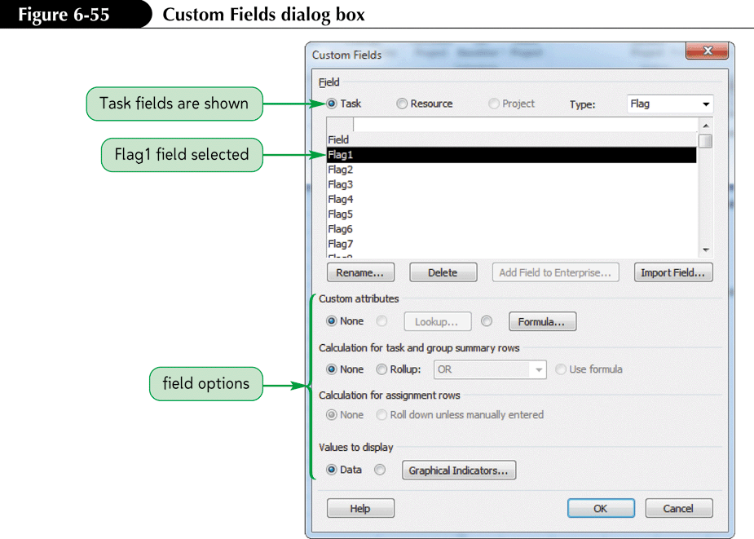
Custom Fields Dialog Box

Slide 64
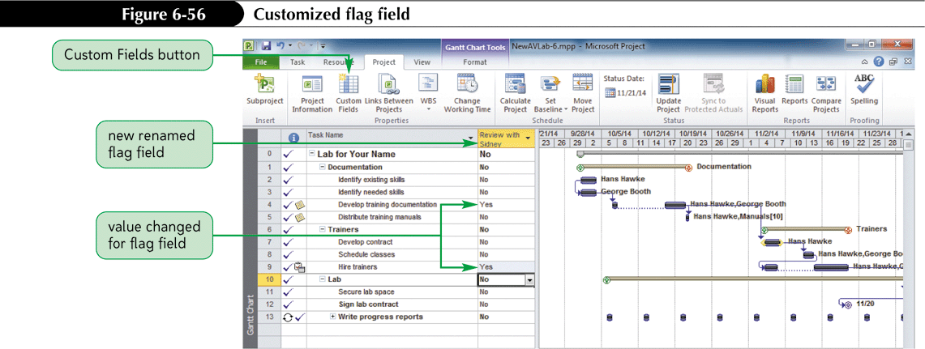
Customized Flag Field

Slide 65
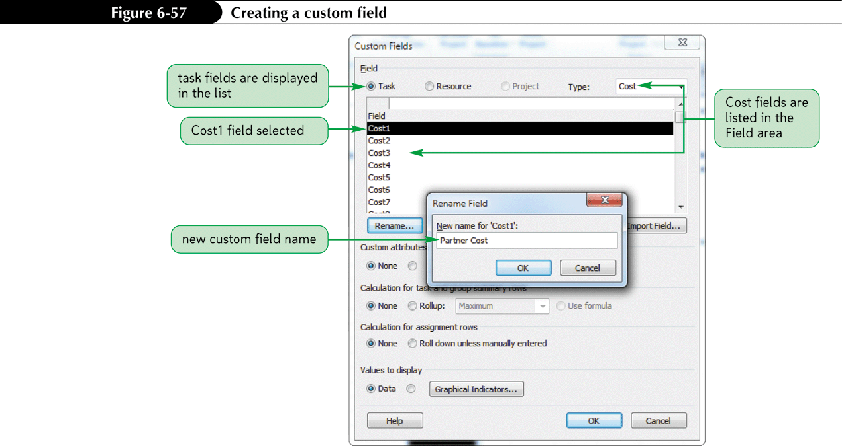
Creating a Custom Field with a Data Value List

Slide 66
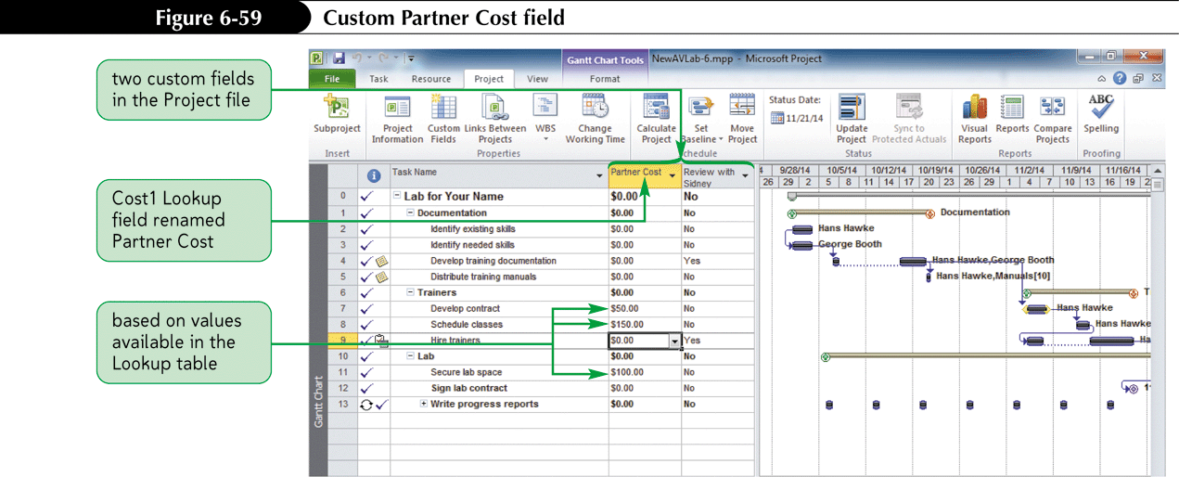
Custom Partner Cost Field

Slide 67
Tutorial 6 Summary
In this tutorial, you learned to:
  export Project 2010 data to other Microsoft Office programs
  copy or import data from Microsoft Office programs to Project 2010
  create a link between Project 2010 information and Microsoft Excel
  embed data in Project 2010
  use the Drawing tool

Slide 68
Tutorial 6 Summary cont.
  use and create Project 2010 templates
  use the Project 2010 global template and Organizer
  create and share a resource pool
  use master projects
  create a hyperlink between a Project 2010 file and a Microsoft Word document
  create a custom field
Notes:
68

