Slide 1
Tutorial 4:
Assigning Resources and Costs

Slide 2
In this tutorial you will:
Session 4.1
  Use resource and cost views
  Enter and edit resource and cost data
  Organize resources into logical groups
  Assign resources and costs to tasks
  Level overallocations and set resource contours

Slide 3
In this tutorial you will:
Session 4.2
  Edit task information based on the relationship among work, duration, and units
  Create fixed-work and fixed duration task
  Sort, filter, and group tasks for resource information.

Slide 4
In this tutorial you will:
Session 4.3
  Correct for overallocations
  Analyze resource usage and entered project costs
  Examine the critical path and slack
  Use cost reports
  Use the Team Planner

Slide 5
Entering Cost and Resource Data
A significant component to planning and managing your project is accurately controlling and tracking cost and resource data.
A cost is an expenditure made to accomplish a task.
  It includes both variable and fixed costs.

Slide 6
Variable Costs
Variable costs are determined by the number of resource units assigned to a task as well as the hourly or per use cost for that resource.
Variable costs can be associated with labor costs or material consumable resources.

Slide 7
Fixed Costs
Fixed costs are expenses such as insurance, a legal fee, or a travel expense that are associated with a task but do not vary according to the length of the task or the number of resources assigned to the task.

Slide 8
Budget
After establishing costs, you can track and manage them so that your project stays within the budget.
The budget is the amount of money that you have allocated for the project based on cost and time estimates.
You can update cost and time estimates so they are in better alignment with the actual costs and time allocations of the project.

Slide 9
Resources and Resource Sheet View
A resource is the person(s), equipment, or materials used to complete a task in a project.
You can enter resource and cost data about a project in many different project views, but for the initial data entry of resources, the Resource Sheet view is commonly used.
A grouping feature is available in the Resource Sheet view so you can get a logical view of your resources based on groups.

Slide 10
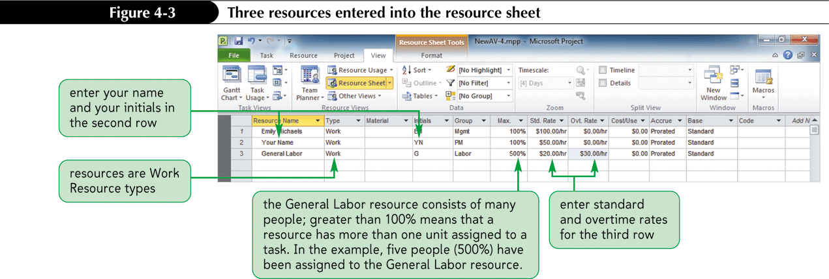
Resource Sheet View

Slide 11
Exploring the Resource Information Dialog Box
The Resource Information dialog box is a comprehensive collection of all of the data stored for a single resource.
  The data is organized on 4 tabs: General, Costs, Notes, and Custom Fields.
  The Costs tab and the Notes tab are only available in the Resource Information Dialog Box

Slide 12
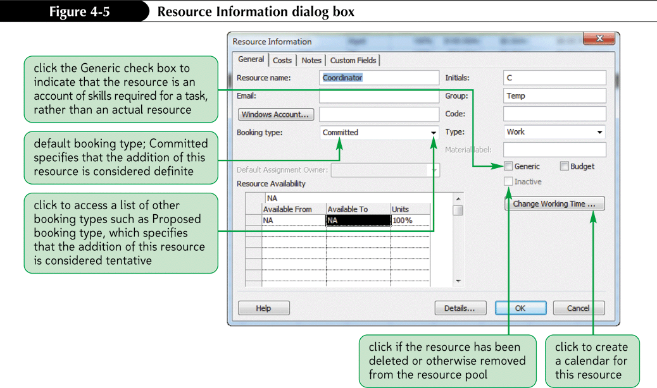
Resource Information Dialog Box

Slide 13
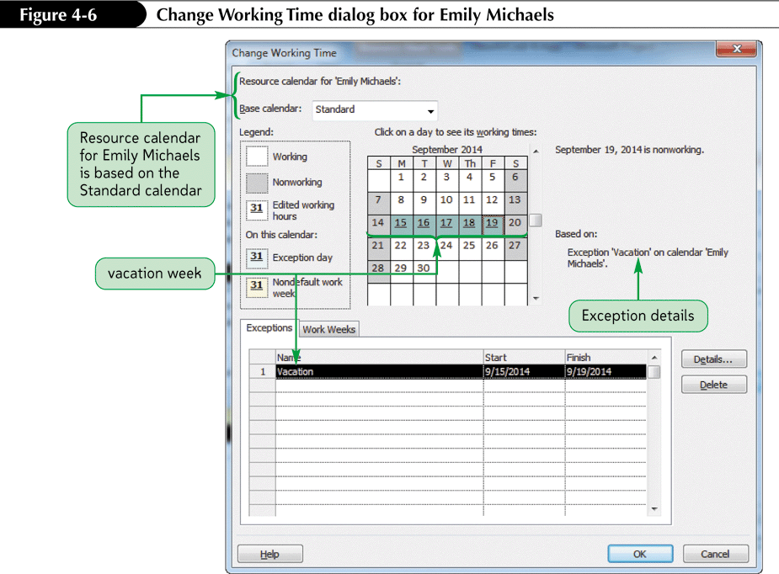
Changing Working Time with the Resource Information Dialog Box

Slide 14
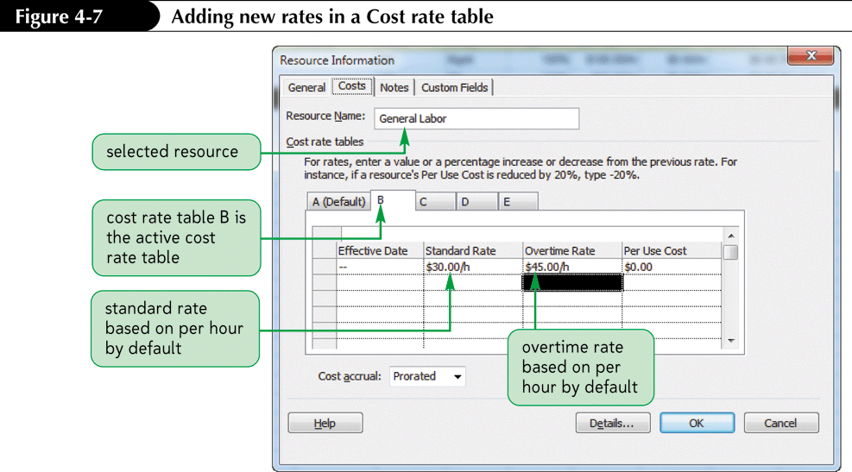
The Cost Rate Table
A Cost rate table is a grid of different hourly and per-use costs that can be stored for a single resource.
Project 2010 has 5 rate tables (Table A-Table E) for each resource to support varying pay scales and rates.

Slide 15
Grouping Resources
A Group By feature is available in Resource Sheet view.
You use the Group By feature to get a logical view of the project resources based on groups.
Grouping options include:
  No Group
  Assignments Keeping Outline Structure
  Complete and Incomplete Resources
  Resource Group, Resource Type
  Standard rate
  (via the “More Groups” option) Work Vs. Material Resources

Slide 16
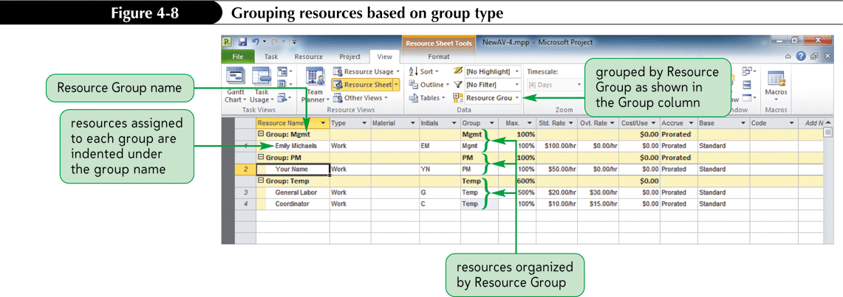
Grouping Resources in Resource Sheet View

Slide 17
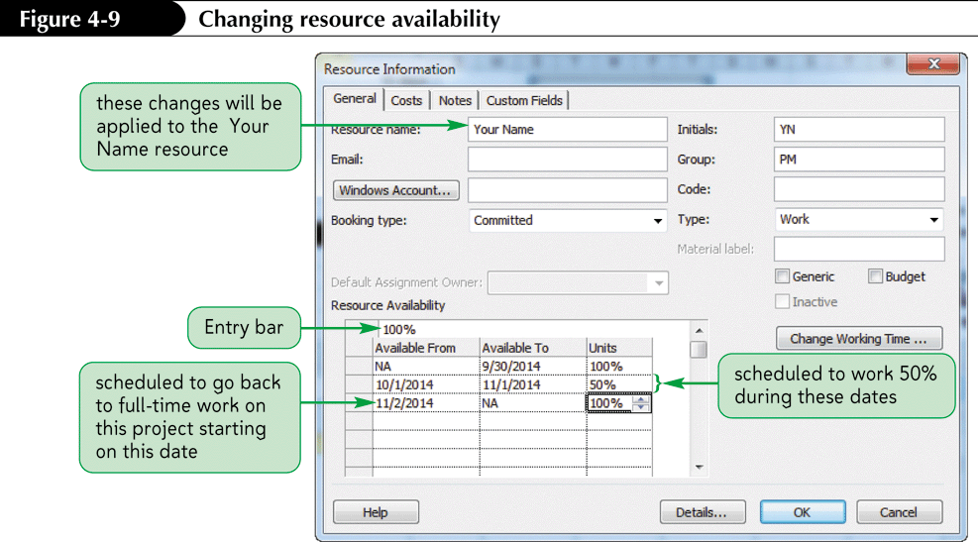
Resource Availability
As a project progresses, you might find that you have to make a change to resource’s availability.
For example, a resource might be available only part-time or for specific dates.

Slide 18
The Importance of Entering Resource Information
Entering resource information on a project takes considerable effort.
The more time put into these initial entry points, the more accurate the entire project will be.
After the resource data has been entered, you can start assigning resources to specific tasks.
Project 2010 automatically calculates task costs by multiplying task durations by the cost information supplied for each resource.

Slide 19
Assigning Resources to Tasks
Project 2010 is designed to give you great flexibility in the way that you enter data.
Many methods are available to assign resources to specific tasks.
  Use the Assign Resources button
  Use a Split Screen view

Slide 20
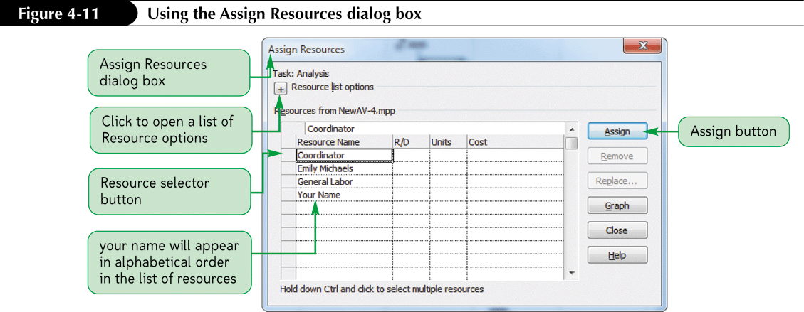
Assigning Resources Using the Assign Resources Dialog Box

Slide 21
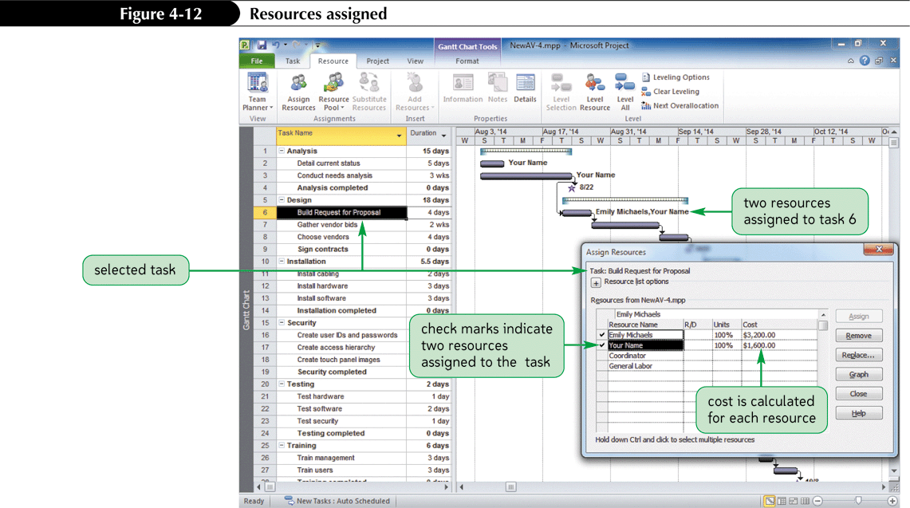
Resources Assigned

Slide 22
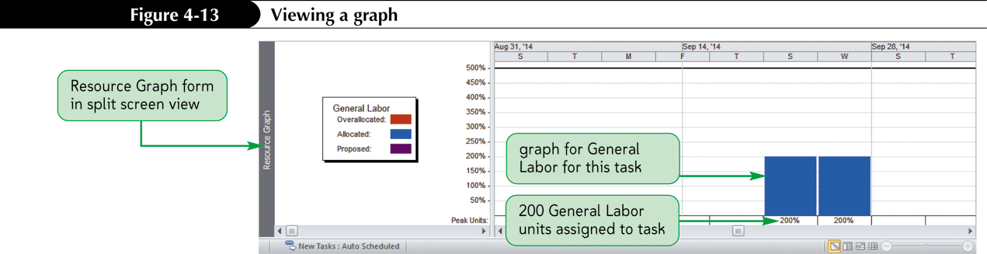
Viewing the General Labor Resource Graph

Slide 23
Assigning A New Cost Rate Table
The General Labor resource has two cost rates, one in Table A and one in Table B.
If you want to change the cost rate table for a task, you can open the Task Usage View and double-click on the task to display the Assignment Information dialog box.

Slide 24
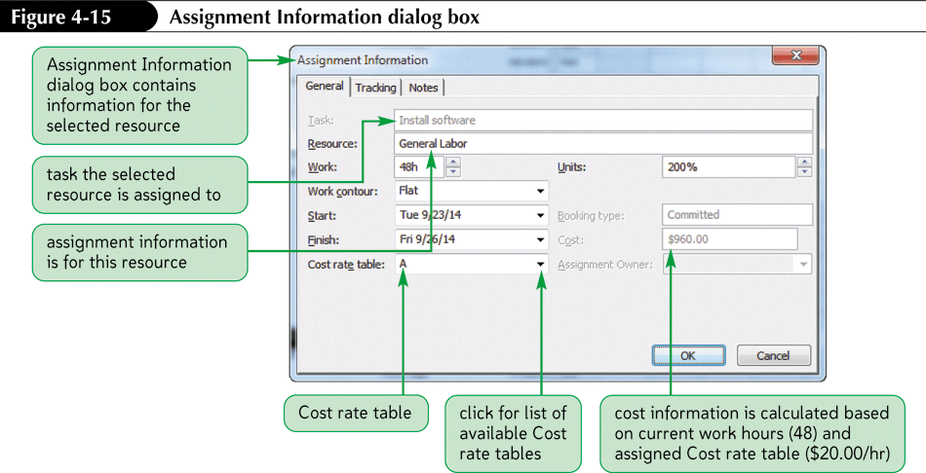
Changing the Cost Rate Table for a Task via Task Usage view

Slide 25
Using the Resource Work Form
Total work for a task is initially calculated as the task duration (converted to hours) multiplied by the number of resources assigned to that task.
Total work is initially calculated based on the initial resource assignment and then recalculated when the task duration changes.

Slide 26
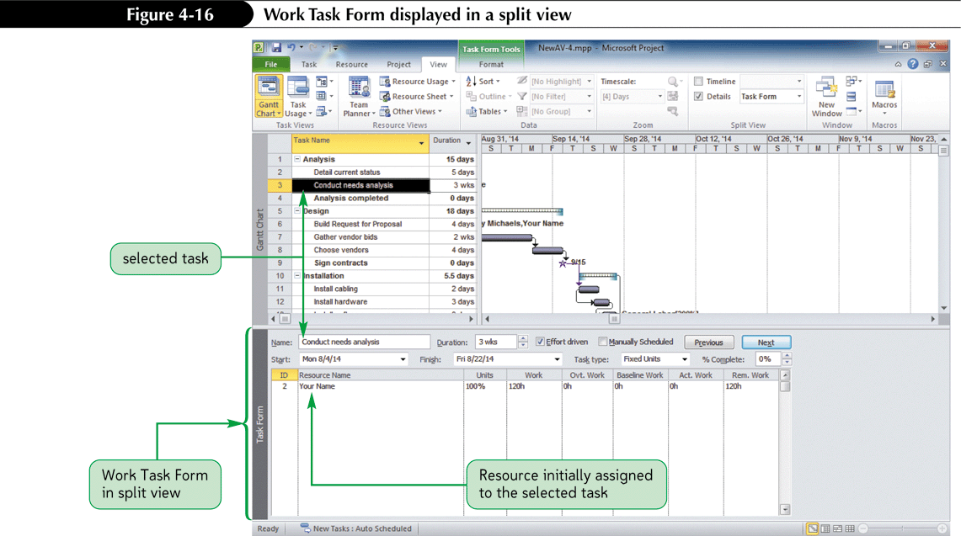
Resource Work Form Displayed in a Split View

Slide 27
Understanding Relationships
By default, work is calculated in hours and follows this formula:
  Work = Duration * Units (W=D*U)
    (where units refers to resources)
  Or Duration = Work/Units
    (to solve for the Duration rather than Work)
Effort-driven scheduling is when the work remains constant and the duration is changed
  Work (effort) remains constant and determines (drives) the way that the W=D*U formula will be calculated.

Slide 28
Understanding Relationships Cont.
When a second resource is assigned after the initial resource assignment:
  The work hours remain constant but are distributed among the existing and new resources, and the duration is adjusted to reflect the redistribution of hours.
How the relationship between work, duration, and units is balanced is a function of both effort-driven scheduling and the task type.

Slide 29
Understanding Relationships Cont.
Tasks are, by default, effort driven.
When effort-driven scheduling is turned off and a new resource is added to a task with an existing resource assignment, the work (effort) no longer drives the assignment.
A fixed-duration task is when effort-driven scheduling is turned off and a new resource is assigned to a task, the duration of the task remains constant and the work (effort) is increased.

Slide 30
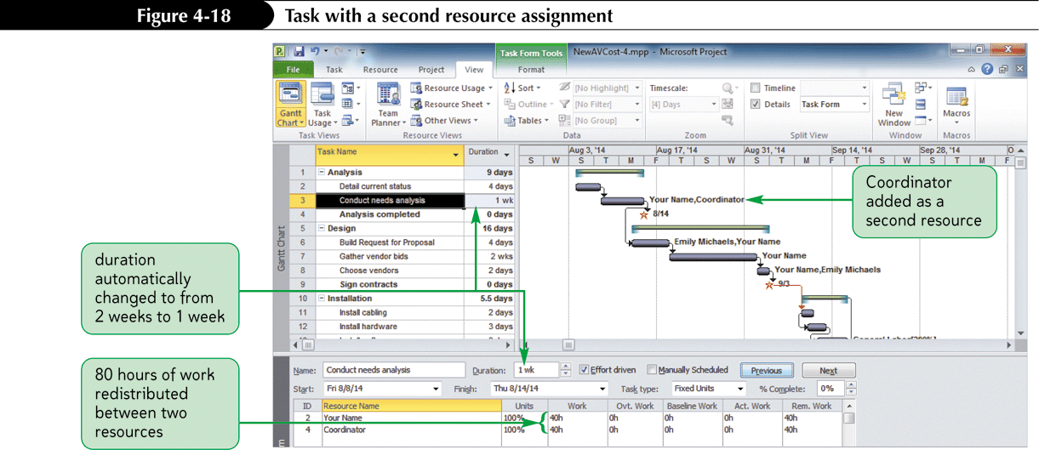
Effect of Adding a Resource to a Task

Slide 31
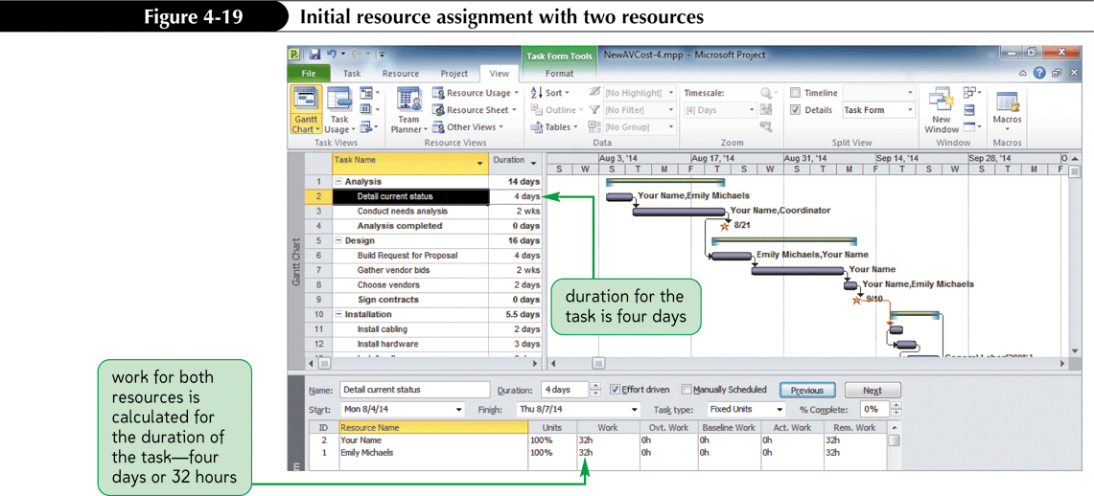
Effect of Adding a Resource to a Task and Changing the Work

Slide 32
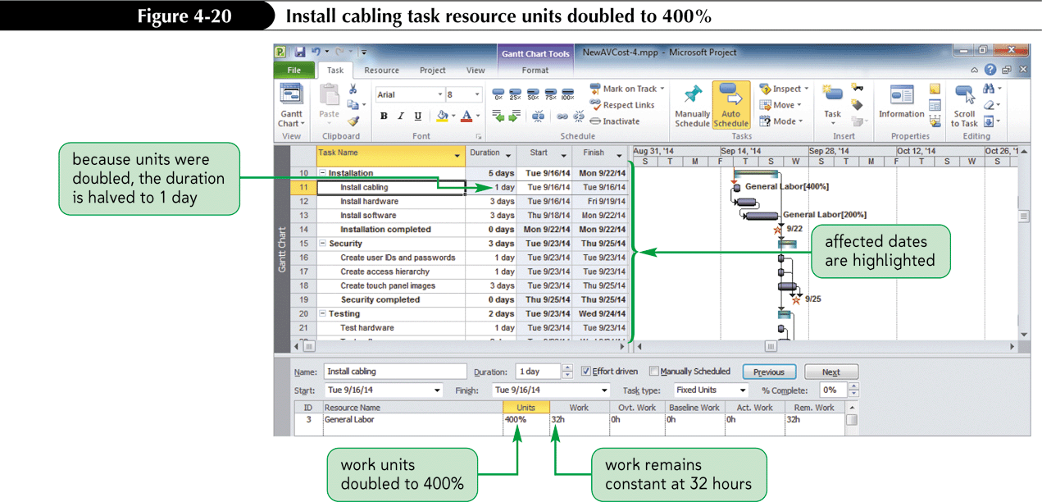
Effect of Adding a Resource to a Task and Changing the Work Cont.

Slide 33
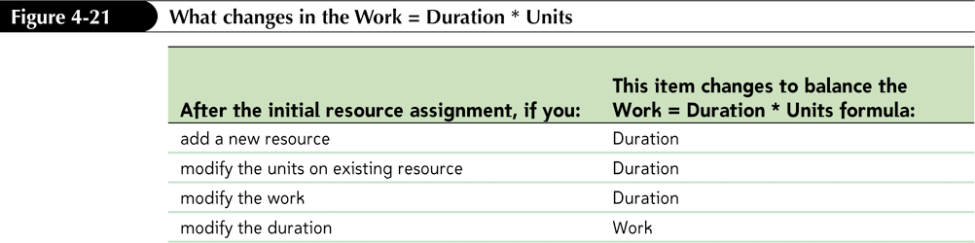
Impact of Changes Made After the Initial Resource Assignment

Slide 34
Creating a Fixed-Duration Task
Task type is a task field that refers to what will remain constant when additional resources are added to a task.
Task types in Project 2010 are Fixed Units, Fixed Duration, or Fixed Work
By default, the task type is Fixed Units and effort driven.

Slide 35
Creating a Fixed-Duration Task Cont.
When an additional resource is added to an effort driven task, the total work (effort) remains constant and the duration is adjusted (shortened).
When an additional resource is added to an fixed-duration task, the total duration remains constant and the work (effort) is decreased for each resource.

Slide 36
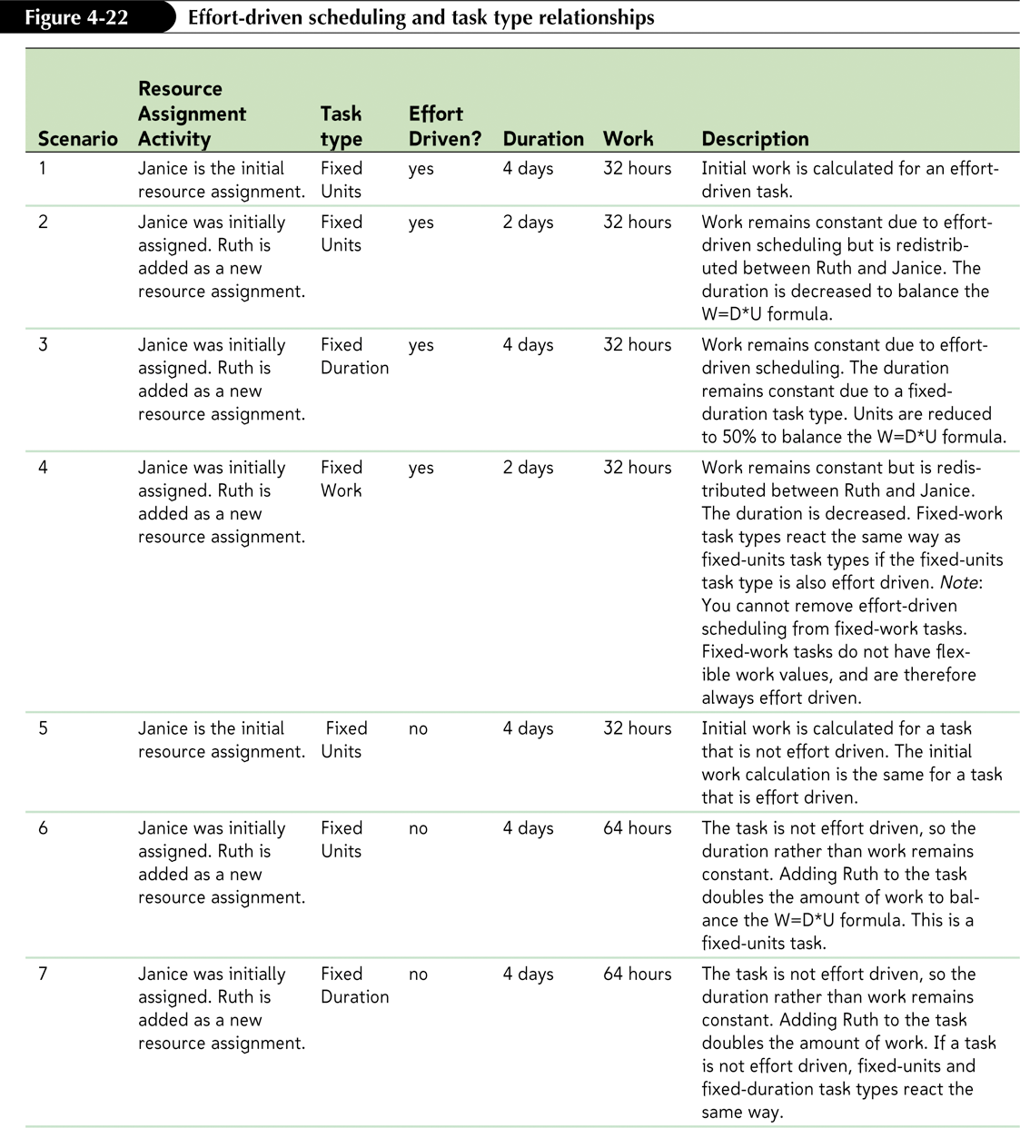
Effort Driven Scheduling and Task Type Relationships

Slide 37
Creating a Fixed Duration Task
Some tasks, such as meetings and seminars, should have fixed durations.
No matter how many people attend, the length of the meeting or seminar does not change.

Slide 38
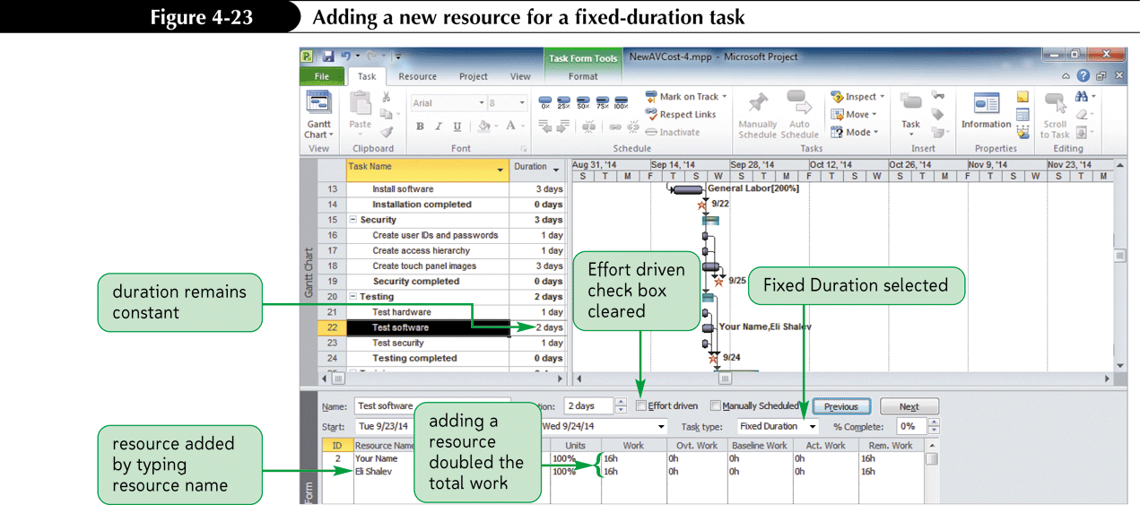
Adding a New Resource for a Fixed-Duration Task

Slide 39
Resources and Task Costs
Project 2010 uses the next available resource ID when you add new resources.
Task costs are calculated by multiplying the work for an assigned resource by its hourly rate plus any cost per use for the task.
The cost associated with a task will be $0 until a resource with completed cost information is assigned to the task.

Slide 40
Resource Usage View
The Resource Usage View shows each resource that has assigned tasks.
Use to filter resources to show a subset of resources that meet certain criteria.
Sorting can identify the most costly resource or develop an alphabetical list.
Grouping quickly shows you how your resources are organized.
Notes:
40

Slide 41
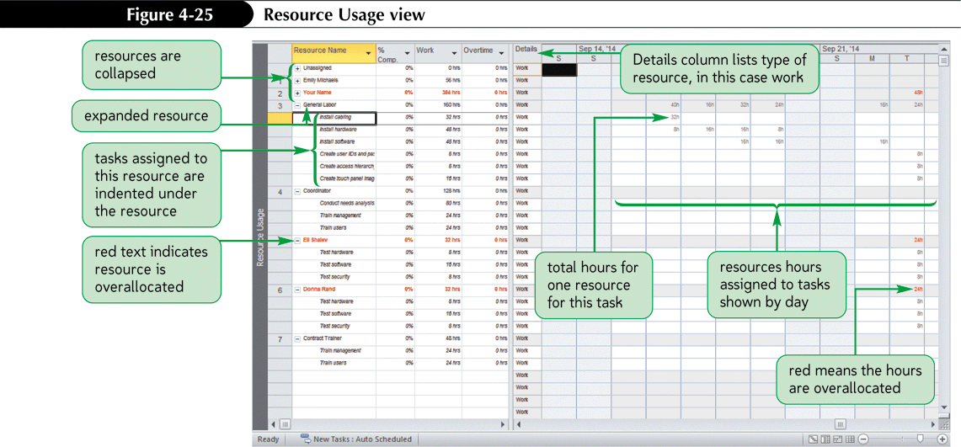
Resource Usage View

Slide 42
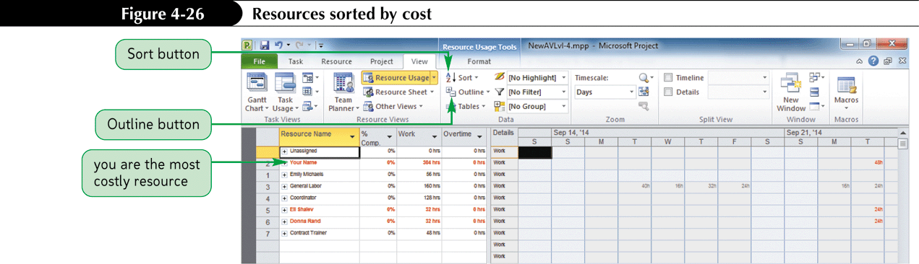
Resource Usage View Sorted by Cost

Slide 43
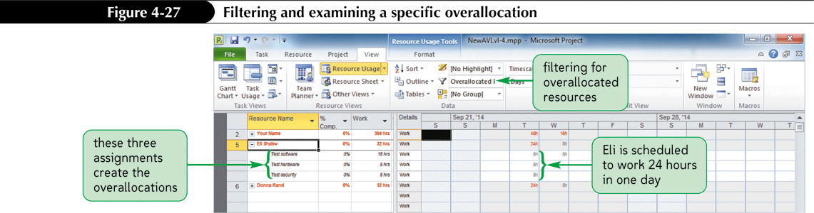
Resource Usage View Filtered for Overallocated Resources

Slide 44
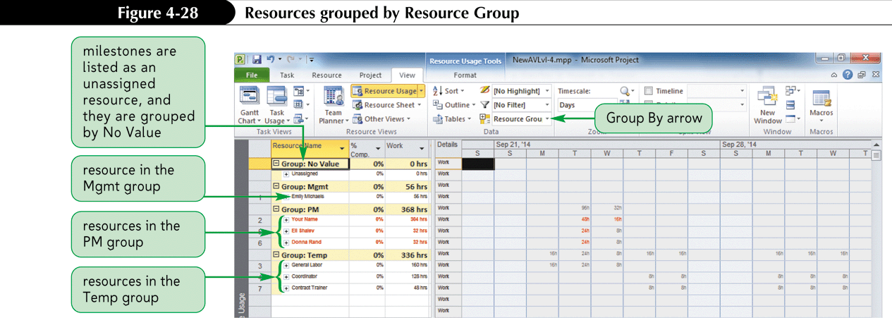
Resource Usage View Grouped by Resource Group

Slide 45
Leveling Overallocations
A resource is overallocated if it is assigned more work in a given time period than it has working hours, such as more than 8 hours in a day.
Overallocations can also occur when resources are scheduled to do more than 60 minutes of work in a given hour of the day.
Leveling means to correct overallocations.
The Resource Schedule Form can be used to redistribute work when you need to level an overallocation.
Redistributing the work to a new resource is a common way to handle an overallocation.
Notes:
45

Slide 46
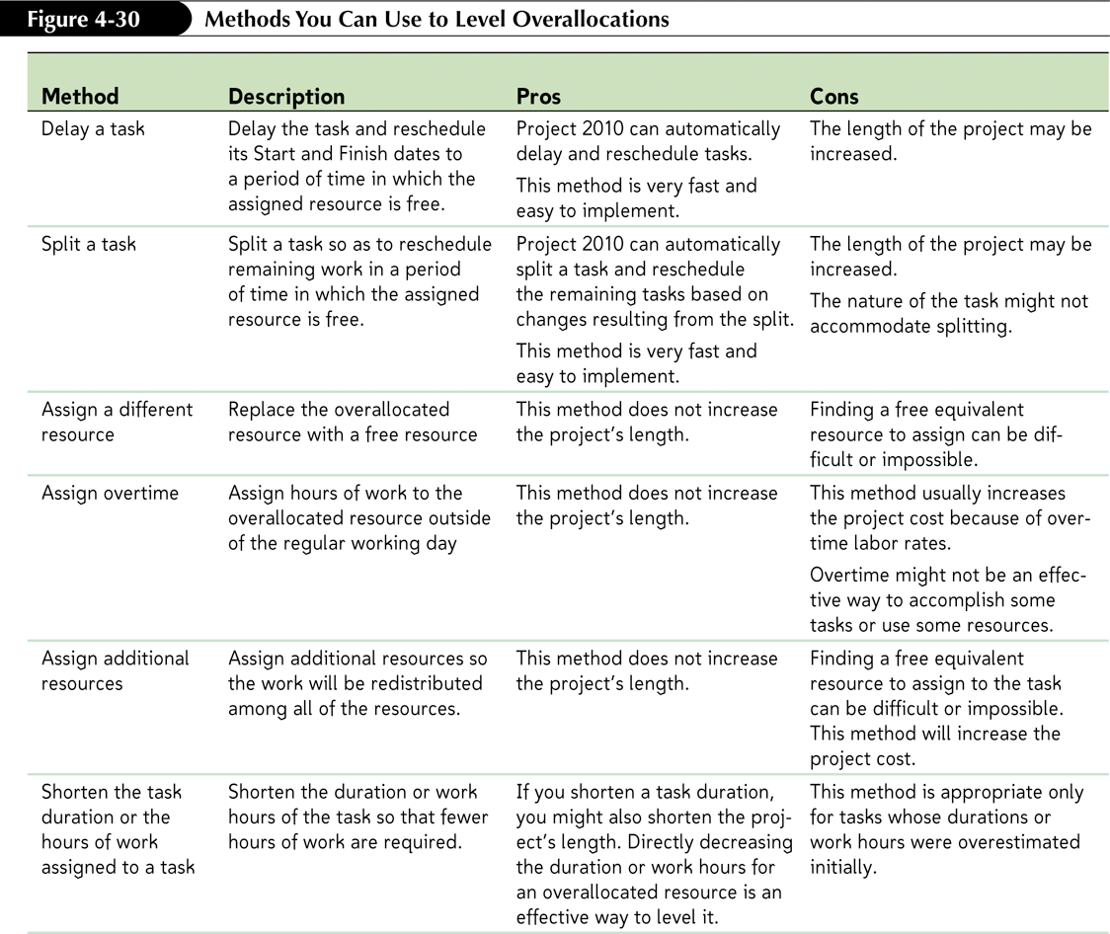
Methods to Level Overallocations

Slide 47
Manually Leveling Overallocations
When leveling resources, it is best to use the leveling techniques that do not extend the project’s length:
  Reassign work
  Assign overtime
  Add additional resources
  Shorten task durations
Using the Project 2010 leveling tools might extend the duration of the overall project, which might not be acceptable.

Slide 48
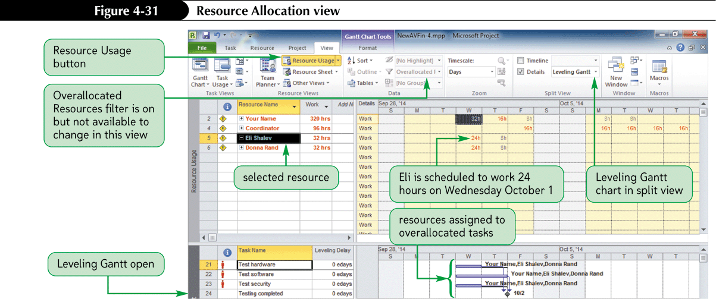
Viewing Overallocation

Slide 49
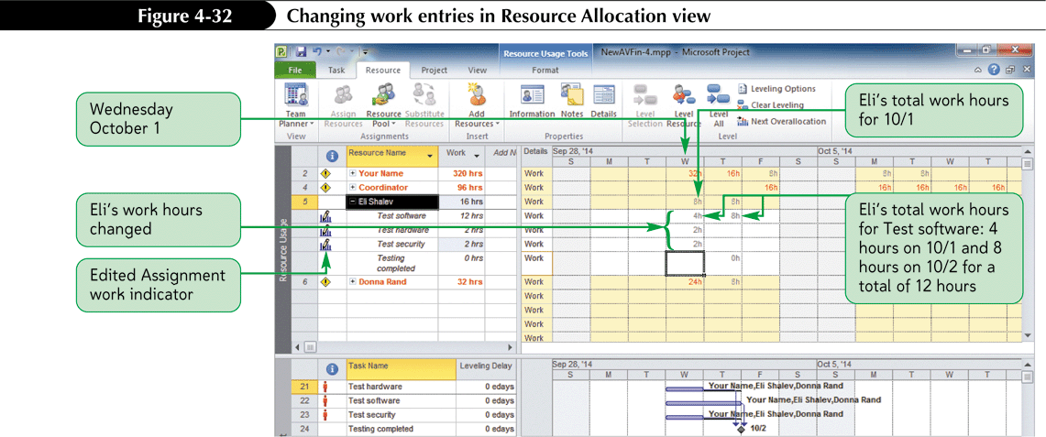
To Level Overallocations Manually by Reducing Work

Slide 50
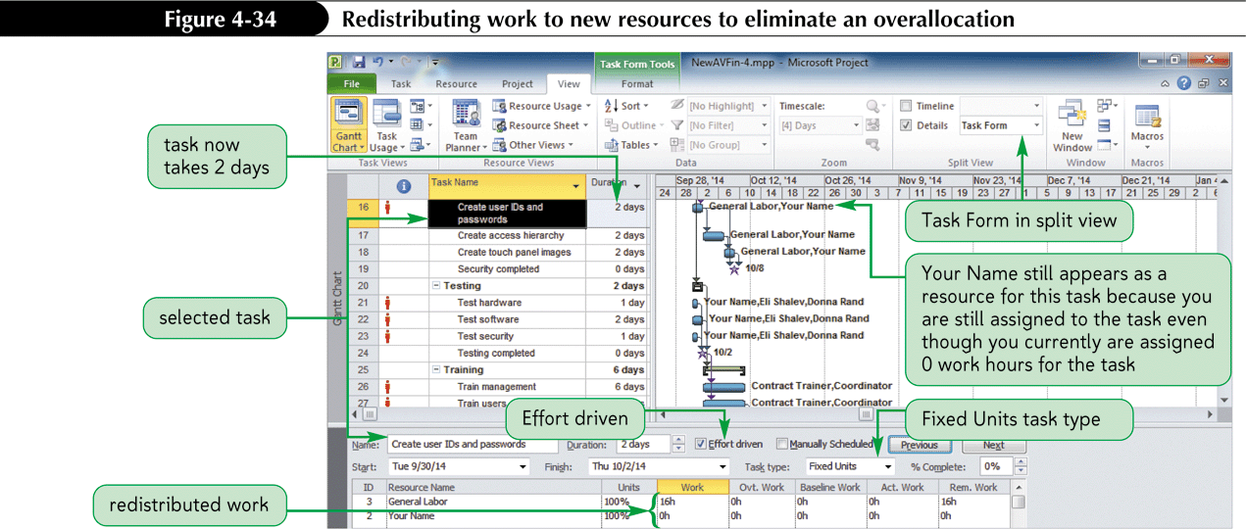
To Level Overallocations Manually by Redistributing Work

Slide 51
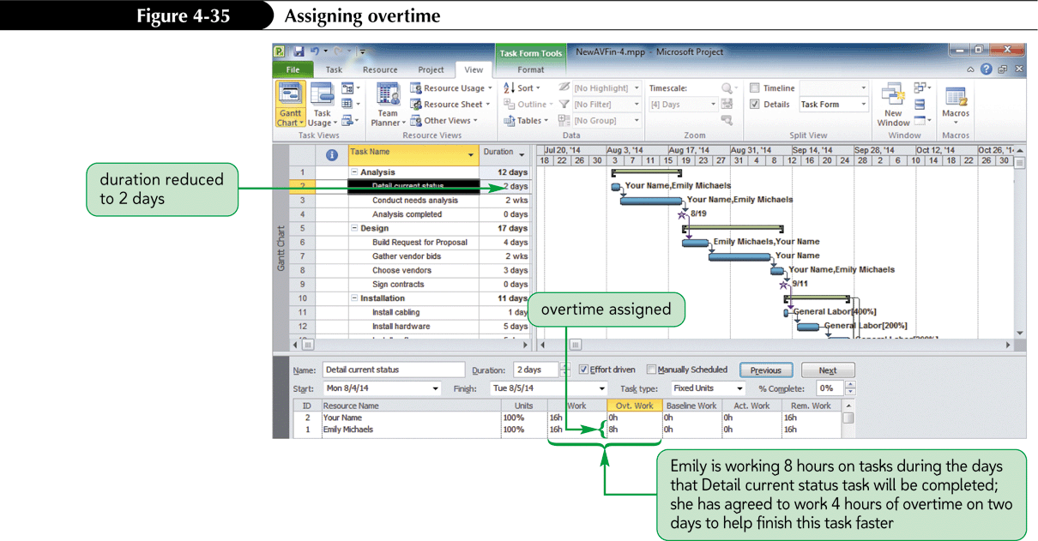
To Level Overallocations Manually by Assigning Overtime Hours

Slide 52
Using the Leveling Tool
The leveling tool levels work resources.
The leveling tool does not adjust task durations, work entries, or resource assignments.
The leveling tool levels overallocations by delaying or splitting tasks.
You can level an entire project, a specific task or group of tasks, or you can level specific resources.
Notes:
52

Slide 53
Using the Resources Leveling Dialog Box to Level Overallocations
The options in the Resource Leveling dialog box can be used to modify the way leveling is process.
The most important decision to make is the choice for Leveling calculations: Automatic or Manual
  Automatic leveling levels your project as you enter and adjust the schedule.
  Manual leveling levels the project only after you click the Level All button in the Resource Leveling dialog box.

Slide 54
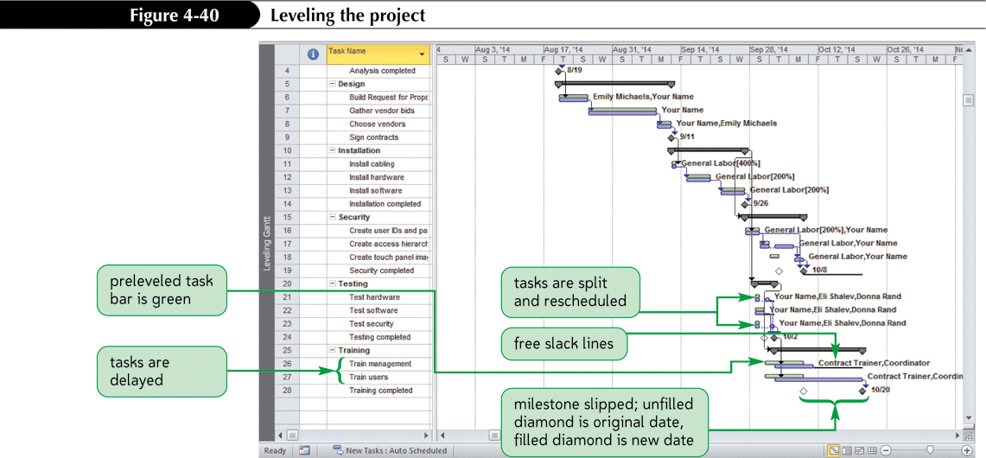
The Leveling Gantt Chart View
(after leveling)

Slide 55
Reviewing Project Costs
When resources are assigned, Project 2010 automatically calculates work costs.
A material cost is a cost associated with a consumable item or items.
A fixed cost is a cost inherent to the task itself.
Both work and material costs are entered in the Resource Sheet.
Notes:
55

Slide 56
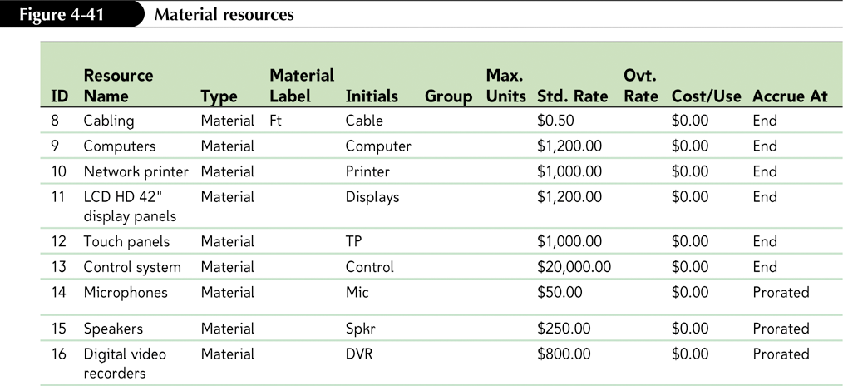
To Enter Material Resources

Slide 57
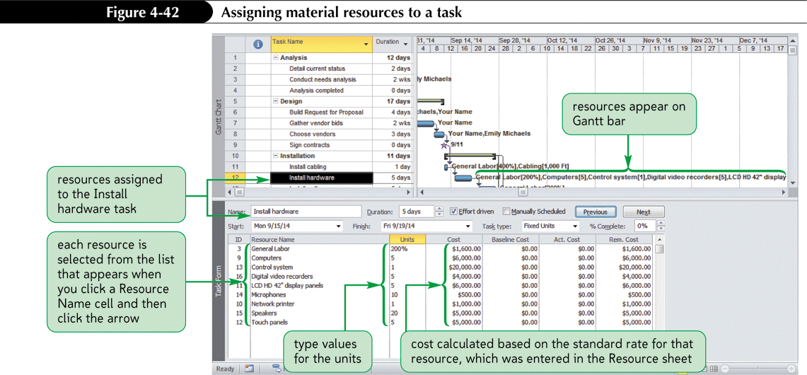
To Assign Material Resources to a Task

Slide 58
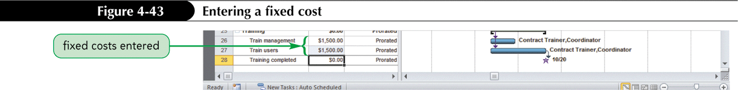
To Enter a Fixed Cost
The Fixed Cost field is the second column in a task sheet when the Cost table is applied to the task sheet.

Slide 59
Understanding the Relationship Between Critical Path, Free Slack and Total Slack
The critical path includes tasks that must be completed in order for the overall project to be completed.
Total slack is the amount of time that a task can be delayed without delaying the project’s Finish date.
Free slack is the amount of time that a task can be delayed without delaying any successor tasks.
Apply the Schedule table if critical path is incorrect.
Notes:
59

Slide 60
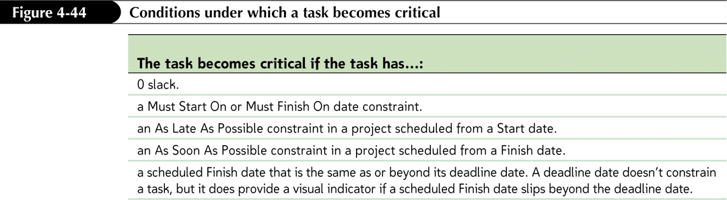
Conditions Under Which a Task Becomes Critical
Notes:
60

Slide 61
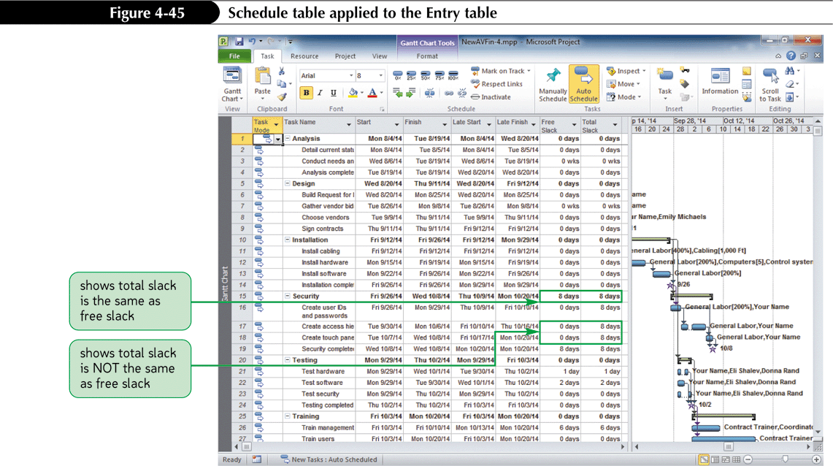
To Explore Critical Tasks and Total and Free Slack
Notes:
61

Slide 62
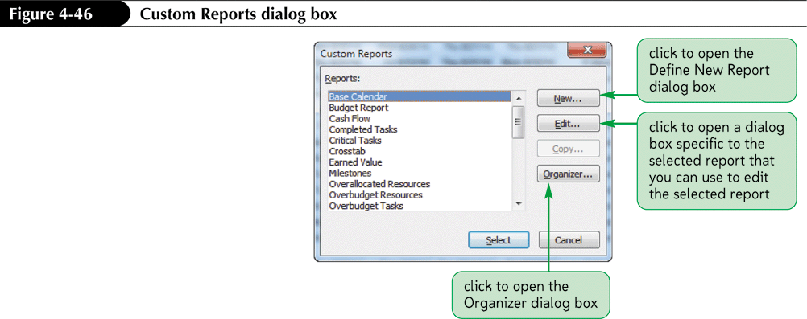
Communicating with Custom Reports

Slide 63
Using the Team Planner
The Team Planner is a new feature in Project 2010 and provides an overview of what your team is doing at any given point in the project schedule.
The Team Planner can be used to make changes to the Project File.

Slide 64
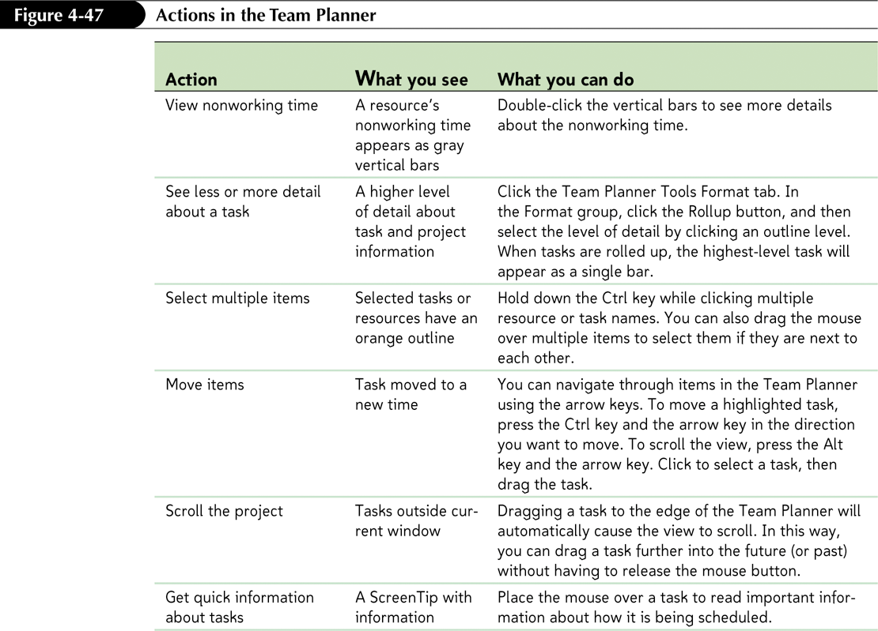
Actions in The Team Planner

Slide 65
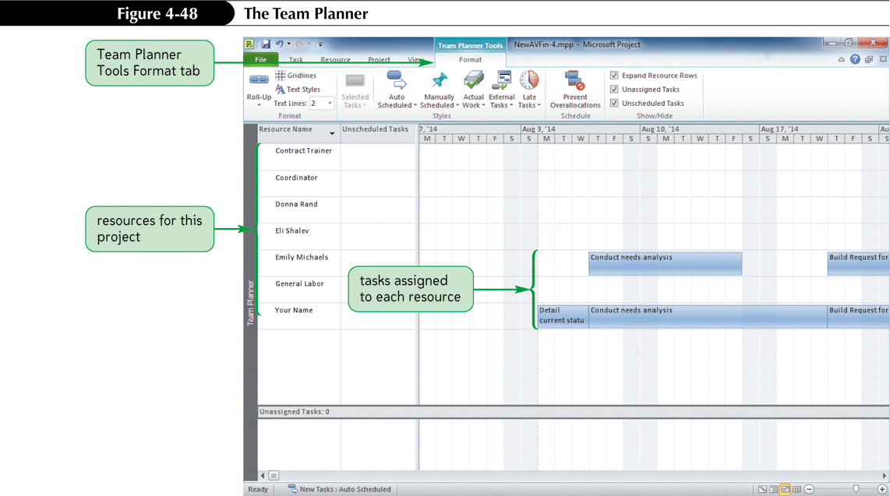
Viewing the Team Planner

Slide 66
Summary
Use resource and cost views.
Enter and edit resource and cost data.
Organize resources into logical groups
Assign resources and costs to tasks.
Level overallocation and set resource contours.
Edit task information based on the relationship among work, duration and units
Create fixed-work and fixed-duration tasks.
Notes:
66

Slide 67
Summary Cont.
Sort, filter, and group tasks for resource information.
Correct for overallocations
Analyze resource usage and entered project costs
Examine the critical path and slack
Use cost reports
Use the Team Planner
Notes:
67

