Slide 1
Tutorial 2:
Creating a Project Schedule

Slide 2
In Tutorial Section 2.1 you will:
Start a new project
Examine scheduling defaults
Change a project and task calendar
Enter and edit tasks and durations
Enter and edit recurring tasks and milestones
Enter lag and lead times

Slide 3
In Tutorial Section 2.2 you will:
Enter and edit task dependencies
View project statistics
Show the project summary
Review project statistics
Create and manipulate summary tasks
Develop a work breakdown structure

Slide 4
By default, the new project file is scheduled from a project Start date
All tasks are scheduled to begin as soon as possible
Project 2010 calculates the project’s Finish date based on the:
  Tasks
  Durations
  Dependencies

Slide 5
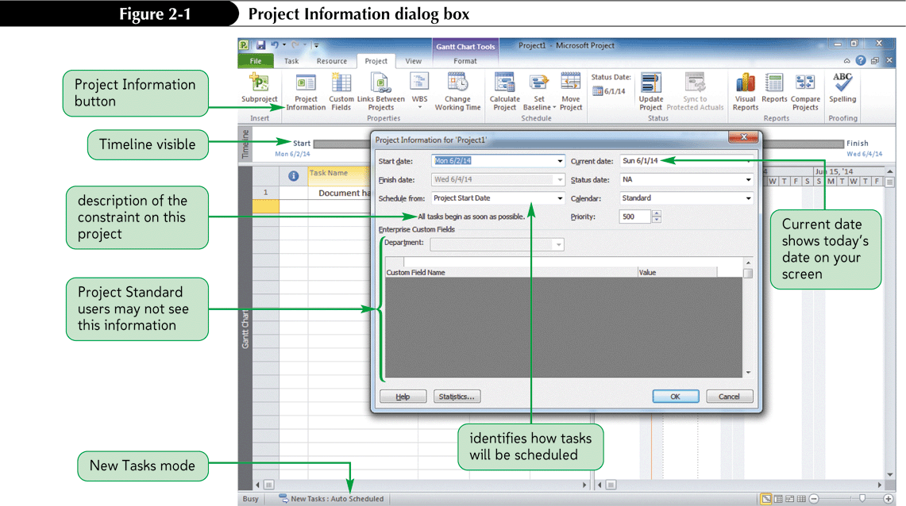
Project Information Dialog Box

Slide 6
Scheduling a Project from a Finish Date
When a project is scheduled from a Finish date, such as a conference, all tasks are scheduled to begin as late as possible.
Project 2010 calculates the project’s Start date based on the tasks, durations and dependencies.
The default is for all tasks and the project to start as late as possible.
To schedule from a Finish Date, you apply this setting as soon as the project is created.

Slide 7
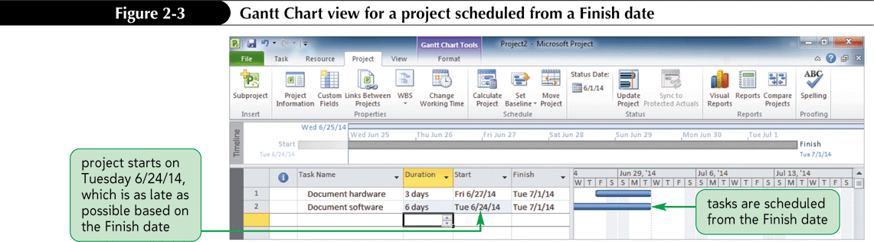
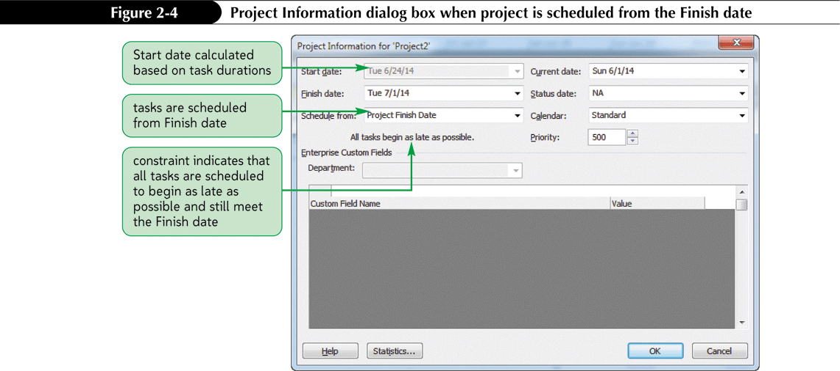
Project Scheduled From Finish Date

Slide 8
The Task Information Dialog Box
The Task Information dialog box is a comprehensive collection of all of the information about each task organized into six categories:
  General
  Predecessors
  Resources
  Advanced
  Notes
  Custom Fields
The Task Information dialog box is another view by which you can examine and enter data about a task.

Slide 9
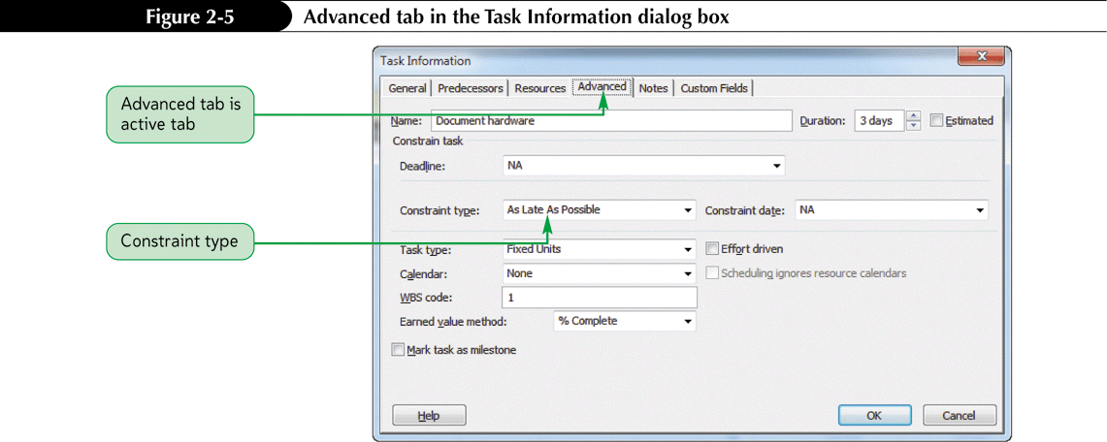
The Task Information Dialog Box

Slide 10
Constraints using Task Information
How the project is originally scheduled (from a Start date or from a Finish date) determines the initial Constraint types (as soon as possible or as late as possible).
The initial Constraint type has a tremendous impact on the calculated start and finish dates for each task entered into the project.
Always take the time to examine the Project Information dialog box before starting a new project.

Slide 11
Examining Project Calendars
By default, the entire project, each task, and each resource is scheduled according to the Standard calendar.
The Standard calendar specifies that Monday through Friday are working days with 8 hours of work completed each day.
Saturday and Sunday are designated as nonworking days.
The Calendar can be modified to identify holidays or other nonworking days or times in which work should not be scheduled.
You can also create unique calendars for tasks and resources that do not follow the working and nonworking times specified by the Standard calendar.

Slide 12
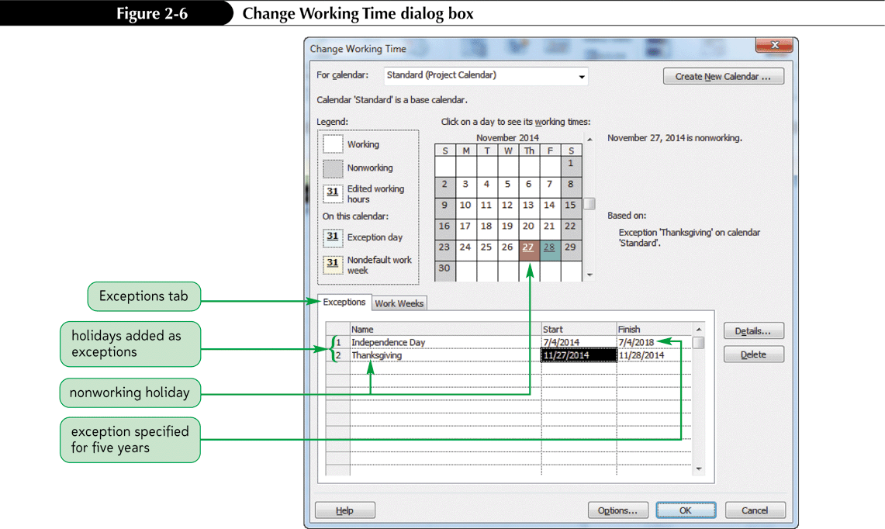
Change Time for a Work Week

Slide 13
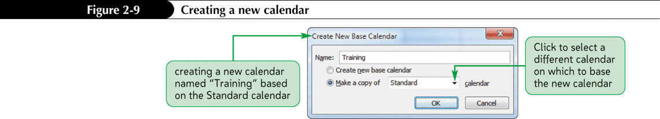
Creating a Task Calendar
An individual task calendar can be created for any task that does not follow the working and nonworking times specified by the project calendar.
An individual resource calendar can be created for a resource that does not follow the working and nonworking times specified by the project calendar.
By default, all tasks and resource assignments inherit the project calendar unless you specify something else.

Slide 14
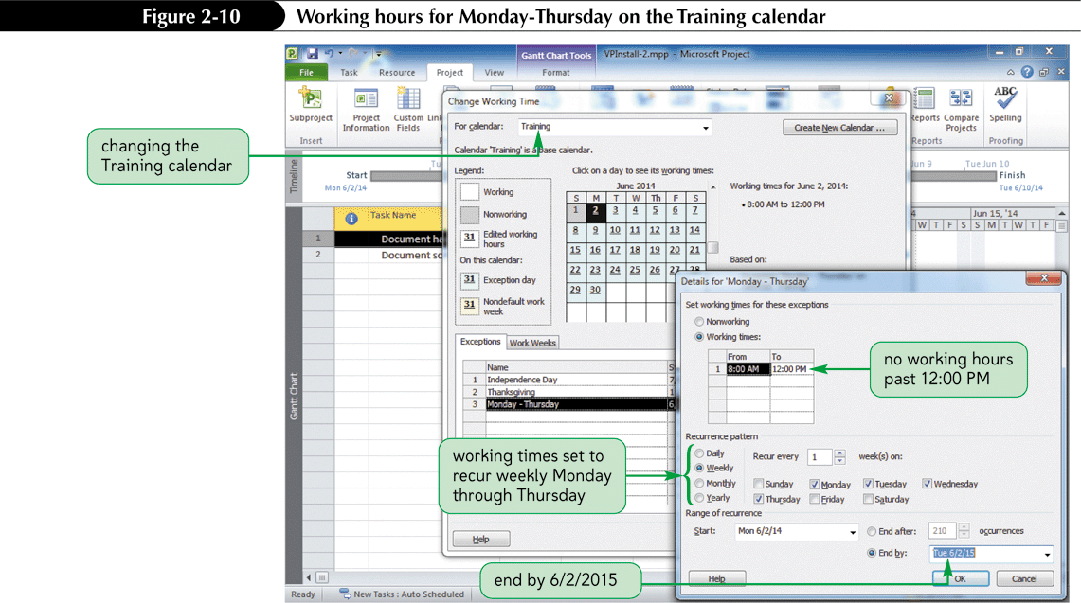
Changing the Calendar for a Task

Slide 15
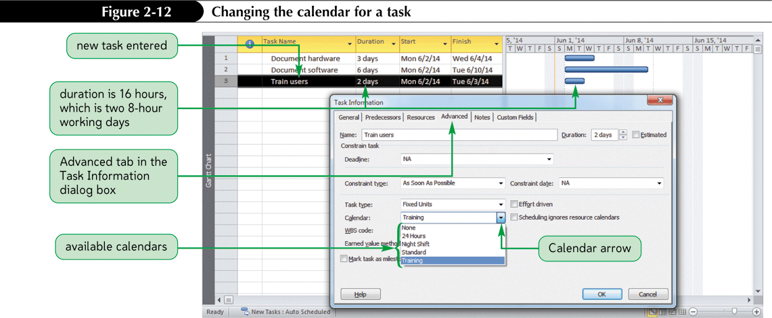
Applying a Task Calendar to a Task

Slide 16
Entering Tasks and Durations in the Entry Table
Entering tasks and durations is probably the single most important effort in developing a useful project file.
If tasks are omitted or durations underestimated, the value of the project’s scheduling and cost information is compromised and the success of the project might be jeopardized.
Often you will need to change an existing task or insert, delete, or move a task.

Slide 17
Editing Tasks and Durations in the Entry Table
Project 2010 makes it very easy to edit an existing project.
Many of the editing skills that you gained when editing a spreadsheet will apply to a project table.
To change an existing entry, you first navigate to the cell. Once there, you have several options:
  Retype the entry
  Edit the entry directly in the cell
  Edit an entry in the Entry bar

Slide 18
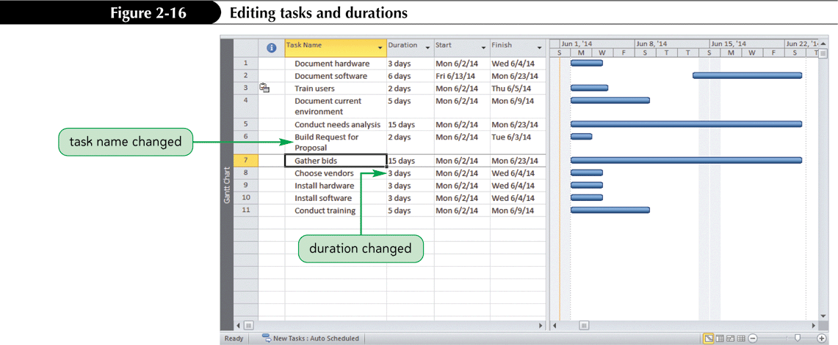
Entering and Editing Tasks in the Entry Table

Slide 19
To Delete a Task
If you want to delete an entire task row in Project 2010, you must select the entire row, then press the Delete key.
Project 2010 includes a Smart Tag to allow you to specify what you want to delete.
A list arrow appears when you place the pointer over the Smart Tag.

Slide 20
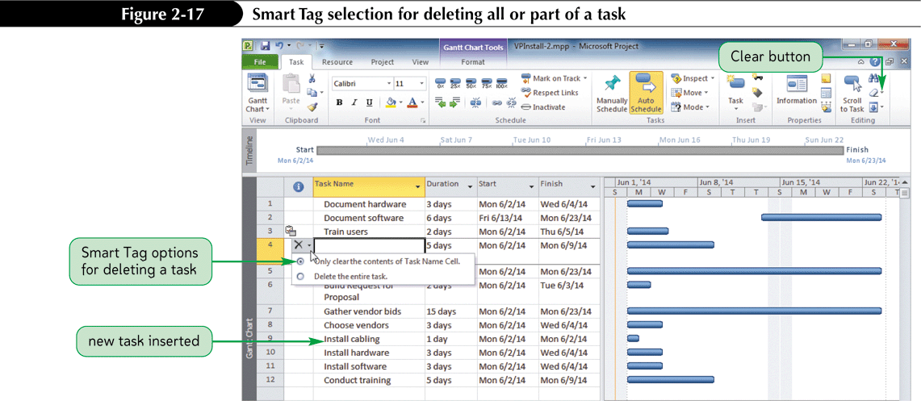
Smart Tag Selection for Task Deletion

Slide 21
Copy, Paste and Move
Copying, pasting, and moving tasks are important task editing skills.
Project 2010 offers a variety of tools that you can use to accomplish these common tasks, including:
  Menu bar options
  Toolbar buttons
  Quick keystrokes
  Right-click shortcut menus

Slide 22
Fill Handle
If several task durations are the same, you can use either the copy and paste features to quickly enter the durations or the fill handle to populate cells.
If you have used the fill handle in Excel or another spreadsheet program, you will find it a very similar process in Project 2010.
The fill handle is a small square that appears in the lower corner of the selected cell.
When you drag a fill handle, the contents of the active cell are copied.
You can also use the fill handle to fill task names.

Slide 23
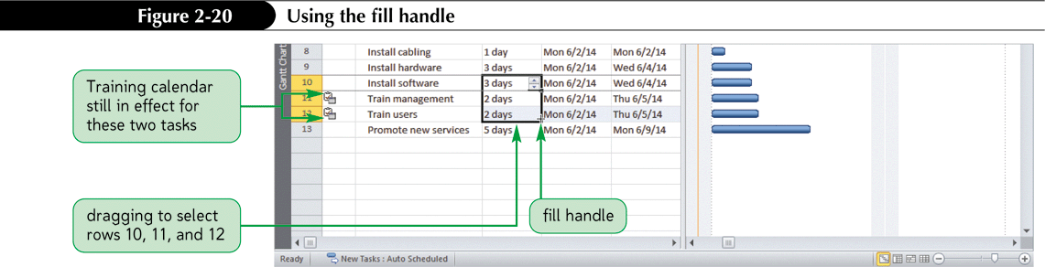
Fill Handle

Slide 24
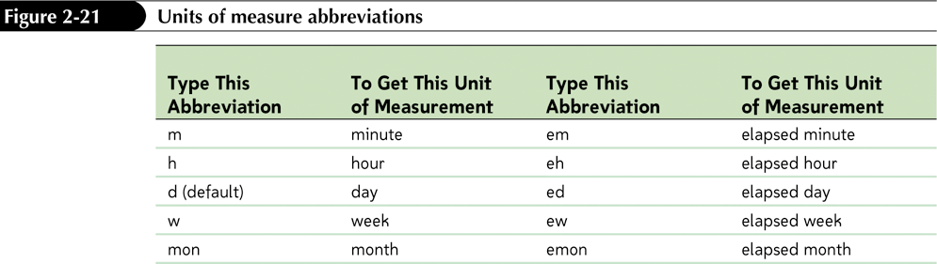
Working with Duration Units of Measure
Entering and editing durations involves understanding the units of measure available for them.
The default unit of measure is day, and therefore “day” does not need to be entered.
To use any other unit, you must type the abbreviation.

Slide 25
Units of Measure Abbreviations
Elapsed refers to clock time rather than working time.
An example is the task “Allow paint to dry.” The paint will dry in exactly the same amount of time regardless of whether it dries on a workday, a weekend or holiday. If it takes one day to dry, the duration should be entered as “1 ed” (for 1 elapsed day).

Slide 26
Editing Tasks and Durations in Other Views
Anything changed in one view is automatically changed in all the other views.
You can use the View Bar to quickly switch between views.
The way data is displayed differs by view and often satisfies different communication and reporting needs as the project develops.

Slide 27
Editing Tasks and Durations in Other Views Cont.’d
Regardless of the view used, you can edit any task by double-clicking it to open its Task Information dialog box.
As you work with Project 2010, you will become more familiar with each view and learn which is the best representation of the data for different purposes.

Slide 28
Entering Recurring Tasks
A recurring task is a task that repeats at a regular interval.
A status meeting is a good example of a recurring task that needs to be scheduled for each week or other regular intervals in the project.
In Project 2010, you can define a recurring task one time using the Recurring Task Information dialog box.
Project 2010 then handles the details of scheduling the task at specified interval for the entire project or for the time period you specify.
You can also change the calendar used on the recurring task in the Calendar section.

Slide 29
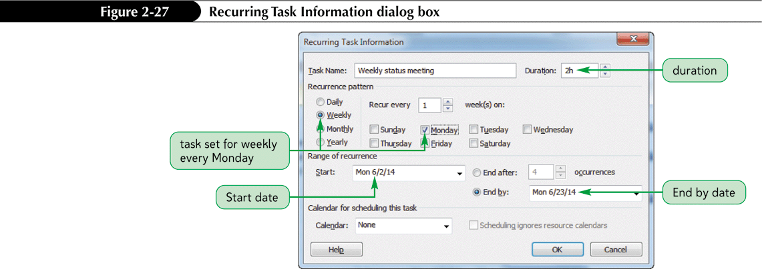
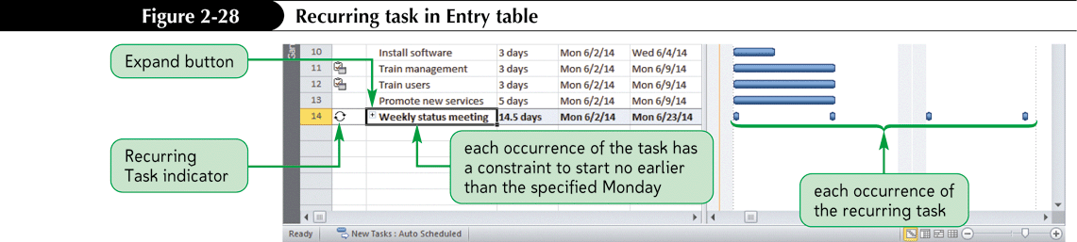
Recurring Task Information Dialog Box

Slide 30
Entering Milestones
A milestone is a task that marks a significant point in time or a progress checkpoint.
It has a zero duration and is therefore a symbolic task that is used mainly to communicate progress or to mark the end of a significant phase of the project.
Examples include the signing of a contract or the announcement of a new product.
Milestones can also be used to motivate project participants by recognizing accomplishments.

Slide 31
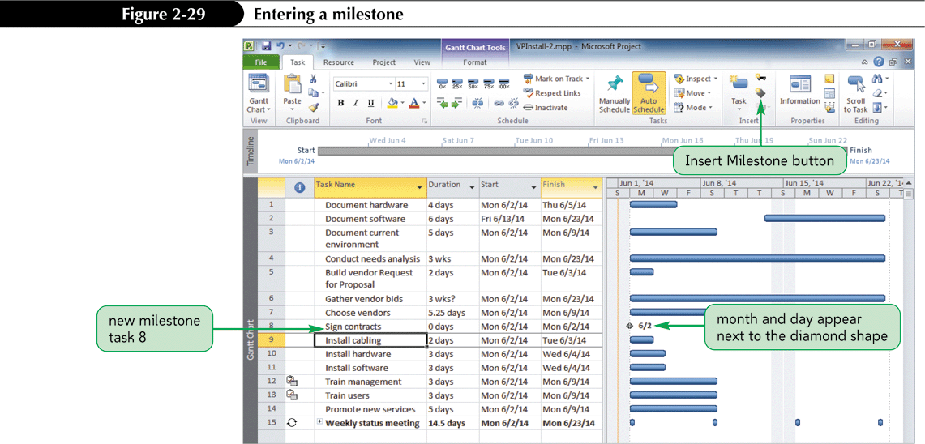
Milestones

Slide 32
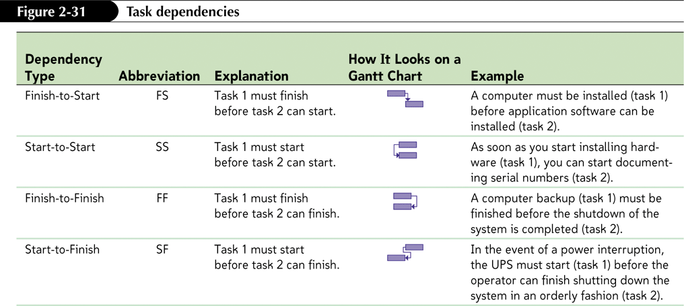
Understanding Task Dependencies
Four task dependencies define the relationships between tasks in a project.

Slide 33
Understanding Task Dependencies Cont.’d
By linking tasks in finish-to-start relationships, you establish the required sequence of tasks.
Project 2010 uses these relationships to set start and finish dates for each task.
Most dependencies are Finish-to-Start (FS), meaning a certain task (the predecessor) must finish before another task (the successor) can start.
In order to use important project management techniques such as critical path analysis, you must determine task dependencies.

Slide 34
Creating Task Dependencies
Project 2010 makes it easy to create, and remove, FS relationships between tasks by providing the Link Tasks and Unlink Tasks buttons on the Standard toolbar.
Task dependencies also can be established in the graphical views.

Slide 35
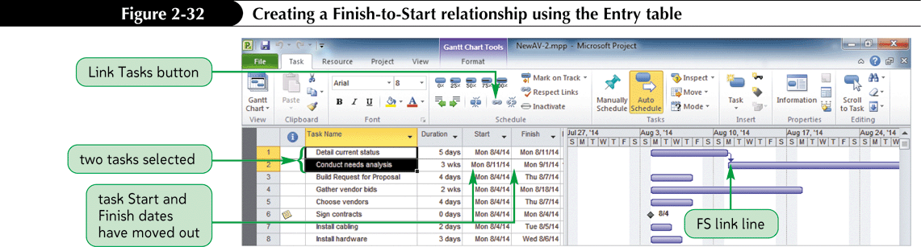
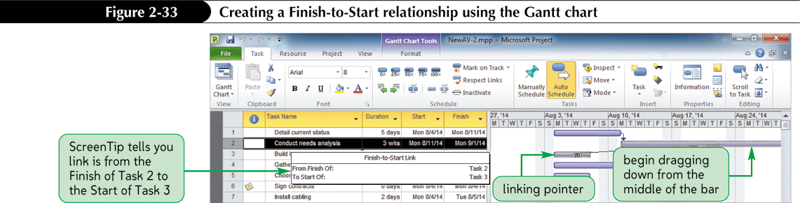
Creating Task Dependencies Cont.

Slide 36
Slack Times
Total slack is the amount of time by which an activity may be delayed from its scheduled Start date without the delay setting back the entire project.
Free slack is the amount of time by which an activity may be delayed without delaying the early start of any immediately following tasks.

Slide 37
Critical and Non-Critical Tasks
In the Network Diagram view, the critical tasks—tasks that are on the critical path—are displayed within a red border.
A task that is not on the critical path is a non-critical task, that is, it doesn’t necessarily have to start on its currently scheduled Start date in order for the overall project to be completed on time.
The Network Diagram is used mainly to view and analyze the critical path.

Slide 38
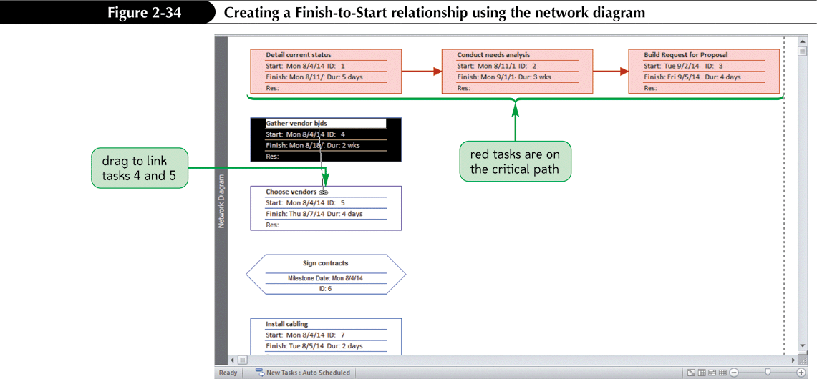
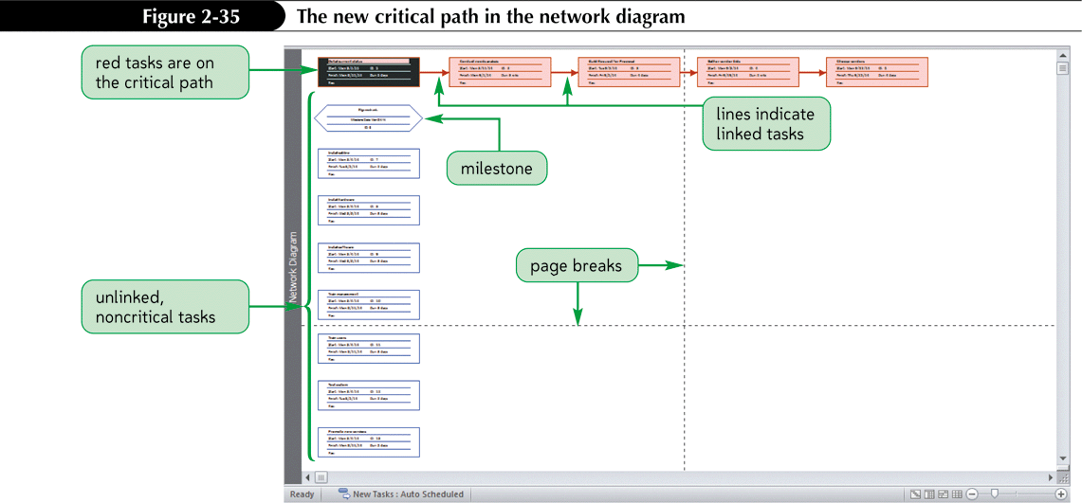
Creating Dependencies using the Network Diagram view

Slide 39
Entering Lag and Lead Times
When a project is scheduled from a Start date, lag and lead times refer to an amount of time that the second task of a relationship is moved backward (lead) or forward (lag) in time.
Lead time moves the second task backward in time so that the two tasks overlap.
Lag time is the opposite of lead time. It moves the second task forward in time so that the tasks are further separated.

Slide 40
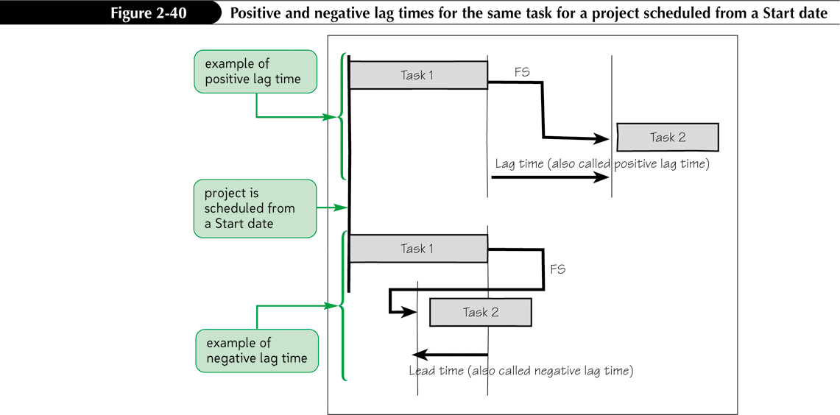
Lag and Lead Time from Start Date

Slide 41
Entering Lag and Lead Times Cont.’d
Project 2010 combines the concepts of lag and lead times into one term, lag time.
When a project is scheduled from a Start date, positive lag time moves the second task forward in time.
  Positive lag time is the traditional definition of lag time in general project management discussions.
Negative lag time moves the second task backward in time so that the tasks overlap.
  Negative lag time is called lead time in general project management discussions.

Slide 42
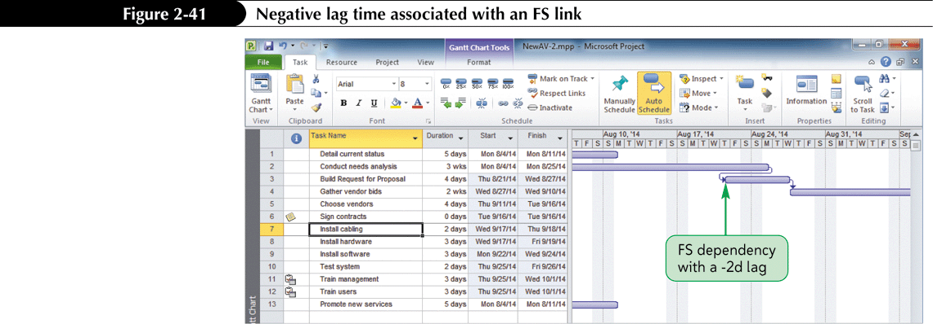
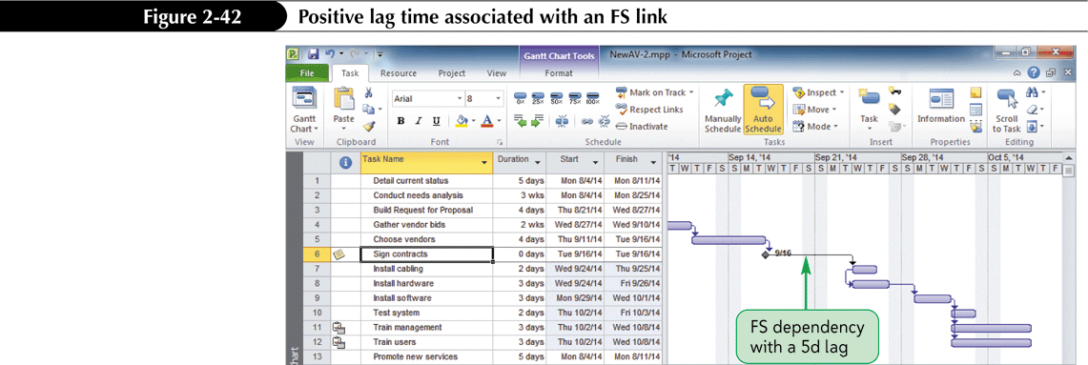
Negative and Positive Lag Time

Slide 43
Check for Lag Time Effects Cont.
Confusing negative and positive lag times is easy, especially when examining them for both a project that is scheduled from a Start date and one scheduled from a Finish date.
Remember:
  Positive lag time always increases the amount of time between tasks.
  Negative lag time always causes the tasks to overlap.
  This rule holds true regardless of whether the project is scheduled from the Start date or the Finish date.

Slide 44
Check for Lag Time Effects
Once the tasks, durations, and relationships are entered, you should check the Project Information dialog box to verify the project’s calculated Finish date if the project is scheduled from a Start date, or calculated Start date if the project is scheduled from a Finish date.
When a project is scheduled from a Start date, applying negative lag time to task dependencies that are on the critical path is a common way to shorten the critical path because it allows tasks to overlap.

Slide 45
Check for Lag Time Effects Cont.’d
When you apply negative lag time, the second task is allowed to start before the first task is completely finished.
When a project is scheduled from a Finish date, all tasks have as late as possible schedules and lag time affects the first task rather than the second.

Slide 46
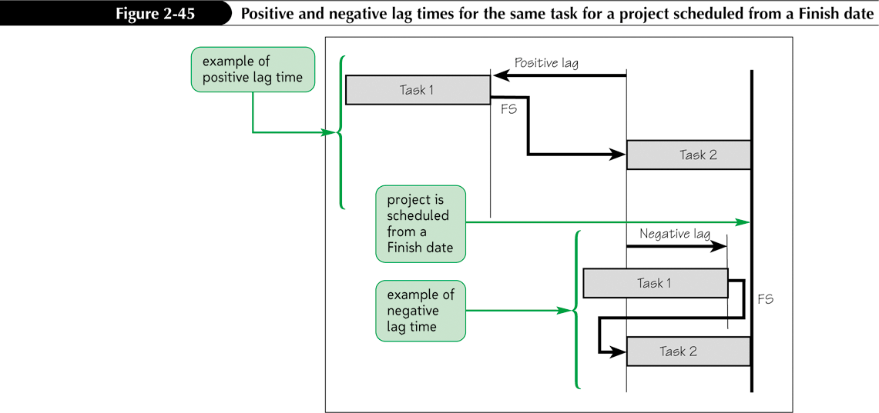
Lag Time From a Finish Date

Slide 47
Creating a Work Breakdown Structure with Summary Tasks
A very important strategy for managing projects well is to organize the work that needs to be done in a logical manner.
A work breakdown structure (WBS) is an outcome-oriented analysis of the work involved in a project that defines the total scope of the project.
  A WBS is a foundation document in project management because it provides the basis for planning and managing project schedules, costs, and changes.
  The WBS provides a hierarchy, similar to an organizational chart, to group project work logically.

Slide 48
Creating a Work Breakdown Structure with Summary Tasks Cont.’d
In order to use a WBS in Project 2010, you must organize tasks into summary tasks (groups of tasks that logically belong together).
When developing a new, large project, some project managers prefer to start with broad groupings of summary tasks and then break them down into smaller tasks.

Slide 49
Creating a Work Breakdown Structure with Summary Tasks Cont.’d
Planning a project by starting with broad categories of tasks is called the top-down method of creating a WBS.
Other project managers prefer to list all of the individual tasks, and then collect them into logical groupings using the bottom-up method.
Once you have indentified your summary tasks, you use Outdenting and Indenting in Project 2010 to create the summary tasks.

Slide 50
Outdenting and Indenting Tasks
Use the Outdent button and the Indent button on the Formatting toolbar to create your WBS.
Outdenting moves a task to the left (a higher level in the WBS), and indenting moves a task to the right (a lower level in the WBS).
Projects can have several levels in the WBS.
Many projects have at least three levels, and some large projects have more.

Slide 51
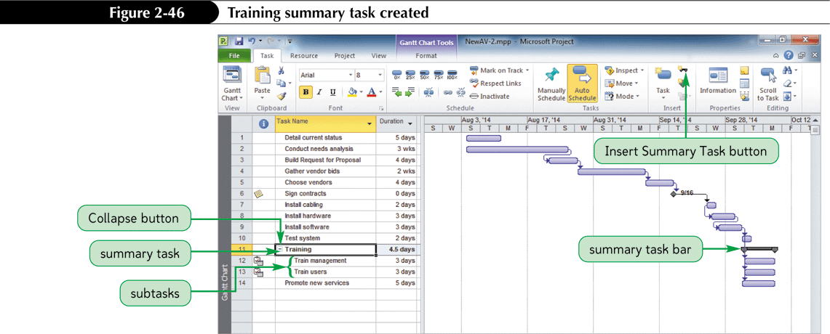
Creating a Summary Task

Slide 52
Displaying Outline Numbers
Tasks and subtasks are organized in an outline, with tasks in a hierarchy, when you have created summary tasks.
In Project 2010, you can view built-in outline numbers, which will display in the Task name cells for all tasks.

Slide 53
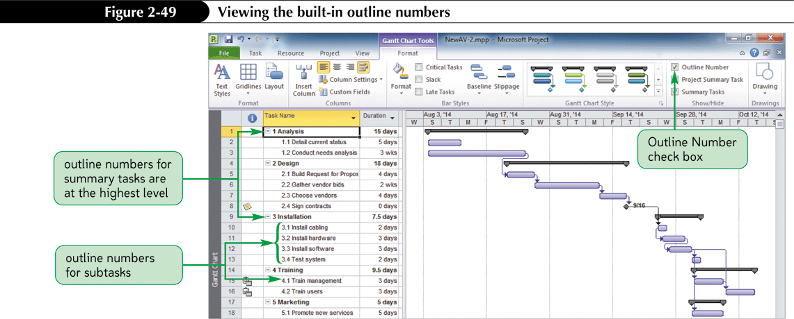
Displaying Outline Numbers Cont.’d

Slide 54
Project Summary Task
Many Project Managers like to create a Project Summary Task which allows them to see how the start and finish dates change as they enter and edit tasks, durations, and dependencies.

Slide 55
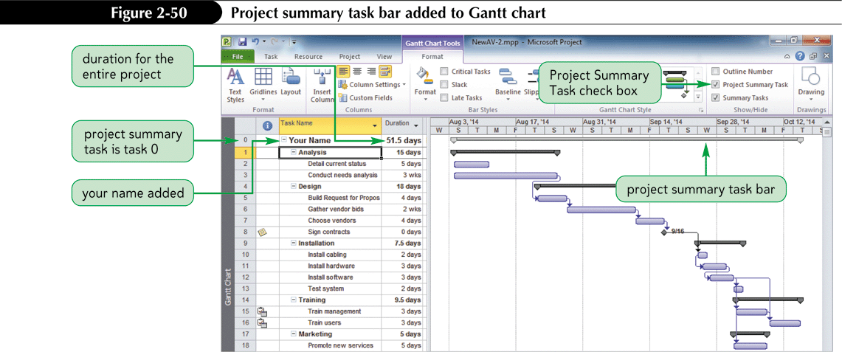
Project Summary Task Cont.’d

Slide 56
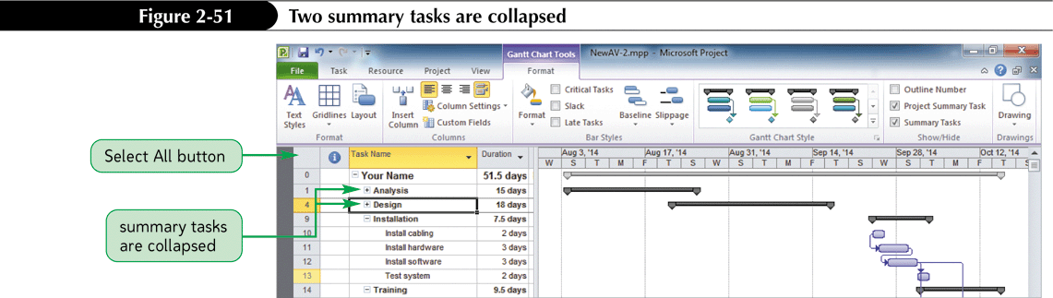
Expanding and Collapsing Tasks
Once your project has been organized into summary tasks, you can easily expand (show) and collapse (hide) the individual tasks within each phase.

Slide 57
Using WBS Codes
Many people like to number tasks in their WBS to show the logical groupings of work.
Using outline numbers or special work breakdown structure (WBS) code is a way to use an alphanumeric code to represent each task’s position within the hierarchical structure of the project.
A WBS code helps identify and group project tasks for project communication, documentation, or accounting purposes.

Slide 58
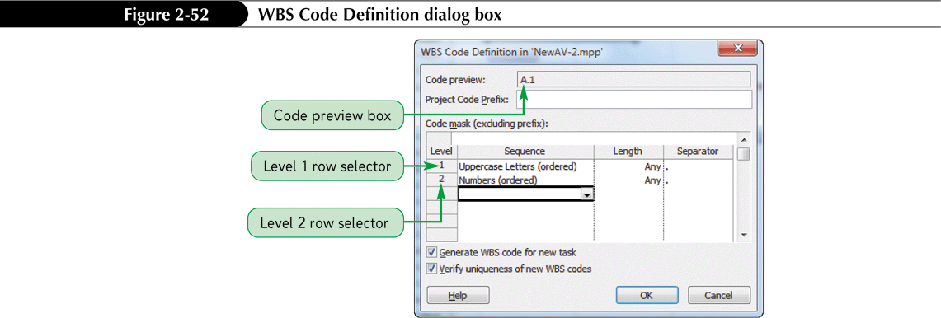
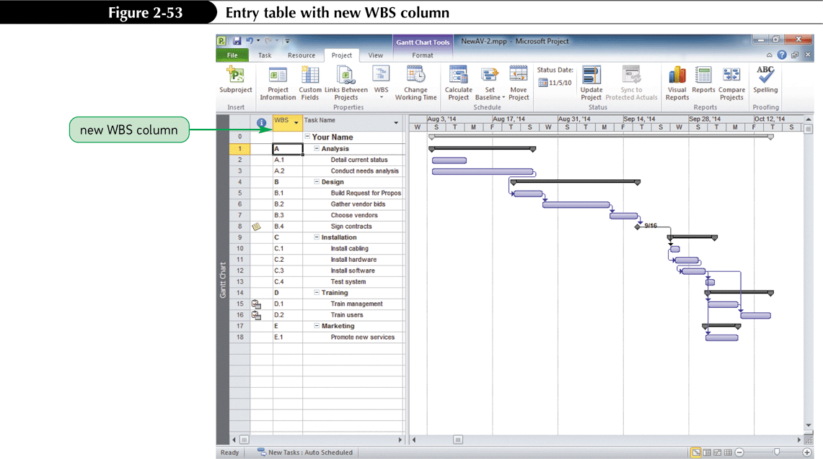
Creating WBS Codes

