Slide 1
Tutorial 1:
Planning a Project

Slide 2
In Tutorial Section 1.1 you will:
Learn project management terminology
Understand the benefits of project management
Explore the Project 2010 window
Check and change default settings
Enter tasks and save a project

Slide 3
In Tutorial Section 1.2 you will:
Open and explore an existing project
Examine different project views
Compare the Gantt Chart and Network Diagram views
Use project time scale and calendar
Use Backstage view and Page Setup dialog box

Slide 4
Introduction to Project Management
Project Management: process of initiating, planning, executing, controlling, and closing a project
Project Goal is the desired outcome
  Should be short and simple, yet clearly communicate scope, time frame, and budget.

Slide 5
Introduction to Project Management, Cont.
A Process Group is a series of steps to complete in order move on to the next phase of a project.
There are 5 Process Groups in Project Management

Slide 6
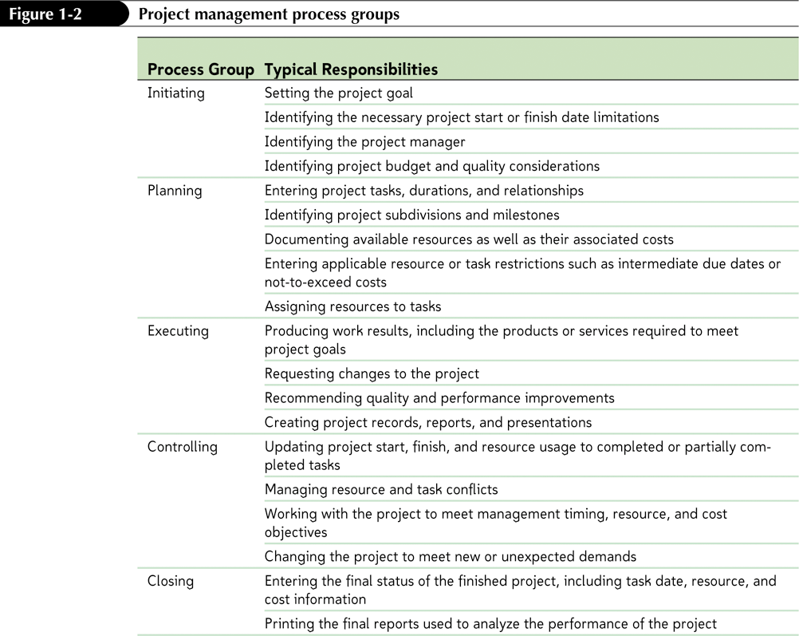
Project Management Process Groups

Slide 7
Initiating
Setting the project goal
Identifying start or finish dates
Identifying the project manager
Identifying project budget and quality considerations

Slide 8
Planning
Entering project information
Identifying project subdivisions and milestones
Documenting resources
Entering restrictions
Assigning Resources to tasks

Slide 9
Executing
Producing work results
Requesting changes
Recommending improvements
Creating project records, reports, and presentations

Slide 10
Controlling
Updating project
Managing resources and tasks
Meet management timing, resource, and cost objectives
Changing project

Slide 11
Closing
Entering final status of finished project
Printing final reports
Review and analyze performance of the project

Slide 12
Project Management Terminology
Understanding key project terminology is fundamental to your success as a project manager:
  Task
  Duration
  Start and Finish Dates
  Predecessor and Successor
  Resources
  Project Manager
  Scope
  Quality
  Risk

Slide 13
Benefits of Project Management
Better understanding of overall project goals
Better understanding of alignment with business objectives
More organized and streamlined way to manage a project
More accurate and reliable project status information
More efficient use of project resources

Slide 14
Benefits of Project Management, Cont.
Better communication
Faster response to conflicting project goals
Greater awareness of project progress
Faster project completion
Lower project costs
Fewer project failures

Slide 15
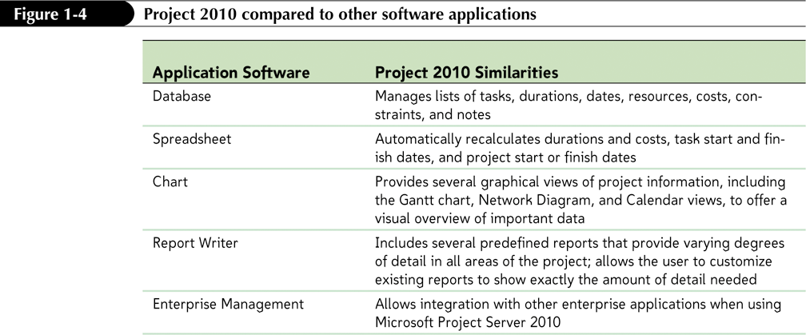
How Project 2010 Supports Successful Project Management
MS Project 2010

Slide 16
Chart and Diagram Tools
The Gantt Chart and Network Diagram are two important project management tools within Project 2010.
The Gantt Chart provides a graphical visualization of the project.
  Tasks are shown as horizontal bars
  Illustrates task dependencies

Slide 17
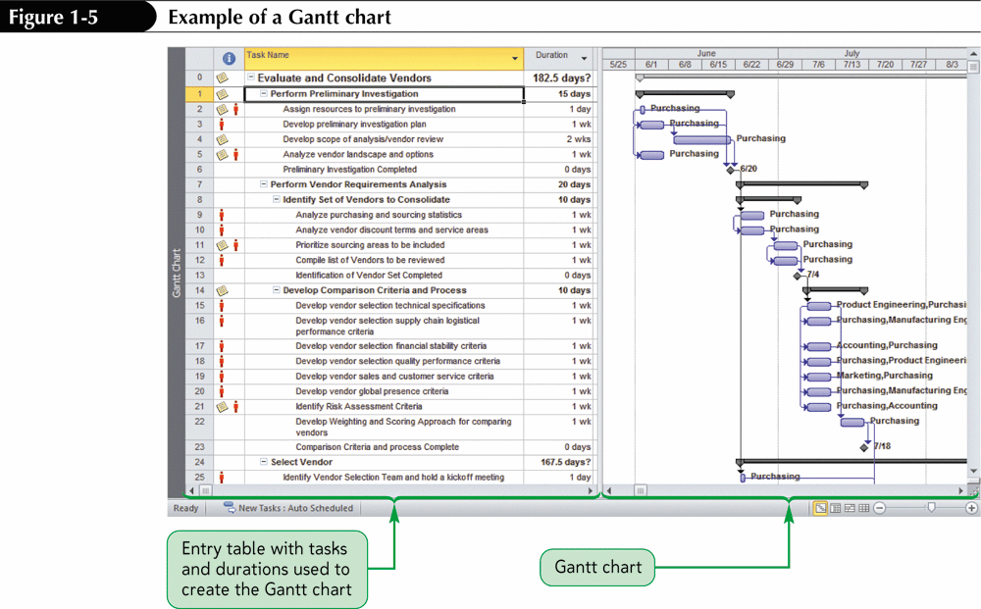
Basic Gantt Chart

Slide 18
Chart and Diagram Tools, Cont.
The Network Diagram’s primary purpose is to show the critical path of the project.
  Tasks are displayed as boxes, called nodes.
  Dependent tasks are linked together via link lines.
  The critical path is the series of tasks that dictates the earliest calculated project finish date.

Slide 19
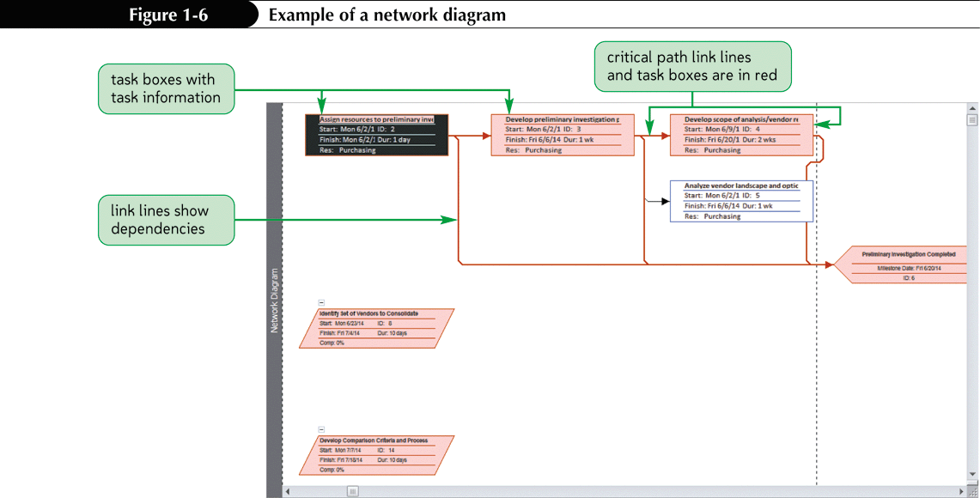
Basic Network Diagram

Slide 20
Getting Started with Project 2010
Starting Project 2010
View Bar
Entry Table
Gantt Chart
Timeline
Timescale
  A major scale (the upper scale)
  A minor scale (the lower scale)

Slide 21
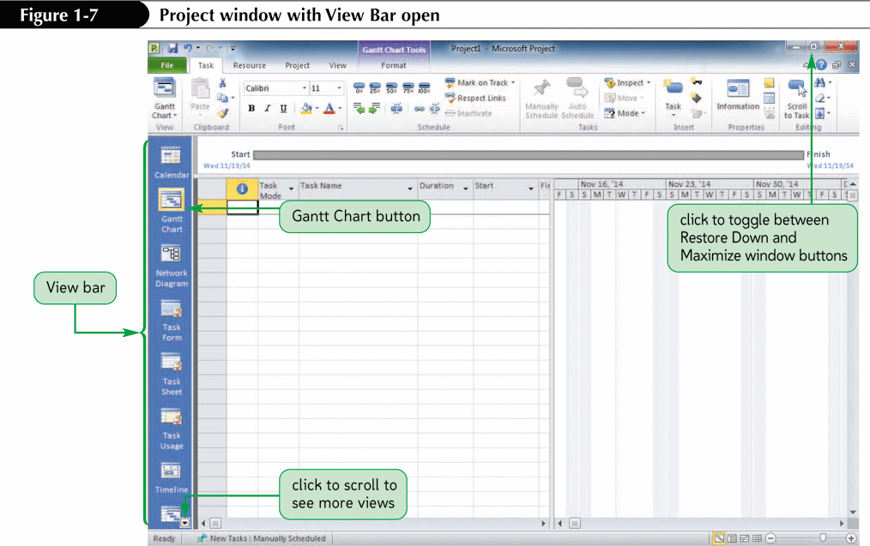
Microsoft Project Window

Slide 22
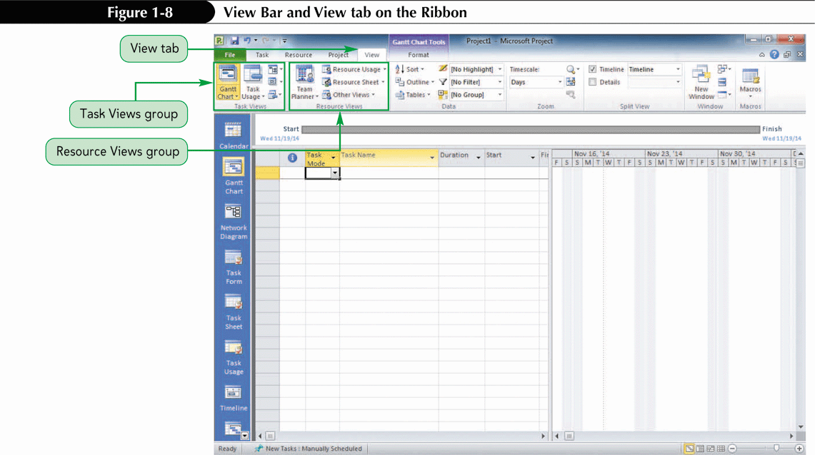
View Bar and View Tab

Slide 23
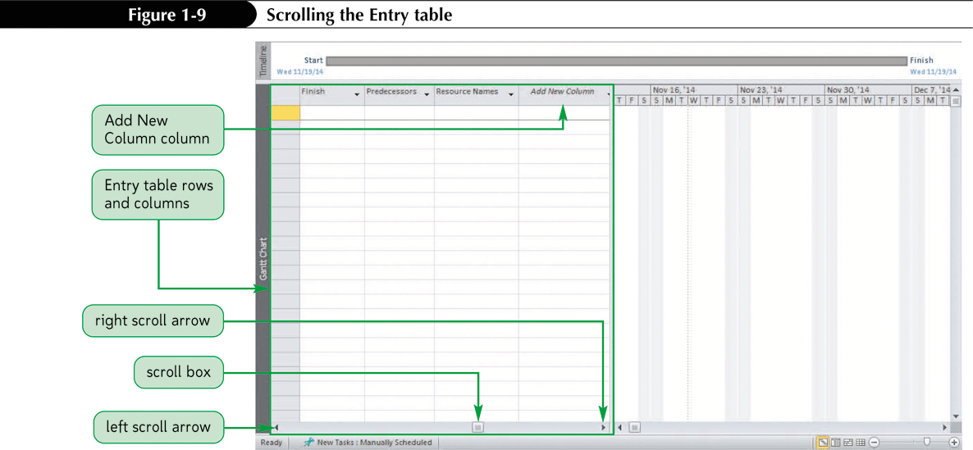
Entry Table

Slide 24
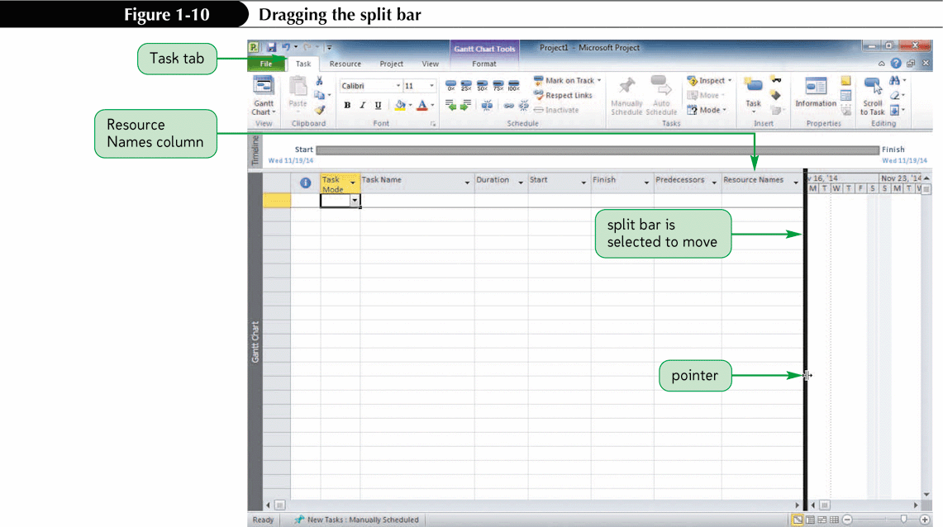
Gantt Chart and Split Bar

Slide 25
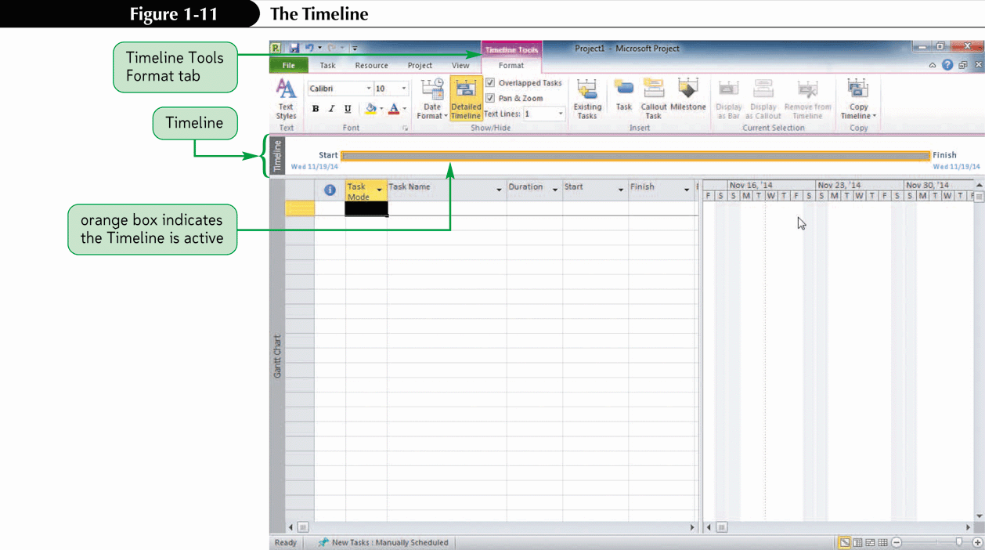
The Timeline

Slide 26
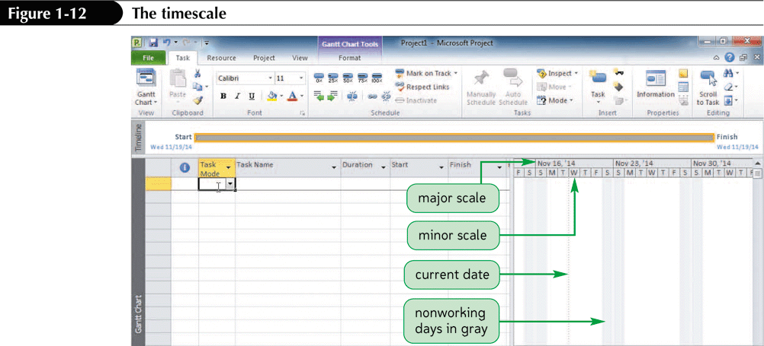
The Timescale

Slide 27
Getting Started with Project 2010, Cont.
Current Date
Working Days and Nonworking Days
Setting Automatic Scheduling
Setting Project Start and Finish Dates
Entering Tasks
Saving a Project
Closing a Project
Opening an Existing Project
Saving a Project with a new name

Slide 28
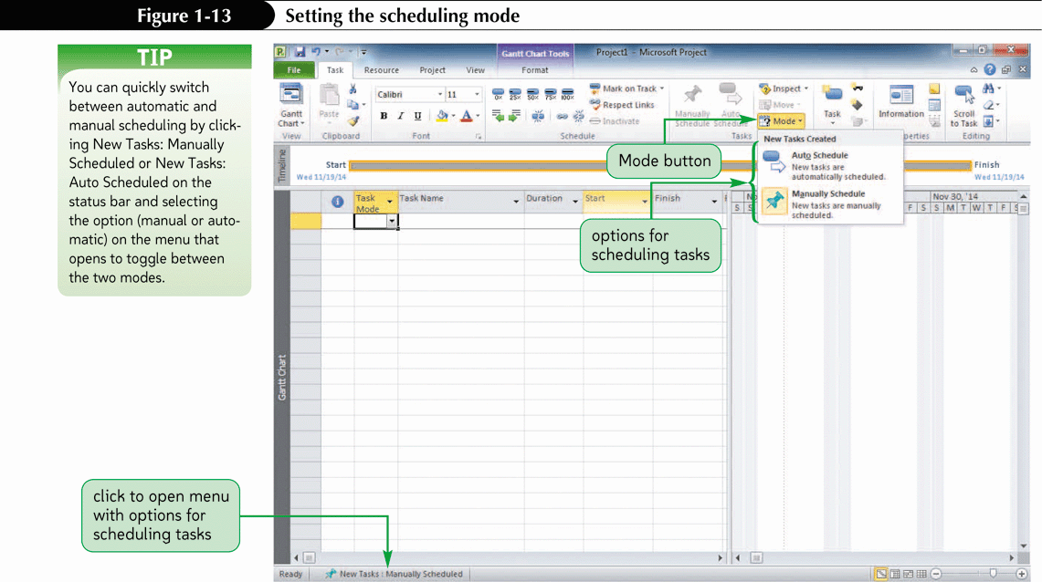
Setting the Scheduling Mode

Slide 29
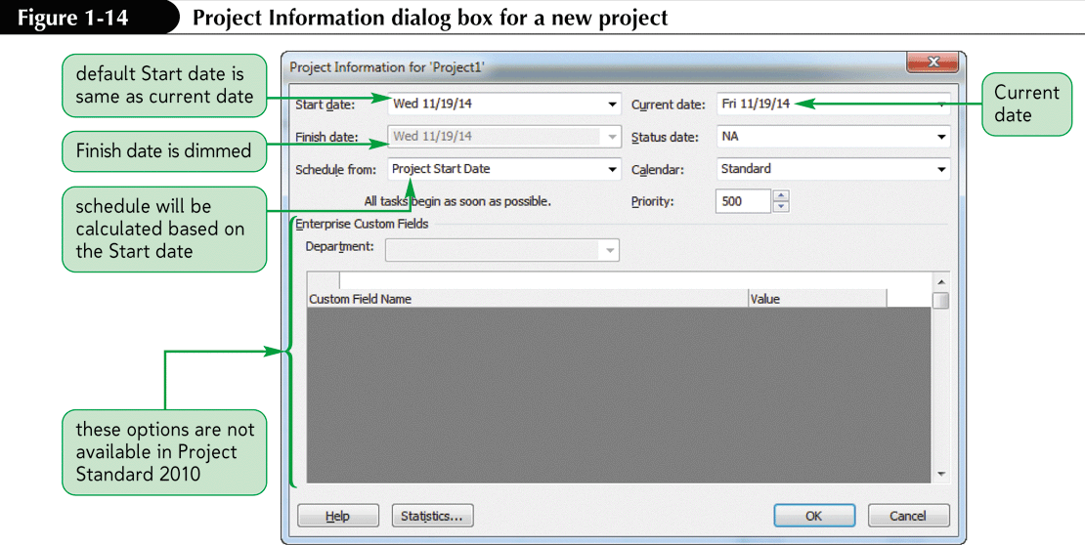
Setting Project Start and Finish Dates

Slide 30
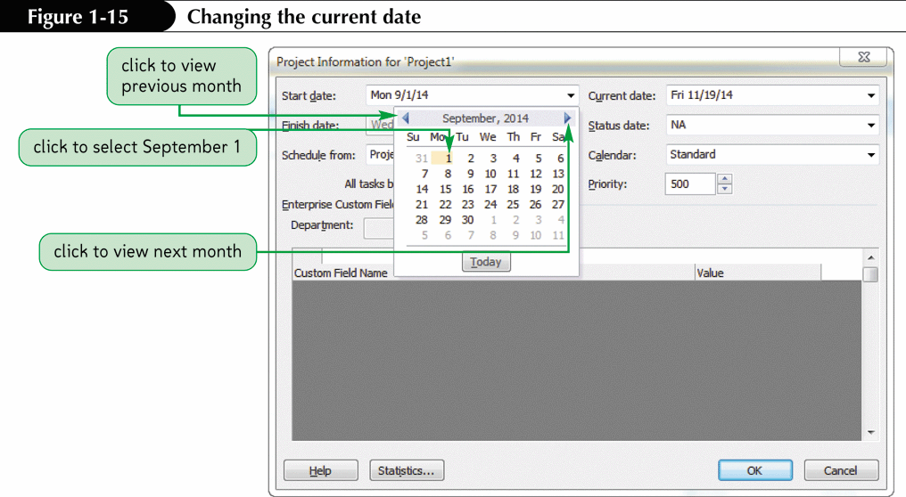
Changing the Current Date

Slide 31
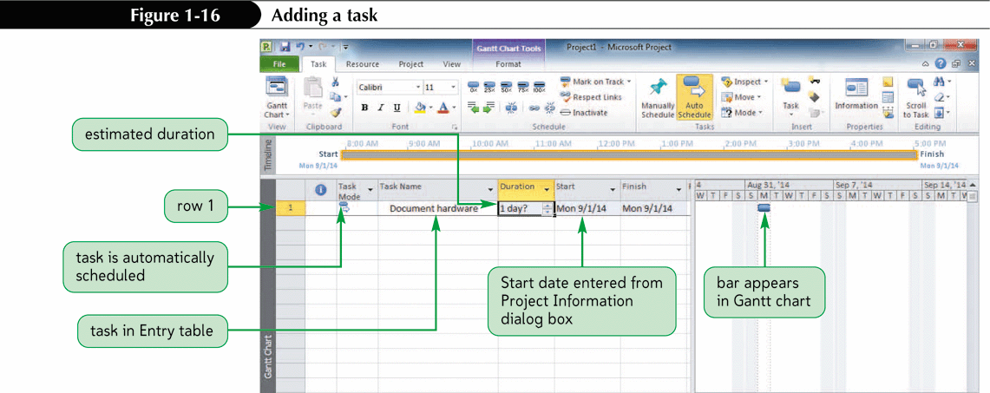
Entering Tasks

Slide 32
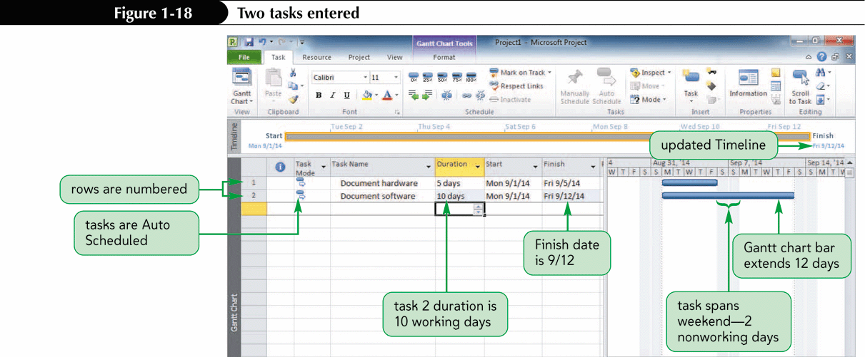
Two Tasks Entered

Slide 33
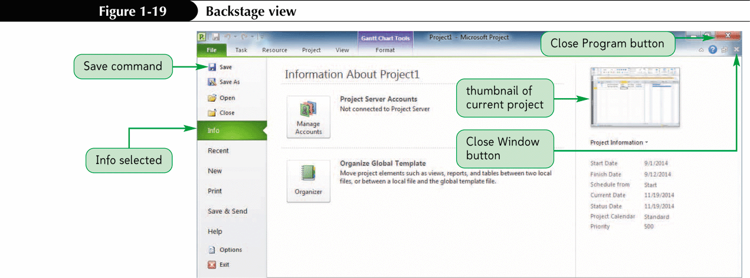
Saving a Project

Slide 34
Working in Different Views
Chart or Graphic: representation of data using bars, boxes, lines, and images
Sheet: A spreadsheet-like representation of data in rows and columns
Form: view of many pieces of information to focus on the details of one task
Combination: view of many tasks at the top of the screen, view of task details below.

Slide 35
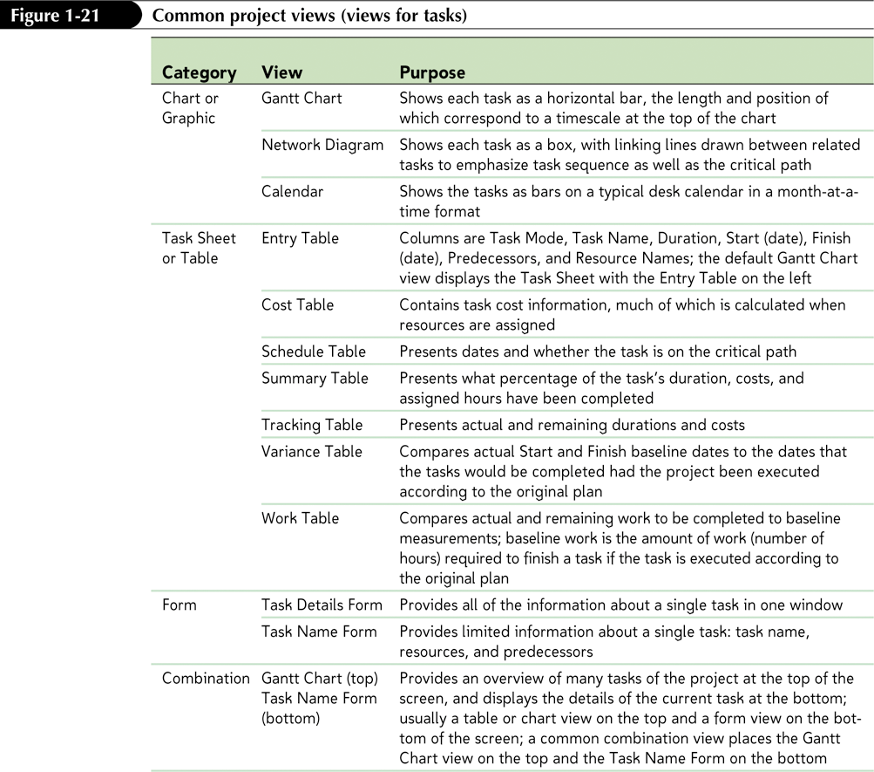
Common Project Views (Task Views)

Slide 36
Common Views
Gantt Chart View
Network Diagram View
Calendar View
Task Information Dialog Box
Notes Tab, Notes Indicator
Relationship View

Slide 37
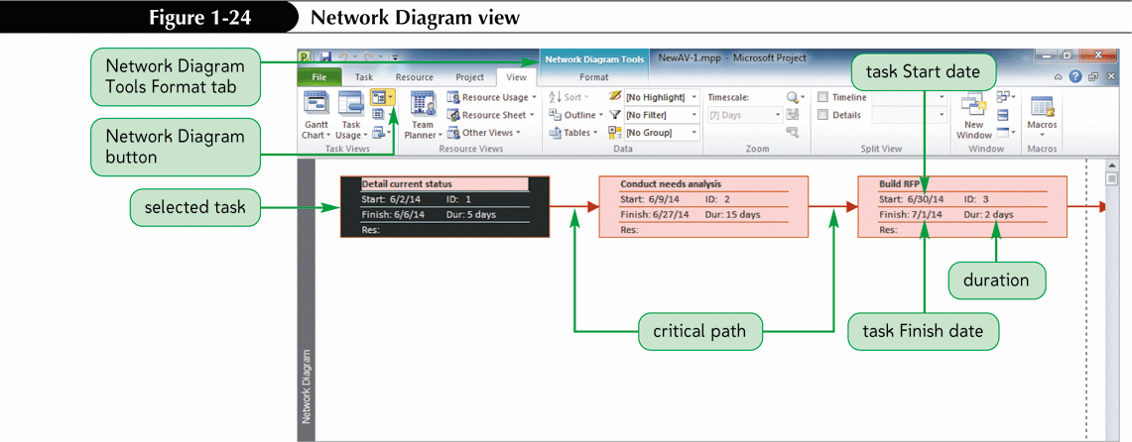
Network Diagram View

Slide 38
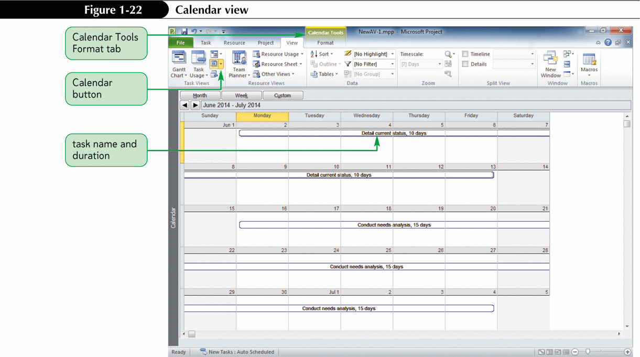
Calendar view

Slide 39
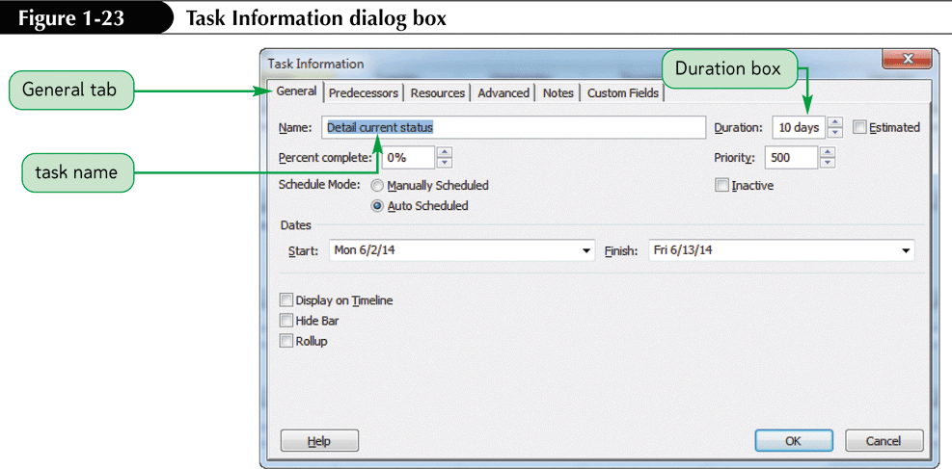
Task Information Dialog Box

Slide 40
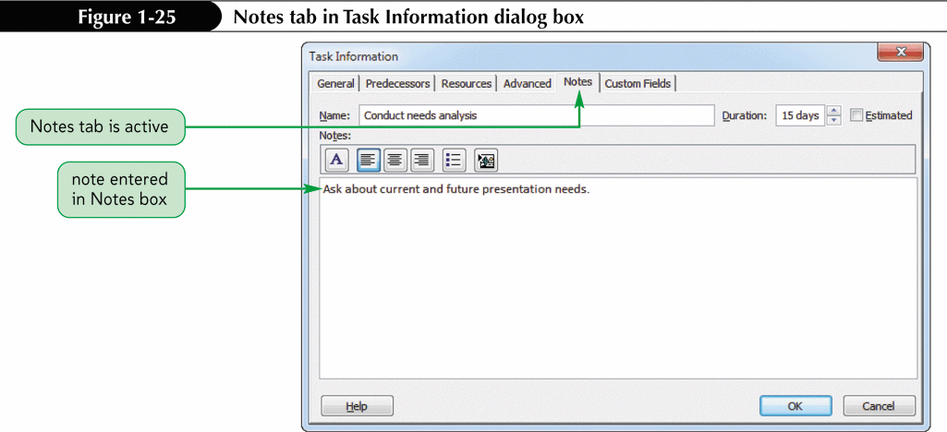
Notes Tab

Slide 41
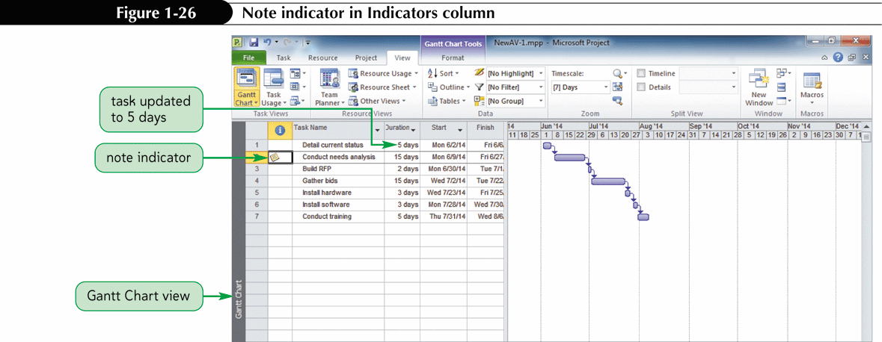
Notes Indicators

Slide 42
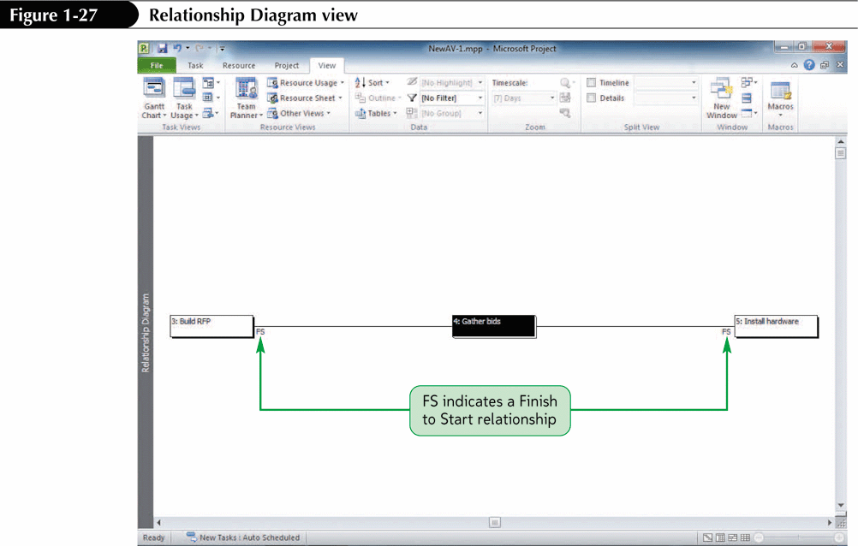
Relationship Diagram View

Slide 43
Common Views, Cont.
Entry Table
Schedule Table
Split View
Zooming in and Out
Timescale Dialog Box
Changing the timescale

Slide 44
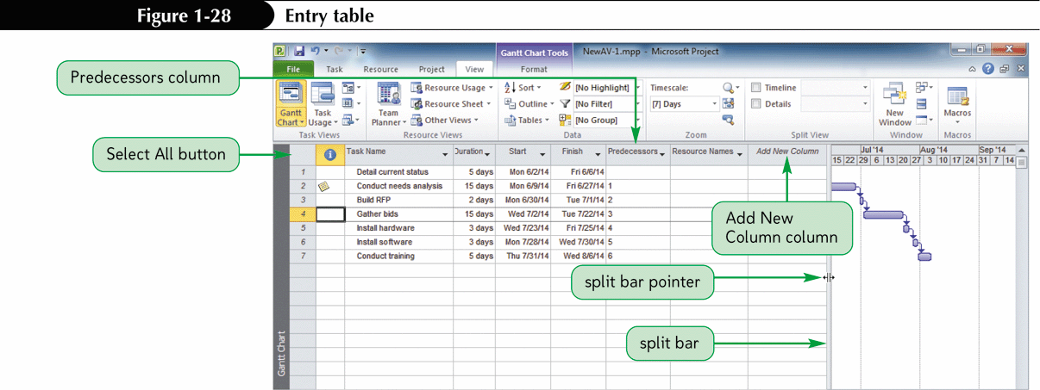
Entry Table

Slide 45
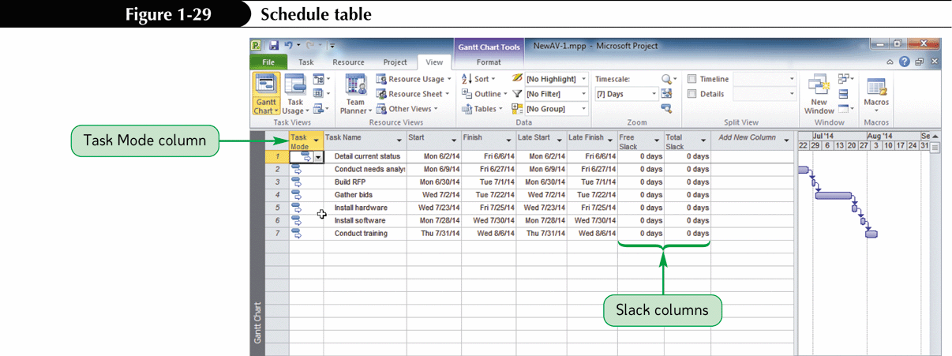
Schedule Table

Slide 46
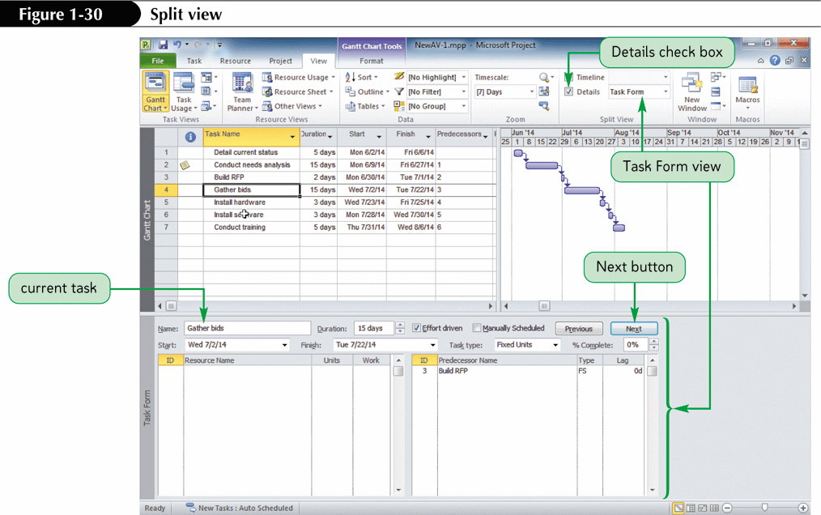
Split View

Slide 47
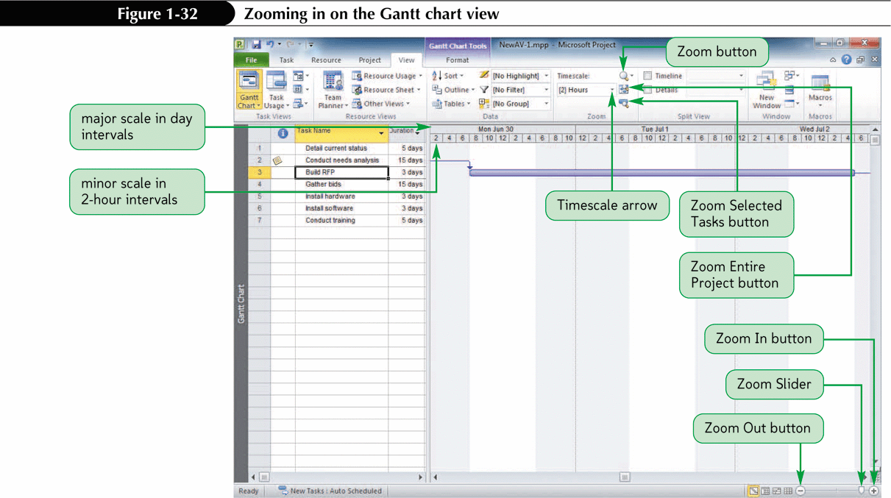
Zooming In and Out

Slide 48
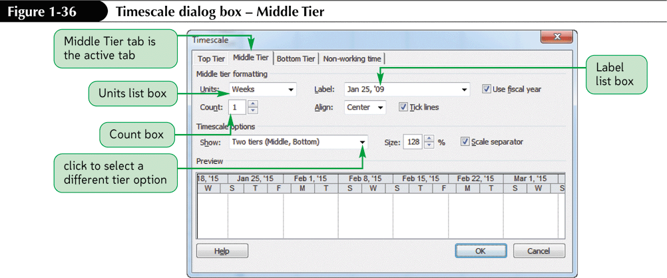
Timescale Dialog Box

Slide 49
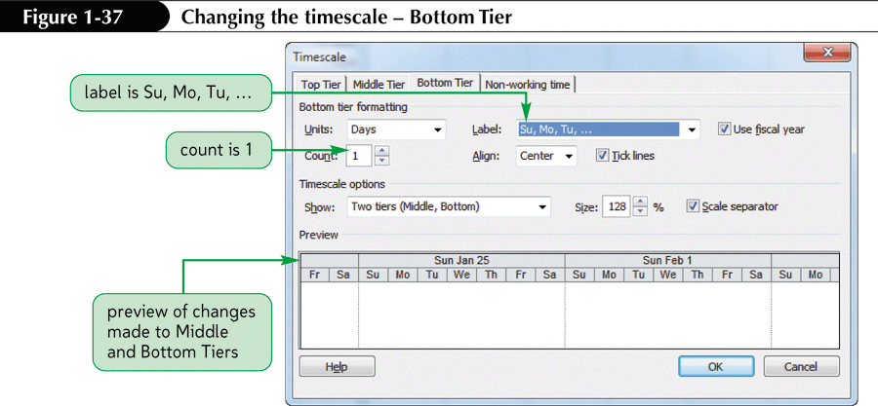
Changing the Timescale

Slide 50
Successful Printing
The key aspects of successful printing:
  Zooming to an acceptable magnification level
  Print previewing your work
  Using the page setup dialog box to make changes

Slide 51
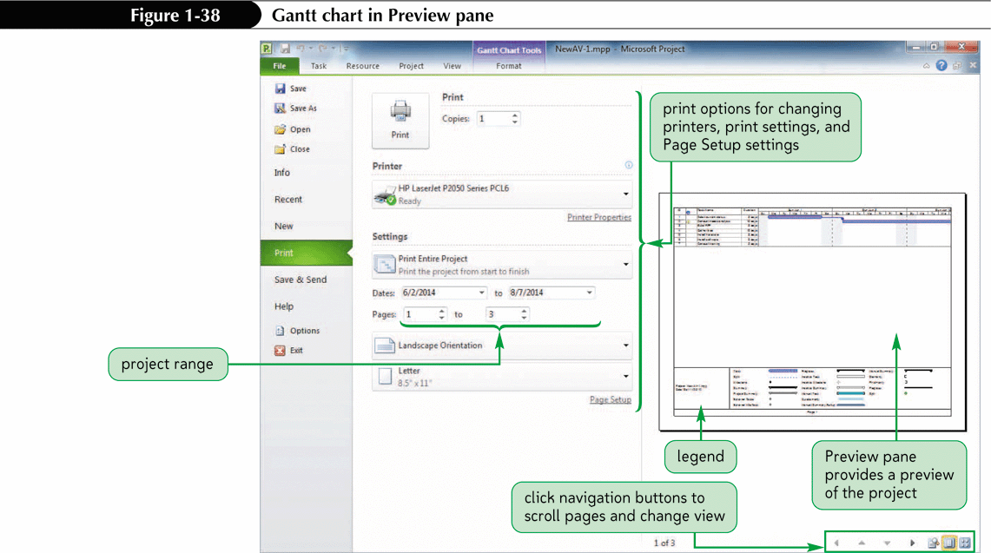
Gantt Chart in Print Preview

Slide 52
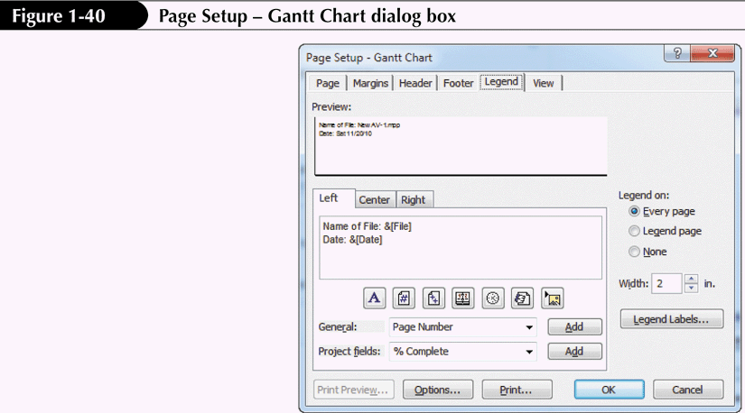
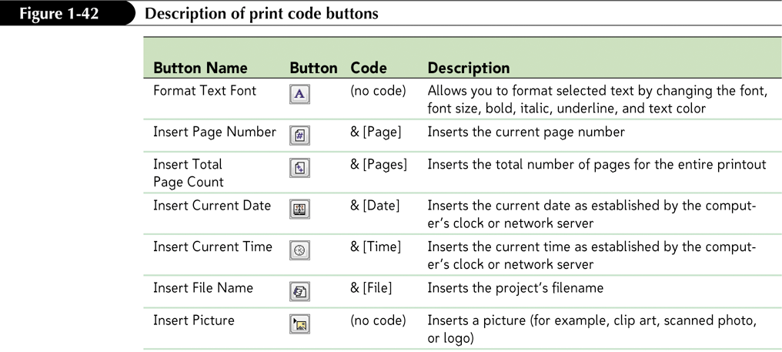
Page Setup

