Slide 1
Possible Solutions:
Test 2

Slide 2
a) Develop an entity-activity diagram (17)
b) Draw an activity diagram (18)
c) Complete a fully developed use case description. (24)

Slide 3
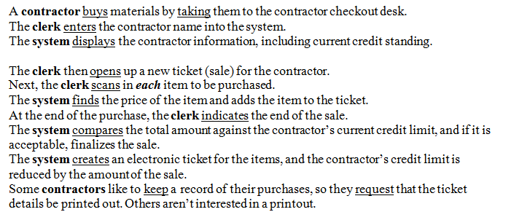

Slide 4
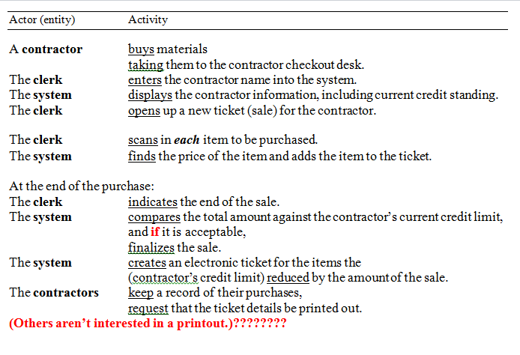

Slide 6
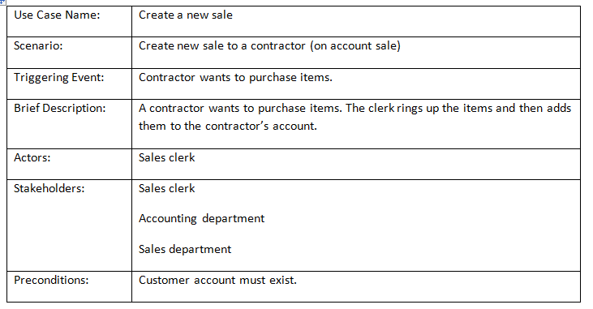

Slide 7
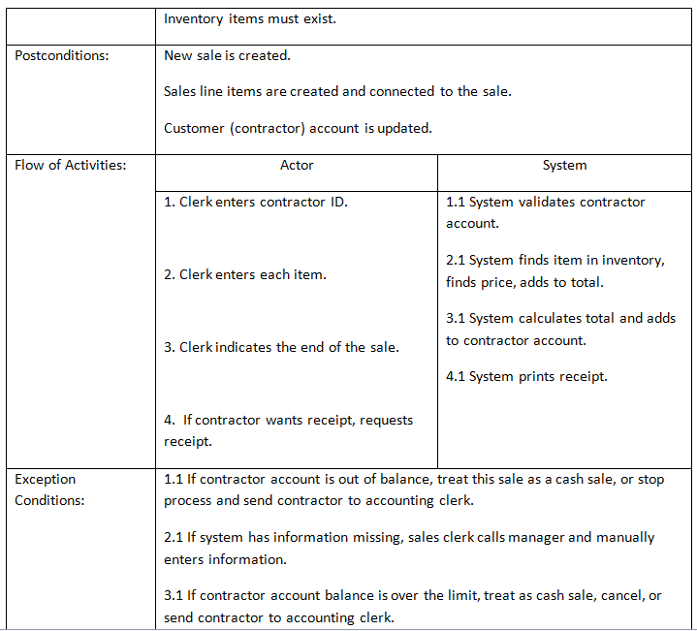

Slide 8
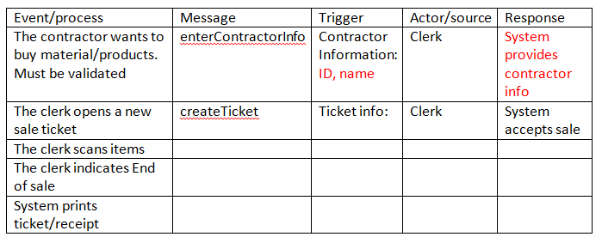

Slide 9
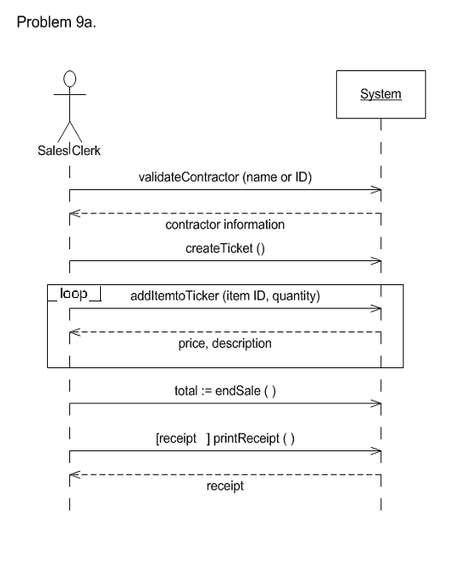

Slide 10
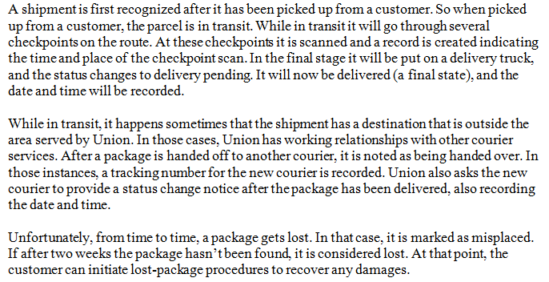

Slide 11
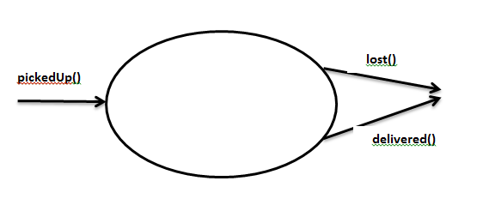

Slide 12
State | Transition | Final state
In transit | On truck | Delivery pending
Delivery pending | Delivered | Delivered
In transit | Hand over | Hand over
Hand over | deliver | delivered
In transit | missing | misplaced
Misplaced | For two weeks | lost

Slide 13
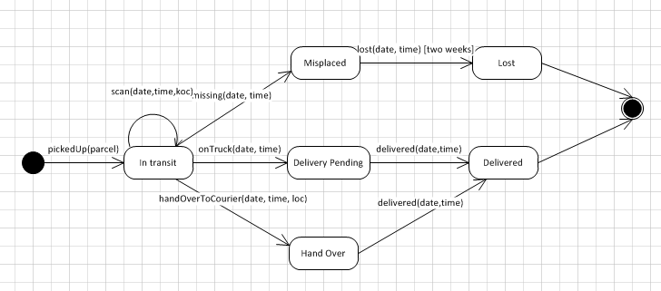

Slide 14
