Slide 1
C H A P T E R
1, 2, 4, 6, 11
THE CONTEXT
OF SYSTEMS ANALYSIS AND DESIGN METHODS
Notes:
This repository of slides is intended to support the named chapter. The slide repository should be used as follows:
Copy the file to a unique name for your course and unit.
Edit the file by deleting those slides you don’t want to cover, editing other slides as appropriate to your course, and adding slides as desired.
Print the slides to produce transparency masters or print directly to film or present the slides using a computer image projector.
Each slide includes instructor notes. To view those notes in PowerPoint, click-left on the View Menu; then click left on Notes View sub-menu. You may need to scroll down to see the instructor notes.
The instructor notes are also available in hardcopy as the Instructor Guide to Accompany Systems Analysis and Design Methods, 6/ed.

Slide 2
Importance of Systems Analysis and Design
Examples
  Denver airport Baggage-handling information system
  WorldCom (now MCI) billing systems
  California DMV system

Slide 3
New Denver airport
Twice the size of Manhattan, NY
10 times wider than London airport
Big enough to land three jets simultaneously-in bad weather
Baggage-handling information system
  One of kind…
  Expensive: $1.7 billion (original price)
  Very large size….
  The most advanced and sophisticated automated baggage handling system

Slide 4
Scale of baggage-handling system
21 miles of steel track
  Tearing like intelligent coal-mine cars
4,000 independent "telecars" route and deliver luggage between the counters, gates and claim areas of 20 different airlines.
Size of the system
  100 computers are networked to one another and to 5,000 electric eyes
  400 radio receivers
  56 bar-code scanners orchestrates the safe and timely arrival of every valise and ski bag.

Slide 5
Result
Scheduled to open Nov, 94
Delayed nine-month because of system glitches.
  Original price $1.7 billion, final cost $4.5 billion
  Their bond rating demoted to junk and their budget hemorrhaging red ink at the rate of $1.1 million a day in interest and operating costs.
    $ 1.1 M can worth more today!!

Slide 6
WorldCom (now under MCI)
Fierce competitors to AT&T and Sprint
Used to have:
  88,000 employees
  60,000 miles of telephone lines around the world
  Revenue of $40 billion
Collapsed because of the accounting fraud
  $11 billion
  The biggest ever
A main trigger
  Simple: failure of systems integration
  Four different billing systems

Slide 7
California DMV system
Straightforward task
  Provide one-stop service: merge of the state’s driver license and vehicle registration systems
Started 1991 and stopped 1998
  In Dec 98, the agency pulled the plug and walked away…
  wasting $44.3 million investment..
Y2K problem (very simple problem…)
  Analysts and designers couldn’t think that systems can live longer than them….
  Billions of dollars were wasted ($740 billion)

Slide 8
Why information systems?
Information age
  Change of Paradigm
  Bill Gates wealth
Globalization
  Dramatic increase of global management
Organizational Change
  Downsizing (less hierarchical)
  Less traditional middle management
  Knowledge asset management
Speed
  Impossible without IT

Slide 9
IS vs. IT
  An information system (IS) is an arrangement of people, data, processes, and information technology that interact to collect, process, store, and provide as output the information needed to support an organization.
  Information technology is a contemporary term that describes the combination of computer technology (hardware and software) with telecommunications technology (data, image, and voice networks).
Notes:
Conversion Notes
This is a more concise definition of “information system” than in previous editions. It better reflects what information systems are and do rather than how they are used.
Some books use the term “computer technology.” We prefer the more contemporary term “information technology” as a superset of computer technology.

Slide 10
Stakeholders: Players in the Systems Game
A stakeholder is any person who has an interest in an existing or proposed information system. Stakeholders can be technical or nontechnical workers. They may also include both internal and external workers.
Figure 1-1: next slide
  System owners
  System users
  System designers
  System builders
  Systems analysts (project managers)
Notes:
Conversion Notes
These three definitions have been placed together to improve the conceptual flow.
Teaching Notes
Give examples of information workers and knowledge workers to reinforce the difference.
Footnote – Information workers (sometimes called “white-collar workers”) have outnumbered blue-collar workers since 1957.
Typically a knowledge worker has a degree or credential in some subject area (hence, they are often called “subject area experts”). Examples include engineers, scientists, accountants, lawyers, etc.
Briefly describe a typical information system that students would be familiar with, such as an enrollment system for the college. Invite the class to brainstorm who the stakeholders would be and which of them would be information workers or knowledge workers.

Slide 11
System Designers and System Builders
System designer – a technical specialist who translates system users’ business requirements and constraints into technical solution.
  DBA, Network architects, web designer, security experts…
System builders – a technical specialist who constructs information systems and components based on the design specifications generated by the system designers.
  Programmers (applications, systems, and DB), network administrators, web masters..
Notes:
Teaching Notes
Using the information system described earlier (enrollment system or other), for the college, invite the class to identify individuals who might play the system designer or system builder role.
Programmers are typically viewed as system builders, but in fact, they are also system designers since good programmers design the software they build.
You might want to remind students that a single individual can play multiple roles in a project. For example:
A person could be both a system owner and system user.
Many systems analysts are also system designers and builders.
In reality, most technical specialists serve in most roles. For instance, database specialists typically design and construct databases.

Slide 12
Systems Analysts
Systems analyst – a specialist who studies the problems and needs of an organization to determine how people, data, processes, and information technology can best accomplish improvements for the business.
Roles:
  Bridge (facilitator) between management and technical specialist: next slide
  Understand both business and computing
  Initiate change within an organization
  Ultimately, a problem solver
Notes:
Teaching Notes
Business analyst is becoming more popular because of the number of end-users and other knowledge workers being assigned to systems analysts roles in organizations.

Slide 13
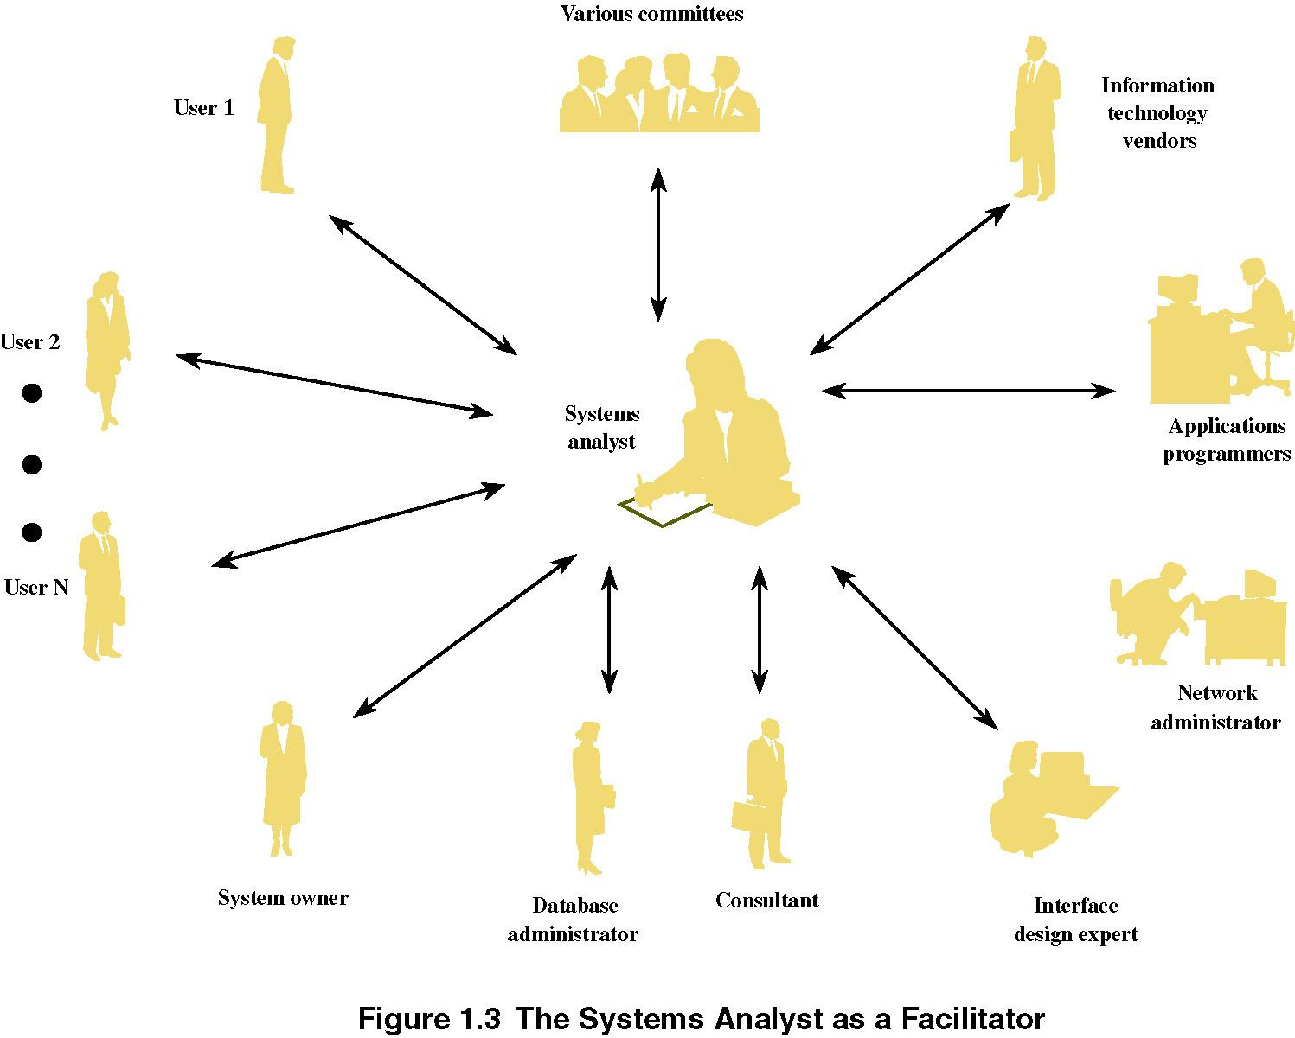
The Systems Analyst as a Facilitator
Notes:
No additional notes

Slide 14
Where Do Systems Analysts Work?
May be permanently assigned to a team that supports a specific business function
May also be pooled and temporarily assigned to specific projects
  Figure on next slide
Career prospect for SA
  Textbook page 19
Notes:
Teaching Notes
It can be useful to present examples of each scenario from the instructor’s personal experiences.
The classification scheme is not mutually exclusive; that is,
a project can be driven by multiple instances and combinations of problems, opportunities, and directives.
a problem might be classified as both a true problem an opportunity, or an opportunity plus directive.

Slide 15
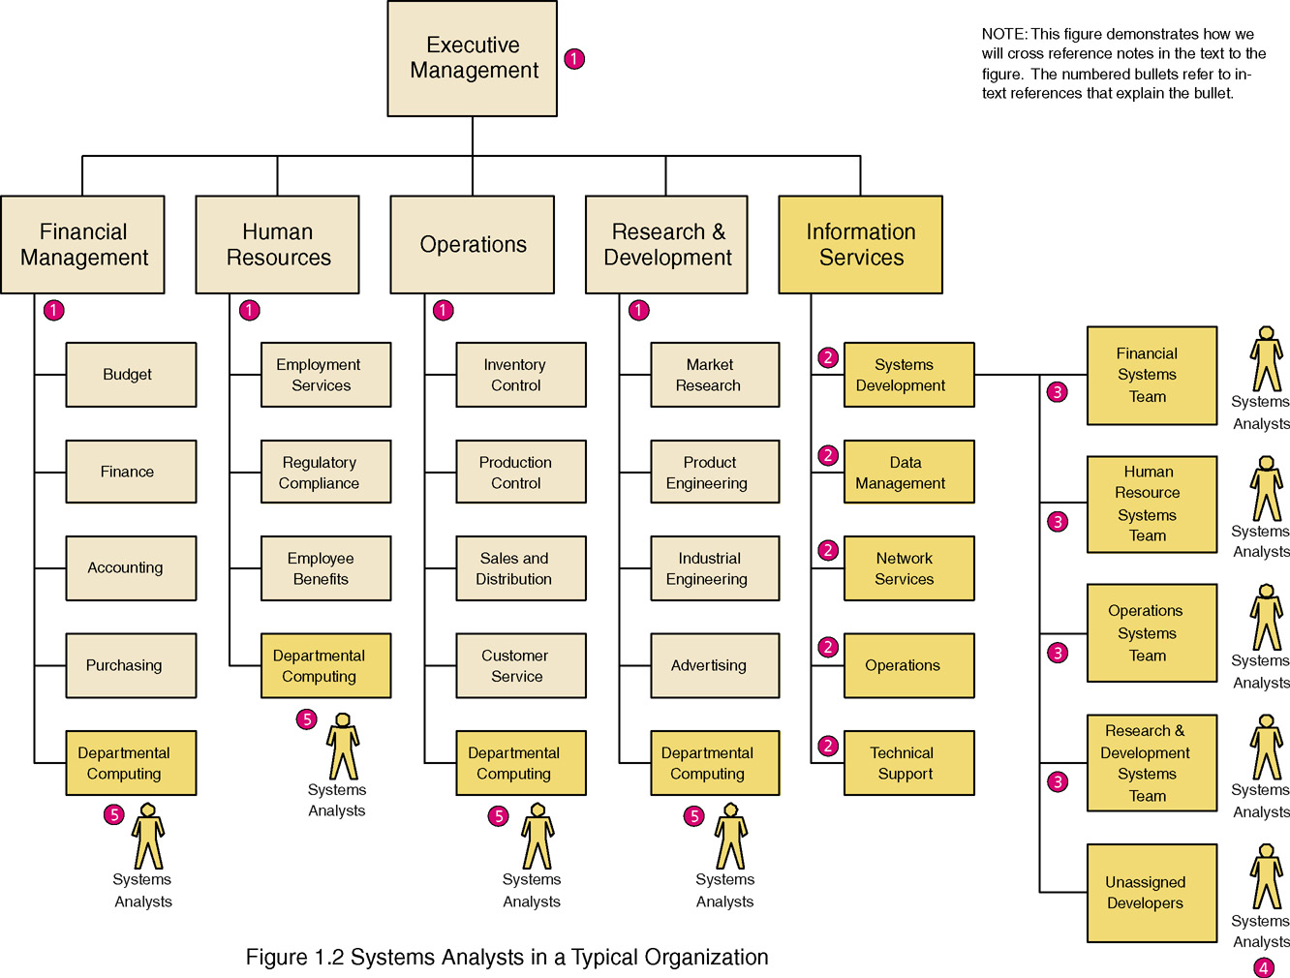
Where Do Systems Analysts Work?
Notes:
Teaching Notes
Note that every organization structures itself uniquely
Systems Analysts also work for:
Outsourcing businesses
Consulting businesses
Commercial software developers
Conversion Notes
This is an expanded view compared to the comparable figure in the 5th edition. This provides a picture of the entire organization and the various place where systems analysts work

Slide 16
Skills Needed by the Systems Analyst
Working knowledge of (existing and emerging) IT
Computer programming experience and expertise
General business problem-solving skills
Good interpersonal communication skills
  Business writing class (Dr.John Stark)
  Technical business skill class (Dr. Ron Pimentel)
Good interpersonal relation skills
Flexibility and adaptability
Character and ethics
Notes:
No additional notes

Slide 17
Skills Needed by the Systems Analyst
Computer programming experience and expertise
  It is difficult to imagine how systems analysts could adequately prepare business and technical specifications for a programmer if they did not have some programming experience.
  Most systems analysts need to be proficient in one or more high-level programming language
Notes:
No additional notes

Slide 18
Other Stakeholders
External Service Provider (ESP) – a systems analyst, system designer, or system builder who sells his or her expertise and experience to other businesses to help those businesses purchase, develop, or integrate their information systems solutions; may be affiliated with a consulting or services organization.
  Accenture (previously Anderson Consulting – spun off from Arthur Anderson consulting)
  Consultants, Contracted SA, SD, SB, programmers..
Project Manager – an experienced professional who accepts responsibility for planning, monitoring, and controlling projects with respect to schedule, budget, deliverables, customer satisfaction, technical standards, and system quality.
  Usually senior analysts
Notes:
Conversion Notes
These terms are new with the 6th edition.

Slide 19
Two Drivers for Today’s Information Systems
Business Drivers
  Globalization of the Economy
  Electronic Commerce
  Security and Privacy
  Collaboration and Partnership
  Knowledge Asset Management
  Continuous Improvement and Total Quality Management
  Business Process Redesign
Notes:
Conversion Notes
With the resolution of Y2K issues but new issues added after 9/11 and continued growth of the Internet, this list is substantially revised from the 5th edition.

Slide 20
Drivers for Today’s Information Systems
Technology Drivers
  Networks and the Internet
  Mobile and Wireless Technologies
  Object Technologies
  Collaborative Technologies
  Enterprise Applications
Notes:
Conversion Notes
This list is substantially revised from the 5th edition.

Slide 21
Object Technologies
Object technology – a software technology that defines a system in terms of objects that consolidate data and behavior (into objects).
  Objects are reusable and extensible
  Object-oriented programming languages include C++, java, Smalltalk, and Visual Basic.net
Object-oriented analysis and design – a collection of tools and techniques for systems development that will utilize object technologies to construct a system and its software.
  Works well in programming level
  May not need some of analysis and design level (e.g., database – structured tools and techniques)
  Hybrid analysis and design
Notes:
Conversion Notes
This slide is new to the 6th edition
Object-oriented analysis and design tools are more integrated into the 6th edition. At the same time, the importance of structured tools and techniques is also recognized and will continue to be covered.

Slide 22
Front- and Back-Office Information Systems
Organizations are served by a federation of information systems (not by a single IS).
Two perspectives of a federation of IS
  Conceptual picture in next slide..
  Front-office information systems:
    support business functions that extend out to the organization’s customers (or constituents).
  Back-office information systems:
    support internal business operations of an organization, aw well as reach out to suppliers (of materials, equipment, supplies, and services).
Notes:
Teaching Notes
This classification scheme comes from popular usage in the trade literature.
This terminology is not to be confused with office automation. In fact, office automation systems can be either front-office or back-office, just as with other types of information system applications.

Slide 23
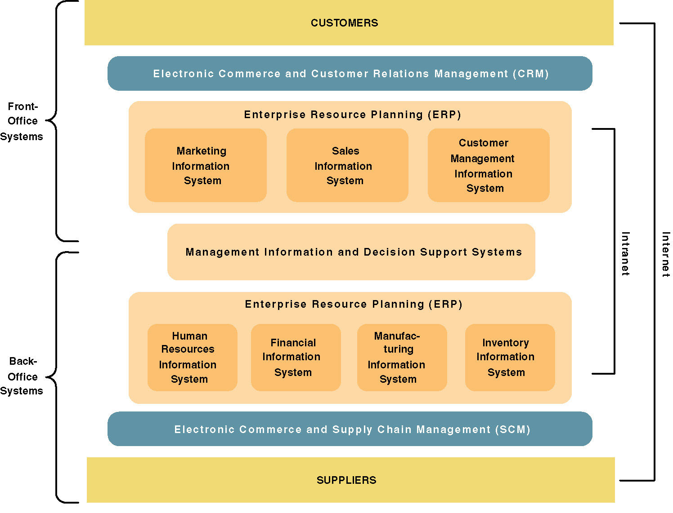
A Federation of Information Systems
Notes:
Teaching Notes
This slide visually illustrates front- and back-office applications and highlights the following:
Many organizations purchase their back-office systems in the form of enterprise resource planning (ERP) products such as SAP, PeopleSoft, and Oracle.
The ERP industry is trying to expand into the front-office applications.
It might be noted that electronic commerce and business extensions are being added to both front- and back-office applications in order to streamline interfaces to both customers and suppliers.
E-commerce is being driven by the Internet (and private extranets).
E-business is being enabled by intranets.

Slide 24
Information System Applications ( by Costco tape)
  A collection of applications serves as a foundation for a federation of information systems……
  A transaction processing system (TPS) is an information system that captures and processes data about business transactions.
  A management information system (MIS) is an information system that provides for management-oriented reporting based on transaction processing and operations of the organization.
  A decision support system (DSS) is an information system that either helps to identify decision making opportunities or provides information to help make decisions.
Notes:
Conversion Notes
These definitions on this and the next slide were not in the 5th edition.
These definitions can be useful to help students understand what an information system is in all its varieties and flavors. Depending on the prerequisites of your course, you may want to cover these in more or less detail.

Slide 25
Information System Applications ( by Costco tape)
  An Executive Information System (EIS) is an information system designed for top-level managers that integrates data from all over the organization into “at-a-glance” graphical indicators and controls.
  An expert system is an information system that captures the expertise of workers and then simulates that expertise to the benefit of nonexperts.
  A communications and collaboration system is an information system that enables more effective communications between workers, partners, customers, and suppliers to enhance their ability to collaborate.
  An office automation system is an information system that supports the wide range of business office activities that provide for improved work flow between workers.
Notes:
Teaching Notes
Some books treat DSS and EIS as distinct; however, if definitions are closely examined, the differences are subtle – they only differ in audience. Both DSS and EIS tend to support the same decision-oriented activities and basically work the same.

Slide 26
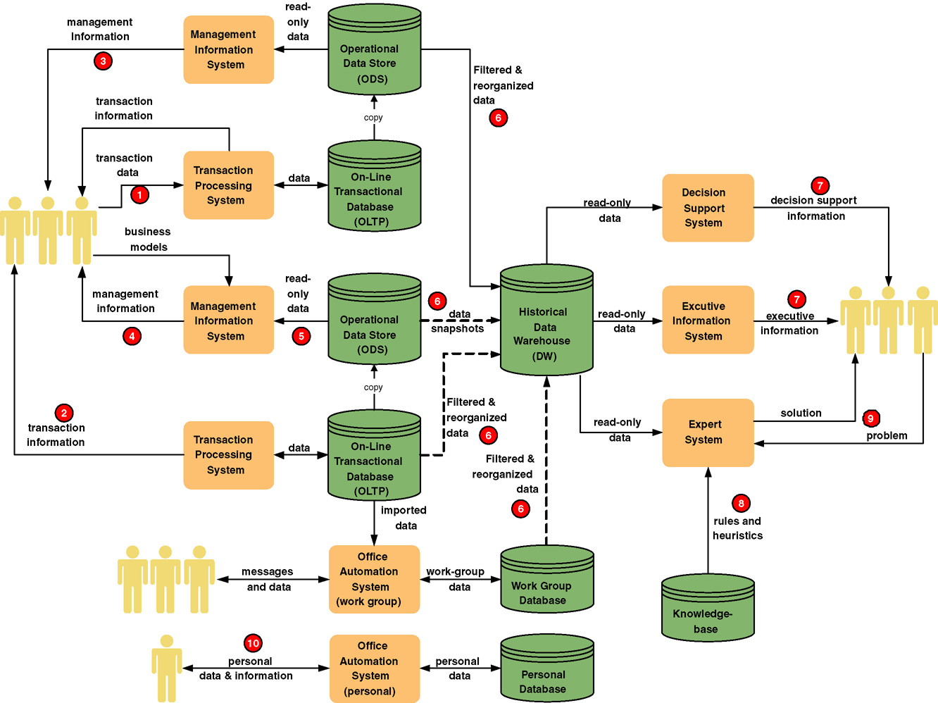
Operational view of Information System Applications
Notes:
Teaching Notes
It may be useful to walk through this diagram in class. The textbook coverage included numbered annotations that highlight portions of this diagram.
Remind students that any given information system may include many instances of each of these IS application processes and databases.

Slide 27
Information Systems Architecture
Information systems architecture
  Provide unifying framework for various stakeholders
  Highest-level of framework term for understanding different views of the fundamental building blocks (next slide) of an information system.
Three ultimate goals of IS
  Improve business knowledge -- using Db tech.
  Improve business processes and service – using SW tech.
  Improve business communications and people collaboration – using interface tech.
Notes:
No additional notes

Slide 28
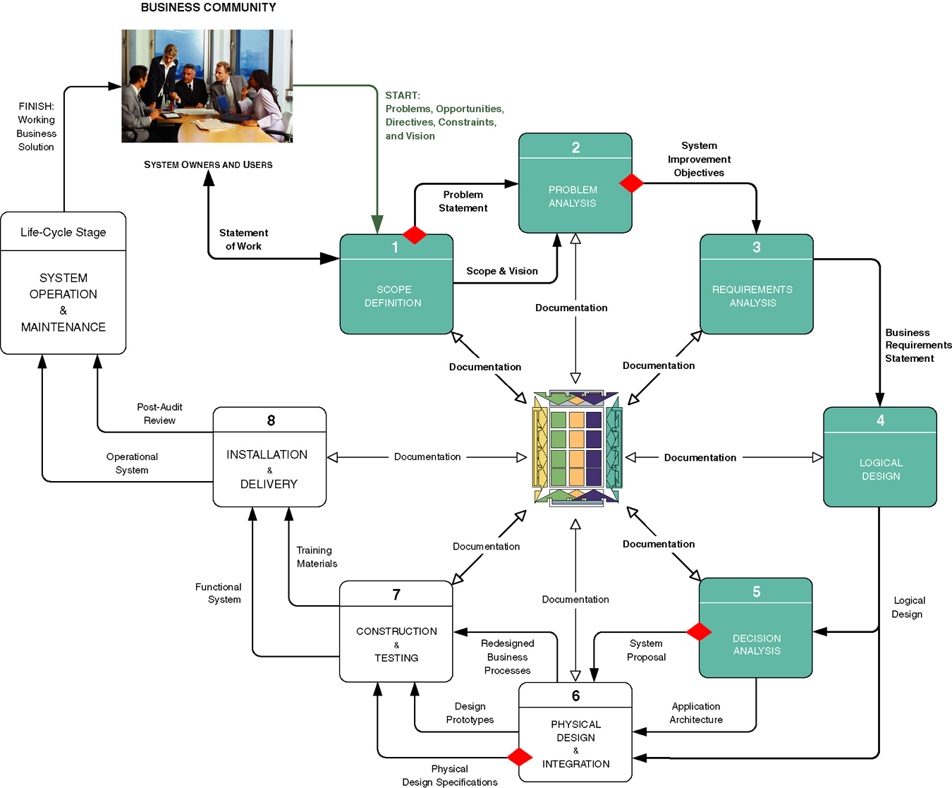
Context of System Analysis

Slide 29
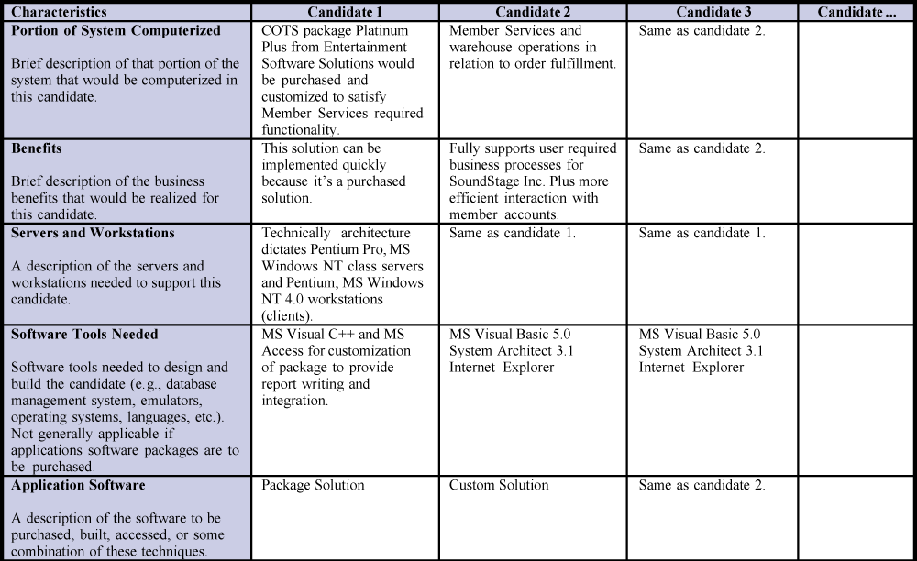
Candidate Systems Matrix
Notes:
No additional notes

Slide 30
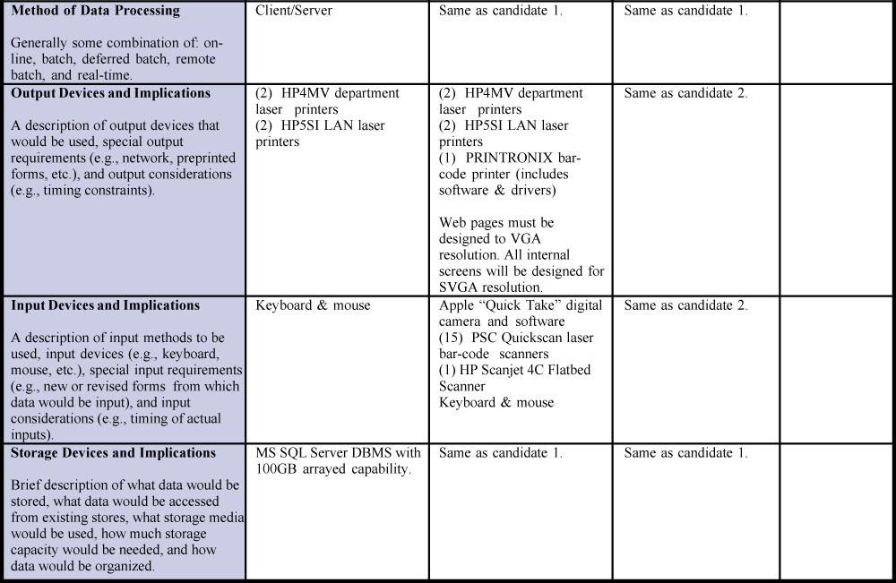
Candidate Systems Matrix..
Notes:
No additional notes

Slide 31
Results of Incorrect Requirements
The system may cost more than projected.
The system may be delivered later than promised.
The system may not meet the users’ expectations and that dissatisfaction may cause them not to use it.
Once in production, the costs of maintaining and enhancing the system may be excessively high.
  Commercial Application Packages
The system may be unreliable and prone to errors and downtime.
The reputation of the IT staff on the team is tarnished because any failure, regardless of who is at fault, will be perceived as a mistake by the team.
Notes:
No additional notes.

Slide 32
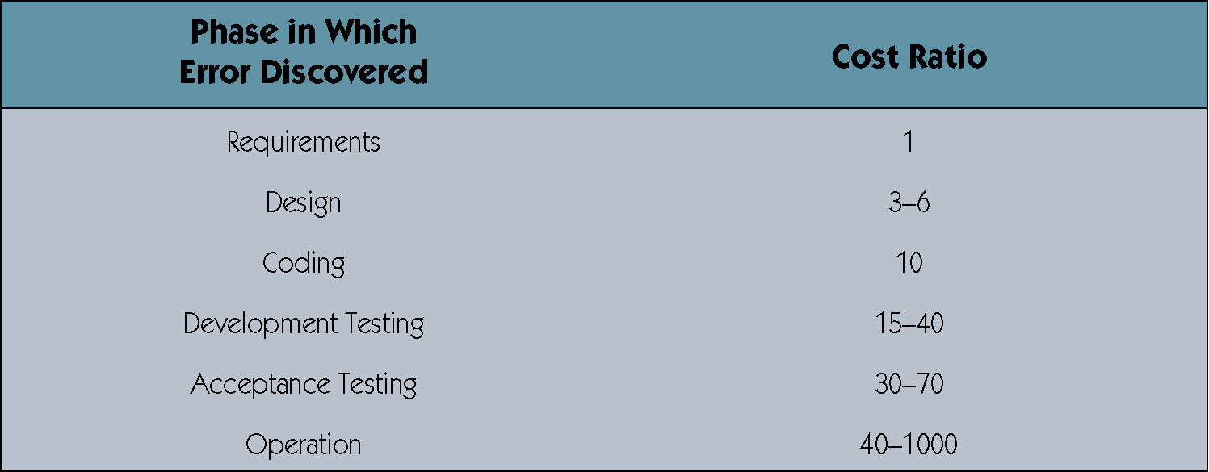
Relative Cost to Fix an Error

Slide 33
The Process of Requirements Discovery
Problem discovery and analysis
  For a system analyst to be successful , they must be skilled in the activity of problem analysis: you must be able to differentiate between a symptom and a real problem:
  A mother takes her child to the doctor because she has an earache, fever and a runny nose. Are these the problems?
  The doctor is trained to analyze further.

Slide 34
The Process of Requirements Discovery
Problem discovery and analysis
  Doctor concludes that the child has an ear infection.
  Doctor recommend now a cure: prescribe some antibiotics, but first determine if the child is allergic to certain medicines, the age, weight, etc.
The same way the system analysts diagnose system problems!

Slide 35
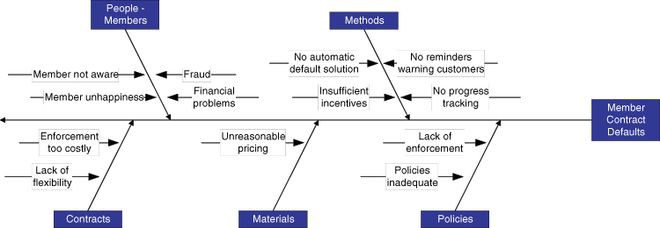
Ishikawa Diagram
The Ishikawa diagram: graphical tool to identify, explore, and depict problems, causes and effects of those problems. (Also called a cause-and-effect diagram or a fishbone diagram.)

Slide 36
Ishikawa Diagram
The Ishikawa diagram: consists of categories:
Four M’s:
  Materials, machines, manpower, methods
Four P’s:
  Places, procedures, policies, people
Four S’s
  Surroundings, suppliers, systems, skills
The key is to have three to six main categories that encompasses all possible causes
Usually a result of a brainstorming exercise.

Slide 37
Feasibility Analysis
Feasibility – the measure of how beneficial or practical an information system will be to an organization.
Feasibility analysis – the process by which feasibility is measured.
Creeping Commitment – an approach to feasibility that proposes that feasibility should be measured throughout the life cycle.

Slide 38
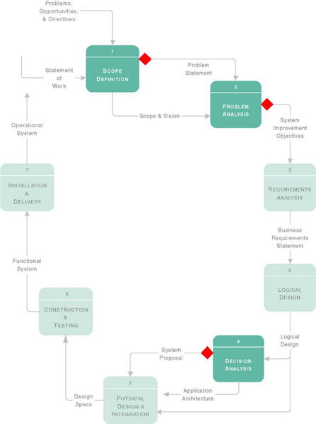
Feasibility Checkpoints During Systems Analysis

Slide 39
Six Tests For Feasibility
Operational feasibility – a measure of how well a solution meets the system requirements.
Cultural (or political) feasibility - a measure of how well a solution will be accepted in an organizational climate.
Technical feasibility – a measure of the practicality of a technical solution and the availability of technical resources and expertise.
Schedule feasibility – a measure of how reasonable the project timetable is.
Economic feasibility - a measure of the cost-effectiveness of a project or solution.
Legal feasibility - a measure of how well a solution can be implemented within existing legal/contractual obligations.

Slide 40
Operational Feasibility
How well proposed system solves the problems and takes advantage of opportunities identified during the scope definition and problem analysis phases
How well proposed system satisfies system requirements identified in the requirements analysis phase
Is the problem still worth solving?

Slide 41
Cultural (or political) feasibility
Does management support the system?
How do end users feel about their role in the system?
What end users may resist or not use the system? How can this be overcome?
How will the working environment change? Can users and management adapt to the change?

Slide 42
Technical feasibility
Is the proposed technology or solution practical?
Do we currently possess the necessary technology?
Do we possess the necessary technical expertise?

Slide 43
Schedule feasibility
Are specified deadlines mandatory or desirable?
Are mandatory deadlines realistic for proposed solution?

Slide 44
Economic feasibility
During Scope Definition
  Do the problems or opportunities warrant the cost of a detailed study and analysis of the current system?
During Problem Analysis
  After a detailed study of the current system
  Better estimates of development costs and benefits
During Decision Analysis
  Requirements now defined
  Development costs can be better estimated

Slide 45
Legal feasibility
Copyrights
Union contracts
Legal requirements for financial reporting
Antitrust laws
National data and work laws

Slide 46
Information System Costs
Development costs - one time costs that will not recur after the project has been completed.
  Personnel
  Computer usage
  Training
  Supply, duplication, and equipment
  Computer equipment and software
Operating costs - costs that recur throughout the lifetime of the system.
  Fixed costs — occur at regular intervals but at relatively fixed rates.
  Variable costs — occur in proportion to usage.

Slide 47
Information System Benefits
Tangible benefits are those that can be easily quantified.
Intangible benefits are those benefits believed to be difficult or impossible to quantify.
  Fewer processing errors
  Increased throughput
  Decreased response time
  Elimination of job steps
  Increased sales
  Reduced credit losses
  Reduced expenses

Slide 48
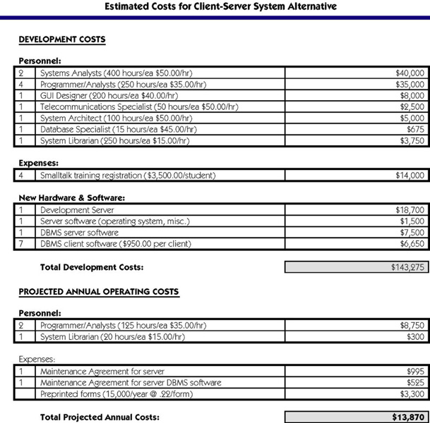
Costs for a Proposed Solution

Slide 49
Three Popular Techniques to Assess Economic Feasibility
Payback Analysis
Return On Investment
Net Present Value

Slide 50
INTANGIBLE BENEFITS:
Improved customer’s GOODWILL
Improved employee Morale
Better service to community
Better decision making
Management does not like facts that can’t be quantified
PROOF IT!!!!!

Slide 51
QUANTIFY GOODWILL:
Analyze customers according to some categories like:
  Ill will
  Why will the customer submit fewer orders
  To what degree will a customer reduce orders

Slide 52
QUANTIFY GOODWILL:
There is a 50% chance that a regular customer would send fewer than 10% of its orders to the competitor to test their performance
There is a 20% chance that a customer will send 50% of its orders to the competitor because we are historical slow to fulfill
There is a 10% chance that a customer would send us an order as a last resort: reduces the normal business to 10% of the current volume, or a 90% loss
5% choose NOT to do business at all with us, or a 100% loss

Slide 53
CALCULATIONS:
Loss = .5 x (.1 loss of business)
    + .2 x (.5 loss of business)
    + .1 x (.9 loss of business)
    + .05 x ( 1 loss of business)
    = .29 or 29% statistical estimated loss of business
If the average customer does R 40 000 per year of business, we can expect to loose R 11 600
If we have 500 customers, the total expected costs amounts to R 5 800 000

Slide 54
CONCLUSION:
There is a wealth of information OUT THERE!!
Hope this assist you with ‘What is MIS?’; ‘What is a system analyst?’; ‘Where do we fit in?’
BUT I hope you picked-up a few things you can apply to your project!! Different what we are use to from our prescribed book.
But remember to reference the source
KNOCK my socks off!
Good luck…I can’t wait AND remember: enjoy the ride

