Slide 1
State Machine Diagram
Chapter 5
Introduction:
Pages 122-132
Some examples were taken from:
Specifying software by RD Tennent

Slide 2
Alan M Turing:
“The behaviour of the computer at any moment is determined by the symbols which he is observing and his “state of mind” at that moment”.

Slide 3
Back ground:
The interaction view:
  Interaction modelling captures the interactions between objects that need to communicate to execute a use case or part of it
  Interaction models are used in the more advanced stages of requirements analysis, when the class model is known so that references to objects are backed up by the class model.

Slide 4
Why FSM?
Many software systems are event-driven:
  which means that they continuously wait for the occurrence of some external or internal event such as a mouse click, a button press, a time tick, or an arrival of a data packet.
After recognizing the event, such systems react by performing the appropriate computation that may include manipulating the hardware or generating “soft” events that trigger other internal software components. (That’s why event-driven systems are alternatively called reactive systems.) Once the event handling is complete, the system goes back to waiting for the next event.

Slide 5
FSM?
The response to an event generally depends on both the type of the event and on the internal state of the system and can include a change of state leading to a state transition.
The pattern of events, states, and state transitions among those states can be abstracted and represented as a finite-state machine (FSM).

Slide 6
For System Analysts?
The concept of a FSM is important in event-driven programming because it makes the event handling explicitly dependent on both the event-type and on the state of the system.
When used correctly, a state machine can drastically cut down the number of execution paths through the code, simplify the conditions tested at each branching point, and simplify the switching between different modes of execution.
Conversely, using event-driven programming without an underlying FSM model can lead programmers to produce error prone, difficult to extend and excessively complex application code

Slide 7
Overview:
The name of the diagram itself clarifies the purpose of the diagram and other details:
  It describes different states of a component in a system
State-chart diagram is one of the 5 UML diagrams used to model the dynamic nature of a system:
  They describe the flow of control from one state to another.

Slide 8
History:
UML 1.x it was called state chart diagrams
UML 2 we call it state machine diagrams
We will use the term interchangeably..
Objects have both
  Behaviour and
  State
Some objects are more complicated than others, and developers can have difficulty understanding them.

Slide 9
Introduction
Objects change the values of their attributes, but not all such changes cause state transitions.
Consider a Student object and an associated business rule that when a student has a mark average of more than 75%, he/she becomes a ‘distinction’ student
It is a normal state other wise.

Slide 10
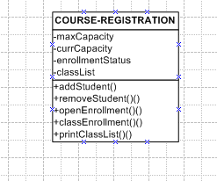
State
  A condition during an object’s life when it satisfies some criterion, performs some action, or waits for an event

Slide 11
Printer: page 125 - 127
Generally you have a device in a” current” state, and then change this state because of an input, or action by external agents.
Think of a printer: it sits in the corridor just “idling” (idling state), and then someone selects the PRINT option on his computer, and the printer changes from idling to “printing”.
Suppose it doesn’t print, but stay “idling”, what can be the problem? It finds itself in a condition of “out of paper”(it enables an action to a transition, depending on some Boolean value).

Slide 12
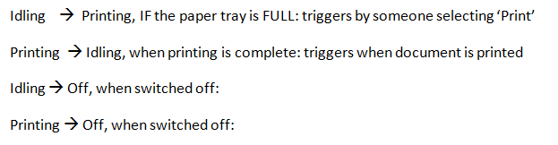

Slide 13
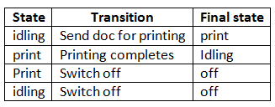

Slide 14
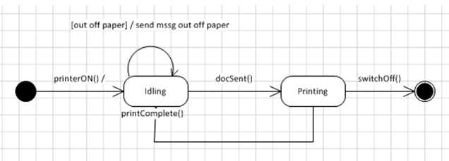

Slide 15
Application to System Analysis:
This paradigm underlies imperative computation: each state records the values of program values, and the state is changed by the effect of assignments and input statements in the program being executed:

Slide 16
Basic definition:
What is a state-transition diagram?
It is essentially a finite directed graph, consisting of nodes with directed edges between them, these edges labelled by elements from an alphabet, in this case:
  {0, 1}.

Slide 17
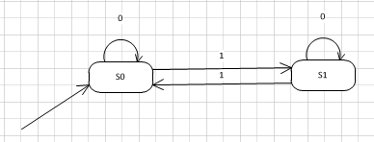

Slide 18
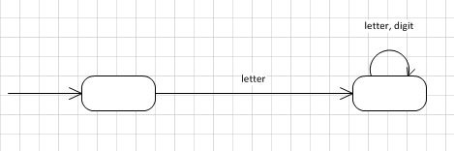
Example 1:
Most programming languages defined an identifier as consisting of a letter, followed by any number of letters or digits.
  The alphabet is {letter, digit}
Diagram:

Slide 19
Example 2:
An “unsigned real number” in most programming languages must contain a decimal part, an exponent part or both. Design a state-transition diagram that will recognise this language. Some examples are:
  3.1415926535, 6.023E+23, 6.625E-34, 0.0 or 1E0
Nice for a Sunday afternoon!!
Hint: Alphabet {digit,. , E, +, -}

Slide 20
Class Door:
What describes a door?
  Type, like wood, steel, etc.
  Colour, like …
  Dimensions, like ….
  State, like Open, or Closed, or Locked!
Behaviour:
  Leave it to you!

Slide 21
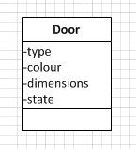

Slide 22
Describing ‘states’:
Initial State | Transition/Event | Final/Exit State
Open | Closes door | Close
Close | Lock door | Lock
Close | Opens door | Open
Lock | Unlocks door | Unlock

Slide 23
How many states?
Open
Closed
Locked
Unlocked?
Let’s rethink the state ‘Unlock’:
  When a door is ‘Closed’ and ‘Locked’ and I ‘Unlock’ it, it is ‘Closed’!
  Doesn’t make sense to ‘Lock’ an ‘Open’ door?

Slide 24
Summary:
A door can be in one of four states:
  Opened, closed, locked, unlocked
It can respond to the events:
  Open, close, lock and unlock
Not all events are valid states: if a door is opened, you cannot lock it until it is closed
Guard: if a door is open, it can only RESPOND to close, if the door way is Empty

Slide 25
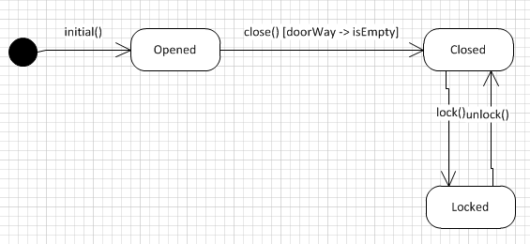
Let’s Model this:

Slide 26
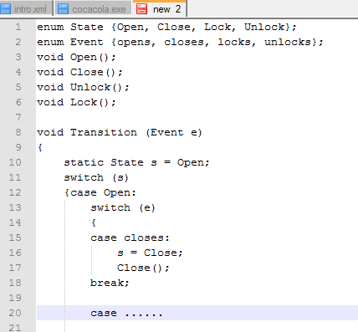

Slide 27
Recap/Transition:
A transition is a progression from one state to another and will be triggered by an event that is either internal or external to the object.
The notation for the labels on transitions is in the format:
Transition (parameter, ..) [guard]/ action-expression.

Slide 28
Transition cont.:
It is mandatory to indicate the event which causes the transition, such as open or cancelled. Guard conditions that must be true for the transition to be triggered, are optionally.
Transitions are the result of the invocation of a method that causes an important change in state. Not all method invocations will result in transitions.

Slide 29
Transitions cont.:
You can see that transitions are a reflection of your business rules. For example, you see that you can attempt to enrol a student in a course only when it is open for enrolment or full, and when a video is returned late, a fine or penalty will be imposed.
You can have recursive transitions, also called self transitions, that start and end in the same state.

Slide 30
Event [guard / action
A guard is a Boolean condition that must be TRUE in order for a transition to “fire”
  When an event occurs the guard conditions are checked, and if they are met, then the transition FIRES.
An action is a procedural expression to be performed when the transition fires

Slide 32
Identify ALL States
State | Transition/event | State

Slide 33
States
State | Transition/event | State
Space available | Add student | Full
Space available | Remove student | Space available
Full | Close Enrollment | Final,Arhive
Full | Remove student | Space available

Slide 34
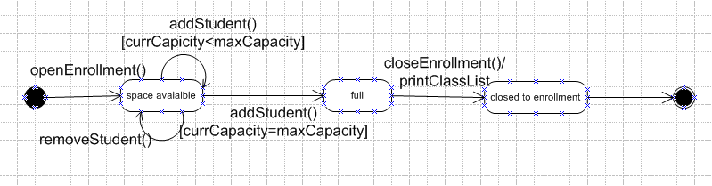

Slide 35
Super States
A state can be nested:
  A super state consists of more than one state
  A super state make it possible to view a state diagram at different levels of abstraction

Slide 36
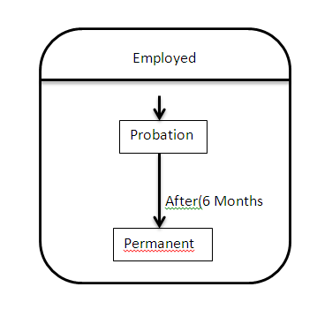
“OR” super state
When the super state is ON, only one of its sub states is ON

Slide 37
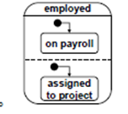
“AND” super state
“Concurrent sub states”: When the super state is ON, all of its states are also ON

Slide 38
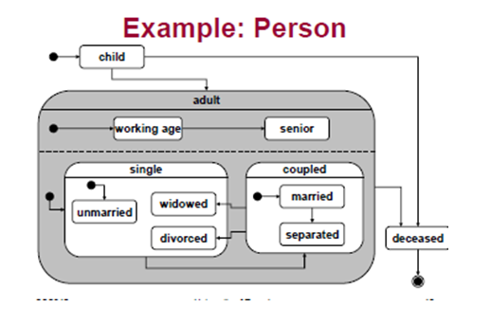
Discuss!!

Slide 39
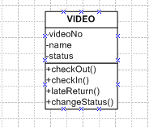
Exercise

Slide 40
Video Rental
State | Transition/Event | State

Slide 41
Summary
Object Oriented Analysis and development provides a way to define and model a system
  A development methodology combines software engineering processes and OOAD modeling
But…..
  There is a steep learning curve. You must be prepared to exercise this method several times before you begin to become proficient!

Slide 42
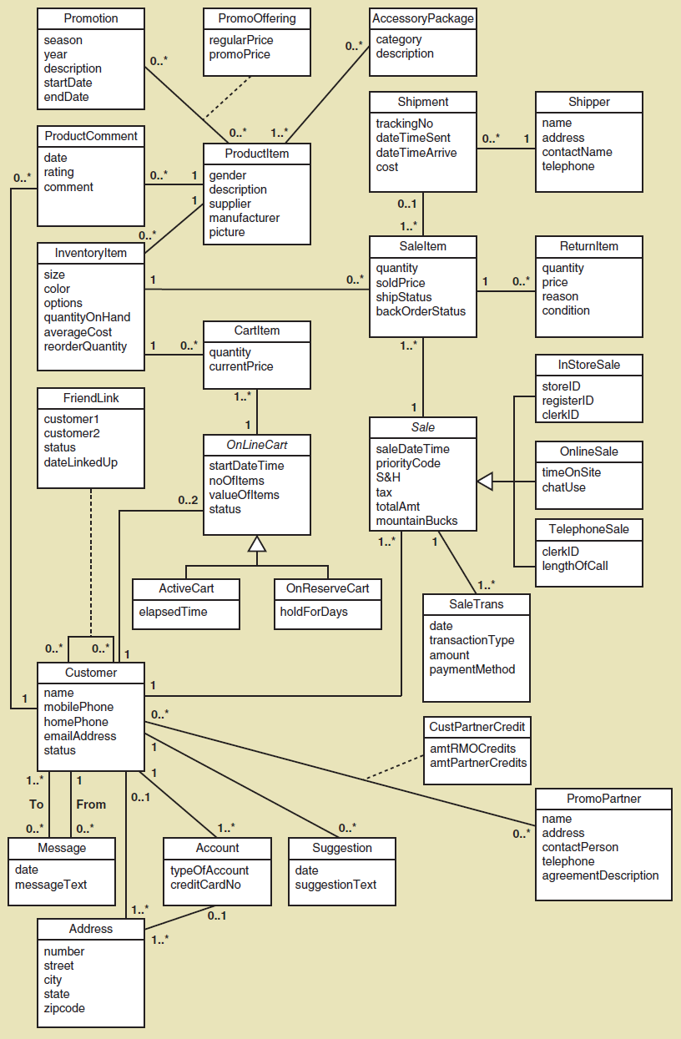

Slide 43
Homework
Read: Page 122 – 132
Study: page 129 – 130, Sale Item diagram
Page 136, No 7

Slide 44
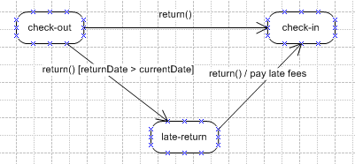
First Cut Diagram:

Slide 45
State Diagram:
But what is a late-return? Is it NOT a special return in a way?
What about if someone wants to borrow more than one video?
Creation State | Transition | Final state
Check-out | Return video | Check-in
Check-out | Return video-late | Check-in

Slide 46
