Slide 1
Data Flow Diagrams

Slide 2
Revision
Two-dimensional summary.
  DFDs summarize the data flow characteristics of a process; provide a useful and concise summary of system-related (e.g., data-driven) process attributes.
Completeness.
  DFDs offer a way to check the completeness of your process model, particularly as regards your understanding of the data that would be required by an information system
Processing, not processes.
  DFDs refer to "process" steps. It might be more useful to think of DFD "processes" as processing steps rather than process activities

Slide 3
Advantages
Data flows and process consequences
  Understand the processing steps that we need to take to complete the relevant transaction(s).
Data inputs and outputs.
  The DFD also makes it possible to understand what data are needed to provide appropriate inputs to any processing step
Simplifying complexity by isolating process components.
  Note how the DFD would make it easier to capture the detail of such data flows.

Slide 4
Testing the DFD/SF:
DFDs look easy on the surface - after all, what's hard about writing down a few bubbles and arrows? In practice the techniques proves to be somewhat more difficult than one might initially anticipate. Obtaining appropriate names for both processing steps and data flows can require careful thought.
As one rule of thumb, imagine that you are producing a diagram that must pass this test: you will finish the DFD, then hand it to someone who will then proceed to describe the process back to you based upon what he or she sees in your diagram.

Slide 5
Illegal data flows
One of the patterns of data flow analysis is that all flows must begin with or end at a processing step.
This makes sense, since presumably data cannot simply metastasize on its own without being processed

Slide 6
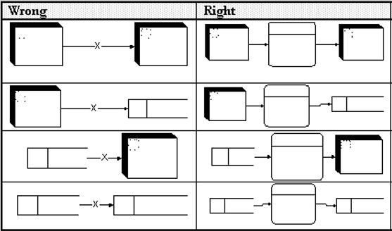

Slide 7
Diagramming Mistakes
A processing step may have input flows but no output flows. This situation is sometimes called a black hole.
A processing step may have output flows but now input flows. This situation is sometimes called a miracle.
A processing step may have outputs that are greater than the sum of its inputs - e.g., its inputs could not produce the output shown. This situation is sometimes referred to as a grey hole.

Slide 8
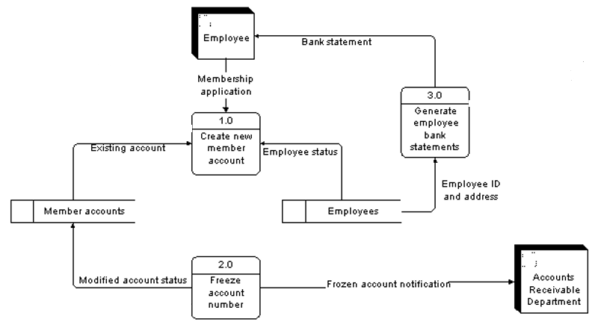

Slide 9
Processing steps that do not change data:
DFD’s are NOT flow charts:
A last class of DFD mistakes are somewhat more difficult to identify. Flow chart diagrams can be useful for describing programming logic or understanding a single sequence of process activities. It is important to recognize, however, that DFDs are not flow charts. Flow charts often show both processing steps and data "transfer" steps (e.g., steps that do not "process" data);

Slide 10
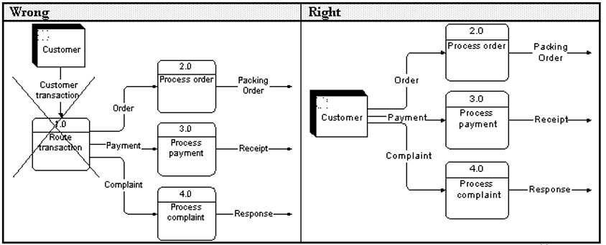

Slide 11
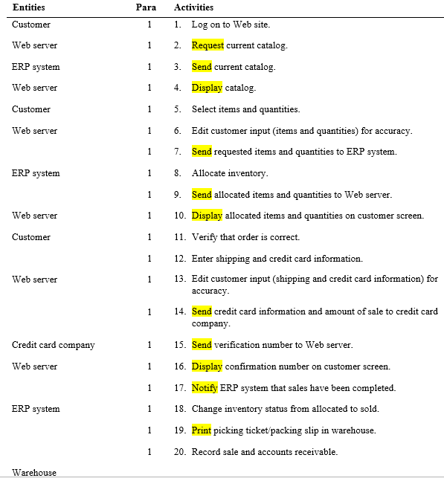

Slide 12
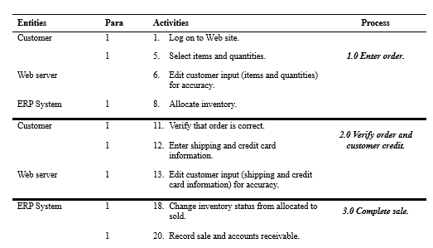

Slide 13
Processing Activities?
Display
Print
Endorse a cheque
Write
Log events

Slide 14
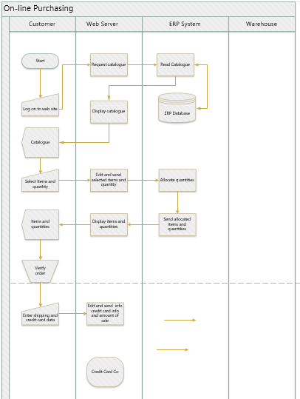

Slide 15
Preparation for test
Know and Understand the notes:
Chapter 2 DFD
Mistakes with DFD

