Slide 1
How to write a research paper
https://www.aresearchguide.com/1steps.html

Slide 2
Why?
The need for students to be able to WRITE well, so that they can
  PRESENT their ideas in a logical READABLE form
I cannot stress enough the importance of a logical development of ideas

Slide 3
Outcome
Success in your career will depend greatly on your written and oral communication skills.
We recognize the need for students to develop proficiency in these skills, and requires all students to submit a research paper and provide an oral presentation of the research paper.

Slide 4
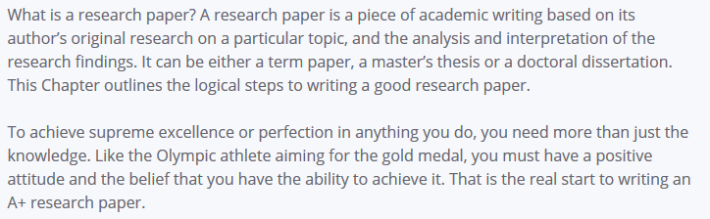

Slide 5
Our Expectations:
Is NOT a research paper/academic essay:
  We decided on an essay (glorified)…but more!
  It’s like we report on latest developments
  How AI influences/supports our jobs as educators?
Is it an interesting topic?
  How did you develop it?
  The different citations to support your topic.
  I want to READ it/it must excite me!
  Did I/We learn something?

Slide 6
Research
The gap between WHAT you know, and do NOT know, is filled with research!
We are REPORTING!

Slide 7
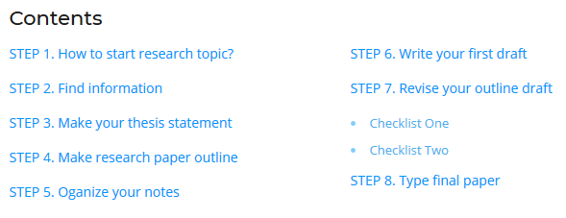

Slide 8

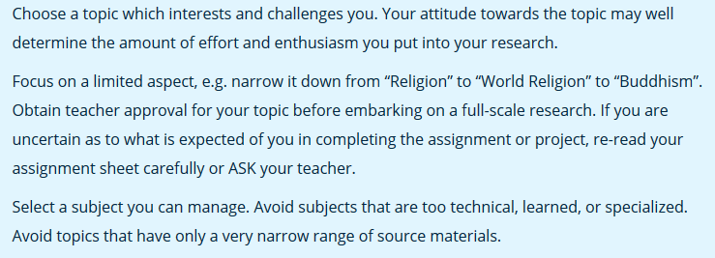

Slide 9
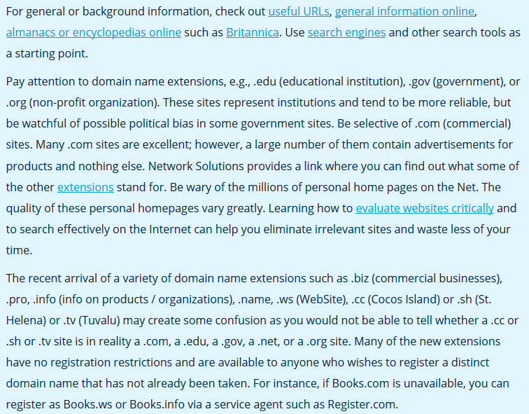
FIND INFORMATION: Surf the NET

Slide 10
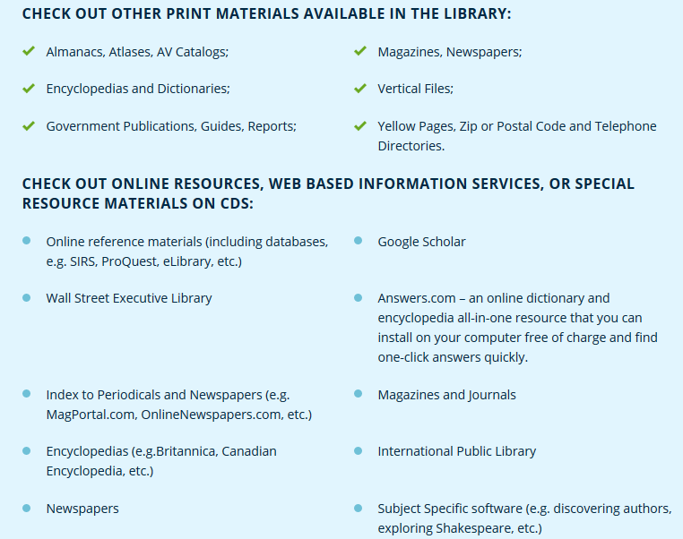

Slide 11
For Us:
Websites
Magazines
Journals
Books
Discuss later

Slide 12
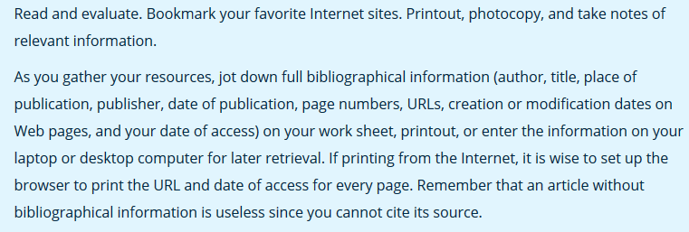

Slide 13
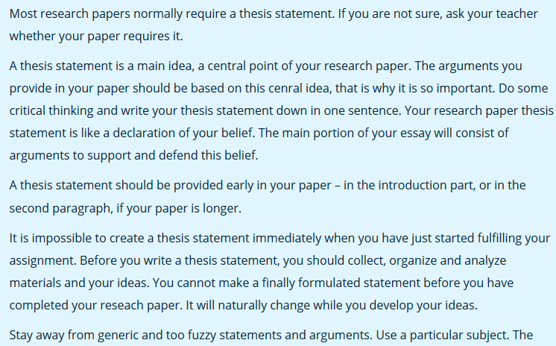
Your topic: make your thesis statement.

Slide 14
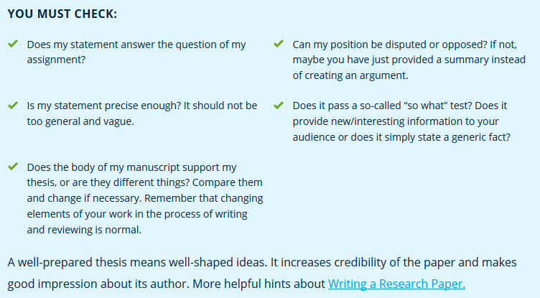

Slide 15
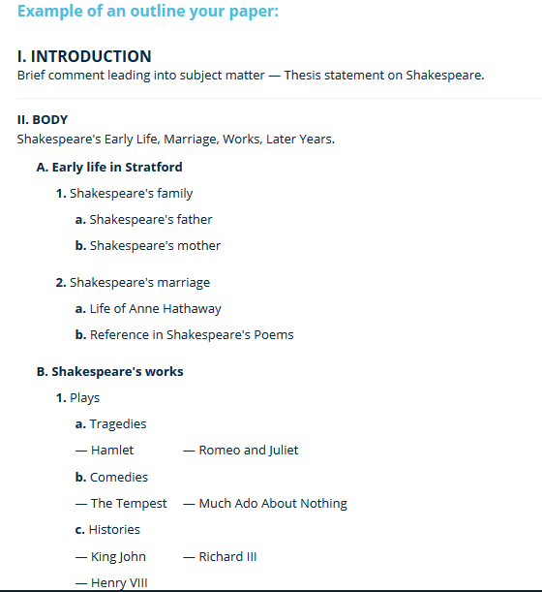

Slide 16
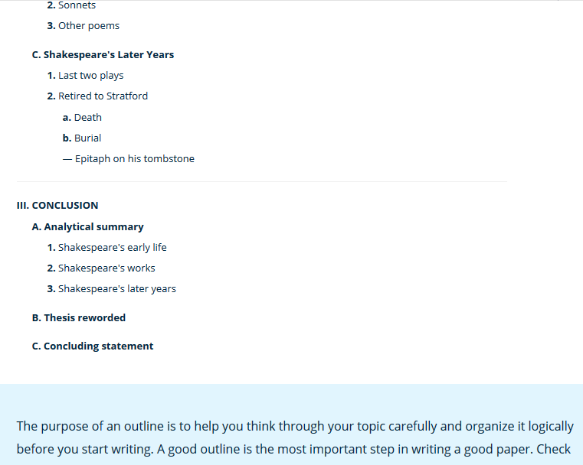

Slide 17
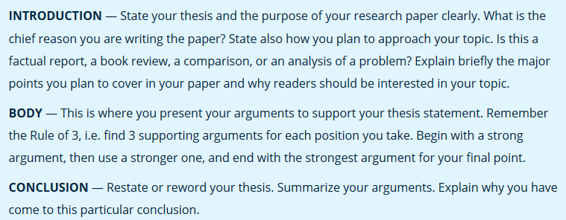

Slide 18
Add more:
The introduction also includes a ‘Background’ information
Abstract:
  A summary, telling the reader in a nutshell, what is covered in the topic.
I will have an example later.
To check your grammar:
  Grammarchecker on the net

Slide 19
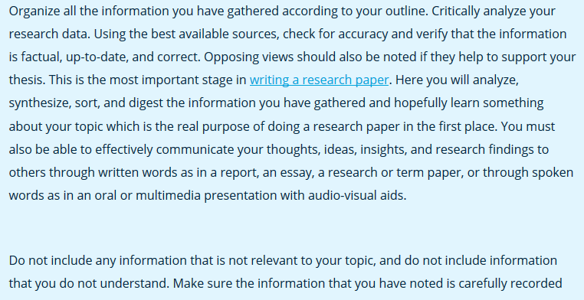
Organize your ideas

Slide 20
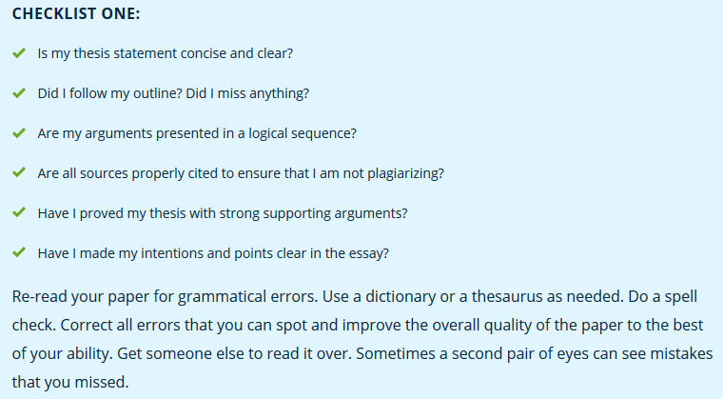

Slide 21
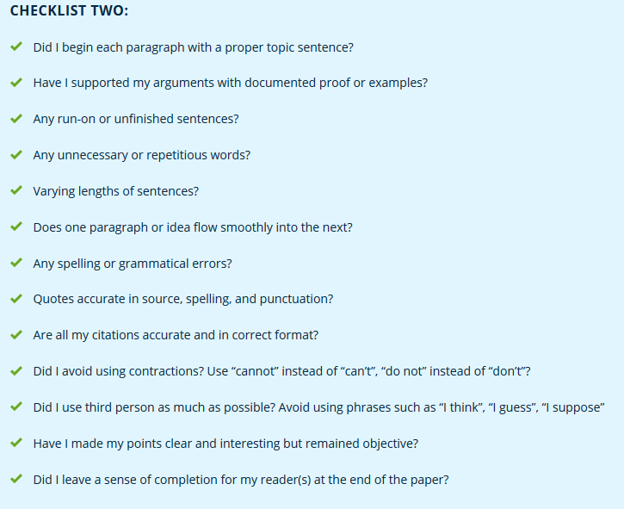

Slide 22
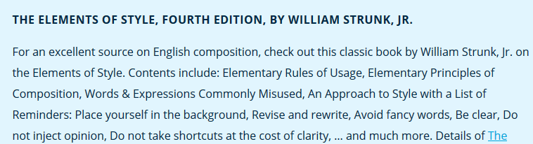
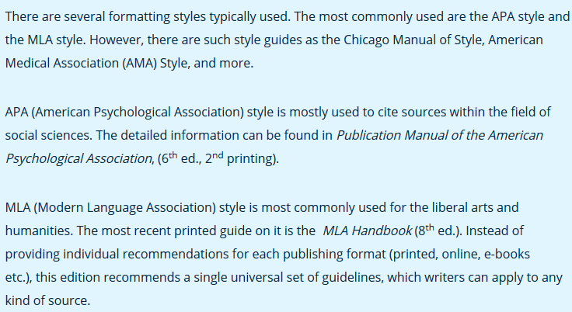

Slide 23
Way forward
I am sure you already did a lot of work!
Let’s put it into a ‘workable’ presentation:
First Draft
  Develop a Outlay/ like an Index
  Print it!
  Let us discuss it
Final Draft
  Now write the essay in MLA style
Prepare presentation in PowerPoint.

Slide 24
First Draft:
Topic Name
Contents:
  I. Introduction: Brief comment leading into the subject matter/topic
  II. Body: introductory note to the body (A and B)
    A….
      1…
        1.1…
      2
    B…….

Slide 25
Still the ‘First Draft’
Contents:
  III. Conclusion: reflect now back onto the ‘body’ of the essay
    A. Analytical summary
      1….see A in body of essay
      2…..see B in body of essay
    B. Thesis reworded
    C. Concluding statement

Slide 26
Mark Distribution/Grading
3 to….not more than 4 pages, as defined in MLA
Title Pages, Tables of Content, figures, pictures, graphs, and references will not be counted as text. Title Page is required. Table of Contents is not required; an Abstract is required.

Slide 27
References: Let’s say 10 Marks
Source Weight
Websites: 2 Marks
Books: 4
Journals: 6
Magazines: 2

Slide 28
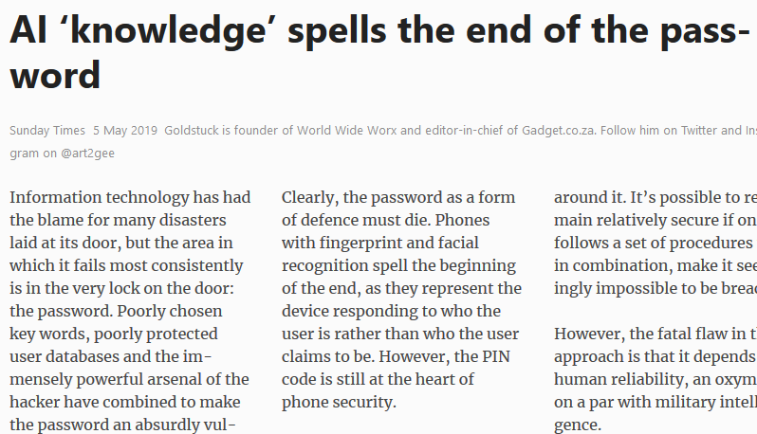

Slide 29
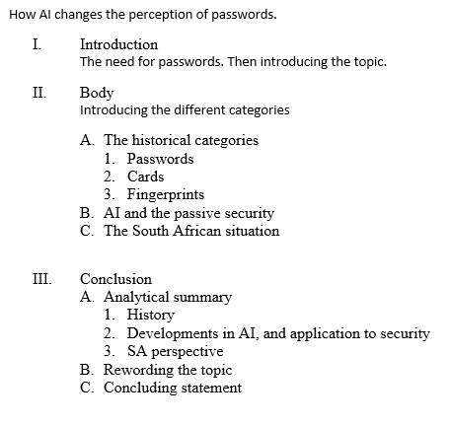

Slide 30
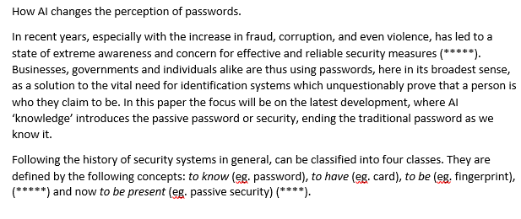

Slide 31
Abstract
In recent years, security systems have proliferated as the necessity to restrict access to those entitled to use particular facilities, has become a reality of modern living. ….
Is passive security the future for personal identification? establishes the advantages and difficulties with both current security …
Passive security although still in its infancy, has already transformed from the experimental stages to numerous….

Slide 32
Conclusion
Students must approach ‘academic’ writing in a disciplined, orderly way
The collection of material must start as soon as possible (you have the topic!!)
The essay must be built into a framework and the writing must be done using accepted standards of style and presentation!!
ENJOY!!!!!!!!

