Slide 1
Introduction to:
Project Management SW
Chapter 9

Slide 2
Rule of time!
Albert Einstein said, “The only reason for time is so that everything doesn’t happen at once.”
The people who work on your project can’t do everything at once, so you have to obey the rules of time and put tasks into a sequence.

Slide 3
Outcomes:
To create a WBS
Create summary tasks
Tasks:
  Number tasks
  Set calendar > start date
  Task durations
  Task dependencies: SS,SF,FS,FF; examples

Slide 4
Outcomes:
Insert milestones
Resource allocation
Total duration and costs
Gant → Pert/Network chart
Determine the critical path
Copying to other applications

Slide 5
Outcomes
Explore Reports
To understand the concepts:
  5 process groups:
  Slide 6; Tut 01
Look into future:
    Project Portfolio Management

Slide 6
Steps
Create a WBS
OPEN blank project
Project > Project Information
  Choose calendar
  Set start date
Enter tasks

Slide 7
Steps
Create Summary tasks
Insert lower level tasks
Number tasks:
  Format > Check: “Outline Number”
Calendars: Mon-Fri; 8h00 – 17h00; lunch 12h00 – 13h00
  You can even have night shifts!

Slide 8
Steps
Task durations:
  Choose Automatic
  Duration units
Task dependencies
  Link Task button
  Predecessor column of Entry table
  Predecessor tab in Task Info
  Drag the Gant Chart symbols

Slide 9
Steps
View tab > check “Details”
  Task Forms > Right click
My way:
  Double click the “successor” task
  Click “predecessor” tab
  Select the task from the Task Name drop-down list

Slide 10
Cost and resource management:
Resource sheet view
  View tab
  Complete sheet
Assign resources
Cost and duration:
  Project > Information Detail > Stats

Slide 11
Project
Select the Network Diagram
Identify the critical path
Click “Report”
Excel → PM
Click in Timeline
  Copy
  Paste in PowerPoint

Slide 12
Project Portfolio Management
Robert Butrick: author of ‘The Project Workout”, mentioned the following two extra points for project success:
  Projects must be driven by business strategy
  Engage your stakeholders

Slide 13
Intro:
PM must also support an emerging business strategy of PPM:
  Organizations group and manage projects and programs as a portfolio of investments that contribute to the entire enterprise’s success.
  PPM: To make wise investment decisions by helping to select and analyse projects from a strategic perspective

Slide 14
Why?
About one quarter of the world’s gross domestic product is spent on projects
  Projects make up a significant portion of work in most business organizations or enterprises, and managing those projects successfully is crucial to enterprise success.
  What is meant by GDP?

Slide 15
PPM:
PPM addresses strategically goals that emphasizes long term goals:
  Are we working on the right project?
  Are we investing in the right areas?
  Do we have the right resources to be competitive?

Slide 16
PM:
Projects address tactical goals that are more specific and short-term:
  Are we carrying out projects well?
  Are projects on time and on budget?
  Do project stakeholders know what they should be doing?

Slide 17
Possible q:
Describe the main differences between PPM and PM?
“PPM is the continuous process of selecting and managing the optimum set of project initiatives that deliver maximum business value”

Slide 18
Three spheres for Systems Management
This deals with the business, organizational, and technological aspects and/or issues related to the project that should be defined and considered in order to select and manage projects effectively and successfully.

Slide 19
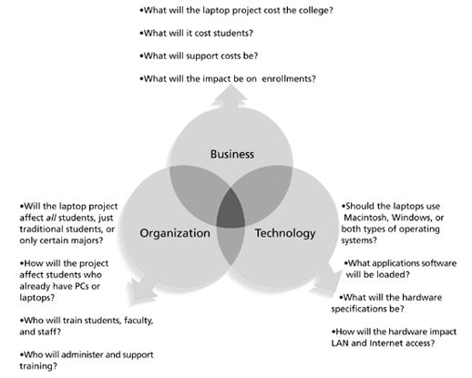

Slide 20
Check this out!
www1.pu.edu.tw/~ytwang/docs/PM/ch02.ppt

