Slide 1
Mini Project
Page 447

Slide 2
Intro:
1. What is the difference between an information system and a computer application?
2. What is the purpose of systems analysis? Why is it important?
3. What is the difference between systems analysis and systems design?
4. What is a project?
5. What are the six core processes for software systems development?
6. What is meant by Agile Development?
7. What is the purpose of a System Vision Document?

Slide 3
Intro:
8. What is the difference between a system and a subsystem?
9. What is the purpose of a Work Breakdown Structure?
10. What are the components of a Work Breakdown Structure? What does it show?
11. What information is provided by use cases or a use case diagram?
12. What information is provided by a class diagram?
13. How do a use case diagram and a class diagram drive the system development process?
14. What is another way to describe an activity diagram? What does it show?

Slide 4
Intro:
15. How does an activity diagram help in user-interface design?
16. What is the purpose of architectural design?
17. What new information is provided in a design class diagram (more than a class diagram)?
18. Why is it a good practice to divide a project into separate iterations?
19. What should be the objective or result of an iteration?

Slide 5
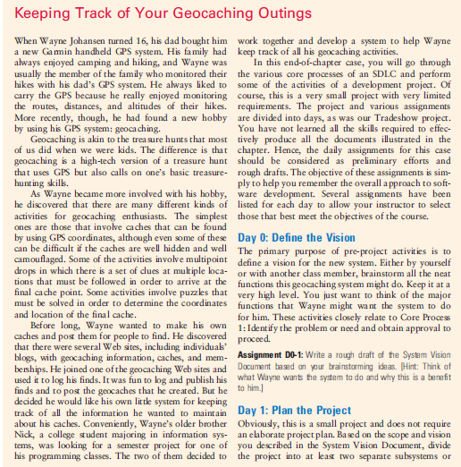

Slide 6
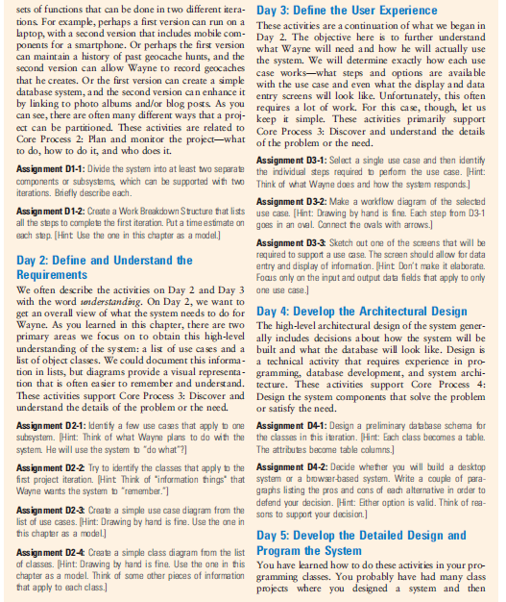

Slide 7
Assignment D0-1: System Vision Document
Brainstorm all the functions this geocaching system might do
Keep it at a very high level
You must think of the major functions that Wayne might want the system to do for him
Core process 1

Slide 8
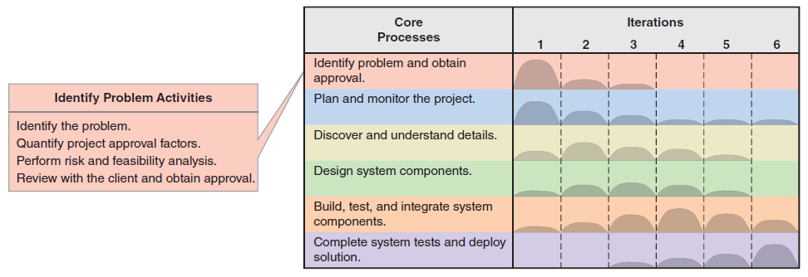

Slide 9
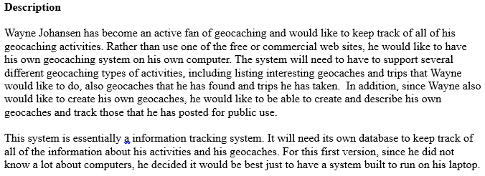

Slide 10
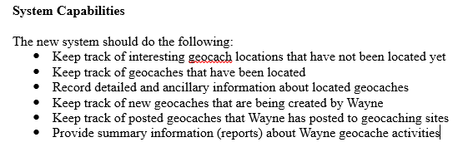

Slide 11
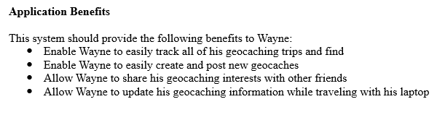

Slide 12
Plan the project
Assignment D1-1:
Divide the system into at least two separate components or subsystems, which can be supported with two
iterations.
Briefly describe each.
Assignment D1-2:
Create a Work Breakdown Structure that lists all the steps to complete the first iteration.
Put a time estimate on each step.

Slide 13
Possible answers:
For example:
  perhaps a first version can run on a laptop, with a second version that includes mobile components for a smartphone.
Or perhaps (functionality)
  the first version can maintain a history of past geocache hunts,
  and the second version can allow Wayne to record geocaches that he creates.
Or the first version
  can create a simple database system, and the second version
  can enhance it by linking to photo albums and/or blog posts

Slide 14
Answer
Divide the system by functionality:
Iteration one will be to capture information about geocaches that Wayne has completed.
Iteration two will be to allow Wayne to create and post his own geocaching information.

Slide 15
Assignment D1-2: Work Breakdown Structure
What to do, how to do it, and who does it.

Slide 16
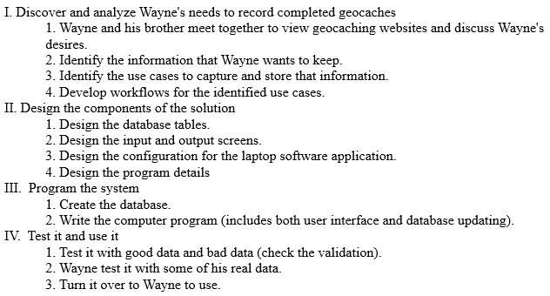

Slide 17
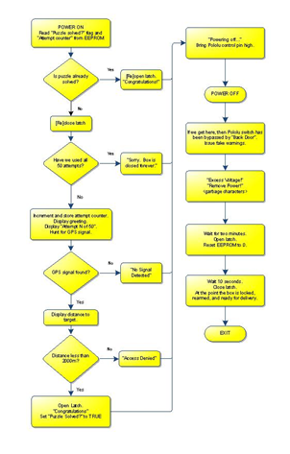

Slide 18
Define and Understand the
Requirements
We want to get an overall view of what the system needs to do.
We identify two primary areas we focus on to obtain this high-level understanding of the system:
  a list of use cases and a list of object classes.
We could document this information in lists, but diagrams provide a visual representation that is often easier to remember and understand.
These activities support Core Process 3: Discover and understand the details of the problem or the need.

Slide 19
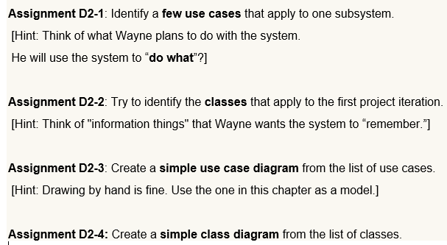

Slide 20
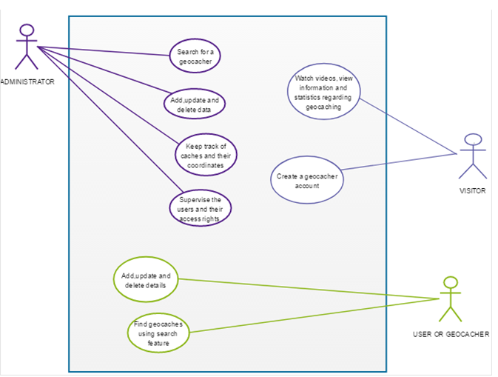

Slide 21
The actors
Administrator – he is having full access to all the systems of the Geocaching. The administrator can search for the geocaches, add, delete and update the information entered in the system, they can keep caches track and also their associated coordinates and also they can supervise the users that are using Geocaching.
User – User has rights to search the geocaches with the help of the feature of search and they can add, delete and update the information that is related to the user in the system.
Visitor – They can only create the login account in the Geocaching system and they can view videos, information and other stuff that are related to the system of Geocaching.

Slide 22
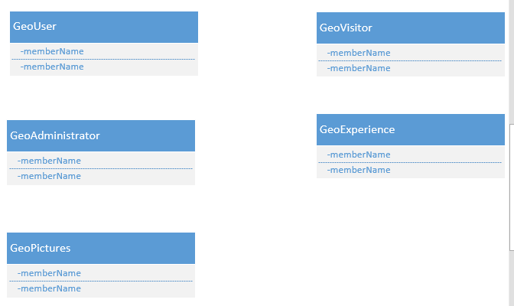

Slide 23
Next steps:
Assignment D3-1: Steps for use case
Use Case: Enter geocache of interest info
Steps:
  Enter basic geocache information from source information
  Review information
  Enter reason for interest in comments
Assignment D3-2: Workflow diagram for a Use Case
Assignment D3-3: Screen Layout for a Use Case

Slide 24
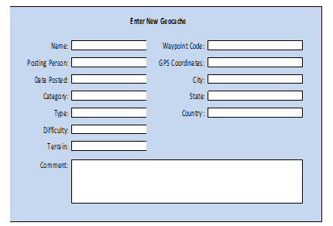

Slide 25
Database Schema

Slide 26
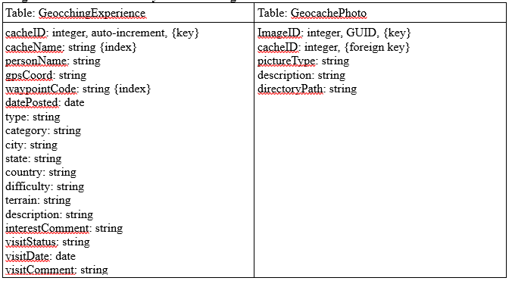

Slide 27
What about:
SSD → Activity diagrams
SD
State machine
Architectural design

Slide 28
