Slide 1
Chapter 4
The Revenue Cycle
COPYRIGHT © 2009 South-Western, a division of Cengage Learning. Cengage Learning and South-Western are trademarks used herein under license

Slide 2
Objectives for Chapter 4
Tasks performed in the revenue cycle, regardless of the technology used
Functional departments in the revenue cycle and the flow of revenue transactions through the organization
Documents, journals, and accounts needed for audit trails, records, decision making, and financial reporting
Risks associated with the revenue cycle and the controls that reduce these risks
The operational and control implications of technology used to automate and reengineer the revenue cycle
Notes:
3

Slide 3
Organization of Chapter 4
The conceptual revenue cycle
The physical revenue cycle
  Basic technology system
  Advanced technology system
  Point-of-sale systems
    Address functionality, efficiency issues, work flow characteristics and Internal control issues in each system at different points on the technology/human continuum

Slide 4
Conceptual Revenue Cycle
Sales order processing
Sales return procedures
Cash receipts processes

Slide 5
Sales Order Processing
Receive Order
Check Credit
Pick Goods
Ship Goods
Bill Customer
Update Inventory Records
Update Accounts Receivable
Post to General Ledger

Slide 6
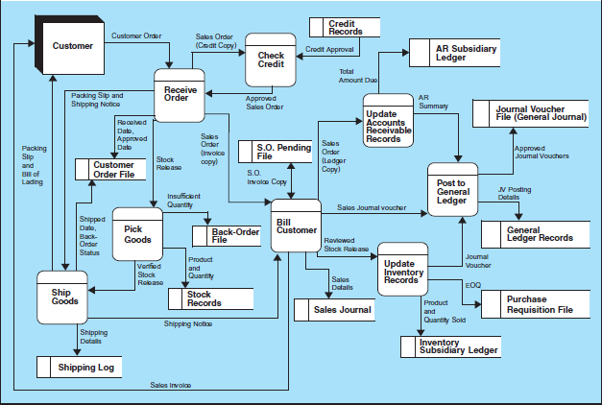
DFD of Sales Order Processing System
Figure 4-1

Slide 7
Sales Return Procedures
Prepare Return Slip
Prepare Credit Memo
Approve Credit Memo
Update Sales Journal
Update Inventory and AR Records
Update General Ledger

Slide 8
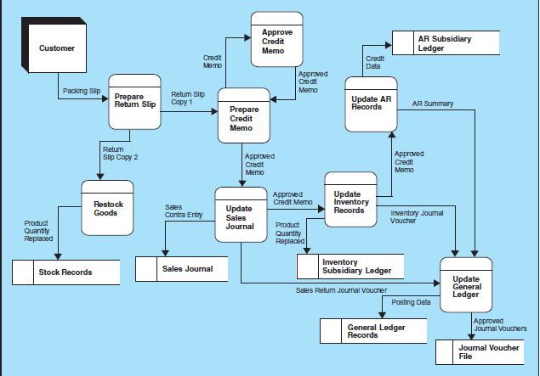
DFD of Sales Return Procedures
Figure 4-7

Slide 9
Cash Receipts Procedures
Open Mail and Prepare Remittance Advice
Record and Deposit Checks
Update Accounts Receivable
Update General Ledger
Reconcile Cash Receipts and Deposits

Slide 10
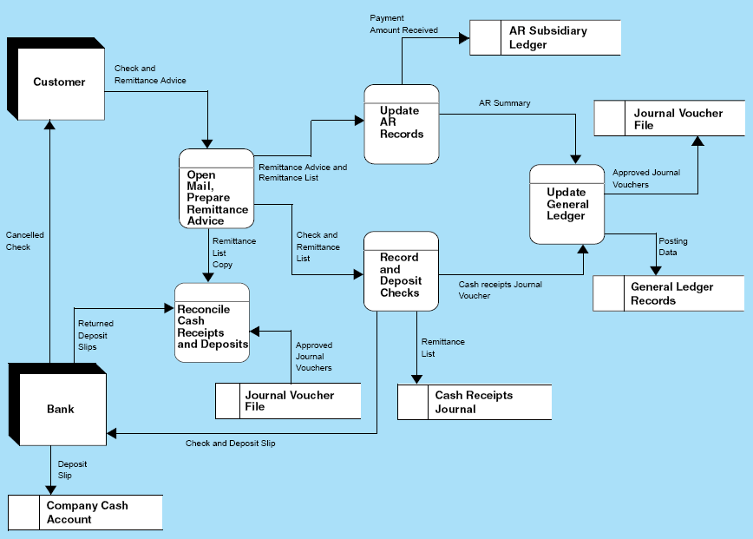
DFD of Cash Receipts Procedure
Figure 4-9

Slide 11
Physical Revenue Systems
Physical accounting information systems combine technology and human activity.
  As a general rule, smaller businesses tend to rely less on technology and more on manual procedures, whereas larger companies tend to employ advanced technologies.
The nature of the technology/human mix employed in a particular system has a direct bearing on the nature of internal controls needed to control the system.

Slide 12
Basic Technology Revenue Cycle
Computers tend to be independent PCs.
Information between departments is communicated via hard-copy documents.
Maintaining physical files of source documents is critical to the audit trail.
In the following flowcharts notice that in many departments, after an individual completes his or her assigned task, documents are filed as evidence that the task was performed.

Slide 13
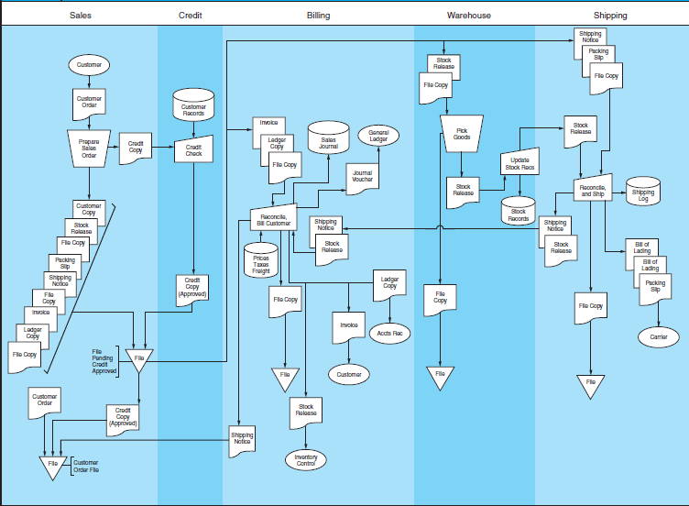
Basic Tech Order Processing System
Figure 4-12

Slide 14
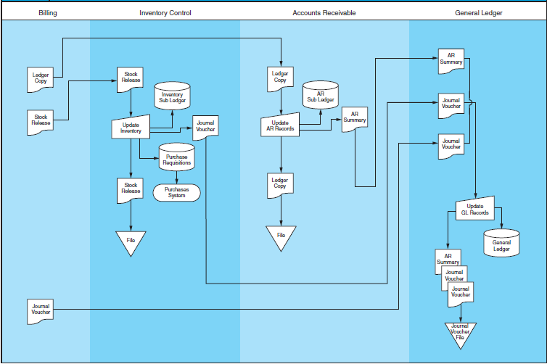
Basic Tech Order Processing System (cont.)
Figure 4-12

Slide 15
Sales Order Processing
Begins with a customer placing an order
  The sales department captures the essential details on a sales order form.
The transaction is authorized by obtaining credit approval by the credit department.
Sales information is released to:
  Billing
  Warehouse (stock release or picking ticket)
  Shipping (packing slip and shipping notice)
Notes:
3

Slide 16
Sales Order Processing
The merchandise is picked from the Warehouse and sent to Shipping.
  Stock records are adjusted.
The merchandise, packing slip, and bill of lading are prepared by Shipping and sent to the customer.
  Shipping reconciles the merchandise received from the Warehouse with the sales information on the packing slip.
Shipping information is sent to Billing. Billing compiles and reconciles the relevant facts and issues an invoice to the customer and updates the sales journal. Information is transferred to:
  Accounts Receivable (A/R)
  Inventory Control
Notes:
4

Slide 17
Sales Order Processing
A/R records the information in the customer’s account in the accounts receivable subsidiary ledger.
Inventory Control adjusts the inventory subsidiary ledger.
Billing, A/R, and Inventory Control submits summary information to the General Ledger dept., which then reconciles this data and posts to the control accounts in the G/L.
Notes:
5

Slide 18
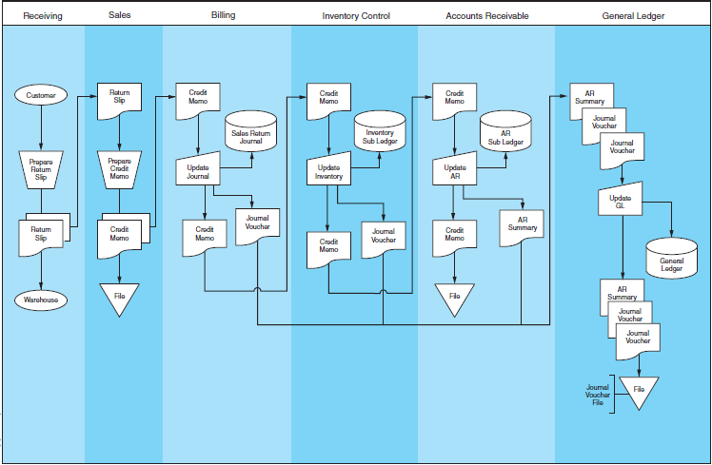
Basic Tech Sales Returns System
Figure 4-14

Slide 19
Cash Receipts Processes
Customer checks and remittance advices are received in the Mail Room.
  A mail room clerk prepares a cash prelist and sends the prelist and the checks to Cash Receipts.
  The cash prelist is also sent to A/R and the Controller.
Cash Receipts:
  verifies the accuracy and completeness of the checks
  updates the cash receipts journal
  prepares a deposit slip
  prepares a journal voucher to send to G/L
Notes:
10

Slide 20
Cash Receipts Processes
A/R posts from the remittance advices to the accounts receivable subsidiary ledger.
  Periodically, a summary of the postings is sent to G/L.
G/L department:
  reconciles the journal voucher from Cash Receipts with the summaries from A/R
  updates the general ledger control accounts
The Controller reconciles the bank accounts.
Notes:
11

Slide 21
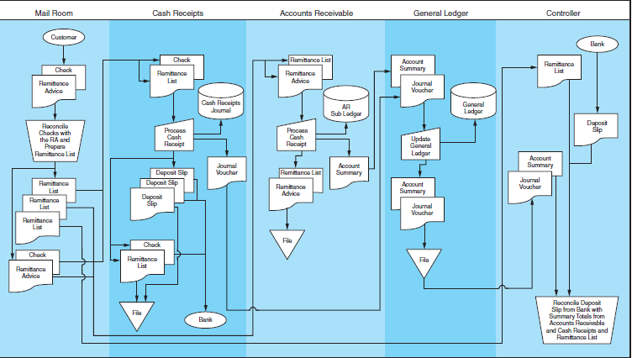
Flowchart of Cash Receipts System
Figure 4-15

Slide 22
Basic Technology: Physical Controls

Slide 23
Authorization Controls
Proper authorization of transactions (documentation) should occur so that only valid transactions get processed.
Within the revenue cycle, authorization should take place when:
  a sale is made on credit (authorization)
  a cash refund is requested (authorization)
  posting a cash payment received to a customer’s account (cash pre-list)
Notes:
13

Slide 24
Segregation of Functions
Three Rules
Transaction authorization should be separate from transaction processing.
Asset custody should be separate from asset record-keeping.
The organization should be so structured that the perpetration of a fraud requires collusion between two or more individuals.
Notes:
14

Slide 25
Segregation of Functions
Sales Order Processing
  credit authorization separate from SO processing
  inventory control separate from warehouse
  accounts receivable sub-ledger separate from general ledger control account
Cash Receipts Processing
  cash receipts separate from accounting records
  accounts receivable sub-ledger separate from general ledger
Notes:
15

Slide 26
Supervision
Often used when unable to enact appropriate segregation of duties.
Supervision of employees serves as a deterrent to dishonest acts and is particularly important in the mailroom.
Notes:
16

Slide 27
Accounting Records
With a properly maintained audit trail, it is possible to track transactions through the systems and to find where and when errors were made:
  pre-numbered source documents
  special journals
  subsidiary ledgers
  general ledger
  files
Notes:
17

Slide 28
Access Controls
Access to assets and information (accounting records) should be limited.
Within the revenue cycle, the assets to protect are cash and inventories and access to records such as the accounts receivable subsidiary ledger and cash journal should be restricted.
Notes:
20

Slide 29
Independent Verification
Physical procedures as well as record-keeping should be independently reviewed at various points in the system to check for accuracy and completeness:
  shipping verifies the goods sent from the warehouse are correct in type and quantity
  warehouse reconciles the stock release document (picking slip) and packing slip
  billing reconciles the shipping notice with the sales invoice
  general ledger reconciles journal vouchers from billing, inventory control, cash receipts, and accounts receivable
Notes:
19

Slide 30
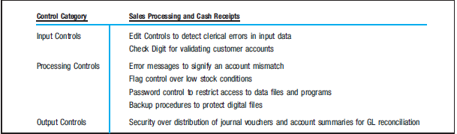
Basic Technology: IT Controls

Slide 31
Input Controls
Input controls focus on the quality of transaction data being entered into the application. The following controls minimize risk:
Controls, including checks for missing data, numeric-alphabetic data, and valid data values, reduce the risk of undetected data entry errors.
Check digits reduce the risk of entering wrong account numbers.

Slide 32
Processing Controls
Processing controls focus on the logic of the application. Revenue cycle examples:
Error messages
Low stock flag
Passwords
File backup

Slide 33
Output Controls
Output controls reduce the rick documents will be misdirected or lost in transit. Revenue cycle examples:
Email of digital copies to secure mail boxes.
Documents physically collected by authorized personnel or a security officer.

Slide 34
Advanced Tech. Revenue Cycle
Integration of accounting and other business functions.
Improved operational performance and reduce costs by eliminating non-value-added tasks.
Advanced technologies significantly alter and simply the revenue cycle.

Slide 35
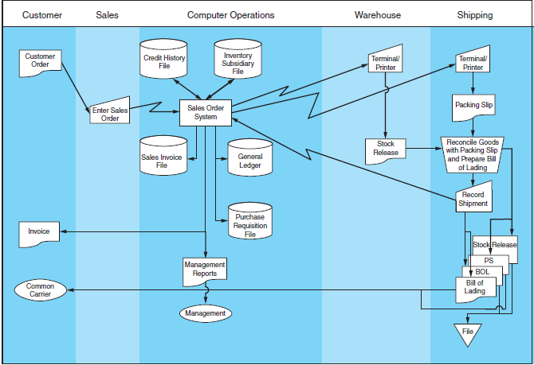
Integrated Sales Order System
Figure 4-16

Slide 36
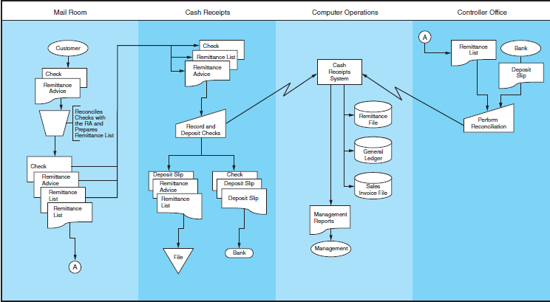
Integrated Cash Receipts System

Slide 37
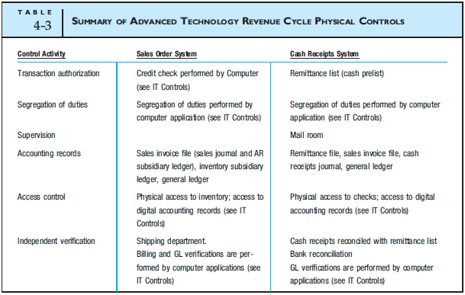
Advanced Technology: Physical Controls

Slide 38
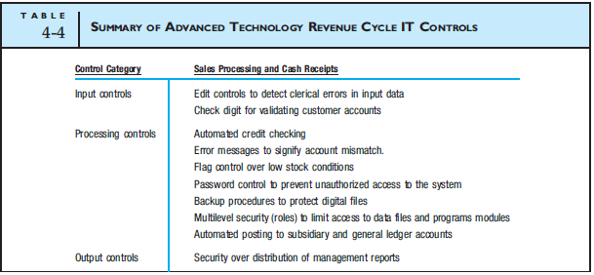
Advanced Technology: IT Controls

Slide 39
Advanced Technology
Revenue Cycle Controls
The previous tables summarize controls, many of which were discussed with the basic technology system. Three additional IT control techniques are specific to the advanced technology system.
Automated Credit Checking
Multilevel Security
Automated Posting

Slide 40
Automated Credit Checking
The system logic (not a human) grants/denies credit based on the customer’s credit history contained in the credit history file.
However, to allow for operational flexibility in unusual circumstances, the system provides a management override option that may only be performed by a supervisor.
Management overrides should be fully documented in the credit history record and in management reports.

Slide 41
Multilevel Security
In the advanced technology system, segregation of duties is accomplished through multilevel security procedures.
Multilevel security employs programmed techniques that permit simultaneous access to a central system by many users with different access privileges but prevents them from obtaining information for which they lack authorization.

Slide 42
Multilevel Security Methods
Access control list (ACL) assigns privileges, such as the right to perform computer program procedures and access data files,directly to the individual.
Role based access control (RBAC) involves creating standard tasks (e.g., cash receipts processing) called roles and assigning roles access privileges to specific data and procedures.

Slide 43
Automated Posting
All record keeping functions are automated.
A computer application decides which accounts to update and by how much.
The elimination of the human element from such accounting activities reduces the potential for errors and the opportunity for fraud.
Automation also greatly improves efficiency of operations.

Slide 44
Point-of-Sale Systems
Point of sale systems are used extensively in retail establishments.
  Customers pick the inventory from the shelves and take them to a cashier.
The clerk scans the universal product code (UPC). The POS system is connected to an inventory file, where the price and description are retrieved.
  The inventory levels are updated and reorder needs can immediately be detected.
Notes:
31

Slide 45
Point-of-Sale Systems
The system computes the amount due. Payment is either cash, check, ATM or credit card in most cases.
  No accounts receivables
If checks, ATM or credit cards are used, an on-line link to receive approval is necessary.
At the end of the day or a cashier’s shift, the money and receipts in the drawer are reconciled to the internal cash register tape or a printout from the computer’s database.
  Cash over and under must be recorded
Notes:
32

Slide 46
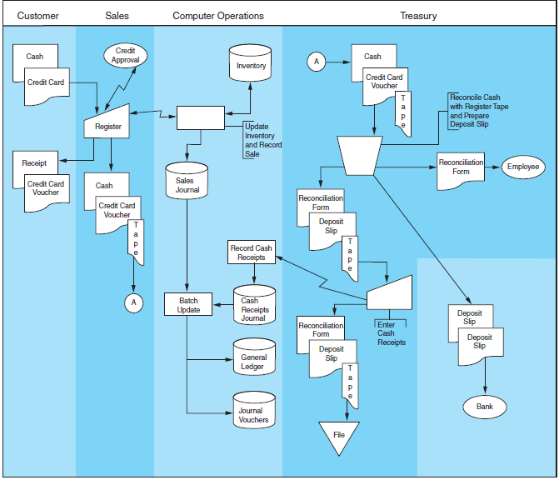
Point-of-Sale System
Figure 4-18

Slide 47
Reengineering Using EDI
EDI helps to expedite transactions.
The customer’s computer:
  determines that inventory is needed
  selects a supplier with whom the business has a formal business agreement
  dials the supplier’s computer and places the order
The exchange is completely automated.
  No human intervention or management
Notes:
35

Slide 48
Reengineering Using the Internet
Typically, no formal business agreements exist as they do in EDI.
Most orders are made with credit cards.
Mainly done with e-mail systems, and thus a turnaround time is necessary
  Intelligent agents are needed to eliminate this time lag.
Security and control over data is a concern with Internet transactions.
Notes:
36

