Slide 1
Chapter 3
Ethics, Fraud, and Internal Control

Slide 2
Objectives for Chapter 3
Broad issues pertaining to business ethics
Ethical issues related to the use of information technology
Distinguish between management fraud and employee fraud
Common types of fraud schemes
Key features of SAS 78 / COSO internal control framework
Objects and application of physical controls
Notes:
3

Slide 3
Business Ethics
Why should we be concerned about ethics in the business world?
Ethics are needed when conflicts arise—the need to choose
In business, conflicts may arise between:
  employees
  management
  stakeholders
Litigation
Notes:
8

Slide 4
Business Ethics
Business ethics involves finding the answers to two questions:
How do managers decide on what is right in conducting their business?
Once managers have recognized what is right, how do they achieve it?

Slide 5
Four Main Areas of Business Ethics
Notes:
8

Slide 6
Computer Ethics…
concerns the social impact of computer technology (hardware, software, and telecommunications).
What are the main computer ethics issues?
  Privacy
  Security—accuracy and confidentiality
  Ownership of property
  Equity in access
  Environmental issues
  Artificial intelligence
  Unemployment and displacement
  Misuse of computer
Notes:
8

Slide 7
Legal Definition of Fraud
False representation - false statement or disclosure
Material fact - a fact must be substantial in inducing someone to act
Intent to deceive must exist
The misrepresentation must have resulted in justifiable reliance upon information, which caused someone to act
The misrepresentation must have caused injury or loss
Notes:
9

Slide 8
Figure 3-1 Fraud Triangle
Pressure
Opportunity
No Fraud
Pressure
Opportunity
Ethics
Fraud
Ethics

Slide 9
2008 ACFE Study of Fraud
Loss due to fraud equal to 7% of revenues—approximately $994 billion
Loss by position within the company:
Other results: higher losses due to men, employees acting in collusion, and employees with advance degrees
Position | % of Frauds | Loss $
Owner/Executive | 23% | $834,000
Manager | 37% | 150,000
Employee | 40% | 70,000
Notes:
16

Slide 10
Enron, WorldCom, Adelphia
Underlying Problems
Lack of Auditor Independence: auditing firms also engaged by their clients to perform nonaccounting activities
Lack of Director Independence: directors who also serve on the boards of other companies, have a business trading relationship, have a financial relationship as stockholders or have received personal loans, or have an operational relationship as employees
Questionable Executive Compensation Schemes: short-term stock options as compensation result in short-term strategies aimed at driving up stock prices at the expense of the firm’s long-term health
Inappropriate Accounting Practices: a characteristic common to many financial statement fraud schemes
  Enron made elaborate use of special purpose entities.
  WorldCom transferred transmission line costs from current expense accounts to capital accounts.

Slide 11
Sarbanes-Oxley Act of 2002
Its principal reforms pertain to:
  Creation of the Public Company Accounting Oversight Board (PCAOB)
  Auditor independence—more separation between a firm’s attestation and non-auditing activities
  Corporate governance and responsibility—audit committee members must be independent and the audit committee must oversee the external auditors
  Disclosure requirements—increase issuer and management disclosure
  New federal crimes for the destruction of or tampering with documents, securities fraud, and actions against whistleblowers

Slide 12
Employee Fraud
Committed by non-management personnel
Usually consists of: an employee taking cash or other assets for personal gain by circumventing a company’s system of internal controls
Notes:
10

Slide 13
Management Fraud
Perpetrated at levels of management above the one to which internal control structure relates
Frequently involves using financial statements to create an illusion that an entity is more healthy and prosperous than it actually is
Involves misappropriation of assets, it frequently is shrouded in a maze of complex business transactions
Notes:
12

Slide 14
Fraud Schemes
Three categories of fraud schemes according to the Association of Certified Fraud Examiners:
    A. fraudulent statements
    B. corruption
    C. asset misappropriation
Notes:
16

Slide 15
A. Fraudulent Statements
Misstating the financial statements to make the copy appear better than it is
Usually occurs as management fraud
May be tied to focus on short-term financial measures for success
May also be related to management bonus packages being tied to financial statements
Notes:
16

Slide 16
B. Corruption
Examples:
  bribery
  illegal gratuities
  conflicts of interest
  economic extortion
Foreign Corrupt Practice Act of 1977:
  indicative of corruption in business world
  impacted accounting by requiring accurate records and internal controls
Notes:
16

Slide 17
C. Asset Misappropriation
Most common type of fraud and often occurs as employee fraud
Examples:
  making charges to expense accounts to cover theft of asset (especially cash)
  lapping: using customer’s check from one account to cover theft from a different account
  transaction fraud: deleting, altering, or adding false transactions to steal assets
Notes:
16

Slide 18
Internal Control Objectives According to AICPA SAS
Safeguard assets of the firm
Ensure accuracy and reliability of accounting records and information
Promote efficiency of the firm’s operations
Measure compliance with management’s prescribed policies and procedures
Notes:
28

Slide 19
Modifying Assumptions to the Internal Control Objectives
Management Responsibility
The establishment and maintenance of a system of internal control is the responsibility of management.
Reasonable Assurance
The cost of achieving the objectives of internal control should not outweigh its benefits.
Methods of Data Processing
The techniques of achieving the objectives will vary with different types of technology.
Notes:
29

Slide 20
Limitations of Internal Controls
Possibility of honest errors
Circumvention via collusion
Management override
Changing conditions--especially in companies with high growth
Notes:
30

Slide 21
Exposures of Weak Internal Controls (Risk)
Destruction of an asset
Theft of an asset
Corruption of information
Disruption of the information system
Notes:
31

Slide 22
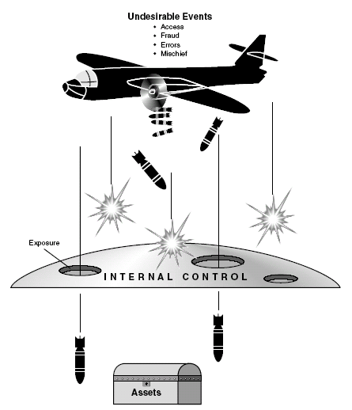
The Internal Controls Shield

Slide 23
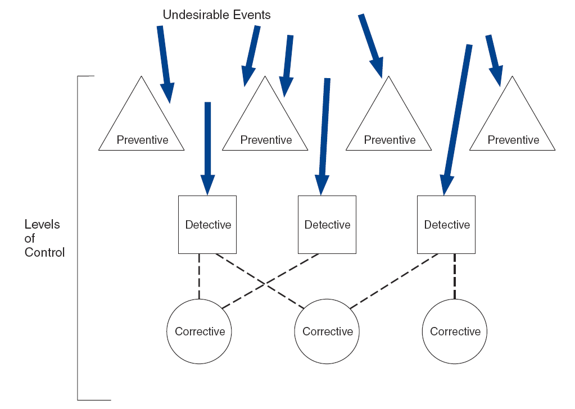
Preventive, Detective, and Corrective Controls
Figure 3-3

Slide 24
SAS 109 / COSO
Describes the relationship between the firm’s…
internal control structure,
auditor’s assessment of risk, and
the planning of audit procedures
How do these three interrelate?
The weaker the internal control structure, the higher the assessed level of risk; the higher the risk, the more auditor procedures applied in the audit.
Notes:
35

Slide 25
Five Internal Control Components: SAS 109 / COSO
1. Control environment
2. Risk assessment
3. Information and communication
4. Monitoring
5. Control activities
Notes:
36

Slide 26
1: The Control Environment
Integrity and ethics of management
Organizational structure
Role of the board of directors and the audit committee
Management’s policies and philosophy
Delegation of responsibility and authority
Performance evaluation measures
External influences—regulatory agencies
Policies and practices managing human resources
Notes:
37

Slide 27
2: Risk Assessment
Identify, analyze and manage risks relevant to financial reporting:
  changes in external environment
  risky foreign markets
  significant and rapid growth that strain internal controls
  new product lines
  restructuring, downsizing
  changes in accounting policies
Notes:
38

Slide 28
3: Information and Communication
The AIS should produce high quality information which:
  identifies and records all valid transactions
  provides timely information in appropriate detail to permit proper classification and financial reporting
  accurately measures the financial value of transactions
  accurately records transactions in the time period in which they occurred
Notes:
40

Slide 29
Information and Communication
Auditors must obtain sufficient knowledge of the IS to understand:
  the classes of transactions that are material
    how these transactions are initiated [input]
    the associated accounting records and accounts used in processing [input]
  the transaction processing steps involved from the initiation of a transaction to its inclusion in the financial statements [process]
  the financial reporting process used to compile financial statements, disclosures, and estimates [output]
[red shows relationship to the general AIS model]
Notes:
41

Slide 30
4: Monitoring
The process for assessing the quality of internal control design and operation
[This is feedback in the general AIS model.]
Separate procedures—test of controls by internal auditors
Ongoing monitoring:
  computer modules integrated into routine operations
  management reports which highlight trends and exceptions from normal performance
[red shows relationship to the general AIS model]
Notes:
42

Slide 31
5: Control Activities
Policies and procedures to ensure that the appropriate actions are taken in response to identified risks
Fall into two distinct categories:
  IT controls—relate specifically to the computer environment
  Physical controls—primarily pertain to human activities
Notes:
43

Slide 32
Two Types of IT Controls
General controls—pertain to the entitywide computer environment
  Examples: controls over the data center, organization databases, systems development, and program maintenance
Application controls—ensure the integrity of specific systems
  Examples: controls over sales order processing, accounts payable, and payroll applications

Slide 33
Six Types of Physical Controls
Transaction Authorization
Segregation of Duties
Supervision
Accounting Records
Access Control
Independent Verification

Slide 34
Physical Controls
Transaction Authorization
used to ensure that employees are carrying out only authorized transactions
general (everyday procedures) or specific (non-routine transactions) authorizations
Notes:
46

Slide 35
Physical Controls
Segregation of Duties
In manual systems, separation between:
  authorizing and processing a transaction
  custody and recordkeeping of the asset
  subtasks
In computerized systems, separation between:
  program coding
  program processing
  program maintenance
Notes:
44

Slide 36
Physical Controls
Supervision
a compensation for lack of segregation; some may be built into computer systems
Accounting Records
provide an audit trail
Notes:
46

Slide 37
Physical Controls
Access Controls
help to safeguard assets by restricting physical access to them
Independent Verification
reviewing batch totals or reconciling subsidiary accounts with control accounts
Notes:
47

Slide 38
Nested Control Objectives for Transactions
TRANSACTION
Control
Objective 1
Control
Objective 2
Control
Objective 3
Authorization
Processing
Authorization
Custody
Recording
Journals
Ta 1
Subsidiary
Ledgers
General
Ledger
Figure 3-4
Notes:
45

Slide 39
Physical Controls in IT Contexts
Transaction Authorization
The rules are often embedded within computer programs.
  EDI/JIT: automated re-ordering of inventory without human intervention
Notes:
48

Slide 40
Physical Controls in IT Contexts
Segregation of Duties
A computer program may perform many tasks that are deemed incompatible.
Thus the crucial need to separate program development, program operations, and program maintenance.
Notes:
50

Slide 41
Physical Controls in IT Contexts
Supervision
The ability to assess competent employees becomes more challenging due to the greater technical knowledge required.
Notes:
49

Slide 42
Physical Controls in IT Contexts
Accounting Records
ledger accounts and sometimes source documents are kept magnetically
  no audit trail is readily apparent
Notes:
50

Slide 43
Physical Controls in IT Contexts
Access Control
Data consolidation exposes the organization to computer fraud and excessive losses from disaster.
Notes:
50

Slide 44
Physical Controls in IT Contexts
Independent Verification
When tasks are performed by the computer rather than manually, the need for an independent check is not necessary.
However, the programs themselves are checked.
Notes:
50

Slide 45
Application Controls
Risks within specific applications
Can affect manual procedures (e.g., entering data) or embedded (automated) procedures
Convenient to look at in terms of:
  input stage
  processing stage
  output stage
PROCESSING
INPUT
OUTPUT
Notes:
21
21

Slide 46
Application Input Controls
Goal of input controls - valid, accurate, and complete input data
Two common causes of input errors:
  transcription errors – wrong character or value
  transposition errors – ‘right’ character or value, but in wrong place
Notes:
21
21

Slide 47
Application Input Controls
Check digits – data code is added to produce a control digit
  especially useful for transcription and transposition errors
Missing data checks – control for blanks or incorrect justifications
Numeric-alphabetic checks – verify that characters are in correct form
Notes:
22
22

Slide 48
Application Input Controls
Limit checks – identify values beyond pre-set limits
Range checks – identify values outside upper and lower bounds
Reasonableness checks – compare one field to another to see if relationship is appropriate
Validity checks – compares values to known or standard values
Notes:
23
23

Slide 49
Application Processing Controls
Programmed processes that transform input data into information for output
Three categories:
  Batch controls
  Run-to-run controls
  Audit trail controls
Notes:
30

Slide 50
Application Processing Controls
Batch controls - reconcile system output with the input originally entered into the system
Based on different types of batch totals:
  total number of records
  total dollar value
  hash totals – sum of non-financial numbers
Notes:
22
22

Slide 51
Application Processing Controls
Run-to-run controls - use batch figures to monitor the batch as it moves from one programmed procedure (run) to another
Audit trail controls - numerous logs used so that every transaction can be traced through each stage of processing from its economic source to its presentation in financial statements
Notes:
30

Slide 52
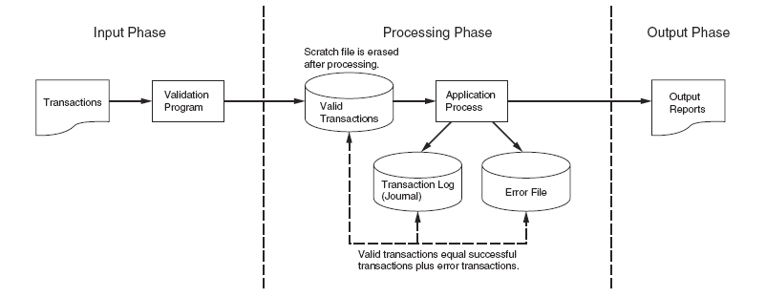
Transaction Log to Preserve
the Audit Trail
Figure 3-7

Slide 53
Master File Backup Controls
Sequential master file system
  GFS Backup Technique
Batch system using direct access files
  Destructive update approach calls for
  Separate master back up procedure
Real-time system master file backup
  Processed continuously, therefore
  Backup at pre-specified intervals through the day

Slide 54
Application Output Controls
Goal of output controls is to ensure that system output is not lost, misdirected, or corrupted, and that privacy is not violated.
In the following flowchart, there are exposures at every stage.
Notes:
33

Slide 55
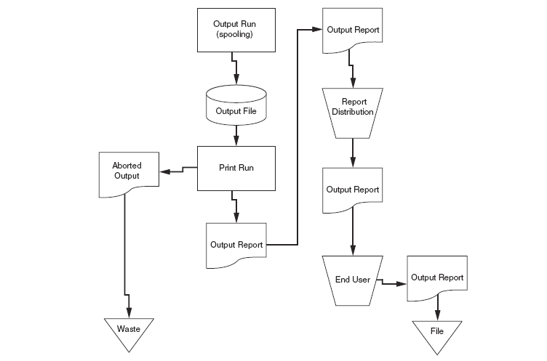
Stages in the Output Process
Figure 3-12

Slide 56
Application Controls Output
Output spooling – creates a file during the printing process that may be inappropriately accessed
Printing – create two risks:
  production of unauthorized copies of output
  employee browsing of sensitive data
Notes:
33

Slide 57
Application Controls Output
Waste – can be stolen if not properly disposed of, e.g., shredding
Report distribution – for sensitive reports, the following are available:
  use of secure mailboxes
  require the user to sign for reports in person
  deliver the reports to the user
Notes:
33

Slide 58
Application Controls Output
End user controls – end users need to inspect sensitive reports for accuracy
  shred after used
Controlling digital output – digital output message can be intercepted, disrupted, destroyed, or corrupted as it passes along communications links
Notes:
35

