Slide 1
Chapter 2
Introduction to
Transaction Processing

Slide 2
Objectives for Chapter 2
Understand the broad objectives of transaction cycles.
Recognize the types of transactions processed by each of the three transaction cycles
Know the basic accounting records used in TPS.
Understand the relationship between the traditional accounting records and their magnetic equivalents.
Be familiar with documentation techniques.
Understand the differences between batch and real-time processing and the impact of these technologies on transaction processing.
Be familiar with data coding schemes used in AIS.
Notes:
2

Slide 3
A Financial Transaction is...
an economic event that affects the assets and equities of the firm, is reflected in its accounts, and is measured in monetary terms.
similar types of transactions are grouped together into three transaction cycles:
  the expenditure cycle
  the conversion cycle
  the revenue cycle
Notes:
2

Slide 4
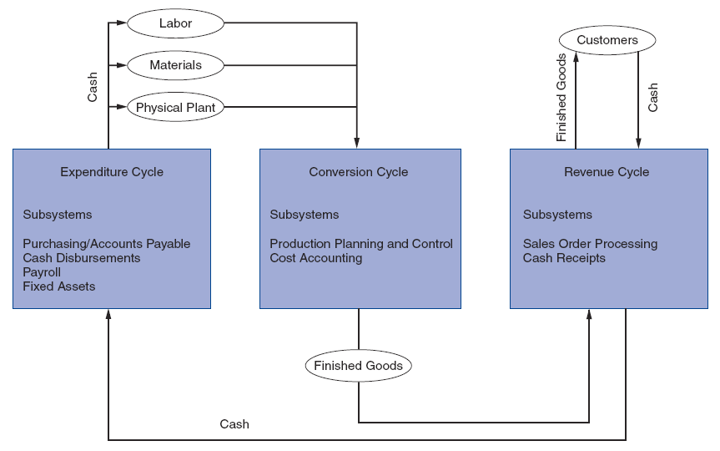
Relationship between Transaction Cycles
Figure 2-1

Slide 5
Each Cycle has Two Primary Subsystems
Expenditure Cycle: time lag between the two due to credit relations with suppliers
  physical component (acquisition of goods)
  financial component (cash disbursements to the supplier)
Conversion Cycle:
  the production system (planning, scheduling, and control of the physical product through the manufacturing process)
  the cost accounting system (monitors the flow of cost information related to production)
Revenue Cycle: time lag between the two due to credit relations with customers
  physical component (sales order processing)
  financial component (cash receipts)
Notes:
5

Slide 6
Manual System Accounting Records
Source Documents - used to capture and formalize transaction data needed for transaction processing
Product Documents - the result of transaction processing
Turnaround Documents - a product document of one system that becomes a source document for another system
Notes:
5

Slide 7
Manual System Accounting Records
Journals - a record of chronological entry
  special journals - specific classes of transactions that occur in high frequency
  general journal - nonrecurring, infrequent, and dissimilar transactions
Ledger - a book of financial accounts
  general ledger - shows activity for each account listed on the chart of accounts
  subsidiary ledger - shows activity by detail for each account type
Notes:
13

Slide 8
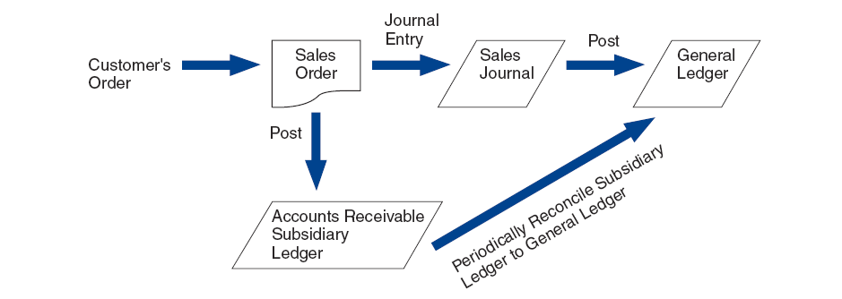
Flow of Information from Economic Event Into the General Ledger
Figure 2-8
Notes:
17

Slide 9
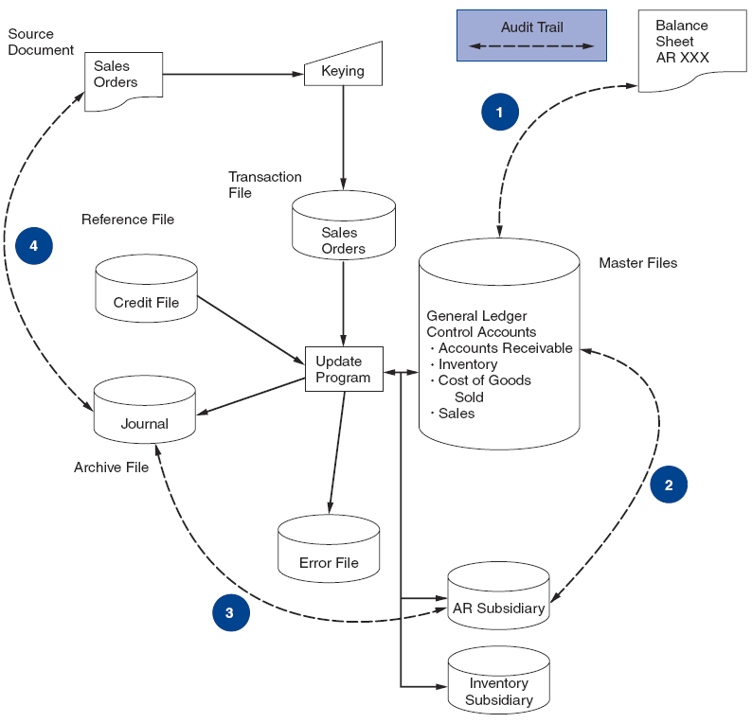
Accounting Records in a Digital System
EXPLANATION OF STEPS IN FIGURE:
1. Compare the AR balance in the balance sheet with the master file AR control account balance.
2. Reconcile the AR control figure with the AR subsidiary account total.
3. Select a sample of update entries made to accounts in the AR subsidiary ledger
and trace these to transactions in the sales journal (archive file).
4. From these journal entries, identify source documents that can be pulled from their files and verified. If necessary, confirm these source documents by contacting the customers.
Figure 2-11
Notes:
17

Slide 10
Computer-Based Systems
The audit trail is less observable in computer-based systems than traditional manual systems.
The data entry and computer programs are the physical trail.
The data are stored in magnetic files.
Notes:
19

Slide 11
Audit Trail
Source
Document
General
Ledger
Financial
Statements
Journal
Financial
Statements
General
Ledger
Source
Document
Journal
Accountants should be able to trace in both directions.
Sampling and confirmation are two common techniques.
Notes:
16

Slide 12
Example of Tracing an Audit Trail
Verifying Accounts Receivable
Accounts Receivable Control Account-General Ledger
Accounts Receivable Subsidiary Ledger
(sum of all customers’ receivables)
Physical
Financial
Sales Journal
Cash Receipts Journal
Sales Order
Deposit Slip
Shipping Notice
Remittance Advice
Notes:
18

Slide 13
Flat-File Model
Figure 2-12

Slide 14
Data Redundancy Problems
Data Storage
  excessive storage costs of paper documents and/or magnetic form
Data Updating
  changes or additions must be performed multiple times
Currency of Information
  potential problem of failing to update all affected files
Task-Data Dependency
  user’s inability to obtain additional information as needs change
Data Integration
  separate files are difficult to integrate across multiple users
Notes:
4

Slide 15
Database Model
Figure 2-13
Notes:
6
Solves the following problems of the flat file approach
no data redundancy - except for primary keys, data is only stored once
single update
current values
task-data independence - users have access to the full domain of data available to the firm
A database is a set of computer files that minimizes data redundancy and is accessed by one or more application programs for data processing.
The database approach to data storage applies whenever a database is established to serve two or more applications, organizational units, or types of users.
A database management system (DBMS) is a computer program that enables users to create, modify, and utilize database information efficiently.

Slide 16
Computer Files
Master File - generally contains account data (e.g., general ledger and subsidiary file)
Transaction File - a temporary file containing transactions since the last update
Reference File - contains relatively constant information used in processing (e.g., tax tables, customer addresses)
Archive File - contains past transactions for reference purposes
Notes:
20

Slide 17
Documentation Techniques
Documentation in a digital environment is necessary for many reasons.
Five common documentation techniques:
  Entity Relationship Diagram
  Data Flow Diagrams
  Document Flowcharts
  System Flowcharts
  Program Flowcharts
Notes:
19

Slide 18
Entity Relationship Diagram (ERD)
A documentation technique to represent the relationship between entities in a system.
Notes:
21

Slide 19
Cardinalities
Represent the numerical mapping between entities:
  one-to-one
  one-to-many
  many-to-many
Notes:
22

Slide 20
Cardinalities
Entity
Relationship
Entity
1
1
Car
Type
Sales-
person
Assigned
1
M
Customer
Places
Order
M
M
Vendor
Supply
Inventory
Notes:
23

Slide 21
Data Flow Diagrams (DFD)…
use symbols to represent the processes, data sources, data flows, and entities in a system
represent the logical elements of the system
do not represent the physical system
Notes:
24

Slide 22
Data Flow Diagram Symbols
Entity
Name
Data Store
Name
N
Process
Description
Direction of
data flow
Figure 2-14
Notes:
25

Slide 23
System Flowcharts…
illustrate the relationship among processes and the documents that flow between them
contain more details than data flow diagrams
clearly depict the separation of functions in a system
Notes:
26

Slide 24
Symbol Set for Representing
Manual Procedures
Terminal showing source
or destination of documents
and reports
Calculated batch total
Source document or
report
On-page connector
Manual operation
Off-page connector
File for storing source
documents and
reports
Description of process
or comments
Accounting records
(journals, registers,
logs, ledgers)
Document flowline
Figure 2-17
Notes:
27

Slide 25
Flowchart Showing Stated Fact I Translated
into Visual Symbols
Sales Department
Credit Department
Warehouse
Shipping Department
Customer
Customer
Order
Prepare
Sales
Orders
Sales
Order #1
Sales
Order #1
Sales
Order #1
Sales
Order #1
Figure 2-20

Slide 26
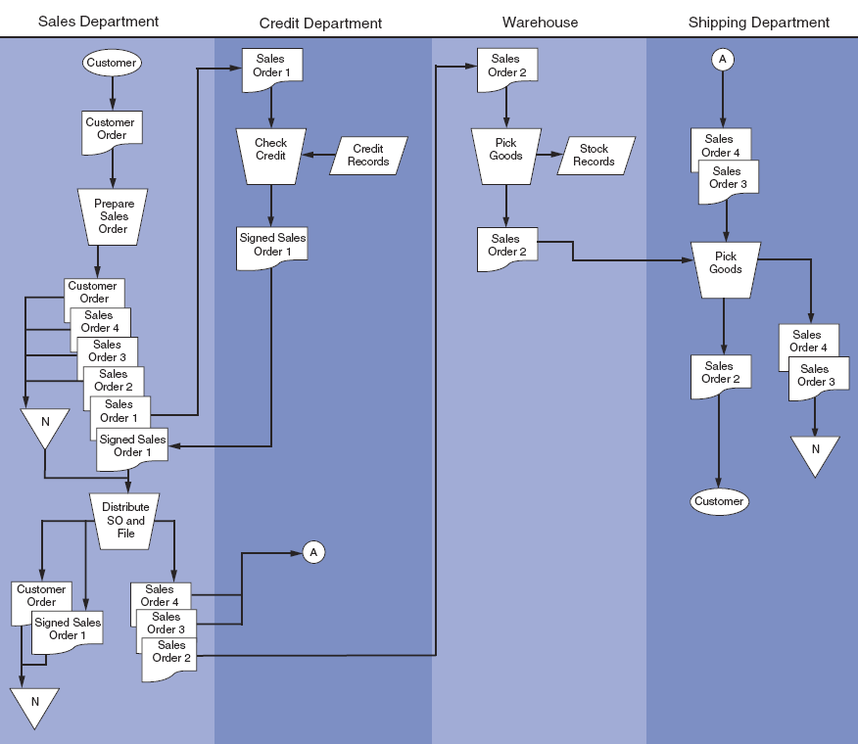
Flowchart Showing All Stated Facts
Translated into Visual Symbols
Figure 2-22

Slide 27
System Flowcharts…
represent the relationship between the key elements--input sources, programs, and output products--of computer systems
depict the type of media being used (paper, magnetic tape, magnetic disks, and terminals)
in practice, not much difference between document and system flowcharts
Notes:
28

Slide 28
Symbol Set for Representing Computer Processes
Hard copy
Terminal input/
output device
Computer process
Process flow
Real-time
(online)
connection
Direct access storage
device
Video display
device
Magnetic tape
Figure 2-23
Notes:
29

Slide 29
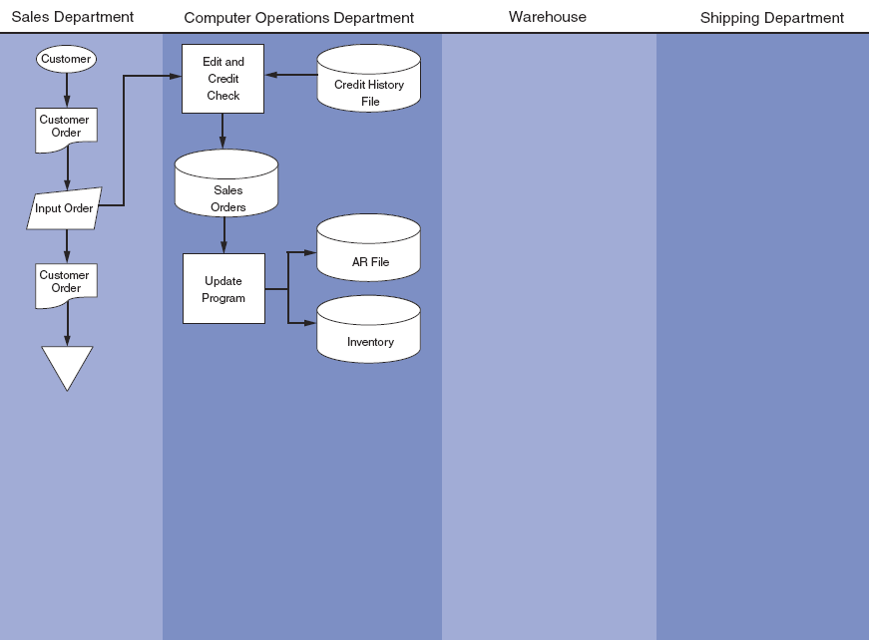
Flowchart Showing Translation of
Facts 1, 2, and 3 into Visual Symbols
Figure 2-24

Slide 30
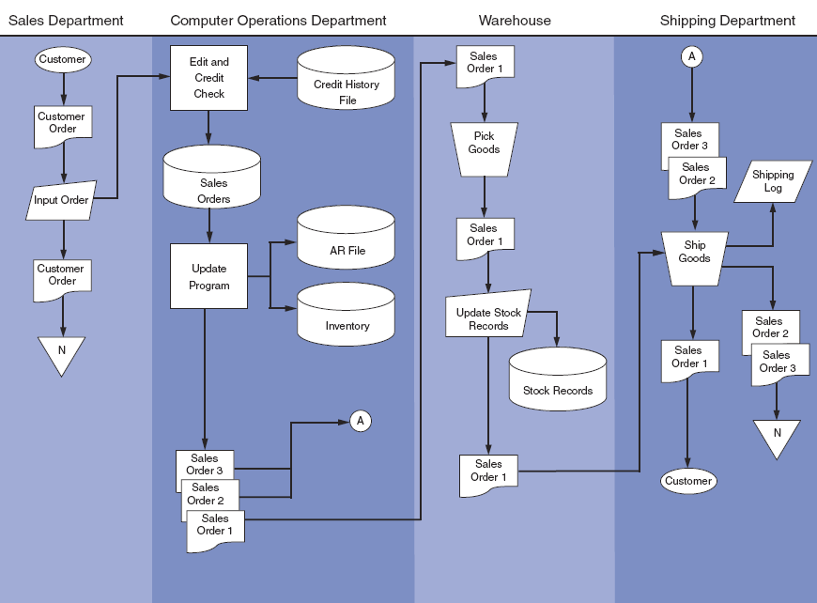
Flowchart Showing All Facts Translated into Visual Symbols
Figure 2-25

Slide 31
Program Flowcharts…
illustrate the logic used in programs
Program Flowchart Symbols
Terminal start or
end operation
Logical process
Input/output
operation
Decision
Flow of logical
process
Figure 2-26
Notes:
30

Slide 32
Transaction Processing Models
Batch versus real time systems (differences)
Information time frame
Resources
Operational efficiency
Efficiency v. effectiveness
Updating master files from transactions
Master file backup procedures

Slide 33
Batch Processing
A batch is a group of similar transactions that are accumulated over time and then processed together.
The transactions must be independent of one another during the time period over which the transactions are accumulated in order for batch processing to be appropriate.
A time lag exists between the event and the processing.
Notes:
32

Slide 34
Batch Processing/Sequential File
Unedited
Transactions
Sales
Orders
Keying
Edit
Run
catches clerical errors
correct errors and
resubmit
Errors
Edited
Transactions
rearranges the transaction data by
key field so that it is in the same
sequence as the master file
Sort
Run
Transactions
Old Master
(father)
AR
Update
Run
changes the values in the master file to reflect the transactions that have occurred
New Master
(son)
AR
Transactions (eventually transferred to an archive file)
Notes:
42

Slide 35
Steps in Batch Processing/Sequential File
Keystroke - source documents are transcribed by clerks to magnetic tape for processing later
Edit Run - identifies clerical errors in the batch and places them into an error file
Sort Run - places the transaction file in the same order as the master file using a primary key
Update Run - changes the value of appropriate fields in the master file to reflect the transaction
Backup Procedure - the original master continues to exist and a new master file is created
Notes:
41

Slide 36
Advantages of Batch Processing
Organizations can increase efficiency by grouping large numbers of transactions into batches rather than processing each event separately.
Batch processing provides control over the transaction process via control figures.
Notes:
33

Slide 37
Real-Time Systems…
process transactions individually at the moment the economic event occurs
have no time lag between the economic event and the processing
generally require greater resources than batch processing since they require dedicated processing capacity; however, these cost differentials are decreasing
oftentimes have longer systems development time
Notes:
34

Slide 38
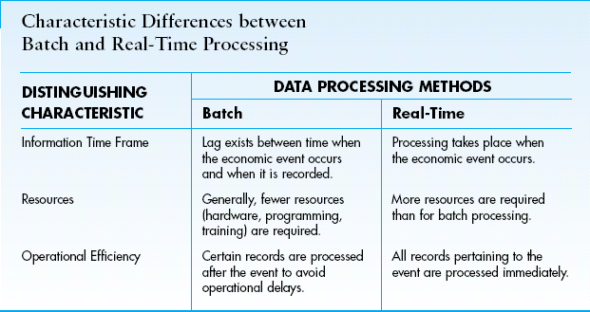

Slide 39
Why Do So Many AIS Use Batch Processing?
AIS processing is characterized by high-volume, independent transactions, such are recording cash receipts checks received in the mail.
The processing of such high-volume checks can be done during an off-peak computer time.
This is one reason why batch processing maybe done using real-time data collection.
Notes:
35

Slide 40
Uses of Coding in AIS
Concisely represent large amounts of complex information that would otherwise be unmanageable
Provide a means of accountability over the completeness of the transactions processed
Identify unique transactions and accounts within a file
Support the audit function by providing an effective audit trail
Notes:
4

Slide 41
Sequential Codes
Represent items in sequential order
Used to prenumber source documents
Track each transaction processed
Identify any out-of-sequence documents
Disadvantages:
  arbitrary information
  hard to make changes and insertions
Notes:
5
Disadvantages
carry no information content beyond their order in the sequence
inserting a new item at some midpoint requires complete renumbering

Slide 42
Block Codes
Represent whole classes by assigning each class a specific range within the coding scheme
Used for chart of accounts
  The basis of the general ledger
Allows for the easy insertion of new codes within a block
  Don’t have to reorganize the coding structure
Disadvantage:
  arbitrary information
Notes:
6
Disadvantage
the information content is not readily apparent.

Slide 43
Group Codes
Represent complex items or events involving two or more pieces of data using fields with specific meaning
For example, a coding scheme for tracking sales might be 04-09-476214-99, meaning:
Store Number Dept. Number Item Number Salesperson
04 09 476214 99
Disadvantages:
  arbitrary information
  overused
Notes:
7
Advantages
facilitates the representation of large amounts of diverse data
allows complex data structures to be represented in a hierarchical form that is logical and more easily remembered by humans
permits detailed analysis and reporting both within an item class and across different classes of items
Disadvantage
tend to be overused which can lead to unnecessarily complex group codes that cannot be easily interpreted

Slide 44
Alphabetic Codes
Used for many of the same purposes as numeric codes
Can be assigned sequentially or used in block and group coding techniques
May be used to represent large numbers of items
  Can represents up to 26 variations per field
Disadvantage:
  arbitrary information
Notes:
9
Disadvantages
difficulty of rationalizing the meaning of codes sequentially assigned
sorting records that are coded alphabetically tend to be more difficult for users

Slide 45
Mnemonic Codes
Alphabetic characters used as abbreviations, acronyms, and other types of combinations
Do not require users to memorize the meaning since the code itself is informative – and not arbitrary
  NY = New York
Disadvantages:
  limited usability and availability
Notes:
10
Disadvantage
they are limited in their ability to represent items within a class

