Slide 1
Chapter 1
The Information System:
An Accountant’s Perspective

Slide 2
Objectives for Chapter 1
Recognize the primary information flows within the business environment.
Understand the difference between accounting information systems and management information systems.
Understand the difference between financial transactions and non-financial transactions.
Know the principal features of the general model for information systems.
Understand the organizational structure and functional areas of a business.
Be able to distinguish between external auditing, internal auditing, and advisory services as they related to accounting information systems.
Notes:
2

Slide 3
Internal & External
Information Flows

Slide 4
Internal Information Flows
Horizontal flows of information used primarily at the operations level to capture transaction and operations data
Vertical flows of information
  downward flows — instructions, quotas, and budgets
  upward flows — aggregated transaction and operations data
Notes:
4

Slide 5
Information Objectives
The goal of an information system is to support
  To support the stewardship function of management,
  To support management decision making, and
  To support the firm’s day-to-day operations.
Notes:
19

Slide 6
What is an Information System?
An information system is the set of formal procedures by which data are collected, processed into information, and distributed to users.
Notes:
9

Slide 7
Transactions
A transaction is a event that affects or is of interest to the organization and is processed by its information system as a unit of work.
Financial transactions
  economic events that affect the assets and equities of the organization
  e.g., purchase of an airline ticket
Nonfinancial transactions
  all other events processed by the organization’s information system
  e.g., an airline reservation — no commitment by the customer
Notes:
10

Slide 8
Transactions
Financial
Transactions
Information
System
User
Decisions
Information
Nonfinancial
Transactions
Notes:
10

Slide 9
What is an
Accounting Information System?
Accounting is an information system.
  It identifies, collects, processes, and communicates economic information about a firm using a wide variety of technologies.
  It captures and records the financial effects of the firm’s transactions.
  It distributes transaction information to operations personnel to coordinate many key tasks.
Notes:
3

Slide 10
AIS versus MIS
Accounting Information Systems (AIS) process
  financial transactions; e.g., sale of goods
  nonfinancial transactions that directly affect the processing of financial transactions; e.g., addition of newly approved vendors
Management Information Systems (MIS) process
  nonfinancial transactions that are not normally processed by traditional AIS; e.g., tracking customer complaints
Notes:
11

Slide 11
AIS versus MIS?
IS
AIS
GLS/FRS
TPS
MIS
Financial
Management
Systems
MRS
Marketing
Systems
Distribution Systems
Human Resource Systems
Notes:
11

Slide 12
AIS Subsystems
Transaction processing system (TPS)
  supports daily business operations
General Ledger/ Financial Reporting System (GL/FRS)
  produces financial statements and reports
Management Reporting System (MRS)
  produces special-purpose reports for internal use
Notes:
12

Slide 13
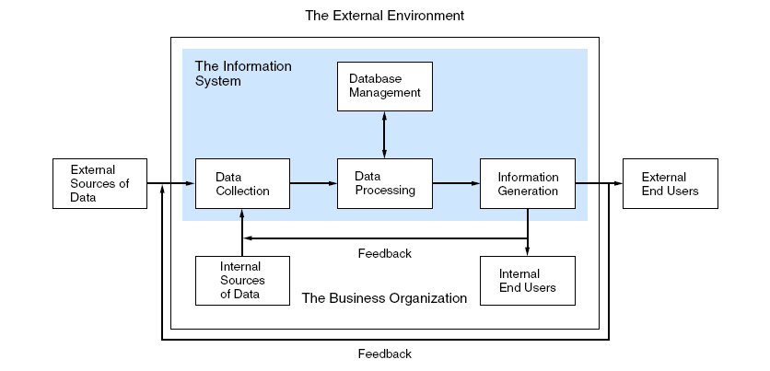
General Model for AIS
Figure 1-5
Notes:
13

Slide 14
Data Sources
Data sources are financial transactions that enter the information system from internal and external sources.
  External financial transactions are the most common source of data for most organizations.
    E.g., sale of goods and services, purchase of inventory, receipt of cash, and disbursement of cash (including payroll)
  Internal financial transactions involve the exchange or movement of resources within the organization.
    E.g., movement of raw materials into work-in-process (WIP), application of labor and overhead to WIP, transfer of WIP into finished goods inventory, and depreciation of equipment

Slide 15
Transforming the Data into Information
Functions for transforming data into information according to the general AIS model:
1. Data Collection
2. Data Processing
3. Data Management
4. Information Generation
Notes:
8

Slide 16
1. Data Collection
Capturing transaction data
Recording data onto forms
Validating and editing the data
Notes:
9

Slide 17
2. Data Processing
Classifying
Transcribing
Sorting
Batching
Merging
Calculating
Summarizing
Comparing
Notes:
10

Slide 18
3. Data Management
Storing
Retrieving
Deleting
Notes:
11

Slide 19
4. Information Generation
Compiling
Arranging
Formatting
Presenting
Notes:
13

Slide 20
Characteristics of Useful Information
Regardless of physical form or technology, useful information has the following characteristics:
  Relevance: serves a purpose
  Timeliness: no older than the time period of the action it supports
  Accuracy: free from material errors
  Completeness: all information essential to a decision or task is present
  Summarization: aggregated in accordance with the user’s needs

Slide 21
Organizational Structure
The structure of an organization helps to allocate
  responsibility
  authority
  accountability
Segmenting by business function is a very common method of organizing.
Notes:
21

Slide 22
Functional Segmentation
Materials Management
  purchasing, receiving and stores
Production
  production planning, quality control, and maintenance
Marketing
Distribution
Personnel
Finance
Accounting
Information Technology
Notes:
22

Slide 23
Accounting Independence
Information reliability requires accounting independence.
  Accounting activities must be separate and independent of the functional areas maintaining resources.
  Accounting supports these functions with information but does not actively participate.
  Decisions makers in these functions require that such vital information be supplied by an independent source to ensure its integrity.
Notes:
20

Slide 24
IT: Data Processing
Distributed Data
Processing
Centralized Data
Processing
Most companies fall in between.
Reorganizing the
computer services
function into small
information processing
units that are distributed
to end users and
placed under their control
All data processing
is performed by
one or more large
computers housed
at a central site
that serves users
throughout the
organization.
Primary areas:
database administration
data processing
systems development
systems maintenance
Notes:
25

Slide 25
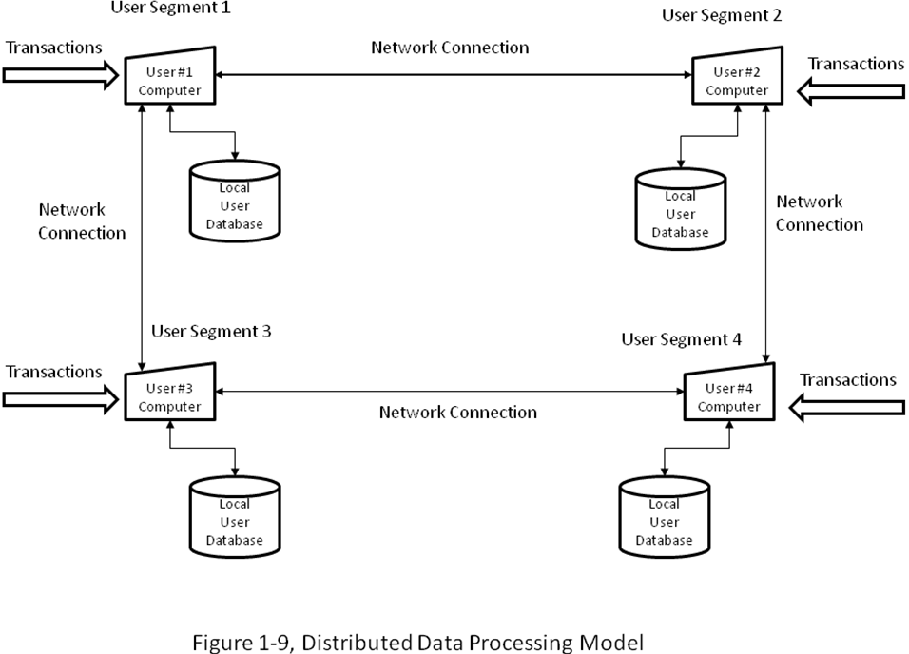
Distributed Data Processing Model

Slide 26
Accountants’ Unique Roles in AIS
Accountants must be able to clearly convey their needs to the systems professionals who design the system.
The accountant should actively participate in systems development projects to ensure appropriate systems design.
Notes:
26

Slide 27
Accountants as System Designers
Accountants are the domain experts and responsible for the conceptual design of the AIS.
Conceptual system design involves specifying the criteria for identifying delinquent customers and the information that needs to be reported.
As the domain expert, the accountant determines the nature of the information required, its sources, its destination, and the accounting rules that need to be applied.
Notes:
27

Slide 28
Accountants as System Auditors
External (Financial) Audits
Internal Audit
Fraud Audit
Notes:
28

Slide 29
External (Financial) Audit
Independent attestation regarding the fairness of the presentation of financial statements
Two types of evidence
  Tests of controls
  Substantive tests
Notes:
28

Slide 30
Attest Service versus Advisory Services
SOX restricts non-audit services to clients. Auditor may not provide:
  bookkeeping or other services related to the accounting records or financial statements of the audit client
  financial information systems design and implementation
  appraisal or valuation services, fairness opinions, or contribution-in-kind reports
  actuarial services
  internal audit outsourcing services
  management functions or human resources
  broker or dealer, investment adviser, or investment banking services
  legal services and expert services unrelated to the audit
  any other service that the Board determines, by regulation, is impermissible.
Notes:
28

Slide 31
Internal Audit
an independent appraisal function established within an organization to examine and evaluate its activities as a service to the organization.
Different constituencies from external audit
Notes:
28

Slide 32
Fraud Audit
investigate anomalies and gather evidence of fraud that may lead to criminal conviction.
Initiated
  When corporate management suspects employee fraud.
  Or, boards of directors hire fraud auditors to investigate their own suspected executives
Notes:
28

Slide 33
The Role of the Audit Committee
A subcommittee of the Board of Directors that has special responsibilities regarding audits.
an independent “check and balance” for the internal audit function and liaison with external auditors
Usually three people (outsiders)
SOX requires one to be a “financial expert”
Notes:
28

