Slide 1
Memo Test
Q1: 30 Marks
Q2: 38 Marks
Q3: 12 Marks

Slide 2
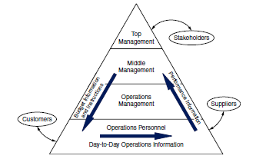

Slide 3
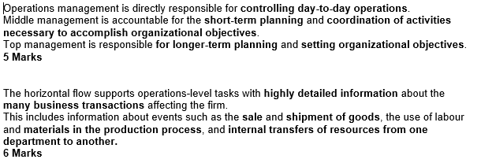
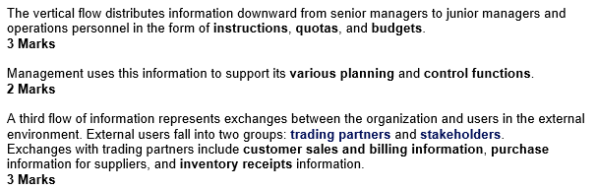

Slide 4


Slide 5
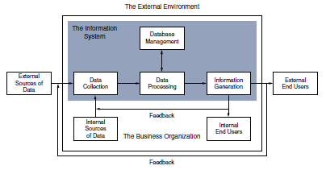

Slide 6
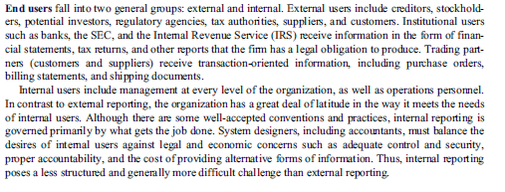
End User: 7 Marks

Slide 7

Data sources: 5 Marks

Slide 8
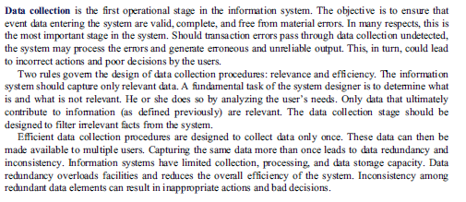
Data Collection: 6 Marks

Slide 9

Data processing: 3 Marks

Slide 10

DB Management: 2 Marks

Slide 11
