Slide 2
Describe information technologies that could be used in computer crimes
Describe basic safeguards in computer and network security
Explain the major security threats
Describe security and enforcement measures
Summarize the guidelines for a comprehensive security system, including business continuity planning

Slide 3
Risks Associated with Information Technologies
Costs of cyber crime to the U.S. economy
  Stolen identities, intellectual property, trade secrets, and damage done to companies’ and individuals’ reputations
  Expense of enhancing and upgrading a company’s network security after an attack
  Opportunity costs associated with downtime and lost trust and sensitive business information

Slide 4
Risks Associated with Information Technologies
Spyware: Software that secretly gathers information about users while they browse the Web
  Prevented by installing antivirus or antispyware software
Adware: Collects information about the user to determine which advertisements to display in the user’s Web browser
  Prevented by ad-blocking feature installed in the Web browser

Slide 5
Risks Associated with Information Technologies
Phishing: Sending fraudulent e-mails appearing to come from legitimate sources
  E-mails direct recipients to false websites to capture private information
Pharming: Hijacking and altering the IP address of an official website
  So that users who enter the correct Web address are directed to the “pharmer’s” fraudulent website

Slide 6
Risks Associated with Information Technologies
Keystroke loggers: Monitor and record keystrokes
  Can be software or hardware devices
  Used by companies to track employees’ use of e-mail and the Internet which is illegal
  Used for malicious purposes
  Prevented by antivirus and antispyware programs

Slide 7
Risks Associated with Information Technologies
Sniffing: Capturing and recording network traffic
  Used for legitimate reasons like monitoring network performance
  Used by hackers to intercept information
Spoofing: Attempt to gain access to a network by posing as an authorized user to find sensitive information

Slide 8
Risks Associated with Information Technologies
Computer fraud: Unauthorized use of computer data for personal gain
  Denial-of-service attacks
  Identity theft and software piracy
  Distributing child pornography
  E-mail spamming
  Writing or spreading malicious code
  Stealing files for industrial espionage
  Changing computer records illegally
  Virus hoaxes

Slide 9
Computer and Network Security: Basic Safeguards
Comprehensive security protects an organization’s resources
  Consists of hardware, software procedures, and personnel that collectively protect information resources and keep intruders and hackers at bay

Slide 10
Aspects of Computer and Network Security
Confidentiality
System must prevent disclosing information to anyone who is not authorized to access it
Integrity
Accuracy of information resources within an organization
Availability
Authorized users can access the information they need from operating computers and networks
Quick recovery in the event of a system failure or disaster

Slide 11
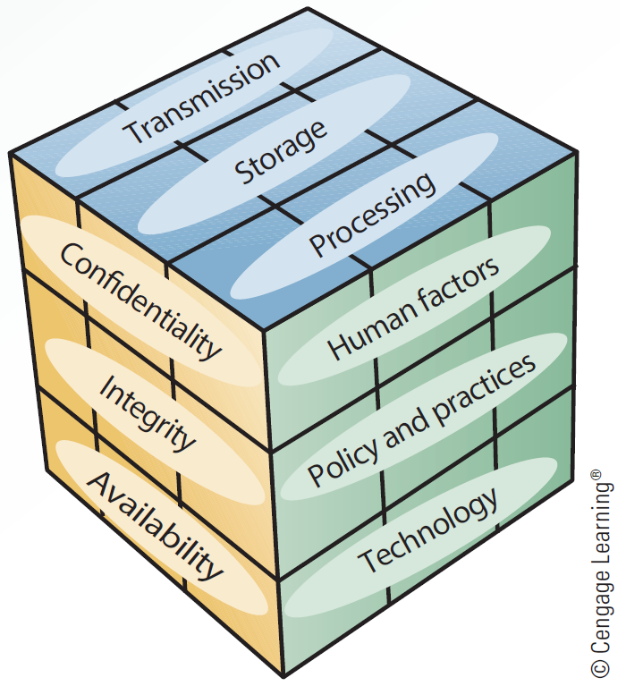
5.1 McCumber Cube

Slide 12
John McCumber’s Framework for Evaluating Information Security
Represented as a three-dimensional cube
Helps designers of security systems consider crucial issues for improving the effectiveness of security measures
Includes different states in which information can exist in a system
  Transaction, storage, and processing

Slide 13
John McCumber’s Framework for Evaluating Information Security
A comprehensive security system must provide three levels of security
  Front-end servers: Must be protected against unauthorized access
    Available to both internal and external users
  Back-end systems: Must be protected to ensure confidentiality, accuracy, and integrity of data
  Corporate network: Must be protected against intrusion, denial-of-service attacks, and unauthorized access

Slide 14
Planning a Comprehensive Security System
Fault-tolerant systems: Ensure availability in the event of a system failure by using a combination of hardware and software
  Methods used:
    Uninterruptible power supply (UPS)
    Redundant array of independent disks (RAID)
    Mirror disks

Slide 15
Types of Security Threats - Intentional
Virus: Consists of self-propagating program code that is triggered by a specified time or event
  Attaches itself to other files, and the cycle continues when the program or operating system containing the virus is used
  Transmitted through a network or e-mail attachments or message boards
  Prevented by installing and updating an antivirus program

Slide 16
Types of Security Threats - Intentional
Worms: Independent programs that can spread themselves without having to be attached to a host program
  Replicates into a full-blown version that eats up computing resources
  Examples: Code Red, Melissa, and Sasser

Slide 17
Types of Security Threats - Intentional
Trojan program: Contains code intended to disrupt a computer, network, or website
  Hides inside a popular program
Logic bomb: Type of Trojan program used to release a virus, worm, or other destructive code
  Triggered at a certain time or by a specific event

Slide 18
Types of Security Threats - Intentional
Backdoor
  Programming routine built into a system by its designer
  Enables the designer to bypass security and sneak back into the system later to access programs or files
Blended threat
  Combines the characteristics of computer viruses, worms, and other malicious codes with vulnerabilities on public and private networks

Slide 19
Types of Security Threats - Intentional
Denial-of-service attacks (DoS): Floods a network or server with service requests to prevent legitimate users’ access to the system
  Distributed denial-of-service (DDoS) attack
    Thousands of computers work together to bombard a website with thousands of requests in a short period causing it to grind to a halt

Slide 20
Types of Security Threats - Intentional
  TDoS (telephony denial of service) attacks
    Uses high volumes of automated calls to tie up a target phone system, halting incoming and outgoing calls
Social engineering: Using people skills to trick others into revealing private information
  Uses techniques called dumpster diving and shoulder surfing

Slide 21
Types of Security Threats - Unintentional
Unintentional threats are caused due to:
  Natural disasters
  User’s accidental deletion of data
  Structural failures

Slide 22
Constituents of a Comprehensive Security System
Biometric security measures
Nonbiometric security measures
Physical security measures
Access controls
Virtual private networks
Data encryption
E-commerce transaction security measures
Computer Emergency Response Team

Slide 23
Biometric Security Measures
Use a physiological element unique to a person which cannot be stolen, lost, copied, or passed on to others
Biometric devices and measures
  Facial recognition, retinal scanning, and iris analysis
  Fingerprints, palm prints, and hand geometry
  Signature analysis
  Vein analysis
  Voice recognition

Slide 24
Nonbiometric Security Measures
Callback modems: Verifies whether a user’s access is valid
  By logging the user off and then calling the user back at a predetermined number
Firewalls: Combination of hardware and software that acts as a filter between a private network and external networks
  Network administrator defines rules for access, and all other data transmissions are blocked
  Types: Packet-filtering firewalls, application-filtering firewalls, and proxy servers

Slide 25
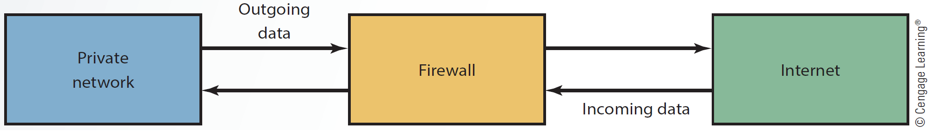
5.3 Basic Firewall Configuration

Slide 26
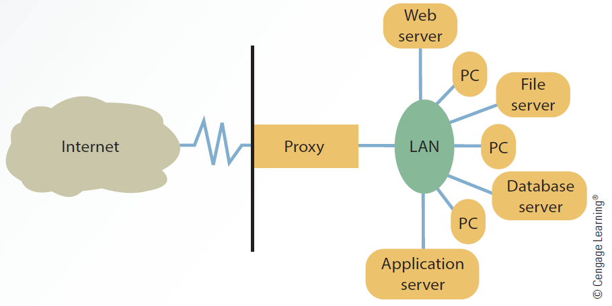
5.4 Proxy Server

Slide 27
Nonbiometric Security Measures
Intrusion detection systems
  Protect against external and internal access
  Placed in front of a firewall
  Identify attack signatures, trace patterns, and generate alarms for the network administrator
  Cause routers to terminate connections with suspicious sources
  Prevent DoS attacks

Slide 28
Physical Security Measures
Control access to computers and networks
Include devices for securing computers and peripherals from theft
  Cable shielding
  Corner bolts
  Electronic trackers
  Identification (ID) badges
  Proximity-release door openers
  Room shielding
  Steel encasements

Slide 29
Access Controls
Designed to protect systems from unauthorized access in order to preserve data integrity
Types
  Terminal resource security: Erases the screen and signs the user off automatically after a specified length of inactivity
  Passwords: Combination of numbers, characters, and symbols entered to allow access to a system

Slide 30
Virtual Private Network (VPN)
Provides a secure passage through the Internet for transmitting messages and data via a private network
  Used so that remote users have a secure connection to the organization’s network
Data is encrypted before it is sent with a protocol such as:
  Layer Two Tunneling Protocol (L2TP)
  Internet Protocol Security (IPSec)

Slide 31
Data Encryption
Transforms data, called plaintext or cleartext, into a scrambled form called ciphertext which cannot be read by others
Rules for encryption: Determine how simple/complex the transformation process is to be
  Known as the encryption algorithm

Slide 32
Data Encryption
Protocols
  Secure Sockets Layer (SSL): Manages transmission security on the Internet
  Transport Layer Security (TLS): Ensures data security and integrity over public networks
PKI (public key infrastructure)
  Enables users of a public network to securely and privately exchange data through the use of a pair of keys
    Obtained from a trusted authority and shared through that authority

Slide 33
Types of Data Encryption
Asymmetric
  Uses public key known to everyone and a private or secret key known only to the recipient
    Known as public key encryption
  Message encrypted with a public key can be decrypted only with the same algorithm used by the public key and requires the recipient’s private key
  Slow and requires a large amount of processing power

Slide 34
Types of Data Encryption
Symmetric
  Same key is used to encrypt and decrypt the message
    Known as secret key encryption
  Sender and receiver must agree on the key and keep it secret
  Works better with public networks, like the Internet
    Sharing the key over the Internet is difficult

Slide 35
E-commerce Transaction Security Measures
Concerned with the issues like:
  Confidentiality
  Authentication
  Integrity
  Nonrepudiation of origin
  Nonrepudiation of receipt

Slide 36
Computer Emergency Response Team (CERT)
Developed by the Defense Advanced Research Projects Agency in response to the 1988 Morris worm attack
Focuses on security breaches and DoS attacks
Offers guidelines on handling and preventing attacks

Slide 37
Computer Emergency Response Team (CERT)
Cyber Incident Response Capability (CIRC)
  Provides information on security incidents
    Information systems’ vulnerabilities, viruses, and malicious programs
  Provides awareness training, analysis of threats and vulnerabilities, and other services

Slide 38
Guidelines for a Comprehensive Security System
Organizations should understand the principles of the Sarbanes-Oxley Act of 2002
Conduct a basic risk analysis before establishing a security program
  Analysis makes use of financial and budgeting techniques
  Information obtained helps organizations weigh the cost of a security system

Slide 39
Business Continuity Planning
Put together a management crisis team
Contact the insurance company
Restore phone lines and other communication systems
Notify all affected people that recovery is underway
Set up a help desk to assist affected people
Document all actions taken to regain normality

Slide 40
Access controls
Adware
Asymmetric encryption
Availability
Backdoor
Biometric security measures
Blended threat
Business continuity planning

Slide 41
Callback modem
Computer fraud
Confidentiality
Data encryption
Denial-of-service (DoS) attack
Fault-tolerant systems
Firewall
Integrity

Slide 42
Intrusion detection system (IDS)
Keystroke logger
Logic bomb
Password
Phishing
Pharming
Physical security measures
PKI (public key infrastructure)

Slide 43
Secure sockets layer (SSL)
Sniffing
Social engineering
Spoofing
Spyware
Symmetric encryption
Transport layer security (TLS)

Slide 44
Trojan program
Virtual private network (VPN)
Virus
Worm

Slide 45
Risks associated with information technologies can be minimized by installing operating system updates regularly, using antivirus and antispyware software, and using e-mail security features
Comprehensive security system protects an organization’s resources, including information, computer, and network equipment

Slide 46
Computer and network security are important to prevent loss of, or unauthorized access to, important information resources

