Slide 2
Define a database and a database management system
Explain logical database design and the relational database model
Define the components of a database management system
Summarize recent trends in database design and use
Explain the components and functions of a data warehouse

Slide 3
Describe the functions of a data mart
Define business analytics, and describe its role in the decision-making process
Explain big data and its business applications

Slide 4
Databases
Database
  Collection of related data that is stored in a central location or in multiple locations
Data hierarchy: Structure and organization of data involving fields, records, and files
Database management system (DBMS)
  Software for creating, storing, maintaining, and accessing database files
  Makes using databases more efficient

Slide 5
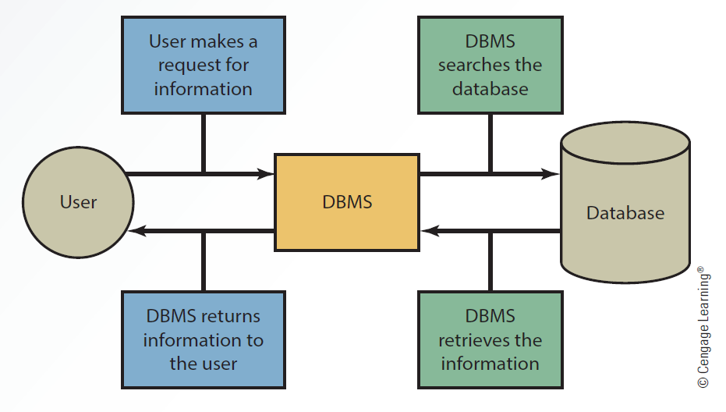
3.2 Interaction Between the User, DBMS and Database

Slide 6
Methods for Accessing Files
Sequential access file structure
  Records are organized and processed in numerical or sequential order
  Organized based on a primary key
    Social Security numbers or account numbers
  Used for backup and archive files as they rarely need updating

Slide 7
Types of Data in a Database
Internal
  Collected from within an organization
  Stored in the organization’s internal databases
External
  Comes from a variety of resources
  Stored in a data warehouse

Slide 8
Methods for Accessing Files
Random access file structure
  Records can be accessed in any order irrespective of the physical locations in storage media
  Fast and very effective when a small number of records need to be processed daily or weekly
  Records are stored on magnetic tapes

Slide 9
Methods for Accessing Files
Indexed sequential access method (ISAM)
  Records are accessed sequentially or randomly depending on the number being accessed
    Random access is used for a small number
    Sequential access is used for a large number
  Uses an index structure and has two parts
    Indexed value
    Pointer to the disk location of the record matching the indexed value

Slide 10
Logical Database Design
Physical view
  Involves how data is stored on and retrieved from storage media
    Hard disks, magnetic tapes, or CDs
Logical view
  Involves how information appears to users and how it can be organized and retrieved
  Includes more than one logical view of data, depending on the user

Slide 11
Logical Database Design
Data model
  Determines how data is created, represented, organized, and maintained
  Contains
    Data structure
    Operations
    Integrity rules
Hierarchical model
  Relationships between records form a treelike structure

Slide 12
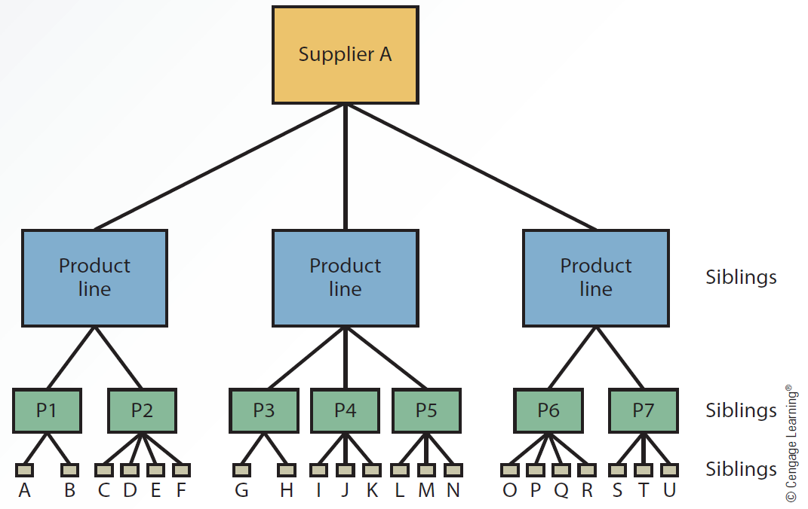
  3.3 A Hierarchical Model

Slide 13
Logical Database Design
Network model
  Similar to the hierarchical model but records are organized differently
  Includes multiple parent and child records

Slide 14
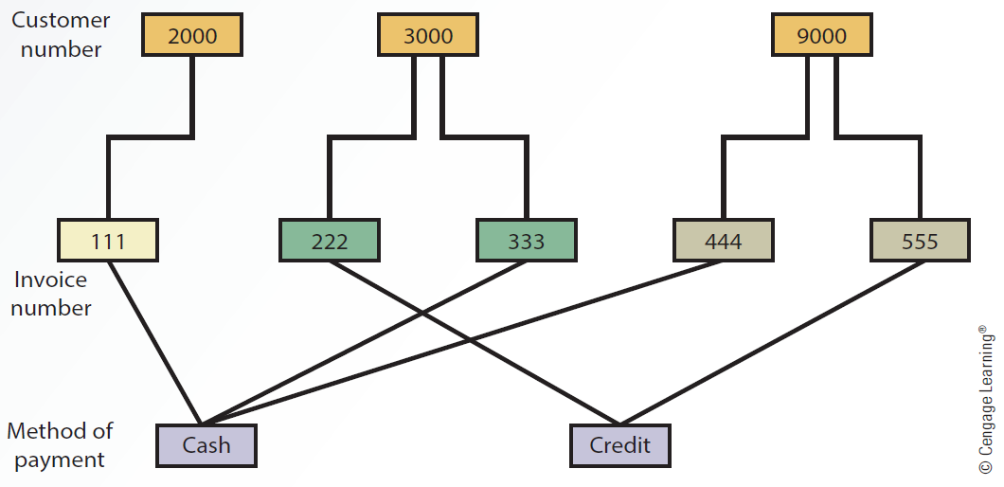
  3.4 A Network Model

Slide 15
Relational Model
Uses a two-dimensional table of rows and columns of data
  Rows are records
  Columns are fields
Data dictionary: Stores definitions
  Data types for fields, default values, and validation rules for data in each field

Slide 16
Relational Model
Primary key
  Uniquely identifies every record in a relational database
Foreign key
  Field in a relational table that matches the primary key column of another table
  Used to cross-reference tables

Slide 17
Relational Model
Normalization
  Improves database efficiency by eliminating redundant data
    Ensures that only related data is stored in a table
  Goes through different stages from first normal form (1NF) to fifth normal form (5NF)

Slide 18
Relational Model
Retrieves data from tables using operations that pick and combine data from one or more tables
  Select
  Project
  Join
  Intersection
  Union
  Difference

Slide 19
Components of a DBMS
Database engine
Data definition
Data manipulation
Application generation
Data administration

Slide 20
Database Engine
Heart of DBMS software
Responsible for data storage, manipulation, and retrieval
Converts logical requests from users into their physical equivalents
  By interacting with other components of the DBMS

Slide 21
Data Definition
Creates and maintains the data dictionary
Defines the structure of files in a database
Makes changes to a database’s structure
  Adding and deleting fields
  Changing field size and data type

Slide 22
Data Manipulation
Used to add, delete, modify, and retrieve records from a database
Uses a query language
  Structured Query Language (SQL)
    Standard fourth-generation query language that consists of several keywords specifying actions to take
  Query by example (QBE)
    Involves requesting data from a database by constructing a statement formed by query forms

Slide 23
Application Generation
Designs elements of an application using a database
  Data entry screens
  Interactive menus
  Interfaces with other programming languages
Used by IT professionals and database administrators

Slide 24
Data Administration
Used for the tasks backup and recovery, security, and change management
Used to determine who has permission to perform certain functions
  Summarized as create, read, update, and delete (CRUD)

Slide 25
Data Administration
Database administrator (DBA)
  Handles database design and management
    Setting up database
    Establishing security measures to determine users’ access rights
    Developing recovery procedures when data is lost or corrupted
    Evaluating database performance
    Adding and fine-tuning database functions

Slide 26
Recent Trends in Database Design and Use
Data-driven website
  Interface to a database
  Retrieves data and allows users to enter data
  Improves access to information
  Gives users more current information from a variety of data sources

Slide 27
Recent Trends in Database Design and Use
Distributed database: Stores data on multiple servers throughout an organization
Approaches to setting up a DDBMS
  Fragmentation: Addresses how tables are divided among multiple locations
  Replication: Each site stores a copy of the data in the organization’s database
  Allocation: Combines fragmentation and replication, with each site storing the data used most often

Slide 28
Recent Trends in Database Design and Use
Object-oriented database: Single object contains data and their relationships
  Object consists of attributes and methods that can be performed on the object’s data
  Encapsulation: Grouping objects along with their attributes and methods into a single unit
  Inheritance: New objects can be created faster and easily by entering new data in attributes

Slide 29
Data Warehouses
Collection of data from a variety of sources
  Used to support decision-making applications and generate business intelligence
  As they store multidimensional data, they are called hypercubes

Slide 30
Characteristics of Data in a Data Warehouse
Characteristics of data in a data warehouse
  Subject oriented
  Comes from a variety of sources
  Categorized based on time
  Captures aggregated data
  Used for analytical purposes

Slide 31
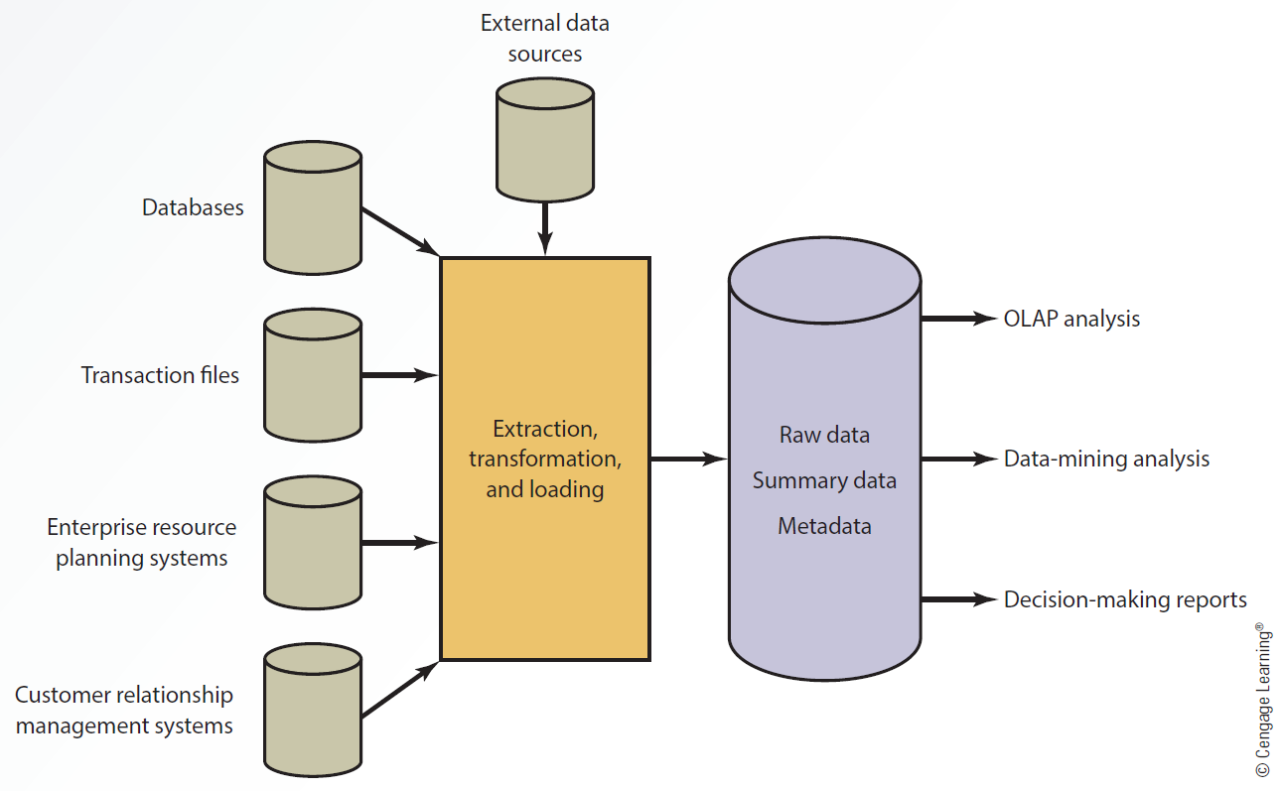
    3.6 A Data Warehouse Configuration

Slide 32
Input
Different sources of data together provide input for a data warehouse to perform analyses and generate reports
  External data sources
  Databases
  Transaction files
  Enterprise resource planning (ERP) systems
  Customer relationship management (CRM) systems

Slide 33
Extraction, Transformation, and Loading (ETL)
Processes used in a data warehouse
  Extracting data from outside sources
  Transforming data to fit operational needs
  Loading data into the database or data warehouse

Slide 34
Storage
Collected information is organized in a data warehouse as:
  Raw data: Information in the original form
  Summary data: Gives users subtotals of various categories
  Metadata: Information about data’s content, quality, condition, origin, and other characteristics

Slide 35
Output
Online transaction processing (OLTP)
  Facilitates and manages transaction-oriented applications
  Uses internal data and responds in real time
Online analytical processing (OLAP)
  Generates business intelligence
  Uses multiple sources of information and provides multidimensional analysis
    Viewing data based on time, product, and location

Slide 36
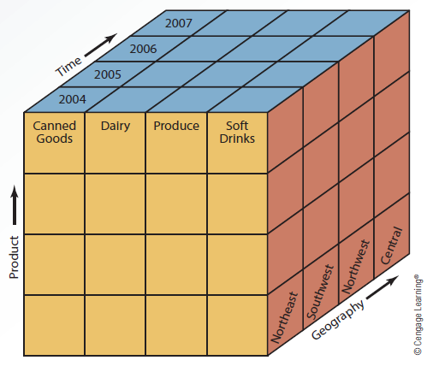
    3.7 Slicing and Dicing Data

Slide 37
Output
Data-mining analysis: Discovers patterns and relationships
Data warehouses help generate various types of information and reports for decision making
  Cross-reference segments of an organization’s operations for comparison purposes
  Generate complex queries and reports faster and easier
  Generate reports efficiently using data from a variety of sources

Slide 38
Output
  Find patterns and trends that can’t be found with databases
  Analyze large amounts of historical data quickly
  Assist management in making well-informed business decisions
  Manage high demand information from many users with different needs and decision making styles

Slide 39
Data Mart
Smaller version of data warehouse, used by single department or function
Advantages over data warehouses
  Access to data is faster due to their smaller size
  Response time for users is improved
  Easy to create because they are smaller and simple
  Less expensive
  Users are targeted better
Has limited scope

Slide 40
Business Analytics (BA)
Uses data and statistical methods to gain insight into the data
Provides decision makers with information to act on

Slide 41
Types of BA Methods
Descriptive analytics
  Reviews past events
  Analyzes the data
  Provides a report indicating what happened over a given period of time and how to prepare for future
  Reactive strategy
Predictive analytics
  Prepares decision maker for future events
  Proactive strategy

Slide 42
Big Data Era
Big data: Voluminous data which the conventional computing methods are unable to efficiently process and manage
  Involves dimensions known as 3 Vs
    Volume: Quantity of transactions
    Variety: Combination of structured and unstructured data
    Velocity: Speed with which data needs to be gathered and processed

Slide 43
Who Benefits from Big Data?
Industries benefit and gain a competitive advantage in areas like:
  Retail
  Financial services
  Advertising and public relations
  Government
  Manufacturing
  Media and telecommunications
  Energy
  Healthcare

Slide 44
Factors in the Growth and Popularity of Big Data
Mobile and wireless technology
Popularity of social networks
Enhanced power and sophistication of smartphones and handheld devices

Slide 45
Allocation
Big data
Business analytics
Create, read, update, and delete (CRUD)
Data dictionary
Data hierarchy
Data mart
Data model
Data warehouse
Database

Slide 46
Database administrator (DBA)
Database management system (DBMS)
Data-driven website
Data-mining analysis
Distributed database management system (DDBMS)
Encapsulation
Extraction, transformation, and loading (ETL)
Foreign key
Fragmentation

Slide 47
Hierarchical model
Indexed sequential access method (ISAM)
Inheritance
Logical view
Network model
Normalization
Object-oriented databases
Online analytical processing (OLAP)
Online transaction processing (OLTP)
Physical view

Slide 48
Primary key
Query by example (QBE)
Random access file structure
Relational model
Replication
Sequential access file structure
Structured Query Language (SQL)

Slide 49
In a database system, all files are integrated
Retrieving data from a database is much faster
Files are accessed by using a sequential, random, or indexed sequential method
Components of a DBMS
  Database engine, data definition, data manipulation, application generation, and data administration

Slide 50
Recent trends in database design and use include data-driven websites, natural language processing, distributed and object-oriented databases
Data marts focus on business functions for a specific user group in an organization
Industries benefit from big data analytics and gain a competitive advantage

