Slide 2
Define a computer system, and describe its components
Discuss the history of computer hardware and software
Explain the factors distinguishing the computing power of computers
Summarize computer operations

Slide 3
Discuss the types of input, output, and memory devices
Explain how computers are classified
Describe the two major types of software
List the generations of computer languages

Slide 4
Defining a Computer
Machine that:
  Accepts data as input
  Processes data without human intervention using stored instructions
  Outputs information
Program
  Step-by-step directions for performing a specific task
  Written in a language the computer can understand

Slide 5
Defining a Computer
GIGO
  Rule stating that, if data is erroneous, the information provided by the computer is also erroneous
  Referred as garbage in, garbage out

Slide 6
Defining a Computer
Writing a computer program requires:
  Identifying the objective and method of achieving the objective
  Selecting the right language
    Depends on the problem being solved and the type of computer being used
A program is also called a source code
  Source code must be translated into object code consisting of binary 0s and 1s

Slide 7
Components of a Computer System
Hardware components
  Physical devices: Keyboards, monitors, and processing units
Software components
  Programs written in computer languages

Slide 8
Components of a Computer System
Central processing unit (CPU): Heart of a computer, consisting of:
  Arithmetic logic unit (ALU): Performs arithmetic operations (+, –, *, /) and comparison or relational operations (<, >, =)
  Control unit: Instructs the computer which device to read or send output to
Computers can either have a single processor or multiprocessors
  Multiprocessing: Use of two or more CPUs in a single computer system

Slide 9
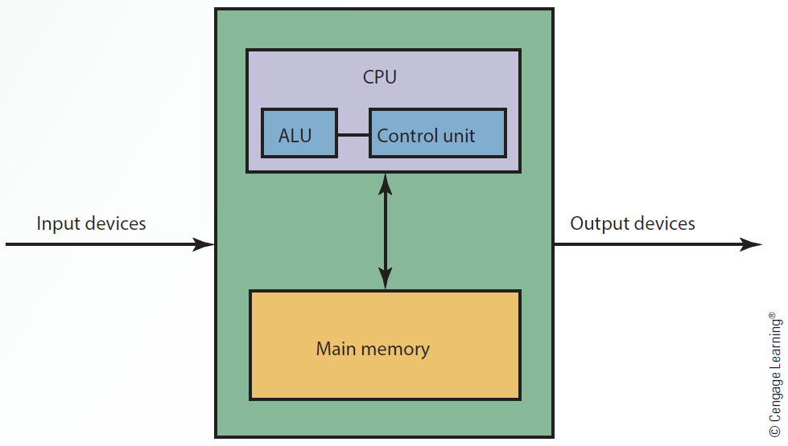
2.1 The Building Blocks of a Computer

Slide 10
Components of a Computer System
Bus: Link between devices connected to the computer
  Exists as parallel or serial, internal (local) or external
Disk drive: Peripheral device for recording, storing, and retrieving information

Slide 11
Components of a Computer System
CPU case: Enclosure containing the computer’s main components
  Referred to as computer chassis or tower
Motherboard: Circuit board containing connectors for attaching additional boards

Slide 12
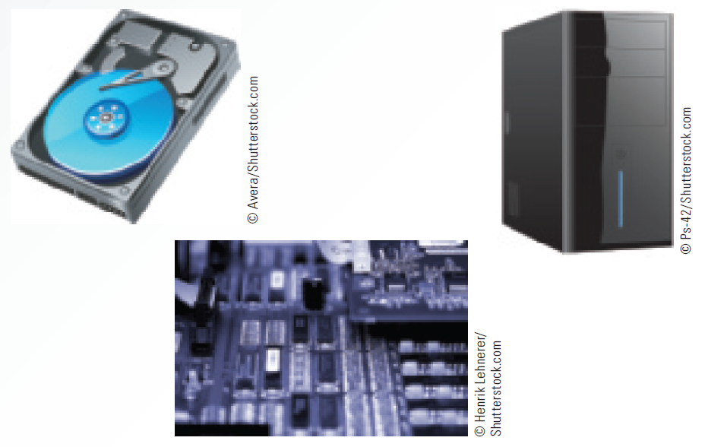
2.2 Components of a Computer System

Slide 13
History of Computer Hardware and Software
First-generation computers used vacuum tube technology in the 1940s
  Size was bulky and unreliable
  Generated excessive heat
  Programming was difficult
Second-generation computers used transistors
  Speed was faster, and more reliable
  Easier to program and maintain

Slide 14
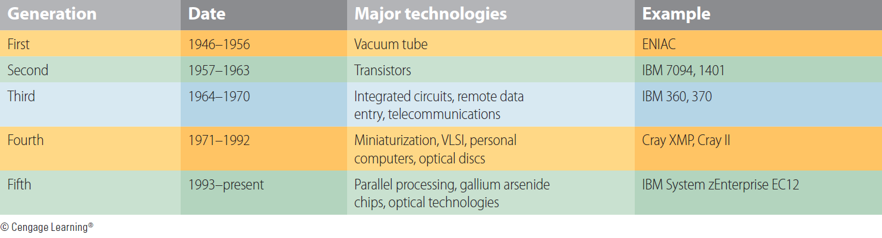
2.1 Hardware Generations

Slide 15
Factors Affecting the Power of Computers
Speed
Accuracy
Storage and retrieval capabilities

Slide 16
Speed and Accuracy
Computer speed is measured as the number of instructions performed per fractions of a second
  Millisecond: 1/1000 of a second
  Microsecond: 1/1,000,000 of a second
  Nanosecond: 1/1,000,000,000 of a second
  Picosecond: 1/1,000,000,000,000 of a second
Degree of accuracy is extremely important for many computer applications

Slide 17
Storage and Retrieval
Storage: Saving data in computer memory
Retrieval: Accessing data from memory
Data is stored in bits
American Standard Code for Information Interchange (ASCII)
  Data code for text files, PC applications, and the Internet
  Defines up to 128 characters

Slide 18
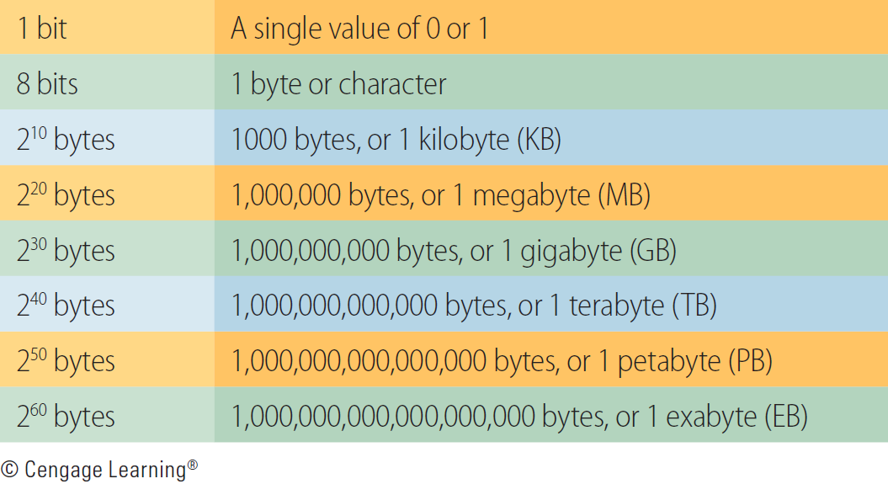
2.3 Storage Measurements (Approximations)

Slide 19
Input Devices
Send data and information to the computer
  Keyboard, mouse, touch screen, light pen, trackball, and data tablet
  Barcode reader, optical character reader (OCR), magnetic ink character recognition (MICR) system, and optical mark recognition (OMR) system

Slide 20
Output Devices
Capable of representing information from a computer
  Form of this output might be visual, audio, or digital
Displays output in the forms of soft copy and hard copy
Plotters: Converts output to graphics
Voice synthesizers: Converts output to voice

Slide 21
Memory Devices
Main memory: Stores data and is volatile
  Volatile: Contents are lost when electrical power is turned off
Secondary memory
  Nonvolatile
  Holds data when the computer is off or during course of a program's operation
  Serves as archival storage

Slide 22
Main Memory Devices
Semiconductor chips made of silicon
  Can be volatile or nonvolatile
Random access memory (RAM): Is a volatile memory, in which data can be read from and written to
  Known as read-write memory
  Cache RAM: Stores recently accessed memory
    Resides on the processor as memory access from main RAM storage takes several clock cycles

Slide 23
Main Memory Devices
Read only memory (ROM): Is nonvolatile
  Data cannot be written to it
  Includes BIOS information and the computer system’s clock
  Types
    Programmable read-only memory (PROM)
    Erasable programmable read-only memory (EPROM)

Slide 24
Secondary Memory Devices
Magnetic disks
Made of mylar or metal
Magnetic tape
Used for random-access processing
Made of a plastic material
Stores data sequentially
Optical discs
Use laser beams to access and store data
CD-ROM, WORM, DVD

Slide 25
Secondary Memory Devices
Includes hard disk, USB flash drive, memory card
Redundant array of independent disks (RAID) system
  Collection of disk drives used for fault tolerance and improved performance
  Found in large network systems

Slide 26
Secondary Memory Devices
Cloud storage
  Used for online storage and backup
  Involves multiple virtual servers that are hosted by third parties
  Customers buy or lease storage space from third parties based on their current or future needs

Slide 27
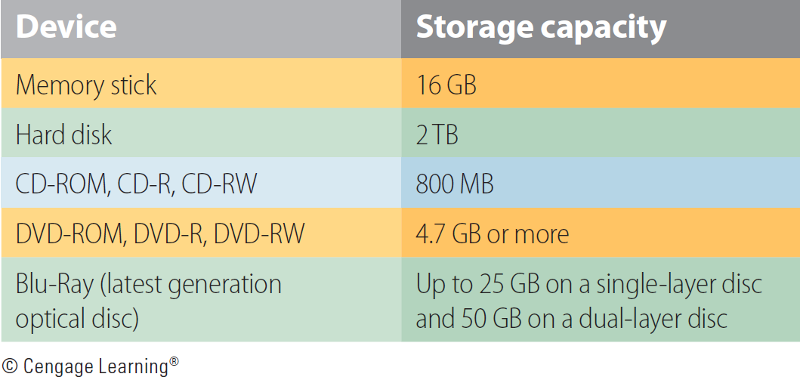
2.4 Capacity of Secondary Memory Devices

Slide 28
Storage Area Networks and Network-Attached Storage
Storage area network (SAN)
  Dedicated high-speed network consisting of both hardware and software
  Used to connect and manage shared storage devices
    Disk arrays, tape libraries, and optical storage devices
Network-attached storage (NAS)
  Network-connected computer dedicated to provide file-based data storage services to other network devices

Slide 29
Classes of Computers
Vary in terms of cost, amount of memory, speed, and sophistication
Types
  Subnotebooks and notebooks
  Personal and minicomputers
  Mainframes
  Supercomputers

Slide 30
Server Platforms: An Overview
Server
  Computer and all the software for managing network resources and offering services to a network
Available server platforms
  Application, database, disk, fax, file, mail, print, remote access servers (RAS ), and Web servers

Slide 31
What is Software?
Programs that run a computer system
Classification
  System software: Works in the background and takes care of tasks such as deleting waste files
  Application software: Performs specialized tasks

Slide 32
Operating System
Set of programs for controlling and managing computer hardware and software
Provides an interface between a computer and the user
Increases computer efficiency by helping users share computer resources and performing repetitive tasks for users

Slide 33
Operating System Software
Consists of control programs to manage hardware and resources by performing:
  Job management
  Resource allocation
  Data management
  Communication
Supervisor program: Responsible for controlling all other programs in the OS
  Known as the kernel

Slide 34
Application Software
Commercial software or software developed in-house, used to perform variety of tasks on a personal computer
  Word processing
  Spreadsheet and database
  Presentation and graphics
  Desktop publishing
  Financial planning and accounting
  Project management
  Computer-aided design (CAD)

Slide 35
Computer Languages
Machine language
  First generation of computer languages
  Consists of a series of 0 s and 1 s representing data or instructions representing data or instructions
  Dependent on the machine
  Time consuming to write a program

Slide 36
Computer Languages
Assembly language
  Second generation of computer languages
  Machine dependent, though a higher-level language than machine language
  Uses a series of short codes, or mnemonics, to represent data or instructions

Slide 37
Computer Languages
High-level languages
  Part of the third-generation of computer languages
  Machine independent and self documenting
  Used for Web development and Internet applications
Fourth generation languages (4GLs)
  Use macro codes that can take the place of several lines of programming
  Commands are powerful and easy to learn

Slide 38
Computer Languages
Fifth-generation languages (5GLs)
  Use artificial intelligence technologies
    Knowledge-based systems, natural language processing (NLP), visual programming, and a graphical approach to programming
  Designed to facilitate natural conversations between an individual and the computer

Slide 39
Application software
Arithmetic logic unit (ALU)
Assembly language
Bus
Cache RAM
Central processing unit (CPU)
Cloud storage
Computer

Slide 40
Control unit
CPU case
Disk drive
Fifth-generation languages (5GLs)
Fourth-generation languages (4gGLs)
High-level languages
Input devices
Machine language

Slide 41
Magnetic disk
Magnetic tape
Main memory
Motherboard
Network attached storage (NAS)
Operating system (OS)
Optical discs

Slide 42
Output devices
Random access memory (RAM)
Read-only memory (ROM)
Redundant array of independent disks (RAID)
Secondary memory
Server
Storage area network (SAN)

Slide 43
Computers perform arithmetic, logical, and storage and retrieval operations
To process data a computer requires input, output, and memory devices
Software is all the programs that run a computer system
Computer languages include machine, assembly, high-level, fourth- and fifth- generation languages

