Slide 2
Discuss common applications of computers and information systems
Explain the differences between computer literacy and information literacy
Define transaction-processing systems
Define management information systems
Describe the four major components of an information system

Slide 3
Discuss the differences between data and information
Explain the importance and applications of information systems in functional areas of a business
Discuss how information technologies are used to gain a competitive advantage

Slide 4
Explain the Five Forces Model and strategies for gaining a competitive advantage
Review the IT job market
Summarize the future outlook of information systems

Slide 5
Computers and Information Systems in Daily Life
Used by organizations to reduce costs and gain a competitive advantage in the marketplace
Used by students for online classes
Used in grocery and retail stores
  Point-of-sale (POS) system speeds up service by reading the universal product codes (UPCs) on items in the shopping cart
Information systems and information technologies are used interchangeably

Slide 6
Computer Literacy and Information Literacy
Computer literacy: Skill in using productivity software such as:
  Word processors, spreadsheets, database management systems, and presentation software
  Knowledge of hardware and software, the Internet, and collaboration tools and technologies

Slide 7
Computer Literacy and Information Literacy
Information literacy: Understanding the role of information in generating and using business intelligence
  Business intelligence (BI)
    Provides historical, current, and predictive views of business operations and environments
    Gives organizations a competitive advantage in the marketplace

Slide 8
The Beginning: Transaction-Processing Systems
Focus on data collection and processing
  Mainly used for cost reduction
  Applied to structured tasks
    Record keeping, simple clerical operations, and inventory control
  Requires minimal human involvement when automated

Slide 9
Management Information Systems
Organized integration of hardware and software technologies, data, processes, and human elements
Designed to produce timely, integrated, relevant, accurate, and useful information for decision-making purposes

Slide 10
Management Information Systems
Processes: Methods for performing a task in an MIS application
Designing involves:
  Defining the system’s objectives
  Collecting and analyzing data
  Providing information in useful format for decision-making purposes
Used in private and public sectors

Slide 11
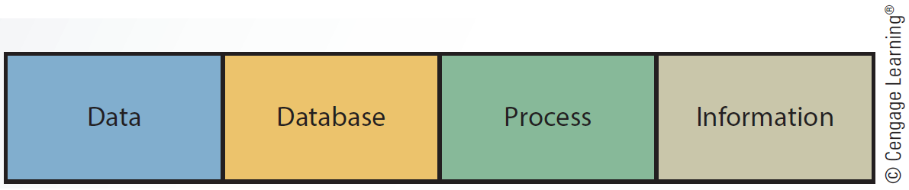
1.3 Major Components of an Information System

Slide 12
Data
Component of an information system consisting raw facts
Sources of data
  Internal: Sales and personnel records
  External
    Customers, competitors, and suppliers
    Government agencies and financial institutions
    Labor and population statistics
    Economic conditions

Slide 13
Data
Has a time orientation
Collected in forms of:
  Aggregated
    Useful for reporting overall performance during a sales quarter
  Disaggregated
    Analyzes sales by product, territory, or salesperson

Slide 14
Database
Collection of relevant data organized in a series of integrated files
Essential for the success of any information system
Database management system (DBMS) is used to create, organize, and manage databases
Reduces personnel time needed to gather, process, and interpret data manually

Slide 15
Process
Component of an information system that generates useful information for decision making
  Transaction-processing reports and models for decision analysis can be built into the system or accessed from external sources

Slide 16
Information
Consists of facts analyzed by the process component and is an output of an information system
Need to have the following qualities to be useful:
  Timeliness
  Integration with other data and information
  Consistency and accuracy
  Relevance

Slide 17
Information
Need to provide either a base for users to explore different options or insight into tasks
Usefulness is affected by the information system’s user interface because:
  Interface must be flexible and easy to use

Slide 18
Information
Information systems should produce information in different formats
  Graphics
  Tables
  Exception reports

Slide 19
Information
Supplied in a variety of formats increases the likelihood of:
  Users understanding and being able to use the information
Users need to be able to make use of informal information to solve problems

Slide 20
Using Information Systems and Information Technologies
Information technologies: Support information systems
  Uses:
    Internet
    Computer networks
    Database systems
    POS systems
    Radio frequency identification (RFID) tags

Slide 21
Importance of Information Systems
Timely, relevant, and accurate information is a critical tool for:
  Enhancing a company’s competitive position in the marketplace
  Managing the four Ms of resources
    Manpower, machinery, materials, and money

Slide 22
Importance of Information Systems
Personnel information system (PIS) or human resource information system (HRIS)
  Type of information system
  Provides information that helps decision makers in personnel performing their tasks more effectively
  Web technologies improve the efficiency and effectiveness of HR departments
    Intranets are used to provide basic HR functions

Slide 23
Importance of Information Systems
Logistics information system (LIS)
  Reduces the cost of transporting materials
  Maintains safe and reliable delivery
Manufacturing information system (MFIS)
  Manages manufacturing resources which help companies to:
    Reduce manufacturing costs
    Increase product quality
    Improve inventory decisions

Slide 24
The Importance of Information Systems
Financial information system (FIS)
  Provides information to financial executives in a timely manner
Marketing information system (MKIS)
  Improves marketing decisions
  Provides timely, accurate, and integrated information about the marketing mix-4Ps
    Price, promotion, place, and product

Slide 25
Using Information Technologies for a Competitive Advantage
Strategies for competing in the marketplace identified by Michael Porter, a professor at Harvard Business School
  Overall cost leadership
  Differentiation
  Focus

Slide 26
Using Information Technologies for a Competitive Advantage
Information systems helps:
  Organizations to reduce the cost of products and services
  Bottom-line strategies
    Improves efficiency by reducing overall costs
  Top-line strategies
    Focuses on generating new revenue

Slide 27
Using Information Technologies for a Competitive Advantage
Organizations:
  Use enterprise systems to reduce costs and improve customer service
  Make the products and services different from their competitors for differentiation strategies
  Focus on specific market segments to achieve a cost or differentiation advantage with focus strategies

Slide 28
Porter’s Five Forces Model: Understanding the Business Environment
Analyzes an organization’s position in the marketplace and how information systems can be used to make it more competitive
Five forces
  Buyer power
  Supplier power
  Threat of substitute products or services
  Threat of new entrants
  Rivalry among existing competitors

Slide 29
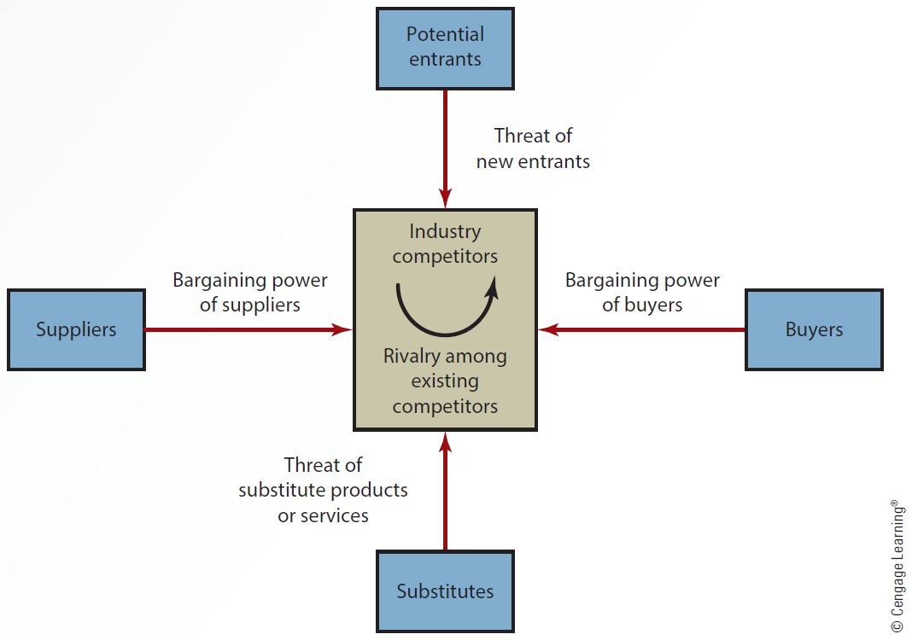
1.4 The Five Forces Model

Slide 30
Porter’s Five Forces Model: Understanding the Business Environment
Buyer power
  High when customers have many choices and low when customers have few choices
Supplier power
  High when customers have fewer options and low when customers have more options
Threat of substitute products or services
  High when alternatives to an organization’s products and services are available

Slide 31
Porter’s Five Forces Model: Understanding the Business Environment
Threat of new entrants
  Low when duplicating a company’s product or service is difficult
  Focus strategies are used by organizations to ensure the threat of new entrants remains low
Rivalry among existing competitors
  High when competitors occupy the same marketplace position and low when there are few competitors

Slide 32
Categorization of IT Jobs
Operations and help desk
Programming
Systems design
Web design and Web hosting
Network design and maintenance
Database design and maintenance
Robotics and artificial intelligence

Slide 33
Popular Jobs in the Information Systems Field
CTO/CIO
  Belongs to the chief technology officer (CTO) / chief information officer (CIO)
    Oversees long-range planning
    Monitors new developments that can affect company’s success
  Chief privacy officer (CPO)
    Responsible for managing risks and business impacts of privacy laws and policies

Slide 34
Popular Jobs in the Information Systems Field
Manager of information systems services
  Responsible for managing hardware, software, and personnel in the information systems department
Systems analyst
  Responsible for the design and implementation of information systems
    Requires understanding of business systems and functional areas within a business organization

Slide 35
Popular Jobs in the Information Systems Field
Network administrator
  Administers a company’s internal and external network systems
  Provides network and cybersecurity
Database administrator
  Responsible for database design and implementation
  Possesses knowledge and understanding of data warehouses and data-mining tools

Slide 36
Popular Jobs in the Information Systems Field
Computer programmer
  Writes programs or software segments allowing the information system to perform a specific task
Webmaster
  Designs and maintains the organization’s website

Slide 37
Outlook for the Future
Hardware and software costs will decline
Artificial intelligence and related technologies will improve and expand
Computer literacy and networking technology will improve
Personal computers will improve in power and quality
Internet growth will continue

Slide 38
Outlook for the Future
Computer criminals will become more sophisticated
  Protecting personal information will become more difficult

Slide 39
Business intelligence (BI)
Computer literacy
Data
Database
Five Forces Model
Information

Slide 40
Information literacy
Information technologies
Management information system (MIS)
Process
Transaction-processing systems (TPSs)

Slide 41
Computers and information systems are used to reduce costs and gain a competitive advantage in the marketplace
Computer and information literacy are the types of knowledge required to be competitive in the workplace
Information systems are designed to collect data, process it, and deliver timely, relevant, and useful information for making decisions

Slide 42
Some segments of the IT job market have shown growth compared to other job markets, even during the economic downturn
Improvement in networking technology will result in easy computer connections and faster transfer of information
Internet growth will make e-collaboration easier, despite geographical distances

