Slide 1
CMIS301
Object-Oriented Analysis
Introduction
Typical Problems
RMO Case Study

Slide 2
Prescribed Book:
Introduction to Systems Analysis and Design
  An Agile, Iterative Approach
Satzinger, Jackson and Burd
6th Edition; 7th Ed.?
ISBN: 9781111972264
Available:
  Bookshop, R 660.95
  Reserve Shelve of Library?

Slide 3
Background:
System analysis and design deal with planning the development of information systems:
  understanding and specifying in detail what a system should do and how the components of the system should be implemented and work together.
System analysts solve business problems through analysing the requirements of information systems and designing such systems by applying analysis and design techniques.
This course deals with the concepts, skills, methodologies, techniques, tools, and perspectives essential for systems analysts.

Slide 4
Introduction
The key to successful system development is thorough systems analysis and design:
  to understand what the business requires from the information system
Systems analysis means understanding and specifying in detail what the information system should do

Slide 5
Introduction (cont.)
Systems design means specifying in detail how the many components of the information system should be physically implemented
We will learn techniques used by a systems analyst, a business professional who develops information systems.
  It focuses specifically on object-oriented analysis and design, using an agile, iterative approach.
This year we will focus on implementation

Slide 6
Mary Wright: (Case Study.ed5)
MIS: Management Information System graduate
  Works at an independent oil refinery
  Comp buys crude oil from petroleum producers
  Refine it and sell it to distributors
  Demand for refined petroleum had increased
Problem: Increase production at reduced cost
  Improve the Capacity Planning System and the Refining Operating System

Slide 7
Challenge:
This increased demand and other competitive changes in the industry made Information Systems particularly important:
IS are crucial to the success of businesses
  They make businesses more competitive
  Having a dramatic impact on productivity and profits
  Examples: Online purchases and reservations, online auctions,…, e-mail, etc.

Slide 8
People vs. Technology:
It’s NOT the technology itself that increases productivity and profits
It’s the people who develop IS solutions that harness the power of the technology that makes these benefits possible.
“Strategic IS”

Slide 9
Ms Wright:
She did some programming
  User support, VB/Java training
  Very much according to her training
The company decided on Integrated Process Control system project:
  More strategic overall planning
  Including IS
She becomes a junior analyst assisting the project manager

Slide 10
Her Job:
  To attend meetings
  To learn about refining
  Distribution
  Met with production supervisors
  Suppliers
  Marketing managers
  To learn about the oil industry
Systems development involves more than just programming

Slide 11
Systems Development:
Understanding the business
Goals and strategies
Defining requirements for IS that support these
  Goals
  Strategies and
  Business

Slide 12
System Analyst:
The work is about solving problems
Problems are solved partly by IS
You need skills:
  Technical
  Business
  People knowledge
Projects like strategic planning, process reengineering and ERP

Slide 13
Case Study: Ridgeline Mountain Outfitters (RMO)
RMO is a sportswear company that sells both its own branded products as well as other national brands. There are two systems for RMO that are discussed in the textbook.
The Tradeshow system is a small system that serves as the example development project in Chapter 1.

Slide 14
RMO:
The Consolidated Sales and Marketing System (CSMS) is a major system that serves as the running example throughout the rest of the textbook
We will analyze this in Ch 2

Slide 15
Solving a Problem:
General:
  Karl Duncer in 1935 with his book The psychology of productive thinking
  The term problem-solving is used in many disciplines, sometimes with different perspectives, and often with different terminologies.
  For instance, it is a mental process in psychology and a computerized process in computer science

Slide 16
How to Solve a problem:
6 core processes
The SDLC defines all the activities required to develop a new system:
  Identify the problem or need and obtain approval to proceed.
  Plan and monitor the project—what to do, how to do it, and who does it.
  Discover and understand the details of the problem or the need.

Slide 17
(cont.)
  Design the system components that solve the problem or satisfy the need.
  Build, test, and integrate system components.
  Complete system tests and then deploy the solution.

Slide 18
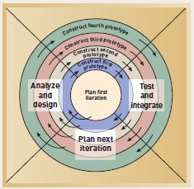
Spiral Model: adaptive approach

Slide 19
Iterative and Agile Systems Development Lifecycle (SDLC)

Slide 20
What is the basic philosophy of Agile development?
That the user cannot predict all of the needs of a new system, so the development process must be structured to anticipate the many requirements changes that normally occur.
The development process must be flexible and agile.

Slide 21
What is iterative development?
an approach to system development in which the system is "grown" piece by piece through multiple iterations

Slide 22
Q: What is the basic purpose of a course in systems analysis and design?
Answer: To provide the student with the necessary tools to
  understand and document the business need, i.e. requirements,
  define a solution,
  work in a team to build the solution and
  launch the application so that it is in productive use.

Slide 23
Q: 6 core processes?
  Identify the problem or need and obtain approval to proceed.
  Plan and monitor the project—what to do, how to do it, and who does it.
  Discover and understand the details of the problem or the need.
  Design the system components that solve the problem or satisfy the need.
  Build, test, and integrate system components.
  Complete system tests and then deploy the solutn

Slide 24
Q: What are the key benefits of iterative development?
A quicker deployment of important portions of the system, being able to address tough problems early, and having a flexible development process that can respond to changing requirements.

Slide 25


Slide 26


Slide 27
The greatest sign of success for a teacher is to be able to say, The learners are now working as if I did not exist.
- Maria Montessori
“This teacher should not be paid. We had to teach ourselves in this course.”

Slide 28
Job Opportunities?
CV
Academic or Applied
Hons
  Make sure about entrance requirements

Slide 29
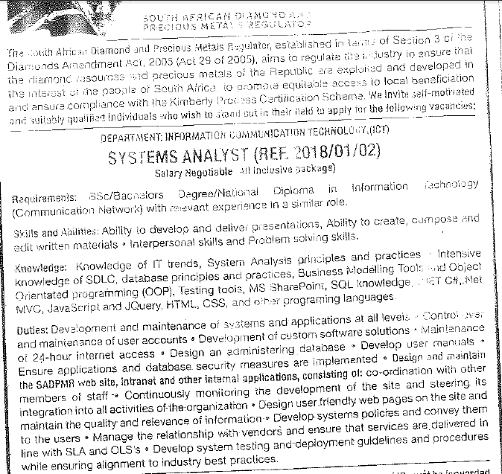

Slide 30
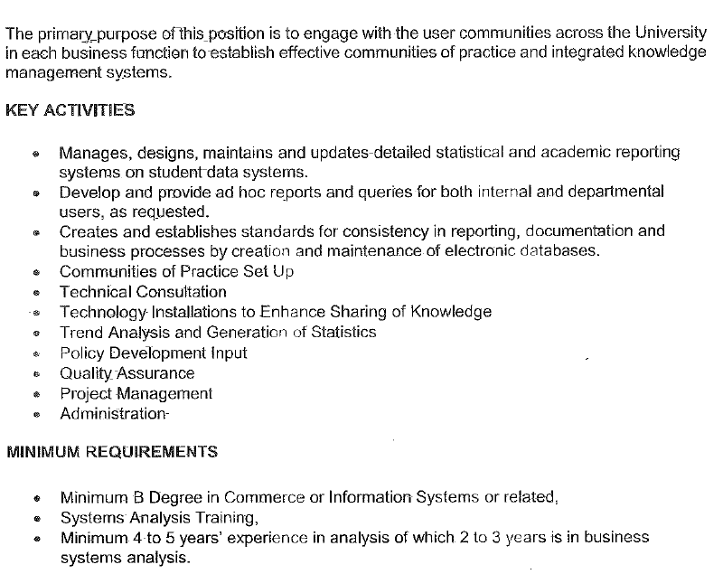

Slide 31
Mountains should be climbed with as little effort as possible and without desire. The reality of your own nature should determine the speed. If you become restless, speed up. If you become winded, slow down. You climb the mountain in an equilibrium between restlessness and exhaustion. Then, when you’re no longer thinking ahead, each footstep isn’t just a means to an end but a unique event in itself.
“The only Zen you find on the tops of mountains is the Zen you bring up there”.

Slide 32
Congratulations:
3rd year/final year student
Best wishes for this year
Make it your best ever

