Slide 1
Intelligent Agent in Education
IFT 6261: Traitement des connaisances
HO Thi Thanh Ai

Slide 2
Plan
Introduction
Intelligent Agent-based approach in Education
Interactive Pedagogical Agent
Developing Intelligent Pedagogical Agent
Examples of Intelligent Pedagogical Agent
Conclusion

Slide 3
Introduction
The development of e-Learning
Real-world constraints
  limited financial resources
  insufficient numbers of qualified instructors
Agent technology
An agent is a computer system that is capable of independent action on behalf of its user or owner. [Wooldridge, 2002]

Slide 4
Active Learning
Expand learning experience.
Take advantage of the power of interaction: dialogue with self, dialogue with others, observing and doing.
Create a dialect between experience and dialogue.
Notes:
Nowadays, one of the major challenges in education is to improve both instructional productivity and learning quality for a large and diverse population of students under real-world constraints such as limited financial resources and insufficient numbers of qualified instructors. Many researches suggest that students who are actively engaged in the learning process are more likely to achieve success.
(1) Expand learning experience. We can give the students the change to communicate with their classmates or with other people (via Web, email…) to help them answer a focused question or find solutions for a problem.
(2) Take advantage of the power of interaction. There are four modes of learning: dialogue with self, dialogue with others, observing and doing. Each of the four modes has its own value, and using them at the same time can add variety, and thereby be more interesting to the learners.
(3) Create a dialect between experience and dialogue. New experience (of doing or observing) can give learners a new perspective on what is true (beliefs) and/or what is good (values) in the world. Dialogue (with self or with others) can help learners construct the many possible meanings of experience and the insights that come from them. People learn faster when new concepts are useful in their present as well as future lives. The role of an educator is to assess the audience’s interests, current skills, and aims. This information then guides the structuring of a learning atmosphere and selection of methods most satisfying and effective for the learners.

Slide 5
Agent’s roles (1)
Agent as Expert
Experts exhibit mastery or extensive knowledge and perform better than the average within a domain.
Agent as Motivator
The Motivator suggests his own ideas, verbally encourages and stimulates the learners.
Agent as Mentor
An ideal human instructor provides guidance for the learner to bridge the gap between the current and desired skill levels.
[Baylor et al., 2003]
Notes:
An important aspect of designing pedagogical agents is to carefully design their role within the learning environment to serve the intended educational purposes. It is thus necessary that the agent roles are able to help the students achieve success in their learning process.
Agent as Expert
Experts exhibit mastery or extensive knowledge and perform better than the average within a domain. Also, experts are generally confident and stable in performance and not swayed emotionally by internal or external conditions. In Baylor’s research, the Expert is based on the image of a professor in forties referred to as “Dr. Erickson”. His appearance was formal with limited animation and he spoke in a formal and professional manner with limited intonation and provided timely and accurate information.
Agent as Motivator
Verbal persuasion to the learners that they are capable to perform a task helps increase the learners’ efficacy belief, a key construct of motivation. The Motivator was not necessarily knowledgeable but rather suggested his own ideas, verbally encouraging the learner to sustain the tasks; and, by asking questions, stimulated the learners to reflect on their personal experiences.
Agent as Mentor
An ideal human instructor does not simply provide information but rather provides guidance for the learner to bridge the gap between the current and desired skill levels. In the same fashion, a true mentor should not be an authoritative figure; instead, a guide or coach with advanced experience and knowledge to work collaboratively with the learners to achieve goals. Thus, the agent as Mentor should demonstrate competence to the learner; at the same time, develop a social relationship to motivate the learner [Baylor et al., 2003].

Slide 6
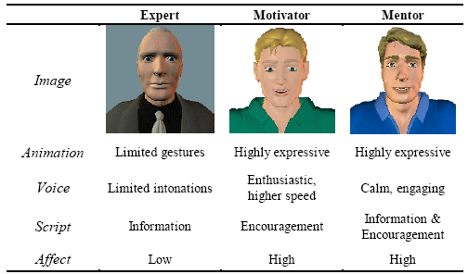
Agent’s roles (2)
Agent Roles by Characteristics ([Baylor et al., 2003])

Slide 7
What is IAPA? (1)
Animated computer characters that are tied into an artificial intelligence backend
Four educational benefits [Lester, 1997] :
  encourage the learner to care more about his own progress;
  sensitive to the learner's progress
  convey foster similar levels of enthusiasm
  make learning funnier.
Notes:
A Pedagogical Agent that appears to care about a learner's progress may convey to the learner that it and she are "in things together" and may encourage the learner to care more about his own progress;
An emotive Pedagogical Agent that is in some way sensitive to the learner's progress may intervene when she becomes frustrated and before he begins to lose interest;
A Pedagogical Agent may convey foster similar levels of enthusiasm to the learner;
A Pedagogical Agent with a rich and interesting personality may simply make learning funnier.

Slide 8
Features of IAPA
Adaptation: evaluate the learner's understanding to adapt the lesson plan accordingly.
Motivation: offer encouragement to the students and give them feedback.
Engagement: have colorful personalities, interesting life histories, and specific areas of expertise.
Evolvement: keep learners current in a rapidly accelerating culture..
Notes:
Adaptation: A Pedagogical Agent evaluates the learner's understanding to adapt the lesson plan accordingly. Pedagogical Agents make sure that the students have a good understanding of the basic concepts then move on to more sophisticated concepts.
Motivation: Pedagogical Agents offer encouragement to the students and give them feedback. They present relevant information, offer memorable examples, interpret student responses, and even tell a clever joke or two;
Engagement: Pedagogical Agents have colorful personalities, interesting life histories, and specific areas of expertise.
Evolvement: Pedagogical agents can be revised and updated as frequently as necessary to keep learners current in a rapidly accelerating culture. They can search out the best or most current content available on the web to enrich the lessons that someone else has previously designed.

Slide 9
Persona effect of IAPA
The strong positive effect of an animated agent on student's perception of their learning experience.
Two potential effects of agents on learning:
  direct cognitive effect in superior knowledge acquisition.
  motivation effect: increases students' positive perceptions of their learning experiences.
Persona effect of animated pedagogical agent
  too much animation or too bad animation can lead to negative effects on the learners
Notes:
According to [Lester et al, 1997], the persona effect is the strong positive effect of an animated agent on student's perception of their learning experience.
There are two potential effects of agents on learning.
First, there may be a direct cognitive effect in superior knowledge acquisition. Pedagogical agent can observe the actions taken by students and assist them during their learning process.
Second, there may be a motivation effect, which may be even more pronounced. Because lifelike characters have such an enchanting presence, they may significantly increase students' positive perceptions of their learning experiences.
Considering the persona effect of animated pedagogical agent, the designers of interactive learning environments should try to integrate the persona gesture into pedagogical agent. Behaviors such as gaze shifting, facial expression, and tone of voice are essential in order to give students the impression that these agents are aware of them and understand them.
However, too much animation or too bad animation can lead to negative effects on the learners. The robotic voice, the awkward gesture can be annoying to learners.

Slide 10
Architectural Patterns in IPA
A written document that describes a general solution to a design problem that recurs repeatedly in many projects.
Architectural Patterns from [Devedzic, Harrer]
  Analysis Pattern: reusable models resulting from the process of software analysis applied to common business problems and application domain.
  General Pedagogical Agent Pattern (GPA Pattern)
  Co-learner Pattern

Slide 11
GPA pattern (1)
Communication
Behavior Engine
State
Knowledge
Acquisitioner
Knowledge
Base
Manager
Problem Solver
Knowledge Base
The GPA Pattern (Source: [Devedzic, Harrer])
Notes:
According to [Devedzic, Harrer], this pattern has been abstracted out of a number of agents playing different roles in different educational settings, yet having much in common.
Knowledge Base: include domain knowledge, pedagogical knowledge and/ or strategies, student model. Example: Knowledge Base Manager in Disciple agent.
Problem Solver: inferencing, case-based reasoning, student model evaluation, and others tasks normally associated with learning and teaching activities.
Communication (Interface): perceiving the dynamic learning environment and acting upon it.
State: a general abstraction for many kinds of states a pedagogical agent can be made “aware of”. It can also contain current values of parameters of the agent’s relationships with other agents.
Knowledge Acquisitioner and Behavior Engines are occasional participants in the GPA pattern.
Knowledge Acquisitioner reflects the learning capability of the agent to update and modify its knowledge over time. Behavior Engine (Expression Engine) is responsible for analysis of the agent’s current internal state and possible modifications of that state.

Slide 12
GPA Pattern (2)
Perception
Action
Emotion Generator
Emotion
Behavior Generator
Personality
Knowledge
Base
Manager
Learning
Knowledge Base
An example of GPA pattern in Classroom Agent Model
Source: [ITS 1998, Lecture Notes in Computer Science, p488]
Notes:
Classroom Agents represent students in a classroom, each one having its own personalities and emotions (instance of State).
Learning: all kinds of problem solving activities associated with learning situations (instance of Problem Solver)
Behavior Engine is split in 2 distinct part: one to generate the agent’s emotion (Emotion Generator) and another one Behavior Generator to formulate the agent’s learning actions and pass them to the effector (the Action part of the Communication Module)
The idea is that for a learning agent perceiving an event that motivates it (ex: an easy exercise), positive emotions will be generated and will promote its learning, which certainly be reflected in Behavior Generator when formulating the agent’s next action.

Slide 13
Co-Learner Pattern (1)
Co-learner is an artificial learner acting as a peer of students. It encourages the student to learn collaboratively, discuss his intentions and their consequences. [Devedzic, Harrer]
Co-learner can be a learning companion, troublemaker or several reciprocal tutoring roles.

Slide 14
Co-Learner Pattern (2)
Tutor
Co-learner Model
Domain Knowledge
Learning Task
Teaching Strategy
Student Model
Co-Learner
Student
Co-Learner pattern: communication paths
(Source: [Devedzic, Harrer])
Notes:
Tutor – Student: The tutor can present learning tasks and materials, provide guidance,… Most of the communication goes through the Learning Task, while all the necessary domain knowledge is in the Domain Knowledge part. Tutor cans use different Teaching Strategies. During the course of the learning task, the tutor develops the Student Model.
Tutor – Co-Learner: If the co-learner is a troublemaker, it does not get much instruction or direction from the Tutor and has access to the Domain Knowledge. During the course of the learning task, the tutor develops the Co-Learner Model.
Student – Co-learner: the student observes the co-leaner work on learning task individually, ask for assistance,…

Slide 15
Disciple (1)
An apprenticeship, multi-strategy learning approach for developing IPA
an expert teaches the agent to perform domain-specific tasks
  by giving examples and explanations,
  by supervising and correcting its behavior.
[Tecuci, Keeling, 1999]
Notes:
Disciple is an apprenticeship, multi-strategy learning approach for developing intelligent agents where an expert teaches the agent to perform domain-specific tasks in a way that resembles how the expert would teach an apprentice, by giving the agent examples and explanations, and by supervising and correcting its behavior.

Slide 16
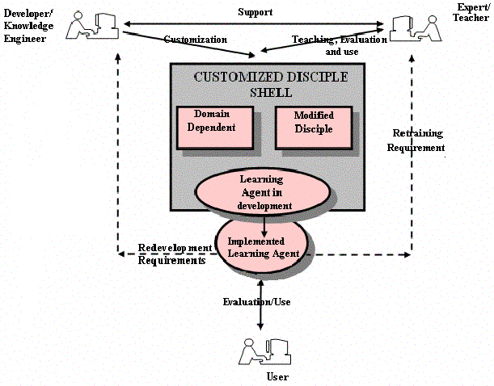
Disciple (2)
Overview of the Disciple agent building methodology
(Source: [Tecuci, Keeling, 1999])
Notes:
In this approach, the agent learns its behavior from its teacher by integrating several machine learning and knowledge acquisition techniques. This process is based on cooperation between the agent and the human expert in which the agent helps the expert to express his/her knowledge using the agent’s representation language, and the expert guides the learning actions of the agent. As a consequence, the Disciple approach significantly reduces the involvement of the knowledge engineer as well as the time required from the domain expert in the process of building an intelligent agent.

Slide 17
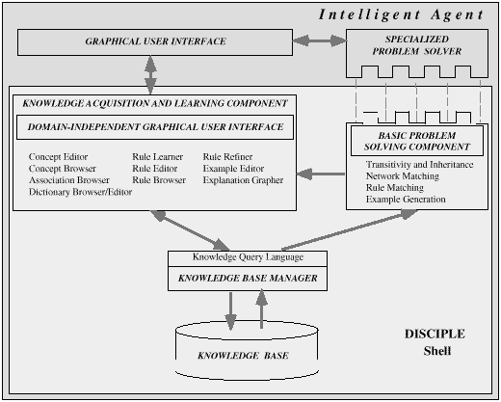
Disciple (3)
The architecture of the Disciple shell.
(Source: [Tecuci, Keeling, 1999])
Notes:
Disciple Learning Agent Shell contains components for basic knowledge acquisition and learning, problems solving and knowledge base management.
The Disciple shell consists of four main domain independent components:
a knowledge acquisition and learning component for developing and improving the knowledge base, with a domain-independent graphical user interface;
a basic problem solving component which provides basic problem solving operations;
a knowledge base manager which controls access and updates to the knowledge base;
an empty knowledge base to be developed for the specific application domain.
a specialized problem solver which provides the specific functionality of the agent;
a domain-specific graphical user interface which facilitates training and use by educators and students.

Slide 18
Disciple (4)
Development phases
analyzing the problem domain, defining agent requirements and the top level ontology of the agent’s knowledge base;
designing domain dependent modules, the agents task structure and problem solver;
customizing the Disciple shell, building the initial knowledge base and problem solver, and teaching the agent how to generate tests; developing the agent with a problem solving engine and a graphical user interface;
verifying, validating and maintaining the agent.

Slide 19
Agent DORIS (1)
A pedagogical follow-up agent for Intelligent Tutoring Systems
Task:
  follow students’ interaction with the intelligent tutor system
  collect the information required for the modeling of students’ profile used to customize the environment
  assist, guide student during the construction of their learning.
Notes:
DORIS is a pedagogical follow-up agent for Intelligent Tutoring Systems developed to perform task such as follow students’ interaction with the intelligent tutor system, collect the information required for the modeling of students’ profile used to customize the environment assist and guide student during the construction of their learning.

Slide 20
Agent DORIS (2)
Perceptive
module
ENVIRONMENT
Knowledge Base
Cognitive
module
Reactive
module
Agent
Pedagogical Agent
Architecture of DORIS
(Source: [Santos et al, 2002])
Notes:
Perceptive module: is responsible for the extraction and storage of information related to students’ interaction with the system. This module is used to monitor students’ actions.
Cognitive module: is responsible for making inferences on the knowledge base, determining which actions should be taken by the agent based upon its perception.
Reactive module: is responsible for executing the actions indicated by the cognitive module. It also establishes the animated interface with the students.
Knowledge Base: is made up of the following elements: audio-visual resources base, class base, visited pages base, content base, students’ answers base, message base, students’ question base, students’ preferences base

Slide 21
Agent DORIS (3)
Two types of behavior:
The cognitive behavior encourages students to follow the class, send them stimulus messages (tips, reminders,…), perceive the interaction environment,…
The reactive behavior manipulates the agent’s appearance and selects an appropriate attitude.
Notes:
The agent DORIS is represented by a character with two types of behavior: cognitive and reactive behavior.
The cognitive behavior encourages students to follow the class, send them stimulus messages (tips, reminders,…), perceive the interaction environment,…
The reactive behavior manipulates the agent’s appearance and selects an appropriate attitude.
The pedagogical follow-up agent developed enables a more pleasant interaction of students with learning system, making the environment more attractive and motivating students to learn. This agent can also collecting relevant information on students, which is a big challenge in this field.

Slide 22
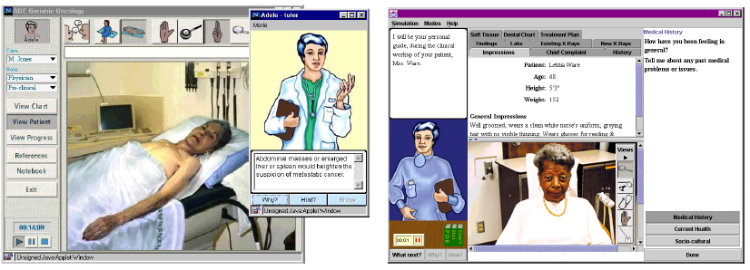
Agent Adele (1)
Adele oversees a student working through clinical dentistry and medical cases. (Source: [Swan et al, 1999])
Notes:
Adele is designed to support students working through problem-solving exercises that are integrated into instructional materials delivered over the World Wide Web.

Slide 23
Agent Adele (2)
Reinforce the following kinds of learning as the students work through clinical problems.
Help learners acquire an understanding of best practice,
  Ex: the appropriate clinical procedures to follow.
Help students to learn how to apply the procedures,
  Ex: what actions to take in order to obtain desired patient information.
Help learners to understand why a diagnostic or therapeutic action should be taken, what effect it will have and what its significance is.
[Johnson et al, 2003]

Slide 24
Component of Agent Adele
The pedagogical agent
  The reasoning engine performs all monitoring and decision making.
  The animated persona is simply a Java applet that can be used alone or incorporated into a larger application.
The simulation
Notes:
The pedagogical agent consists further of two sub-components, the reasoning engine and the animated persona. An optional third component, the session manager, is employed when the system is run is multiple-user mode.
The reasoning engine performs all monitoring and decision making. Its decisions are based on a student model, a case task plan, and an initial state, which are downloaded from the server when a case is chosen, and the agent’s current mental state, which is updated as a student works through a case. Upon completion, the student’s actions are saved to the server where they will help determine the student’s level of expertise, as well as how Adele will interact with the student in future cases.
The animated persona is simply a Java applet that can be used alone or incorporated into a larger application. Animation frames can be swapped in and out to provide the case author or user with a choice of persona.
The simulation can be authored using the language or authoring tool of one’s choice. All simulations communicate with the agent via a common API that supports event (e.g., the student orders a lab) and state change (e.g., the lab results get updated) notifications as defined by the simulation logic.

Slide 25
Multi-Agent System in Education
Autonomously designed;
Flexibly designed;
Autonomously executed.
Notes:
Among the features of agents, modularity is one of the foremost. Because of this feature, we can design agents with different functions locally as long as they satisfy some high-level communication and performance standards of the system. Moreover, we can expand our system in the future by adding more agents as long as all agents can co-operate well. Thus, it offers us a very attractive implementing environment.
The multi-agent system has three main features that make it more effective and reliable to implement and emulate the learning of programming. It can be:
Autonomously designed;
Flexibly designed;
Autonomously executed.
This section presents the system MAS-PLANG as an example of using Multi-agent System in Education.

Slide 26
MAS-PLANG (1)
Developed by Agents Research Lab, University of Girona.
A multi-agent system oriented to support students when using the educational web-based platform PLANG.
Case-based reasoning approach for student modeling:
  The system can categorize students according to their skills in processing, perceiving, entering, organizing and understanding the information.
  [Peña et al.]
Notes:
MAS-PLANG is developed by Agents Research Lab, University of Girona. This is a multi-agent system oriented to support students when using the educational web-based platform PLANG. An important feature of the MAS-PLANG student agent is the case-based reasoning approach for student modeling. The system can categorize students according to their skills in processing, perceiving, entering, organizing and understanding the information. [Peña et al.]

Slide 27
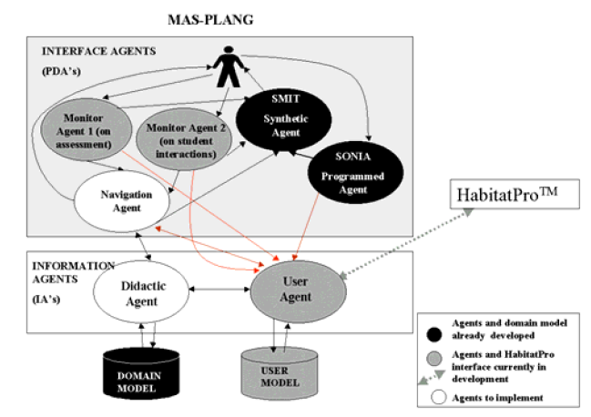
MAS-PLANG (2)
MAS-PLANG architecture
(Source: [Peña et al.])
Notes:
SONIA – Programmed Agent
The Programmed agent tries to automate learning tasks, either allowing the student to program their activities based on examples, or imitating the student's behavior and adapting to it.
The SONIA (Student Oriented Network Interface Agent) agent receives the user's petitions to carry out tasks like:
A warning when a specific classmate comes on-line.
Suggesting the revision of the bibliographical references in some sections of the lesson.
Suggesting the carrying out the interactive exercises proposed when the student gets to particular sections of the lesson.
Warning if he/she has gone beyond a specific time of study.
Reminding the student with personalized messages at a determined time.
In the special case of a professor's message, getting the attention of some students currently connected to the system so that they could revise some specific sections of the lesson, solve a particular problem or enter the chat room to carry out an on-line discussion.
The Monitoring agents
This agent monitors the student's activities in order to generate feedback to their behavior model (on assessment and on interactions).
The Synthetic agent
This agent is introduced with an animated design (anthropomorphous) in the interface, presenting the messages coming from other agents, in the form of suggestions or warnings when the student exhibits special behavior during the learning activity.
The Navigation agent
This agent organizes the navigation paths by directly interaction with databases and by communicating with the didactic agent and the user agent.
Each user’s agent will proactively increase the knowledge that it has about his/her student by applying his own strategies. It will be able to orientate the motivation information to the student’s needs and to improve the system’s performance by using different motivation techniques, collaborative filtering and self-criticism.

Slide 28
Conclusion
Prospect of developing pedagogical agents
  improve both instructional productivity and learning quality for a large and diverse population of students under real-world constraints
More research
  evaluate and analyze the effectiveness of pedagogical agents in various leaning contexts
  analyze well-known pedagogical agent architecture from the pattern perspective.
Notes:
As a result of rapid advances in agent technology, the prospect of developing pedagogical agents on a broad scale is quickly becoming a reality. These agents can provide students with customized advice in response to their problem-solving activities. In addition, they can remove some barriers of learning like fears of asking stupid questions. As a result, they can improve both instructional productivity and learning quality for a large and diverse population of students under real-world constraints.
The animated agent can be developed in a desktop GUI interface like agent Adele. In our opinion, no clear advantage of 3D over 2D as far as user acceptance is concerned. With 2D design, although the agent will have fewer options for interacting with students, we still can take advantage of the persona effect and reduce the development cost.
As the intelligent pedagogical agent is currently complex to create, we can apply the patterns in the development process. Using a pattern, it would be able to build Pedagogical Agent with reduced effort or at least make them easier to maintain in the future. The developers of pedagogical agents can have a good starting point in designing solutions to new problems without “reinventing the wheel”.
Concerning the knowledge representations that support problem solving, pedagogical agents need enough domain knowledge to support the anticipated instructional dialogs and behavior. In addition, users can react to agents in unexpected ways, so prototyping and experimentation are essential. We can use the Disciple methodology, where an expert teaches the agent to perform domain-specific tasks in a way that resembles how the expert would teach an apprentice, by giving the agent examples and explanations, and by supervising and correcting its behavior.
In order to take full advantage and to reduce the complexity of pedagogical agent, we can design agents with different functions locally. Then we can expand our system in the future by adding more agents as long as all agents can co-operate well. Thus, it offers us a very attractive and flexible implementing environment. Moreover, the presence of multiple agents can provide different perspectives from which to view the learning situation, and thus provide new opportunities for interaction. More than one type of pedagogical agent in a system can have a significantly more positive impact on both learning and the perceived value of the agents.
However, more research still needs to be carried out to evaluate and analyze the effectiveness of pedagogical agents in various leaning contexts and to analyze well-known pedagogical agent architecture from the pattern perspective. These efforts can well establish a new paradigm in computer-assisted learning.

Slide 29
Reference (1)
Baylor, A. L. The Split-Persona Effect with Pedagogical Agents. Department of Educational Psychology and Learning Systems.
Baylor, A. L. Kim, Y. Validating pedagogical agent roles: Expert, Motivator, and Mentor. ED-MEDIA, Honolulu, Hawaii. 2003.
Devedzic, V., Harrer, A. Architectural Patterns in Pedagogical Agents. Lecture Notes in Computer Science (Intelligent Tutoring Systems). ITS 2002
Johnson, W. L. (1998), Pedagogical agents. ICCE'98 - Proceedings Sixth International Conference on Computers in Education. China.
Johnson, W. L., Rickel, J. W., Lester, J. C. Research in Animated Pedagogical Agents: Progress and Prospect for Training. May 2001.
Johnson W.L., Shaw, E., Marshall, A., & Labore, C. Evolution of user interaction: The case of agent Adele. Proceedings of IUI'03. New York: ACM Press, 2003.
Lester, J. C., Converse, S. A., Kahler, S. E., Barlow, S. T., Stone, B. A., Bhoga, R. S. (1997). The Persona Effect: Affective Impact of Animated Pedagogical Agents. CHI'97 - Conference on Human Factors in Computing Systems. ACM: Electronic Publication.

Slide 30
Reference (2)
Marcello Thiry, Suresh Khator, Ricardo M. Barcia, Alejandro Martins, Intelligent Agent-Based Approach for Distance Learning
Nwana, H. Software Agents: An Overview. Knowledge Engineering Preview, Vol. 11, No. 3. Cambridge University Press. 1996
Peña, Clara-Inés. Marzo, Jose-L. Josep-Lluis de la Rosa. Intelligent Agents in a Teaching and Learning Environment on the Web, University of Girona, Spain. 2002.
Russell, S.J. and P. Norvig. "Artificial intelligence: a modern approach." Prentice Hall series in artificial intelligence. Prentice Hall, N.J. 1995
Slater, D. (2000). Interactive Animated Pedagogical Agents: An introduction to an emerging field. ED324/G345: Stanford University. 2000
Swan, E., Johnson, L. and Ganesham, R. Pedagogical Agents on the Web. Autonomous Agents'99, ACM Press, 1999.
Santos, C., Frozza, R., Dhamer, A., Gaspary, L. P. : DORIS – Pedagogical Agent in Intelligent Tutoring Systems. Lecture Notes in Computer Science (Intelligent Tutoring Systems). ITS 2002
TECUCI, G., KEELING, H. Developing an Intelligent Educational Agent with Disciple. International Journal of Artificial Intelligence in Education,1999.

