Slide 1
Project: NNG Hospital
Overview
Payback Analysis
NPV

Slide 2
Tasks:
Provide an overview of the proposed system, including costs and benefits, with an explanation of the various cost-benefit types and categories.
Develop an economic feasibility analysis, using payback analysis, ROI, and present value (assume a discount rate of 10%).
  Cost-Benefit Summary
  Payback Analysis

Slide 3
Current System:
six hours of office staff (2 people) overtime per week (1.5 times normal rate) at a base rate of R150 per hour for 6 months
add another full-time clerical position in about six months for another 6 months.
an average of three errors per day, and each error takes about 20 minutes to correct

Slide 4
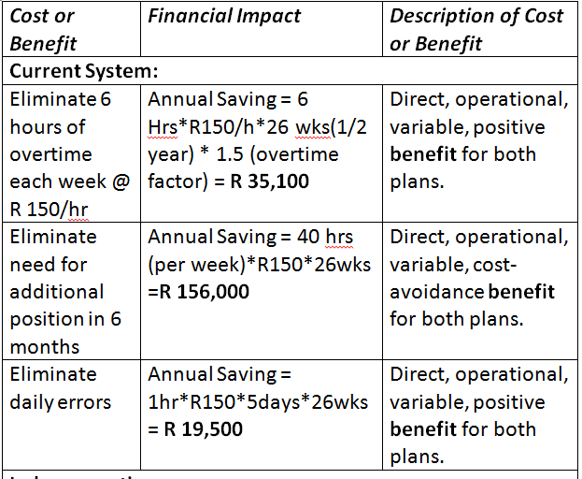

Slide 5
In-House System
complete the project in about 12 weeks
R350 per hour.
database application, you can expect to spend about R42,000 for a networked commercial package

Slide 6
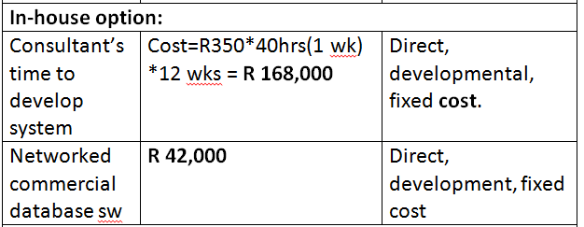

Slide 7
Vertical-Package:
a vertical software package is available for about R120,000. The vendor offers a lease-purchase package of R40,000 down, followed by two annual installments of R40,000 each.
four weeks to install, configure, and test it
free support during the first year of operation, but then NNH must sign a technical support agreement at an annual cost of R6,000

Slide 8
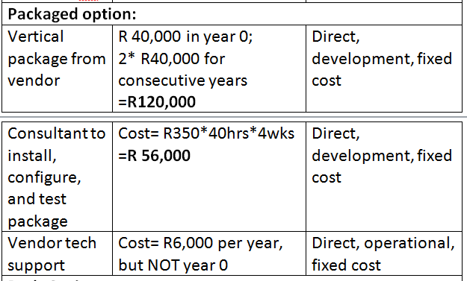

Slide 9
Costs for Both Systems:
10 hours of initial training and support each week for the first three months of operation
routine maintenance, file backups, and updating. These tasks will require about four hours per week and can be performed by a clinic staff member
hardware and network installation will cost about R125,000
System life will be about five years

Slide 10
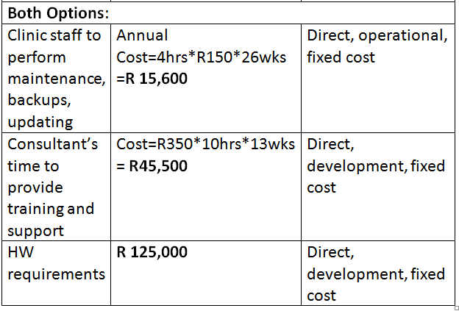

Slide 11
Tasks:
Provide an overview of the proposed system, including costs and benefits, with an explanation of the various cost-benefit types and categories.
Develop an economic feasibility analysis, using payback analysis, ROI, and present value (assume a discount rate of 10%).
  Cost-Benefit Summary
  Payback Analysis

Slide 12
