Slide 1
Functions
EEC591: 2019

Slide 2
Contents:
MS Project
Revision:
  Amortization table (p21-22)
    What-if analysis
    Goal seek
    Interactive scroll bar
Vlookup function (13-17)
Descriptive Statistics
  Histogram

Slide 3
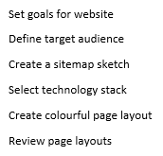

Slide 4
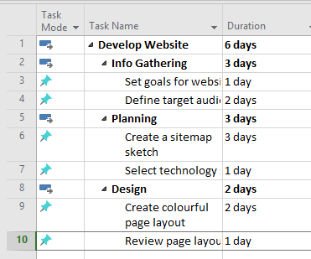

Slide 5
VLOOKUP/LOOKUP (page 13)
Download the excel file ‘Mark-sheet’
  Average
  Roundup
  Named range, instead of I1:J5
  VLOOKUP
  Draw a 3d-Column clustered chart showing the test scores for each student
  Draw a spark-line bar chart showing the progress of each student

Slide 6
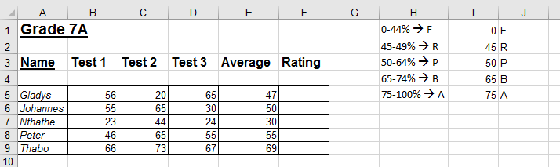

Slide 7
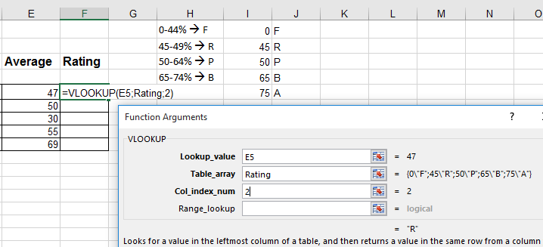

Slide 8
Descriptive Statistics
File > Options > Add-Ins > Go
Select Toolpak
Data Analysis > Descriptive Statistics
“ > Histogram

Slide 9
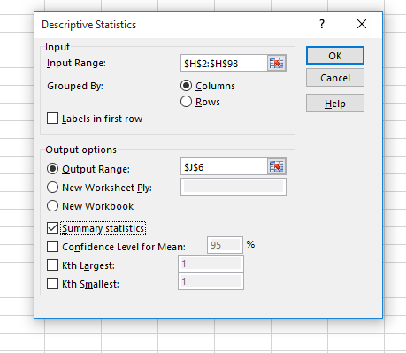

Slide 10
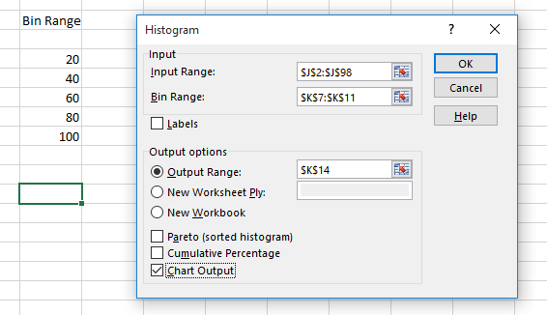

Slide 11
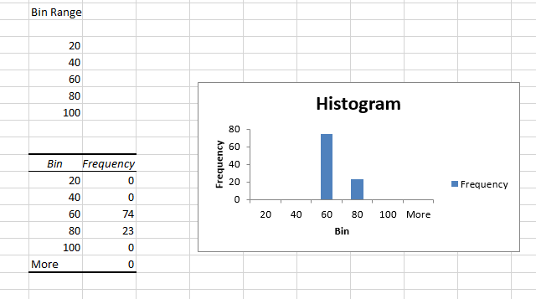

Slide 12
