Slide 1
Feasibility Analysis
Project Management :

Slide 2
Background Info
What is the relationship between
  Project Portfolio Management and
  Project Management?
What are the nine knowledge areas in the Project Management Body of Knowledge (PMBOK)?
  And the objectives of each area?

Slide 3
Introduction
A capital investment is an expenditure by an organization in equipment, land, or other assets that are used to carry out the objectives of the organization.
Because money—including money available for capital investment—is a scarce resource, one important responsibility of senior-level management in any organization is to decide which investments to choose

Slide 4
Financial Tools:
Organizations use several different methods to determine which investment is best.
The three methods we will discuss:
  Discounted Cash Flows (DCF)
  Net present value (NPV) and
  Payback analysis.

Slide 5
Outcomes:
You must be able to use Excel to calculate:
  DCF to determine NET PV, finding IRR
  Using a certain RR and determine the NPV
  Payback Analysis:
    Graphical
    Interpolation
    and determining ROI
  Putting ALL of the above on ONE sheet!

Slide 6
Heading For:

Slide 7
DCF:
To find the rate of interest when equating the PV of negative and positive cash flows:
  Negative when incurring COST and
  Positive when BENEFITS are anticipated
This interest rate is called the IRR
Or indicated as r
Let’s put it in mathematical form!

Slide 8


Slide 9
Example:
Initial Capital Cost = R 1000
End of year cash flows(NET):
  Year 1: R 500
  Year 2: R 600
  Year 3: R 400
To express as a FORMULA, see next slide:

Slide 10
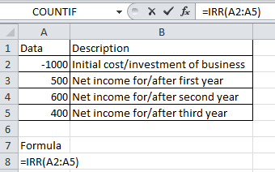

Slide 11
NPV:
We assume a rate of return, usually a rate what a company decides on
You first calculate the PV of the future benefits or costs, using this interest rate
Then you equate it with the initial cost
The result is the NPV…..hopefully it is POSITIVE!!

Slide 12
DISCOUNT FACTORS
Net PV of
Cash Flows
COSTS

Slide 13
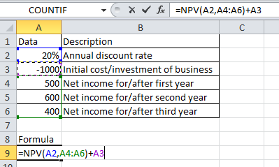

Slide 14
Exercise:
On the next slide you will see net cash flows over a span of 5 years:
Use Excel and calculate the different NPV’s using the suggested discount rates.
Explain to the audience the effect of these different rates and what rate will be the most advantageous for the company. [10]

Slide 15
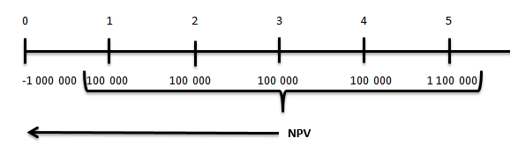
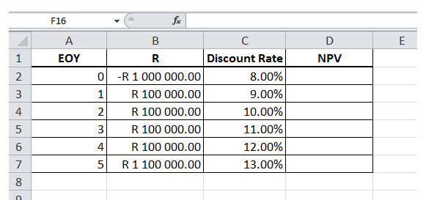

Slide 16
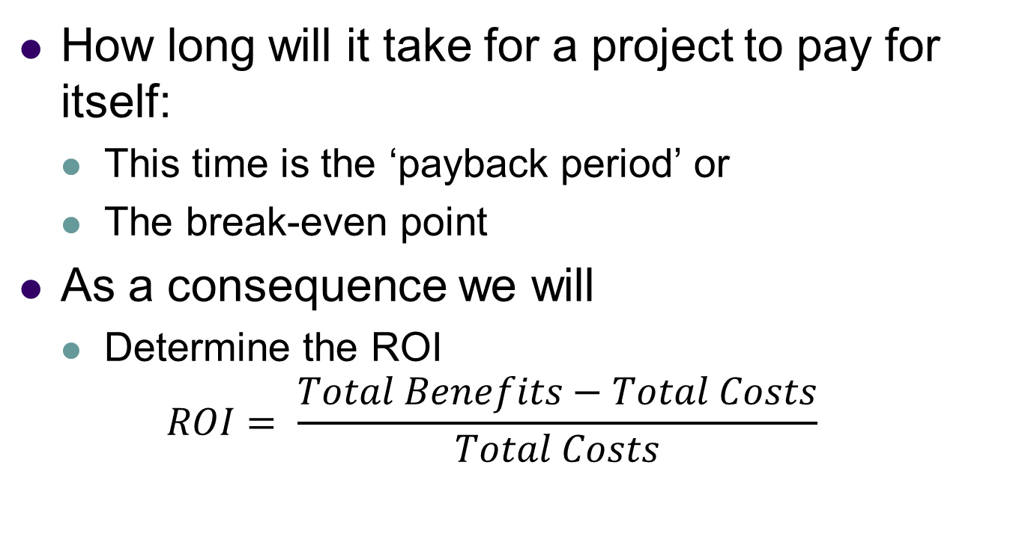
Payback Analysis:
How long will it take for a project to pay for itself:
  This time is the ‘payback period’ or
  The break-even point
As a consequence we will
  Determine the ROI
  $$ROI= \frac{Total Benefits−Total Costs}{Total Costs}$$

Slide 17
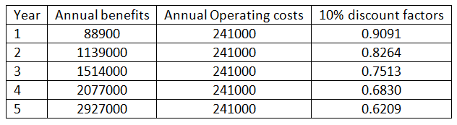
Example:
You receive the following detail for a new project:
  Initial development costs is R 1336000
  Benefits, costs and discount factors:

Slide 18
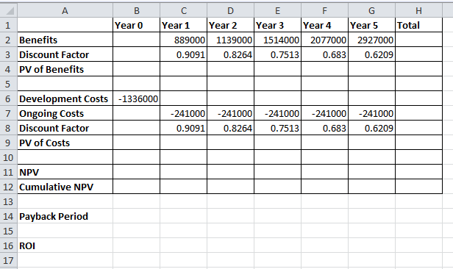

Slide 19
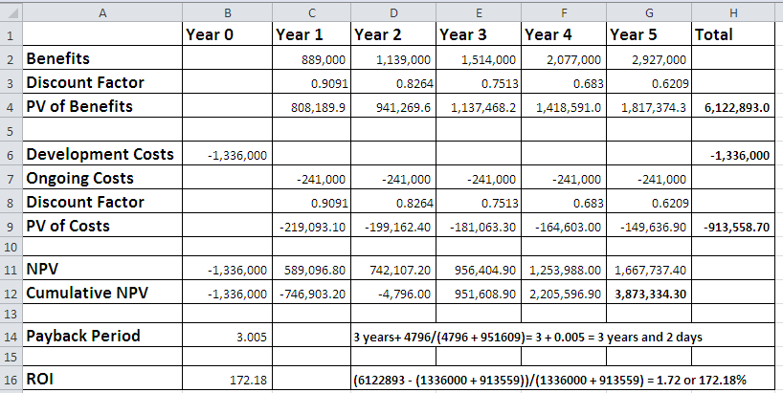

Slide 20
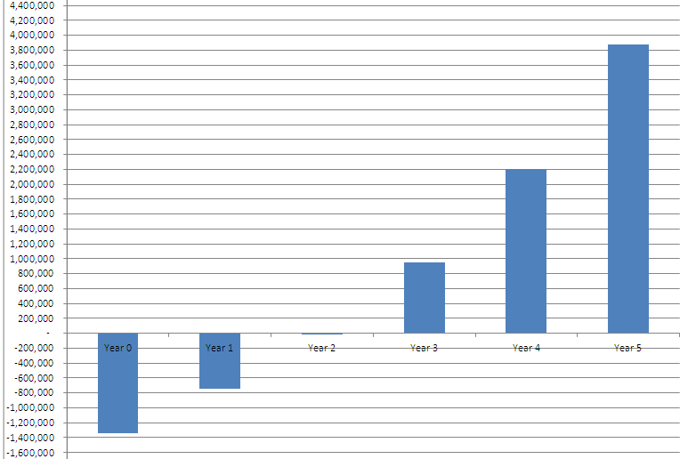

Slide 21
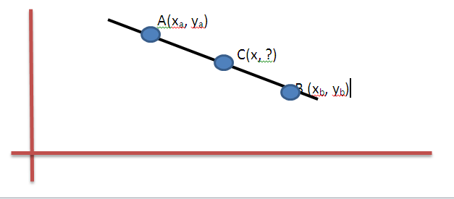

Linear Interpolation

Slide 22
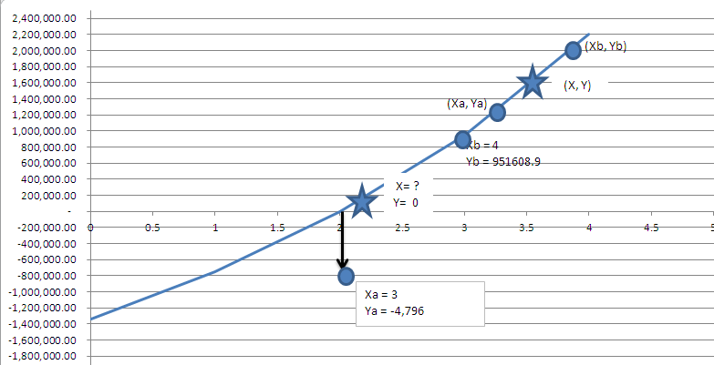

Slide 23
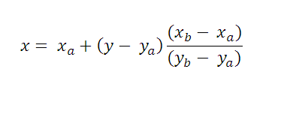
Formula in terms of x?

Slide 24
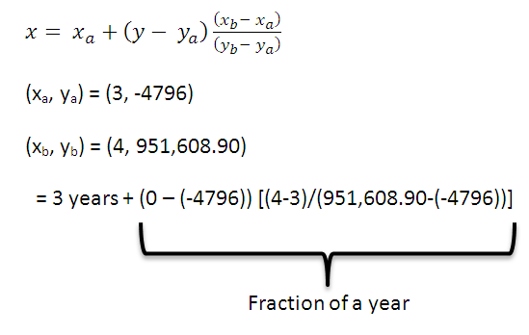
Solving for x:

Slide 25
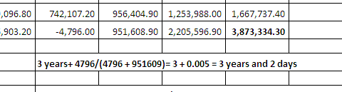

NPV Sheet

Slide 26
Homework
Study guide:
  Read pages 15-23
  Do the different exercises and homework;
  Especially Homework 4; page 23

Slide 27
Points to ponder on:
What is the difference between the following two procedures?
  Discount benefits and discount costs first, then net these values together to get a net present value.
  Net benefits and costs together first, then discount the combined figure to get a net present value.

Slide 28
Continues:
Explain the difference between the discount rate and the discount factor.
How do you determine the time period for
  NPV?
  ROI?
What is meant by payback period?

Slide 29
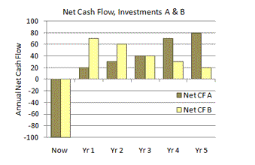

Slide 30
Previous slide:
Discuss/compare the two investments:
  Overall net cash flows
  Cash flow timing
  What tools do you have at your disposal to assist in this analysis?
Source:
https://www.business-case-analysis.com/return-on-investment.html

