Slide 1
Intro to MS Excel
This is only an introduction!!

Slide 2
In CAMS101/CCDI111, we will use Excel to:
Store and organize data,
Analyze data, and
Represent data graphically (e.g., in bar graphs, histograms, and scatterplots)
All with a financial slant!!

Slide 3
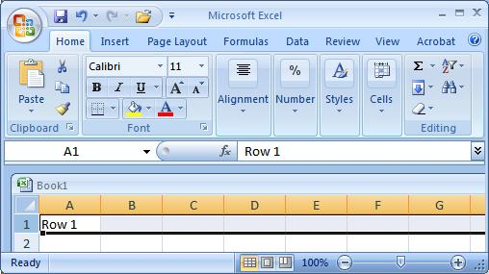
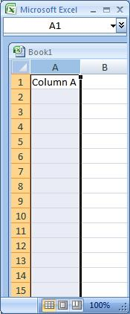
Excel Basics
Excel spreadsheets organize information (text and numbers) by rows and columns:
This is a row.
Rows are represented by numbers along the side of the sheet.
This is a column.
Columns are represented by letters across the top of the sheet.
Notes:
3

Slide 4
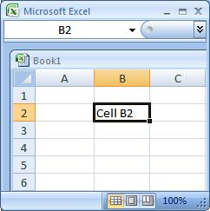
Excel Basics
A cell is the intersection between a column and a row.
Each cell is named for the column letter and row number that intersect to make it.
Notes:
4

Slide 5
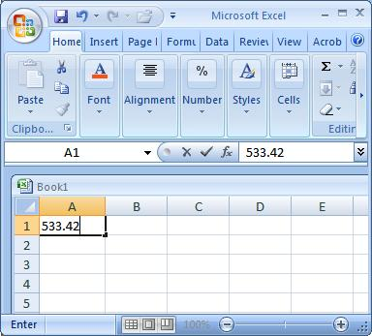
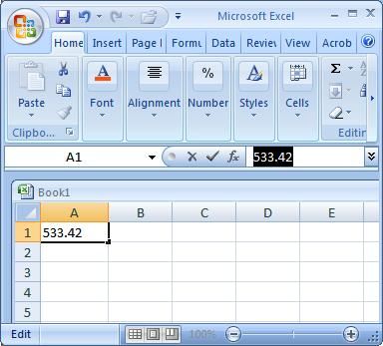
Data Entry
There are two ways to enter information into a cell:
1. Type directly into the cell.
Click on a cell, and type in the data (numbers or text) and press Enter.
2. Type into the formula bar.
Click on a cell, and then click in the formula bar (the space next to the ). Now type the data into the bar and press Enter.
Notes:
5

Slide 6

Let’s START?
Open Excel (Start → All Programs → MS Office → Excel).
Do the following:
  Highlight Cell A1; B7
  Highlight the Range: B2:B9; C3:G9;
  “ “ :B3:B9 AND F5:F10
Formulae:
  Calculate 8*3; 21 – 55; 7-2*3 IN cell C5

Slide 7
Formulas and Functions
Formulas are equations that perform calculations in your spreadsheet. Formulas always begin with an equals sign (=). When you enter an equals sign into a cell, you are basically telling Excel to “calculate this.”
Functions are Excel-defined formulas. They take data you select and enter, perform calculations on them, and return value(s).

Slide 8
More on Functions
All functions have a common format – the equals sign followed by the function name followed by the input in parentheses.
The input for a function can be either:
  A set of numbers (e.g., “=AVERAGE(2, 3, 4, 5)”)
    This tells Excel to calculate the average of these numbers.
  A reference to cell(s) (e.g., “=AVERAGE(B1:B18) or “=AVERAGE (B1, B2, B3, B4, B5, B6, B7, B8)”
    This tells Excel to calculate the average of the data that appear in all the cells from B1 to B8.
    You can either type these cell references in by hand or by clicking and dragging with your mouse to select the cells.

Slide 9
Functions for Descriptive Statistics
Below are several functions you will need to learn for this class. Try them out with the practice data set.
=AVERAGE(first cell:last cell): calculates the mean
=MEDIAN(first cell:last cell): calculates the median
=MODE(first cell:last cell): calculates the mode
=VARP(first cell:last cell): calculates the variance
=STDEVP(first cell:last cell): calculates the standard deviation
You may directly write the functions for these statistics into cells or the formula bar, OR
You may use the function wizard ( in the toolbar)

Slide 10
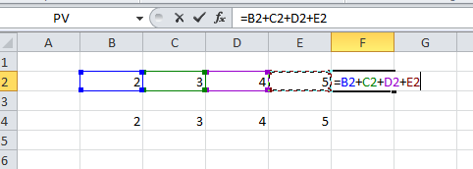
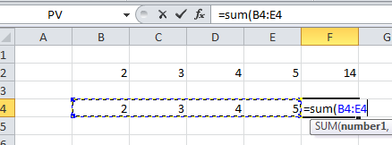
More on Functions:
Your Excel spreadsheet should now look like this:

Slide 11
Revision: Formulas
A formula is a sequence of values, cell references and operators that produce a new value.
= E8 + 3*(E10 - E11)
Formulas always start with an equal sign =
In addition a formula can also contain built-in functions like SUM, AVERAGE, IF, COUNTIF, etc. =Sum(A2:A8)*2

Slide 12
Let’s look forward:
MS Excel:
  EX Chapter 01
  EX Chapter 02
  EX Chapter 03
www.misuz.yolasite.com > practicals

Slide 13

Highlight your data, select a Chart type and Edit & its done!

Slide 14
Things you need to know when writing formulas in Excel
Data precision vs. cell display
Types of operators that can be used
Order of precedence of operators
/ ≤ −
=B2+B3*B1/B8^2

Slide 15
In order to write Excel formulas we also need to use the correct Operator Symbols
Formulas contain two types of components:
Operators: Operations to be performed
Arithmetic operators: * / + - ^
  Relational operators: >, <, <=, >=,< >,=
Operands: Values to be operated on
Addition Operator
= B2 + 5
Operands

Slide 16
Precedence of Operators
( ) Parenthesis is a special operator that forces evaluation of the expression inside it first
Exponentiation (2^3 →8)
Arithmetic operators: Multiplication & Division
  Multiplication & Division have equal precedence and are evaluated from left to right
Arithmetic operators: Addition & Subtraction
  Addition & Subtraction have equal precedence and are evaluated from left to right
Relational operators have a lower precedence than arithmetic operators

Slide 17
Walkthrough: Building a Simple Spreadsheet
Entering labels and values
Formatting cells
    font, size, style, color, borders, alignment
    Numeric Format, Currency, Decimal Places
    text wrap, center titles
    Column widths, row height
Inserting/Deleting rows and columns and sheets
Writing a simple formula & modify decimal display
Create a simple chart
Sheet tabs
  Creating a new worksheets in a workbook (“new sections in a document”, Naming Sheets

Slide 18
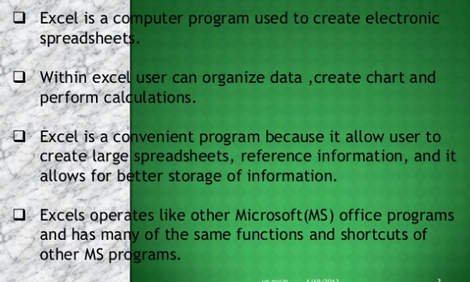
Why MS Excel?

Slide 19

Questions?

