Slide 2
Revision
Q1 Ms Project 19 marks
Q2 NPV 20 M
Q3 Excel ~~~ Test 1 40 M
Q4 Monte Carlo 15 M

Slide 3

Goal Seek

Slide 4
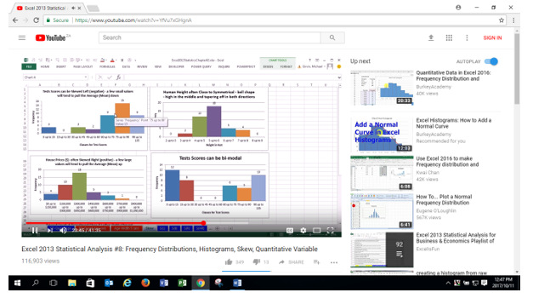

Slide 5
Average
Mean: Value of central tendency

Slide 6
SD
Standard deviation is a number used to tell how measurements for a group are spread out from the average (mean), or expected value. A low standard deviation means that most of the numbers are close to the average. A high standard deviation means that the numbers are more spread out.

Slide 7
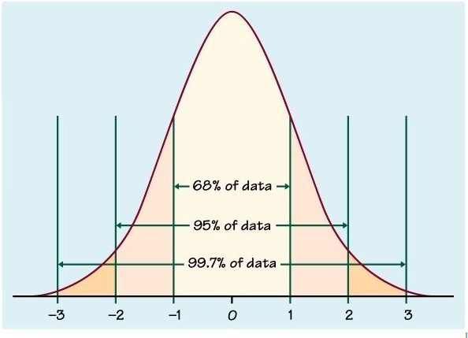

Slide 8
