Slide 1
Microsoft
Excel 2010
Chapter 3
What-If Analysis, Charting, and Working
with Large Worksheets

Slide 2
Objectives
Rotate text in a cell
Create a series of month names
Copy, paste, insert, and delete cells
Format numbers using format symbols
Freeze and unfreeze rows and columns
Show and format the system date
Use absolute and mixed cell references in a formula
Use the IF function to perform a logical test

Slide 3
Objectives
Create Sparkline charts
Use the Format Painter button to format cells
Create a 3-D Pie chart on a separate chart sheet
Rearrange worksheet tabs
Change the worksheet view
Answer what-if questions
Goal seek to answer what-if questions

Slide 4
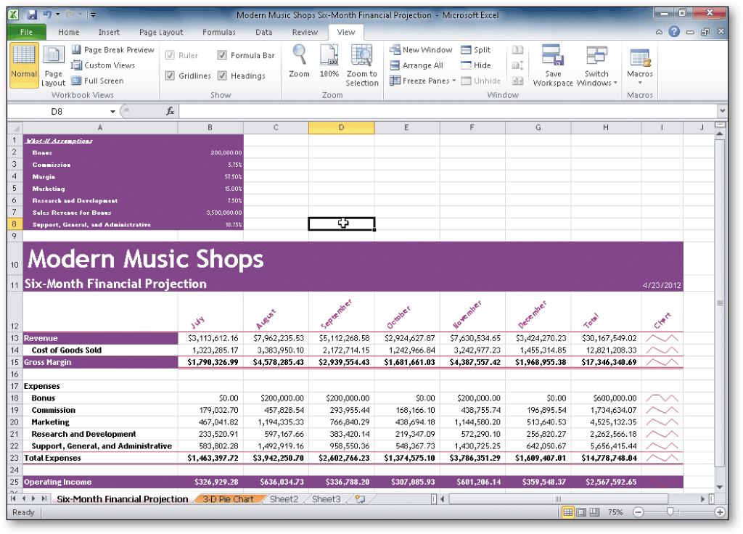
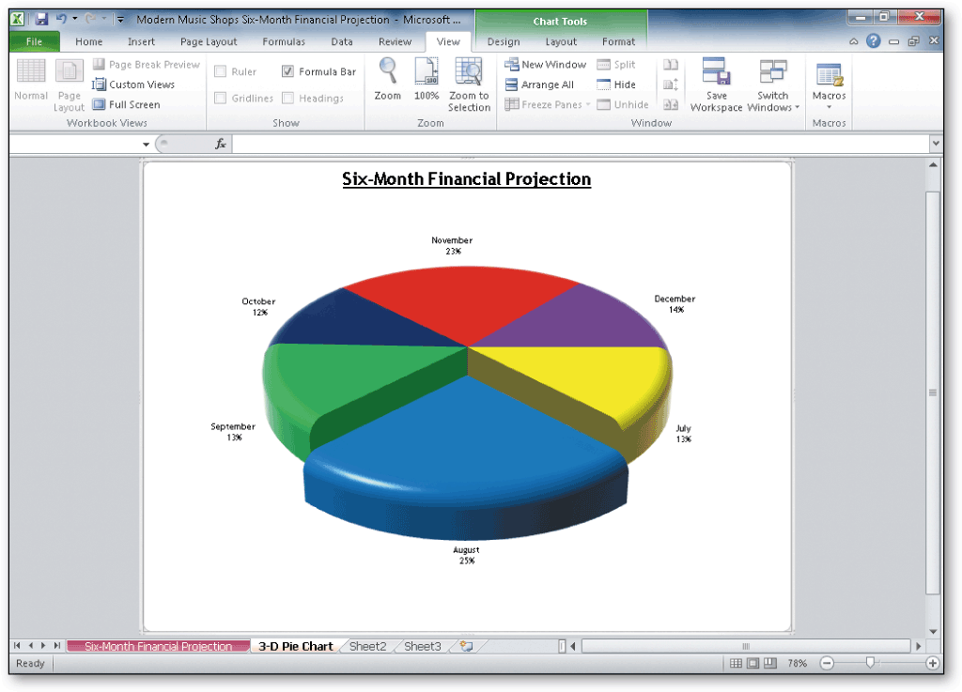
Project – Financial Projection Worksheet with What-If Analysis and Chart

Slide 5
General Project Guidelines
Plan the layout of the worksheet
Determine the necessary formulas and functions needed
Specify how to best utilize Sparkline charts
Identify how to format various elements
Specify how charts should convey necessary information
Perform what-if analysis and goal seeking using the best techniques

Slide 6
Rotating Text and Using the Fill Handle to Create a Series of Month Names
If necessary, select the Home tab and then select the cell that will include the first month name in the series of month names
Type the first month in the series as the cell entry and then click the Enter box
Click the Format Cells: Alignment Dialog Box Launcher on the Home tab to display the Format Cells dialog box
Click the desired point in the Orientation area to move the Text hand in the Orientation area and to display a new orientation in the Degrees box
Click the OK button to rotate the text in the active cell and automatically increase the height of the current row to best fit the rotated text

Slide 7
Rotating Text and Using the Fill Handle to Create a Series of Month Names
Point to the fill handle on the lower-right corner of the cell containing the first month to display the crosshair mouse pointer in preparation of filling the month series
Drag the fill handle to select the range to contain the remainder of the series, and then release the mouse button
Click the Auto Fill Options button below the lower-right corner of the fill area to display the Auto Fill Options menu
Click the Auto Fill Options button to hide the Auto Fill Options menu

Slide 8
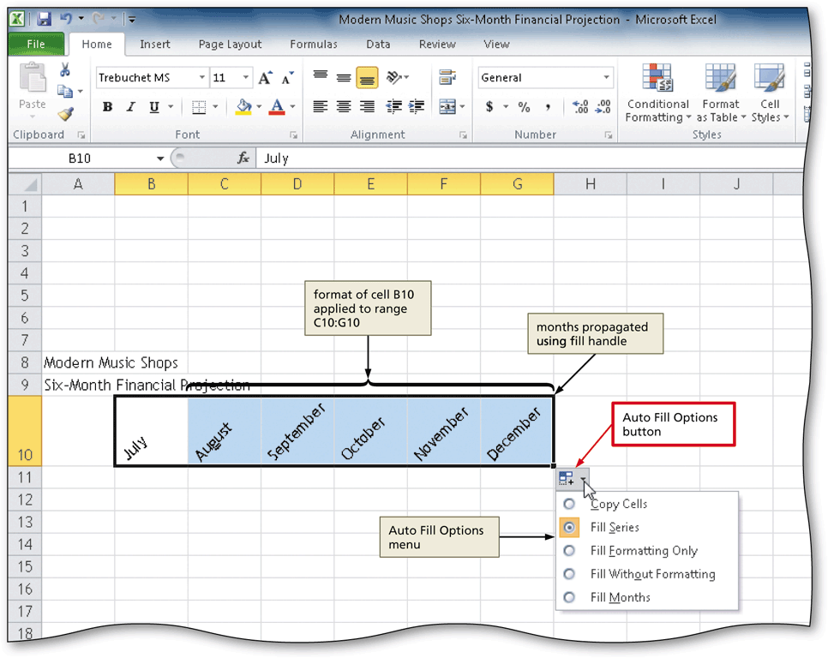
Rotating Text and Using the Fill Handle to Create a Series of Month Names

Slide 9
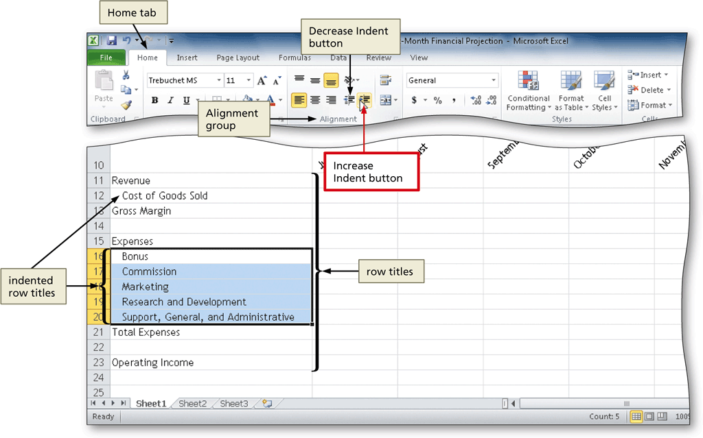
Indenting Text in Cells
Select the cell to which you want to apply the indent
Click the Increase Indent button on the Home tab to increase the indentation of the text in the selected cell

Slide 10
Copying a Range of Cells to a Nonadjacent Destination Area
Select the cell or range of cells to copy, and then click the Copy button on the Home tab to copy the values and formats of the selected range to the Office Clipboard
Click the first cell in the destination area
Click the Paste button on the Home tab to copy the values and formats of the last item placed on the Office Clipboard to the destination area

Slide 11
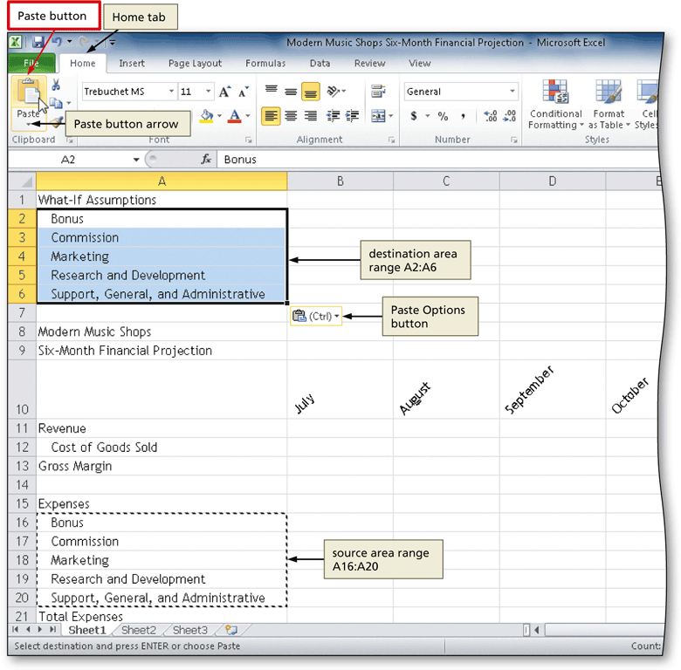
Copying a Range of Cells to a Nonadjacent Destination Area

Slide 12
Inserting a Row
Right-click the row heading below where you want to insert a row to display the shortcut menu and the Mini toolbar
Click Insert on the shortcut menu to insert a new row in the worksheet by shifting the selected row and all rows below it down one row

Slide 13
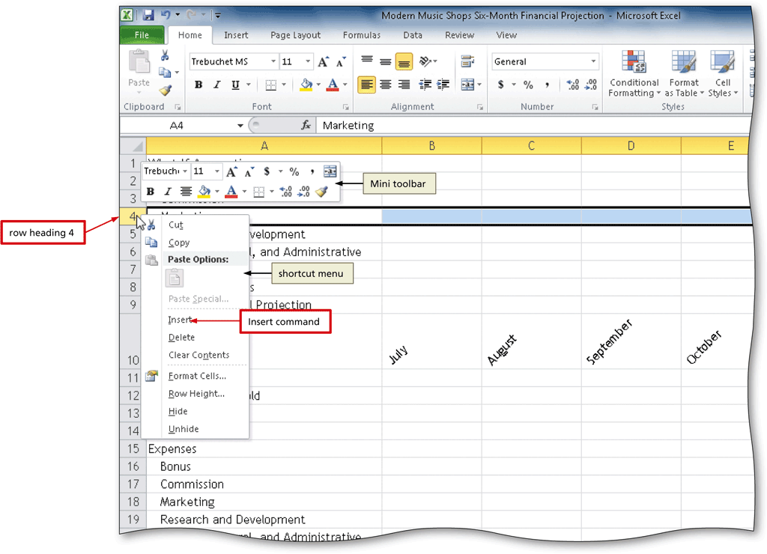
Inserting a Row

Slide 14
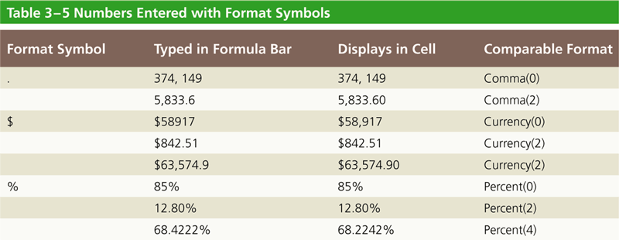
Entering Numbers with Format Symbols

Slide 15
Freezing Column and Row Titles
Select the cell on which to freeze panes
Display the View tab and then click the Freeze Panes button to display the Freeze Panes gallery
Click Freeze Panes in the Freeze Panes gallery to freeze rows and columns to the left and above the selected cell

Slide 16
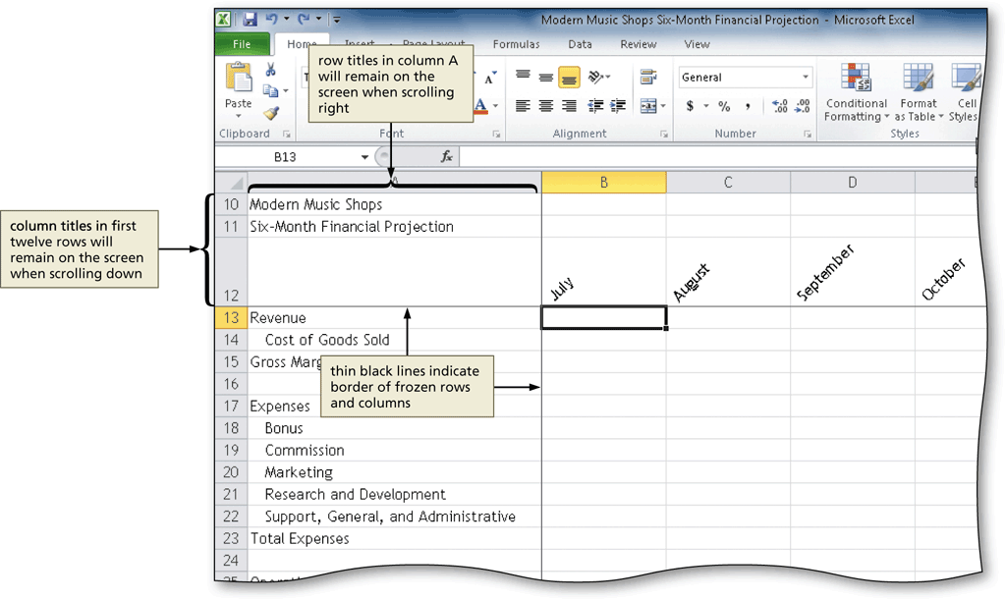
Freezing Column and Row Titles

Slide 17
Entering the System Date
Select the cell in which you want to insert the date, and then click the Insert Function box in the formula bar to display the Insert Function dialog box
Click the ‘Or select a category’ box arrow and then select Date & Time in the list to populate the ‘Select a function’ list with date and time functions
Scroll down in the ‘Select a function list’ and then click NOW to select the function
Click the OK button to close the Insert Function dialog box
Click the OK button to display the system date and time in the selected cell

Slide 18
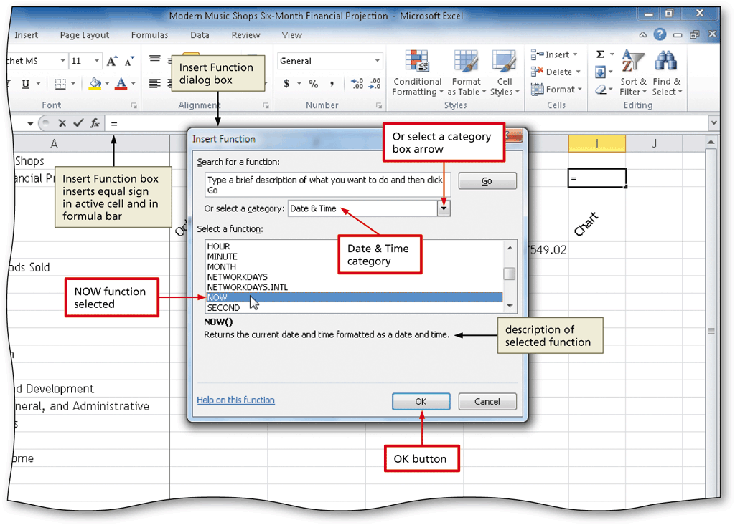
Entering the System Date

Slide 19
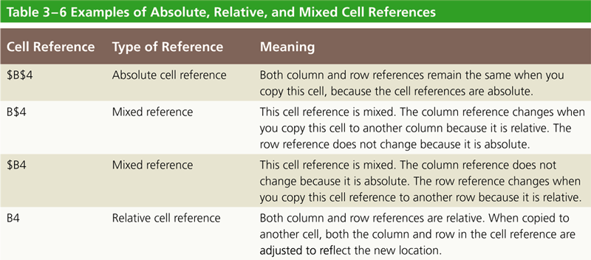
Absolute versus Relative Addressing

Slide 20
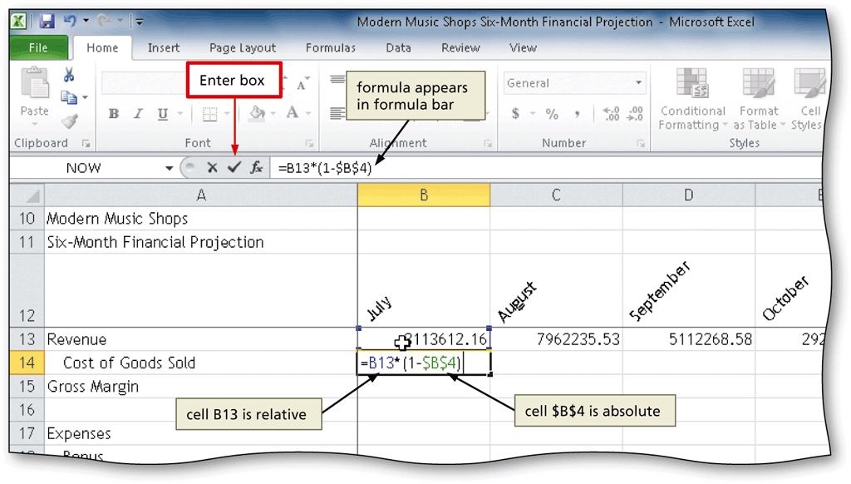
Absolute versus Relative Addressing

Slide 21
Entering an IF Function
Click the cell to contain the formula, and then click the Insert Function box in the formula bar to display the Insert Function dialog box
Click the ‘Or select a category’ box arrow and then select Logical in the list to populate the ‘Select a function’ list with logic functions
Click IF in the ‘Select a function list’ to select the required function
Click the OK button to display the Function Arguments dialog box

Slide 22
Entering an IF Function
Enter the logical test in the Logical text box to enter a logical test for the IF function
Type the result of the IF function if the logical test is true in the Value_if_true box
Type the result of the IF function if the logical test is false in the Value_if_false box
Click the OK button to insert the IF function in the selected cell

Slide 23
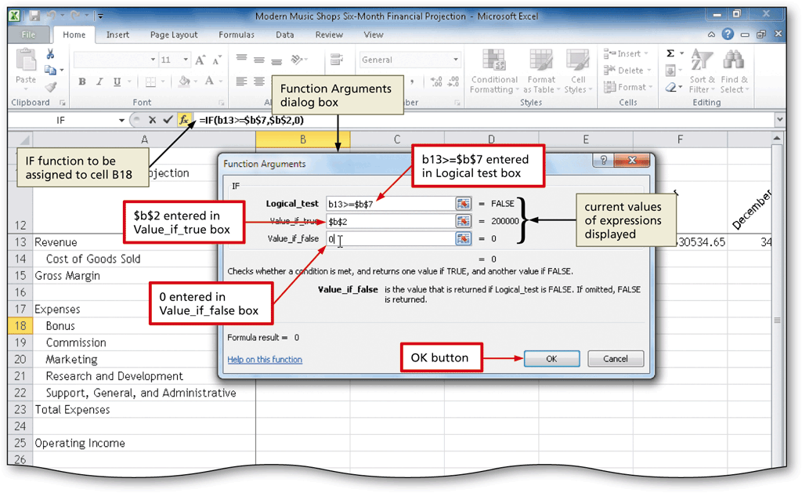
Entering an IF Function

Slide 24
Adding a Line Sparkline Chart to the Worksheet
Select the cell in which you want to insert a Sparkline chart
Display the Insert tab and then click Line to display the Create Sparklines dialog box
Drag through the range of cells of which you want to chart, and then release the mouse button to insert the selected range in the Data Range text box
Click the OK button to insert a Line Sparkline chart in the selected cell and display the Sparkline Tools contextual tab

Slide 25
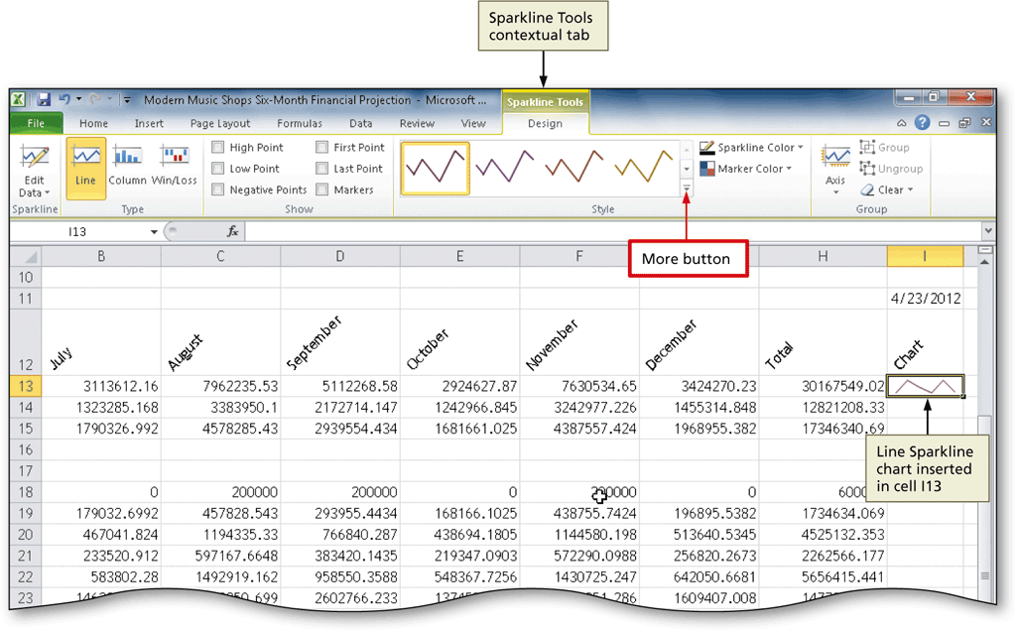
Adding a Line Sparkline Chart to the Worksheet

Slide 26
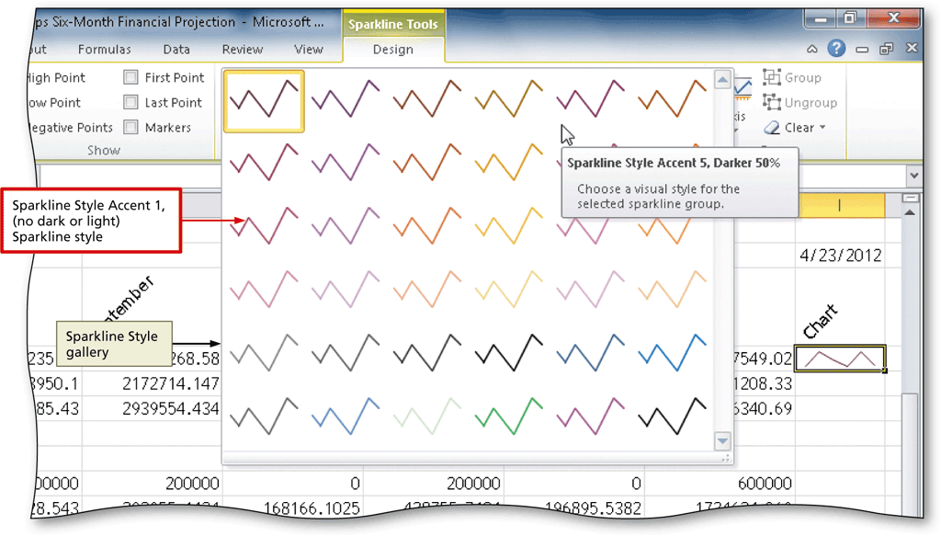
Formatting the Sparkline Chart
Select the cell containing the Sparkline chart, and then click the More button on the Sparkline Tools Design tab to display the Style gallery
Click the desired Sparkline style to apply the style to the Sparkline chart in the selected cell

Slide 27
Assigning Formats to Nonadjacent Ranges
Select the first range to format
While holding down the CTRL key, select the nonadjacent ranges
Click the Format Cells: Number Dialog Box Launcher on the Home tab to display the Format Cells dialog box
Click the desired category and style, and then click the OK button

Slide 28
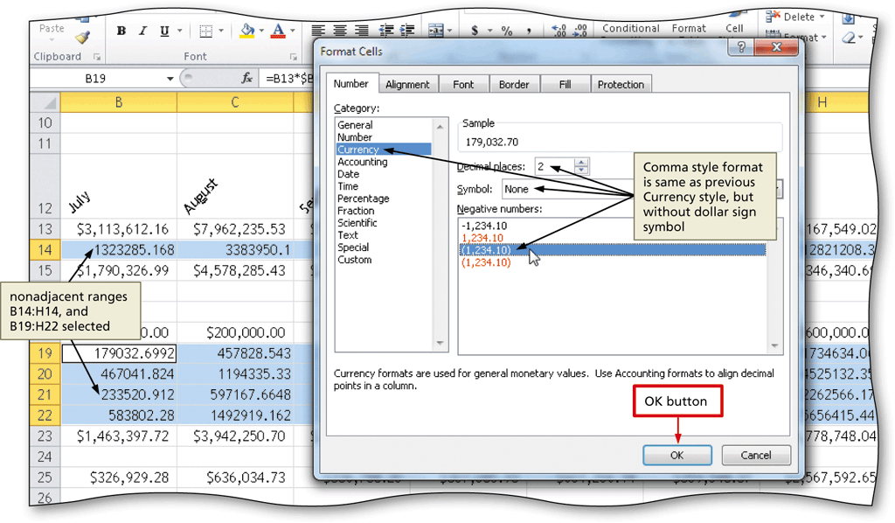
Assigning Formats to Nonadjacent Ranges

Slide 29
Formatting the Worksheet Titles
Select the desired cell(s) to format
Click the Bold button on the Home tab to bold all of the data in the selected cell(s)
Click the Font Size box arrow on the Home tab, and then click the desired font size
Click the Fill Color button arrow on the Home tab, and then click the desired color to add a background color to the selected cell(s)
Click the Font Color button arrow on the Home tab, and then click the desired color to change the font color of the selected cell(s)

Slide 30
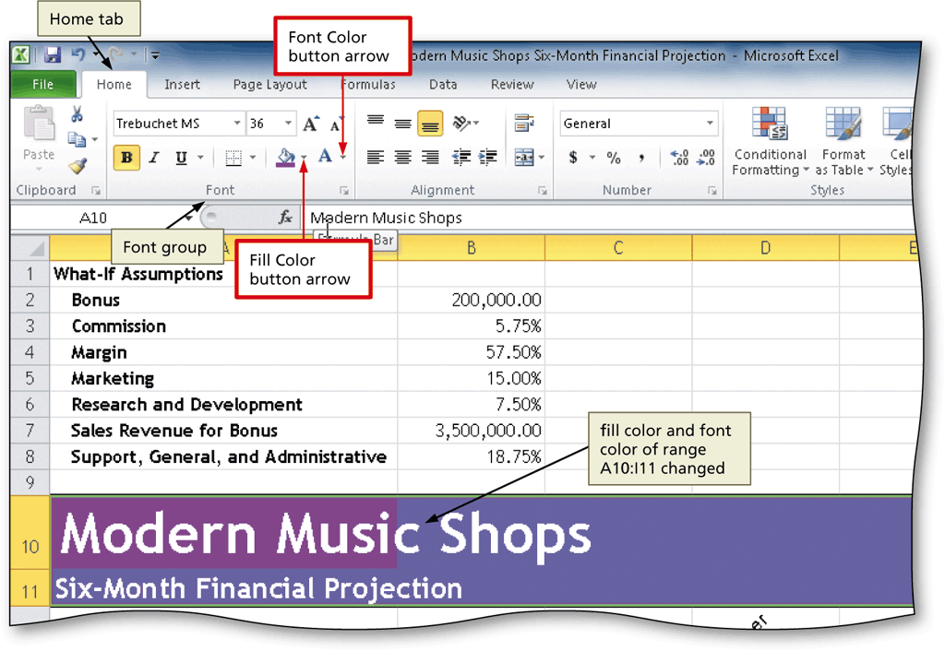
Formatting the Worksheet Titles

Slide 31
Copying a Cell’s Format
Using the Format Painter Button
Select the source cell for the format to paint
Double-click the Format Painter button on the Home tab
Click the cell(s) to receive the format to assign the format of the source cell to the destination cell(s)
Press the ESC key to stop the format painter

Slide 32
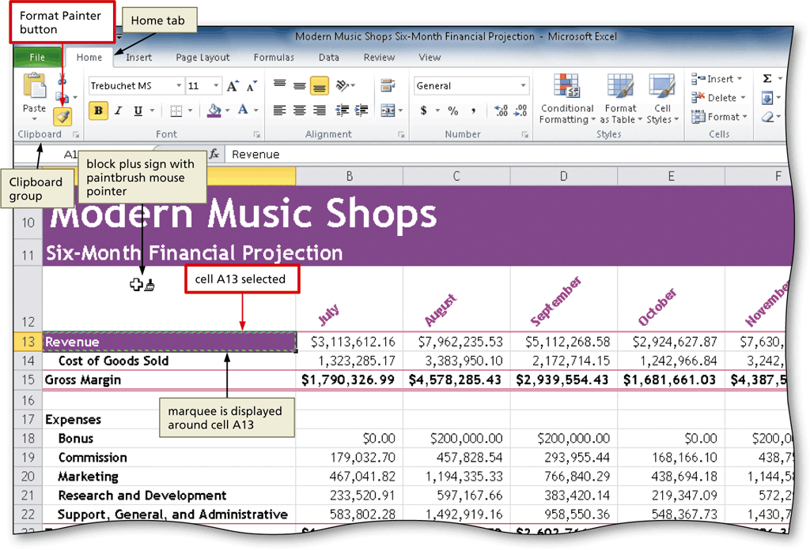
Copying a Cell’s Format
Using the Format Painter Button

Slide 33
Drawing a 3-D Pie Chart on a Separate Chart Sheet
Select the range of cells to include in the chart
Click the Pie button on the Insert tab to display the Pie gallery
Click the desired chart type in the Pie gallery
Click the Move Chart button on the Chart Tools Design tab to display the Move Chart dialog box
Click New sheet, and then type the name of the sheet tab for the chart sheet
Click the OK button to move the chart to a new chart sheet

Slide 34
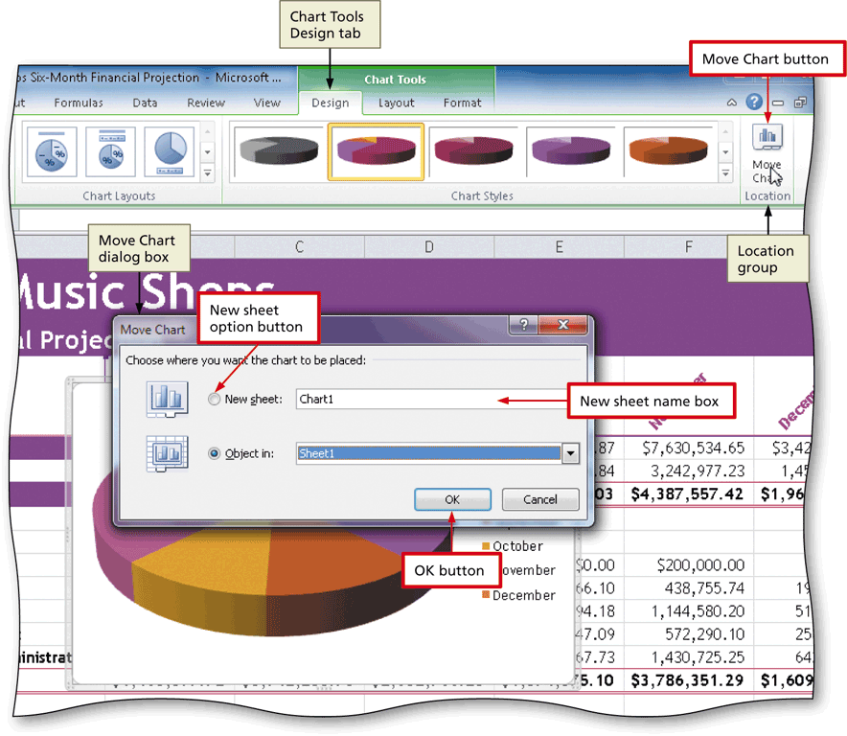
Drawing a 3-D Pie Chart on a Separate Chart Sheet

Slide 35
Inserting a Chart Title and Data Labels
Click anywhere in the chart area outside the chart to select the chart
Click the Chart Title button on the Chart Tools Layout tab to display the Chart Title gallery
Click the desired option to add a chart title
Select the text in the chart title and then type the new chart title
Display the Chart Tools Layout tab and then click the Legend button to display the Legend gallery

Slide 36
Inserting a Chart Title and Data Labels
Select the desired option for the legend
Click the Data Labels button on the Layout tab and then click the desired location for the data labels
If necessary, right-click any data label to select all of the data labels on the chart and to display a shortcut menu
Click the Format Data Labels command on the shortcut menu to display the Format Data Labels dialog box
Select the desired formatting options for the data labels, and then click the Close button to close the Format Data Labels dialog box and display the chart

Slide 37
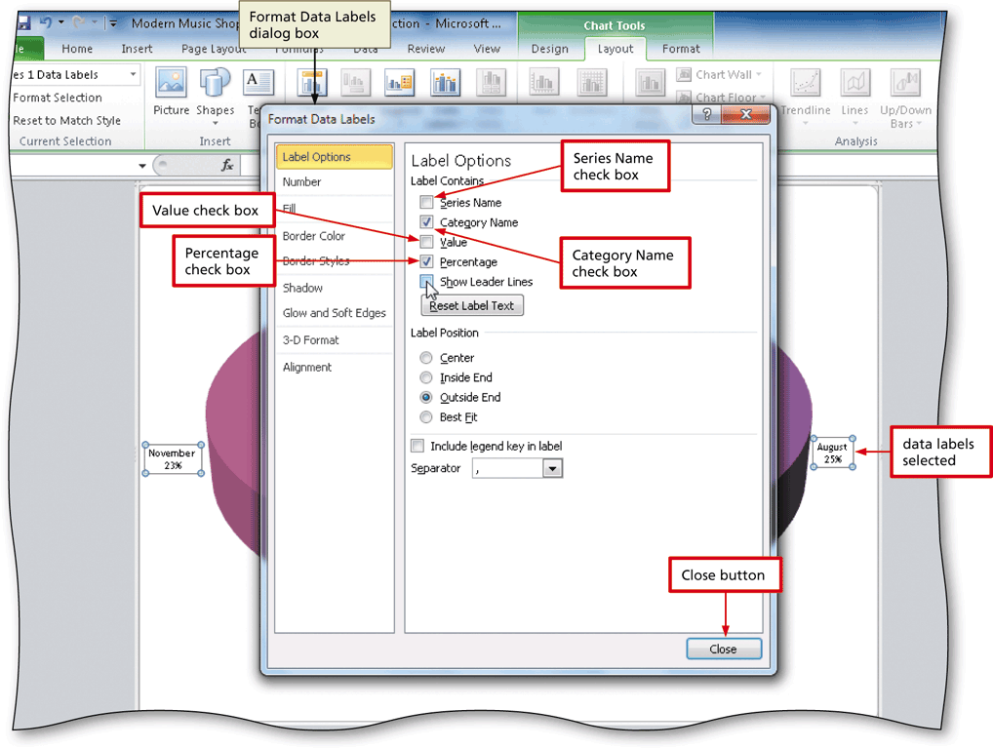
Inserting a Chart Title and Data Labels

Slide 38
Rotating a 3-D Pie Chart
Select the chart, and then click the 3-D Rotation button on the Chart Tools Layout tab to display the Format Chart Area dialog box
Click the Increase X Rotation button in the Rotation area until the X rotation is at the desired setting
Click the Close button to close the dialog box and display the rotated chart

Slide 39
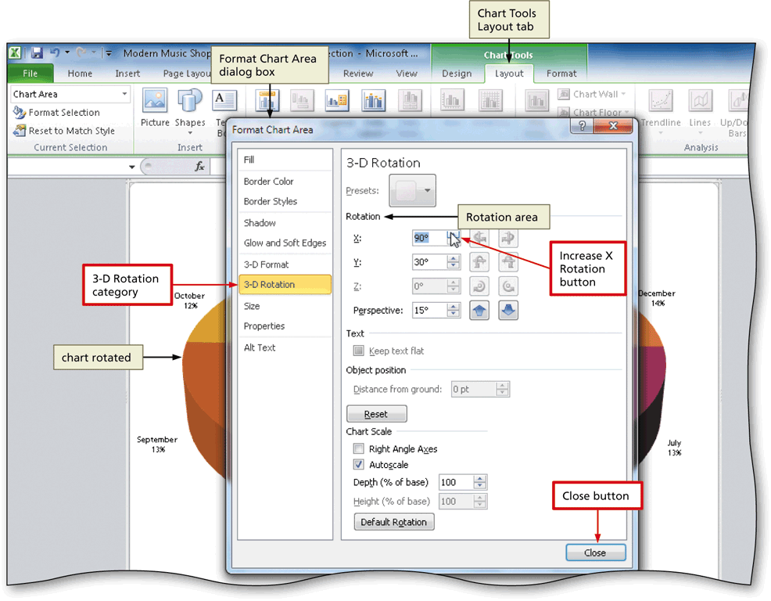
Rotating a 3-D Pie Chart

Slide 40
Applying a 3-D Format to the Pie Chart
Right-click the chart to display a shortcut menu and Mini toolbar
Click the Format Data Series command on the shortcut menu to display the Format Data Series dialog box and then click the 3-D Format category on the left side of the dialog box to display the 3-D Format panel
Select the desired formatting options, and then click the Close button to apply the desired formatting to the chart

Slide 41
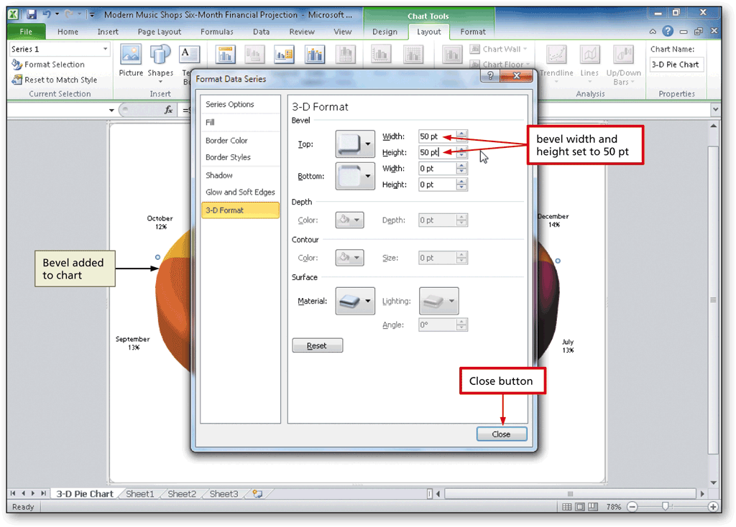
Applying a 3-D Format to the Pie Chart

Slide 42
Exploding the 3-D Pie Chart and Changing the Color of a Slice
Click the slice to explode twice (do not double-click), and then right-click the slice to display a shortcut menu and Mini toolbar
Click Format Data Point on the shortcut menu to display the Format Data Point dialog box
Drag the Point Explosion slider to the desired location to set how far the slice in the 3-D Pie Chart should be offset from the rest of the chart
Click the Fill category on the left side of the dialog box to display the Fill panel
Click the desired fill type, and then click the Color button to display the Color gallery
Click the desired color in the color gallery and then click the Close button to change the color of the selected slice and close the dialog box

Slide 43
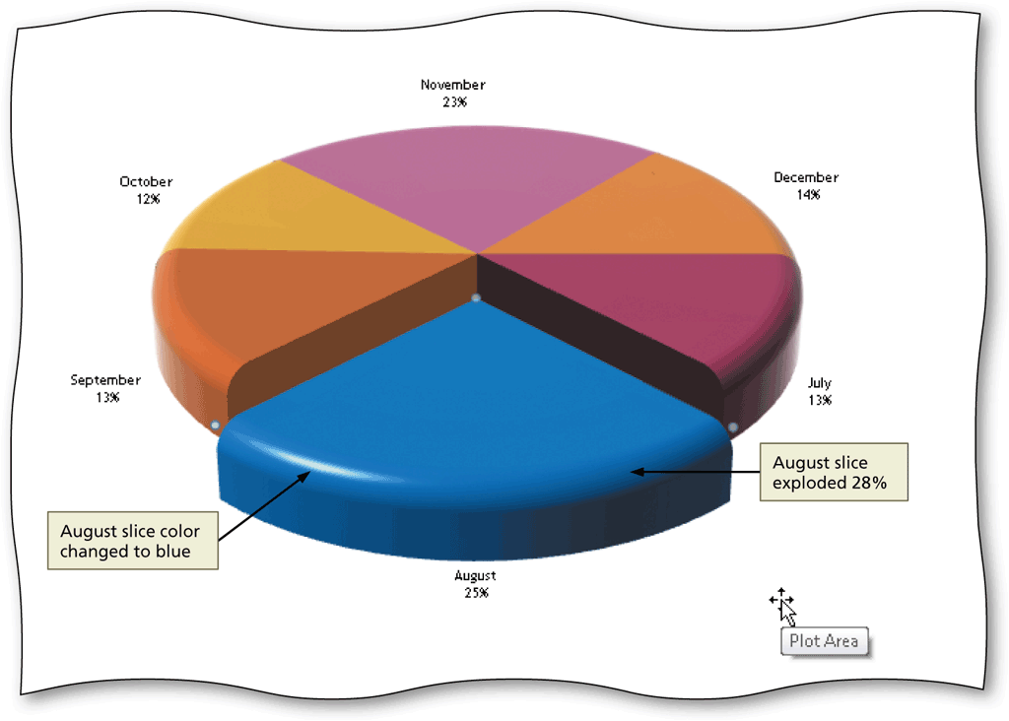
Exploding the 3-D Pie Chart and Changing the Color of a Slice

Slide 44
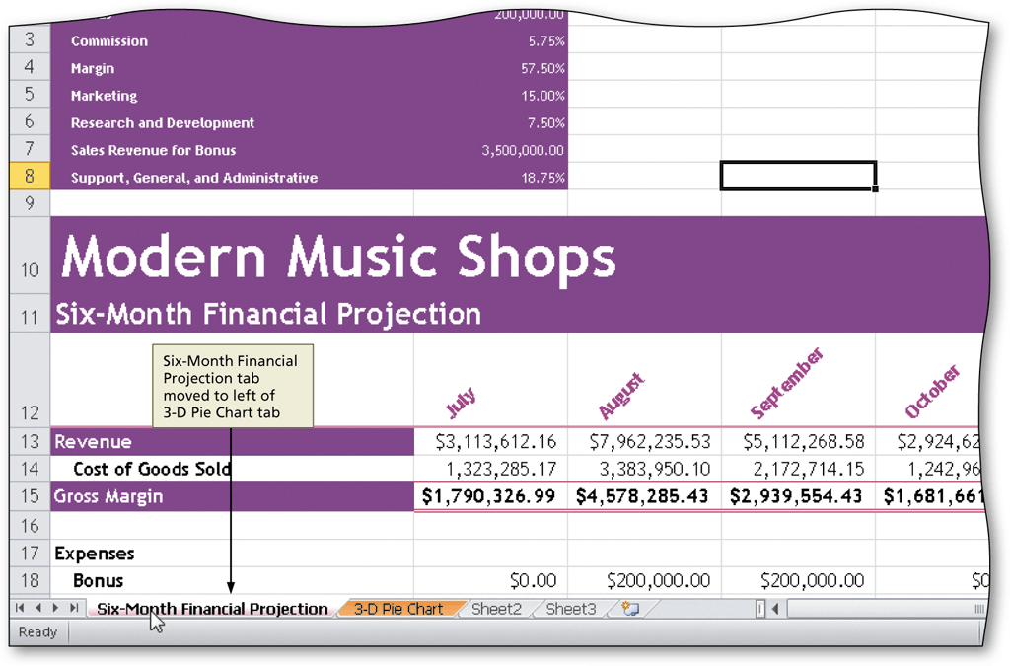
Reordering the Sheet Tabs
Drag the tab to reorder to the tabs

Slide 45
Shrinking and Magnifying the View of a Worksheet or Chart
Display the View tab and then click the Zoom button to display a list of magnifications in the Zoom dialog box
Click the desired zoom level, and then click the OK button
Click the Zoom in button on the status bar until the worksheet is displayed at the desired magnification

Slide 46
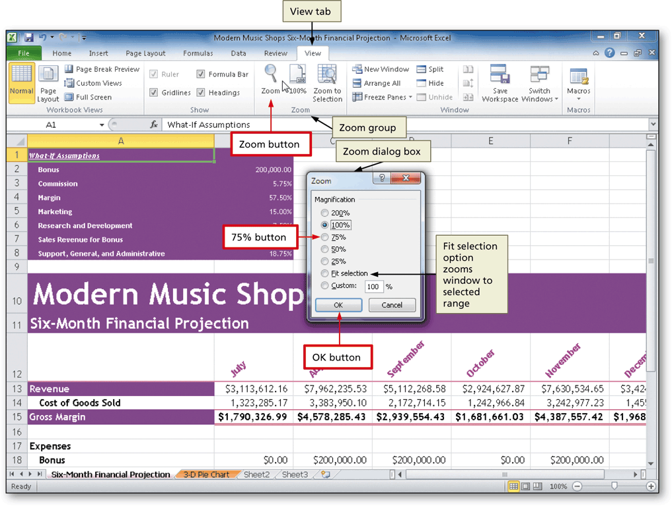
Shrinking and Magnifying the View of a Worksheet or Chart

Slide 47
Splitting a Window into Panes
Click the cell at the intersection of the four proposed panes to select the cell at which to split the window
Click the Split button on the View tab to divide the window into four panes

Slide 48
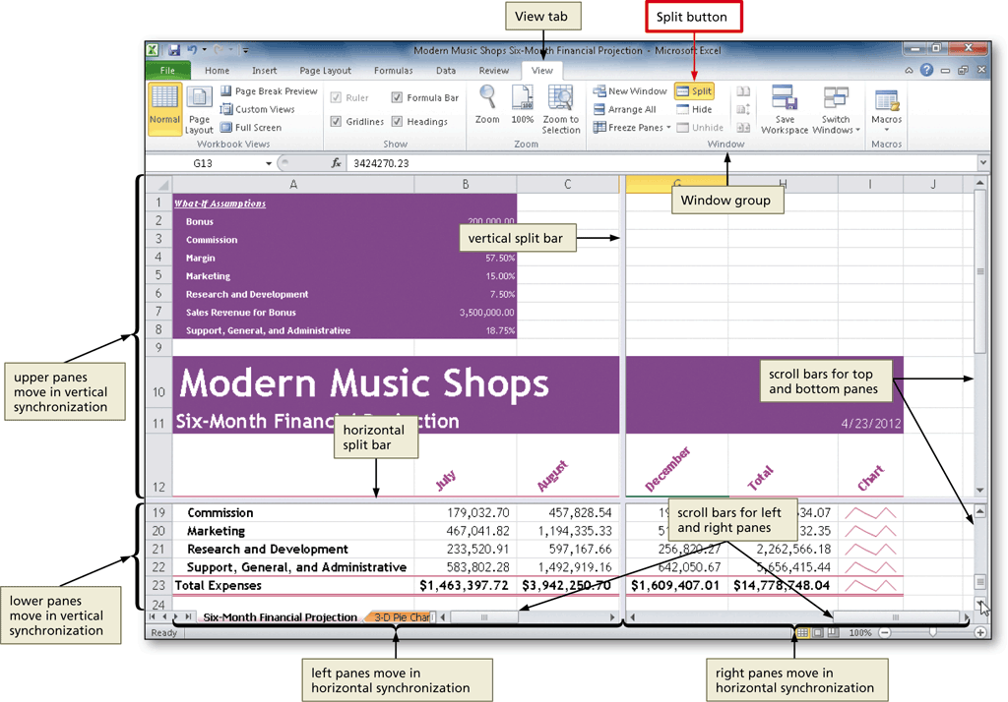
Splitting a Window into Panes

Slide 49
What-If Analysis
The automatic recalculation feature of Excel is a powerful tool that can be used to analyze worksheet data
Using Excel to scrutinize the impact of changing values in cells that are referenced by a formula in another cell is called what-if analysis or sensitivity analysis

Slide 50
Goal Seeking
If you know the result you want a formula to produce, you can use goal seeking to determine the value of a cell on which the formula depends
  Goal Seek command on the Data tab
Goal seeking assumes you can change the value of only one cell referenced directly or indirectly to reach a specific goal for a value in aother cell

Slide 51
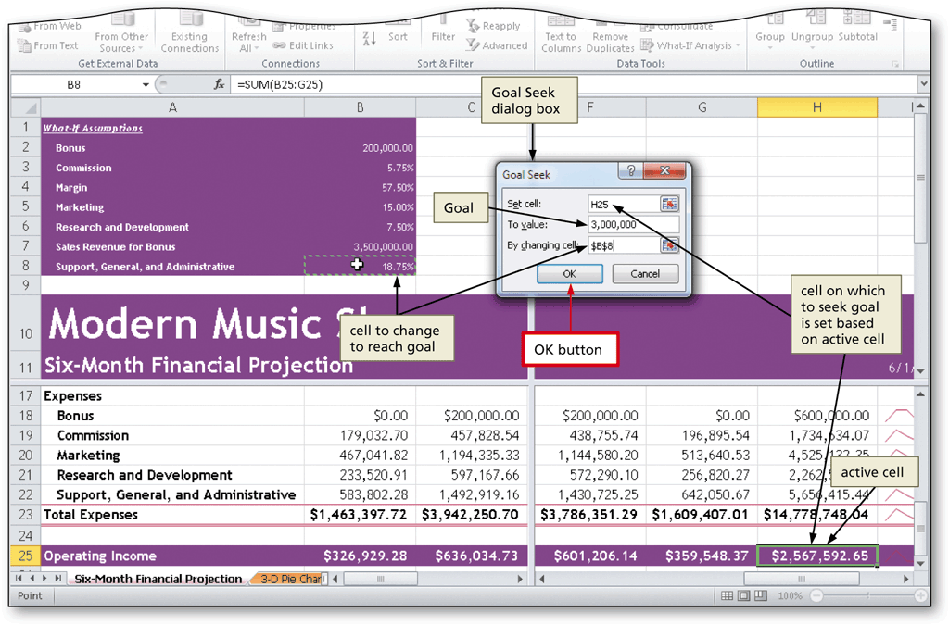
Goal Seeking

Slide 52
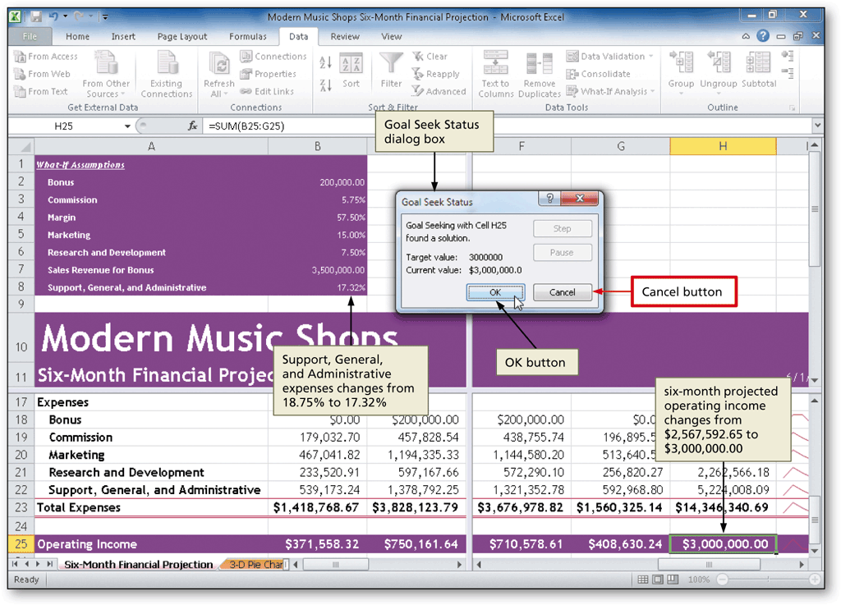
Goal Seeking

Slide 53
Chapter Summary
Rotate text in a cell
Create a series of month names
Copy, paste, insert, and delete cells
Format numbers using format symbols
Freeze and unfreeze rows and columns
Show and format the system date
Use absolute and mixed cell references in a formula
Use the IF function to perform a logical test

Slide 54
Chapter Summary
Create Sparkline charts
Use the Format Painter button to format cells
Create a 3-D Pie chart on a separate chart sheet
Rearrange worksheet tabs
Change the worksheet view
Answer what-if questions
Goal seek to answer what-if questions

Slide 55
Microsoft
Excel 2010
Chapter 3 Complete

