Slide 1
Microsoft
Excel 2010
Chapter 2
Formulas, Functions,
and Formatting

Slide 2
Objectives
Enter formulas using the keyboard
Enter formulas using Point mode
Apply the AVERAGE, MAX, and MIN functions
Verify a formula using Range Finder
Apply a theme to a workbook
Apply a date format to a cell or range

Slide 3
Objectives
Add conditional formatting to cells
Change column width and row height
Check the spelling in a worksheet
Set margins, headers, and footers in Page Layout view
Preview and print versions of a worksheet

Slide 4
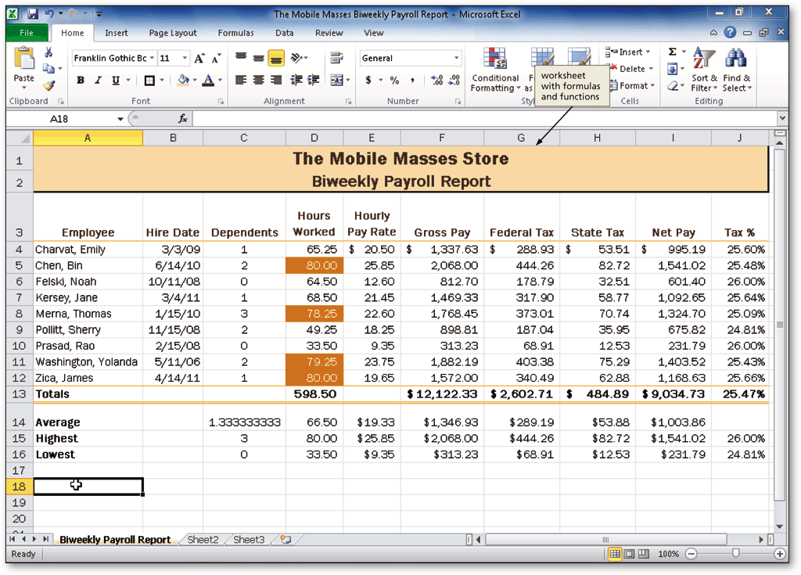
Project – Worksheet with Formulas and Functions

Slide 5
General Project Guidelines
Plan the layout of the worksheet
Determine the necessary formulas and functions needed
Identify how to format various elements of the worksheet
Establish rules for conditional formatting
Specify how the hard copy of a worksheet should appear

Slide 6
Entering a Formula Using the Keyboard
With the cell to contain the formula selected, type the formula in the cell to display the formula in the formula bar and in the current cell and to display colored borders around the cells referenced in the formula
Press the RIGHT arrow key to complete the arithmetic operation indicated by the formula, to display the result in the worksheet, and to select the cell to the right

Slide 7
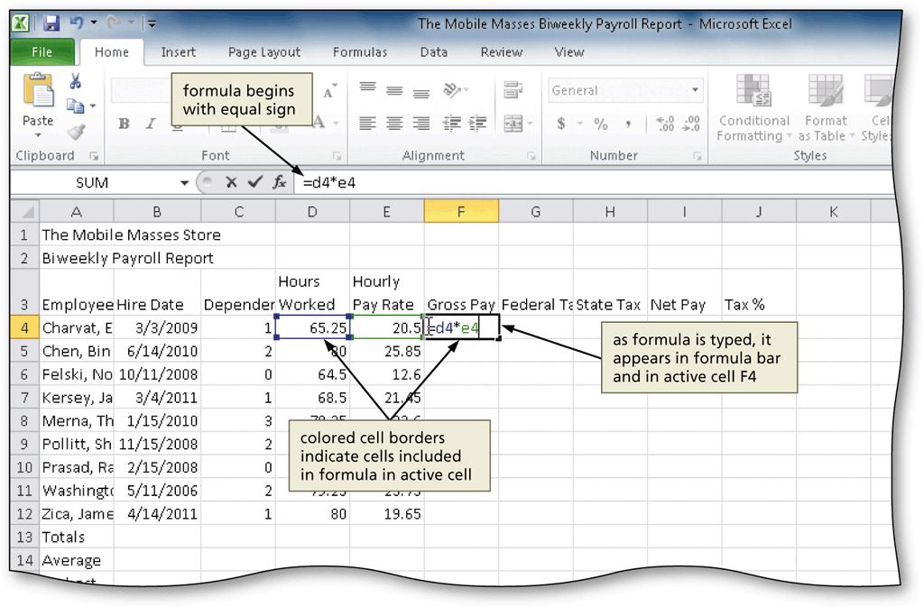
Entering a Formula Using the Keyboard

Slide 8
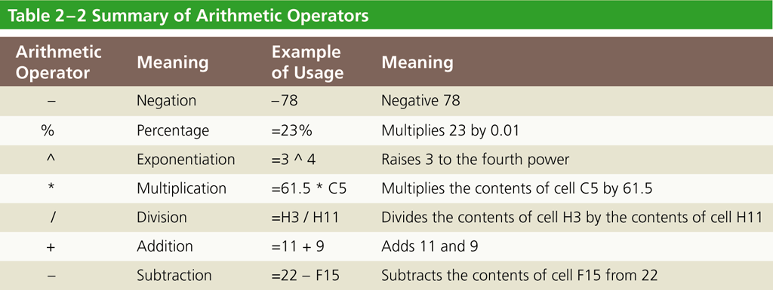
Arithmetic Operations

Slide 9
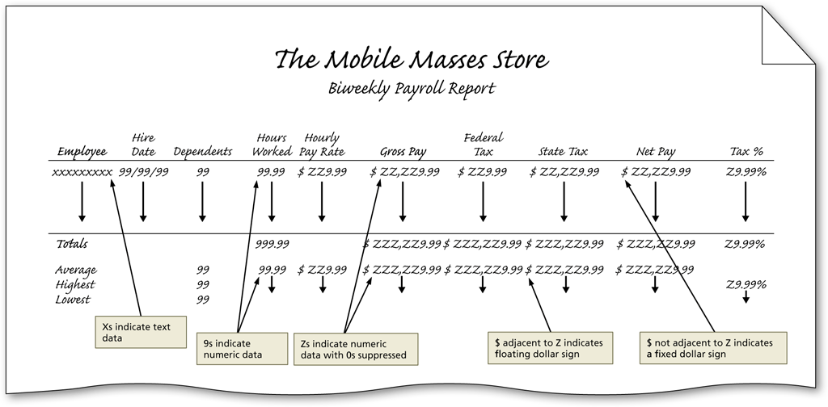
Order of Operations

Slide 10
Entering Formulas Using Point Mode
Click the cell in which you want to enter the formula
Type the formula. Instead of using the keyboard to type cell references, select the cells for use in the formula by clicking the cells with the mouse
Click the Enter box in the formula bar when you have finished entering the formula

Slide 11
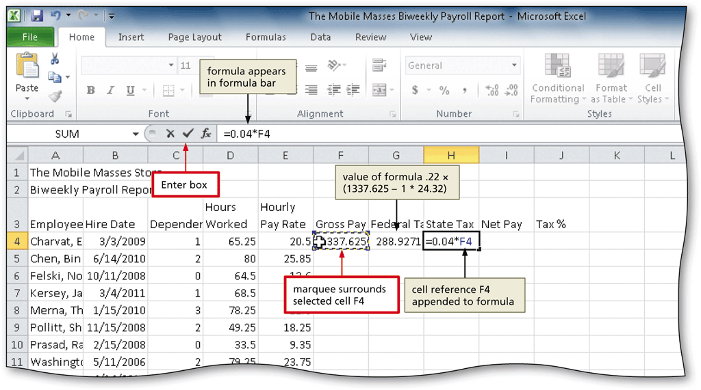
Entering Formulas Using Point Mode

Slide 12
Copying Formulas Using the Fill Handle
Select the source range, and then point to the fill handle
Drag the fill handle down through the cells to receive the copied formula(s) to select the destination range
Release the mouse button to copy the formulas to the destination range

Slide 13
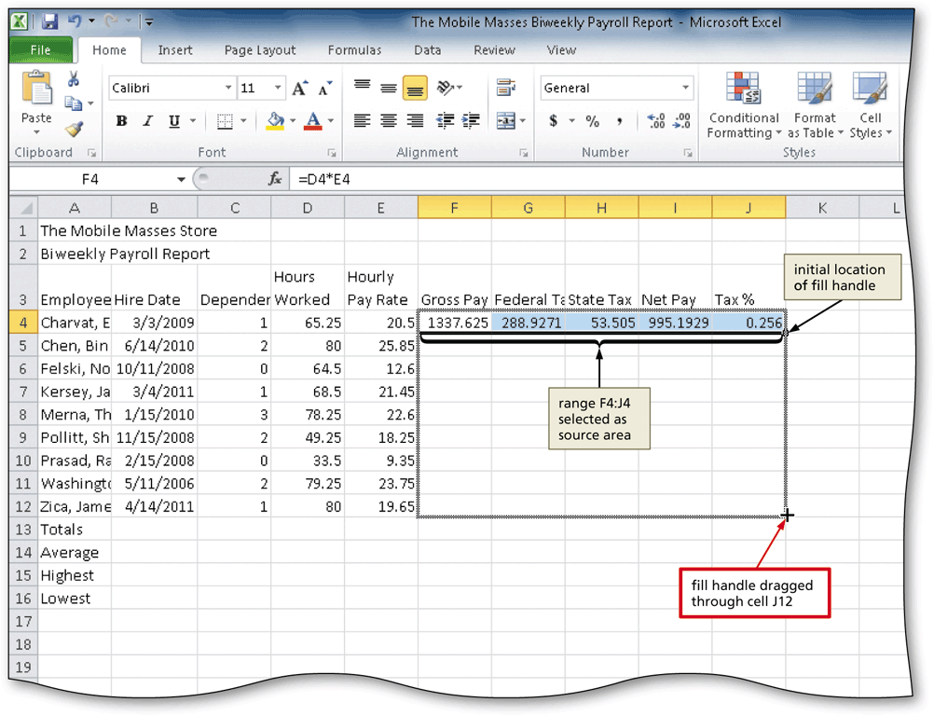
Copying Formulas Using the Fill Handle

Slide 14
Determining the Average of a Range of Numbers Using the Keyboard and Mouse
Select the cell to contain the average
Type =av in the cell to display the Formula AutoComplete list. Press the DOWN ARROW key to highlight the required formula
Double-click AVERAGE in the Formula AutoComplete list to select the function
Select the range to be averaged to insert the range as the argument to the function
Click the Enter box to compute the average of the numbers in the selected range and display the result in the selected cell

Slide 15
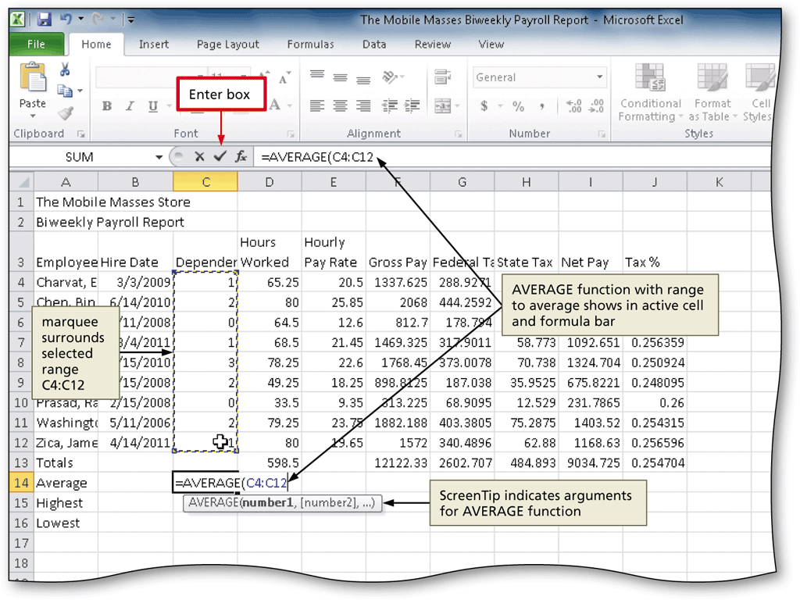
Determining the Average of a Range of Numbers Using the Keyboard and Mouse

Slide 16
Determining the Highest Number in a Range of Numbers Using the Insert Function Box
Select the cell to contain the maximum number
Click the Insert Function box in the formula bar to display the Insert Function dialog box
Click MAX in the ‘Select a function’ list to select it
Click the OK button to display the Function arguments dialog box
Type the range in the Number1 box to enter the first argument of the function
Click the OK button to display the highest value in the chosen range in the selected cell

Slide 17
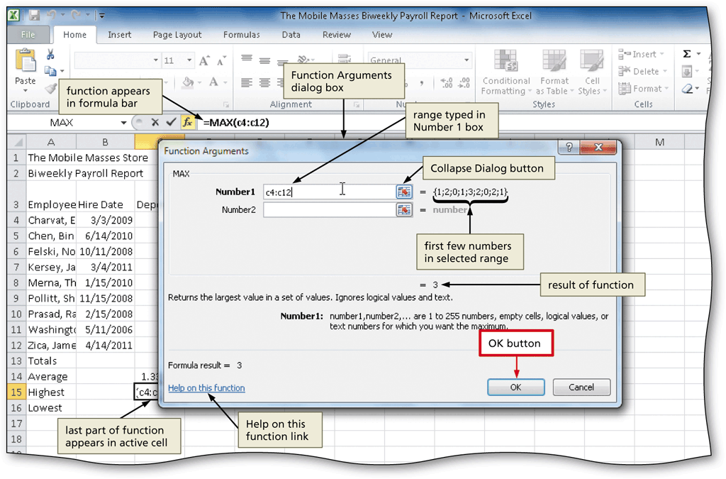
Determining the Highest Number in a Range of Numbers Using the Insert Function Box

Slide 18
Determining the Lowest Number in a Range of Numbers Using the Sum Menu
Select the cell to contain the lowest number
Click the Sum button arrow on the Home tab to display the Sum button menu
Click Min to display the MIN function in the formula bar and in the active cell
Drag through the range of values of which you want to determine the lowest number
Click the Enter box to determine the lowest value in the range and display the result in the formula bar and in the selected cell

Slide 19
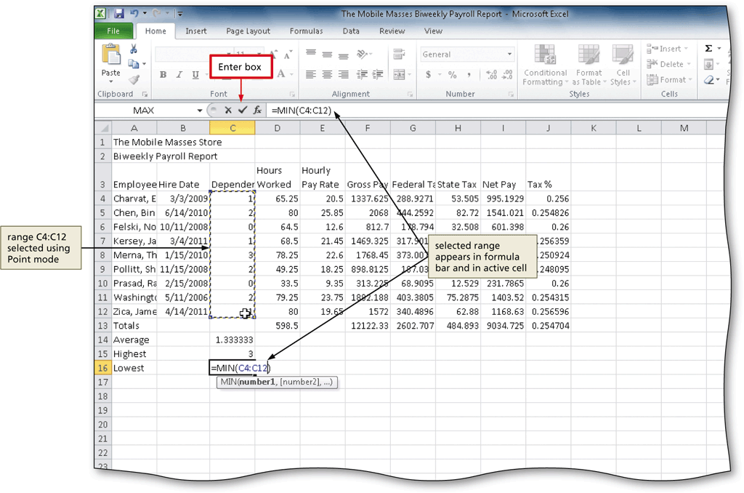
Determining the Lowest Number in a Range of Numbers Using the Sum Menu

Slide 20
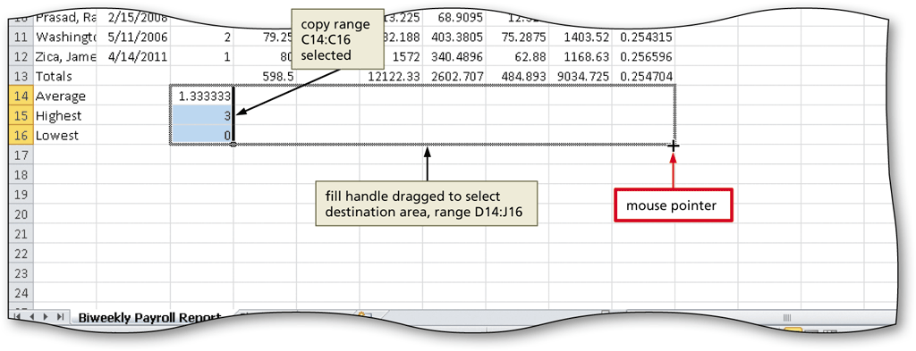
Copying a Range of Cells Across Columns to an Adjacent Range Using the Fill Handle
Select the source range from which to copy
Drag the fill handle in the lower-right corner of the selected range through the end of the destination area, and then release the mouse button

Slide 21
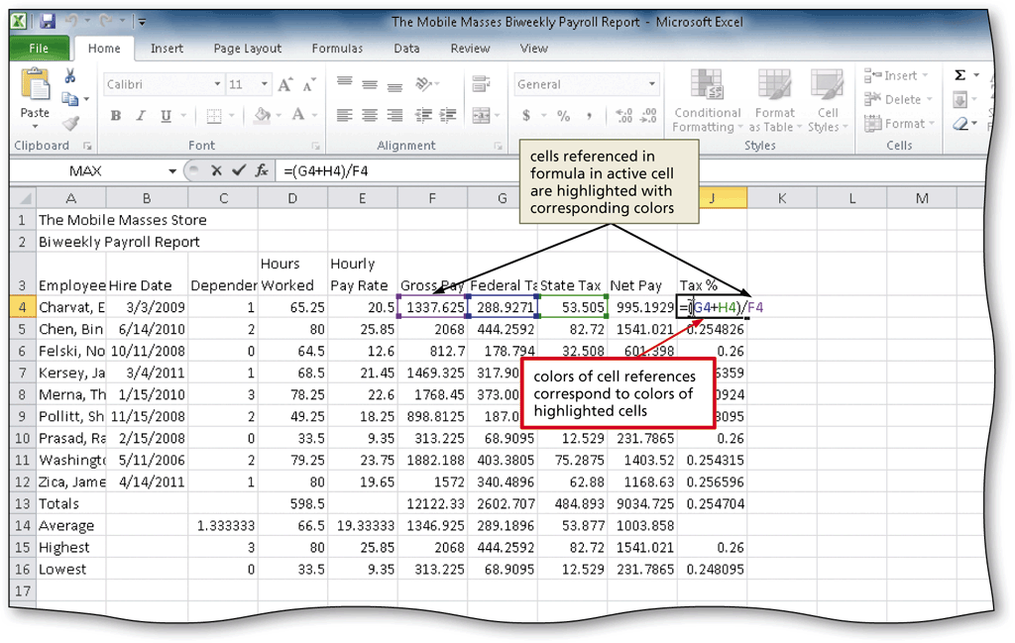
Verifying a Formula Using Range Finder
Double-click a cell containing a formula to activate Range Finder
Press the ESC key to quit Range Finder

Slide 22
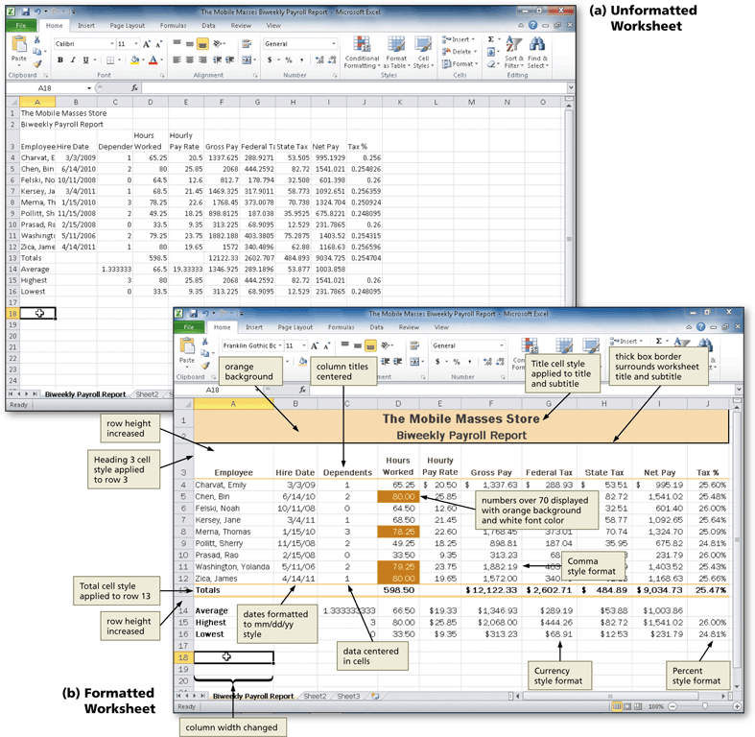
Formatting a Worksheet

Slide 23
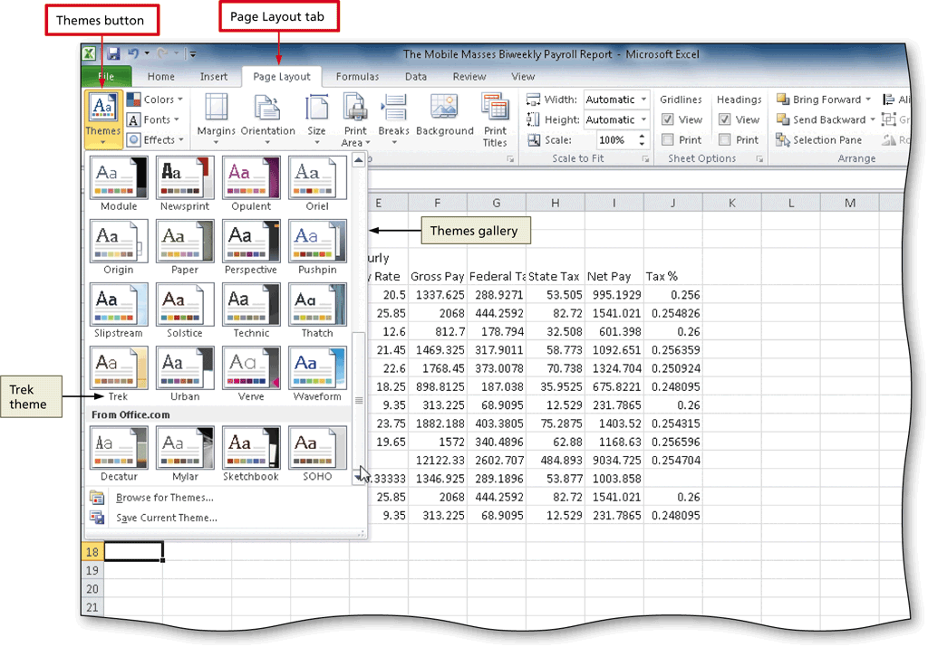
Changing the Workbook Theme
Click the Themes button on the Page Layout tab to display the Themes gallery
Click the desired theme in the Themes gallery to change the workbook theme

Slide 24
Changing the Background Color and Applying a Box Border to the Worksheet Title and Subtitle
Select the range to format, and then click the Fill Color button arrow on the Home tab to display the Fill Color gallery
Click the desired fill color in the Fill Color gallery to change the background color of the range of cells
Click the Borders button arrow on the Home tab to display the Borders list
Click the desired border in the Borders list to display the border around the selected range

Slide 25
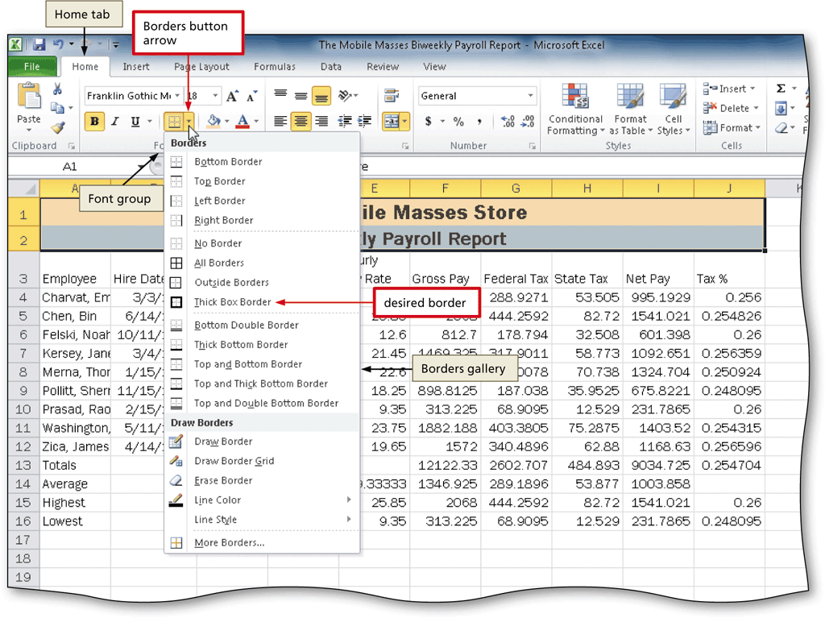
Changing the Background Color and Applying a Box Border to the Worksheet Title and Subtitle

Slide 26
Formatting Dates and Centering Data in Cells
Select the range to contain the new date format
Click the Format Cells: Number Dialog Box Launcher on the Home tab to display the Format Cells dialog box
If necessary, click the Number tab, click Date in the Category list, and then click the desired date type in the Type list to choose the format for the selected range
Click the OK button to format the dates in the selected range using the selected date format style
Select the range containing data to center, and then click the Center button on the Home tab to center the data in the selected range

Slide 27
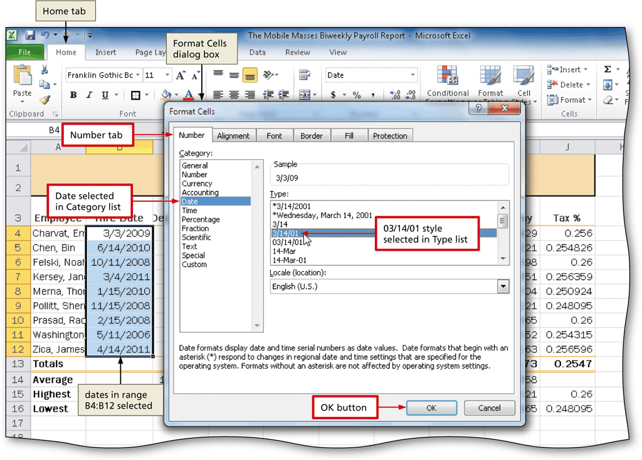
Formatting Dates and Centering Data in Cells

Slide 28
Applying an Accounting Number Format and Comma Style Format Using the Ribbon
Select the range to contain the Accounting number format
Click the Accounting Number Format button on the Home tab to apply the Accounting number format to the selected range
Select the range to contain the Comma style format
Click the Comma Style button on the Home tab to assign the Comma style format to the selected range

Slide 29
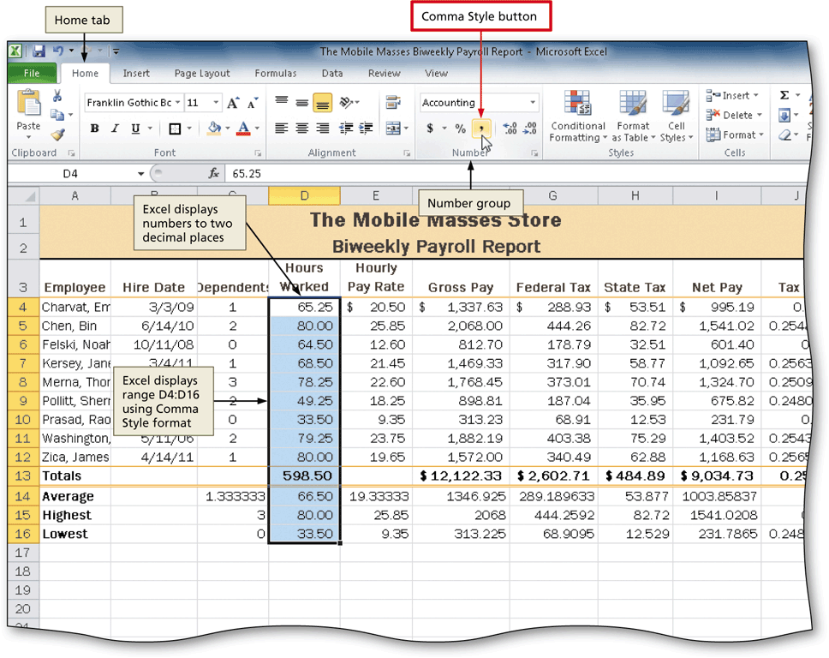
Applying an Accounting Number Format and Comma Style Format Using the Ribbon

Slide 30
Applying a Currency Style Format with a Floating Dollar Sign Using the Format Cells Dialog Box
Select the range to format, and then click the Format Cells: Number Dialog Box Launcher on the Home tab to display the Format Cells dialog box
If necessary, click the Number tab to display the Number tab
Click Currency in the Category list to select the necessary number format category, and then click the desired style to select the desired currency format
Click the OK button to assign the Currency style format to the selected range

Slide 31
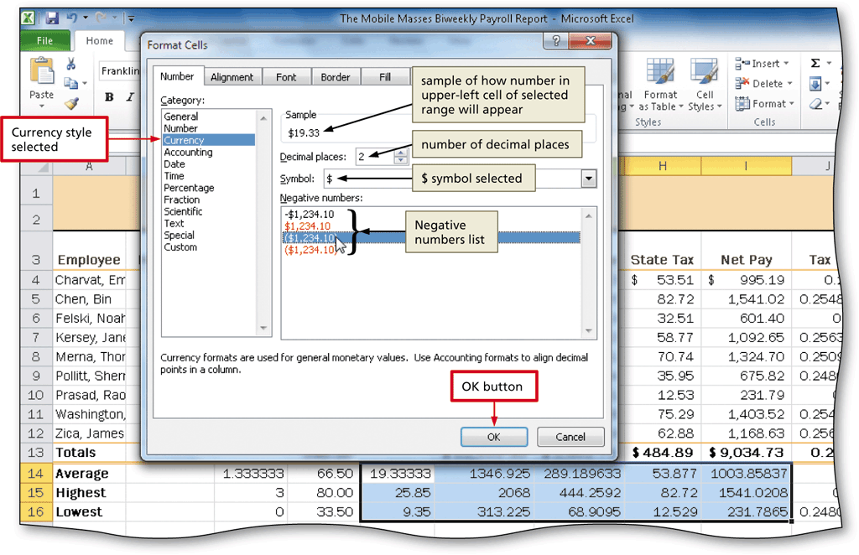
Applying a Currency Style Format with a Floating Dollar Sign Using the Format Cells Dialog Box

Slide 32
Applying a Percent Style Format and Using the Increase Decimal Button
Select the range to format
Click the Percent Style button on the Home tab to display the numbers in the selected range as a rounded whole percent
Click the Increase Decimal button on the Home tab two times to display the numbers in the selected range with two decimal places

Slide 33
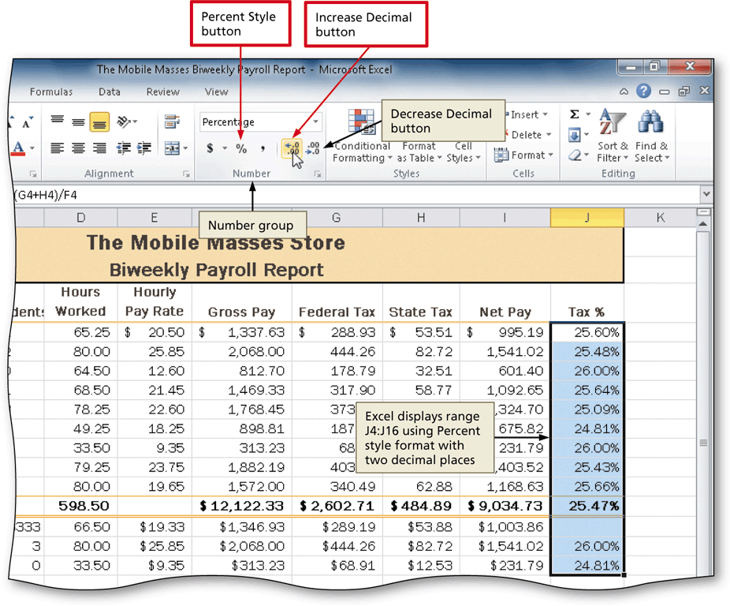
Applying a Percent Style Format and Using the Increase Decimal Button

Slide 34
Applying Conditional Formatting
Select the range to which you wish to apply conditional formatting
Click the Conditional Formatting button on the Home tab to display the Conditional Formatting list
Click New Rule in the Conditional Formatting list to display the New Formatting Rule dialog box
Click the desired rule type in the Select a Rule Type area
Select and type the desired values in the Edit the Rule Description area

Slide 35
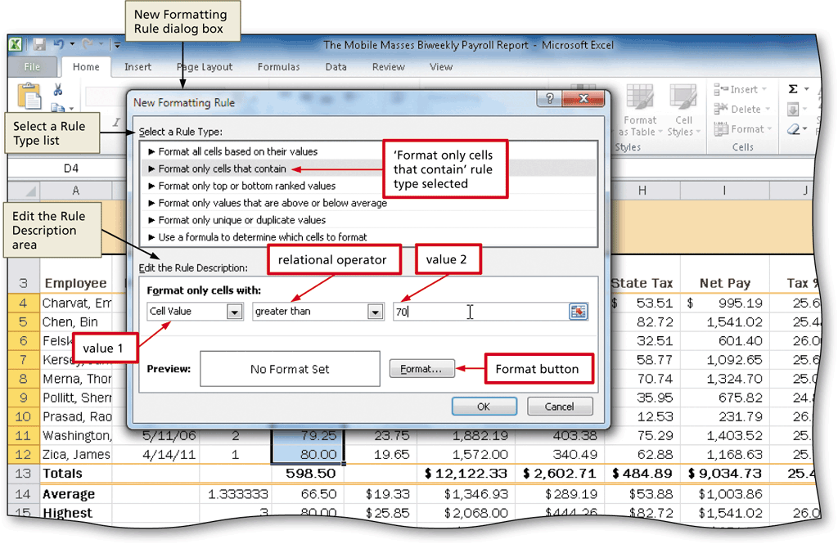
Applying Conditional Formatting

Slide 36
Applying Conditional Formatting
Click the Format button to display the Format Cells dialog box
If necessary, click the Font tab. Click the Color box arrow to display the Color gallery and then click the desired font color
Click the Fill tab to display the Fill sheet and then click the desired background color
Click the OK button to close the Format Cells dialog box with the desired font and background colors displayed in the Preview box
Click the OK button to assign the conditional format to the selected range

Slide 37
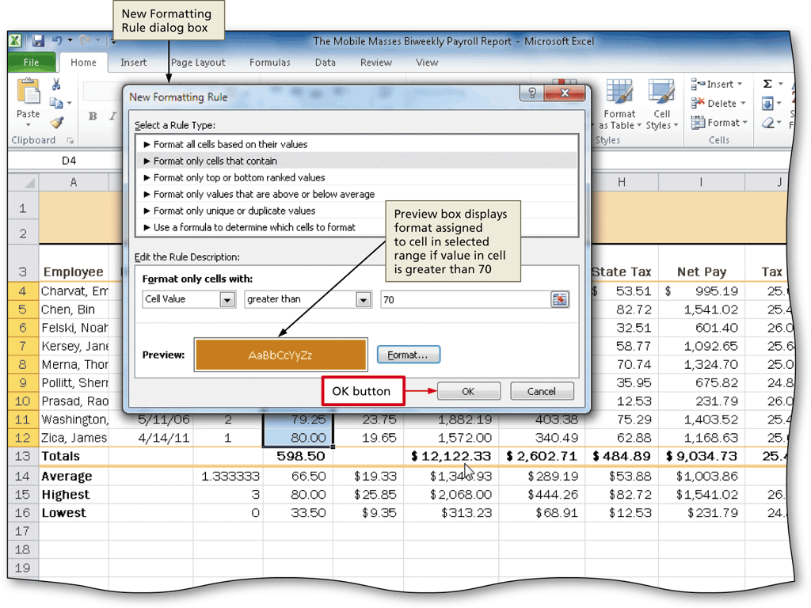
Applying Conditional Formatting

Slide 38
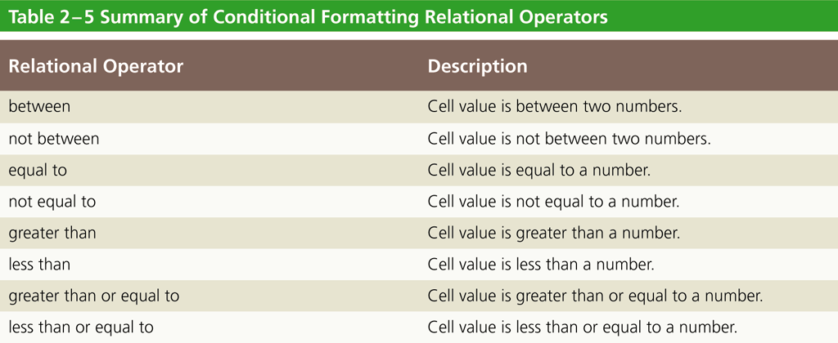
Conditional Formatting Operators

Slide 39
Changing the Width of Columns
Drag through the column headings for the columns you wish to resize
Point to the boundary on the right side of the rightmost column to cause the mouse pointer to become a split double arrow
Double-click the right boundary of the column to change the width of the selected columns to best fit
To resize a column by dragging, point to the boundary of the right side of the column heading. When the mouse pointer changes to a split double arrow, drag to the desired width, and then release the mouse button

Slide 40
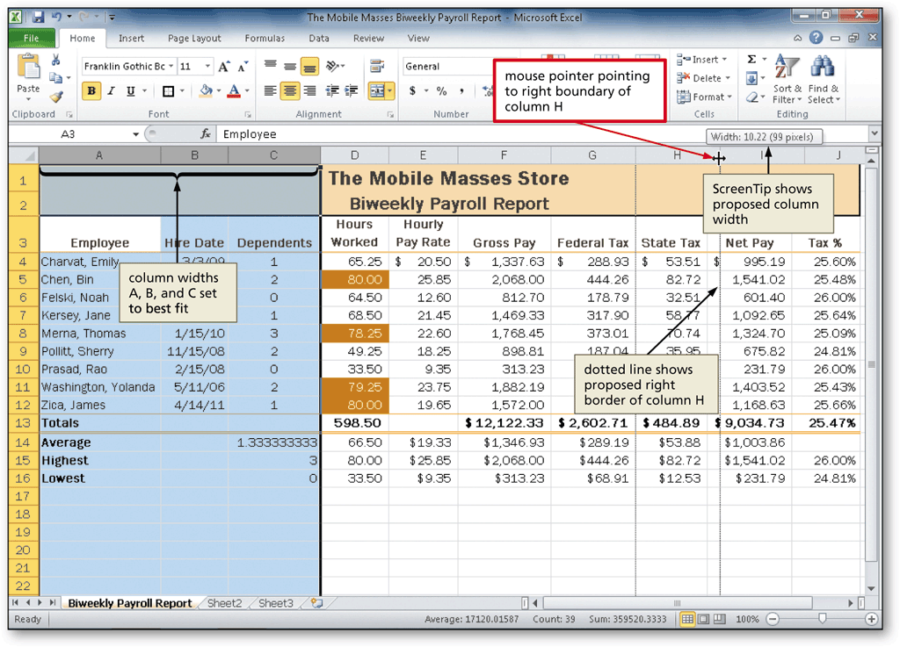
Changing the Width of Columns

Slide 41
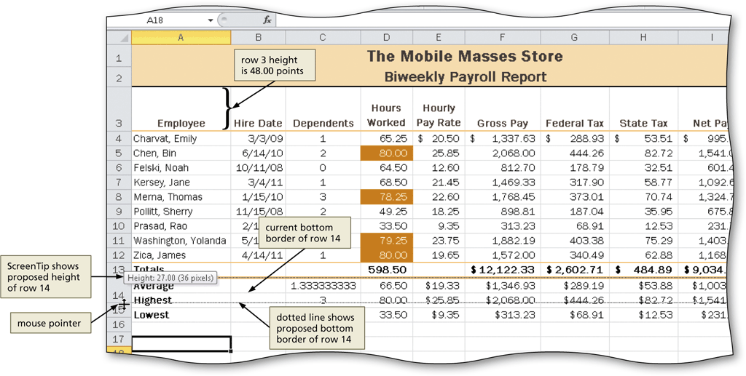
Changing the Heights of Rows
Point to the boundary below the row heading to resize
Drag the boundary to the desired row height and then release the mouse button

Slide 42
Checking Spelling on the Worksheet
Click cell A1 so that the spell checker begins checking at the selected cell
Click the Spelling button on the Review tab to run the spell checker and display the misspelled words in the Spelling dialog box
Apply the desired action to each misspelled word
When the spell checker is finished, click the Close button

Slide 43
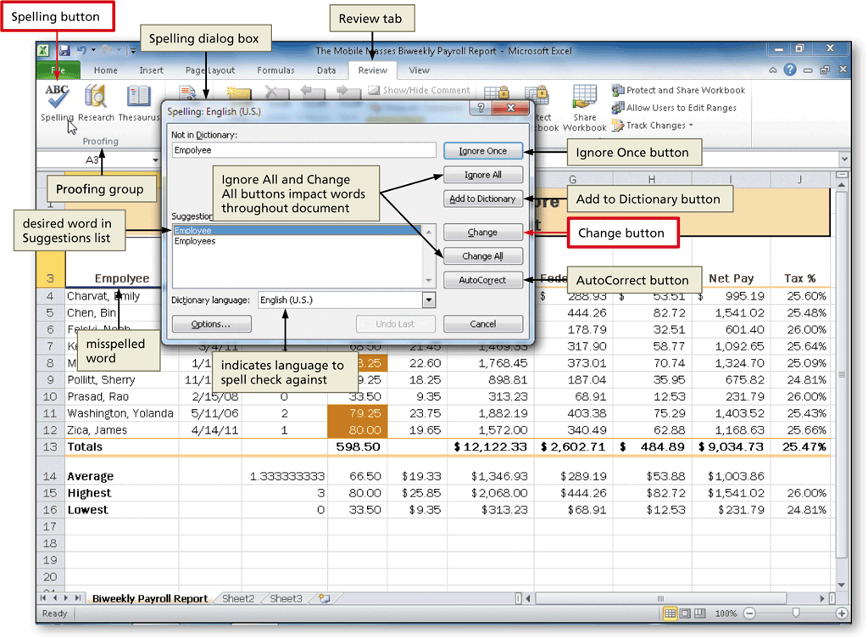
Checking Spelling on the Worksheet

Slide 44
Changing the Worksheet’s Margins, Header, and Orientation in Page Layout View
Click the Page Layout button on the status bar to view the worksheet in Page Layout view
Click the Margins button on the Page Layout tab to display the Margins gallery
Click the desired margin style to change the worksheet margins to the selected style
Click above cell A1 in the center area of the Header area
Type the desired worksheet header, and then press the ENTER key

Slide 45
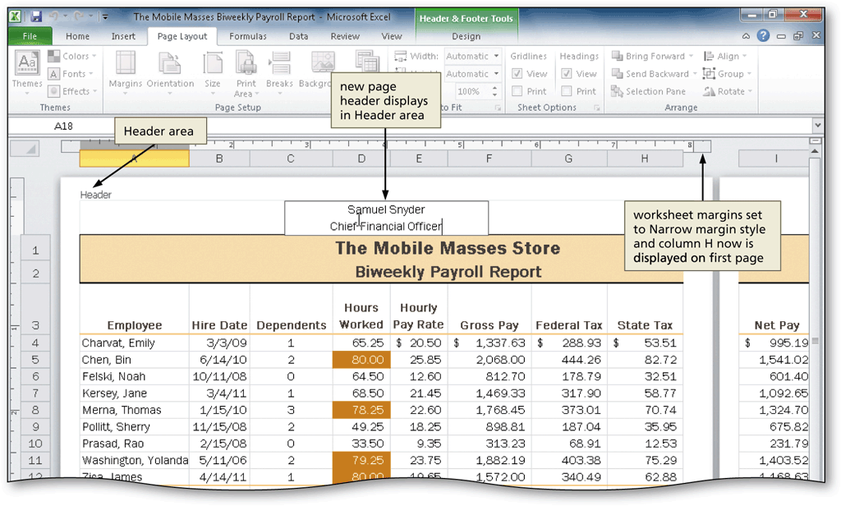
Changing the Worksheet’s Margins, Header, and Orientation in Page Layout View

Slide 46
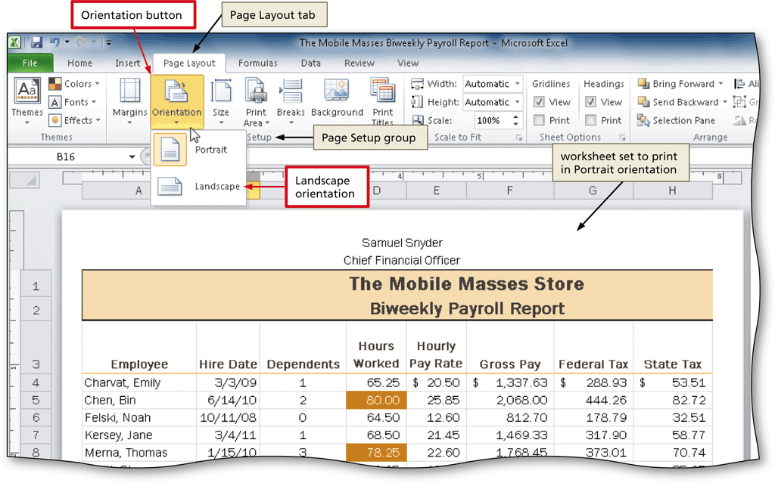
Changing the Worksheet’s Margins, Header, and Orientation in Page Layout View
Click another cell to deselect the header, and then click the Orientation button on the Page Layout tab to display the Orientation gallery
Click the desired orientation in the Orientation gallery to change the worksheet’s orientation

Slide 47
Printing a Section of the Worksheet
Select the range to print
Click File on the Ribbon to open the Backstage view
Click the Print tab to display the Print gallery
Click Print Active Sheets in the Settings area to display a list of options that determine what Excel should print
Click Print Selection to instruct Excel to print only the selected range
Click the Print button in the Print gallery to print the selected range of the worksheet on the currently selected printer

Slide 48
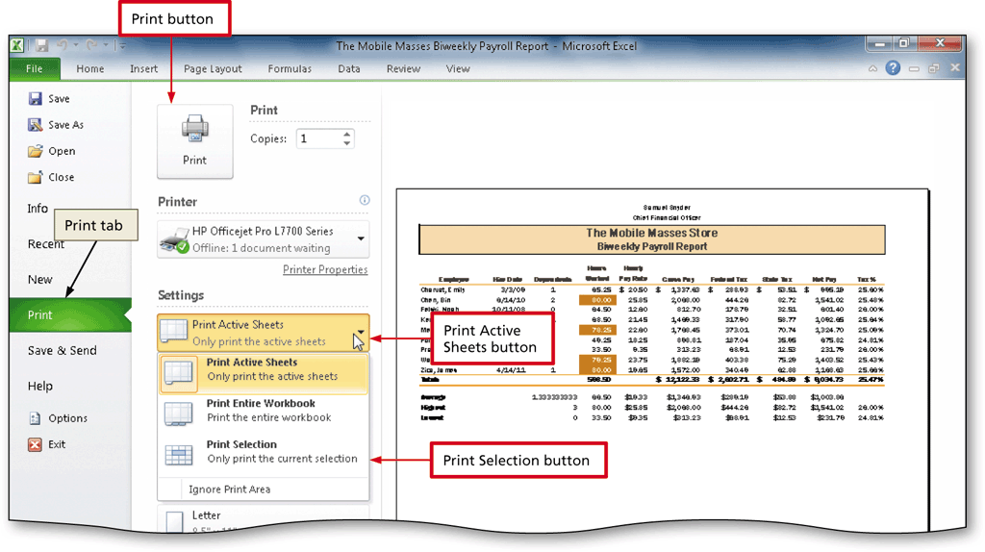
Printing a Section of the Worksheet

Slide 49
Displaying the Formulas in the Worksheet and Fitting the Printout on One Page
Press CTRL+ACCENT MARK (`) to display the worksheet with formulas
Click the Page Setup Dialog Box Launcher on the Page Layout tab to display the Page Setup dialog box
If necessary, click Fit to in the Scaling area to select it
Click the Print button to print the formulas in the worksheet on one page. If necessary, in the Backstage view, select the Print Active Sheets option in the Settings area of the Print gallery
When Excel displays the Backstage view, click the Print button to print the worksheet
After viewing and printing the formulas version, press CTRL+ACCENT MARK (`) to instruct Excel to display the values version

Slide 50
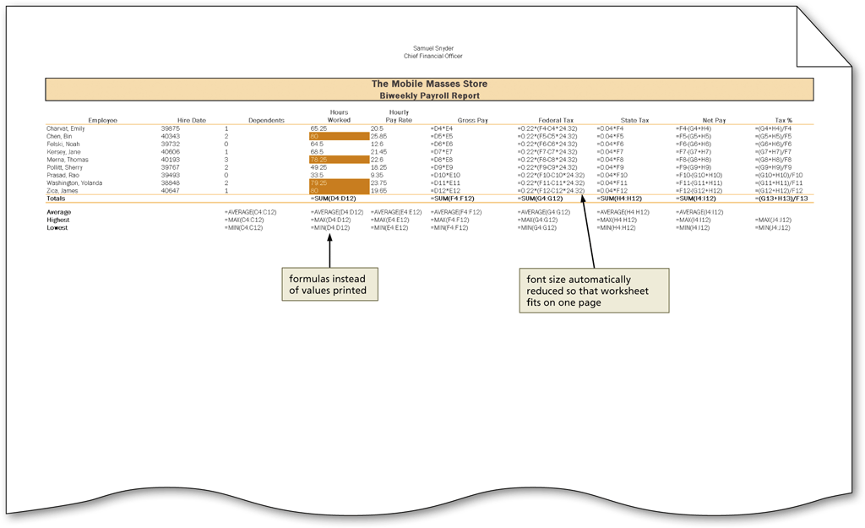
Displaying the Formulas in the Worksheet and Fitting the Printout on One Page

Slide 51
Chapter Summary
Enter formulas using the keyboard
Enter formulas using Point mode
Apply the AVERAGE, MAX, and MIN functions
Verify a formula using Range Finder
Apply a theme to a workbook
Apply a date format to a cell or range

Slide 52
Chapter Summary
Add conditional formatting to cells
Change column width and row height
Check the spelling in a worksheet
Set margins, headers, and footers in Page Layout view
Preview and print versions of a worksheet

Slide 53
Microsoft
Excel 2010
Chapter 2 Complete

