Slide 1
Microsoft
Excel 2010
Chapter 1
Creating a Worksheet and an Embedded Chart

Slide 2
Objectives
Describe the Excel worksheet
Enter text and numbers
Use the Sum button to sum a range of cells
Copy the contents of a cell to a range of cells using the fill handle
Apply cell styles
Format cells in a worksheet

Slide 3
Objectives
Create a Clustered Cylinder chart
Change a worksheet name and worksheet tab color
Change document properties
Preview and print a worksheet
Use the AutoCalculate area to display statistics
Correct errors on a worksheet

Slide 4
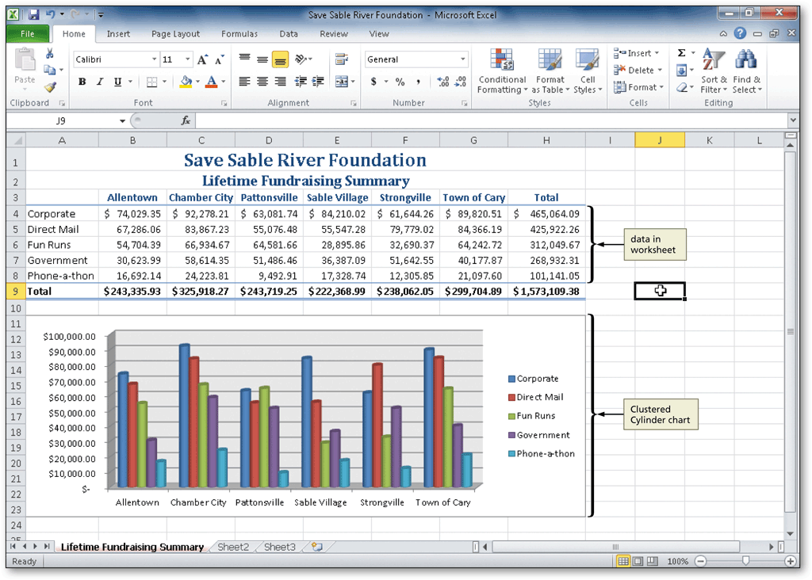
Project – Working with an Embedded Chart

Slide 5
General Project Guidelines
Select titles and subtitles for the worksheet
Determine the contents for rows and columns
Determine the calculations that are needed
Determine where to save the workbook
Identify how to format various elements of the worksheet
Decide on the type of chart needed
Establish where to position and how to format the chart
Choose a name for the worksheet
Determine the best method for distributing the workbook

Slide 6
Entering the Worksheet Title
Click cell A1 to make cell A1 the active cell
Type the worksheet title in cell A1 and then click the Enter box to complete the entry and enter a worksheet title
Click cell A2 to select it
Type the worksheet subtitle in cell A2 and then click the Enter box to complete the entry and enter a worksheet subtitle

Slide 7
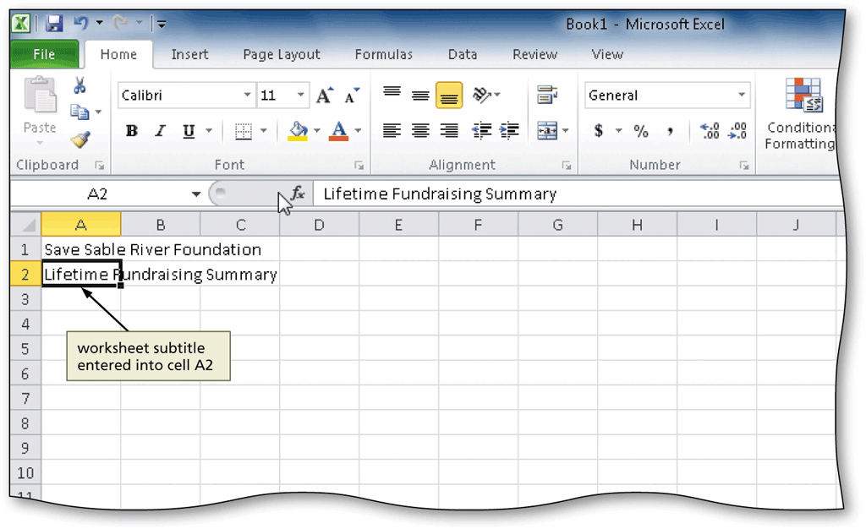
Entering the Worksheet Title

Slide 8
Entering Column Titles
Click the cell to place the first column title
Type the column title
Press the RIGHT ARROW key to enter a column title and make the cell to the right the active cell
Repeat the previous two steps until all column titles are entered. Click the Enter box after entering the last column title

Slide 9
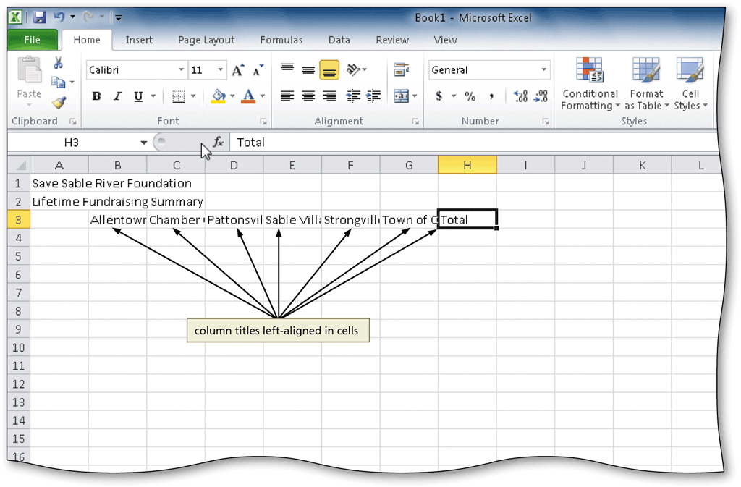
Entering Column Titles

Slide 10
Entering Row Titles
Click the cell to place the first row title
Type the column title
Press the DOWN ARROW key to enter a row title and make the cell below the current cell the active cell
Repeat the previous two steps until all row titles are entered. Click the Enter box after entering the last row title

Slide 11
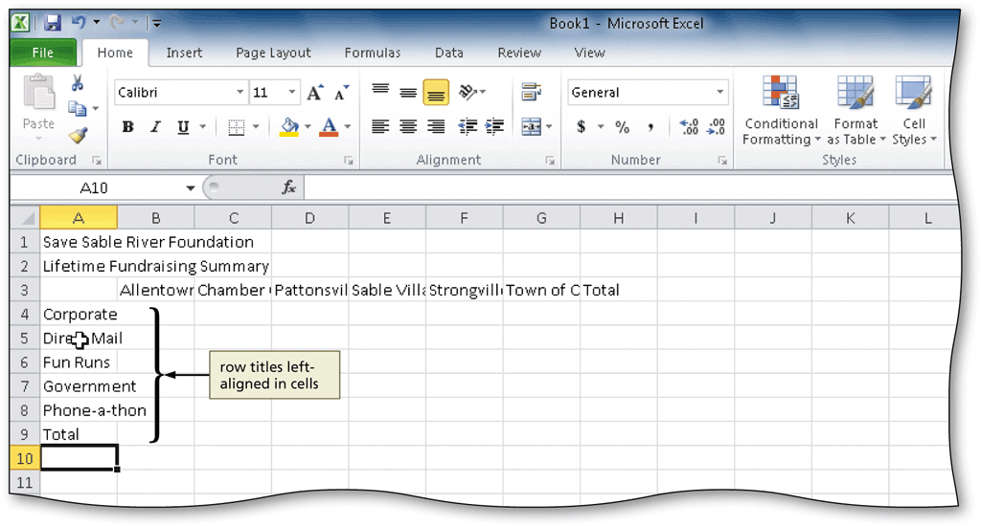
Entering Row Titles

Slide 12
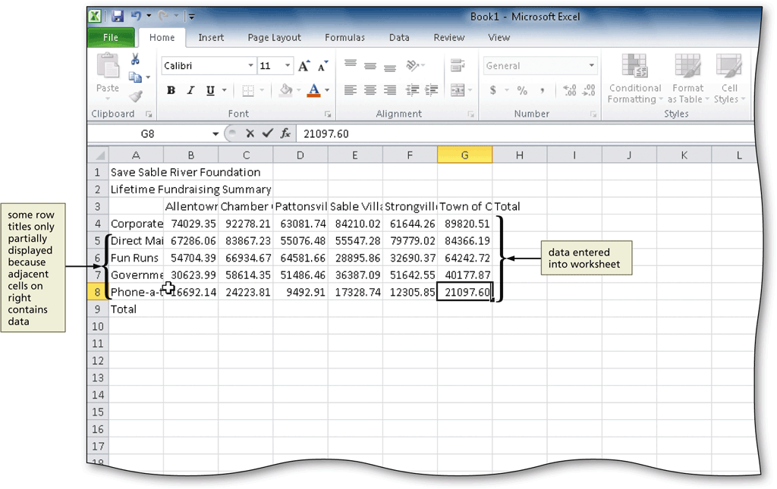
Entering Numbers
In Excel, you can enter numbers in Excel to represent amounts
If a cell entry contains any other keyboard character, Excel interprets it as text and treats it accordingly

Slide 13
Summing a Column of Numbers
Click the first empty cell below the column of numbers to sum
Click the Sum button on the Home tab to display the formula in the formula bar and in the active cell
Click the Enter box in the formula bar to enter a sum in the active cell

Slide 14
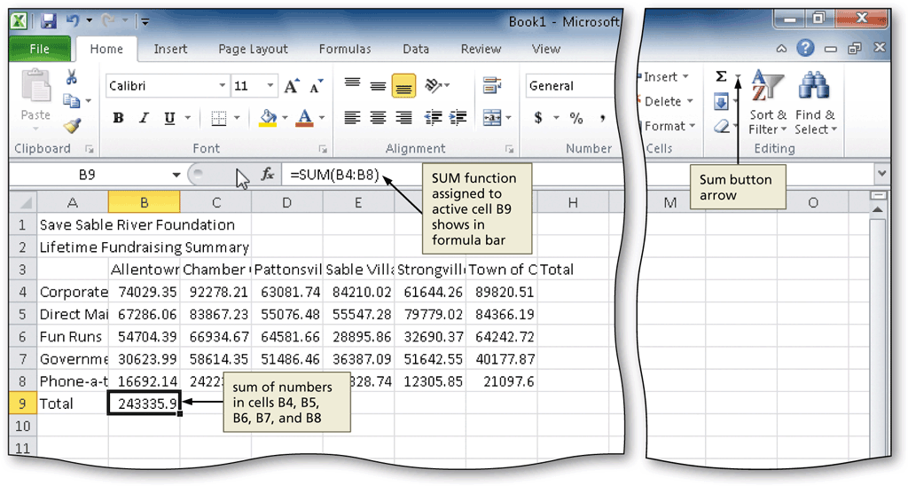
Summing a Column of Numbers

Slide 15
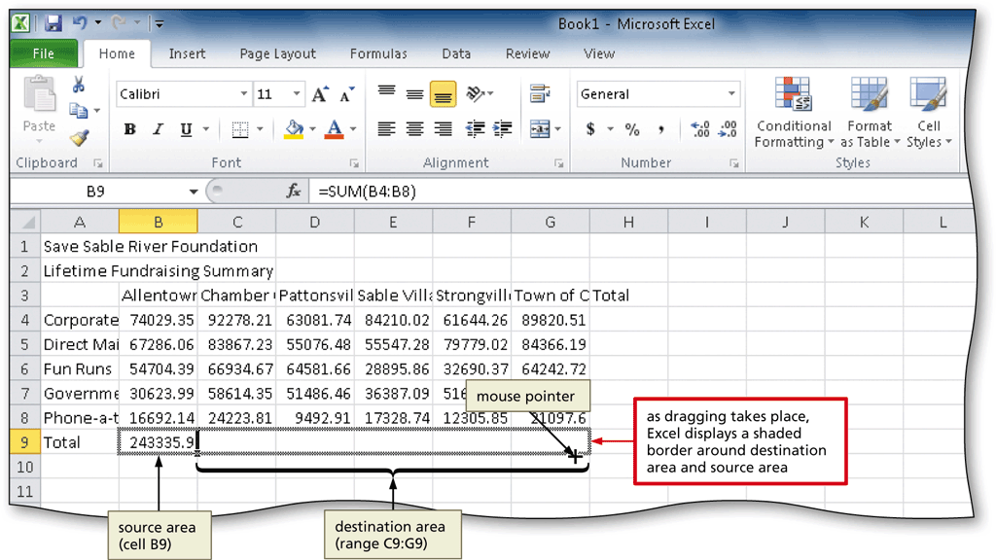
Copying a Cell to Adjacent Cells in a Row
Point to the fill handle in the cell containing the contents to fill across the row
Drag the fill handle to select the destination area, and release the mouse button

Slide 16
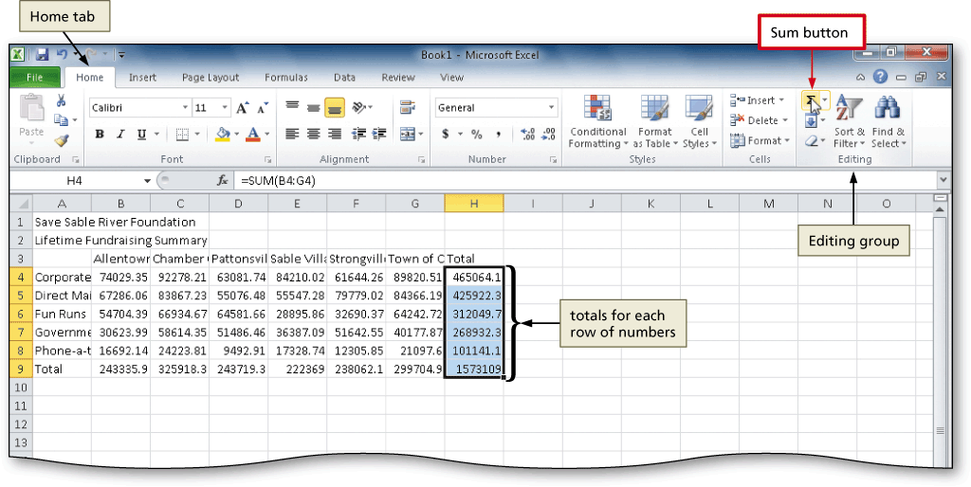
Determining Multiple Totals at the Same Time
Highlight a range at the end of rows or columns of numbers to total
Click the Sum button on the Home tab to calculate and display the sums of the corresponding rows or columns

Slide 17
Changing a Cell Style
Click the desired cell for which you want to change the style
Click the Cell Styles button on the Home tab to display the Cell Styles gallery
Point to the desired style to see a live preview of the cell style in the active cell
Click the desired style to apply the cell style to the active cell

Slide 18
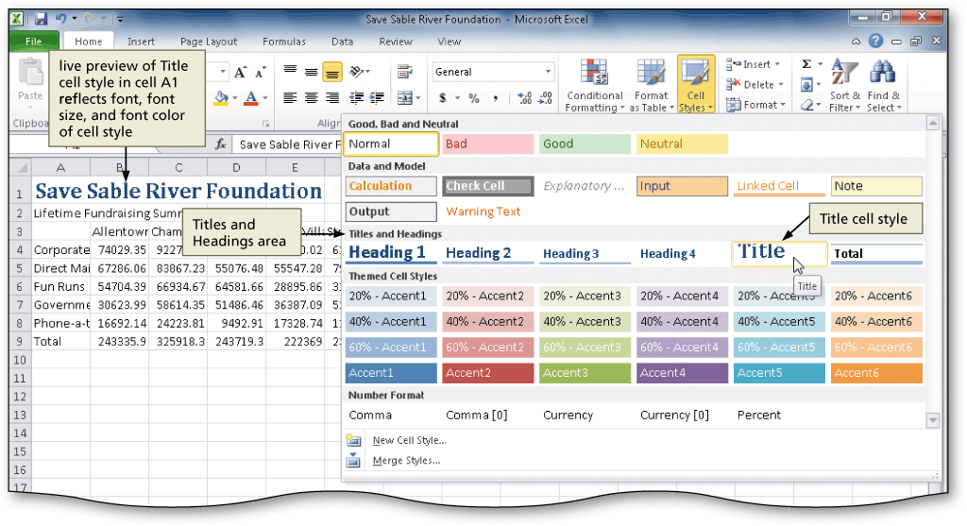
Changing a Cell Style

Slide 19
Changing the Font
Click the desired cell for which you want to change the font
Click the Font box arrow on the Home tab to display the Font gallery
Point to the desired font in the Font gallery to see a live preview of the selected font in the active cell
Click the desired font to change the font of the selected cell

Slide 20
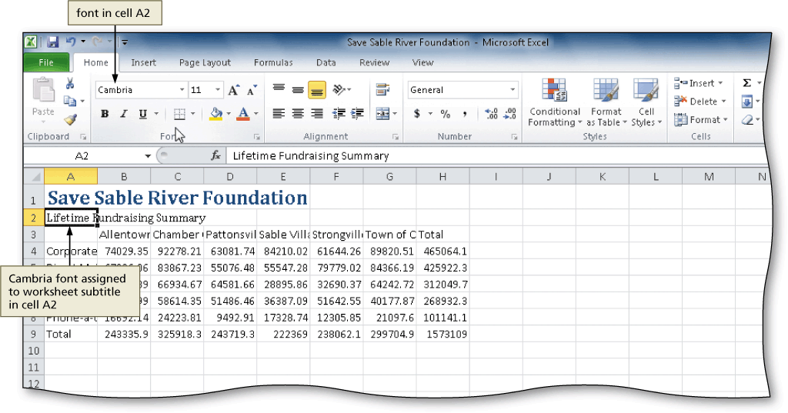
Changing the Font

Slide 21
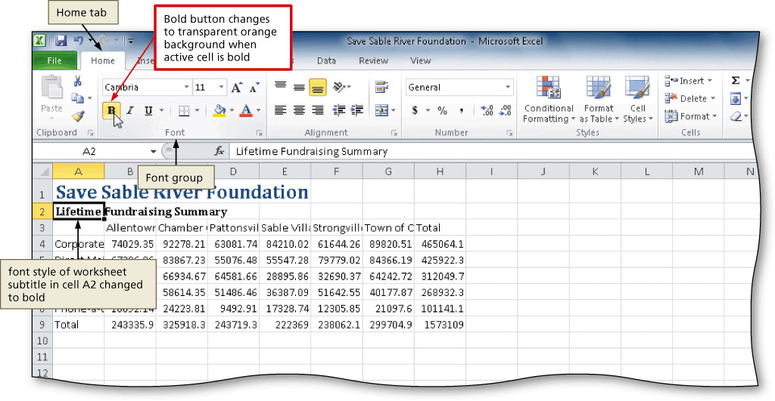
Bolding a Cell
With the cell to bold active, click the Bold button on the Home tab to change the font style of the active cell to bold

Slide 22
Increasing the Font Size of a Cell Entry
With the desired cell selected, click the Font Size box arrow on the Home tab to display the Font Size list
Point to the desired font size in the Font Size list to see a live preview of the active cell with the selected font size
Click the desired font size in the Font Size list to change the font size in the active cell

Slide 23
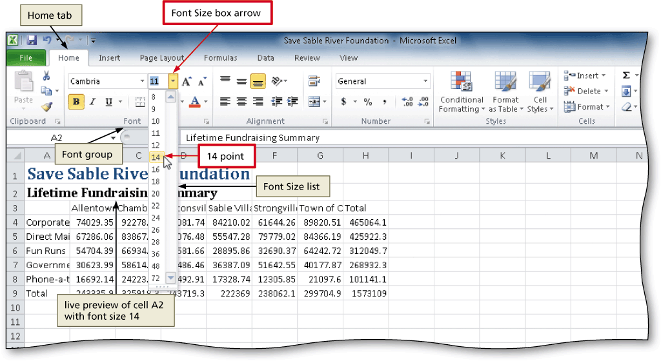
Increasing the Font Size of a Cell Entry

Slide 24
Changing the Font Color of a Cell Entry
Select the cell for which you want to change the font color, and then click the Font Color button arrow on the Home tab to display the Font Color gallery
Point to the desired font color in the Font Color gallery to see a live preview of the font color in the active cell
Click the desired font color on the Font Color gallery to change the font color of the selected cell

Slide 25
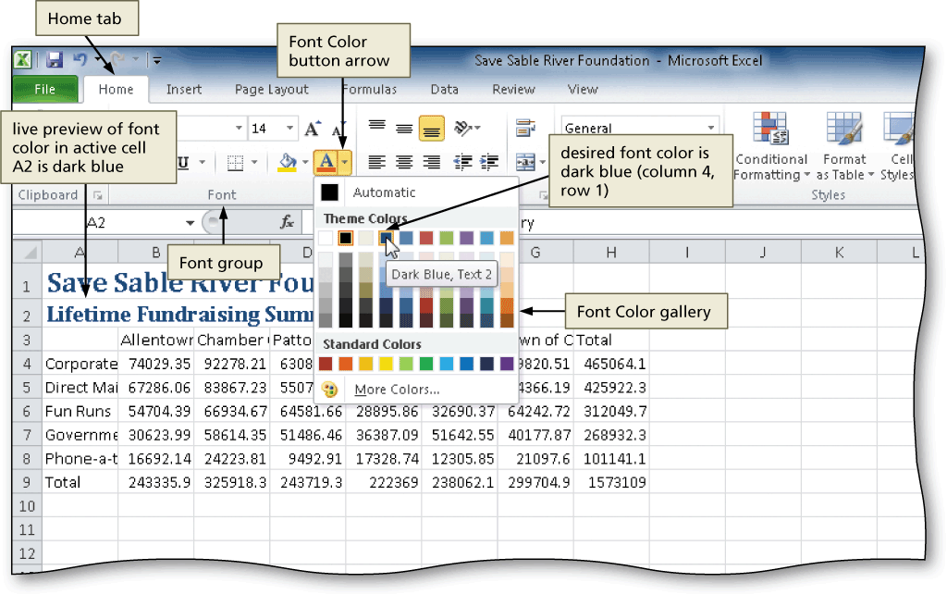
Changing the Font Color of a Cell Entry

Slide 26
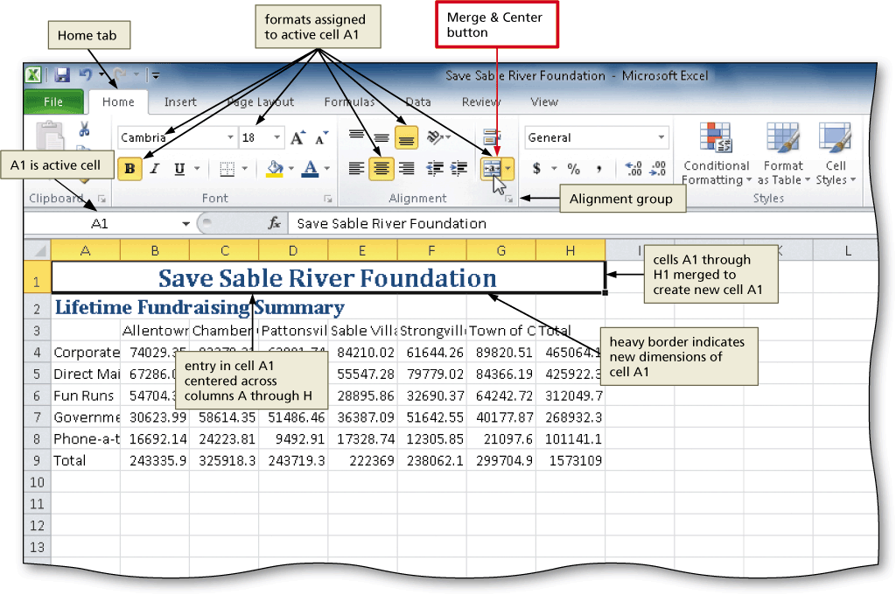
Centering Cell Entries Across Columns by Merging Cells
Drag to select the range of cells you want to merge and center
Click the Merge & Center button on the Home tab to merge the selected range and center the contents of the leftmost cell across the selected cells

Slide 27
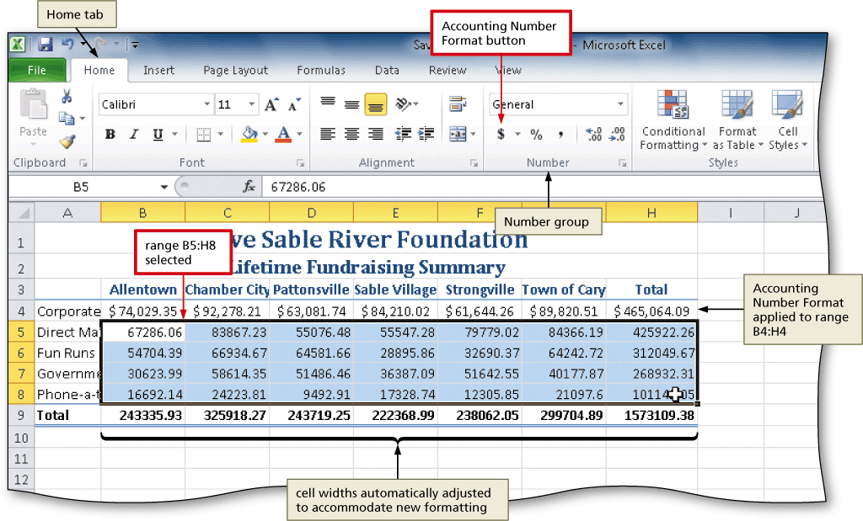
Format Numbers in the Worksheet
Select the range of cells containing numbers to format
Click the desired format in the Number group of the Home tab to apply the format to the cells in the selected range

Slide 28
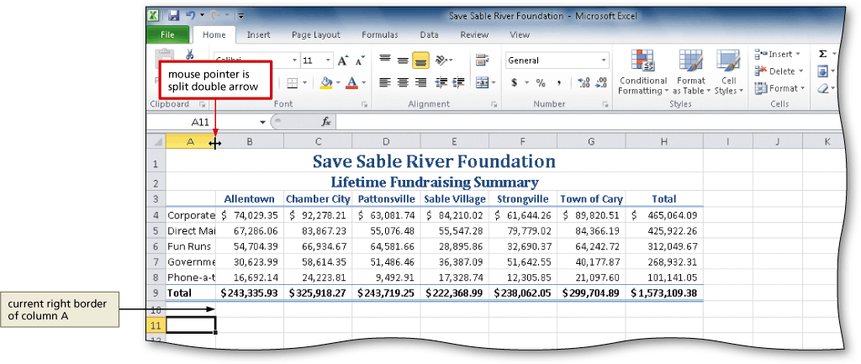
Adjusting the Column Width
Point to the boundary on the right side of the column of which you want to change the size to change the mouse pointer to a split double arrow
Double-click on the boundary to adjust the width of the column to the width of the largest item in the column

Slide 29
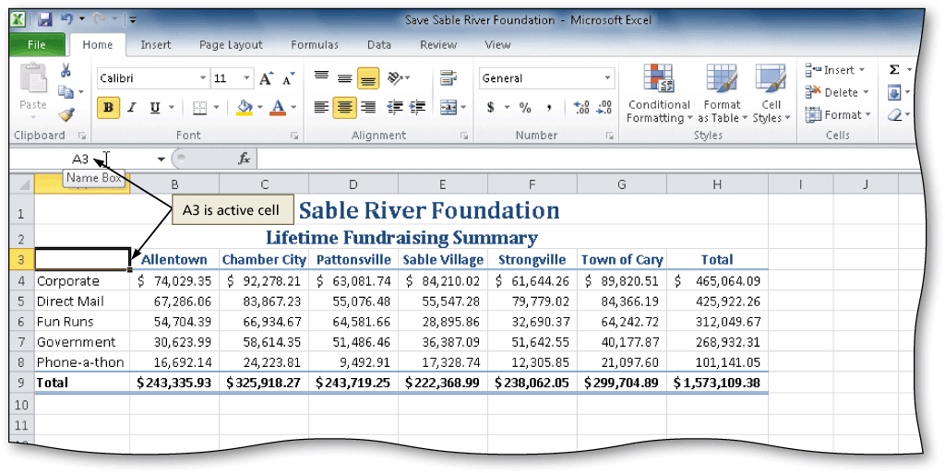
Using the Name Box to Select a Cell
Click the Name box in the formula bar and then type the cell reference of the cell you wish to select
Press the ENTER key to change the active cell in the Name box

Slide 30
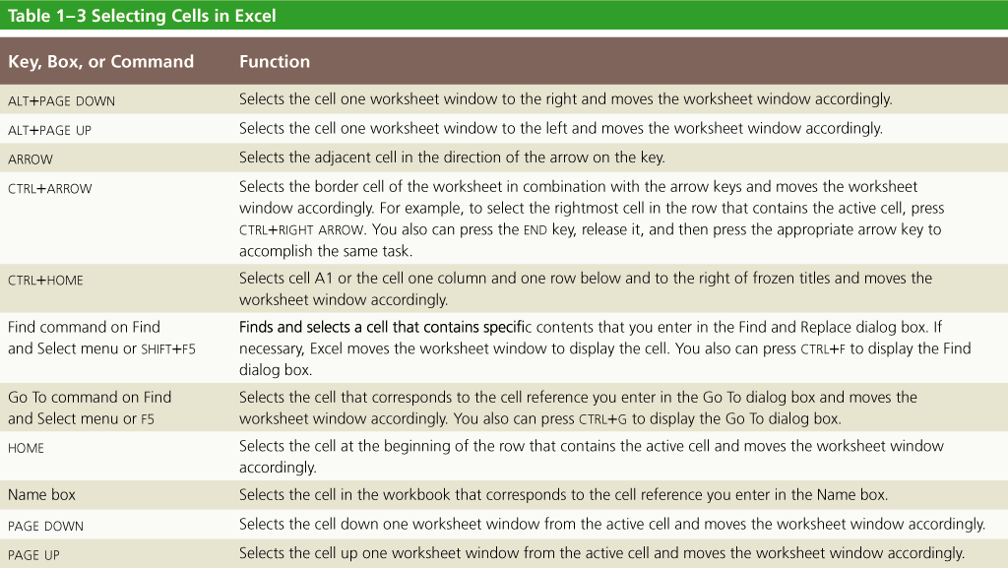
Other Ways to Select Cells

Slide 31
Adding a Clustered Cylinder Chart to the Worksheet
Select the range to be charted
Click the Column button on the Insert tab to display the Column gallery
Click the Clustered Cylinder chart type in the Cylinder area of the Column group to add the selected chart to the middle of the worksheet in a selection rectangle
Drag the chart border to the desired location on the worksheet

Slide 32
Adding a Clustered Cylinder Chart to the Worksheet
Drag the sizing handles to resize the chart
Click the More button in the Chart Styles gallery on the Chart Tools Design tab to expand the gallery
Click the desired style in the Chart Styles gallery to apply the chart style to the chart

Slide 33
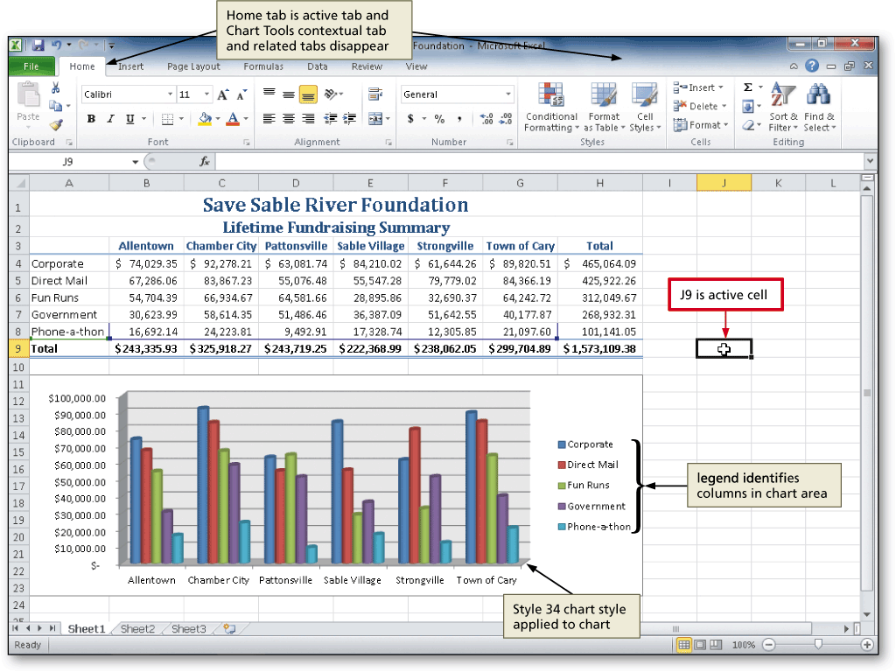
Adding a Clustered Cylinder Chart to the Worksheet

Slide 34
Changing the Worksheet Name
Double-click the sheet tab you wish to change in the lower-left corner of the window
Type the desired new worksheet name and then press the ENTER key
Right-click the sheet tab you just renamed to display a shortcut menu
Point to Tab Color on the shortcut menu to display the color gallery
Click the desired color to change the color of the tab

Slide 35
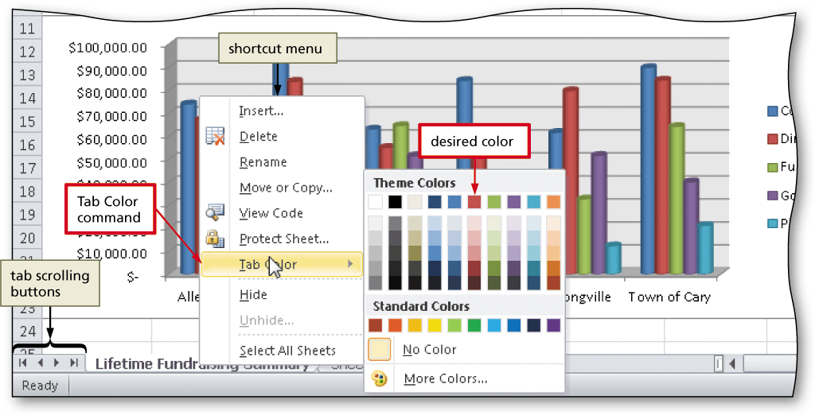
Changing the Worksheet Name

Slide 36
Changing Document Properties
Click File on the Ribbon to open the Backstage view. If necessary, click the Info tab in the Backstage view to display the Info gallery
Click the Properties button in the right pane of the Info gallery to display the Properties menu
Click Show Document Panel on the Properties menu to close the Backstage view and display the Document Information Panel in the Excel workbook window
Type the desired properties in the appropriate text boxes, and then click the Close the Document Information Panel button so that the Document Information Panel no longer is displayed

Slide 37
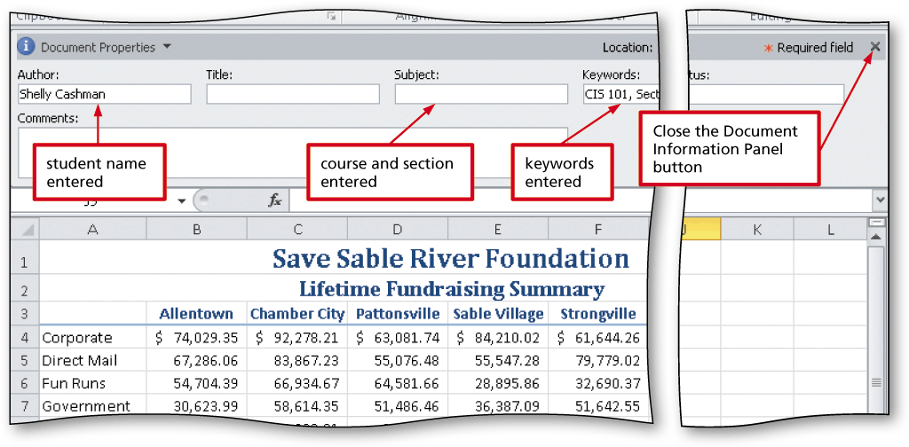
Changing Document Properties

Slide 38
Previewing and Printing a Worksheet in Landscape Orientation
Click File on the Ribbon to open the Backstage view
Click the Print tab in the Backstage view to display the Print gallery
Verify the printer name that appears on the Printer Status button will print a hard copy of the document. If necessary, click the Printer Status button to display a list of available printer options and then click the desired printer to change the currently selected printer
Click the Portrait Orientation button in the Settings area and then select Landscape Orientation to change the orientation of the page to landscape and view the entire worksheet on one page

Slide 39
Previewing and Printing a Worksheet in Landscape Orientation
Click the Print button in the Print gallery to print the worksheet in landscape orientation on the currently selected printer
When the printer stops, retrieve the hard copy

Slide 40
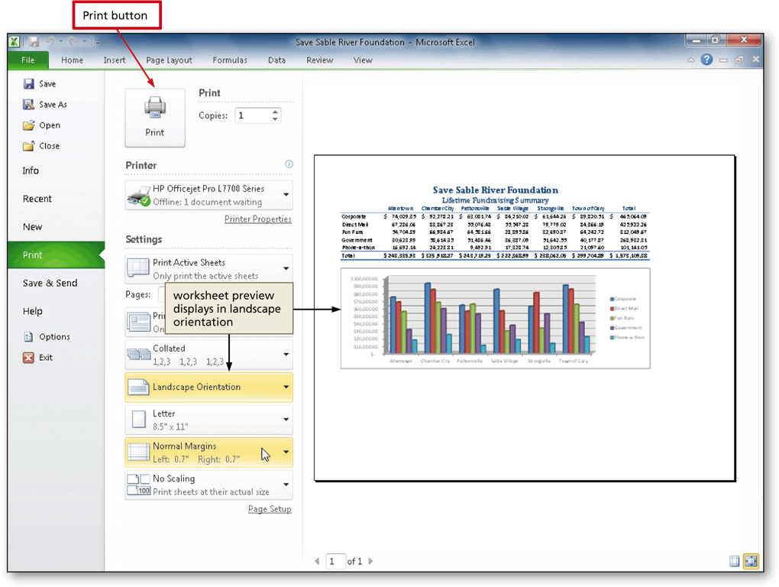
Previewing and Printing a Worksheet in Landscape Orientation

Slide 41
Using the AutoCalculate Area to Determine a Maximum
Select the range of which you wish to determine a maximum, and then right-click the AutoCalculate area on the status bar to display the Customize Status Bar shortcut menu
Click Maximum on the shortcut menu to display the Maximum value in the range in the AutoCalculate area of the status bar

Slide 42
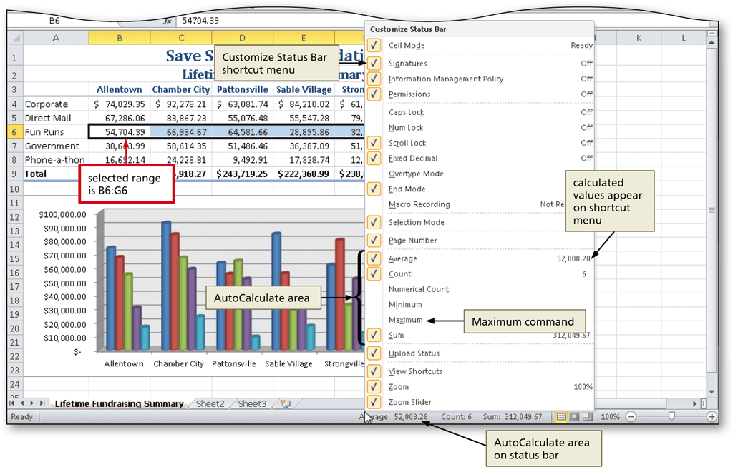
Using the AutoCalculate Area to Determine a Maximum

Slide 43
Chapter Summary
Describe the Excel worksheet
Enter text and numbers
Use the Sum button to sum a range of cells
Copy the contents of a cell to a range of cells using the fill handle
Apply cell styles
Format cells in a worksheet

Slide 44
Chapter Summary
Create a Clustered Cylinder chart
Change a worksheet name and worksheet tab color
Change document properties
Preview and print a worksheet
Use the AutoCalculate area to display statistics
Correct errors on a worksheet

Slide 45
Microsoft
Excel 2010
Chapter 1 Complete

