Slide 1
Chapter 3
Use Cases
Vision Document
Use Case Diaram

Slide 2
Revision Chapter 2:
What is meant by System Requirements?
FURPS+ (DIIPS)
What do we document with an ‘activity’-diagram?
What is a model?

Slide 3
SD:
We want to develop a system:
  What is our guide?
  System Analysis
  SDLC
  Vision document
    Problem description
    System capabilities
    Business benefits

Slide 4
Vision Document
Chapter 2:
  RMO
  Get familiar with the problem to be solved
  System capabilities provides the foundation information for the overall project plan
  Divide the system into subsystems
    Major components or functional areas
  Planning/Project management

Slide 6
SA activities
Broad definitions of ‘functions’
Get more specific:
  Fact finding tasks to understand the requirements
    Gathering ???
    Define ???
    Prioritize ???
    Develop UI dialogues
    Evaluate requirements with ???

Slide 7
AN EXTENSIVE AMOUNT OF INFORMATION IS REQUIRED TO PROPERLY DEFINE THE SYSTEM’S FUNCTIONAL /NON-FUNCTIONAL REQUIREMENTS

Slide 8
Drilling-down: general
Activity diagrams
  To understand business processes in terms of workflows
Single user-triggered business events:
  Use Cases:
    How can I trigger this business process?
    I want the system to calculate the Semester mark. So what workflows are involved?
    System response:
Identify object classes

Slide 9
To emphasize:
Requirements and the models that represent them are a key focus of analysis phase activities.
Documentation using UML Models

Slide 10
Overview: the next document!
“A use case documents a single user-triggered business event and the system’s response to that event”
Example:
  The purchasing agent wants to contact the supplier for ‘sport jackets’.
  He wants to use the system to “Look up the supplier” Use Case

Slide 11
OR!!
An activity that the system performs, usually in response to a request by a user:
  The system: “Look-up the supplier”
  The system: provide the supplier information
  Request by user: “I want to know the supplier”
Introduce the Event Table

Slide 12
LO:
What is an EVENT?
  How to identify an event?
  Event analysis
  Event Table Use Case Diagram
Techniques:
  User Goals
  Event Decomposition
  CRUD-table

Slide 13
Types of Events:
An event is an occurrence which takes place at a specific time and initiates or triggers a predetermined response from the system
  External Events: occurs outside the system border. “A student registers for a course” if the system is “Registration” or “Customer buys an item”, then the system can be any purchasing system.

Slide 14
Events (Cont):
  State/Internal: Occurs inside a system boundary A purchase took place and the quantity of an item falls below the re-order point, and triggers an automatic re-order event. These are very important in real time systems.
  Temporal: is an event that occurs at a pre-specified time. They usually trigger periodic outputs, like on the 5th of each month employee’s paychecks are produced.

Slide 15
System’s Response:
Understanding system behavior in terms of events takes a stimulus-response perspective. Pattern of operation:
  The system does nothing until triggered by an event. It sits and waits for an event to occur.
  When an event occurs, the system responds as completely as possible.
  After the response is finished, the system sits and waits until something happens.

Slide 16
An Analogy: (Ref: Stumpf, Teague)
Vending Machine:
  It sits in the hallway until someone drops money in the coin slot.
  The purchaser presses a button to select the desired beverage
  The machine then dispenses the beverage.
When the coins are entered, the machine recognizes that an event has occurred. A customer wants to buy a beverage.

Slide 17
Vending Machine:
The signal from the coin slot is the trigger.
In order to response, the machine now needs two pieces of data:
  The specification of the beverage
  The amount paid
Pressing the beverage selection button tells which drink is desired.
The coin slot senses the amount paid

Slide 18
Event Analysis:
Event analysis is like a giant vending machine, waiting for buttons to be pushed or coins to be inserted before it springs into action.
In order to respond to an event, the system or some object within it must be able to recognize that an event has occurred.

Slide 19
Event Table
Event | Trigger | Source | Use Case | Response | Destination
Wants to buy a drink | Coins; Drink selection | Customer | Purchase drinks | Provides drink; Change | Customer

Slide 20
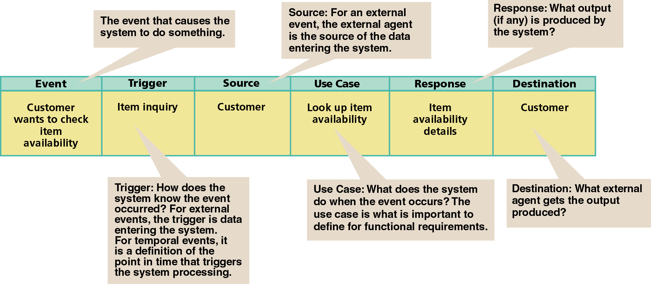
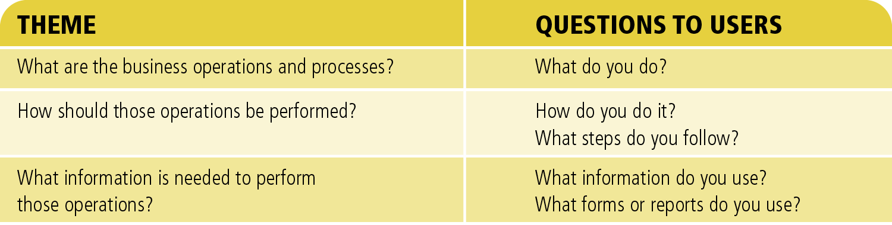

Slide 21
Summary:
The system must respond when certain events occur.
The system produces at specific points in time certain deliverables.
To support the business operations you need to store information.
The system must maintain information.

Slide 22
System Requirements
Two system requirements that must be defined and modeled:
  Processing requirements
  Data requirements

Slide 23
Use Cases
How to find and identify use cases:
  User goal technique.
  In this technique a systems analyst identifies the users of the system, as a role or type of user, and then identifies each goal or “actions to perform.” These goals then are used to define use cases.
  “the actor uses the system to .... [use case description].” For example, “the customer uses the system to 'make a purchase'

Slide 24
2nd Technique:
The “event-decomposition” technique.
  This technique first identifies the business events that occur. By understanding the business events, the actions leading up to the event, and the resulting processing required to support each event, a list of use cases can be developed.

Slide 25
Event Decomposition (cont.)
  This is a powerful technique that takes a broader business point of view and can be used to identify many different types of events, which then produce a comprehensive list of use cases
  “What business events occur that will require the system to respond?”

Slide 26
3rd Technique
Another technique to help refine and verify events is the CRUD technique. CRUD, which stands for Create, Report, Update, Delete, is best used as a validation technique rather than a technique to find use cases.
  First need to do chapter 4

Slide 27
What is a Use Cases?
What are they?
  Use cases capture the functional requirements of a system. What the system should do. It describes the behavior of the system.
  Use cases describe the interactions between various actors and the system

Slide 28
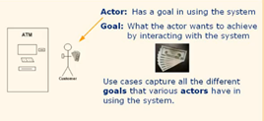
What elements they consists of?

Slide 29
Let’s create an ATM system!
Draw the system
Identify who wants to interact with the system
What are their goals?
What do we need to complete the use case successfully?

Slide 30
Event Table
Event | Trigger | Source | Use Case | Response | Destination
Want to draw money

Slide 31
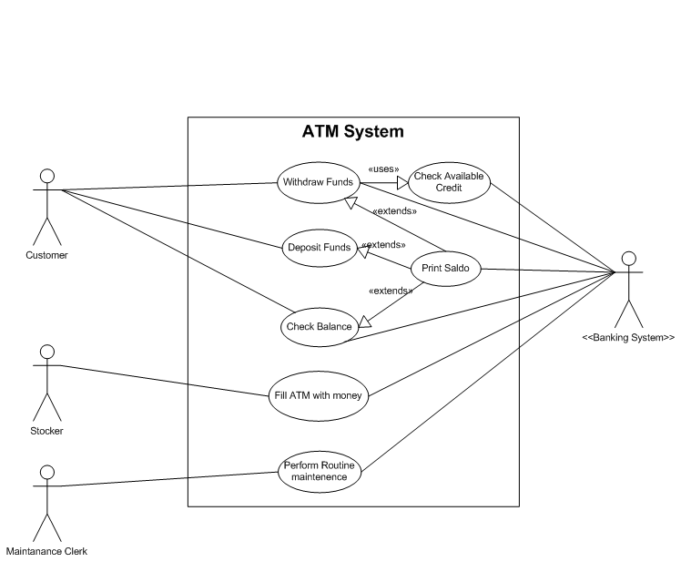

Slide 32
Written Use Case:
For each use case:
  Describe the steps involved in an interaction between an actor and the system, beginning with the primary actor (the one that initiates the use case)
  Start with the main success scenario: happy path
  Look for alternative paths:
    Exceptions: What could go wrong?
    Extensions: What other goal might come into play here?

Slide 33
Associations between use cases:
Is it possible that parts of many use cases will share the same narrative?
  Example: “Withdraw funds” requires “Check available balance” or even “Card Authorization” routine to be COMPLTETE.
  Example: “Print Balance”

Slide 34
Associations
The UML specification provides for three different kinds of associations between use cases:
  <<includes>> or <<uses>>,
  <<extends>> and
  <<generalizes>> relationships.

Slide 35
<< >>:
The use of << >> or guillemets is the UML’s way of depicting a stereotype: A categorization of a concept. Stereotypes are often used to help designers expressing more completely what is convey in the models.
<<includes>> association between use cases means that the included use case occurs whenever the use case which includes it occurs.

Slide 36
Example:
The status of a hotel room must be changed during check-in, and check-out.

Slide 37
<<uses>>

Slide 38
<< extends >>
This association augments the behavior of the use case which it extends. The occurrence of the extension is conditional and does not necessarily occur every time.

Slide 39
Example:
A special discount for employees might apply at the payment step in a POS application.
When a student registers for classes, he may be allowed to register for a class even if the class is full because the student is on the university’s athletic team.

Slide 41
<< generalizes >>:
<<generalizes>> association implies that the child use case contains all the attributes , behavior and extension of the parent use case.

Slide 42
Homework 1:
Problems and Exercises: p80
  1, 2, 7, 8
  Project Case Study: ?
What is expected from you:
  Work through the chapter, and understand the RMO case study
  Draw a rough Vision document
  Do the review questions (Not to be handed in)

Slide 43
Homework 2: RMO
The Sequence of Events: Tracing a Transaction Life Cycle
  The customer wants a catalog to search for products
  A new customer wants to add his information to system
  Customer wants to place an order
  Customer wants to change the order

Slide 44
Homework 2:
  Customer wants to check the status of the order to find the shipping date
  Customer changes address and still wants future catalog mailings
  Customer wants to return an item or product
It is often useful in identifying events to trace the sequence of events that might occur for a specific external agent or actor

Slide 45
Homework 2:
Draw an Event Table
Use MS Visio and draw a use case diagram

