Slide 1
Investigating System Requirements
Chapter 2
Systems Analysis and Design in a Changing World 6th Ed
Satzinger, Jackson & Burd

Slide 2
Chapter 2 Outline
The RMO Consolidated Sales and Marketing System Project
Systems Analysis Activities
What Are Requirements?
Models and Modeling
Stakeholders
Information-Gathering Techniques
Documenting Workflows with Activity Diagrams

Slide 3
Learning Objectives
Describe the activities of systems analysis
Explain the difference between functional and nonfunctional requirements
Describe the role of models in systems analysis
Identify and understand different kinds of stakeholders and their contributions to requirements definition
Describe information-gathering techniques and determine when each is best applied
Develop activity diagrams to model workflows

Slide 4
RMO is a sportswear company that sells both its own branded products as well as other national brands.

Slide 6
Existing RMO Information Systems and Architecture:
At present, RMO has a disparate collection of computers dispersed across home offices, retail stores, telephone centres, order fulfilment/shipping centres, and warehouses—everything connected by a complex set of local area networks (LANs), wide area networks (WANs), and virtual private networks (VPNs).
RMO’s technology architecture is modern but not state of the art. The term application architecture describes how software resources are organized and constructed to implement an organization’s information systems.

Slide 7
RMO Existing Application Architecture
Supply Chain Management (SCM)
  5 years old; Java/Oracle
  Tradeshow system will interface with SCM
Phone/Mail Order System
  12 years old; Visual Studio/MS SQL
  Reached capacity; minimal integration
Retail Store System
  Older package solution; minimal integration
Customer Support System (CSS)
  Web based system; evolved over the years, minimal integration

Slide 8
Ridgeline Mountain Outfitters (RMO)
RMO has an elaborate set of information systems that support operations and management
Customer expectations, modern technological capabilities, and competitive pressures led RMO to believe it is time to upgrade support for sales and marketing
A new Consolidated Sales and Marketing System was proposed
This is a major project that grew out of the RMO strategic planning process

Slide 9
Ridgeline Mountain Outfitters (RMO)
Strategic planning and competitive advantage for organizations involves leveraging information systems
The information systems strategic plan is based on the overall strategic needs of the organization
The information systems strategic plan includes definition of the technology architecture and the application architecture needed by the organization

Slide 10
Information Systems Strategic Plan
Technology architecture— the set of computing hardware, network hardware and topology, and system software employed by the organization
Application architecture—the information systems that supports the organization (information systems, subsystems, and supporting technology)

Slide 11
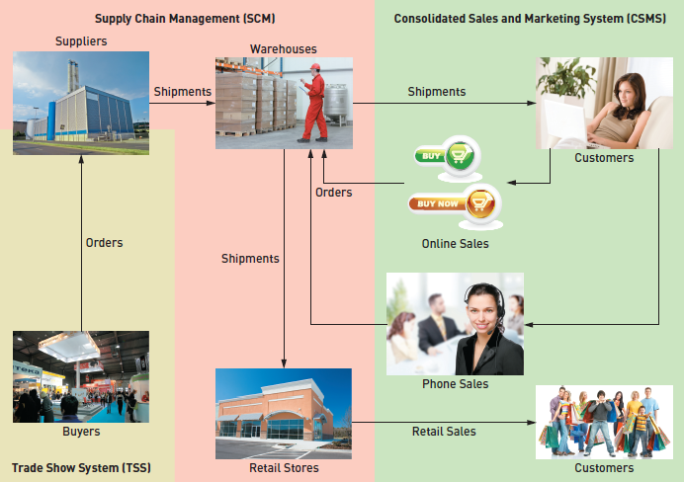
Proposed Application Architecture: Integrate SCM and New CSMS

Slide 12
RMO
SCM
Order
Retail
CSS

Slide 13
Current problems with sales system includes:
Treating phone, Web, and retail sales as separate systems rather than as an integrated whole
Employing out-dated Web-based storefront technology
Not supporting modern technologies and customer interaction modes, including mobile computing devices and social networking

Slide 14
New Consolidated Sales and Marketing System (CSMS)
Sales Subsystem
  Integrates online, phone, and retail stores
Order Fulfillment Subsystem
  Track shipments, rate products and services
Customer Account Subsystem
  Shopping history, linkups, “mountain bucks” rewards
Marketing Subsystem
  Promotional packages, partner relationships, more complete merchandise information and reporting

Slide 15
CSMS
Sales
Order
Cust
Marketing

Slide 16
Systems Analysis Activities
The New Consolidated Sales and Marketing System (CSMS) will require discovering and understanding extensive and complex business processes and business rules
The SDLC indicates the project starts with identifying the problem, obtaining approval, and planning the project (as seen in Chapter 1)
To get to the heart of systems analysis, this text skips right to analysis activities generally and the specifically for the RMO CSMS project
Project planning and project management are covered detail later in the text

Slide 17
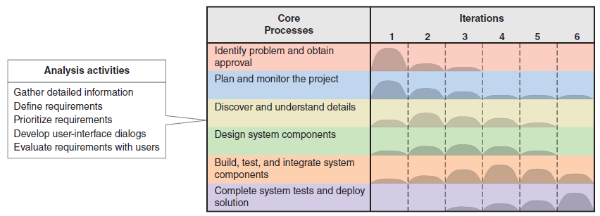
Systems Analysis Activities
Involve discovery and understanding

Slide 18
Systems Analysis Activities
Gather Detailed Information
  Interviews, questionnaires, documents, observing business processes, researching vendors, comments and suggestions
Define Requirements
  Modeling functional requirements and non-functional requirements
Prioritize Requirements
  Essential, important, vs. nice to have
Develop User-Interface Dialogs
  Flow of interaction between user and system
Evaluate Requirements with Users
  User involvement, feedback, adapt to changes

Slide 19
What Are Requirements?
System Requirements =
  Functional requirements
  Non-functional requirements
Functional Requirements– the activities the system must perform
  Business uses, functions the users carry out
  Use cases
Non-Functional Requirements– other system characteristics
  Constraints and performance goals

Slide 20
FURPS+ Requirements Acronym
Functional requirements
Usability requirements
Reliability requirements
Performance requirements
Security requirements
+ even more categories…

Slide 21
FURPS+ Requirements Acronym

Slide 22
Models and Modeling
How do we define requirements? After collecting information, create models
Model– a representation of some aspect of the system being built
Types of Models
  Textual model– something written down, described
  Graphical models– diagram, schematic
  Mathematical models– formulas, statistics, algorithms
Unified Modeling Language (UML)
  Standard graphical modeling symbols/terminology used for information systems

Slide 23
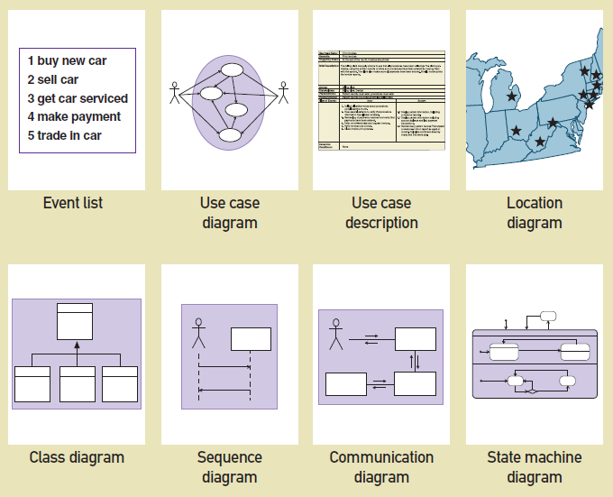
Some Analysis and Design Models

Slide 24
Reasons for Modeling
Learning from the modeling process
Reducing complexity by abstraction
Remembering all the details
Communicating with other development team members
Communicating with a variety of users and stakeholders
Documenting what was done for future maintenance/enhancement

Slide 25
Stakeholders
Who do you involve and talk to?
Stakeholders– persons who have an interest in the successful implementation of the system
Internal Stakeholders– persons within the organization
External stakeholders – persons outside the organization
Operational stakeholders – persons who regularly interact with the system
Executive stakeholders– persons who don’t directly interact, but use the information or have financial interest

Slide 26
Stakeholders of a comprehensive accounting system for public company

Slide 27
Stakeholders
For RMO CSMS Project
Phone/mail sales order clerks
Warehouse and shipping personnel
Marketing personnel who maintain online catalog information
Marketing, sales, accounting, and financial managers
Senior executives
Customers
External shippers (e.g., UPS and FedEx)

Slide 28
RMO Internal Stakeholders

Slide 29
Information Gathering Techniques
Interviewing users and other stakeholders
Distributing and collecting questionnaires
Reviewing inputs, outputs, and documentation
Observing and documenting business procedures
Researching vendor solutions
Collecting active user comments and suggestions

Slide 30
Interviewing Users and Other Stakeholders
Prepare detailed questions
Meet with individuals or groups of users
Obtain and discuss answers to the questions
Document the answers
Follow up as needed in future meetings or interviews

Slide 31
Themes for Information Gathering Questions

Slide 32
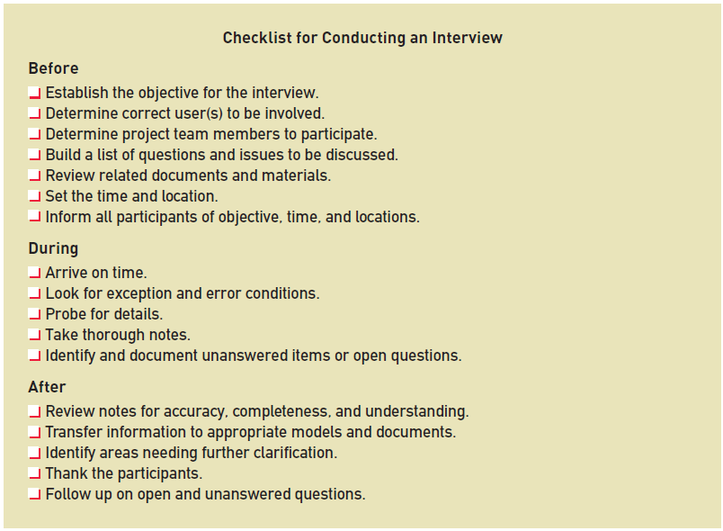
Preparing for Interview

Slide 33
Interview Session Agenda

Slide 34
Keeping an Open Items List

Slide 35
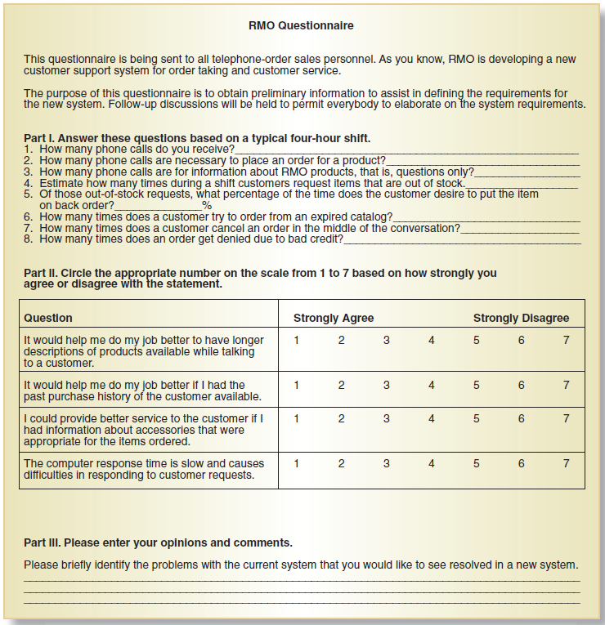
Distribute and Collect Questionnaires

Slide 36
Review Inputs, Outputs, and Procedures

Slide 37
Additional Techniques
Observe and Document Business Processes
  Watch and learn
  Document with Activity diagram (next section)
Research Vendor Solutions
  See what others have done for similar situations
  White papers, vendor literature, competitors
Collect Active User Comments and Suggestions
  Feedback on models and tests
  Users know it when the see it

Slide 38
Documenting Workflows with Activity Diagrams
Workflow– sequence of processing steps that completely handles one business transaction or customer request
Activity Diagram– describes user (or system) activities, the person who does each activity, and the sequential flow of these activities
  Useful for showing a graphical model of a workflow
  A UML diagram

Slide 39
Entity-Activity Table
The first step is to identify the agents to create the appropriate swim lanes.
Follow the various steps of the workflow and then make appropriate ovals for the activities.
Usually there is a swimlane for the actor or user of the system.
Use a decision symbol (IF) to represent an either/or situation—one path or the other path but not both. Use synchronization bars for parallel paths—situations in which both paths are taken (at the SAME TIME). Include a beginning and an ending synchronization bar. You can also use a synchronization bar as a “do while” loop, or “for every “.

Slide 40
Key Terms:
Workflow – sequence of processing steps that completely handles one business transaction or customer request
activity diagram – describes user (or system) activities, the person who does each activity, and the sequential flow of these activities
swimlane – heading activity diagram column containing all activities for a single agent or organizational unit

Slide 41
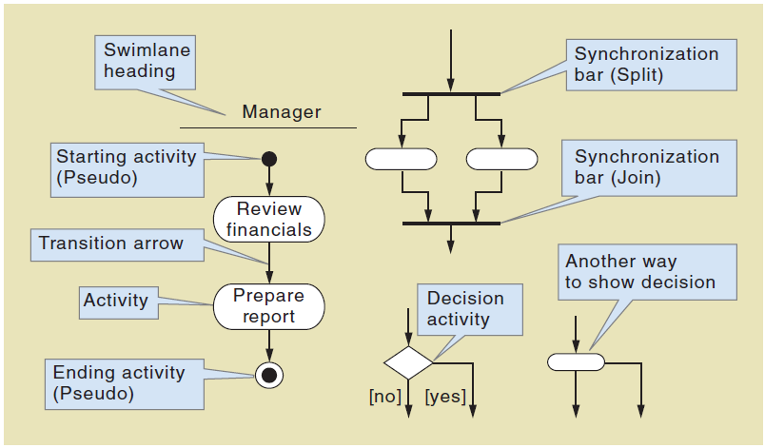
Activity Diagrams Symbols

Slide 42
Example: Activity Diagram with Concurrent Paths

Slide 43
Examples:
The accounting department (AP) sends an invoice to a customer for payment. The customer makes an electronic transfer to the accounting department (AR)
The accounting department (AP) sends an invoice to a customer for payment. The customer draws money from the ATM-System. If the withdrawal is bigger than the balance, the transaction is abort; otherwise an electronic transfer is made to the accounting department (AR)

Slide 44
Homework/Tut 1
Processing begins when the customer has completed the order checkout process:
The order subsystem will send the order information, consisting of line items to the Inventory subsystem that will find a location with sufficient stock. If the stock is found information will be passed on to the warehouse where items will be picked. When all the items are picked, it will be prepared for shipment.
If some stock is not available, a back order record will be created, and this information will be sent back to the order subsystem to update the order status

Slide 45
Cont.
When the item is picked in the warehouse, the Inventory subsystem will decrement the item stock count for each item and also update the order status. When all the items had been picked, the warehouse will prepare the shipment.
After all the items had been picked, the order subsystem will transmit the shipping details to the warehouse subsystem to prepare the shipment.
After preparation of shipment, information is sent to the shipping company to initiate the generation of a tracking record. This record information will be stored in the warehouse as a shipment record. After the shipment record is stored the warehouse transmits the shipment to the shipping company that receives the shipment. The warehouse also sends information to the order subsystem to update order shipment status.

Slide 46
Summary
Systems analysis activates correspond to the core SDLC process Discover and understand details
System projects originate from the information system strategic plan, which contains an technology architecture plan and an application architecture plan
The RMO CSMS Project will be used throughout the text as an example of analysis and design

Slide 47
Summary
Systems analysis involves defining system requirements– functional and non-functional
Analysis activities include
  Gather detailed information
  Define requirements
  Prioritize requirements
  Develop user-interface dialogs
  Evaluate requirements with users
FURPS+ is the acronym for functional, usability, reliability, performance, and security requirements

Slide 48
Summary
Models and modeling are used to explore and document requirements
A model represents some aspect of a system, and can include textual, graphical, and mathematical models
Unified Modeling Language (UML) is the standard set of notations and terminology for information systems models

Slide 49
Summary
Stakeholders are the people who have an interest in the success of the project
There are internal vs. external stakeholders and operational vs. executive stakeholders
Information gathering techniques are used to collect information about the project
  Interviews, questionnaires, reviewing documents, observing business processes, researching vendors, comments and suggestions
The UML Activity Diagram is used to document (model) workflows after collecting information

