Slide 1
Chapter 4
Domain Classes
Classes
Objects
Associations
Domain Model

Slide 2
Revision: The Use Case View
The use case model is the main UML representative and the focal point of behaviour modelling.
Behaviour modelling presents the dynamic view of the system – it models functional requirements.
  A behaviour model represents business transactions, operations and algorithms on data.

Slide 3
Use Case:
Use cases drive the entire software development lifecycle, from requirements analysis to testing and maintenance.
They are the focal point and reference for most development activities
A use case diagram is a visual representation of actors and use cases, together with any additional definitions and specifications.

Slide 4
Object-Oriented Analysis ??
Object-oriented analysis looks at the problem domain, with the aim of producing a conceptual model of the information that exists in the area being analysed.
Analysis models do not consider any implementation constraints or how the system is to be built. The identified objects reflect entities and operations that are associated with the problem to be solved.

Slide 5
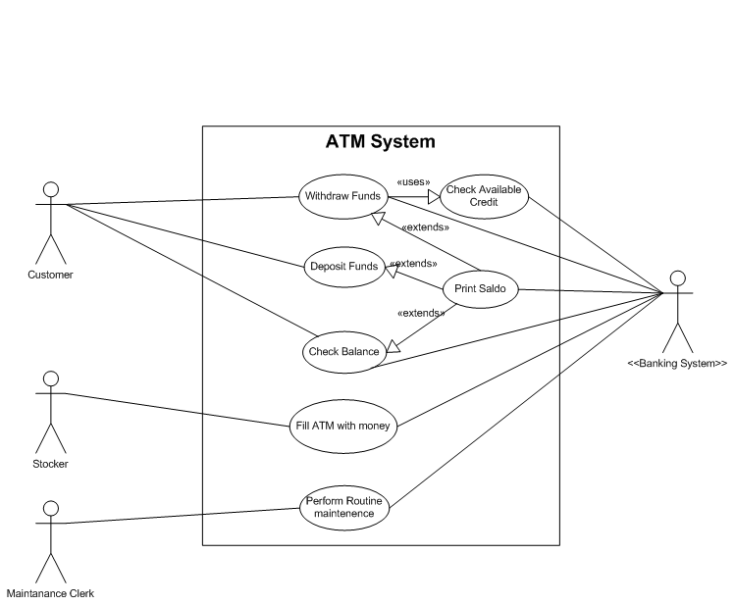

Slide 6
Narrative
The ATM will service one customer at a time. A customer takes his card, insert it into the ATM, enters a personal PIN and select a transaction.
The transaction can be either to check the balance, to withdraw money, or to deposit money. After the execution of the desired transaction the card will be ejected.

Slide 7
System Requirements:
Two system requirements that must be defined and modeled:
  Processing requirements
  Data requirements
An activity that the system performs, usually in response to a request by a user:
  Request by user: “I want to know the supplier”
  The system: “Look-up the supplier”
  The system: provide the supplier information

Slide 8
Event Info:
The system must respond when certain events occur.
The system produces at specific points in time certain deliverables.
To support the business operations you need to store information.
The system must maintain information.

Slide 9
ID Nouns/Classes:
Set of people
Places
Things
Transactions
“that” share common attributes and perform common functions to help an organization reaches its goals.

Slide 10
Classes/Objects
Each sentence on new line
Identify nouns…..”underline verbs”
List nouns
Analyse nouns
List of possible/candidate classes/objects
Create conceptual object model

Slide 11
The ATM will service one customer at a time
A customer takes his card, insert it into the ATM, enters a personal PIN and select a transaction.
The transaction can be either to check the balance, to withdraw money, or to deposit money.
After the execution of the desired transaction the card will be ejected.

Slide 12
Prospective classes
ATM
customer
card,
transaction.
Balance →check balance
Money → withdrawal; deposit
transaction
card
Can it take a value?

Slide 13
Object Model

Slide 14
Associations:
Indicates a significant connection between problem-domain concepts or TYPES.
A concept is an abstraction of a person, a thing, or an idea. I prefer to call it a type.
A customer places an order.
  The association is manifested in the verb: places
  The association is bi-directional: A customer places an order, and an order is placed by a customer. But its not that simple….

Slide 15
Put it together!!
NOUN…..verb…….NOUN
A customer uses his card, and
Card is insert it into the ATM
A transactions is selected from the ATM
A transaction can be either a:
  Balance check
  Withdrawal
  Deposit

Slide 16
Model a class diagram, based on the following business rules:
  A customer has one or many accounts.
  An account belongs to a customer.
  An account is maintained by a branch
  A branch may have many accounts
  An account has one or many transactions
  A transaction is associated with one account

Slide 17
Multiplicity:
The multiplicity of an association defines how many instances of one concept can be associated with one instance of another concept.
These multiplicities are sometimes shown as pairs of numbers at the end of the association, indicating [minimum, maximum]

Slide 18
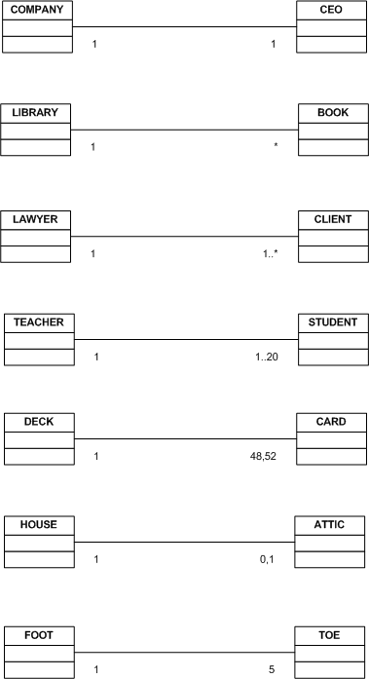

Slide 19
A customer uses his card, and
A card belongs to a customer
Card is insert it into the ATM
The ATM receives a card
A transactions is selected from the ATM
A transaction can be either a:
  Balance check
  Withdrawal
  Deposit

Slide 20
Associations:
An association is a naturally occurring relationship between specific things, such as an order is placed by a customer and an employee works in a department.
Is placed by and works in are two associations that naturally occur between specific things. Information systems need to store information about employees and about departments, but equally important is storing information about the specific associations.

Slide 21
Course Enrolment:
Where is each student’s grade remembered in this model?
  Each section has many grades and each grade is association with a student
  Each student has many grades and each grade is association with a section

Slide 22
More “Associations”
Association class(??)
Generalization/specialization
Whole-part relationships
  aggregation and
  composition

Slide 23
Association Class
Example:
  Courses may be offered as many Course-Sections
  A student may enrolls in many Course-Sections
  A Course-Section may be taken by many students
  A course is described by
    Course ID, Description, Credit hours
  Course Section
    Section no, times, venue
  Student:

Slide 24
Association Class cont.
There is a M:N association between Course Section and Student
Problem:
  Sometimes M:N associations involve additional data that are important and must be stored
  Where must the Grade that each student receives for the course-section be stored?
Solution: Association Class

Slide 25
Introducing Association Class
Association class— an association that is treated as a class in a many to many association because it has attributes that need to be remembered, such as grade

Slide 26
Generalization/Specialization
The idea that people classify “things” ito similarities and differences
There are several types of motor vehicles:
  Cars, trucks, and tractors
  All motor vehicles share certain general characteristics
Specialization groups different type of things
  Special types of cars include sports-, sedan- and sport utility cars

Slide 28
Generalization/Specialization
This association is used to structure or rank things from more general to the more special
The more general class is a superclass
The more specialized class below it is the subclass
It is learning by refining the classification
Set/Subset

Slide 29
Inheritance
Allows subclasses to share characteristics of their superclass
It is a key concept that is possible because of Generalization/Specialization

Slide 30
Whole-Part Associations
Aggregation
  whole-part relationship between the aggregate (whole) and its components (parts), where the parts can exist separately and is represented by an open diamond
Composition
  whole-part relationships that are even stronger, where the parts, once associated, can no longer exist separately, and is represented by a solid dark diamond

Slide 32
OPEN MS Visio and Model the ATM problem below
A customer uses his card, and
Card is insert it into the ATM
A transactions is selected from the ATM
A transaction can be either a:
  Balance check
  Withdrawal
  Deposit

