Slide 1
Chapter 4
Domain Classes
Classes
Objects
Associations
Domain Model

Slide 2
Revision: The Use Case View
The use case model is the main UML representative and the focal point of behaviour modelling.
Behaviour modelling presents the dynamic view of the system – it models functional requirements.
  A behaviour model represents business transactions, operations and algorithms on data.

Slide 3
Use Case:
Use cases drive the entire software development lifecycle, from requirements analysis to testing and maintenance.
They are the focal point and reference for most development activities
A use case diagram is a visual representation of actors and use cases, together with any additional definitions and specifications.

Slide 4
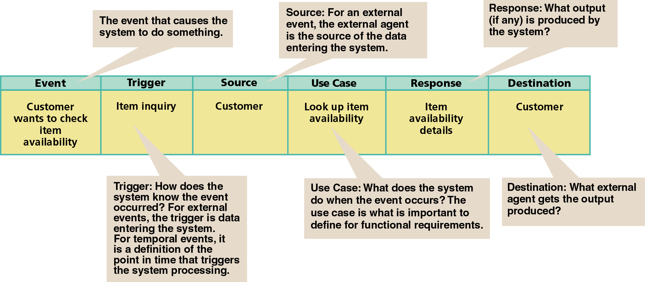

Slide 5
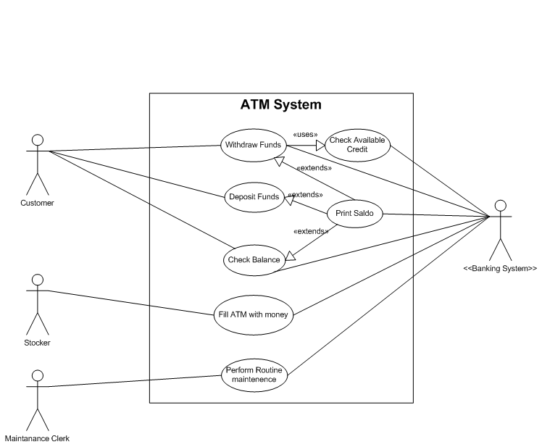

Slide 6
System Requirements:
Two system requirements that must be defined and modeled:
  Processing requirements
  Data requirements

Slide 7
OR!!
An activity that the system performs, usually in response to a request by a user:
  Request by user: “I want to know the supplier”
  The system: “Look-up the supplier”
  The system: provide the supplier information
Identify the NOUNS

Slide 8
Event Info:
The system must respond when certain events occur.
The system produces at specific points in time certain deliverables.
To support the business operations you need to store information.
The system must maintain information.

Slide 9
Why Databases?
Why use a database system? What are the advantages?
Is the system a single- or multi-user environment?
When a particular database is so small and simple that the advantages might not be all that obvious, but imagine a large database for a large restaurant: a stock of thousands of bottles of wine and frequent changes to the stock, and ever changing menu’s?

Slide 10
Advantages: (Database Systems by Date)
Compactness: There is no need for possibly voluminous files
Speed: The machine can retrieve and update data far faster than a human can. In particular, ad hoc, spur-of-the-moment queries (“Do we have more Zinfandel than Pinot Noir?”) can be answered quickly without any need for time-consuming manual or visual searches.
Less drudgery: Much of the sheer tedium of maintaining files by hand is eliminated. Mechanical tasks are always better done by machines.
Currency: Accurate, up-to-date information is available on demand at any time.

Slide 11
History:
EF Codd, “A Relational Model of Data for Large Shared Data Banks”, June 1970: Codd was the inventor of the relational model. Received the ACM Reward in 1981 for his work!
Employee = empId, empSurname, empIDNO
The information principle: The entire information content of the database is represented in one and only one way, namely as explicit values in column positions in rows in tables.
This paved the way for SQL. (Relational algebra and relational calculus).
Semantic model: E/R Model, by Chen in 1976, “The Entity-Relationship Model – Towards a Unified View of Data”.

Slide 12
A bank account is a financial account between a bank customer and a financial institution. The financial institution, as represented by the branch, promised to maintain that account. It can happen that some branches have no accounts. A customer have many accounts, and an account is associated with a customer. A bank account can be a deposit account, a credit card, or any other type of account offered by a financial institution. The financial transactions which have occurred within a given period of time on a bank account are reported to the customer on a bank statement and the balance of the account at any point in time is the financial position of the customer with the institution. (Wikipedia..edited)

Slide 13
ID Nouns/Classes:
Set of people
Places
Things
Transactions
“that” share common attributes and perform common functions to help an organization reaches its goals.

Slide 14
Classes/Objects
Each sentence on new line
Identify nouns…..”underline verbs”
List nouns
Analyse nouns
List of possible/candidate classes/objects
Create conceptual object model

Slide 15
Associations:
Indicates a significant connection between problem-domain concepts or TYPES.
A concept is an abstraction of a person, a thing, or an idea. I prefer to call it a type.
A customer places an order.
  The association is manifested in the verb: places
  The association is bi-directional: A customer places an order, and an order is placed by a customer. But its not that simple….

Slide 16
Multiplicity:
The multiplicity of an association defines how many instances of one concept can be associated with one instance of another concept.
These multiplicities are sometimes shown as pairs of numbers at the end of the association, indicating [minimum, maximum]

Slide 17
Model a class diagram, based on the following business rules:
  A customer has one or many accounts.
  An account belongs to a customer.
  An account is maintained by a branch
  A branch may have many accounts
  An account has one or many transactions
  A transaction is associated with one account

Slide 18
