Slide 1
The Domain Model
“Special” Associations
Page 94-99

Slide 2
What are we busy with?
What is SOFTWARE ANALYSIS?
  In broad we are making stuff ….listening to clients and solve their problems. In an IT way of course..
But
  In a structured and disciplined manner!
  Using tried and tested approaches
SOFTWARE DESIGN/Development
  Data/Network designs
  Code (instructions)

Slide 3
Why Software Analysis?
Software development is hard !
Important to distinguish :
  “easy” systems (one developer, one user, experimental use only)
  “hard” systems (multiple developers, multiple users, products)
Experience with “easy” systems is misleading
  Single person techniques do not scale up
Analogy with bridge building:
  Over a stream = easy, one person job
  Over the Amazon River … ?

Slide 4
Continues:
Software failure can be very serious
  Software controls safety critical systems
  Software protects sensitive data
  Software is involved in systems which handle money
Software Developer has to
  Produce software which has a very low chance of faulting
  Be able to demonstrate/proof that software has very low chance of fault
    Testing or program proving
Still 70% failure rate?
Example of radiation machine:

Slide 5
Revision:
Study-guide:
  P 6 – 13, O-O Principles
  Exercises p13

Slide 6
Definition of OO Terms:
Is based on the notion of objects which encapsulates both data and processes
An object is an entity from the real world whose processes and attributes (data) are modelled in an computerized application
  Example?

Slide 7
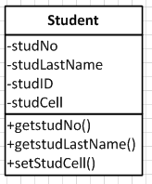
Name
Data or attributes
Behaviour/Operations/functions

Slide 8
Class/Object:
Class/objects define a set of items which share the same attributes and processes.
Class defines the attributes and processes; objects are the instances of the class definition.
Instance?

Slide 9
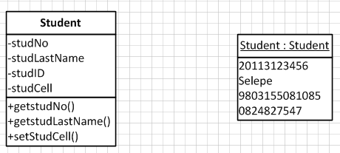

Slide 10
Constructing a Class Diagram:
Two perspectives
  Top-down analysis: classes are found first on the basis of general understanding of the subject matter/domain
  Which information or domain concepts can be of use for my IT system?
    Domain knowledge, verbal descriptions of the area of application, and user representatives are important sources of information. In this way, a basic structure of classes can be found for most IT systems.

Slide 11
2nd Approach:
Bottom-up analysis: classes are found mainly on the basis of the inputs and outputs of the IT system. The question is:
  What information is needed for the individual inputs and outputs of the IT system?
  Inputs and outputs, for instance, screen forms and paper forms are important sources of information

Slide 12
Top-down Analysis:
Identify and model classes
  Which classes do we need?
Identify and model associations
  How are the classes connected?
Define attributes
  What do we want to know about the objects?

Slide 13
Associations
Classes in an application system do not exist in vacuum
Classes are associated with, or related to, other classes
Start with the core class: the class that interacts with as many other classes as possible
An association is usually modeled using a solid line that connects two classes.
Associations also have roles: Each class in an association has a role that describes its meaning in the relationship.

Slide 14
Multiplicity
An indication of how many objects participate in the relationship
Thy are conditional or unconditional:
  Objects of class A may know about many objects of class B
  Objects of class A may know about a single object of class B
  Objects of class A must know about a single object of class B
  Objects of class A must know at least one object of class B

Slide 15
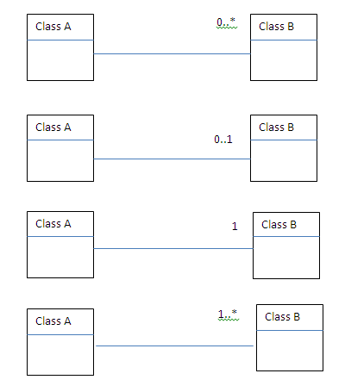

Slide 16
Let’s see:
Develop a domain model diagram:
  A team has zero or more players and each player is on one and only one team.
Draw a simple diagram (free hand), showing the semantics: two teams and five players

Slide 17
More “Associations”
Association class
Generalization/specialization
Whole-part relationships
  aggregation and
  composition

Slide 18
Example:
Model the following:
  Student Buthelezi got a mark of 77% for his database course
After careful analysis:
  A student may take many courses, and a course can be taken by many students (Business Rule!).
  How can we now accommodate marks for a student?

Slide 19
Association Class
Let’s make it “real”….or complex!!:
  Courses may be offered as many Course-Sections
  A student may enrolls in many Course-Sections
  A Course-Section may be taken by many students
  A course is described by
    Course ID, Description, Credit hours
  Course Section
    Section no, times, venue
  Student:

Slide 20
Course Enrolment:
Where is each student’s grade remembered in this model?
  Each section has many grades and each grade is association with a student
  Each student has many grades and each grade is association with a section

Slide 21
Introducing Association Class
Association class— an association that is treated as a class in a many to many association because it has attributes that need to be remembered, such as grade

Slide 22
Test understanding:
Consider the domain model class diagram on previous slide:
  Does this model allow a student to enroll in more than one course section at a time?
  Does the model allow a course section to contain more than one student?
  Does the model allow a student to enroll in several sections of the same course and get a grade for each enrollment?
  Does the model store information about all grades earned by all students in all sections?

Slide 23
Generalization/Specialization
The idea that people classify “things” ito similarities and differences
There are several types of motor vehicles:
  Cars, trucks, and tractors
  All motor vehicles share certain general characteristics
Specialization groups different type of things
  Special types of cars include sports-, sedan- and sport utility cars

Slide 25
Generalization/Specialization
This association is used to structure or rank things from more general to the more special
The more general class is a superclass
The more specialized class below it is the subclass
It is learning by refining the classification
Set/Subset

Slide 26
Inheritance
Allows subclasses to share characteristics of their superclass
It is a key concept that is possible because of Generalization/Specialization

Slide 27
Example
A Sale is described by
  A sales date, tax and the total amount
  A sale is defined by certain types of sales
    An online sale, described by the on site time and the chat that was use
    An in-store sale, described by the store ID, register ID and the clerk ID
    Telephone sale, described by the clerk ID and the length of the call

Slide 28
Generalization/Specialization
Abstract class— a class that allow subclasses to inherit characteristics but never gets instantiated. In Italics (Sale above)
Concrete class— a class that can have instances

Slide 29
Abstract class
It exists so that subclasses can inherit from it
There is no actual object called Sale
Each sale must be one of the three sub-classes
Concrete class:
  Have actual objects
All depends on the intention of the analyst

Slide 30
Whole-Part Associations
Aggregation
  whole-part relationship between the aggregate (whole) and its components (parts), where the parts can exist separately and is represented by an open diamond
Composition
  whole-part relationships that are even stronger, where the parts, once associated, can no longer exist separately, and is represented by a solid dark diamond

Slide 31
To identify:
“has-a”, “contains”, “is part of”, “is a member of”, “is-contained in”, all describing an aggregation or composition.

Slide 33
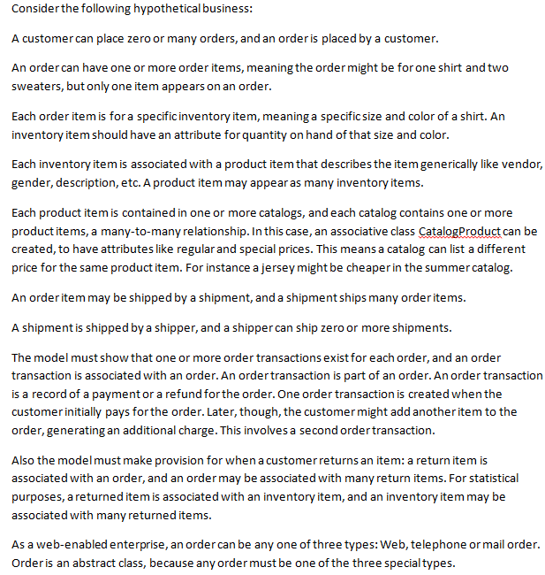

Slide 34
Problems:
Design a domain class diagram for the above narrative. Show multiplicity and add at least two attributes per class.
From your model, can an order have items shipped by different shippers?
Why do many analysts choose not to indicate aggregation or composition on a class diagram for a business system?

Slide 35
Extra reading: next 4 slides
An employee is an HOD of a department.
An employee is described by an employee number, surname, salary, etc.
A department is described by a department code, department name, an address, etc.
What is the association type if the business rule says: An employee is an HOD of a Department, and a department is lead by a HOD.

Slide 36
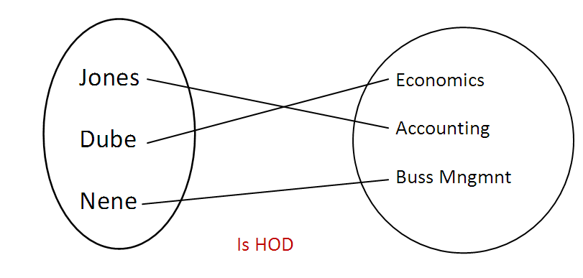

Slide 37
1:1
Each record in the first table have only ONE match in the second table
AND
Each record in the second table have only ONE match in the first table

Slide 38
1:M
Each record in the first table can have more than one matching record in the second table
AND
Each record in the second table have only ONE match in the first table
A person buys many insurance, but an insurance is bought by only one person.

Slide 39
