Slide 1
Process Models:
Data Flow Diagrams
Chapter 2
References:
Accounting Information Systems: 7th Edition, 2013: Gelinas, Dull;
Accounting: An Information System for Organizations, 2012: JA Costa;

Slide 2
Bigger Picture:
Wider/broader definition of accounting systems:
  to provide the basic knowledge required to understand financial statements,
  the concepts that rule the elaboration of the information derived from a firm’s activity,
  the accounting methodology and the most common tools used in accounting.

Slide 3
The utility of the AIS
It is also important to highlight how accounting orders and treats the information in such a way that it helps a firm in its decision making process:
  The interpretation of the accounting information, which is reflected in the financial statements, is key to the success of a firm.
  To understand and comprehend the concepts, methodology and utility of financial accounting

Slide 4
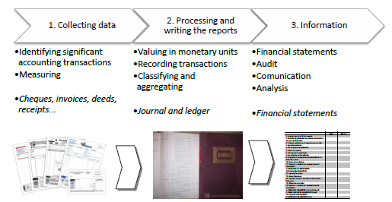

Slide 5
Interview question?
What is the difference between Financial- and Managerial Accounting?

Slide 6
Summary: DFD’s
A data flow diagram (DFD) is a graphical representation of the "flow" of data through an information system, modelling its process aspects.
A DFD shows what kind of information will be input to and output from the system, where the data will come from and go to, and where the data will be stored

Slide 7
The purpose of a DFD:
To act as the starting point for redesigning a system
To show the scope and boundaries of a system
To show that how the data flows in a system
May be used as a communications tool between a systems analyst and any person who plays a part in the system

Slide 8
Process Modeling
Objective:
  Understand the concept of business processes
  Understand and create Data Flow Diagrams.
  Understand System Flow Charts

Slide 9
DFDs
Visually represent
  data flows
  processes
Emphasize the logic of system
Provide documentation for Analysis & Design

Slide 10
Data Flow Diagrams
Data Flow
Process
File or Data Store
Source or Entity

Slide 11
DFDs
Do not show technical aspects
Show interrelations of systems & subsystems
Facilitates
  developer understanding
  user-developer communication
Completeness of data & process definitions

Slide 12
The Systems Concept
Input
Process
Output

Slide 13
DFDs
1
Data Flow
Input
Data Flow
Output
Process

Slide 14
Developing DFDs
Context Diagram
  System Overview
  Little or no detail
Zero Level Explosion
  More detailed
First,Second, Third Levels
  More detailed levels

Slide 15
Context DFD
Basic overview of the system
Contains only 1 process
  given the number zero
Shows all external entities
Major data flows among entities
Generally no data stores
Assign a name to the whole system

Slide 16
Big Picture: Example
Modelling: ‘Rental Apartment’ scenario
What is it about?
  Apartment Rental
Who is involve?
  Are they part of the system?

Slide 17
Context DFD Examples
Apartment Rental
Receipts, Notices
0
Lease
Cash
Report
External
Manager
Tenant
Apartment
Rental
System
Lease,
Payments
Bank Deposit
Bank

Slide 18
Overview:
A written description of a system is wordy and difficult to follow
Experience has shown that a visual image can convey vital system information more effectively and efficiently
To document a system in graphic form is an important skill for AIS:

Slide 19
Why Documentation?
Process documentation is a important skill in accounting systems:
You will learn that data flow diagrams portray a business processes’ activities, stores of data, and flows of data among those elements.

Slide 20
More Documentation:
Systems flowcharts, on the other hand, present a comprehensive picture of the management, operations, information systems, and process controls embodied in business processes.

Slide 21
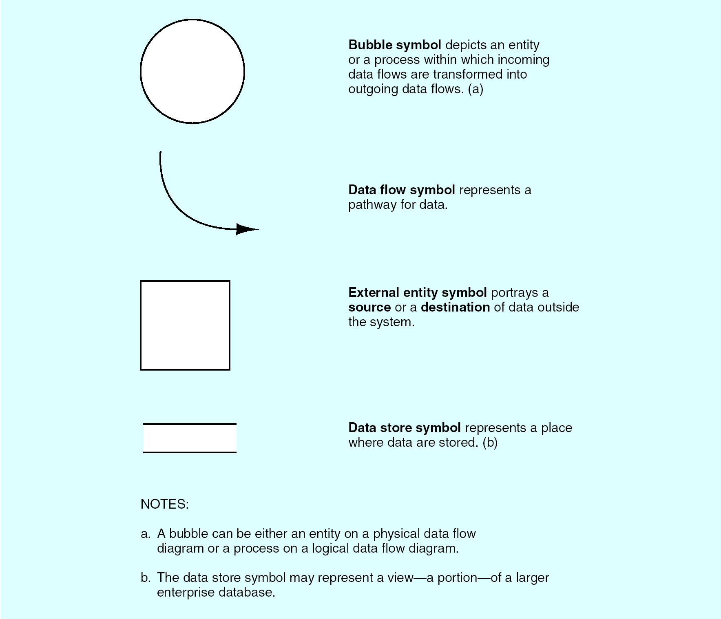

Slide 22
Context Diagram:
Is a top-level, or least detail diagram of an information system:
  Depicting the system and ALL of its activities as a single BUBBLE
  And shows data flows into and out of the system into external entities
Entity: person, place, or thing; something that data are send to/receive

Slide 23
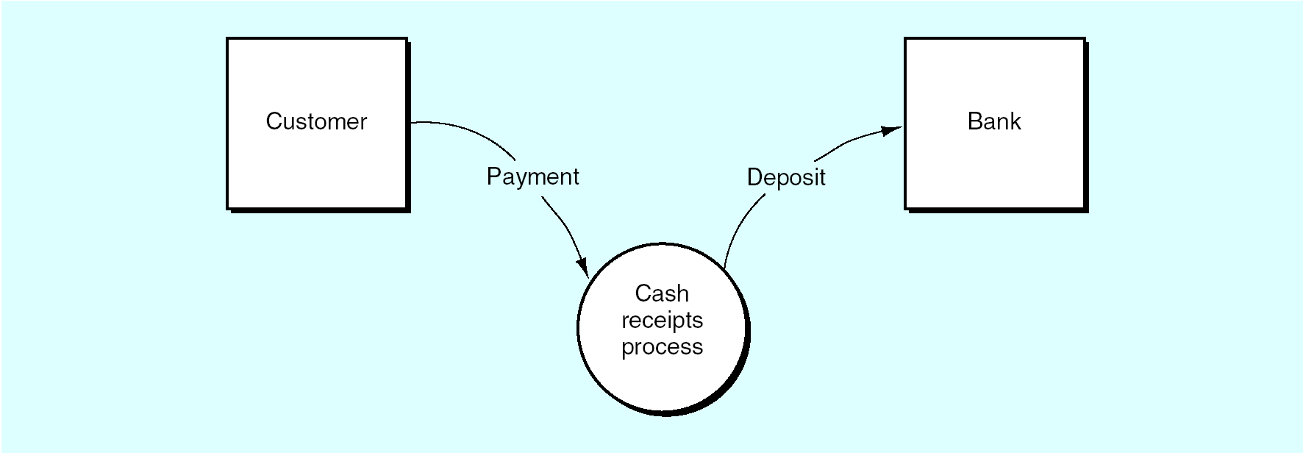
Context Diagram: Cash Receipts

Slide 24
Top-down analysis:
The challenge is now to go INTO the bubble and see the INTERNAL workings or PROCESSES
  Identify ‘0-level’ diagram
  Further analysis ‘1-level diagram’, etc.
  Till a bubble perform one activity: cannot break it down in sub activities: functional primitives
Consider the following NARRATIVE:

Slide 25
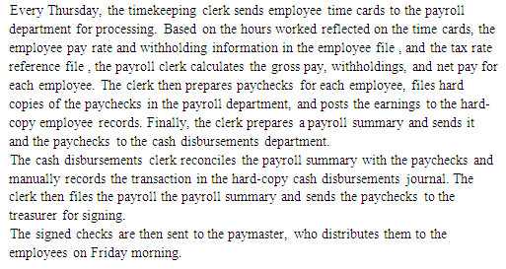

Slide 26
Steps to follow:
Rewrite in paragraph and line form
Identify the ENTITIES and ACTIVITIES
Draw-up the ENTITY-ACTIVITY Table
Identify the activities that are NOT Information Processes
  They become the external ENTITIES

Slide 27
Steps:
Draw the CONTEXT DIAGRAM
Group the related processes together to form the Level 0 diagram

Slide 28
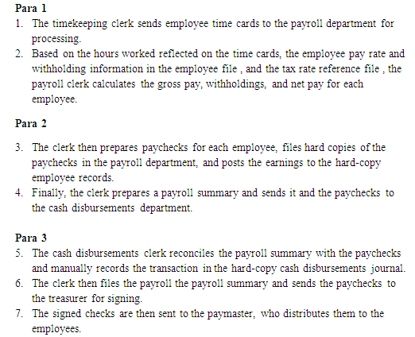

Slide 29
Activities:
Any ACTION performed is an activity, like:
  DATA: send, transform, file, retrieve or receive
  OPERATIONS PROCESS: picking/inspecting goods in a warehouse, counting cash
For each activity, there is an entity, because an entity performs an activity
An entity is a person, place or thing
Prepare the TABLE of Entities and Activities

Slide 30
Identify the ENTITIES & ACTIVITIES:
See next slide

Slide 32
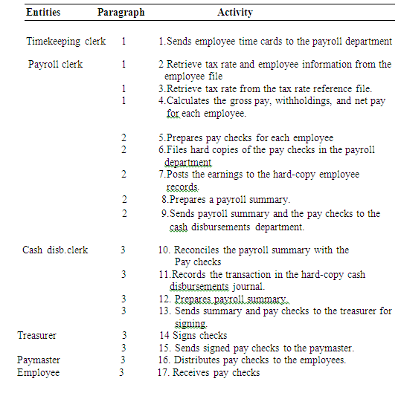

Slide 33
Identify Internal, External Entities:
Information processing activities:
  A process TRANSFORMS… data retrieve, transforms , or file management. Includes document preparation, data entry, verification, classification, summarize, sorting
  Sending and receiving of data is NOT a process
  Operations are NOT processes

Slide 34
External entities:
MARK the activities that are NOT IPA: These are the EXTERNAL entities.
An external entity are those entities outside the system that sends data to, or receive data from, the system
Let’s identify the Non IPA’s:

Slide 36
External Entities:
Timekeeping Clerk
Employee

Slide 37
Revision: (Context Diagram:)
It’s a top-level, or least detailed, diagram of an information system that depicts the system and all of its activities as a single bubble.
It shows the data flows into and out of the system and into and out of the external entities.

Slide 38
Drawing the Context Diagram:
Draw the external entities on the side of the page as boxes, surrounding the one context bubble.
Label the entities.
Draw the data flows that connect to the bubble from the entities and label them as Logical flows
Bubble: Write a descriptive label that encompasses the processing taking place in the system:

Slide 39
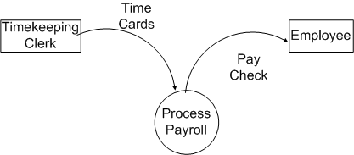

Slide 40
Logical DFD:
This portrays the logical activities performed in the system
  Processes are described with VERBS
  The data flows are labeled as logical descriptions:
  It describes the nature of the data, rather than HOW the data are transmitted

Slide 41
Logical DFD:
List: 2 – 8; 10 – 12; 14, 16
Group activities if they occur in the same place and at the same time.
Group activities if they occur at the same time but in different places.
Group activities that seem to be logically related.
To make the DFD readable, use between five and seven bubbles.

Slide 42
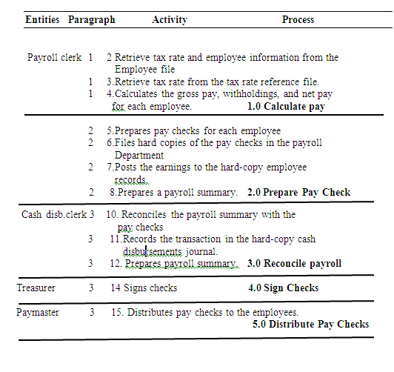

Slide 43
Data Flows:
Because this is a logical DFD, the data flows to and from entities must have logical descriptions:
It describes the nature of the data, rather than HOW the data are transmitted
Logical DFD:

Slide 44
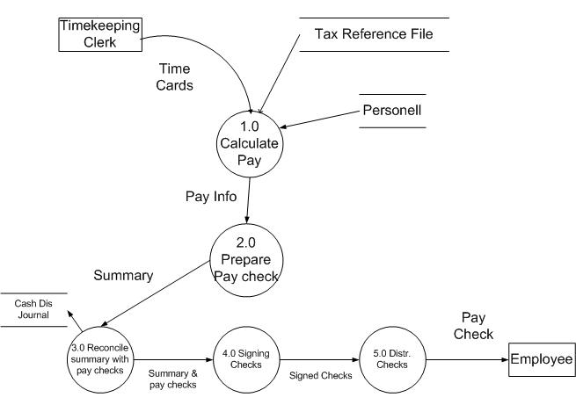

Slide 45
Study Example in Book, p55:
Sales Order Processing System
What will be the Context Diagram?
How many processes?
What activities can you identify in:
  Approve sales
  Ship goods
  Bill customer
  Prepare AR

Slide 46
A company uses the following procedure to process cash receipts from customers: A sales clerk will receive the payment, in the form of cash, and will issue a receipt. The sales clerk will prepare a receipt summary, and send it as a batch to the cashier. The cashier will compare the cash with the register tape.
At the same time the sales clerk will prepare a 66W from, containing the sales record and will send it to bookkeeping. The cashier will verify the cash against the tape records and will also send it to bookkeeping. The bookkeeping department will update the master records (known as the blue sales record database) with the new information.
Validated receipts will be used by the cashier to prepare a deposit slip, and with the accompanying cash, will be deposited in a bank.

Slide 47
Questions
Use the above narrative and create an Entity and Activity Table
Use MS Visio and:
  Construct a context diagram based on the above table.
  Construct a Level 0 DFD.

Slide 48
Revision
What describes a Context diagram?
Logical DFD:

Slide 49
Logical DFD:
WHAT explaining also the nature of the data
Payment
1.0 Receive
Payment

Slide 50
Balancing flow charts:
A process used to maintain consistency among an entire series of diagrams:
  DFD’s by ensuring that the input and output data flows align ‘properly’:
  Input and output data flows of the parent DFD are maintained on the child DFD

Slide 51
Context Diagram

Slide 52
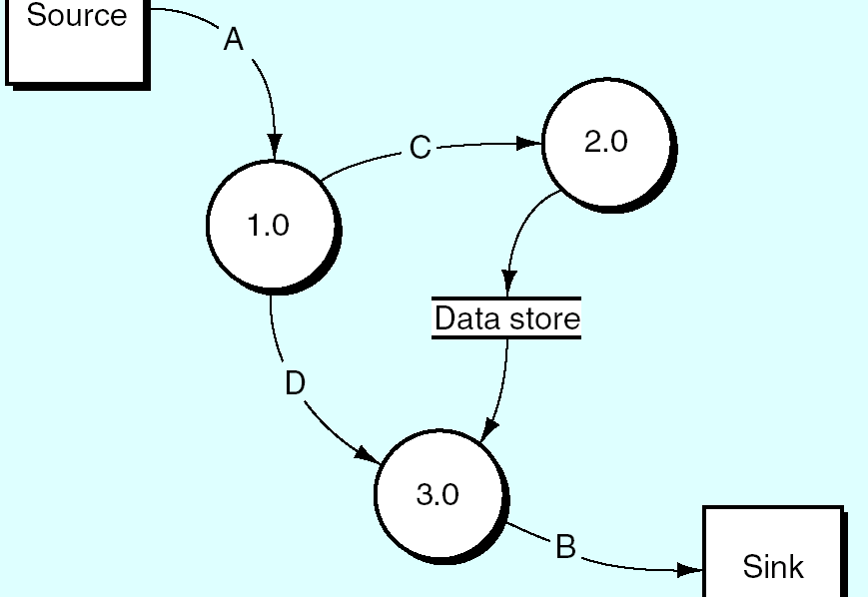

Slide 53
Overview:
The context diagram is exploded/partitioned/decompose into Level 0 Diagram, consisting of ……. processes.
  Processes follow a decimal notation, consisting of the parent’s reference number, a decimal point, and a sequence number according to the diagram level.
  How many flows?
  Is balancing maintained?
  Let’s explode process 3.0 to another level:
  level 1

Slide 54
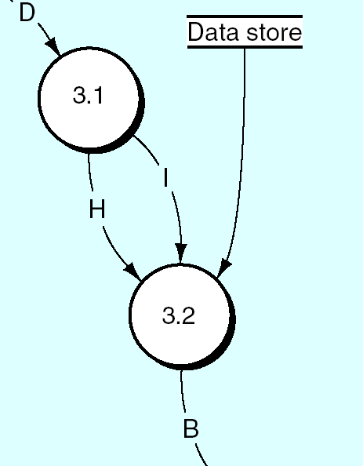

Slide 55
Questions:
How many flows enter/exit process 3.0?
  Name them
Is level 1 balanced?

Slide 56
Introduction: System Flowchart
A system flowchart is a graphical representation of a business process: information processes + operations processes
It depicts the sequence of activities as the business event flows through the process
It represents a logical and physical rendering of the who, what, how, and where.

Slide 57
Purpose:
Auditors and managers use it to understand a system and
To analyze a system’s control
Summary: Together, a DFD and flowcharts provide multiple, complementary methods for describing a system.

Slide 58
Narrative: A typical two-step data entry process.
A data entry clerk keys an input document into a computer. The computer accesses data in data store 1 and in data store 2 to edit/validate the input. The computer displays the input, including any errors. The clerk compares the input document to the display, keys corrections as necessary, and accepts the input. The computer updates the table in data store 2 and notifies the clerk that the input has been recorded.

Slide 59
To Do:
Put each sentence on a new numbered line
Identify the relationship: ENTITY → ACTIVITY
Set up the Entity-Activity Table
Translates each line into Flowchart Symbols

Slide 60
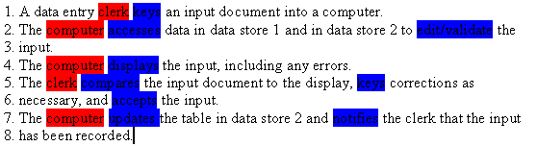

Slide 61
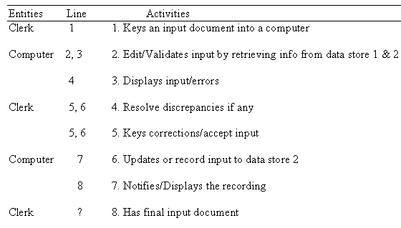

Slide 62
Standard Flowchart Symbols:
Study these symbols
They are a limited set!
See next slide for symbols

Slide 63
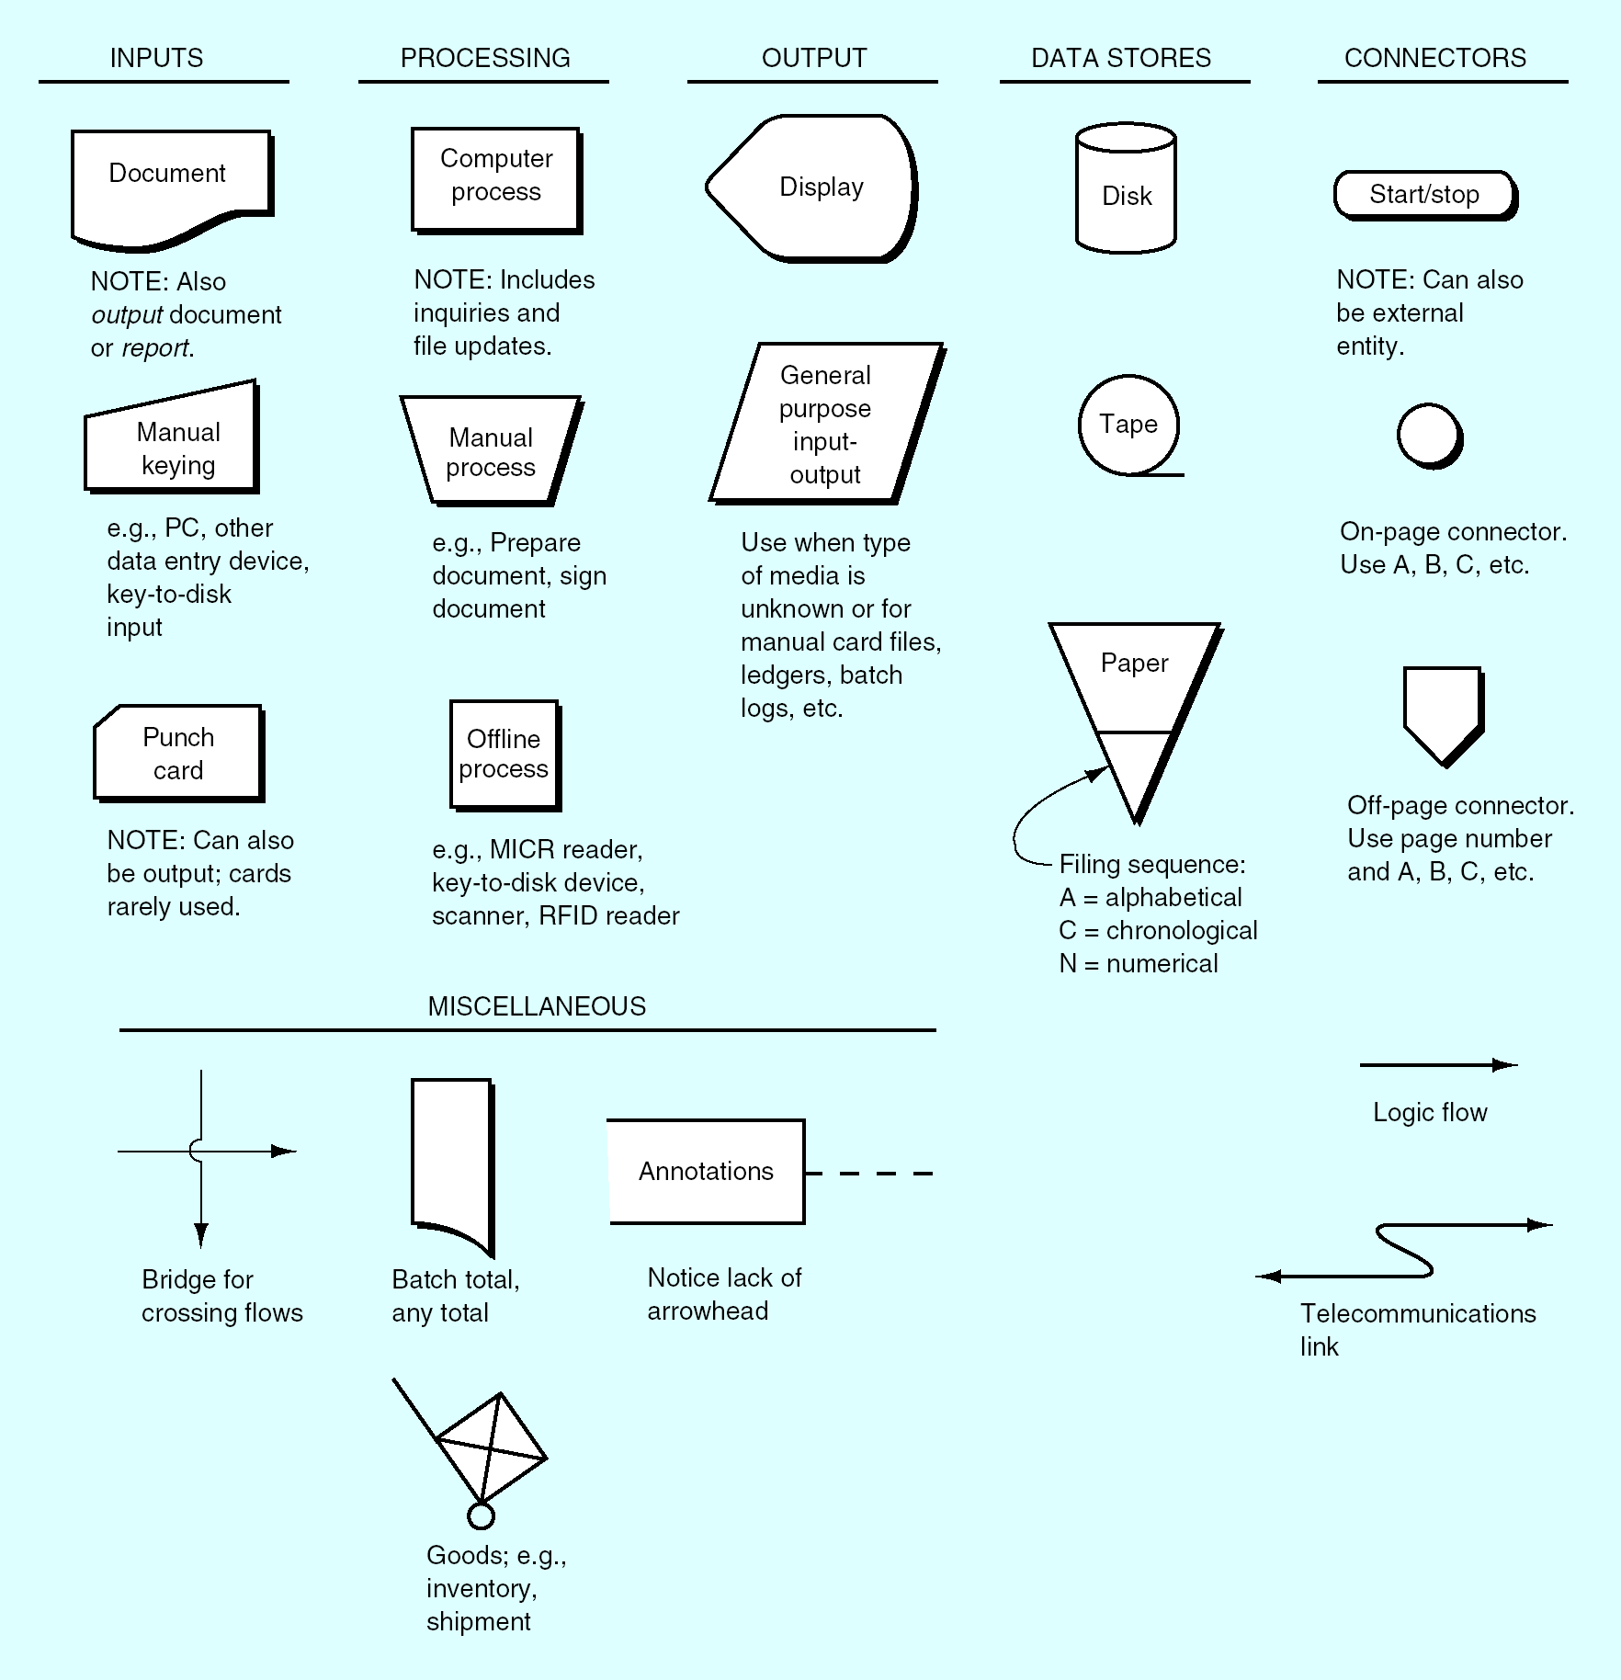

Slide 64
Flowchart: Activity 1
Keys an input document into a computer
The clerk has an INPUT Document
Keys it into computer
What symbols can you attach to points 1, 2
OPEN MS Visio > Basic Flowchart:
  Find symbols for Input document and
  Manual Input

Slide 65
Activity 1 by Clerk:

Slide 66


Activity 2 by computer:
Edit/Validates input by retrieving info from data store 1 & 2
Computer process of validating inputs
Computer retrieves data from data stores
What symbols can you use to describe the above operations?

Slide 67
Activity 2 by Computer
?

Slide 68
Flow Lanes:
Divide the flowchart into columns: one for each internal entity. Label each column
Activities flow left to right
Logic should flow from top to bottom and from left to right
Keep it on one page, otherwise connect the pages with off-page connectors
See next slides for Entity-Activity Table.

Slide 69
Activity 3: Displays input/errors
The computer displays INPUT and ERRORS to the clerk:

Slide 70
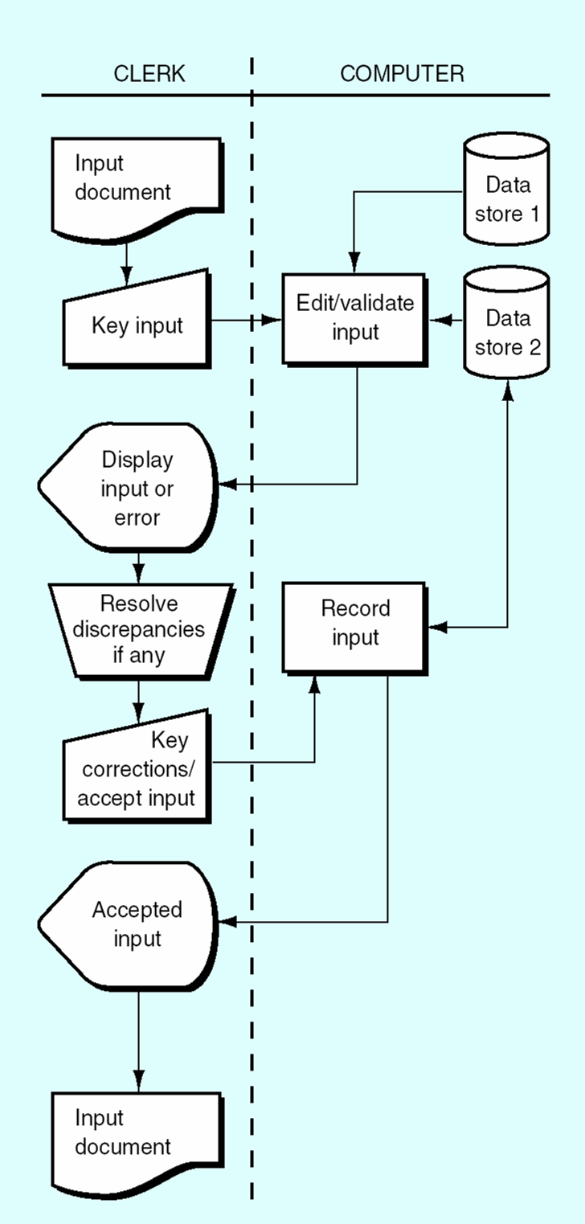

Slide 71
Narrative 2: A computer query
A user keys a query request into a computer. The computer accesses the tables in one or more data stores and presents a response to the user.
* A user keys a query request into a computer. The computer processes the query and accesses the tables in one or more data stores and presents a response to the user.

Slide 72
Identify entities and activities:
A user keys a query request into a computer.
The computer processes the query and
accesses the tables in one or more data stores
and presents a response to the user.

Slide 73
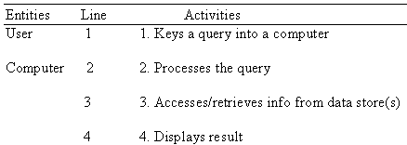
Entity, Activity table:

Slide 74



Translate this now to FC Symbols
Keys a query into a computer:
Processes query:
Accesses/retrieves info from data store(s):

Slide 75
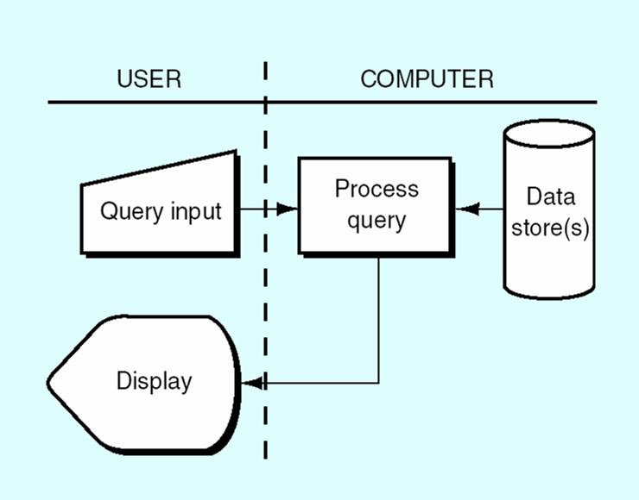
User queries the computer

Slide 76
Narrative 3:
Inputs (cash receipts, for example) that had previously been recorded on a magnetic disk are input to the computer, along with the existing (old) master data (accounts receivable master data, for example). The computer updates the existing master data and creates a new version of the master data.

Slide 77
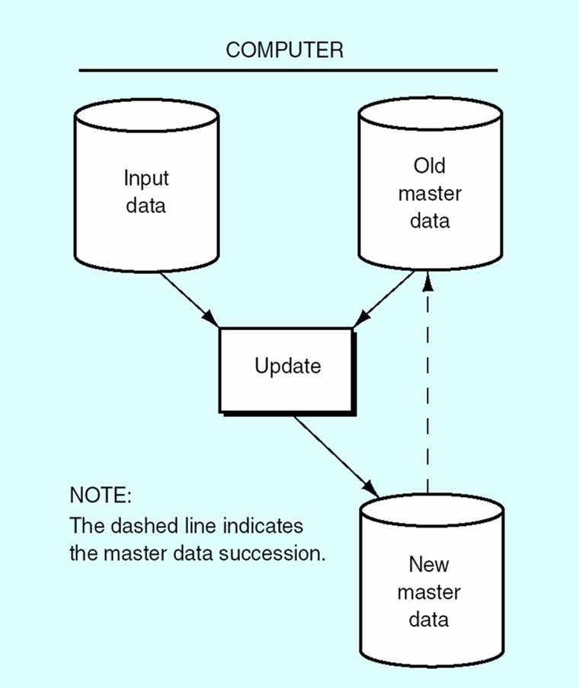
Update sequential data store:

