Slide 1
Organizing Data
Chapter 3
Theory + Practical
On databases

Slide 2
Revision:
The components of an Information System are: ___________, ____________, ___________, ______________.
To quote “a database is the heart of an Information System “, and “a comprehensive database is essential for the success of any Information System “

Slide 3
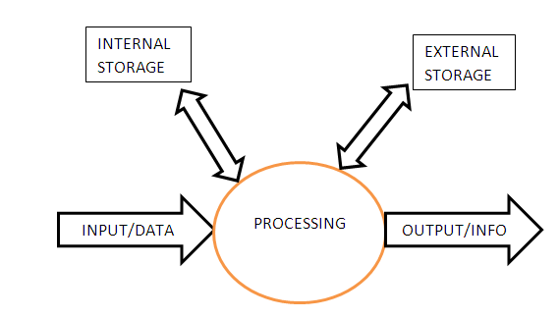

Slide 4
Introduction:
In any business data is accumulated. How does one store this data, so that it can be used efficiently?
Consider the following data about Invoices and Customers: see next slide

Slide 5
A Table of data:
Invoice | Customer | Amount | Payment | Name | Address
1110 | 2000 | R 2000.00 | Cash | Nene | KwaMashu
2220 | 3000 | R 4000.00 | Credit | Hlela | Eshowe
3330 | 3000 | R 1500.00 | Cash | Hlela | Eshowe
4440 | 9000 | R 6400.00 | Cash | Mfeka | Mtunzini
5550 | 9000 | R 7000.00 | Credit | Mfeka | Mtunzini

Slide 6
Terminology: How many
Files? Records? Fields?
Field
Invoice | Customer | Amount | Payment | Name | Address
1110 | 2000 | R 2000.00 | Cash | Nene | KwaMashu
2220 | 3000 | R 4000.00 | Credit | Hlela | Eshowe
3330 | 3000 | R 1500.00 | Cash | Hlela | Eshowe
4440 | 9000 | R 6400.00 | Cash | Mfeka | Mtunzini
5550 | 9000 | R 7000.00 | Credit | Mfeka | Mtunzini
File
Record

Slide 7
Data Hierarchy:
A file consists of a group of related records
A record is a group of related fields
Now we can define a database:
A database can consist of only a single file, but usually it is a group of related files

Slide 8
Slide 5:
Can you foreseen any problems with the data?
Consider the following data operations:
  Update,
  Insert,
  Delete
Mfeka bought more products
Hlela changes address

Slide 9
Can you spot the ‘mistakes’ or ANOMALIES?
Invoice | Customer | Amount | Payment | Name | Address
1110 | 2000 | R 2000.00 | Cash | Nene | KwaMashu
2220 | 3000 | R 4000.00 | Credit | Hlela | Eshowe
3330 | 3000 | R 1500.00 | Cash | Hlela | Empangeni
4440 | 9000 | R 6400.00 | Cash | Mfeka | Mtunzini
5550 | 9000 | R 7000.00 | Credit | Mfeka | Mtunzini
6660 | 8000 | R 5000.00 | Cash | Mfeca | Mtunzinni

Slide 10
File Queries:
What does Mfeka owes?
What is the address when posting the bill to Hlela?
Is customer ‘8000’ a new customer?

Slide 11
More problems:
Anomalies also exists in different files:
  File systems
File systems are maintained by programming code or instructions
All of this will lead to the solution: creation of a database, using a DBMS:
Database Management System
See next slides:

Slide 12
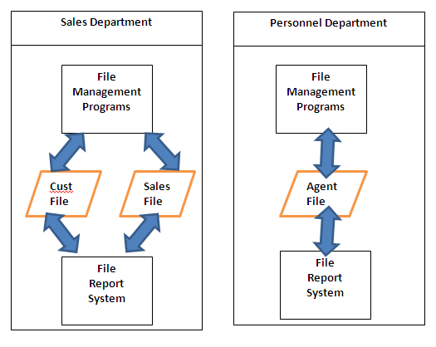
File Systems:

Slide 13
File Contents:
Customer- and Agent Files
custName | custPhone | agentName
Tim Buthelezi | 999-55555 | Sandy Ndlovu
agentName | agentPhone | ……………..
Sandy Ndlovu | 713-4343434

Slide 14
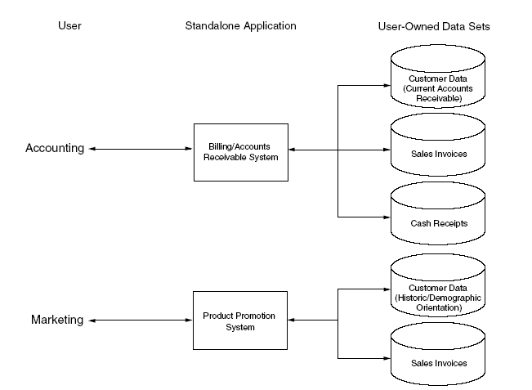
File System

Slide 15
Points to take notice of:
Duplication of data leads to anomalies:
  Changing information in the Customer file and NOT in the Agent file leads to inconsistency that impact on the integrity of the data.
Programmers interact DIRECTLY with the file, according to the STRUCTURE of the file.
  If the file organization changes, so must the software!

Slide 16
How do a DB solve these problems:
File:
DB:
Duplication of data
Changes to software programs
Introduces the DBMS:
  Data is stored in ONLY one File
  The DBMS introduces data independence:
  The programmer do NOT need to know about data structures. The DBMS interact with the files

Slide 17
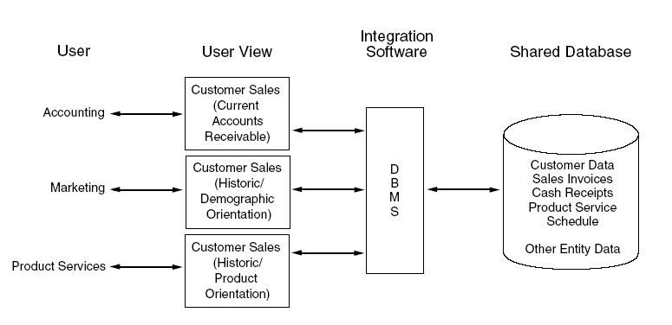
DBMS: See page 45,
Exhibit 3.2 Also pages 50, 51

Slide 18
How to get rid of anomalies:
Page 48: Normalization
1NF:
  Eliminate duplicated fields from the same table
  Create separate tables for each group of related data
  Identify each record with a unique field: the primary key

Slide 19
Visualise it like this:
Set A Set B
All related Data
PK
All related Data
PK

Slide 20
Each table MUST represents a SINGLE subject:
Invoice | Customer | Amount | Payment | Name | Address
1110 | 2000 | R 2000.00 | Cash | Nene | KwaMashu
2220 | 3000 | R 4000.00 | Credit | Hlela | Eshowe
3330 | 3000 | R 1500.00 | Cash | Hlela | Eshowe
4440 | 9000 | R 6400.00 | Cash | Mfeka | Mtunzini
5550 | 9000 | R 7000.00 | Credit | Mfeka | Mtunzini

Slide 21
Two Tables:
InvNo | InvAmount | InvPayment
1110 | R 2000.00 | Cash
2220 | R 4000.00 | Credit
3330 | R 1500.00 | Cash
4440 | R 6400.00 | Cash
5550 | R 7000.00 | Credit
CustNo | CustSurname | CustAddress
2000 | Nene | KwaMashu
3000 | Hlela | Eshowe
9000 | Mfeka | Mtunzini

Slide 22
Creation of a DB:
Create the LOGICAL view
  Know the tables/entities,
  Identify the attributes/field names,
    Identify a PK for EACH table
  Identify the relationship between entities.

Slide 23
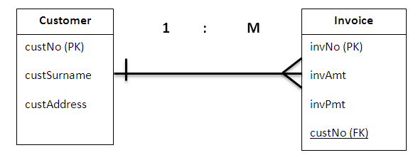
Creation of a DB:
Logical view:

Slide 24
Visualise it like this:
Set A Set B
All related Data
PK
All related Data
PK

Slide 25
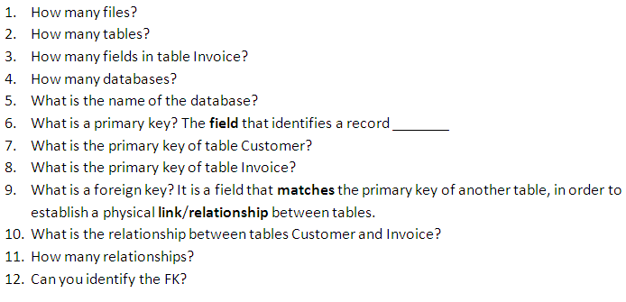

Slide 26
Relationships:
1 : 1
1 : M or M : 1
M : N
Example:
A person has a passport
How many subjects or tables do you identify?

Slide 27
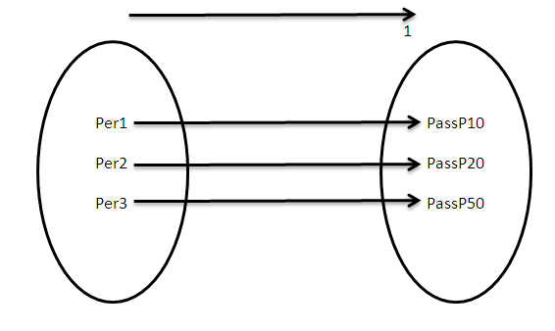
A person has a passport

Slide 28
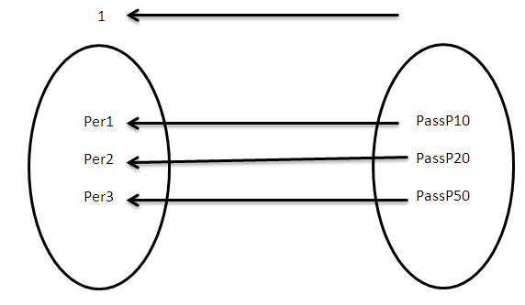
A passport belongs to a person

Slide 29
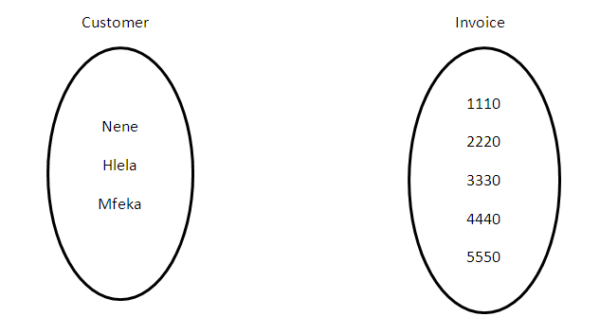

Slide 30
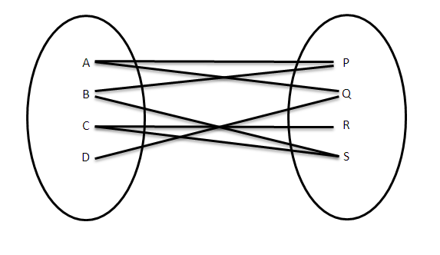
Can you determine the type of relationship?

Slide 31
Example of M : N
A student registers for many courses
A course is taken by many students
Or:
Students take many courses
Note:
  A relationship is bi-directional

Slide 32
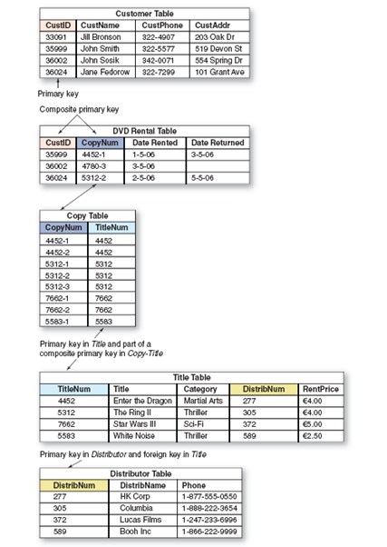

Slide 33
Queries?
What is the phone number of customer John Smith?
Who is the customer who rented copy number 4780-3?
What is the phone number of the customer who rented ‘The Ring II’?

Slide 34
Summary
We could ONLY answer the above questions because the data was well organized.
Organization starts with good database design.
Database software make it possible to handle such questions or queries.

Slide 35
Implementation:
Designing Step 1:
  Data is in 1NF
Designing Step 2:
  Determine the relationship
  1 : 1
  1 : M
  M : N

Slide 36
Implementation cont.
Designing Step 3:
Assign data types to each field or attribute
  Text
  Number (calculations)
  Date
  Logical
  Currency

Slide 37
Implementation:
Design Step 4: Create a data base SCHEMA representing all the information of the previous steps.
See next slide

Slide 38
Database Schema
Use MS Word

Slide 39
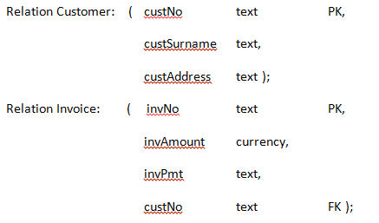

Slide 40
Relational Data Model

Slide 41
Populate:
Insert the values
Put the PK of the ONE side on the MANY side, now as a FK
Answer queries:
  Selection
  Project
  Join
QBE versus SQL

