Slide 1
What-If Analysis
Chapter 3
Additional notes to EX Chapter 03:

Slide 2
Before Slide 14:
INSERT another ROW:
  A7: Sales Revenue for Bonus

Slide 3
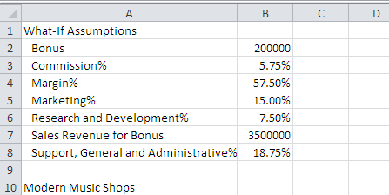
What-If Assumptions: ‘slide 15’

Slide 4
System’s Date: Function:
Cell I11
  Insert the NOW() function
Slide 18:
  Right click I11
  Format Cells
  Number Tab
  Date
  Select ‘Desired Date’

Slide 5
Relative Referencing:
When copying a formula, Excel adjusts the cell references so that the new formula contains references corresponding to the new cell locations:
  if you copy downward, Excel adjust the ROW portion of the cell reference,
  and if copied across, Excel adjusts the COLUMN portion of the cell reference in the formula.
This is RELATIVE REFERENCING

Slide 6
Formulae: Slide 20
Cell | Row Title | Formula | Comment
B14 | Cost of Sales |  | Revenue – Revenue*Margin%
B15 | Gross Margin |  | Revenue – Cost of Sales
B18 | Bonus |  | IF Revenue is larger than Set Sales Revenue, get Bonus otherwise Bonus = 0
B19 | Commission |  | Revenue * Commission%
B20 | Marketing |  | Revenue * Marketing%
B21 | Research |  | Revenue * Research%
B22 | Support |  | Revenue * Support%
B23 | Total Expenses |  | Sum of Expenses
B25 | Operating Income |  | Gross Margin – Total Expenses

Slide 7
Functions;
A function is a prewritten formula that performs certain types of calculations automatically.
Syntax or rules of structure for entering all functions is:
  =Function name (argument1, argument2,…..)
Function name correspond to the type of calculation.
Arguments are usually data or references the function needs to perform the calculation.

Slide 8
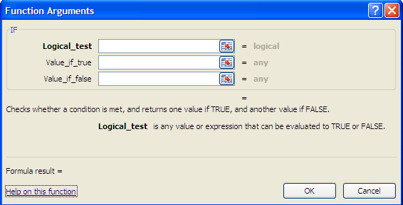
IF Syntax:
IF ‘statement’

Slide 9
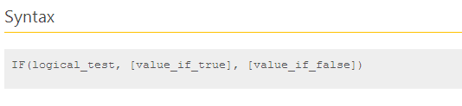

Slide 10
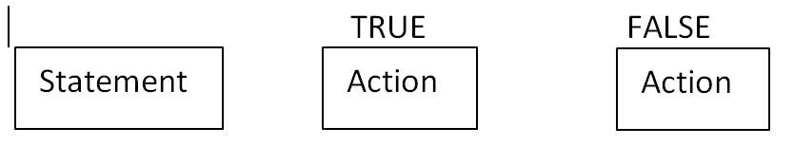

Slide 11
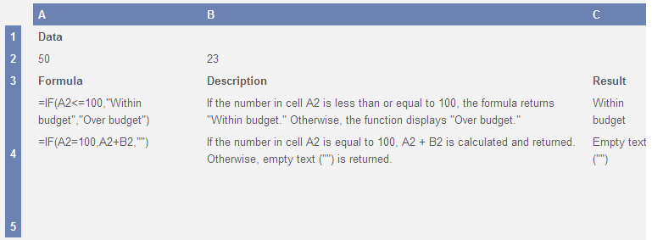

Slide 12
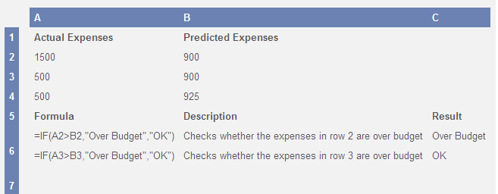

Slide 13
Slide 27: Formatting
A12:I12, Style Heading 3
Apply style Total to Gross Margin and Total Expenses
Make the row headings Currency style
Make the rest of data style currency, without ‘R’
What-If Assumptions box:
  Heading: point 14, underline, and italics
  The rest point 8

Slide 14
What-If analysis:
Automatic recalculation: What would happen to the six month operating income in cell H25 IF the Bonus, or Commission, etc. changes.
All the formulas dependent on the assumptions in the range B2:B8
B2 → 150000
B3 → 4%
B8 → 15.75%
H25 →

Slide 15
To Goal Seek:
If you know the result, you can determine how the dependable values must change, to produce that outcome:
Data Tab > Data Tools group > Goal Seek
The operating income (H25) must be 3000000.
What must the Support, General and Admin% be?

Slide 16
Nested IF:
Sometimes the problem lends itself to more than one outcome, or there are more than one condition.
This leads to multiple IF statements, or nested IF statements

Slide 17
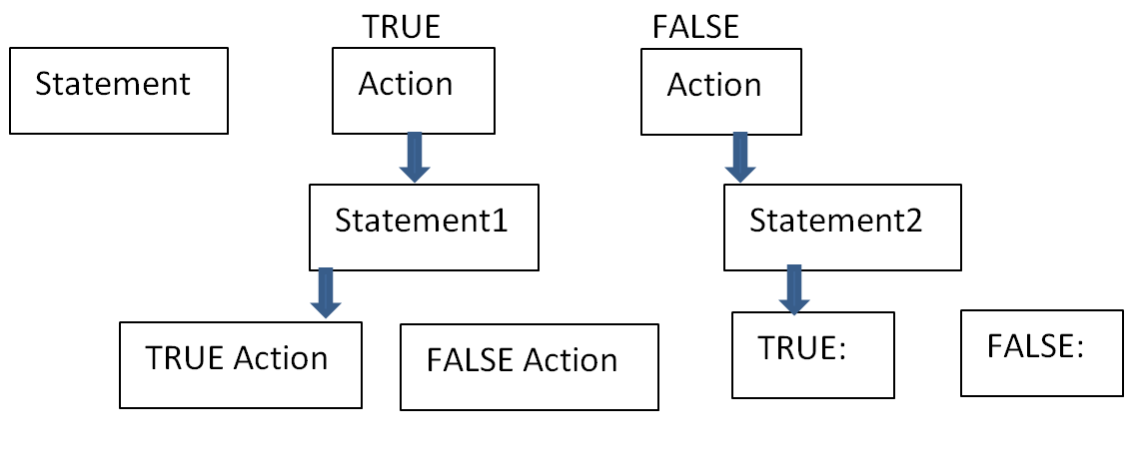

Slide 18
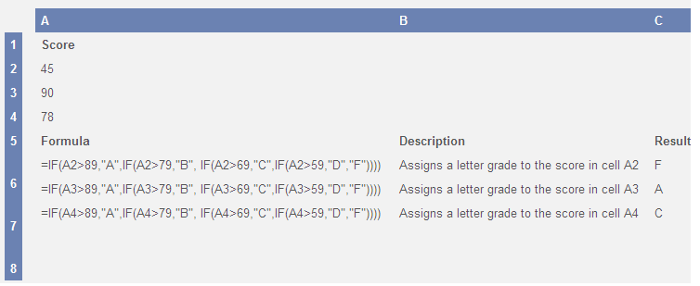

Slide 19
Problem Statement:
The school permits the student to attend a field trip:
  IF the student is older or equal to 14
  AND the parents signed permission:
  IF the parents did not signed permission, there must be an indication
ELSE the learner cannot go on trip

Slide 20
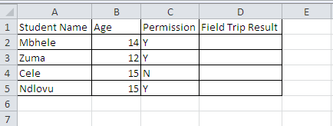
Nested IF:

