Slide 1
Object-Oriented Analysis Chapter 6 – Summary Notes
SATZINGER JACKSON BURD (6th Ed) CHAPTER 6:
Essentials of Design and the Design Activities

Slide 2
DESIGN AND DESIGN ACTIVITIES:
During ANALYSIS, the focus is on understanding what the system should do (i.e., the requirements), whereas
During DESIGN the focus is on the solution (i.e. specifying how the system will be built and what the structural components of the new system will be)
The objective of systems analysis is to thoroughly understand the organization’s informational needs or requirements and to document those requirements in a set of specifications - WHAT the solution needs to do

Slide 3
DESIGN:
The objective of systems design is to define, organize, and structure the components of the final solution system that will serve as the blueprint for construction - HOW the solution will be configured and constructed.
The objective of software construction is to build a system that satisfies those requirements.
Systems design is the bridge that takes the project from requirements to solution

Slide 4
THE ELEMENTS OF DESIGN
Network Diagram - a model that shows how the application is deployed across networks and computers
Analysts first identify the overall application deployment environment by defining the hardware and software environments.
The hardware environment includes computers, networks and firewalls.
The software environment includes such things as what operating systems, what database management system, and what kind of network protocol will be used

Slide 5
DESIGN:
Systems Design - those activities that enable the project team to describe in detail the system that solves the need
Architectural Design - broad design of the overall system structure, also called general design or conceptual design
Detail Design - low-level design that includes the design of the specific program details
Design should proceed in a top-down fashion

Slide 6
INPUTS AND OUTPUTS FOR SYSTEMS DESIGN
Design is a model-building activity. Analysts convert the information gathered during analysis—the requirements models—into models that represent the solution system.
Design is much more oriented toward technical issues and requires less user involvement and more involvement by other systems professionals.
Design involves describing, organizing, and structuring the system solution.
The output of the design activities is a set of diagrams and documents that model and document various aspects of the solution system

Slide 7
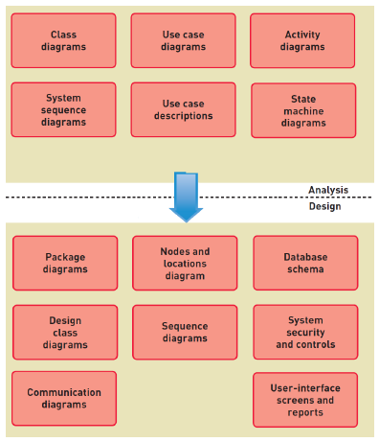

Slide 8
Analysis and Design Models
Design system components
Design the environment - the network and hardware linking the system together
Design application architecture and software - the computer programs
Design user interfaces - screens, reports, and controls for the inputs and outputs from users
Design system interfaces - the communications to other systems
Design the database - structure of the database
Design system controls and security – firewall, physical and logical security controls

Slide 9
Design the Environment
The environment is all the technology required to support the software application.
Environment includes computers and other hardware required for the deployment of the application as well as such things as
  server computers, desktop computers, mobile computers, firewalls, routers and cabling, fibre optics, and wireless access points

Slide 10
Continue:
Identify and define all the types of computing devices that will be required as well as locations and communication protocols necessary to integrate computing hardware.
  Some applications are simple stand-alone applications
  Some applications may be deployed to remote computing devices

Slide 11
Design the Application Architecture and Software
Includes decisions about the structure and configuration of the new system as well as the design of the computer software
Early step in this design process is partitioning the software into subsystems
Decide which subsystems will need to reside on which pieces of equipment
The other part of application design is designing the application software at a detailed level
  Examples: activity diagrams, sequence diagrams, design class diagrams, and other physical models

Slide 12
Design the User Interfaces
The user interface is everything the user comes into contact with while using the system—conceptually, perceptually, and physically.
New technology has led to many new requirements for the user interface - PDAs, mobile phones, tablets
As information systems become increasingly interactive and accessible, the user interface is becoming a larger and more important part of the total system.
Designing the user interface can be thought of as an analysis and a design activity

Slide 13
UI
Analysis activity - developers must understand the user’s needs and how the user carries out his or her job. User interface must also be ergonomically efficient and aesthetically attractive
Design activity - requires creativity and conformity to rigorous technology requirements
Models and tools are used to perform user-interface design, including:
  mock-ups, storyboards, graphical layouts, and prototyping with screen-modelling tools

Slide 14
Design the System Interfaces
New information system will affect and utilize many other information systems.
The component that enables systems to share information is the system interface, and each system interface needs to be designed in detail.
Form of system interfaces varies dramatically:
  In some cases, a file is sent from one system to another. In other cases, real-time data exchange is necessary, and live transactions are transferred between system
The format of the interchange can also vary, from binary format to encrypted formats to text-based formats

Slide 15
Design the Database
Integral part of every computer information system is the information itself, with its underlying database.
Data model (the domain model) is created early during systems analysis and is then used to create the implementation model of the database.
Many of the technical (as opposed to functional) requirements defined during systems analysis concern database performance needs (such as response times).
Design work might involve performance tuning

Slide 16
Design the Security and System Controls
System controls - adequate safeguards to protect organizational assets
Design of security and system controls should be included in all other design activities: user interface, system interface, application architecture, database, and network design
All system controls need to be thoroughly tested

Slide 17
Design the Environment - affects all the other design decisions
Design for Internal Deployment
  Stand-Alone Software Systems
  Internal Network-Based Systems
  Three-Layer Client-Server Architecture
Design for External Deployment
  Configuration for Internet Deployment
  Hosting Alternatives for Internet Deployment
  Diversity of Client Devices with Internet Deployment
  Design for Remote, Distributed Environment

Slide 18
Stand-Alone Software Systems
Any software system that executes on a single computing device without connecting externally via an Internet or network connection is a stand-alone system
Most standalone systems are developed by individuals and then sold or delivered to companies or other individuals e.g. office suites, Quickbooks
Design issues are usually straightforward
These systems usually read and write data into files without database access

Slide 19
Internal Network-Based Systems
An internal network-based system is one that is for the exclusive use of the organization that builds it or buys it
Made up of Local Area Network, Client and Server computers. Server computers provide applications over the network or access to large storage data
Desktop application systems and Browser-based application systems are deployed in a client-server architecture

Slide 20
Three-Layer Client-Server Architecture
Separates the user-interface routines (view layer) from the business logic routines and separate the business logic routines from the database access routines (data layer)
Advantages:
  Programmers can more easily focus their attention on solving one issue at a time
  Easier to upgrade and enhance different portions of the system
  Provides flexibility to deploy and redeploy information-processing resources in response to rapidly changing conditions

Slide 21
Design for External Deployment
Largest and most rapidly growing arena for new software applications is the deployment of systems that are purely for external use on the Internet
Configuration for Internet Deployment - Is similar to the three-layer architecture

Slide 22
Advantages:
Accessibility — Web browsers and Internet connections are nearly ubiquitous, Web-based applications are accessible to a large number of potential users (including customers, suppliers, and off-site employees).
Low-cost communication — Traffic on the backbone networks travels free of extra charges to the end user. Connections to the Internet can be purchased from a variety of private Internet service providers at relatively low costs.
Widely implemented standards — Web standards are well known, and many computing professionals are already trained in their use.

Slide 23
Disadvantages:
Security; throughput; changing standards
Security — Web servers are a well-defined target for security breaches because Web standards are open and widely known.
  Wide-scale interconnection of networks and the use of Internet and Web standards make servers open to hackers
  Protection must be provided for the home systems, including the data, and for the data as they are transmitted over the Internet.

Slide 24
Throughput:
When high loads occur, throughput and response time can suffer significantly.
The configuration must support not only daily average users but also a peak-load number of users.
Is unpredictable and can vary widely.

Slide 25
Changing standards:
Web standards change rapidly.
Client software is updated every few months.
Developers of widely used applications are faced with a dilemma: Use the latest standards to increase functionality or use older standards to ensure greater compatibility with older user software

Slide 26
Hosting Alternatives for Internet Deployment:
Hosting refers to running and maintaining a computer system on someone’s behalf where the application software and the database reside.
Critical issues that must be considered:
  Reliability — The hardware environment must be completely reliable. This often requires mirroring computers, hard drives, and database records.
  Security — The systems—hardware and software—must be secure
  Physical facilities — To ensure reliability and security
  Staff — To ensure reliability and security, a well-qualified technical staff
  Growth — External systems often grow dramatically as a business expands, increasing the number of servers needed to respond to the traffic.

Slide 27
Alternatives:
Co-location - a hosting service with a secure location but in which the computers are usually owned by the client businesses
Managed Services - hosting company's special technical staff manages the company's server system software
Virtual server - a method to partition the services of a physical Web server so it appears as multiple, independent Internet servers
Cloud computing - an extension of virtual servers in which the resources available include computing, storage, and Internet access and appear to have unlimited availability

Slide 28
Rest:
Diversity of Client Devices with Internet Deployment
Design for Remote, Distributed Environment
  VPN

Slide 29
Revision
Draw diagrams with MS Visio to show the configurations for
A two-tier client/server architecture
A three-tier architecture
An n-tier architecture

Slide 30
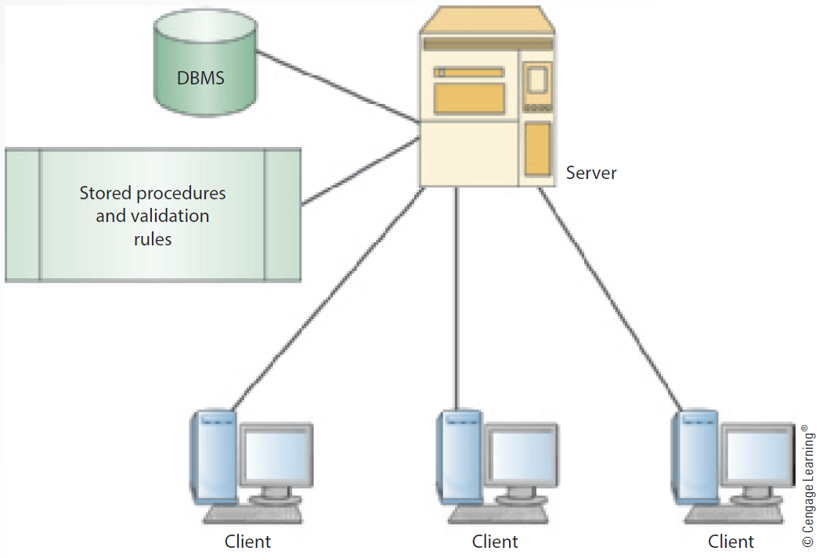

Slide 31
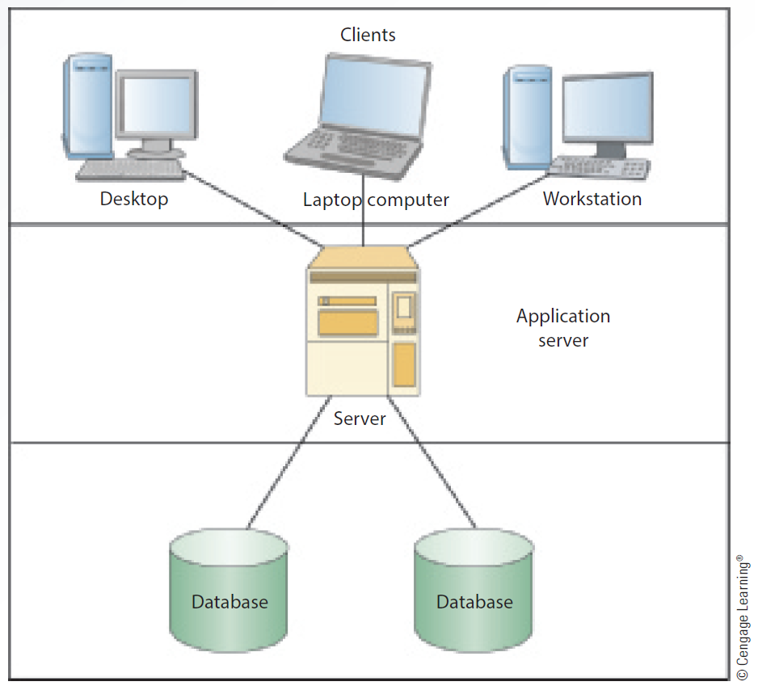

Slide 32
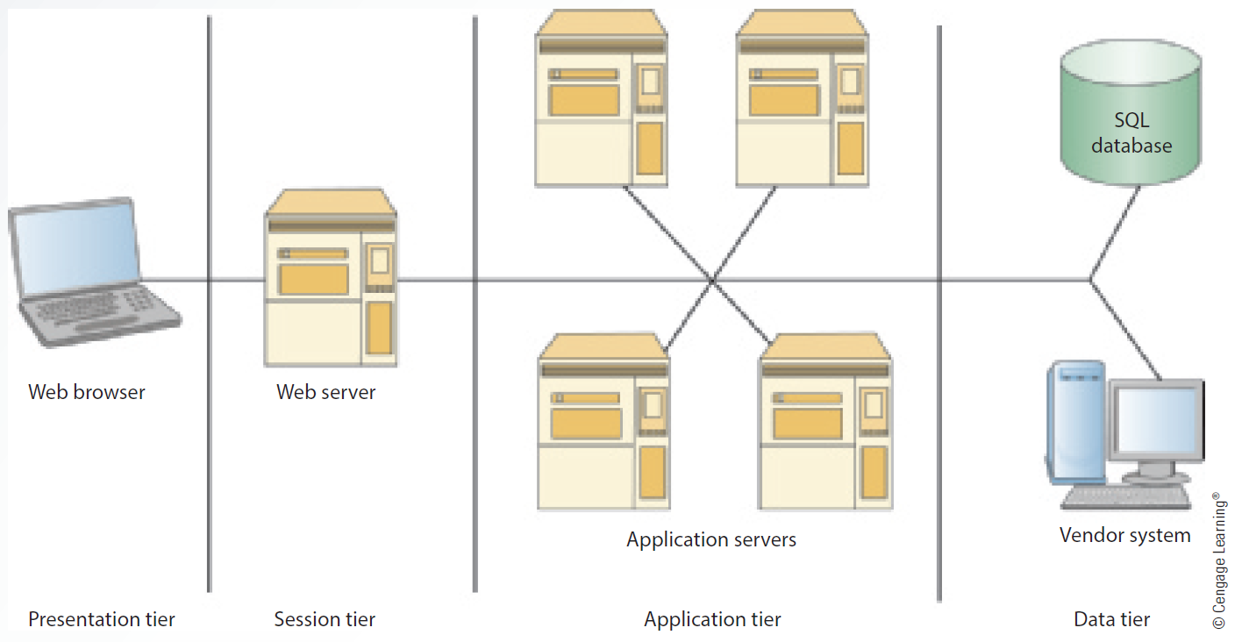

Slide 33
Problems and Exercises p170
Example Pr 1:
A financial corporation has desktop applications running in several different offices that are all supported by a centralized application bank of two computers. In addition, there is a centralized database, which requires three servers. Draw a network diagram representing this requirement

Slide 34
Homework
Pr 2, 3

