Slide 1
Microsoft
Word 2010
Chapter 3
Creating a Business Letter with a Letterhead
and Table

Slide 2
Objectives
Change margins
Insert and format a shape
Change text wrapping
Insert and format a clip art image
Insert a symbol
Add a border to a paragraph
Clear formatting
Convert a hyperlink to regular text

Slide 3
Objectives
Create a file from an existing file
Apply a Quick Style
Set and use tab stops
Insert the current date
Create, insert, and modify a building block
Insert a Word table, enter data in the table, and format the table
Address and print an envelope

Slide 4
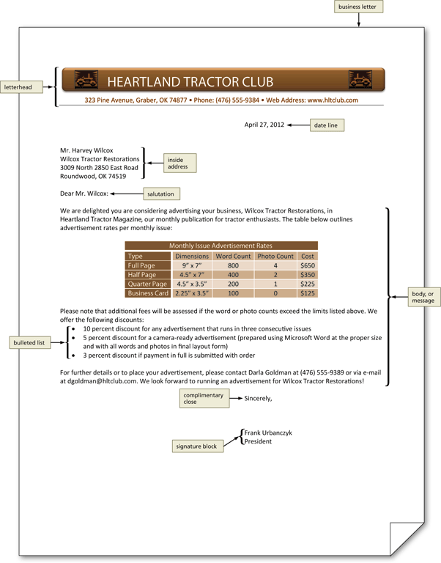
Project – Business Letter with a Letterhead and Table

Slide 5
General Project Guidelines
Determine how to create a letterhead
If you do not have preprinted letterhead paper, design a creative letterhead
Compose an effective business letter

Slide 6
Changing Margin Settings
Display the Page Layout tab
Click the Margins button to display the Margins gallery
Click the desired setting in the Margins gallery to change the margins

Slide 7
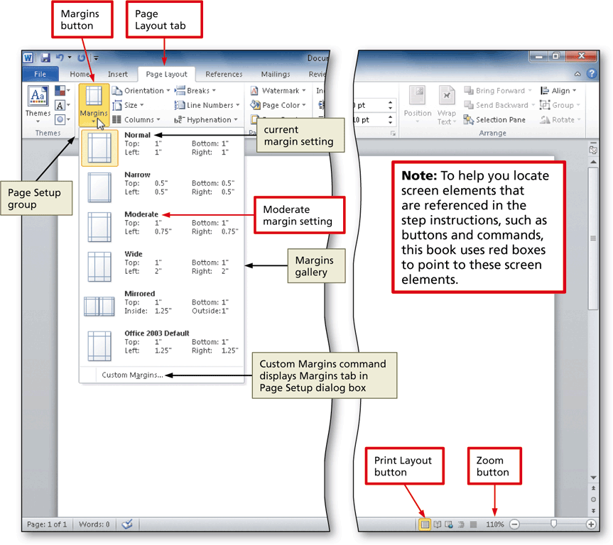
Changing Margin Settings

Slide 8
Inserting a Shape
Display the Insert tab
Click the Shapes button to display the Shapes gallery
Click the desired shape to remove the gallery and change the mouse pointer to the shape of a crosshair
Position the mouse pointer in the location for the upper-left corner of the desired shape
Drag the mouse to the right and downward to form the boundaries of the shape
Release the mouse button

Slide 9
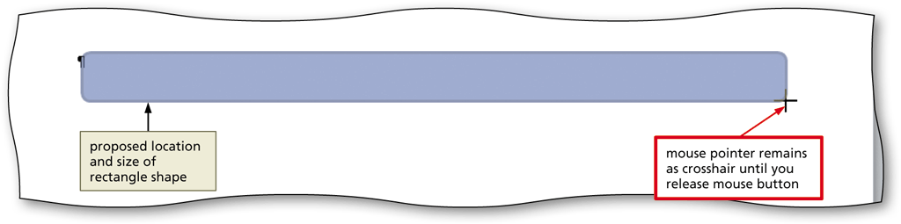
Inserting a Shape

Slide 10
Applying a Shape Style
Select the shape, and click the More button in the Shape Styles gallery to expand the gallery
Point to the desired style to display a live preview of that style applied to the shape in the document
Click the desired style to apply the selected style to the shape

Slide 11
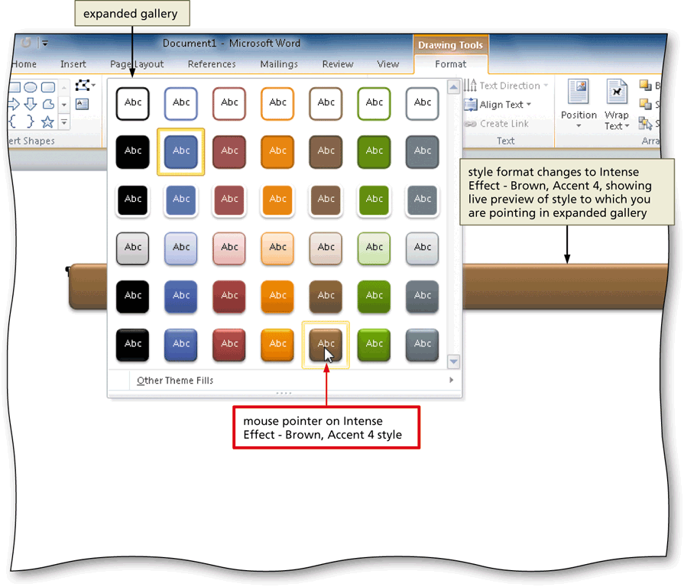
Applying a Shape Style

Slide 12
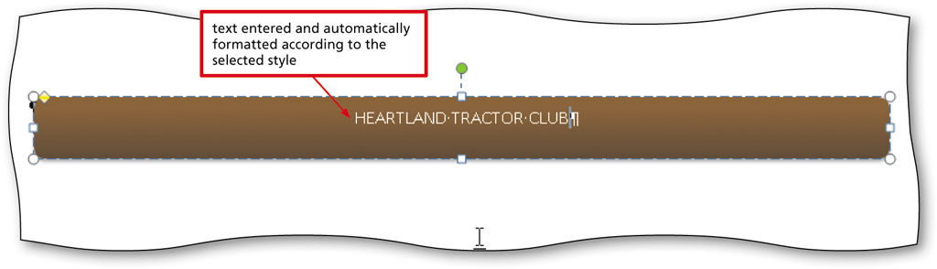
Adding Text to a Shape
Right-click the shape to display a shortcut menu and the Mini toolbar
Click Add Text on the shortcut menu to place an insertion point centered in the shape
Type the desired text in the shape

Slide 13
Using the Grow Font Button to Increase Font Size
Select the text of which you wish to increase the font size
Display the Home tab
Repeatedly click the Grow Font button until the text is the desired font size

Slide 14
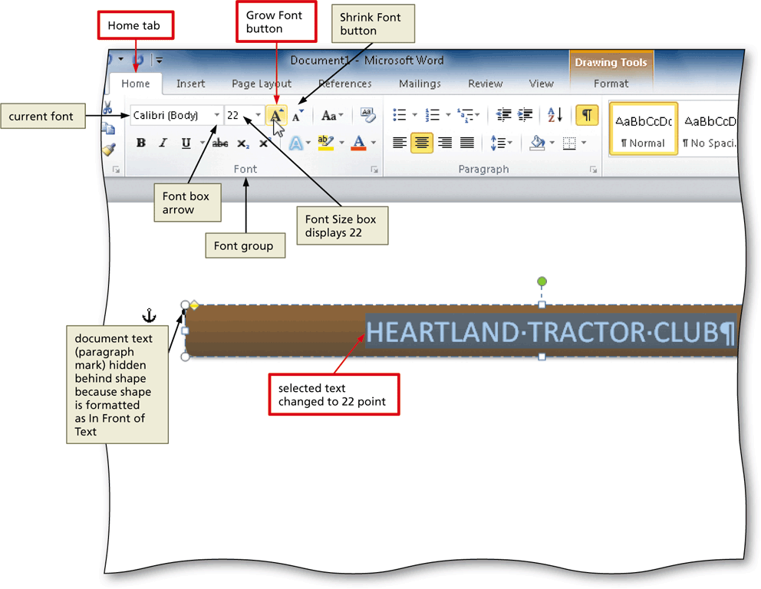
Using the Grow Font Button to Increase Font Size

Slide 15
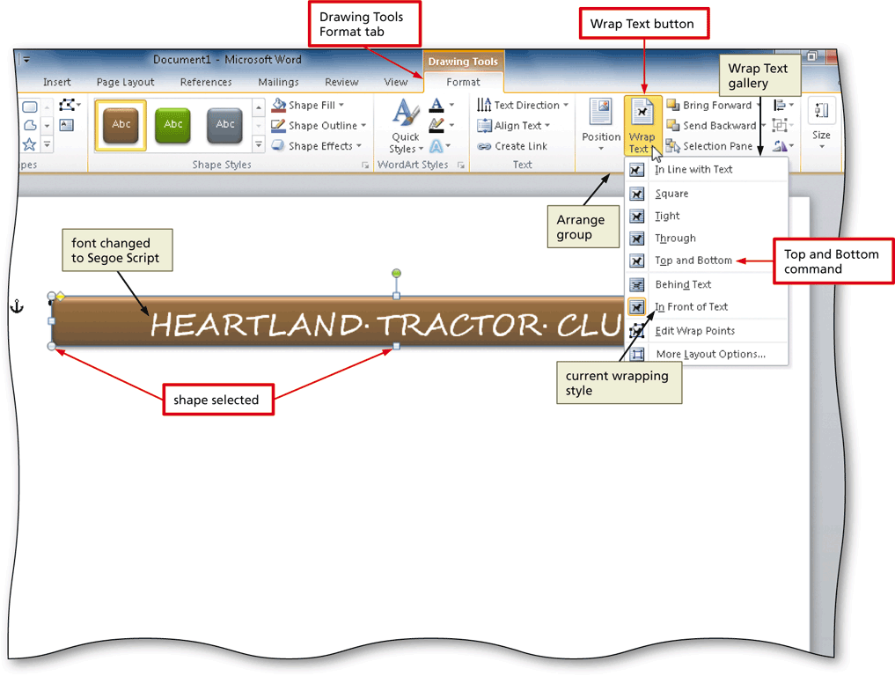
Changing an Object’s Text Wrapping
Click the edge of the shape to select the shape
Display the Drawing Tools Format tab
Click the Wrap Text button to display the Wrap Text gallery
Click the desired wrapping command

Slide 16
Inserting Clip Art
Position the insertion point where you want to insert the clip art image
Display the Insert tab
Click the Clip Art button to display the Clip Art pane
If the Search for text box displays text, drag through the text to select it
Type the desired search text
Click the Go button to display a list of clips that match the entered search text

Slide 17
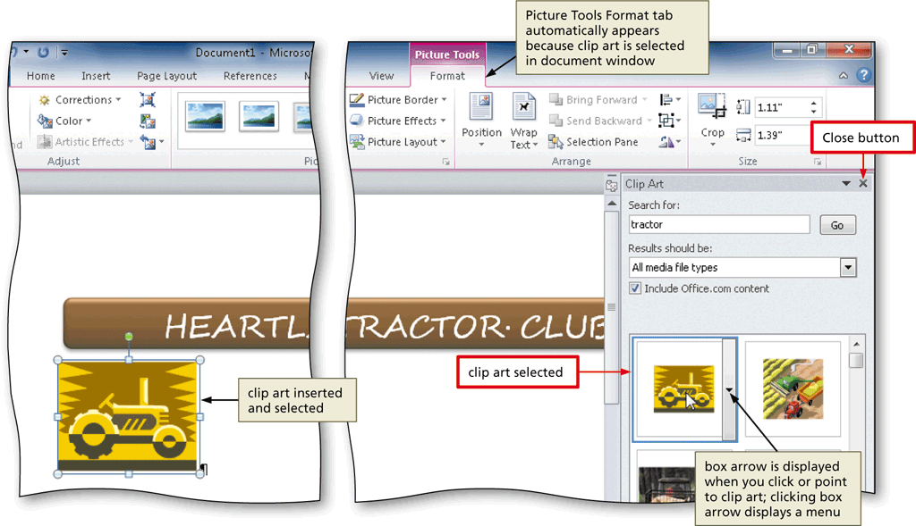
Inserting Clip Art
Click the desired clip art to insert the clip art image in the document at the location of the insertion point
Click the Close button on the Clip Art pane title bar to close the task pane

Slide 18
Resizing a Graphic to a Percent of the Original
With the graphic selected, click the Advanced Layout: Size Dialog Box Launcher to display the Layout dialog box
In the Scale area, double-click the current value in the Height box to select it
Type the desired height in the Height box and then press the TAB key to display the same percent value in the Width box
Click the OK button to close the dialog box and resize the selected graphic

Slide 19
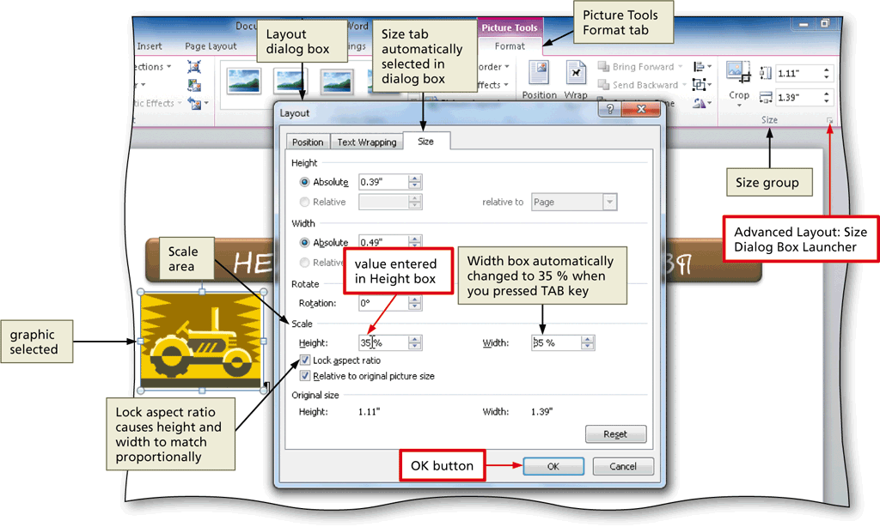
Resizing a Graphic to a Percent of the Original

Slide 20
Changing the Color of a Graphic
With the graphic selected, click the Color button to display the Color gallery
Point to the desired color to display a live preview of that color applied to the selected graphic in the document
Click the color to change the color of the selected graphic

Slide 21
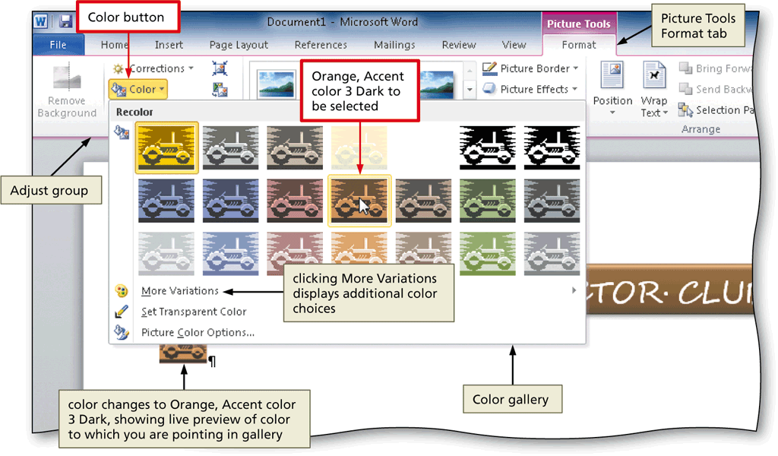
Changing the Color of a Graphic

Slide 22
Setting a Transparent Color in a Graphic
With the graphic selected, click the Color button to display the Color gallery
Click Set Transparent Color in the Color gallery to display a pen mouse pointer in the document window
Position the pen mouse pointer in the graphic where you want to make the color transparent
Click the location of the graphic where you want the color to be transparent

Slide 23

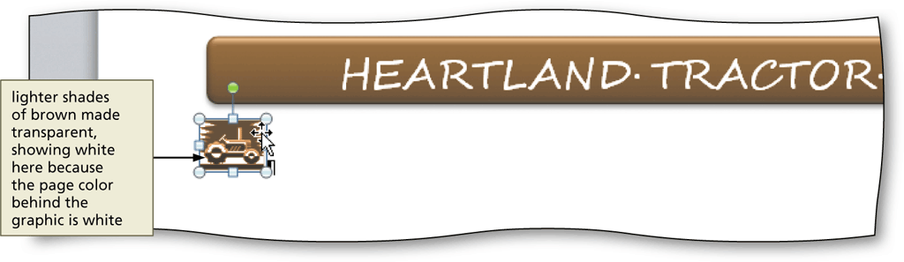
Setting a Transparent Color in a Graphic

Slide 24
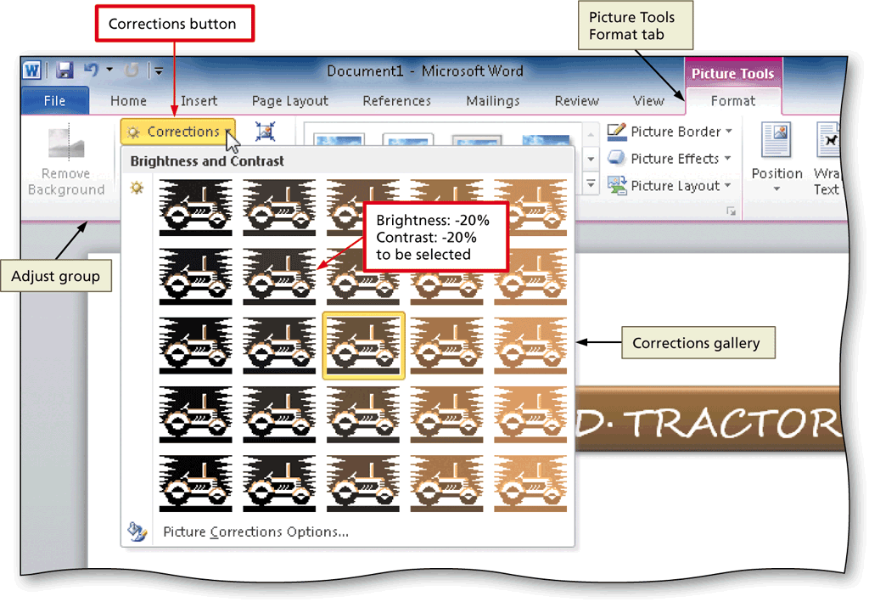
Adjusting the Brightness and Contrast of a Graphic
With the graphic selected, click the Corrections button to display the Corrections gallery
Click the desired correction to change the brightness and contrast of the selected graphic

Slide 25
Changing the Border Color on a Graphic
With the picture selected, click the Picture Border button arrow to display the Picture Border gallery
Point to the desired border color to display a live preview of that border color around the picture
Click the border color in the Picture Border gallery to change the picture border color

Slide 26
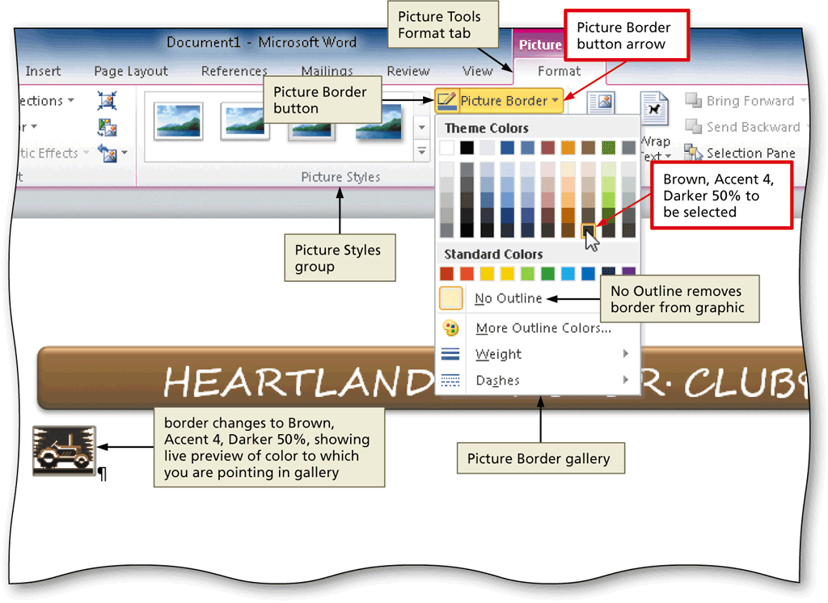
Changing the Border Color on a Graphic

Slide 27

Moving a Graphic
Position the mouse pointer in the graphic so that the mouse pointer has a four-headed arrow attached to it
Drag the graphic to the desired location

Slide 28
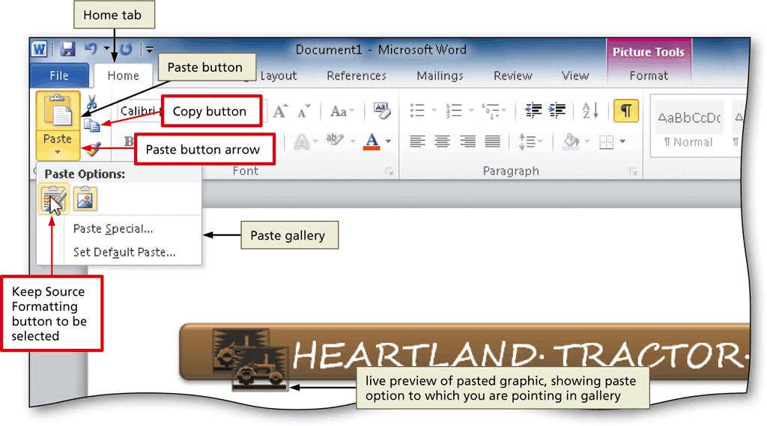
Using Paste Options
With text or a graphic copied, click the Paste button arrow on the Home tab to display the Paste gallery
Point to the desired command to see a live preview of that paste option
Click the desired paste option to paste the object

Slide 29
Flipping a Graphic
With the graphic selected, click the Rotate button to display the Rotate gallery
Point to the desired command to display a live preview of the selected rotate option applied to the selected graphic
Click the desired rotate option

Slide 30
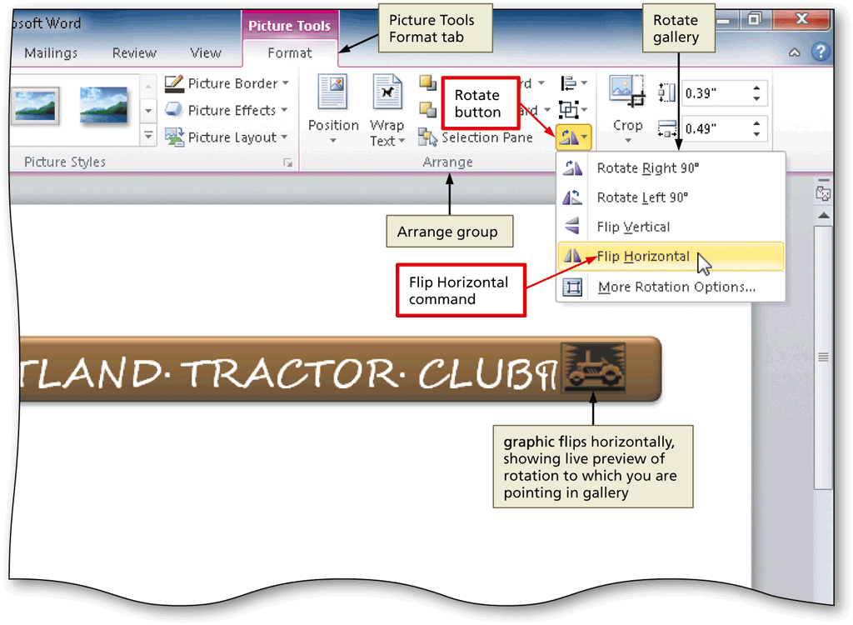
Flipping a Graphic

Slide 31
Inserting a Symbol from the
Symbol Dialog Box
Display the Insert tab
Click the Insert Symbol button to display the Insert Symbol gallery
Click More Symbols in the Insert Symbol gallery to display the Symbol dialog box
Select the desired font and subset
Click the desired symbol to select it, and then click the Insert button to place the selected symbol in the document to the left of the insertion point
Click the Close button to close the dialog box

Slide 32
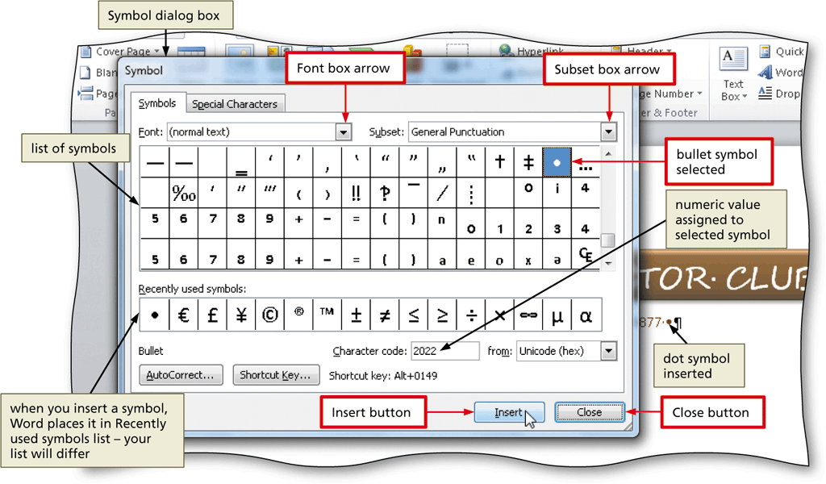
Inserting a Symbol from the
Symbol Dialog Box

Slide 33
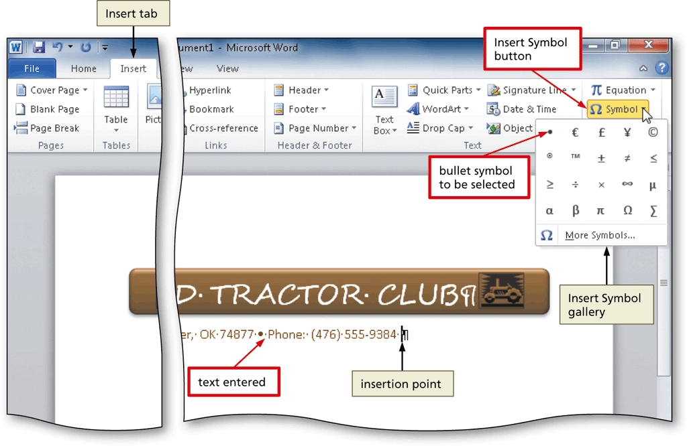
Inserting a Symbol from the Symbol Gallery
Click the Insert Symbol button to display the Insert Symbol gallery
Click the desired symbol in the Insert Symbol gallery to insert the symbol at the location of the insertion point

Slide 34
Bottom Bordering a Paragraph
Display the Home tab
With the insertion point in the paragraph to border, click the Border button arrow to display the Border gallery
Click Bottom Border in the Border gallery to place a border below the paragraph containing the insertion point

Slide 35
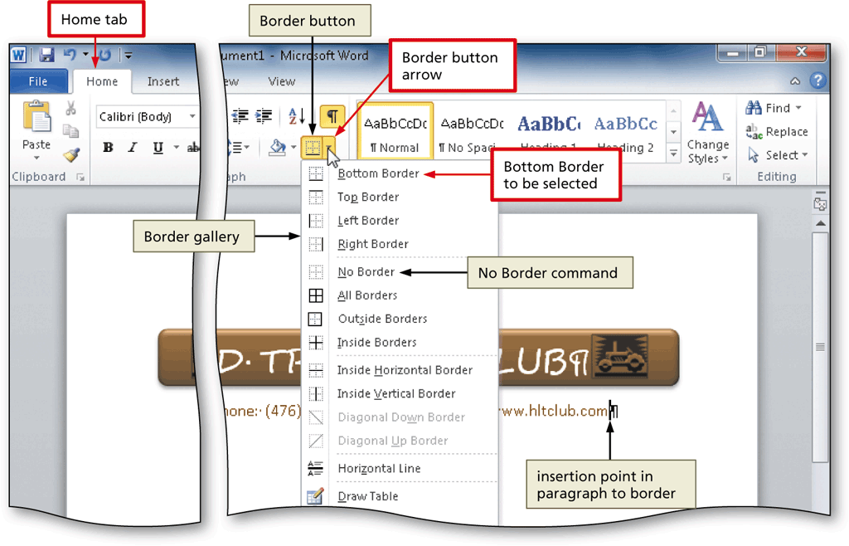
Bottom Bordering a Paragraph

Slide 36
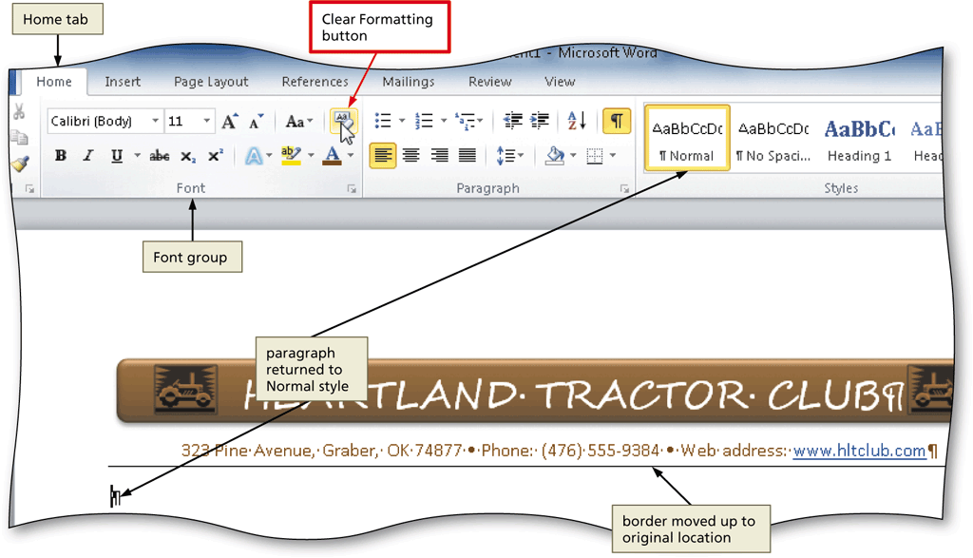
Clearing Formatting
Click the Clear Formatting button on the Home tab to apply the Normal style to the location of the insertion point

Slide 37
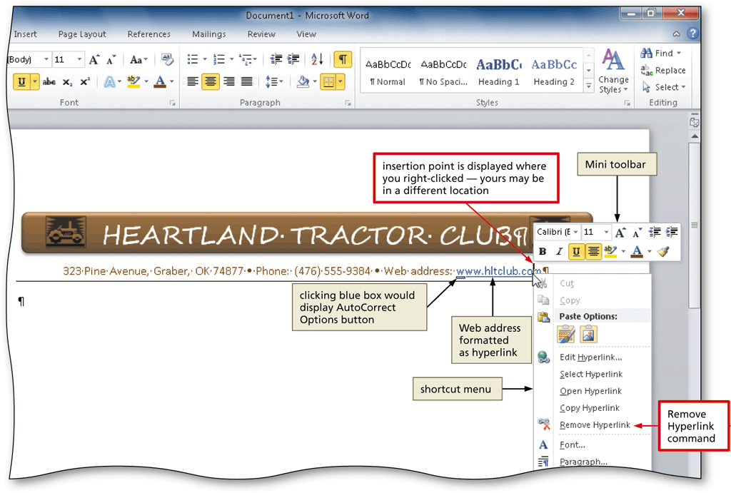
Converting a Hyperlink to Regular Text
Right-click the hyperlink to display the Mini toolbar and a shortcut menu
Click Remove Hyperlink on the shortcut menu to remove the hyperlink format from the text

Slide 38
Creating a New File from an Existing File
Click File on the Ribbon to open the Backstage view
Click the New tab in the Backstage view to display the New gallery
Click the ‘New from existing’ button in the New gallery to display the New from Existing Document dialog box
Navigate to the location of the existing document
Click to select the existing file
Click the Create New button to open a new document window that contains the contents of the selected file

Slide 39
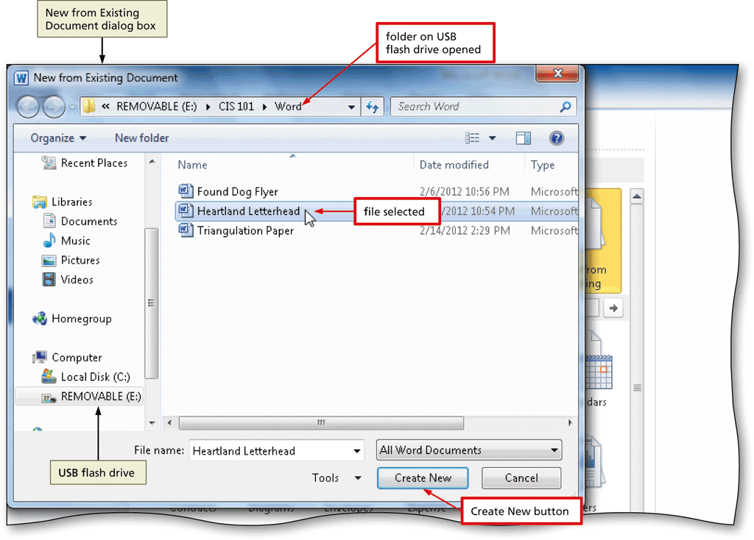
Creating a New File from an Existing File

Slide 40
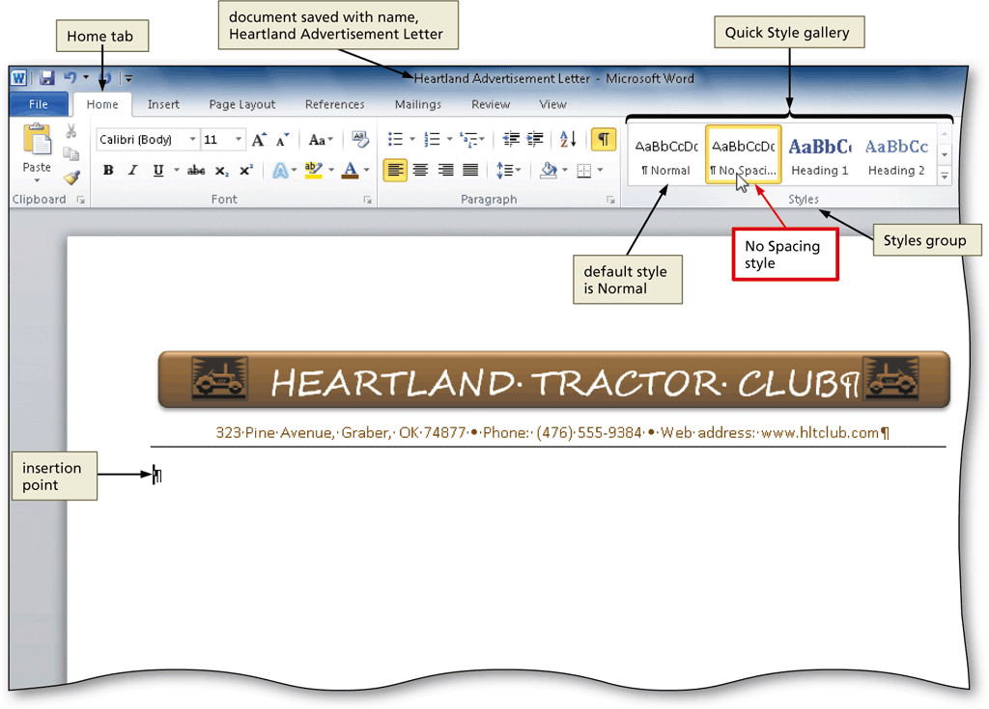
Applying a Quick Style
With the insertion point positioned in the paragraph to be formatted, click the desired style in the Quick Style gallery to apply the selected style to the current paragraph

Slide 41
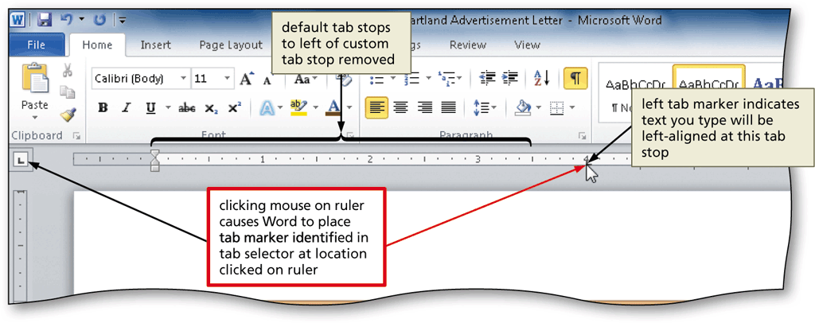
Setting Custom Tab Stops
If necessary, click the tab selector at the left edge of the horizontal ruler until it displays the type of tab you wish to use
Click the location on the ruler where you want to place a tab stop

Slide 42
Inserting the Current Date in a Document
Display the Insert tab
Click the Insert Date and Time button to display the Date and Time dialog box
Select the desired format
If desired, click the Update automatically check box
Click the OK button to insert the current date at the location of the insertion point

Slide 43
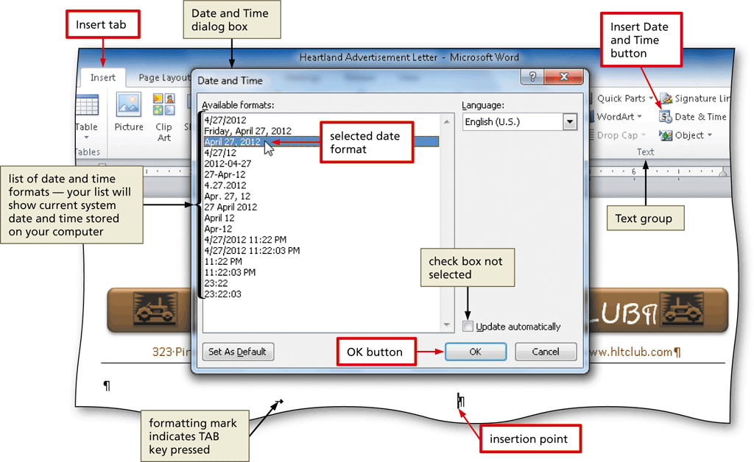
Inserting the Current Date in a Document

Slide 44
Creating a Building Block
Select the text to be a building block
Click the Quick Parts button on the Insert tab to display the Quick Parts gallery
Click Save Selection to Quick Part Gallery in the Quick Parts gallery to display the Create New Building Block dialog box
Type the name of the building block in the Name text box
Click the OK button to store the building block entry and close the dialog box

Slide 45
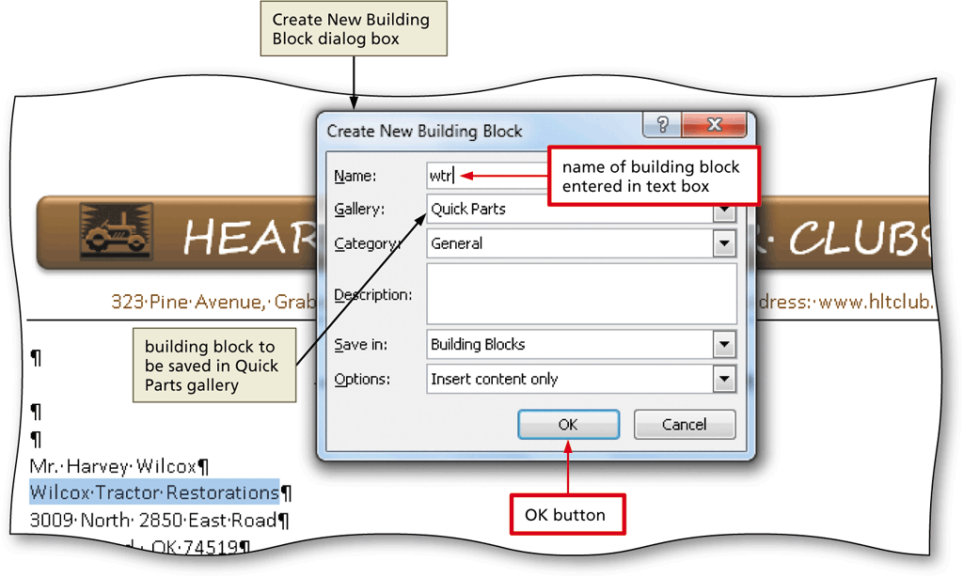
Creating a Building Block

Slide 46
Modifying a Building Block
Click the Quick Parts button on the Insert tab to display the Quick Parts gallery
Right-click the building block to display a shortcut menu
Click Edit Properties on the shortcut menu to display the Modify Building Block dialog box
Make the desired changes in the Modify Building Block dialog box
Click the OK button to store the building block entry and close the dialog box

Slide 47
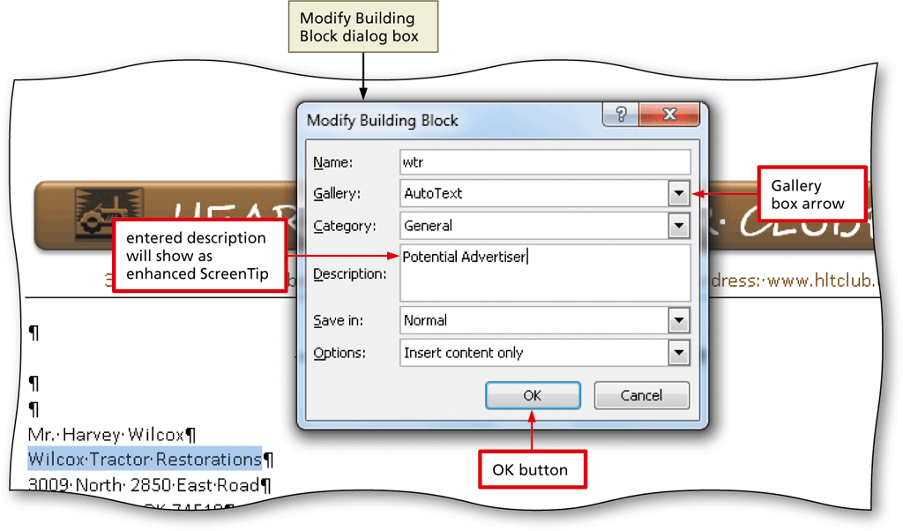
Modifying a Building Block

Slide 48
Inserting a Building Block
Position the insertion point where you wish to insert the building block
Type the desired text, including the building block name
Press the F3 key to instruct Word to replace the building block name with the stored building block entry

Slide 49
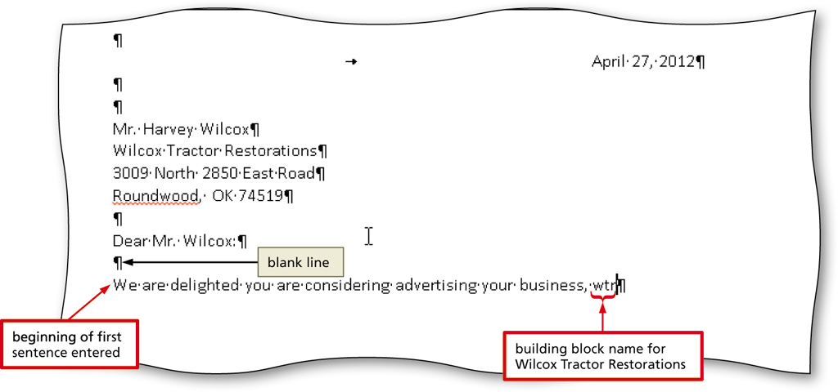
Inserting a Building Block

Slide 50
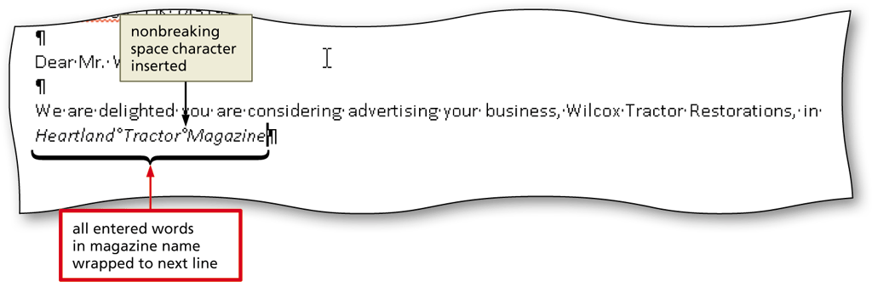
Inserting a Nonbreaking Space
Press CTRL+SHIFT+SPACEBAR to insert a nonbreaking space

Slide 51
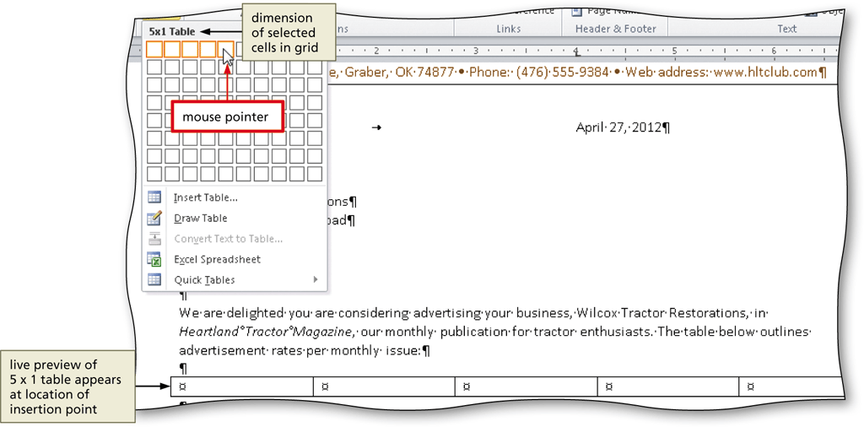
Inserting an Empty Table
Click the Table button on the Insert tab to display the Table gallery
Click the cell representing the desired number of rows and columns in the table

Slide 52
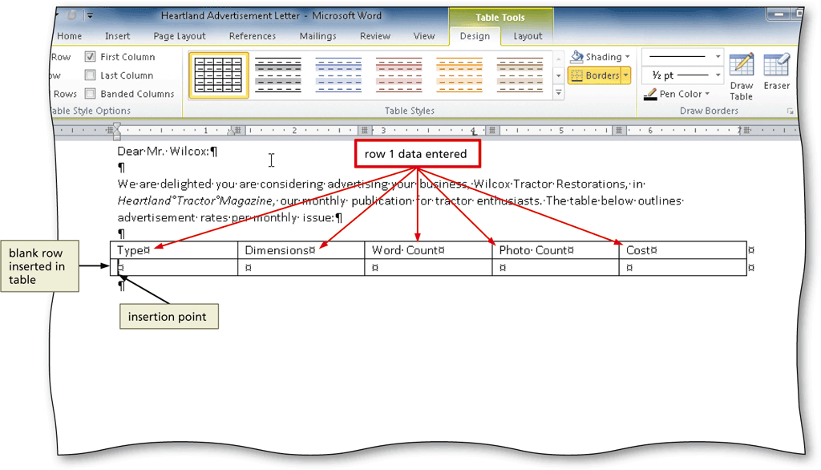
Entering Data in a Table
Click the cell in which you want to enter data, and type the data
Press the TAB key to advance the insertion point to the next cell

Slide 53
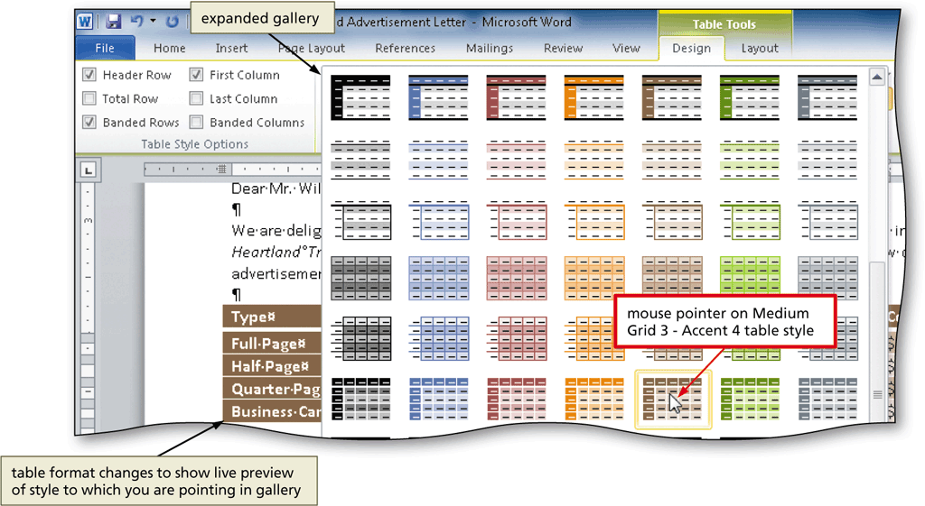
Applying a Table Style
Place the insertion point in the table
Click the More button in the Table Styles gallery on the Table Tools Design Tab to expand the gallery
Click the desired table style

Slide 54
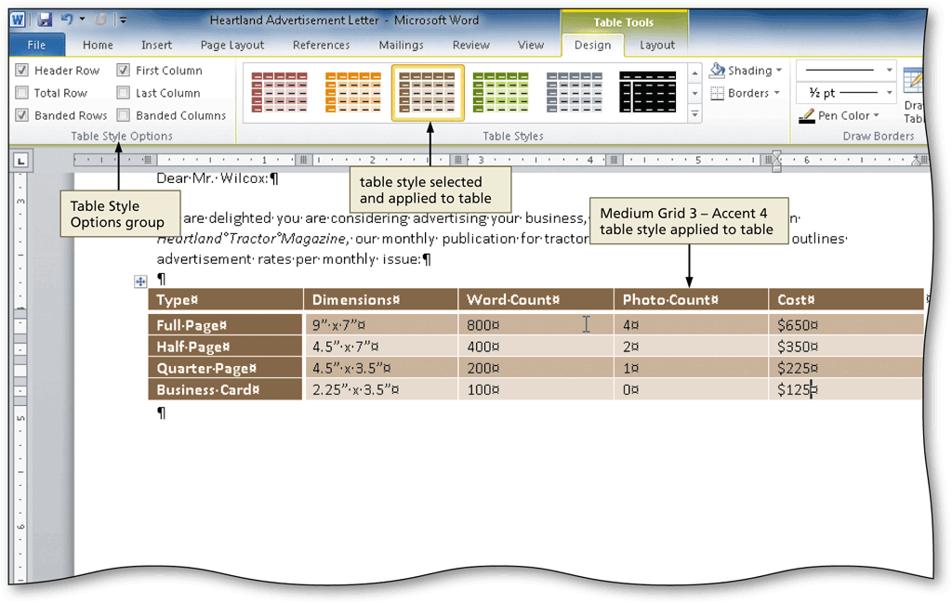
Applying a Table Style

Slide 55
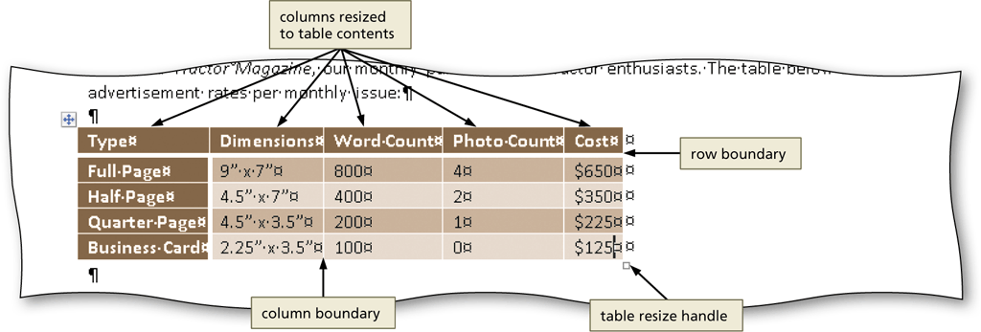
Resizing Table Columns to Fit Table Contents
With the insertion point in the table, display the Table Tools Layout tab
Click the AutoFit button to display the AutoFit menu
Click AutoFit Contents on the AutoFit menu, so that Word automatically adjusts the widths of the columns based on the text in the table

Slide 56
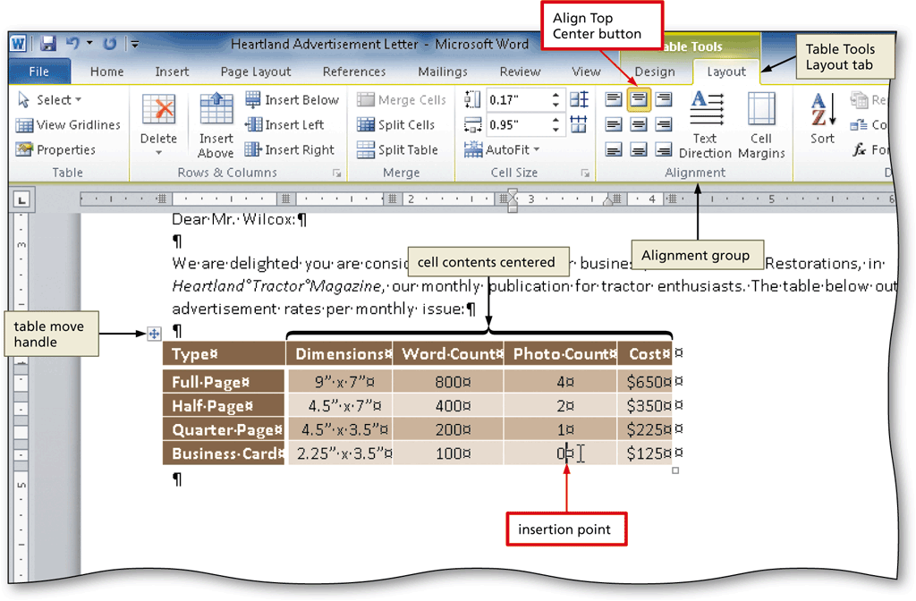
Aligning Data in Cells
Select the cells containing data to align
Click the desired alignment option on the Table Tools Layout tab to apply the alignment option

Slide 57
Centering a Table
Position the mouse pointer in the table so that the table move handle appears
Click the table move handle to select the entire table
Move the mouse pointer into the Mini toolbar, so that the toolbar changes to a bright toolbar. Click the Center button on the Mini toolbar to center the selected table between the left and right margins

Slide 58
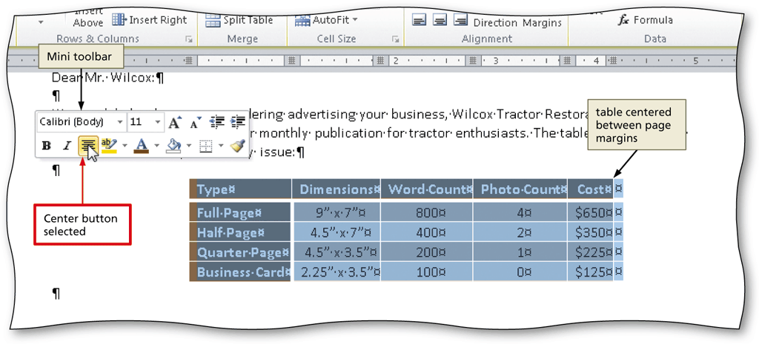
Centering a Table

Slide 59
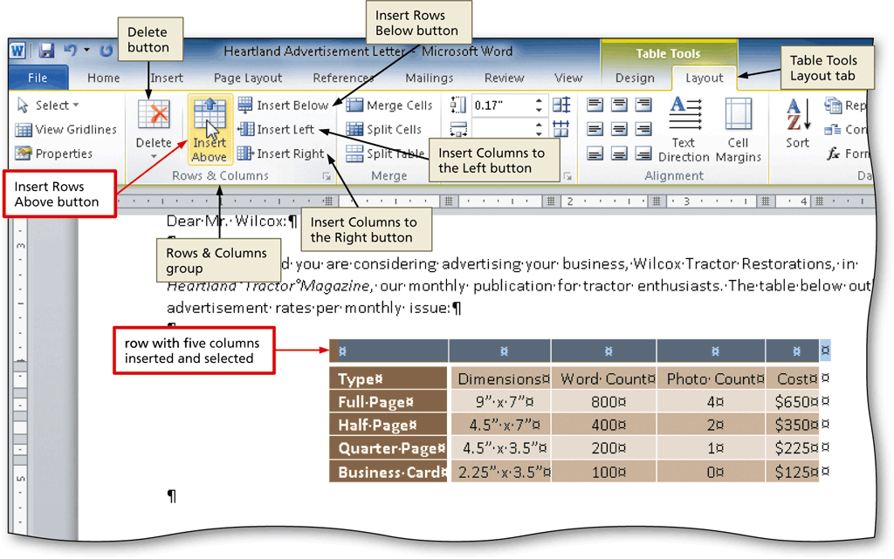
Inserting a Row in a Table
Click the Insert Rows Above button on the Table Tools Layout Tab to insert a row above the row containing the insertion point and then select the newly inserted row

Slide 60
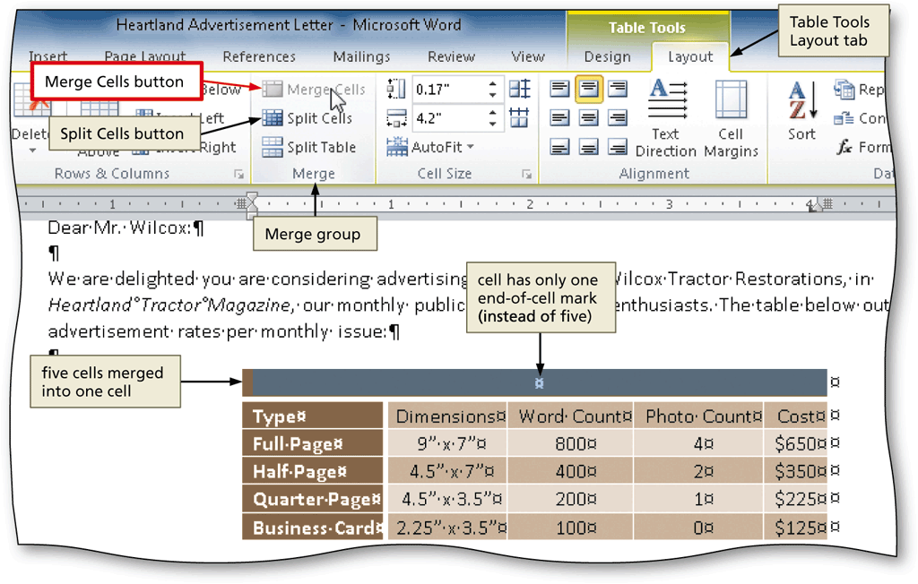
Merging Cells
With the cells to merge selected, click the Merge Cells button on the Table Tools Layout tab to merge the cells into one cell

Slide 61
Bulleting a List as You Type
Press the ASTERISK key (*) as the first character on the line
Press the SPACEBAR to convert the asterisk to a bullet character
Type the text for the list item
Press the ENTER key to place another bullet character at the beginning of the next line
Repeat the previous two steps for the remainder of the list
After typing the last list item, press the ENTER key two times to turn off automatic bullets as you type

Slide 62
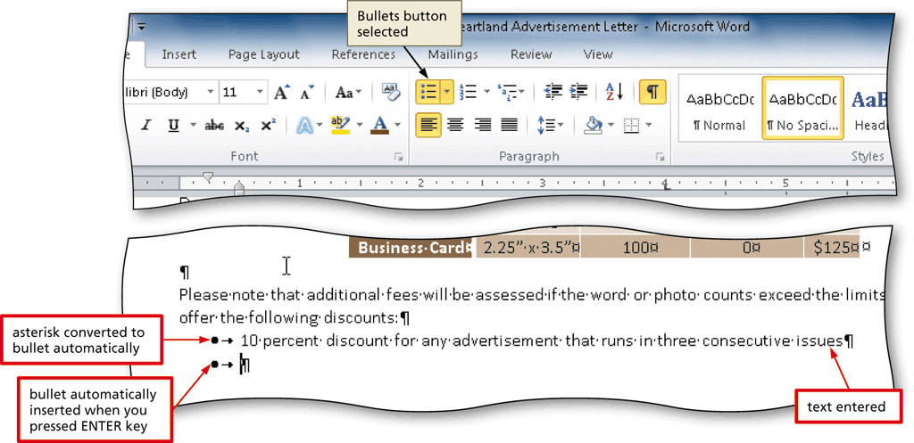
Bulleting a List as You Type

Slide 63
Addressing and Printing Envelopes
Drag through the address in the letter to select it
Display the Mailings tab
Click the Create Envelopes button to display the Envelopes and Labels dialog box
If necessary, click the Envelopes tab
Insert an envelope in your printer
Click the Print button to print the envelope

Slide 64
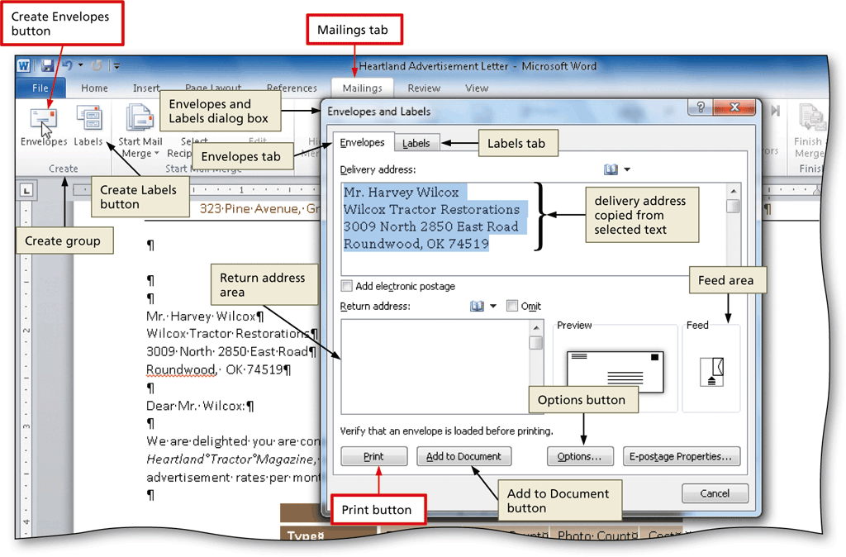
Addressing and Printing Envelopes

Slide 65
Chapter Summary
Change margins
Insert and format a shape
Change text wrapping
Insert and format a clip art image
Insert a symbol
Add a border to a paragraph
Clear formatting
Convert a hyperlink to regular text

Slide 66
Chapter Summary
Create a file from an existing file
Apply a Quick Style
Set and use tab stops
Insert the current date
Create, insert, and modify a building block
Insert a Word table, enter data in the table, and format the table
Address and print an envelope

Slide 67
Microsoft
Word 2010
Chapter 3 Complete

