Slide 1
Excel Ch 3: Final touches
Chapters Ex 3

Slide 2
Instructions:
Select:
  A2:B8, background color purple; font color white
  A10:I10; font size 36, font color Trebuchet MS
  A13: , background color purple; font color white
  Use Format painter: A15, A17; A25:J25

Slide 3
Pie Chart:
Highlight A12:G12
AND
A25:G25
Select 3Dim pie graph:
  Write Month and % outside graph:
    Right click and select Data Labels
Select a wedge by clicking twice
  Right click and select Data Points
Rotation

Slide 4
Sensitivity Analysis:
What-If analysis
What will happen to the Total operating income, IF
  Commission % = 6%

Slide 5
Goal Seek:
I like to have a Total Operating Income of
R 3 000 000
What factors can I change to ACHIEVE this GOAL?

Slide 6
Interest Rates:
The interest rate is the profit over time due to financial instruments.
In a loan structure whatsoever, the interest rate is the difference (in percentage) between money paid back and money got earlier, keeping into account the amount of time that elapsed. If you were given 100$ and you give back 120$ after a year, the interest rate you paid was 20% a year.
http://www.economicswebinstitute.org
www.wikinvest.com

Slide 7
Problem:
You ‘make’ a loan of R 1 000 000
The bank agrees to assist you on the following terms:
  Interest rate of 8% pa, compounded monthly
  Term of 20 Years
What is your monthly instalment?
What is the Total money and Interest you paid back over this loan period of 20 years?

Slide 8
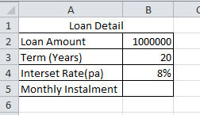
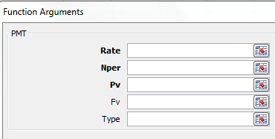

Slide 9
Amortization:
An amortization schedule is a record of your loan or mortgage payments, showing, payment number, payment date, payment amount (and a breakdown of how much is principal and how much is interest) and the balance owing after that payment has been made
www.investopedia.com

Slide 10

Problem:
Draw-up an Amortization Schedule for the above loan:
  Starting at 1 June 2016

