Slide 1
Chapter 2
Investigating System Requirements
Introduction
Typical Problem
Modeling: Activity Diagram

Slide 2
Outcomes:
The importance of building models. Can the builder build the house without house plans?
The need to ask probing questions during the interview process. Going deep with probing questions to really understand the user's needs.
Understand the business process and to develop an activity diagram: the documentation is done by using a model.

Slide 3
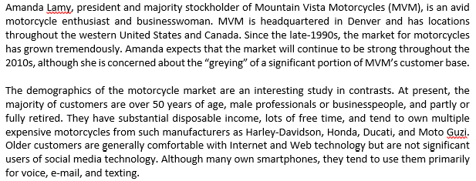

Slide 4
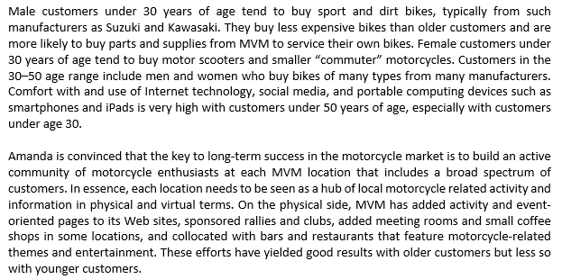

Slide 5
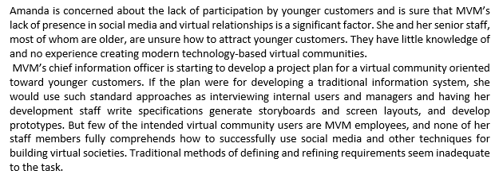

Slide 6
Reflect on story/narrative:
What is Amanda’s problem?
Does she need an IS?
Can we assist her?
How are we going to do it?

Slide 7
Identifying Needs and Establishing
Requirements

Slide 8
Introduction
System analysis and design deal with planning the development of information systems:
  understanding and specifying in detail what a system should do and how the components of the system should be implemented and work together.
System analysts solve business problems through analysing the requirements of information systems and designing such systems by applying analysis and design techniques.

Slide 9
What are requirements?
A requirement is a statement about an intended product that specifies what it should do or how it should perform.
Goal: To make it as specific, unambiguous, and clear as possible.

Slide 10
Why do we need Requirements?
When 38 IT professionals in the UK were asked about which project stages caused failure, respondents mentioned “requirements definition” more than any other phase.

Slide 11
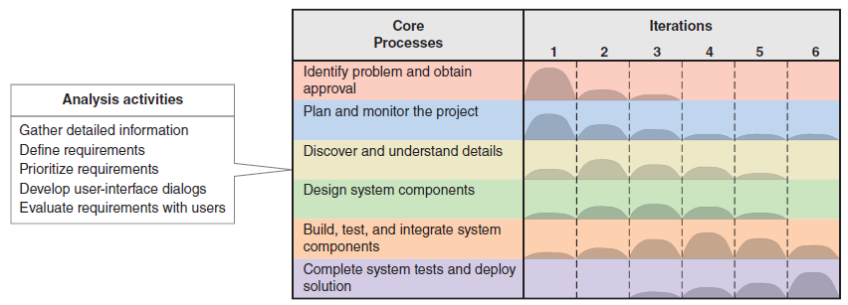
Systems Analysis Activities
Involve discovery and understanding

Slide 12
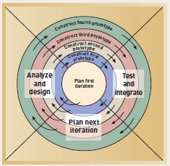
Spiral Model: adaptive approach

Slide 13
What Are Requirements?
System Requirements =
  Functional requirements
  Non-functional requirements
Functional Requirements
  the activities the system must perform or support and the constraints that the new system must meet.
Non-Functional Requirements
  other system characteristics it must perform or support

Slide 14
FURPS+ Requirements Acronym
Functional requirements
Usability requirements
Reliability requirements
Performance requirements
Security requirements
+ even more categories…

Slide 15
FURPS+ Requirements Acronym

Slide 16
Data Gathering Techniques
Questionnaires: Series of questions designed to elicit specific information from client. The questions may require different kinds of answers: some require a simple Yes/No, others ask us to choose from a set of pre-supplied answers.
Interviews: Interviews involve asking someone a set of questions. Often interviews are face-to-face, but they don’t have to be (more on next page).

Slide 17
Data Gathering Techniques (continued)
Interviews:
  Forum for talking to people
  Structured, unstructured or semi-structured
  Props, e.g. sample scenarios of use,
  prototypes, can be used in interviews
  Good for exploring issues
  But are time consuming and may be
  infeasible to visit everyone

Slide 18
Data-gathering techniques
Focus groups and workshops: Interviews tend to be one on one, and elicit only one person’s perspective. It can be very revealing to get a group of stakeholders together to discuss issues and requirements.
Naturalistic Observation: It can be very difficult for humans to explain what they do or to even describe accurately how they achieve a task. (more on next page)

Slide 19
Data-gathering Techniques (continued)
Naturalistic observation:
  Spend time with stakeholders in their day-to-day tasks, observing work as it happens
  Gain insights into stakeholders’ tasks
  Good for understanding the nature and
  context of the tasks
  But, it requires time and commitment
  from a member of the design team, and
  it can result in a huge amount of data

Slide 20
Data-gathering Techniques
Studying documentation: Procedures and rules are often written down in a manual and these are a good source of data about the steps involved in an activity and any regulations governing a task.
Use All of the above In Combination : Constraints of Time and Money

Slide 21
Summary: Information Gathering Techniques
Interviewing users and other stakeholders
Distributing and collecting questionnaires
Reviewing inputs, outputs, and documentation
Observing and documenting business procedures
Researching vendor solutions
Collecting active user comments and suggestions

Slide 22
Caution:
It’s difficult to show that a set of requirements does in fact meet a user’s need. Because users need to use the system in operation and imagine how that system would fit into their work.
So, it’s inevitable that there will be further requirements changes.

Slide 23
Themes for Information Gathering Questions

Slide 24
Business Processes:
Understand the current system, BUT which of these functions are fundamental: which will remain or eliminated with a new system
Example: check a customer’s credit rating when they placed an order
New system: system will check automatically.
It is still a system requirement: method is changing

Slide 25
How are the buss processes performed?
Usually start with current system and gradually moves to new system
As an analyst you must assist the user to realise there are more efficient approaches. Maybe using new technologies

Slide 26
What info is needed?
Formal to informal
Ask about exceptions
Unusual situations
DETAIL is the watchword!!

Slide 27
Question Types
Open-ended questions:
  “How do you do this function?”. Encourage discussion and explanation
Closed-ended questions:
  “How many forms a day do you process?”. Are used to get specific facts.

Slide 28
What are we busy with?
Busy building a narrative describing all the system requirements
This link to the business processes.
Then we document it ito a model
UML2:

Slide 29
What is UML
Stands for Unified Modeling Language
standard language:
to specify, visualize, construct, and document the artifacts of software systems, as well as other non-software systems.
very important part of object oriented software development process.
uses graphical notations to express the design of software projects.

Slide 30
Documenting Workflows with Activity Diagrams
Workflow– sequence of processing steps that completely handles one business transaction or customer request
Activity Diagram– describes user (or system) activities, the person who does each activity, and the sequential flow of these activities
  Useful for showing a graphical model of a workflow
  A UML diagram

Slide 31
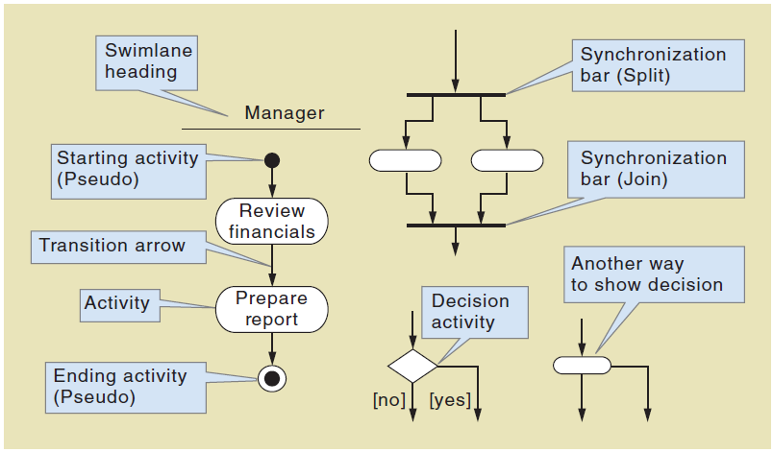
Activity Diagrams Symbols

Slide 32
Homework:
List and briefly describe the six information gathering techniques
Interview questions for Amy of MVM:
  Two open-ended questions
  Two closed-ended questions
It is like MVM need customer input for the new system? How can we involve customers in the process? How can we interest them in participating? Can we get everyone involved?

Slide 33
Visit Website:
http://adage.com/article/digitalnext/teach-employees-social-tech-skills/297287/

Slide 34
Next week:
Read chapter 2
  Focus on our case study RMO: will give you a better understanding of requirement analysis
  System analysis activities
  Requirements
  Models
  Stakeholders
  Info-gathering techniques
  I will introduce the activity diagram

