Slide 1
Microsoft
Word 2010
Chapter 2
Creating a Research Paper with Citations
and References

Slide 2
Objectives
Describe the MLA documentation style for research papers
Change line and paragraph spacing in a document
Modify a style
Use a header to number pages of a document
Apply formatting using shortcut keys
Modify paragraph indentation
Insert and edit citations and their sources

Slide 3
Objectives
Add a footnote to a document
Insert a manual page break
Create a bibliographical list of sources
Cut, copy, and paste text
Find text and replace text
Find a synonym
Use the Research task pane to look up information

Slide 4
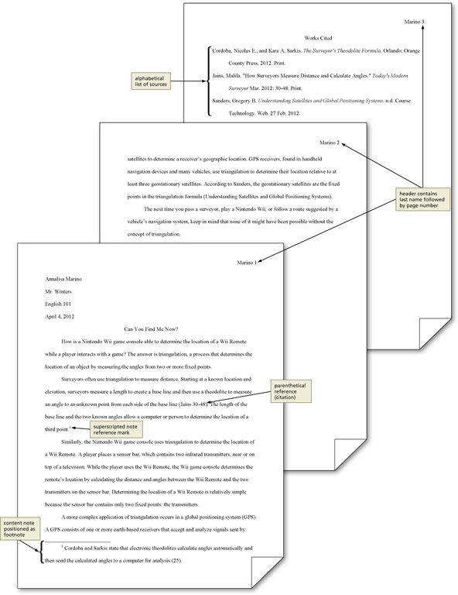
Project – Research Paper

Slide 5
General Project Guidelines
Select a topic
Research the topic and take notes
Organize your ideas
Write the first draft, referencing sources
Create the list of sources
Proofread and revise the paper

Slide 6
Modifying a Style
Right-click the style to modify in the Quick Style gallery (Home tab | Styles group) to display a shortcut menu related to styles
Click Modify on the shortcut menu to display the Modify Style dialog box
Make the desired changes to the style in the Modify Style dialog box, and then click the OK button to update the style

Slide 7
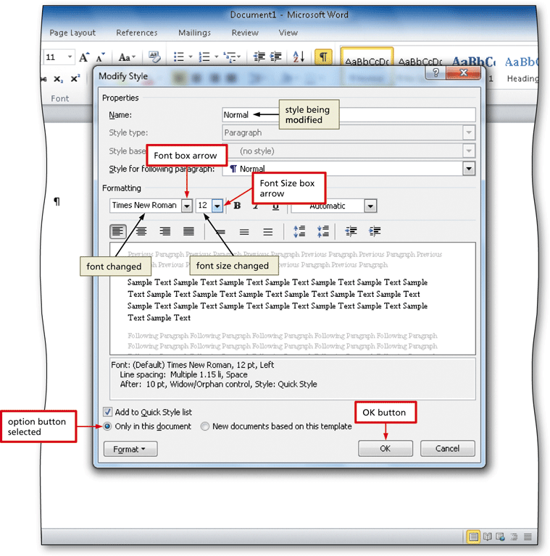
Modifying a Style

Slide 8
Changing Line Spacing
Click the Line and Paragraph Spacing button (Home tab | Paragraph group) to display the Line and Paragraph Spacing gallery
Click the desired setting in the Line and Paragraph Spacing gallery to change the line spacing at the location of the insertion point

Slide 9
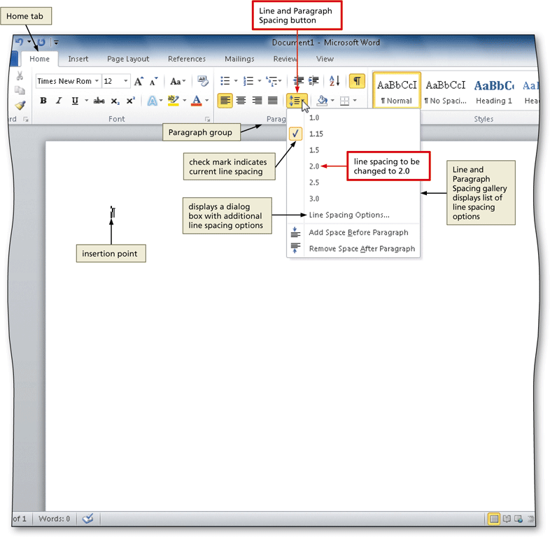
Changing Line Spacing

Slide 10
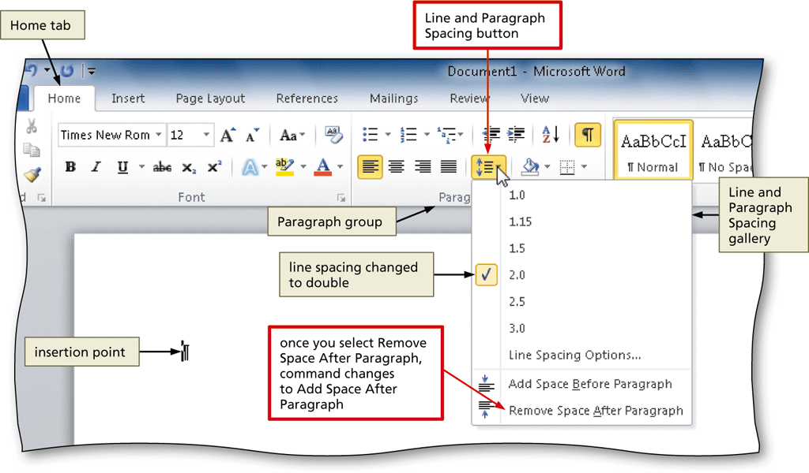
Removing Space after a Paragraph
Click the Line and Paragraph Spacing button (Home tab | Paragraph group) to display the Line and Paragraph Spacing gallery
Click Remove Space After Paragraph in the Line and Paragraph Spacing gallery so that no blank space appears after paragraphs

Slide 11
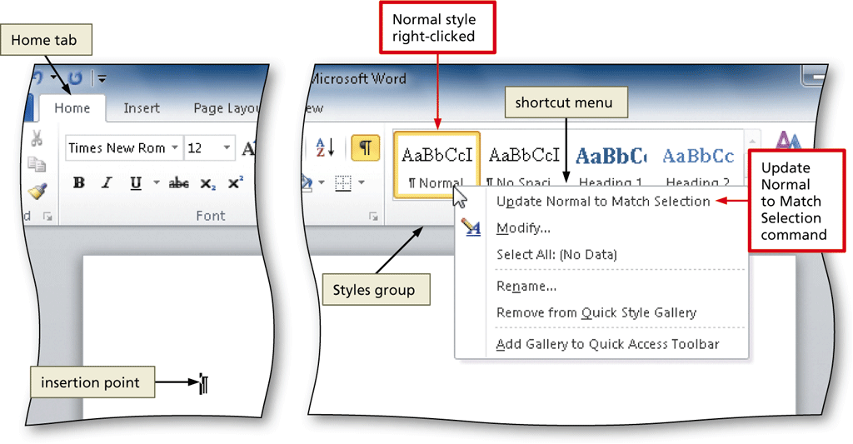
Updating a Style to Match a Selection
Right-click Normal in the Quick Style gallery (Home tab | Styles group) to display a shortcut menu
Click Update Normal to Match Selection on the shortcut menu to update the selected (or current) style to reflect the settings at the location of the insertion point

Slide 12
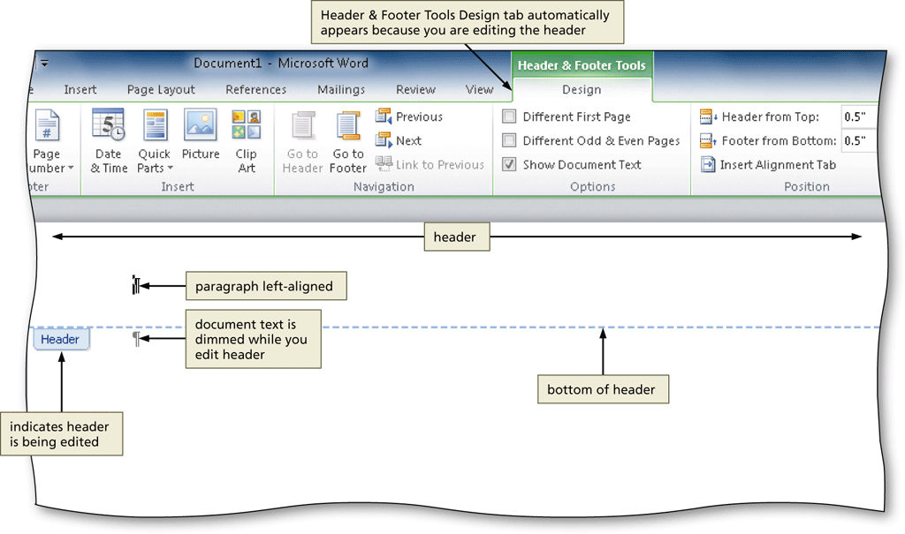
Switching to the Header
Click Insert on the Ribbon to display the Insert tab
Click the Header button (Insert tab | Header & Footer group) to display the Header gallery
Click Edit Header in the Header gallery to switch from the document text to the header, which allows you to edit the contents of the header

Slide 13
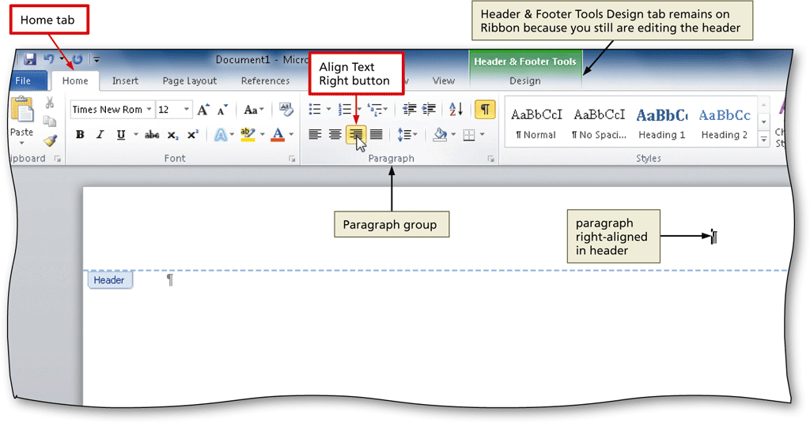
Right-Aligning a Paragraph
Click Home on the Ribbon to display the Home tab
Click the Align Text Right button (Home tab | Paragraph group) to right-align the current paragraph

Slide 14
Inserting a Page Number
Click the Insert Page Number button (Header & Footer Tools Design tab | Header & Footer group) to display the Insert Page Number
Point to the position at which you want to insert the page number, and then select the desired style in the gallery

Slide 15
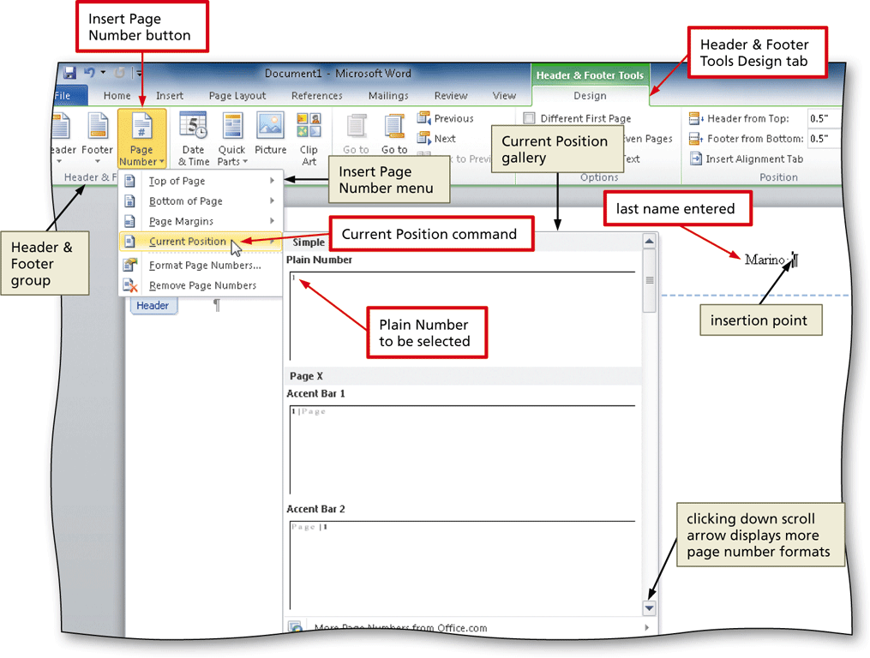
Inserting a Page Number

Slide 16
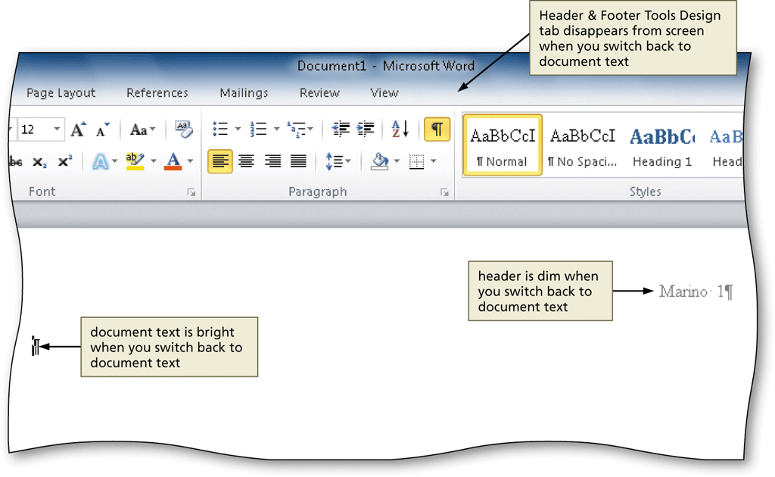
Closing the Header
Click the Close Header and Footer button (Header & Footer Tools Design tab | Close group) to close the header and switch back to the document text

Slide 17
Click and Type
Position the mouse pointer in the location where you want to type, in the center of the document window until a center icon appears below the I-beam
Double-click to center the paragraph and mark the insertion point between the left and right margins
Type the desired text and then press the ENTER key to position the insertion point on the next line

Slide 18
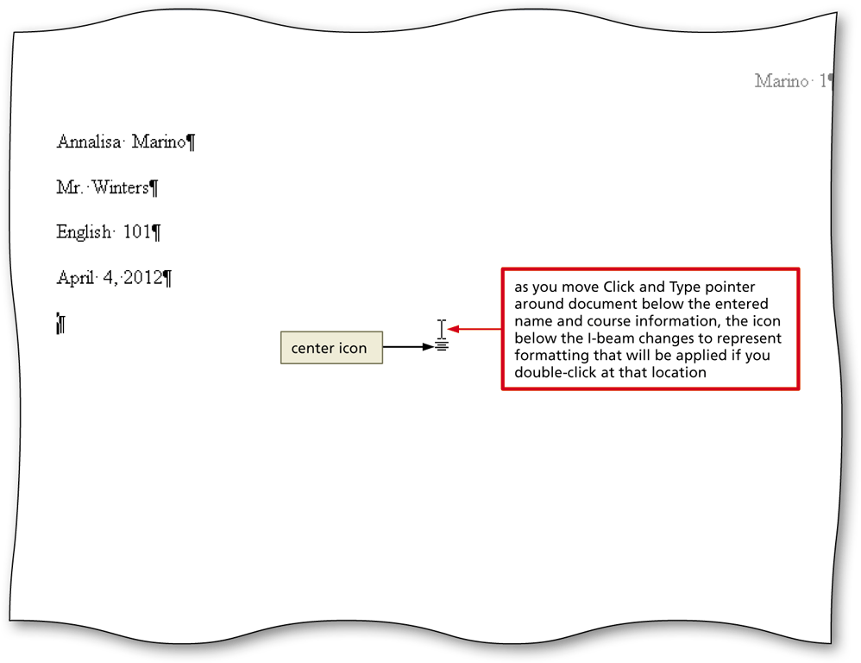
Click and Type

Slide 19
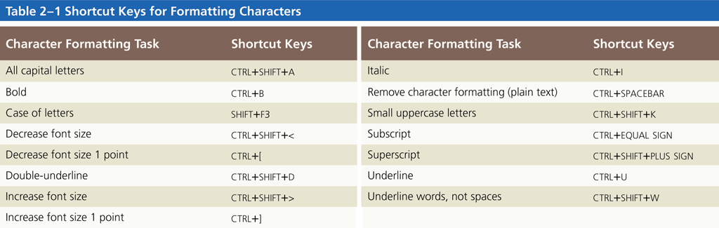
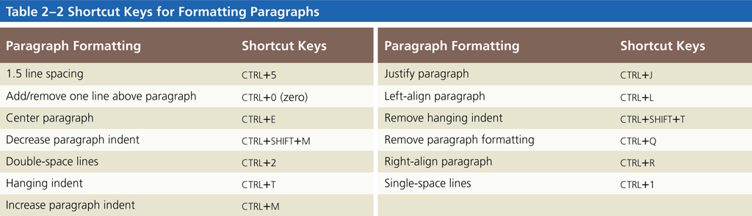
Shortcut Keys

Slide 20
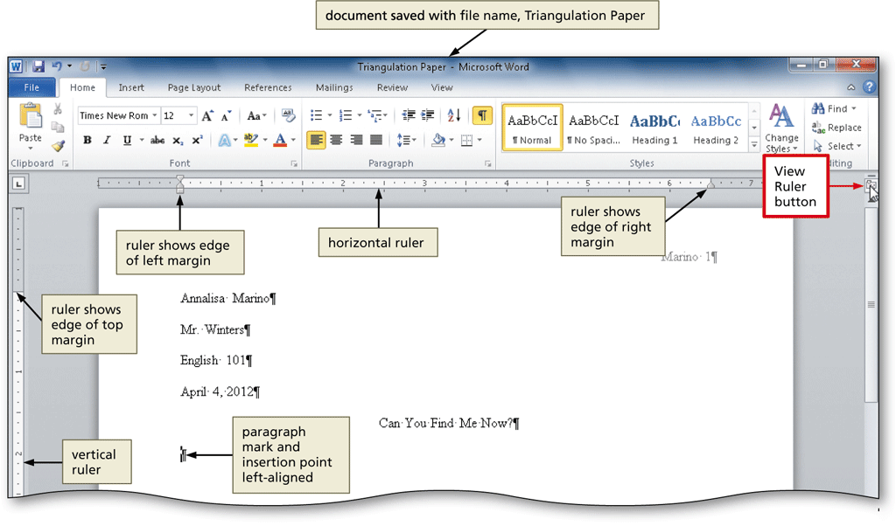
Displaying the Rulers
If the rulers are not displayed, click the View Ruler button on the vertical scroll bar to display the horizontal and vertical rulers on the screen

Slide 21
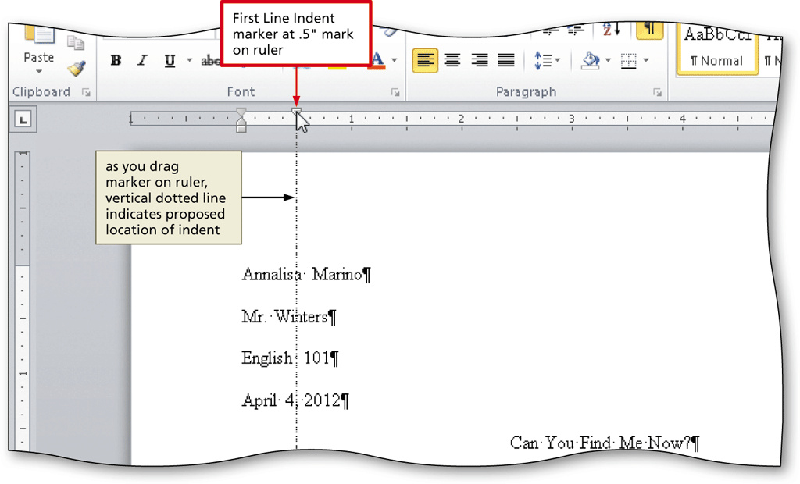
First-Line Indenting Paragraphs
With the insertion point in the paragraph to be indented, drag the First Line Indent marker to the desired location on the ruler to set the location for the first-line indent

Slide 22
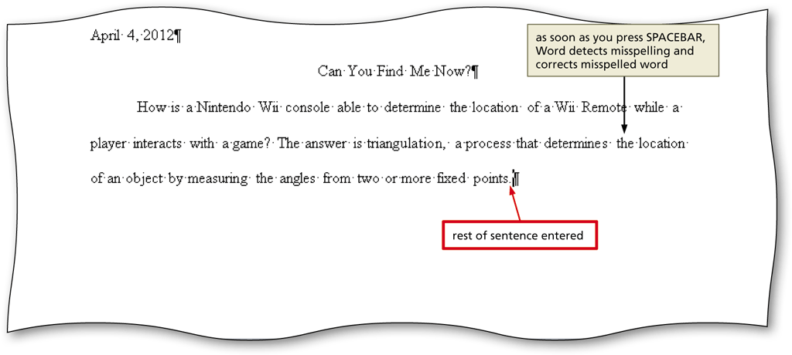
AutoCorrecting as You Type
Word provides an AutoCorrect feature that automatically corrects certain typing, spelling, capitalization, or grammar errors as you type a document

Slide 23
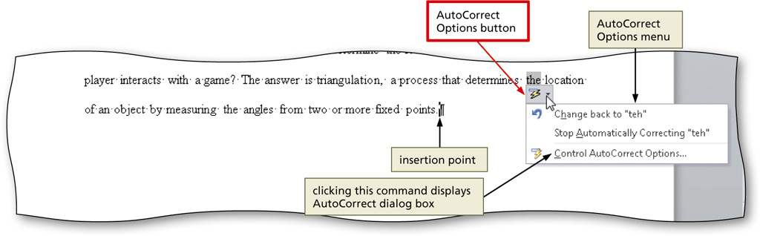
Using the AutoCorrect Options Button
Position the mouse pointer in the text automatically corrected by Word to display a small blue box below the automatically corrected word
Point to the small blue box to display the AutoCorrect Options button
Click the AutoCorrect Options button to display the AutoCorrect Options menu
Press the ESCAPE key to remove the AutoCorrect Options menu from the screen

Slide 24
Creating an AutoCorrect Entry
Click File on the Ribbon to open the Backstage view
Click Options in the Backstage view to display the Word Options dialog box
Click Proofing in the left pane to display proofing options in the right pane
Click the AutoCorrect Options button in the right pane to display the AutoCorrect dialog box
When Word displays the AutoCorrect dialog box, type the word you want to replace in the Replace text box, and the word to replace with in the With text box
Click the Add button
Click the OK button
Click the OK button

Slide 25
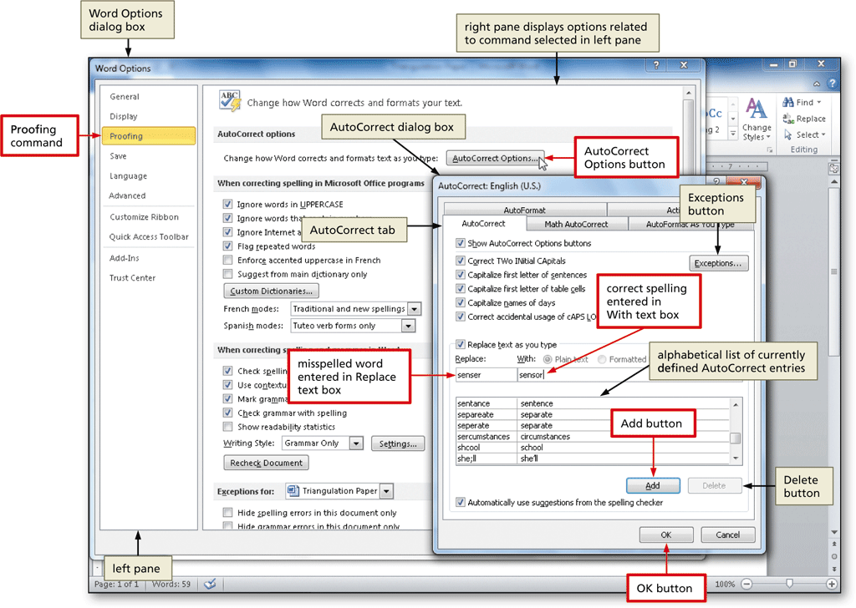
Creating an AutoCorrect Entry

Slide 26
Changing the Bibliography Style
Click References on the Ribbon to display the References tab
Click the Bibliography Style box arrow (References tab | Citations & Bibliography group) to display a gallery of predefined documentation styles
Click the desired style in the Bibliography Style gallery to change the documentation style

Slide 27
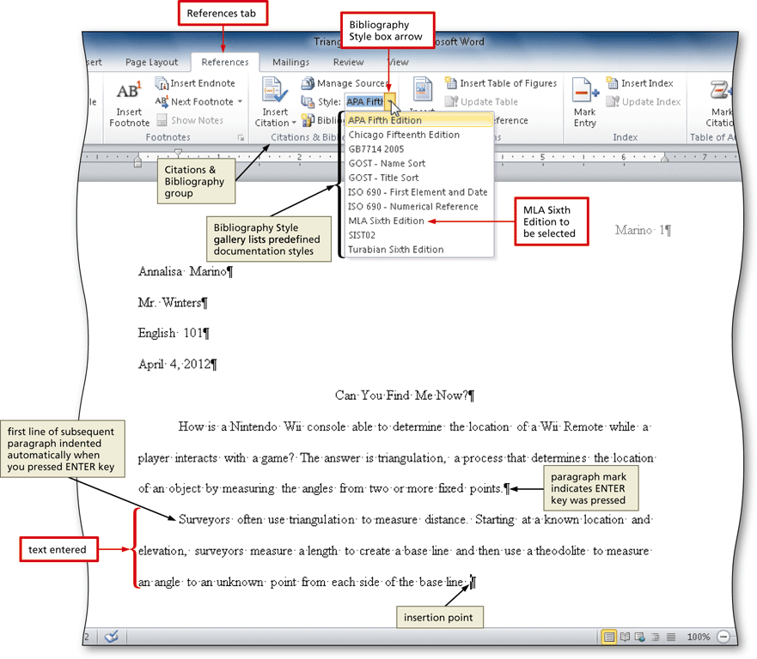
Changing the Bibliography Style

Slide 28
Inserting a Citation and Creating Its Source
Click the Insert Citation button (References tab | Citations & Bibliography group) to display the Insert Citation menu
Click Add New Source on the Insert Citation menu to display the Create Source dialog box
Click the Type of Source box arrow, and then click the type of source you are adding
Type the source information in the appropriate text boxes, and then click the OK button to insert the citation in the document at the location of the insertion point

Slide 29
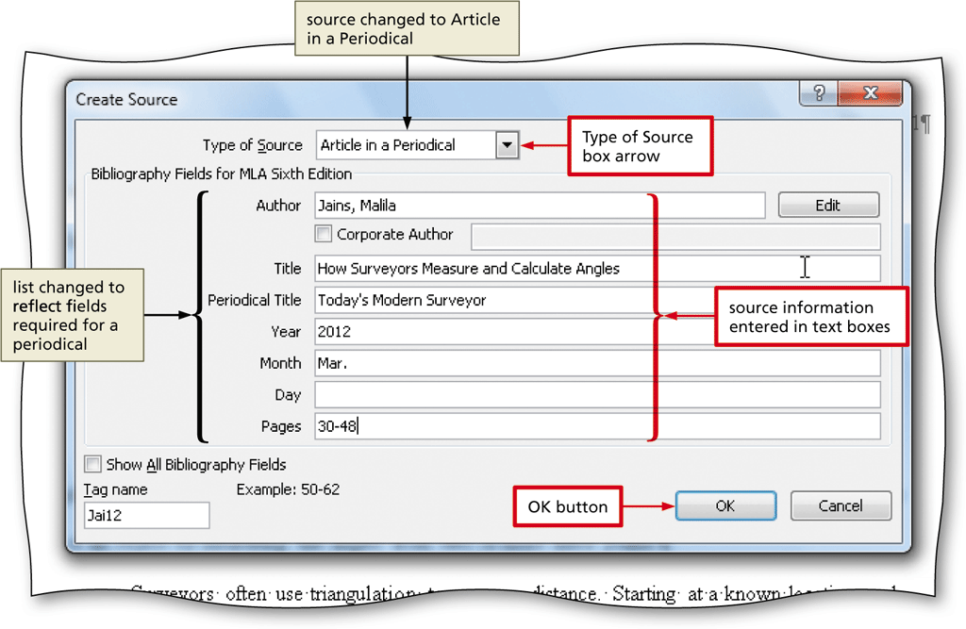
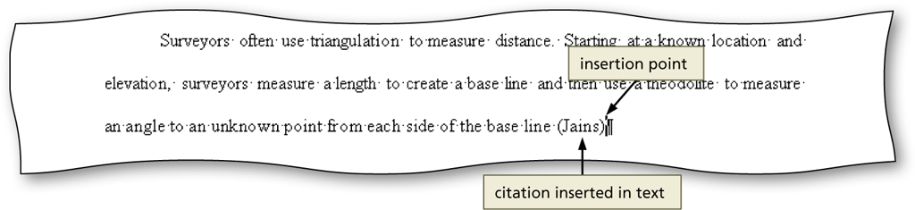
Inserting a Citation and Creating Its Source

Slide 30
Editing a Citation
Click somewhere in the citation to be edited, which selects the citation and displays the Citation Options box arrow
Click the Citation Options box arrow to display the Citation Options menu
Click Edit Citation on the Citation Options menu to display the Edit Citation dialog box
Change the information as necessary in the Edit Citation dialog box, and then click the OK button

Slide 31
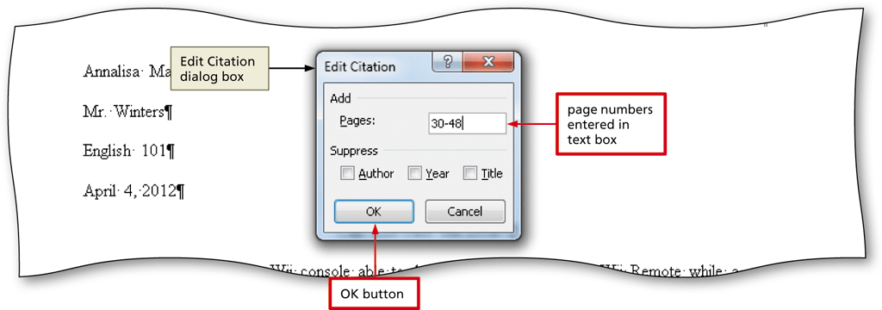
Editing a Citation

Slide 32
Inserting a Footnote Reference Mark
Click the Insert Footnote button (References tab | Footnotes group) to display a note reference mark (a superscripted 1) in two places: (1) in the document window at the location of the insertion point and (2) at the bottom of the page where the footnote will be positioned, just below a separator line
Type the footnote text

Slide 33
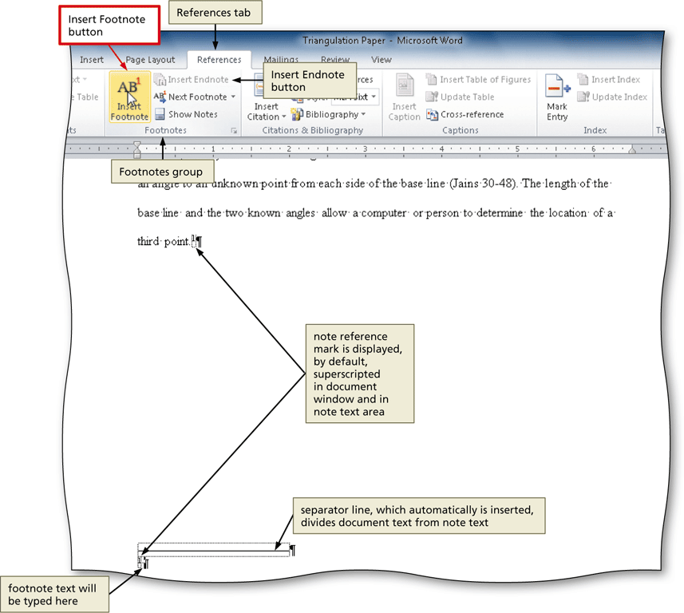
Inserting a Footnote Reference Mark

Slide 34
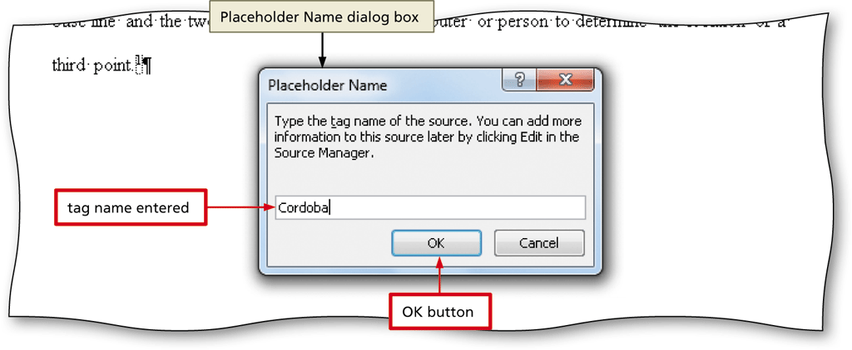
Inserting a Citation Placeholder
Click the Insert Citation button (References tab | Citations & Bibliography group) to display the Insert Citation menu
Click Add New Placeholder on the Insert Citation menu to display the Placeholder Name dialog box
Click the placeholder name, and then click the OK button

Slide 35
Editing a Source
Click somewhere in the citation placeholder to be edited to select the citation placeholder
Click the Citation Options box arrow to display the Citation Options menu
Click Edit Source on the Citation Options menu to display the Edit Source dialog box
If necessary, click the Type of Source box arrow and then select the type of source
Enter the source information, and then click the OK button

Slide 36
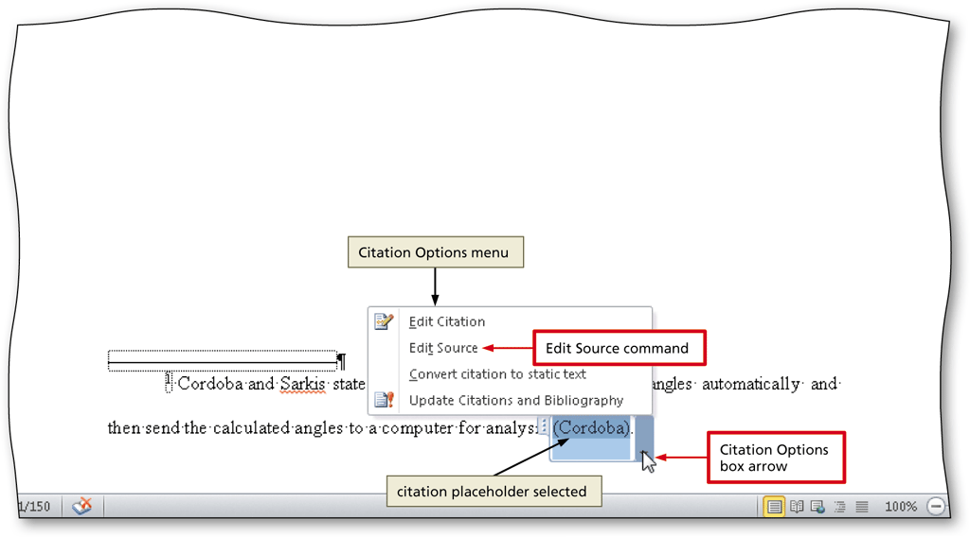
Editing a Source

Slide 37
Counting Words
Click the Word Count indicator on the status bar to display the Word Count dialog box
If necessary, place a check mark in the ‘Include textboxes, footnotes and endnotes’ check box
Click the Close button to close the dialog box

Slide 38
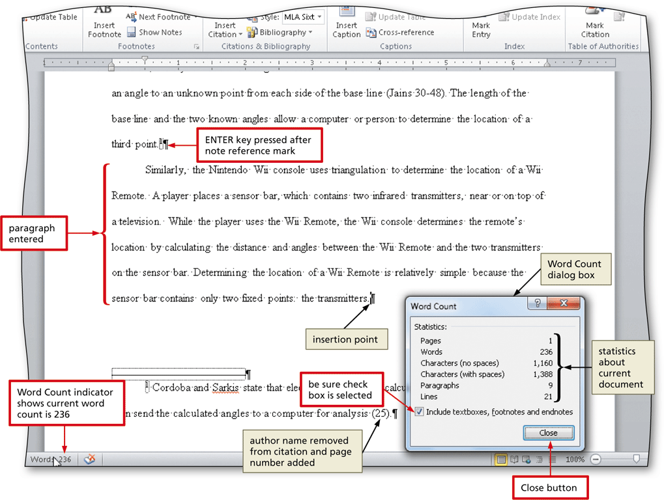
Counting Words

Slide 39
Page Breaking Manually
Position the insertion point where you wish to insert the page break
Click Insert on the Ribbon to display the Insert tab
Click the Page Break button (Insert tab | Pages group) to insert a manual page break immediately to the left of the insertion point and position the insertion point immediately below the manual page break

Slide 40
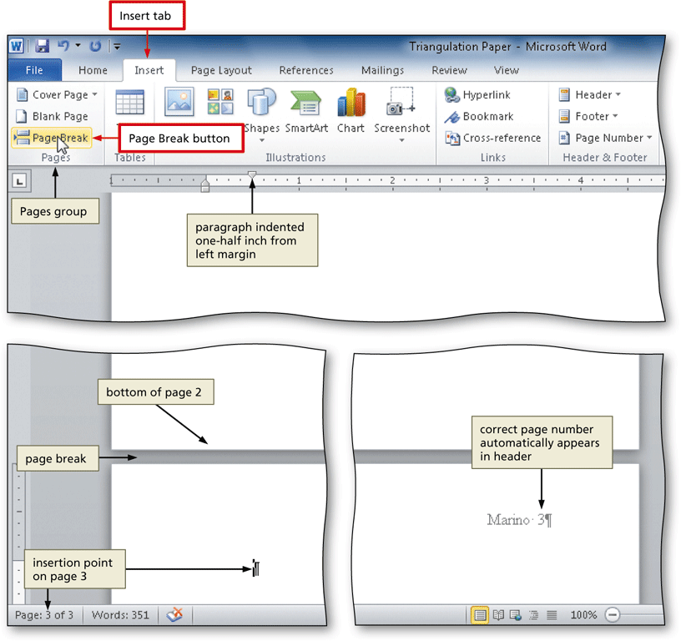
Page Breaking Manually

Slide 41
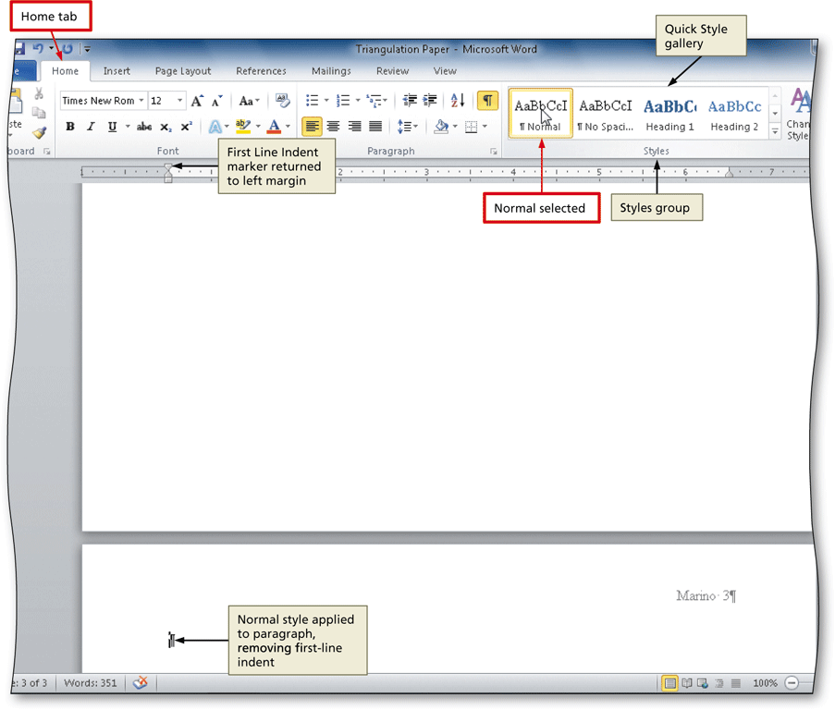
Applying a Style
Click Home on the Ribbon to display the Home tab
With the insertion point in the paragraph to be modified, click the desired style in the Styles gallery

Slide 42
Creating a Bibliographical List
Click References on the Ribbon to display the References tab
With the insertion point positioned where the bibliographical list is to be inserted, click the Bibliography button to display the Bibliography gallery
Click Insert Bibliography in the Bibliography gallery to insert a list of sources at the location of the insertion point

Slide 43
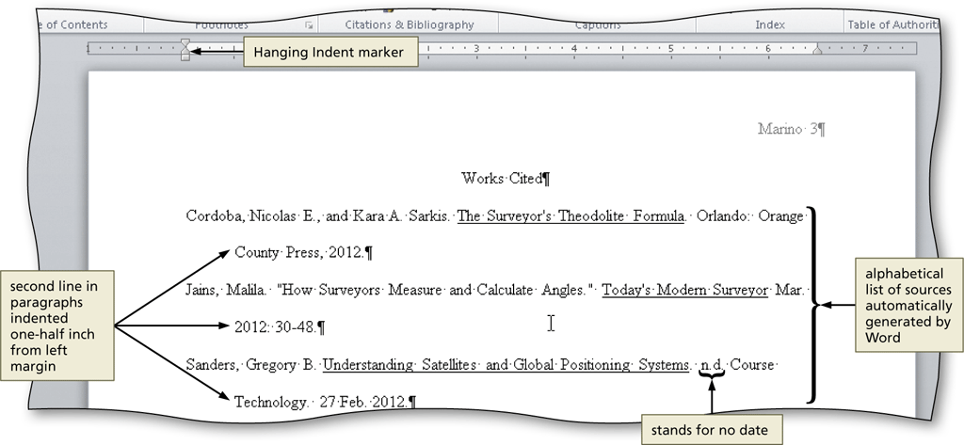
Creating a Bibliographical List

Slide 44
Modifying a Source and Updating the Bibliographical List
Click the Manage Sources button (References tab | Citations & Bibliography group) to display the Source Manager dialog box
Click the source you wish to edit in the Current List
Click the Edit button to display the Edit Source dialog box
Make the desired changes to the source, and then click the OK button
If necessary, click Yes to update all occurrences of the source
Click the Close button to update the list of sources in the document and close the dialog box

Slide 45
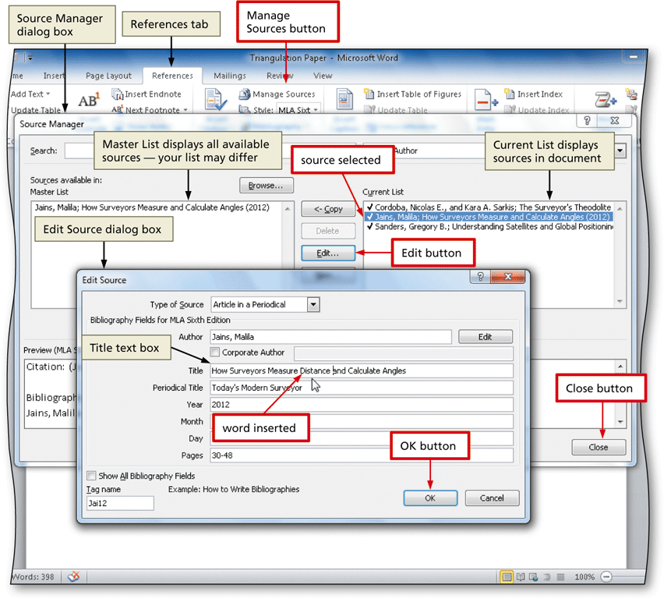
Modifying a Source and Updating the Bibliographical List

Slide 46
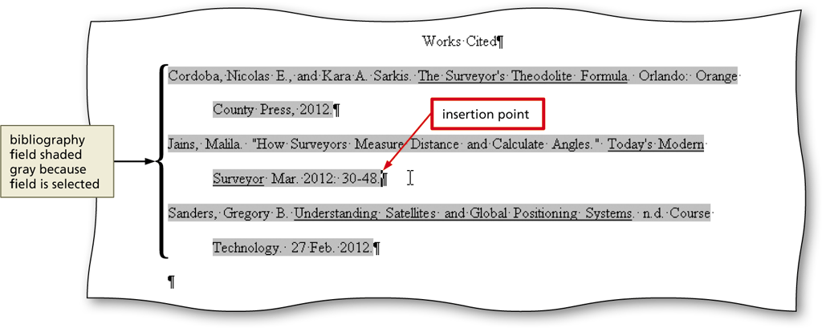
Converting a Field to Regular Text
Click somewhere in the field to select it
Press CTRL+SHIFT+F9 to convert the selected field to regular text

Slide 47
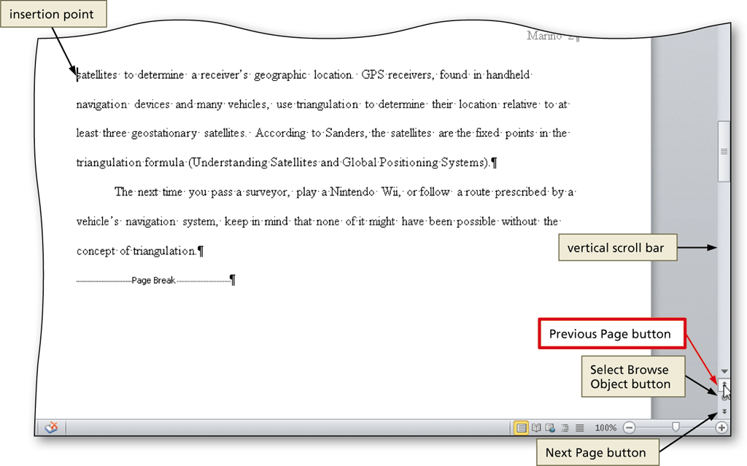
Scrolling Page by Page through a Document
Click the Previous Page button or Next Page button on the vertical scroll bar to scroll through the document

Slide 48
Copying and Pasting
Select the item to be copied
Click the Copy button (Home tab | Clipboard group) to copy the selected item in the document to the Office Clipboard
Position the insertion point at the location where the item should be pasted
Click the Paste button (Home tab | Clipboard group) to paste the copied item in the document at the location of the insertion point

Slide 49
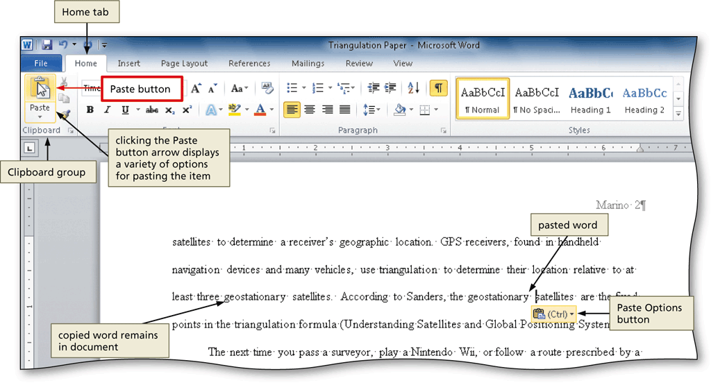
Copying and Pasting

Slide 50
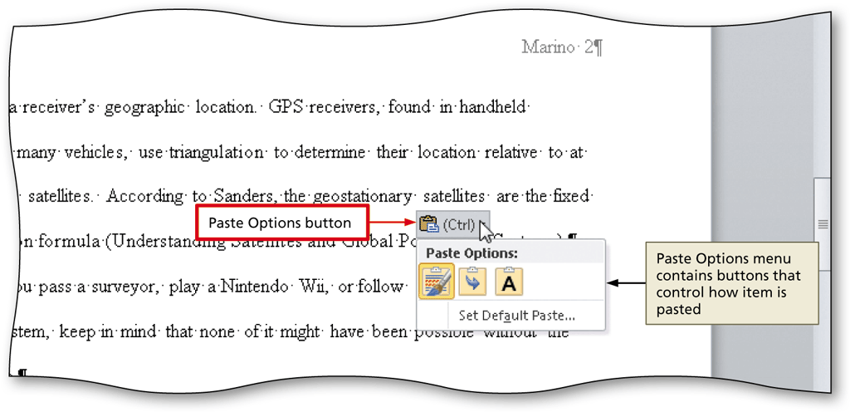
Displaying the Paste Options Menu
Immediately after pasting text, click the Paste Options button to display the Paste Options menu
Press the ESCAPE key to remove the Paste Options menu from the window

Slide 51
Finding Text
Click the Find button (Home tab | Editing group) to display the Navigation Pane
Type the text to find in the Navigation Pane text box to display all occurrences of the typed text, called the search text, in the Navigation Pane and to highlight the occurrences of the search text in the document window

Slide 52
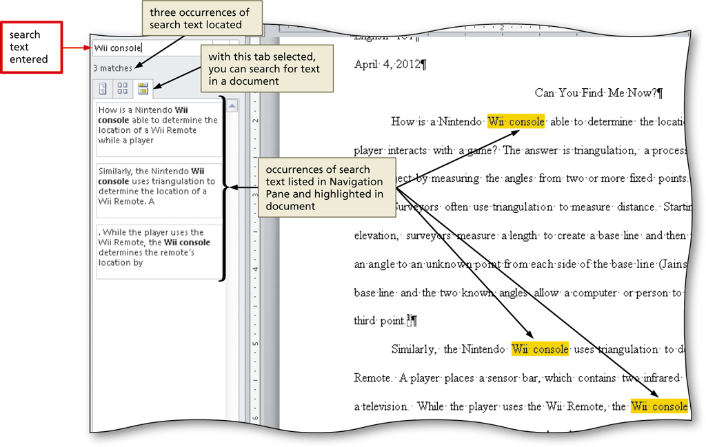
Finding Text

Slide 53
Replacing Text
Click the Replace button (Home tab | Editing group) to display the Replace sheet in the Find and Replace dialog box
Type the text to find in the Find what text box
Press the TAB key. Type the text to replace within the Replace with text box
Click the Replace All button to instruct Word to replace all occurrences of the Find what text with the Replace with text. If Word displays a dialog box asking if you want to continue searching from the beginning of the document, click the Yes button
Click the OK button
Click the Close button

Slide 54
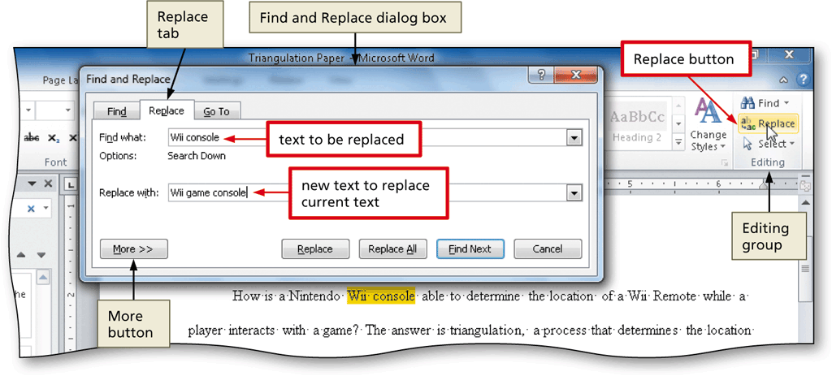
Replacing Text

Slide 55
Going to a Page
Click the ‘Browse the pages in your document’ tab in the Navigation Pane to display thumbnail images of the pages in the document
Click the thumbnail of the page you wish to display to display the top of the selected page in the top of the document window
Click the Close button in the Navigation Pane to close the pane

Slide 56
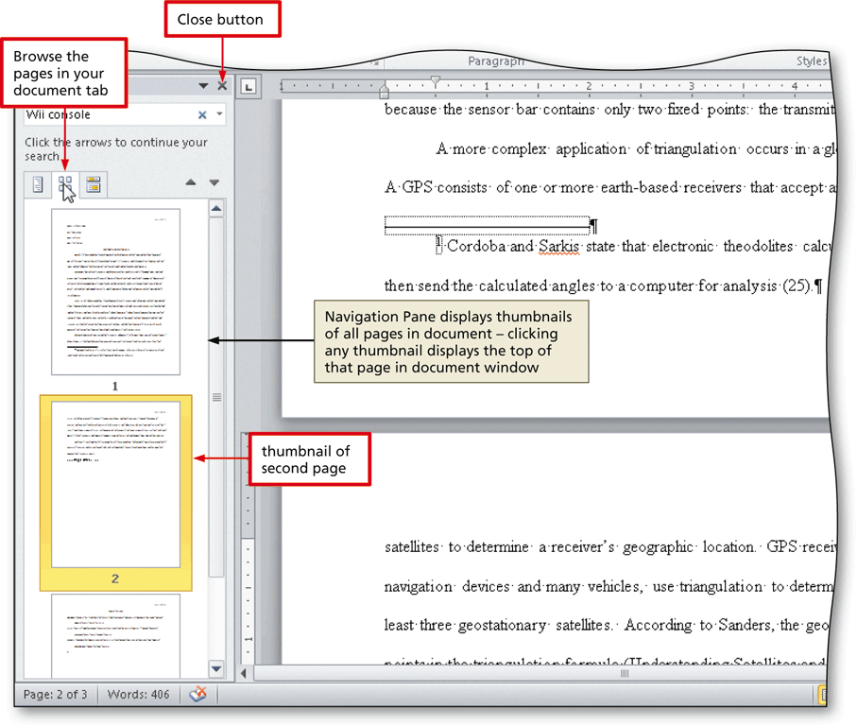
Going to a Page

Slide 57
Finding and Inserting a Synonym
Locate and then right-click the word for which you want to find a synonym to display a shortcut menu related to the word you right-clicked
Point to Synonyms on the shortcut menu to display a list of synonyms for the word you right-clicked
Click the synonym you want on the Synonyms submenu to replace the selected word in the document with the selected synonym

Slide 58
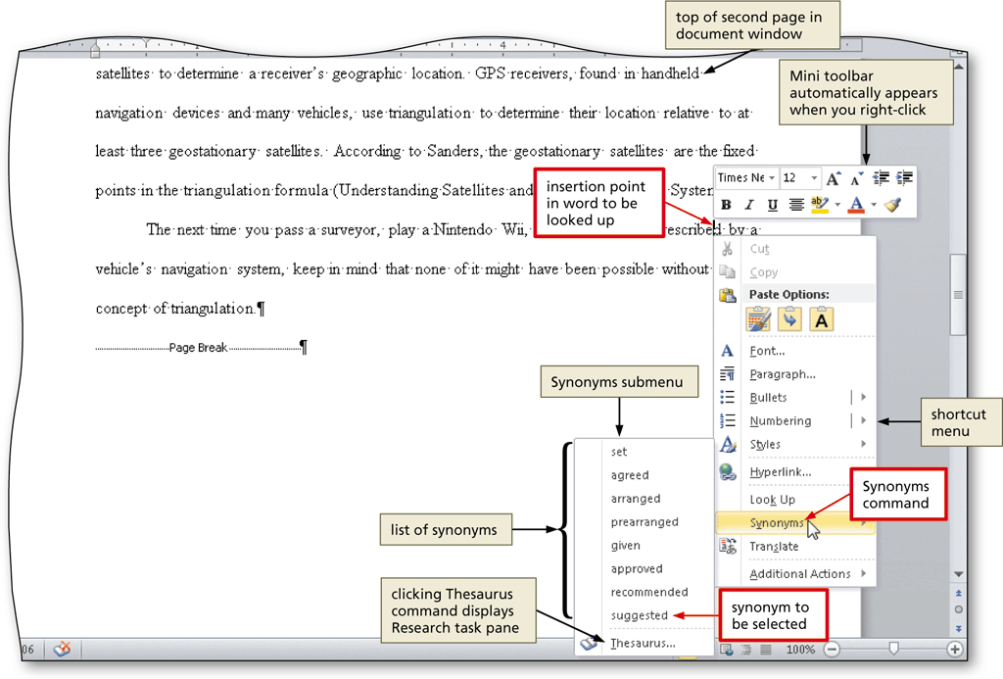
Finding and Inserting a Synonym

Slide 59
Checking Spelling and Grammar at Once
Press CTRL+HOME because you want the spelling and grammar check to begin from the top of the document
Click Review on the Ribbon to display the Review tab
Click the Spelling & Grammar button (Review tab | Proofing group) to begin the spelling and grammar check at the location of the insertion point, which in this case, is at the beginning of the document
Click the desired spelling in the Suggestions list
If items are found, click the desired selection

Slide 60
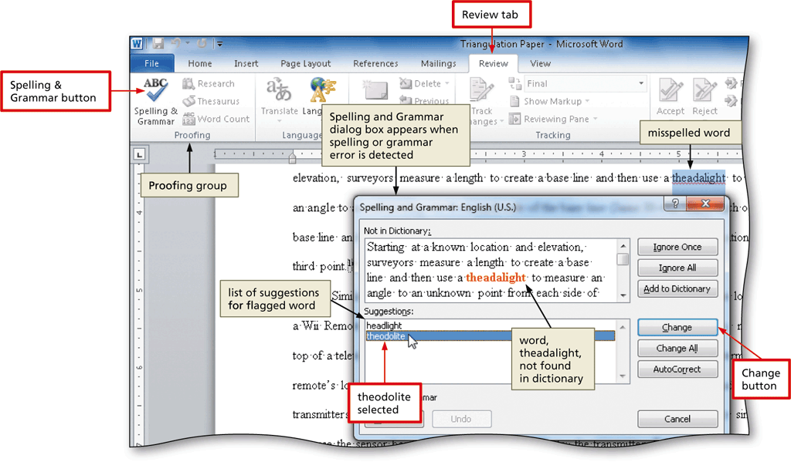
Checking Spelling and Grammar at Once

Slide 61
Using the Research Task Pane to Look Up Information
Locate the word you want to look up
While holding down the ALT key, click the word you want to look up to open the Research task pane and display a dictionary entry for the ALT+clicked word. Release the ALT key
Click the Search for box arrow in the Research task pane to display a list of search locations
Click the desired search location
Click the Close button in the Research task pane

Slide 62
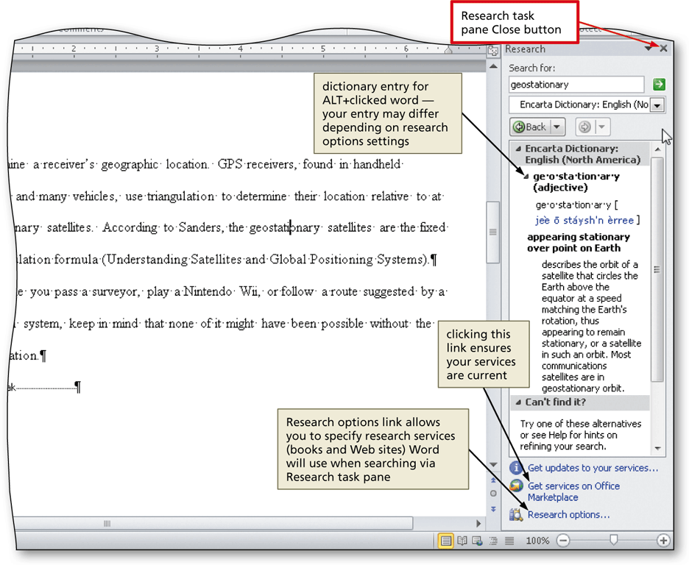
Using the Research Task Pane to Look Up Information

Slide 63
Printing Document Properties
Click File on the Ribbon to open the Backstage view and then click the Print tab in the Backstage view to display the Print gallery
Verify the printer name that appears on the Printer Status button will print a hard copy of the document. If necessary, click the Printer Status button to display a list of available printer options and then click the desired printer to change the currently selected printer
Click the first button in the Settings area to display a list of options specifying what you can print

Slide 64
Printing Document Properties
Click Document Properties in the list to specify you want to print the document properties instead of the actual document
Click the Print button in the Print gallery to print the document properties on the currently selected printer

Slide 65
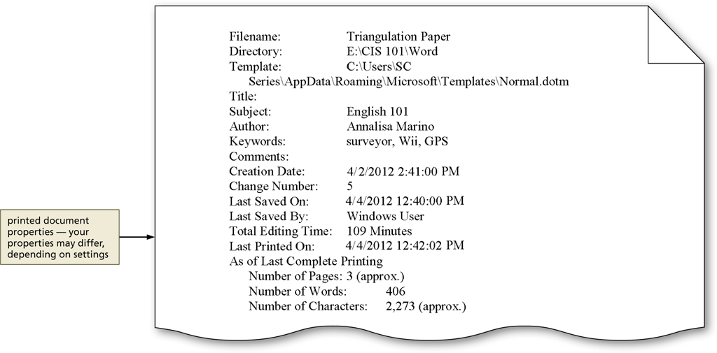
Printing Document Properties

Slide 66
Previewing the Document and Then Printing It
Position the insertion point at the top of the document because you want initially to view the first page in the document
Click File on the Ribbon to open the Backstage view and then click the Print tab in the Backstage view to display the Print gallery
Verify the printer name that appears on the Printer Status button will print a hard copy of the document. If necessary, select a different printer
Click the first button in the Settings area to display a list of options specifying what you can print

Slide 67
Previewing the Document and Then Printing It
Click Print All Pages in the list to specify you want to print all pages in the actual document
Click the Next Page button in the Print gallery to preview the next page of the document in the Print gallery
Click the Print button in the Print gallery to print the document on the currently selected printer

Slide 68
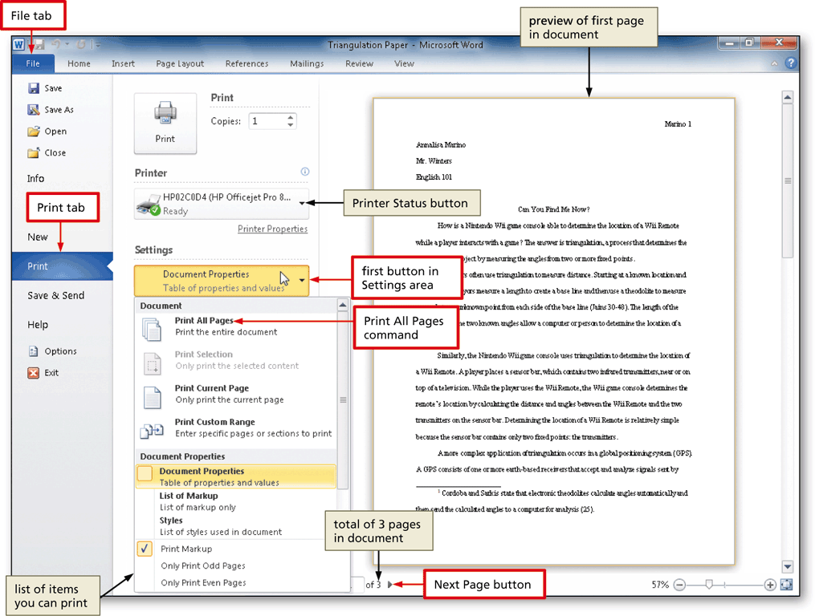
Previewing the Document and Then Printing It

Slide 69
Chapter Summary
Describe the MLA documentation style for research papers
Change line and paragraph spacing in a document
Modify a style
Use a header to number pages of a document
Apply formatting using shortcut keys
Modify paragraph indentation
Insert and edit citations and their sources

Slide 70
Chapter Summary
Add a footnote to a document
Insert a manual page break
Create a bibliographical list of sources
Cut, copy, and paste text
Find text and replace text
Find a synonym
Use the Research task pane to look up information

Slide 71
Microsoft
Word 2010
Chapter 2 Complete

