Slide 1
Analyzing the Business Case
“I give you a freedom putting your business case forward”

Slide 2
Objectives
Explain the concept of a business case and how a business case affects an IT project
Conduct a SWOT analysis and describe the four factors involved
Describe systems requests and the role of the systems review committee
Define operational, technical, economic, and schedule feasibility
Describe the steps and the end product of a preliminary investigation

Slide 3
Introduction
The term business case refers to the reasons, or justification, for a proposal
A strong business case suggests that the company should pursue the alternative, above other options, because it would be in the firm’s best interest to do so
Systems development typically starts with a systems request, followed by a preliminary investigation, which includes a feasibility study

Slide 4
What is a business case?
Why are we doing this project?
What is the project about?
How does this solution address key business issues?
How much will it cost and how long will it take?
What are the risks of ‘doing/not doing’ the project?
How will we measure success?

Slide 5
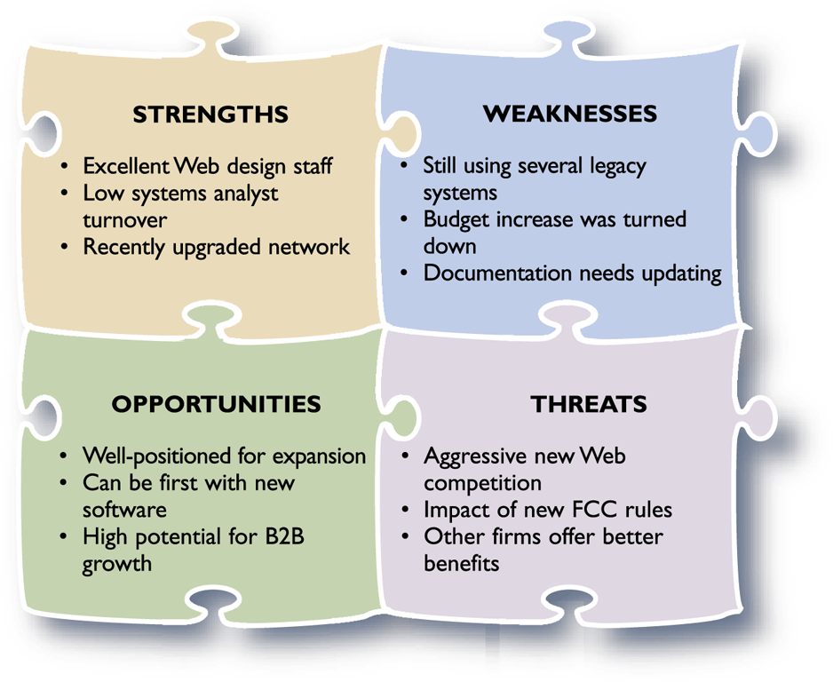
Strategic Planning – A Framework for IT Systems Development
Strategic Planning Overview
  SWOT analysis

Slide 6
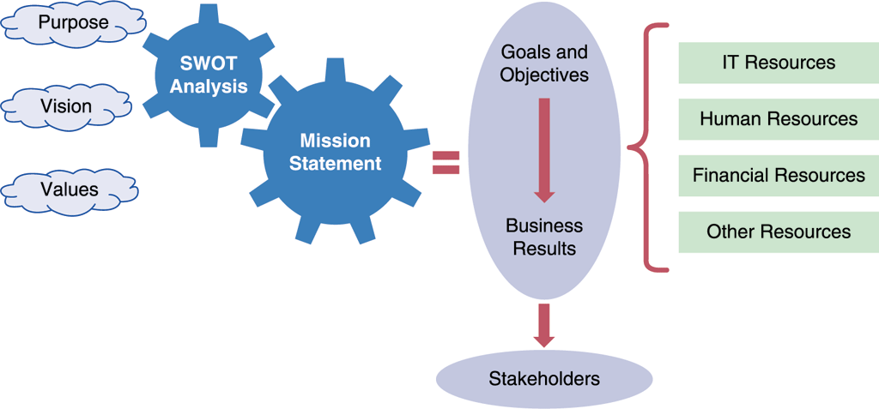
Strategic Planning – A Framework for IT Systems Development
From Strategic Plans to Business Results
  Mission statement
  Stakeholders
  Goals
  Objectives

Slide 7
Strategic Planning – A Framework for IT Systems Development
A CASE Tool Example
  You are a systems analyst
  You research the MS Visio CASE tool
  Planning statements can include assumptions, goals, objectives, and critical success factors, and many other types of statements

Slide 8
Strategic Planning – A Framework for IT Systems Development
The Role of the IT Department in Project Evaluation
  Management leadership and information technology are linked closely, and remarkable changes have occurred in both areas
  Today, systems development is much more team oriented
  Although team-oriented development is the norm, some companies see the role of the IT department as a gatekeeper

Slide 9
Strategic Planning – A Framework for IT Systems Development
The Future
  If you could look into the future, here is what you might see: new industries, products, and services emerging from amazing advances in information technology, customers who expect world-class IT support, a surge in Internet-based commerce, and a global business environment that is dynamic and incredibly challenging

Slide 10
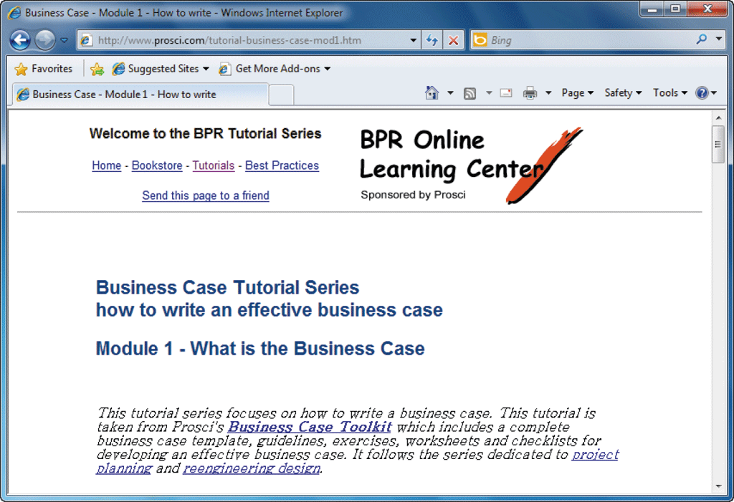
What Is a Business Case?
Should be comprehensive, yet easy to understand
Should describe the project clearly, provide the justification to proceed, and estimate the project’s financial impact

Slide 11
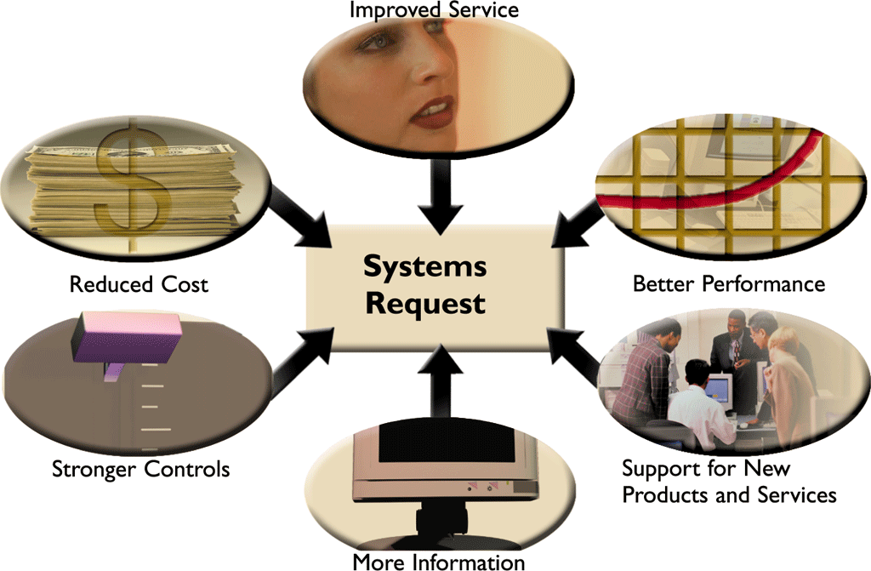
Information Systems Projects
Main Reasons for Systems Projects

Slide 12
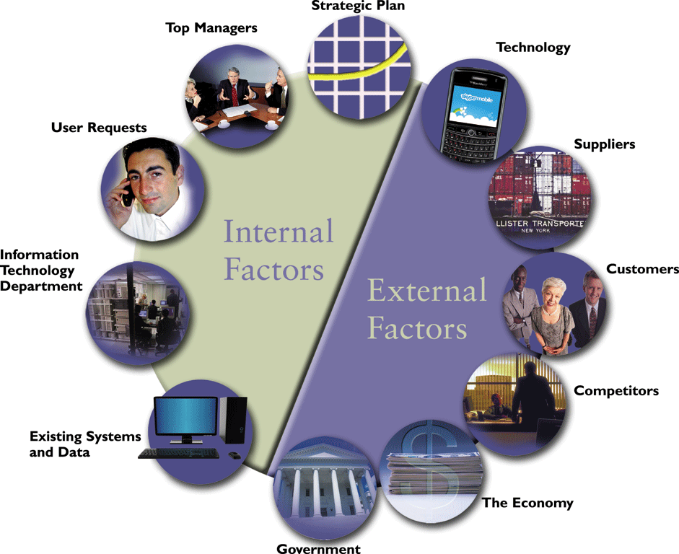
Information Systems Projects
Factors that Affect Systems Projects

Slide 13
Information Systems Projects
Project Management
  If the project is approved, it can be planned, scheduled, monitored and controlled, and reported upon
  Individual analysts or IT staff members often handle small projects, but companies usually designate a project manager to coordinate the overall effort for complex projects

Slide 14
Evaluation of Systems Requests
Systems review committee or a computer resources committee evaluate systems requests
Systems Requests Forms
  A properly designed form streamlines the request process and ensures consistency
  Occasionally a situation will arise that requires an immediate response

Slide 15
Evaluation of Systems Requests
Systems Review Committees
  Most large companies use a systems review committee to evaluate systems requests
  Many smaller companies rely on one person to evaluate systems requests instead of a committee
  The goal is to evaluate the requests and set priorities

Slide 16
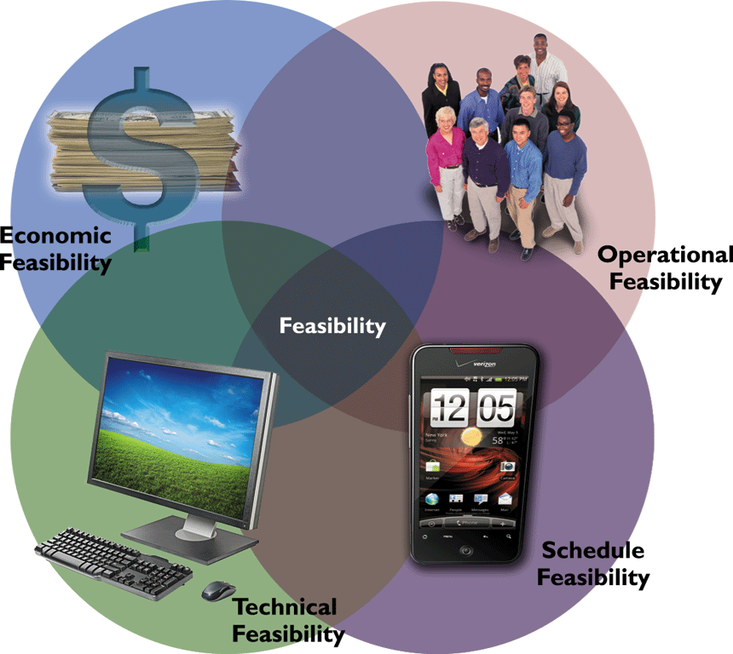
Overview of Feasibility
A systems request must pass several tests, called a feasibility study, to see whether it is worthwhile to proceed further
Operational Feasibility
  Depends on several vital issues

Slide 17
Overview of Feasibility
Technical Feasibility
Economic Feasibility
  Total cost of ownership (TCO)
  Tangible benefits
  Intangible benefits
Schedule Feasibility

Slide 18
Evaluating Feasibility
The first step in evaluating feasibility is to identify and weed out systems requests that are not feasible
Even if the request is feasible, it might not be necessary
Feasibility analysis is an ongoing task that must be performed throughout the systems development process

Slide 19
Setting Priorities
Factors that Affect Priority
  Will the proposed system reduce costs? Where? When? How? How much?
  Will the system increase revenue for the company? Where? When? How? How much?

Slide 20
Setting Priorities
Factors that Affect Priority
  Will the systems project result in more information or produce better results? How? Are the results measurable?
  Will the system serve customers better?
  Will the system serve the organization better?

Slide 21
Setting Priorities
Factors that Affect Priority
  Can the project be implemented in a reasonable time period? How long will the results last?
  Are the necessary financial, human, and technical resources available?
  Whenever possible, the analyst should evaluate a proposed project based on tangible costs and benefits that represent actual (or approximate) dollar values

Slide 22
Setting Priorities
Discretionary and Nondiscretionary Projects
  Projects where management has a choice in implementing them are called discretionary projects
  Projects where no choice exists are called nondiscretionary projects

Slide 23
Preliminary Investigation Overview
Preliminary investigation
Interaction with Managers and Users
  Let people know about the investigation and explain your role
  Employee attitudes and reactions are important and must be considered
  Question users about additional capability they would like to have

Slide 24
Preliminary Investigation Overview
Planning the Preliminary Investigation
  During a preliminary investigation, a systems analyst typically follows a series of steps
  The exact procedure depends on the nature of the request, the size of the project, and the degree of urgency

Slide 25
Preliminary Investigation Overview
Step 1: Understand the Problem or Opportunity
  A popular technique for investigating causes and effects is called a fishbone diagram, or Ishikawa diagram

Slide 26
Preliminary Investigation Overview
Step 2: Define the Project Scope and Constraints
  Project scope
  Project creep
  Constraint

Slide 27
Preliminary Investigation Overview
Step 2: Define the Project Scope and Constraints
  Present versus future
  Internal versus external
  Mandatory versus desirable
  Regardless of the type, all constraints should be identified as early as possible to avoid future problems and surprises

Slide 28
Preliminary Investigation Overview
Step 3: Perform Fact-Finding
  Fact-finding involves various techniques
  Depending on what information is needed to investigate the systems request, fact-finding might consume several hours, days, or weeks
  Analyze Organization Charts
    Obtain organization charts to understand how the department functions and identify individuals you might want to interview

Slide 29

Preliminary Investigation Overview
Step 3: Perform Fact-Finding
  Conduct interviews
  Review documentation
  Observe operations
  Conduct a user survey

Slide 30
Preliminary Investigation Overview
Step 4: Analyze Project Usability, Cost, Benefit, and Schedule Data
  Before you can evaluate feasibility, you must analyze this data carefully
  What information must you obtain, and how will you gather and analyze the information?
  What sources of information will you use, and what difficulties will you encounter in obtaining information?

Slide 31
Preliminary Investigation Overview
Step 4: Analyze Project Usability, Cost, Benefit, and Schedule Data
  Will you conduct interviews? How many people will you interview, and how much time will you need to meet with the people and summarize their responses?
  Will you conduct a survey? Who will be involved? How much time will it take people to complete it? How much time will it take to prepare it and tabulate the results?

Slide 32
Preliminary Investigation Overview
Step 4: Analyze Project Usability, Cost, Benefit, and Schedule Data
  How much will it cost to analyze the information gathered and to prepare a report with findings and recommendations?

Slide 33
Preliminary Investigation Overview
Step 5: Evaluate Feasibility
  Start by reviewing the answers to the questions you asked
  Operational feasibility
  Technical feasibility
  Economic feasibility
  Schedule feasibility

Slide 34
Preliminary Investigation Overview
Step 6: Present Results and Recommendations to Management
  The final task in the preliminary investigation is to prepare a report to management
  The format of the preliminary investigation report varies from one company to another

Slide 35

Preliminary Investigation Overview
Step 6: Present Results and Recommendations to Management
    Introduction
    Systems request summary
    Findings
    Case for action

Slide 36
Preliminary Investigation Overview
Step 6: Present Results and Recommendations to Management
    Project Roles
    Time & cost estimates
    Expected benefits
    Appendix

Slide 37
Summary
Strategic planning allows a company to examine its purpose, vision, and values and develops a mission statement, which leads to goals, objectives, day-to-day operations, and business results that affect company stakeholders
Systems projects are initiated to improve performance, provide more information, reduce costs, strengthen controls, or provide better service

Slide 38
Summary
Various internal and external factors affect systems projects, such as user requests, top management directives, existing systems, the IT department, software and hardware vendors, technology, customers, competitors, the economy, and government
During the preliminary investigation, the analyst evaluates the systems request and determines whether the project is feasible from an operation, technical, economic, and schedule standpoint

Slide 39
Summary
Analysts evaluate systems requests on the basis of their expected costs and benefits, both tangible and intangible
The steps in the preliminary investigation are to understand the problem or opportunity; define the project scope and constraints; perform fact-finding; analyze project usability, cost, benefit, and schedule data; evaluate feasibility; and present results and recommendations to management

Slide 40
Summary
The last task in a preliminary investigation is to prepare a report to management
The report must include an estimate of time, staffing requirements, costs, benefits, and expected results for the next phase of the SDLC

