Slide 1
App Inventor
MIT App Inventor

Slide 2
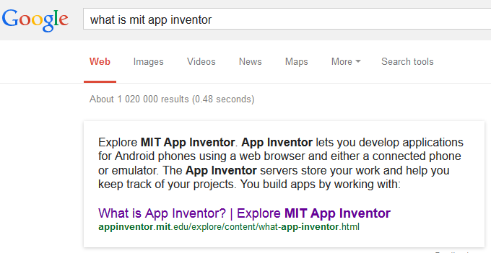

Slide 3
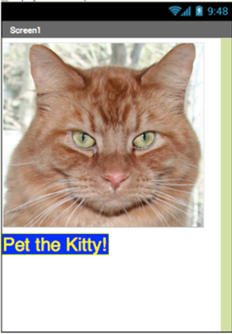

Slide 4
HelloPurr: tap the kitty, hear her meow!
HelloPurr is a simple app that you can build in a very short time. You create a button that has a picture of a cat on it, and then program the button so that when it is clicked a "meow" sound plays.
To build HelloPurr, you'll need a image file of a cat and an audio file with a "meow" sound. Download these files to your computer by clicking the following links:

Slide 5
HelloPurr:
To download: Open misuz.yolasite.com > CMIS302
After clicking a link, right click on the image or sound bar and select "Save As." Save both files onto your desktop or downloads folder, or anywhere that you can easily find later.
Kitty picture: kitty.png (Right-click and Save)
Meow sound: meow.mp3 (Right-click and Save)

Slide 6
Pre Condition:
Make sure you have a Google account
Web: ai2.appinventor.mit.edu
“Survey Later”
Click “Continue” to dismiss the splash screen
Start a new project:
  helloPurr

Slide 7
App Inventor:
The App Inventor Components are located on the left hand side of the Designer Window under the title Palette. Components are the basic elements you use to make apps on the Android phone. They're like the ingredients in a recipe. Some components are very simple, like a Label component, which just shows text on the screen, or a Button component (#1 left) that you tap to initiate an action.
Other components are more elaborate: a drawing Canvas

Slide 8
Kitty!!
HelloPurr will have a Button component that displays the image of the kitty you downloaded earlier. To accomplish this:
  Step 1. From the User Interface palette, drag and drop the Button component to Screen1.
  Step 2.To make the button have an image of a cat, in the Properties pane, under Image, click on the text "None..." and click "Upload New”

Slide 9
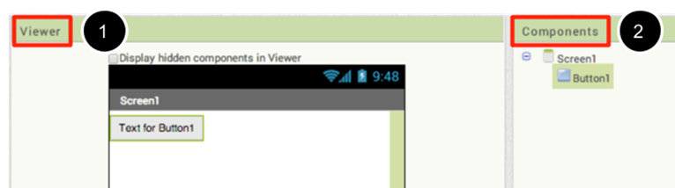

Slide 10
Kitty!!
Step 3. Change the Button's Text property: Delete "Text for Button1", leaving the Button's text property blank so that there is no writing over the kitty's face.
If the entire kitty picture is not showing up, you can fix this by setting the Height and Width properties of the button to "Fill Parent".

Slide 11
Label
Step 4. From the User Interface palette, drag and drop the Label component to the Viewer, placing it below the picture of the kitty. It will appear under your list of components as Label1.

Slide 12
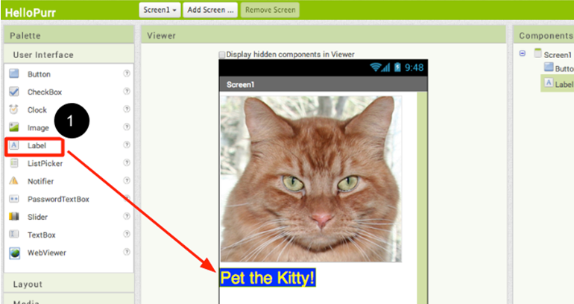

Slide 13
Label properties:
Under the Properties pane, change the Text property of Label1 to read "Pet the Kitty" . The text change in the Designer and on your device.
Change the FontSize of Label1 to 30.
Change the BackgroundColor of Label1 by clicking on the box : any colour?
Change the TextColor of Label1 to any color you like. Here, the background colour is set to blue and the text colour is set yellow.

Slide 14
Sound!!
Step 5. Under Palette, click on the Media drawer and drag out a Sound component and place it in the Viewer. Wherever you drop it, it will appear in the area at the bottom of the Viewer marked Non-visible components. Under the Media pane, Click Upload New...
Browse to the location of the meow.mp3 file that you downloaded earlier and upload it to this project.
Under the Properties pane, see that the Source property currently says None.... Click the word None... to change the Sound1 component's Source to meow.mp3

Slide 15
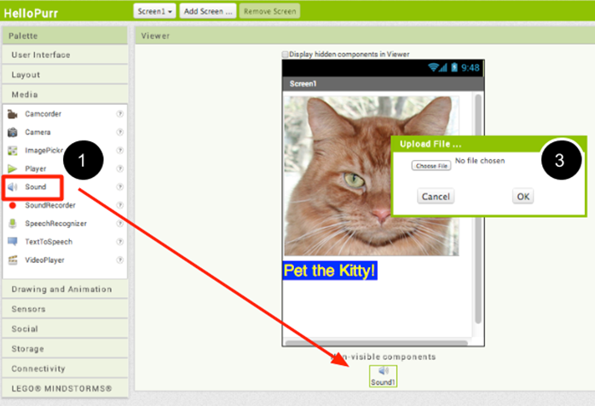

Slide 16
Programming with the Blocks Editor:
To start programming the behaviour of the app, you need to go to the Blocks Editor. Click the Blocks button to go to the Blocks Editor:
On the left side of the Blocks Editor, click the Button1 drawer to open it. Drag and drop the Button1.Click block in the work area (the open area on the right).

Slide 17
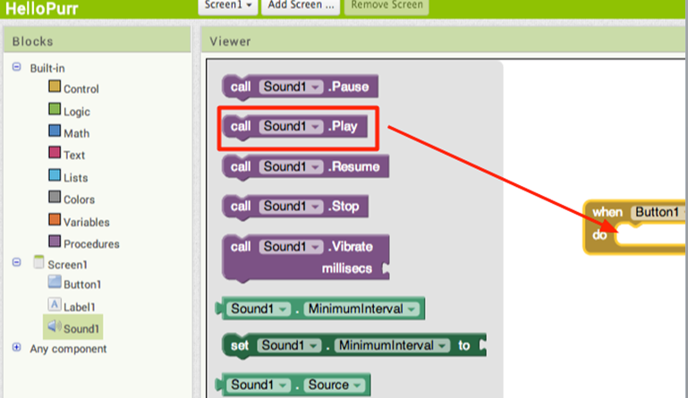

Slide 18
Event programming
Those mustard yellow blocks are called event handler blocks. The event handler blocks specify how the phone should respond to certain events: a button has been pressed, the phone is being shaken, the user is dragging her finger over a canvas, etc. The event handler blocks are mustard yellow in colour and use the word when. For example, when Button1.Click is an event handler

Slide 19
Completing the puzzle
The purple blocks are called command blocks, which are placed in the body of event handlers. When an event handler is executed, it runs the sequence of commands in its body. A command is a block that specifies an action to be performed (e.g., playing sound) when the event (e.g., pressing Button1) is triggered.
Your blocks should look like this at this point:

Slide 20


Slide 21
Review:
You build apps by selecting components (ingredients) and then telling them what to do and when to do it.
You use the Designer to select components and set each component's properties. Some components are visible and some aren't.
You can add media (sounds and images) to apps by uploading them from your computer.
You use the Blocks Editor to assemble blocks that define the components' behavior
when ... do ... blocks define event handlers, that tell components what to do when something happens.
call ... blocks tell components to do things.

Slide 22
Class Exercise
We need 3 horizontal arrangements:
  Label
  Text Box
  Button
Specifications:
  The user enters their name in the text box
  The user clicks on the 'Hello you' button
  The program must take the name that is in the text box and display: 'Hello ^name'

Slide 23
Pseudocode:

Slide 24
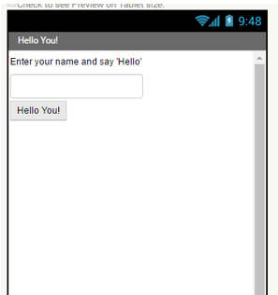
Screen Layout:

Slide 25

Code:

Slide 26
App Inventor (Example):
The Screen Layouts:
  A horizontal screen arrangement
  4 buttons
  4 vertical screen arrangement
  HelloYou – ( 2 labels, a text field and a button)
  2 table arrangements – ( 4 buttons and 6 canvas objects)

Slide 27
