Slide 1
The Revenue Cycle
Accounting Information Systems
James A. Hall Chapter 4

Slide 2
Background:
The revenue cycle is the set of activities in a business which brings about the exchange of goods or services with customers for cash.
Most business transactions are conducted on a credit basis. Cash is received after goods are shipped to the customer:
  the physical phase in which goods or services are transferred to the buyer; and
  the financial phase in which the cash is received from the buyer.
The first phase is handled by the sales order processing subsystem,
the latter by the cash receipts subsystem.

Slide 3
Introduction:
The first section of the chapter provides an overview of the revenue cycle presented as a
manual system.
The second section examines various ways to computerize this effort, from traditional data processing to process reengineering.
The last section considers microcomputer systems and control implications

Slide 4
Objectives:
to recognize the fundamental tasks that must be performed;
to be able to identify the functional departments involved;
to trace the flow of revenue transactions through the organization;
to be able to specify the documents, journals, and accounts that provide audit trails,
promote the maintenance of historical records, support internal decision making, and sustain financial reporting;
to understand the risks associated with the revenue cycle and to recognize the controls that reduce these risks; and
to be aware of the operational and control implications of technology used to automate and reengineer the revenue cycle

Slide 5
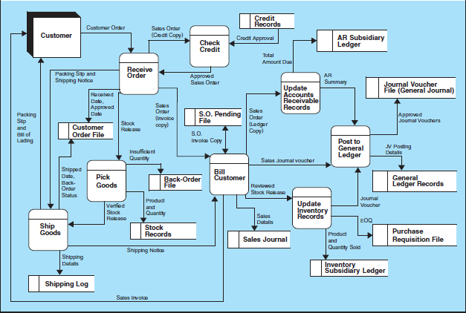

Slide 6
DFD of Sales Order Processing System
How many processes?
  What is happening in each process?
Data stores?
Entities?

Slide 7
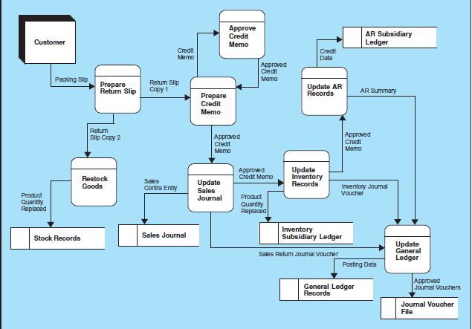

Slide 8
Sales Return Procedures:
How many processes?
  What is happening in each process?
Data stores?
Entities?

Slide 9
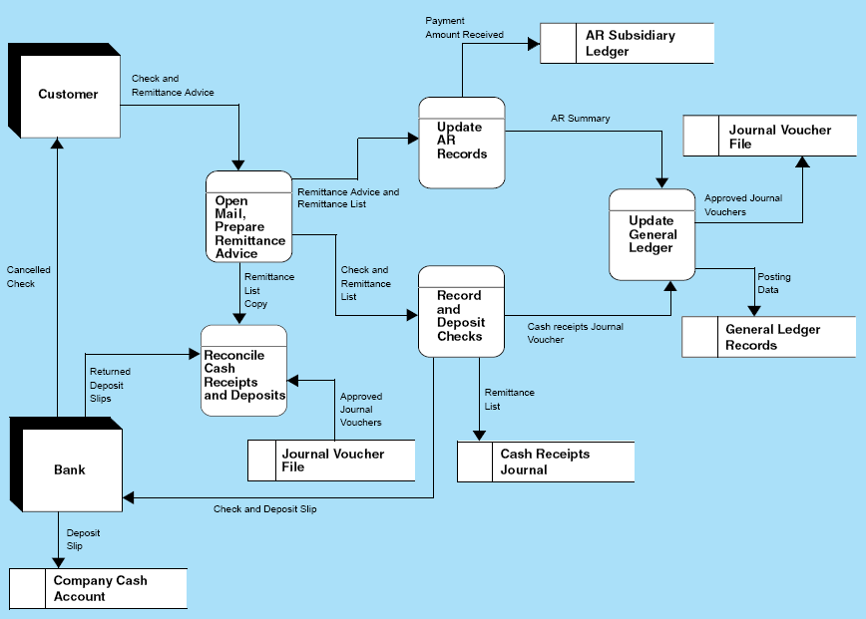

Slide 10
DFD of Cash Receipts Procedure
Open Mail and Prepare Remittance Advice
Record and Deposit Checks
Update Accounts Receivable
Update General Ledger
Reconcile Cash Receipts and Deposits

Slide 11
The next two slides:
How many departments are involved?
What are their roles?
What documents are involved?
  Who prepares the documents,
  the number of copies of each,
  what is done to the various copies (e.g.,
  approval of the credit copy), and
  where the individual copies end up.
What happened with reconciliation?

Slide 12
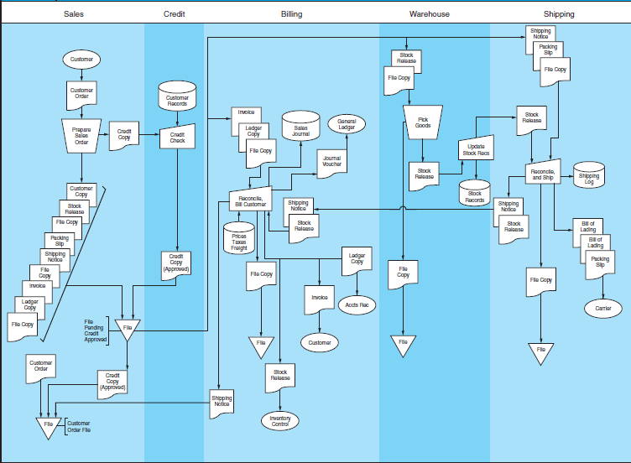

Slide 13
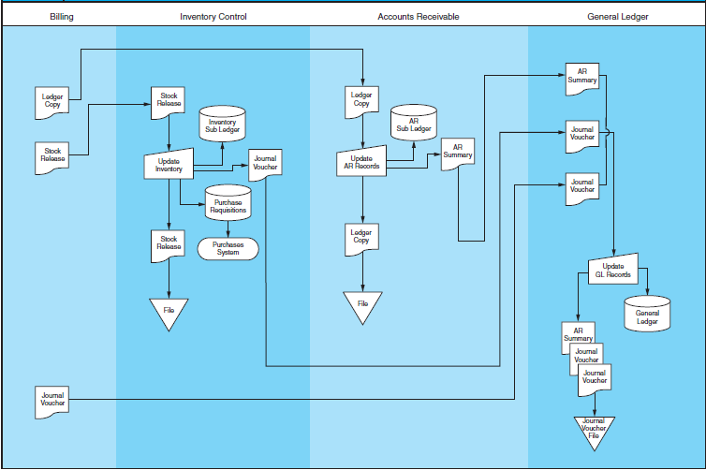

Slide 14
Sales Order Processing
Begins with a customer placing an order
  The sales department captures the essential details on a sales order form.
The transaction is authorized by obtaining credit approval by the credit department.
Sales information is released to:
  Billing
  Warehouse (stock release or picking ticket)
  Shipping (packing slip and shipping notice)
Notes:
3

Slide 15
Sales Order Processing
The merchandise is picked from the Warehouse and sent to Shipping.
  Stock records are adjusted.
The merchandise, packing slip, and bill of lading are prepared by Shipping and sent to the customer.
  Shipping reconciles the merchandise received from the Warehouse with the sales information on the packing slip.
Shipping information is sent to Billing. Billing compiles and reconciles the relevant facts and issues an invoice to the customer and updates the sales journal. Information is transferred to:
  Accounts Receivable (A/R)
  Inventory Control
Notes:
4

Slide 16
Sales Order Processing
A/R records the information in the customer’s account in the accounts receivable subsidiary ledger.
Inventory Control adjusts the inventory subsidiary ledger.
Billing, A/R, and Inventory Control submits summary information to the General Ledger dept., which then reconciles this data and posts to the control accounts in the G/L.
Notes:
5

Slide 17
Rest of Chapter:
Sales Returns
Cash Receipts System
Revenue Cycle Controls
Computer-Based Accounting Systems
  Batch Processing Using Sequential Files
  Batch System Using Direct Access Files
  Reengineering Sales Order Processing with Real-Time Technology
  Batch Cash Receipts System with Direct Access Files
  Reengineered Cash Receipts Process
  Point-of-Sale (POS) Systems
  Reengineering Using EDI; the Internet
  Control Considerations for Computer-Based Systems

Slide 18
Sales Returns
All sales are not final!
And procedures must be in place to handle sales returns.
Various reasons can lead to returns from customers:
  incorrect goods shipped, defected or damaged product, late delivery, etc.

Slide 19
Cash Receipts System
Booking the order and shipping the goods to the customer are good starts but . . .
The cash receipts system is a very important part of the revenue cycle.
It is also an extremely vulnerable part. Cash is very liquid and has been known to walk away if not tied down.
Again, an overview of the system is given in a data flow diagram. It shows the
  procedures required to receive payment, update records, and get the money to the bank.

Slide 20
Revenue Cycle Controls
Authorization must occur at many points in the revenue cycle–to make sure that the transaction should occur.
As a result, a specific OK must be given to sell on credit to new or repeat customers, to permit the return of goods for credit, and to record payments received.

Slide 21
Controls:
The segregation of functions material is extremely important. No one person should have the ability, let alone the authority, to carry out a transaction from beginning to end.
The separation of authorization, recordkeeping, and custody of assets must be maintained.
This does not prevent fraud, but it does make collusion necessary.
Many individuals who might pull a scam on their own would not solicit the help of someone else.

Slide 22
Controls:
Although segregation of function is conceptually valid, many firms are not able to separate all conflicting duties.
The alternative to adequate separation of duties is increased supervision.
This works well in many small businesses where an owner/manager is highly involved in the day-to-day operations

Slide 23
Controls:
The discussion of the accounting records, and the related controls, is particularly important.
You need to know how the records “work.” Chapter 2
introduced the basic accounting documents.
In discussing control in the revenue cycle, specific attention is paid to aspects of the records that serve to preserve the audit trail.
NOTE: ask yourself
  why things are done, what purpose is served, what problems are prevented.

Slide 24
Controls:
It is easy to think of the need to lock up valuable physical assets. But it is just as important to secure the organization’s records.
Access controls refer to both.
And depending on the types of goods a firm handles, unauthorized access to the accounting records may be a greater risk than access to the physical assets.
One of the good things about a manual system is the frequency with which one part of the system checks up on another and can therefore catch errors.
The importance of independent verification:

Slide 25
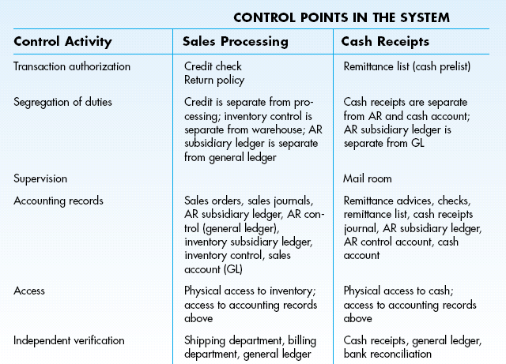

Slide 26
Computer-Based Accounting Systems
In its simplest form, automation, technology can be used to increase the efficiency and/or effectiveness of tasks.
In these cases, technology does the same things that are done in a fully manual system.
At the other extreme, business processes and work flow are thoroughly examined and reengineered.
A key concept behind reengineering is the identification and elimination of tasks that do not make a difference, non-value-added tasks

