Slide 1

My Notes

Slide 2
Overview:
Ethics
Fraud
Internal control
  These three topics are closely related

Slide 3
Introduction: Ethics
Ethics is a hallmark of the accounting profession. The principles which guide a manager’s decision making are important to all affected.
Computer ethics involves questions related to the use of technology and its social impact.

Slide 4
Introduction: Fraud
Fraud is a serious problem for most businesses today and often technology compounds the problem.
In addition, the role of the independent auditor/IT forensics in the detection of fraud is often questioned.

Slide 5
Introduction: Internal Controls
Because managers and accountants need to be confident that the information produced by the accounting system is both accurate and reliable, the importance of internal control is great

Slide 6
Outcomes/Objectives:
to understand the broad issues pertaining to business ethics;
to know why the subject of ethics is important to the study of accounting information systems;
to have a basic understanding of ethical issues relating to the use of IT
to be able to distinguish between management fraud and employee fraud;
to be familiar with the common fraud techniques used in both manual systems and computer-based systems;
to be aware of the gap that exists between the expectations of users of financial statements and the ability of auditors to detect fraud;
to understand the internal control structure defined by SAS 78; and
to recognize on a fundamental level the implications of the use of IT for the internal control structure

Slide 7
Ethics:
Highlight the organization’s conflicting responsibilities to its:
  Employees, Shareholders, Customers, General public
Managers have an ethical responsibility to seek a balance between
  Risk and Benefits as a result from their decisions

Slide 8
Business Ethics:
Managers make decisions → choices → risks/benefits : conflicting responsibilities
Business ethics assist in the “how to take these decisions”.
  Finding the answers to two questions:
    How do managers decide what is right in conducting their business?
    Once managers have recognised what is right, how do they achieve it? (Constitution; Gau-Train: V/D Merwe

Slide 9
Proportionality:
Justice: the benefit of the decision should be distributed fairly to those who share the risks. Those who do not benefit should not carry the burden of the risk
Minimize risk: even if judged acceptable by the principles, the decision should be implemented so as to minimize all of the risks and avoid any unnecessary risks.

Slide 10
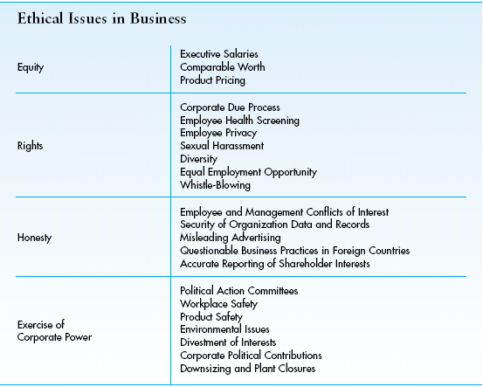

Slide 11
Computer Ethics:
The analysis of the nature and social impact of Comp Tech and the corresponding formulation and justification of policies for the ethical use of technology:
  Privacy
  Security
  Ownership
  Equity of access
  Environmental issues + AI

Slide 12
Computer ethics:
Three levels :
pop, para, and theoretical computer ethics.
Pop: the exposure to stories and reports found in the popular media regarding the good and bad ramifications of IT
Para: real interest, and ask for some skills and knowledge in the field
Theoretical: research on different topics

Slide 13
SOX Section 406/King III
Ethical issues applying specifically to executives and financial officers of a company. (A company’s code of ethics should apply to all employees):
  Conflict of interest
  Full and fair disclosure
  Legal compliance
  Internal reporting of code violations
  Accountability

Slide 14
Fraud
One of the reasons, though not the only one, for the discussion of ethics is the reality of its absence.
Reports of various occurrences of fraudulent behaviour are commonplace in the press. It appears that fraud is widespread/endemic.
Two types of fraud
  management fraud and employee fraud,
and several motivating factors.

Slide 15
Concept:
Despite the fact that the purpose of a financial statement audit is to attest to the fairness of the financial statements prepared by management, the public and other groups often want to blame the auditors when fraud goes undetected
Auditing companies must rotate/KPMG

Slide 16
Definition of Fraud
Defining and discussing fraud as it has evolved in common law.
For an act to be regarded as fraudulent, five conditions must be present:
  False representation (misrepresentation/omission)
  Material fact (it matters)
  Intent (intention to deceive)
  Justifiable reliance (it affects someone’s decision)
  Injury or loss (must have occured)

Slide 17
Fraud in the business environment
It is an intentional deception, misappropriation of a company’s assets, or manipulation of its financial data to the advantage of the perpetrator
  Employee fraud: usually involves the stealing of firm assets: take, sell, and hide.
  Management fraud: not only lining the pockets of the perpetrator, but to present an overly optimistic picture of the firm in order to enhance share price or to obtain more favourable financing

Slide 18
Factors contributing to fraud:
Fraud Triangle:
  Pressure, opportunity and ethics.
Financial Losses from Fraud
The Perpetrators of Frauds:
  This section will be an eye-opener. Read carefully the narrative that accompanies Tables 3-2 to 3-7, on pages 120-122. In particular, consider the issues of gender, position, age, education, and collusion.

Slide 19
SOX: Sarbanes-Oxley Act
Creating an accounting oversight board
Auditor’s independence
Corporate governance and responsibilities
Disclosure requirements
Penalties for fraud and other violations

Slide 20
Corruption: page 125
Bribery
Illegal gratuities
Conflict of interest
Economic extortion

Slide 21
Asset misappropriation: p 126-128
Skimming
Cash Larceny
Billing schemes
Cheque tampering
Payroll fraud
Expense reimbursements
Theft of cash
Computer fraud: comp central to AIS

Slide 22
Internal Control
Objectives:
  Safeguard assets of the firm
  Ensure accuracy and reliability of accounting records and info
  Promote efficiency in firm’s operations
  To measure compliance with management’s prescribed policies and procedures
Preventive, detective, corrective model

Slide 23
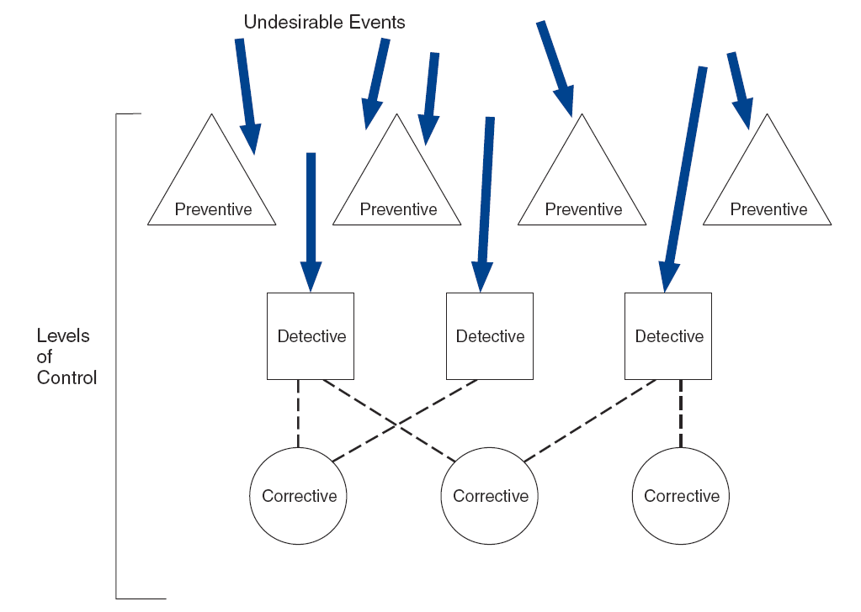

Slide 24
Standard model for an
AIS.
The discussion of computer fraud techniques looks at the types of fraud possible at each of the stages in the system:
  data collection (input),
  data processing,
  database management (storage), and
  information generation (output).

Slide 25
SOX 302, 404, COSO Framework /SAS 78:
The COSO framework was the basis for SAS 78, but was designed as a management tool rather than an audit tool
SAS 78 was developed for auditors. Describe the relationship between the firms
  Internal controls
  Assessment of risk
  Planning the audit procedures

Slide 26
COSO/SAS 78 framework
Five components:
  Control environment
  Risk assessment
  Info and communication
  Monitoring
  Control activities
    IT controls
    Physical controls

Slide 27
Control Environment:
The control environment is the atmosphere created in the organization in support of control objectives.
The other four assume this environment!

Slide 28
Risk Assessment:
Risk assessment is a necessary part of management’s effort.
It must identify, analyse, and manage risks, not just hope that nothing goes wrong.

Slide 29
Information and Communication:
Information and communication are the basis of the accounting information system.
Recording of the organizations transaction records and to account for the related assets and liabilities.
It is crucial that the quality of the information generated be secured.

Slide 30
Monitoring:
Having a system of internal control is a start.
Monitoring the system to assure that the internal controls are functioning properly is required.

Slide 31
Control activities:
Control activities are outlined in SAS 78.
There are two categories: computer controls and physical controls. [Computer controls are the topic of Chapters 15 and 17.]

Slide 32
Physical controls
Transaction authorization
Segregation of duties
Supervision
Accounting records
Access control
Independent verification

Slide 33
Areas of Control:
Transaction authorization:
  Only valid, approved transactions should be recorded.
Segregation of functions:
  the same person should not be responsible for authorization, recordkeeping, and custody of assets

Slide 34
Areas of Control:
Supervision:
  when there are too few individuals to implement total segregation, the compensating control is good supervision.
Accounting records:
  implies the design and use of adequate documents and records to help ensure the proper recording of transactions and events.

Slide 35
Areas of Controls:
Access controls:
  assures that access to assets is permitted only in accordance with management’s authorization (this refers to both physical and logical assets). Again, the integrity of the audit trail is the concern.
Independent verification:
  to check on the performance of individuals, the integrity of processing, and the correctness of data.

Slide 36
Conclusion:
The Importance of the Internal Control Structure as part of the preparation for a financial statement audit, the auditors must evaluate the system of internal control.
This must occur before the planning of the rest of the audit.

